Slide 1
Bolstering Real-Time Learning and Course Correction
GEO Learning Conference 2011
Dan Wilson, Ontario Trillium Foundation
Marilyn Darling, Signet Research & Consulting
“In a fast-changing environment, the capacity to learn lessons is more valuable than any individual lesson learned.”
-- Darling, Parry, Moore, “Learning in the Thick of It,”
Harvard Business Review

Slide 2
Strengthening Real-Time Reflection
Good Practice | Great Practice*
Reflects soon after action. | Starts intentionally before action to set the stage for learning.
Reflects on what happened, what worked and what did not work. | Starts by stating intended outcomes and metrics before action and compares intended outcomes and actual results afterwards.
Identifies a list of problems to address and successes to celebrate. | Identifies the most pressing learning questions to tackle over time and focuses reflection on those few priorities.
Is well facilitated. | Is designed to be capable of being self-facilitated.
* Based on Signet’s research into the origins and best practice of real-time learning using After Action Reviews.

Slide 3
Before and After Action Reviews
Our Framing Question: (What will it take to…? How can we…?)
Before Action Review
What are our intended outcomes and measures (related to our Framing Question)?
What challenges can we anticipate?
What have we/others learned from similar situations?
What will make us successful this time?
What will it take to test it out?
After Action Review
What were our intended outcomes (related to our Framing Question)?
What were our actual results?
What caused our results?
What is our next opportunity?
What did we learn and how can we take that forward for next time?

Slide 4

Getting started with Real-Time Learning
Identify an event or activity you want to learn from (for your foundation, your grantees or other key stakeholders)
What are your outcomes and what is the biggest challenge to achieving them? Turn that into a Framing Question:
“What will it take to…?” …or…
“How can we…?”
Who should be involved in planning and reflection?
When should you schedule brief planning (BAR) and reflection (AAR) conversations?
When and how will you use what you learn?
O U R F I E L D O F A C T I O N
Jan.
June
Sept.
Dec.
© 2010, Signet Research & Consulting, LLC For more information, visit us at www.emergentlearning.com

Slide 5
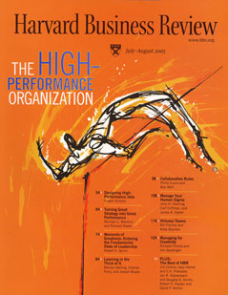
For more information on
Signet’s research into the origins of
After Action Reviews:
Darling, M., Parry, C., & Moore, J.(2005).
“Learning in the Thick of It.”
Harvard Business Review, 83(7), 84-92.
www.emergentlearning.com

