Slide 2
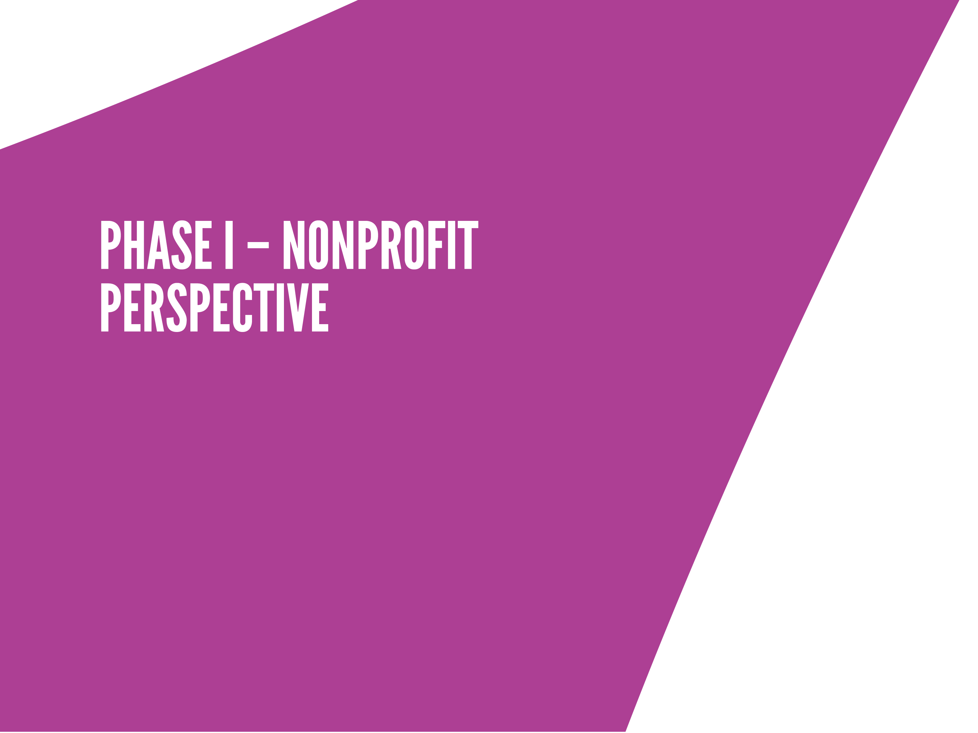
Very educational… learned a lot!
Consultants were true experts, guides and task masters
Impressive array of funders

Slide 3
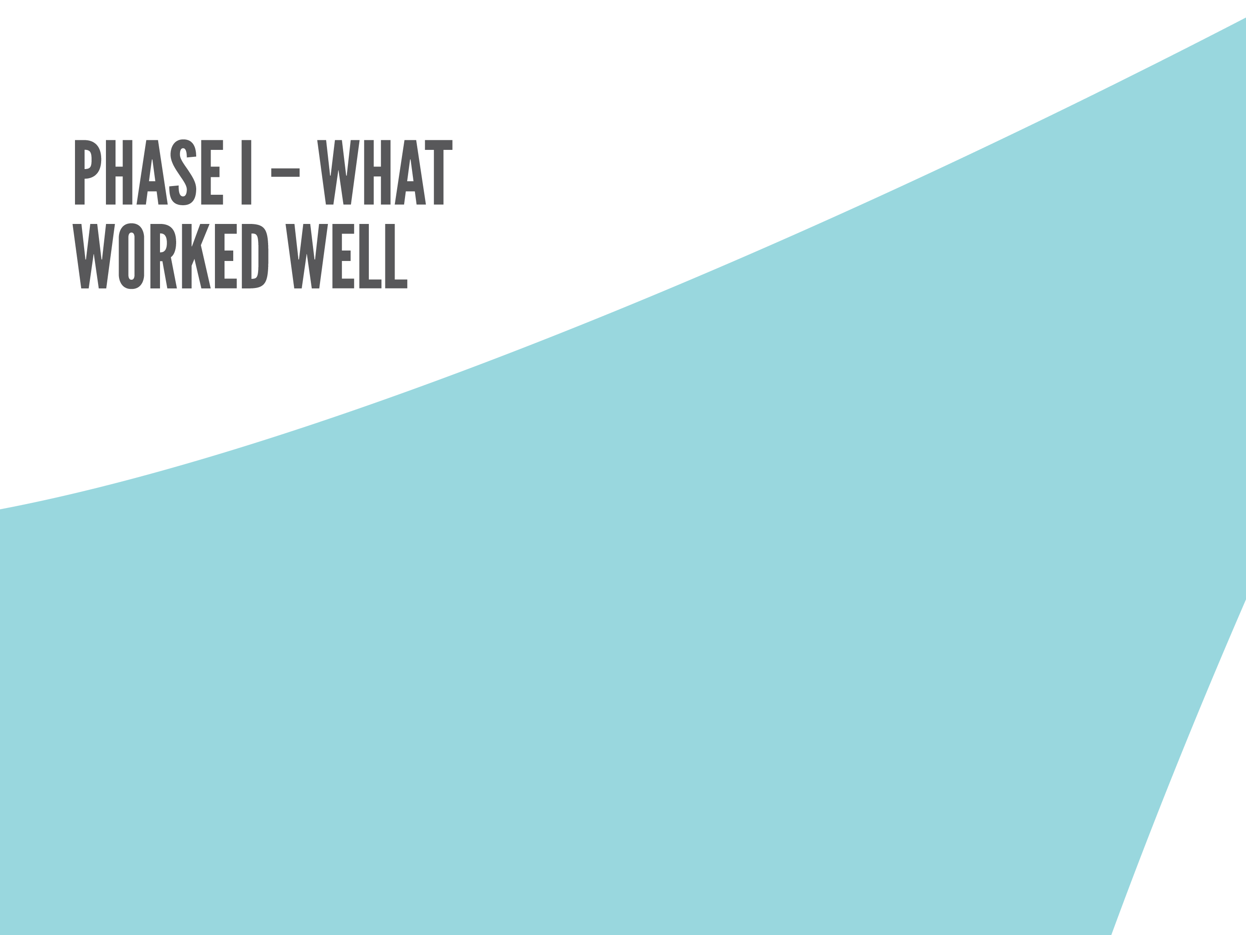
Participation of top leaders
Highlighted restructuring successes
Formal Intent to Proceed called the question

Slide 4
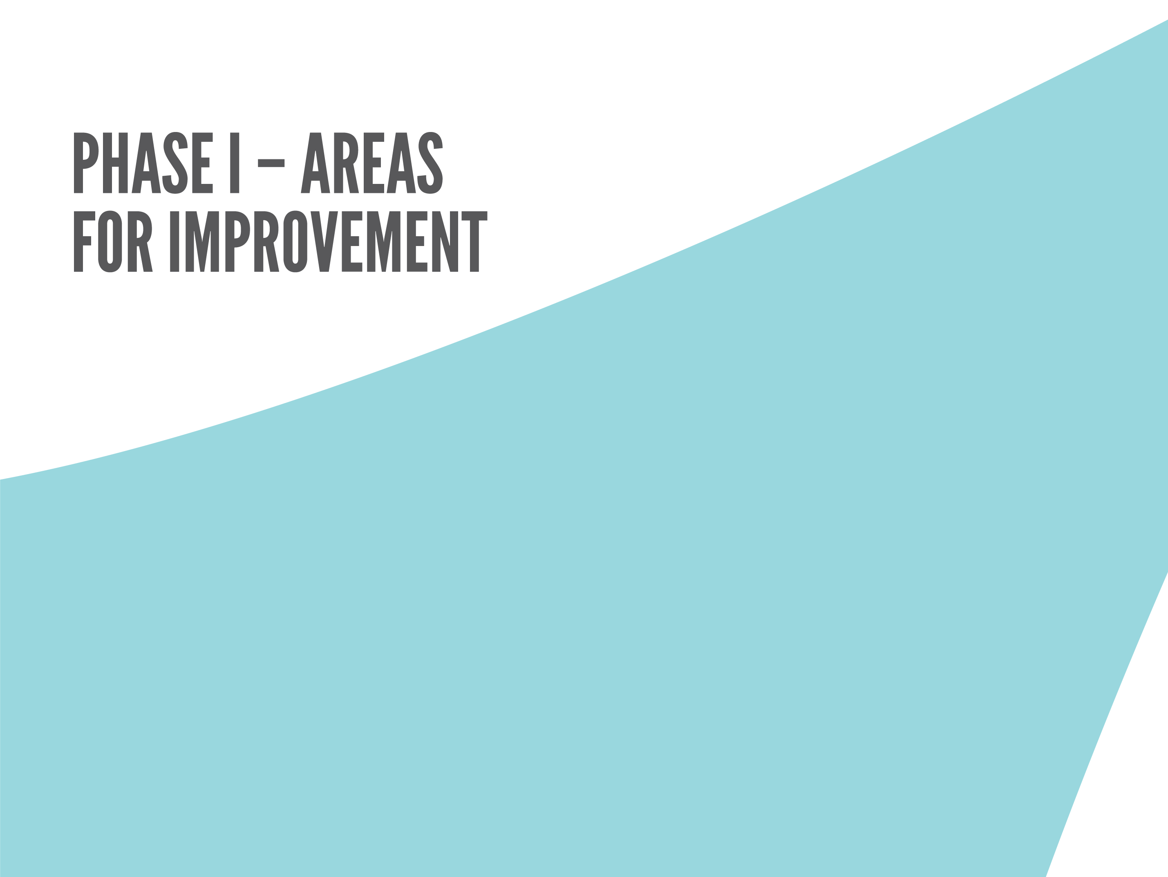
Felt like a race against the clock
Poor venue detracted from the workshop
More advice/options for those not ready

Slide 5


Slide 6
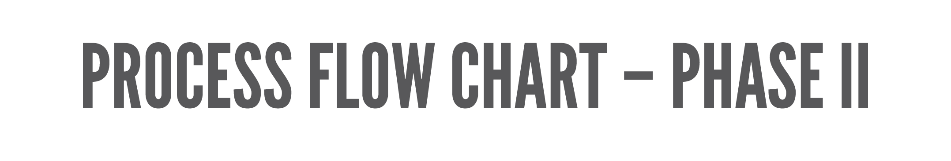

Slide 7
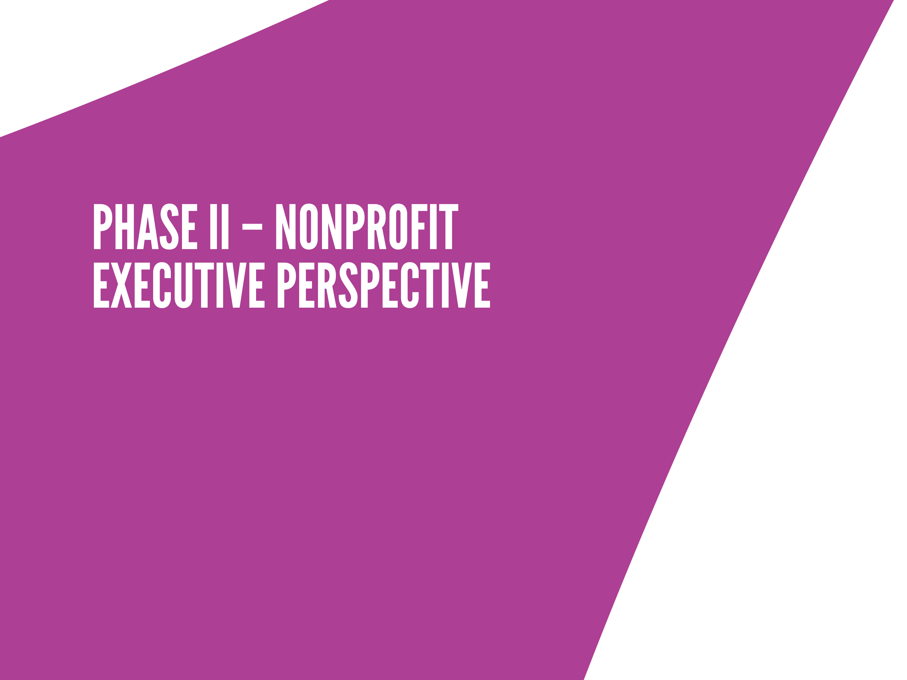
Who is pairing up with whom?
Agency assessments and other tools time-consuming but very helpful

Slide 8
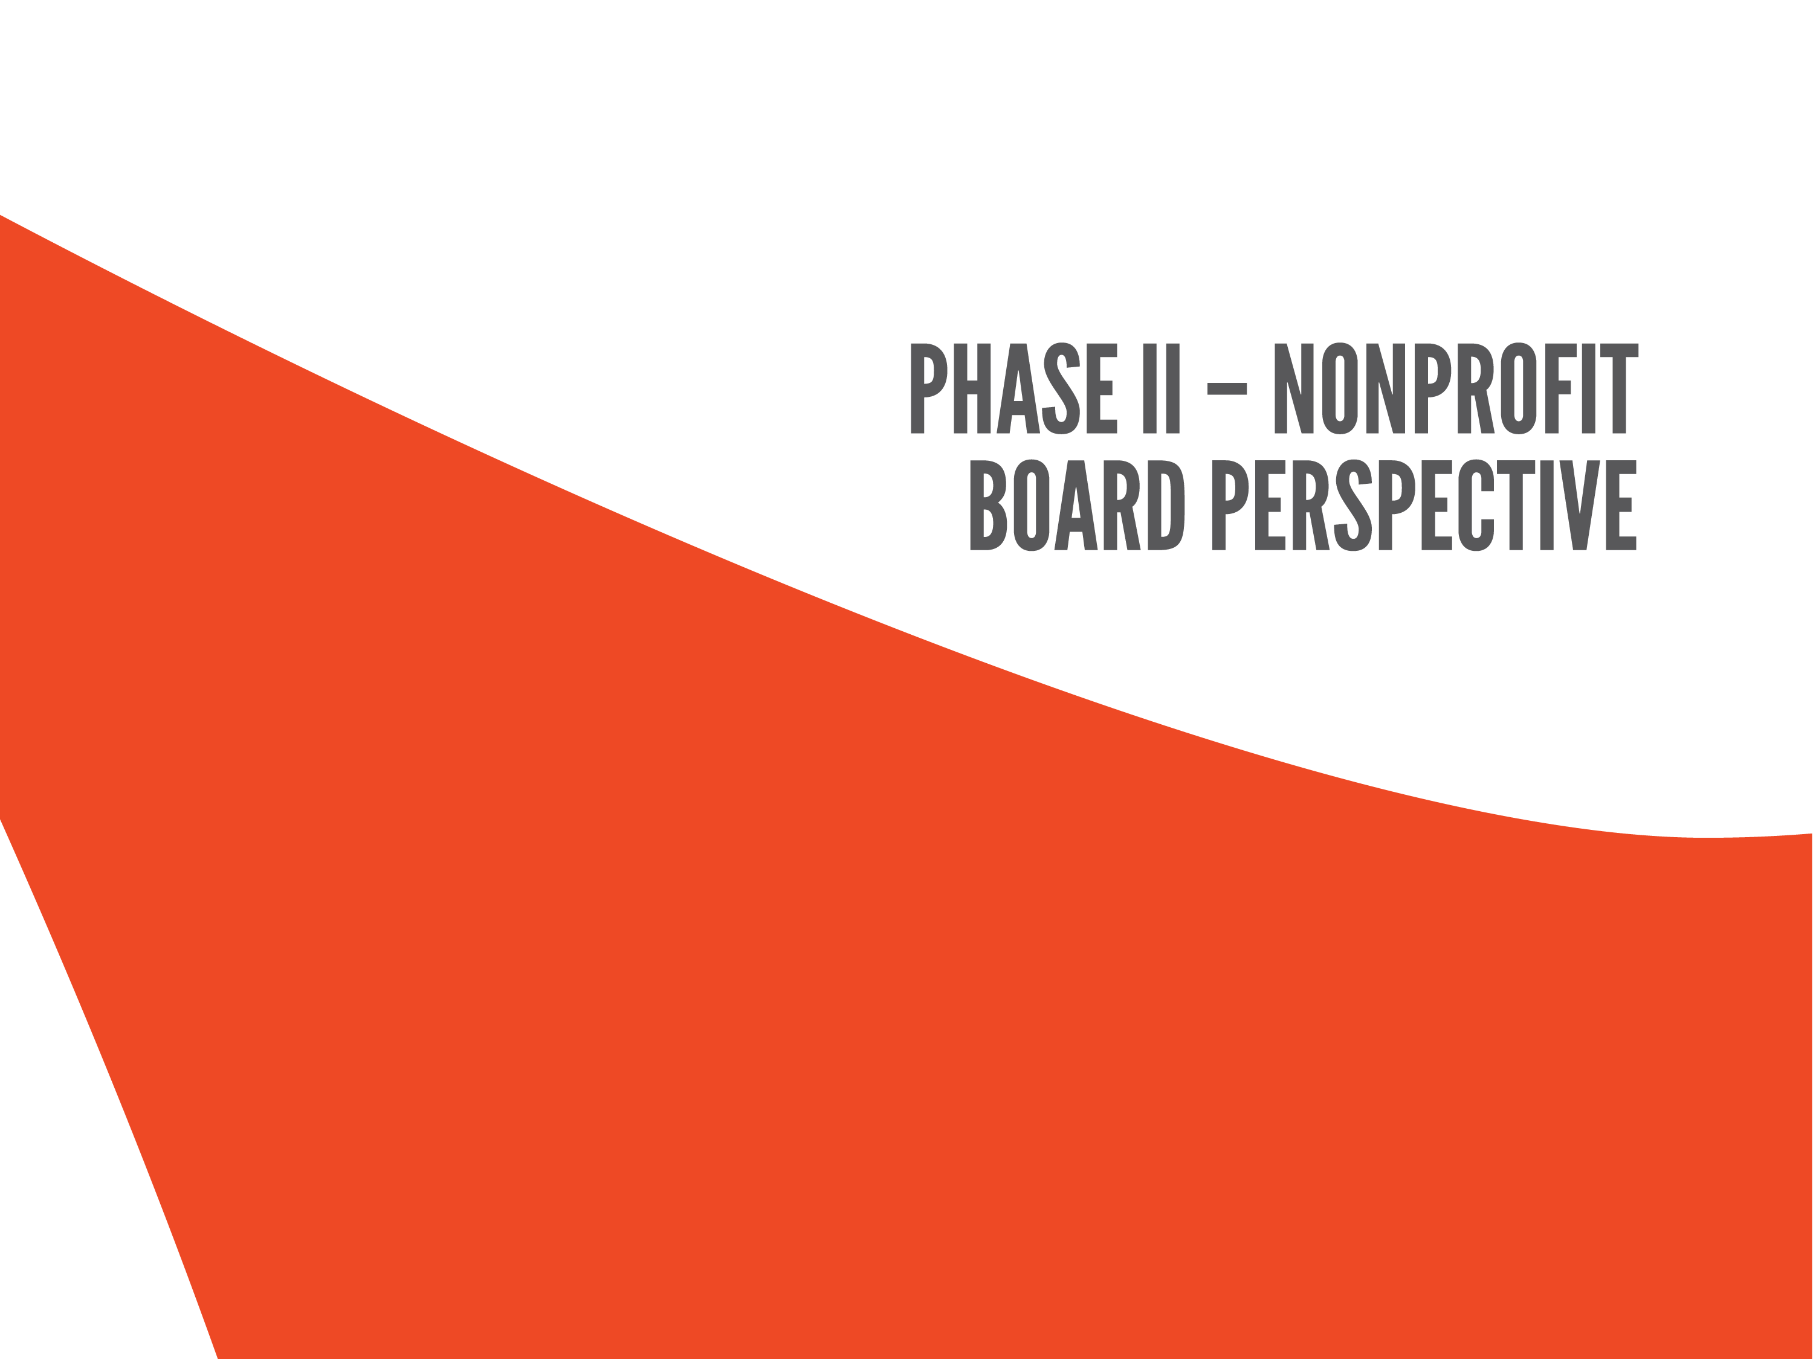
Too much process
Doubt fueled by past experiences

Slide 9
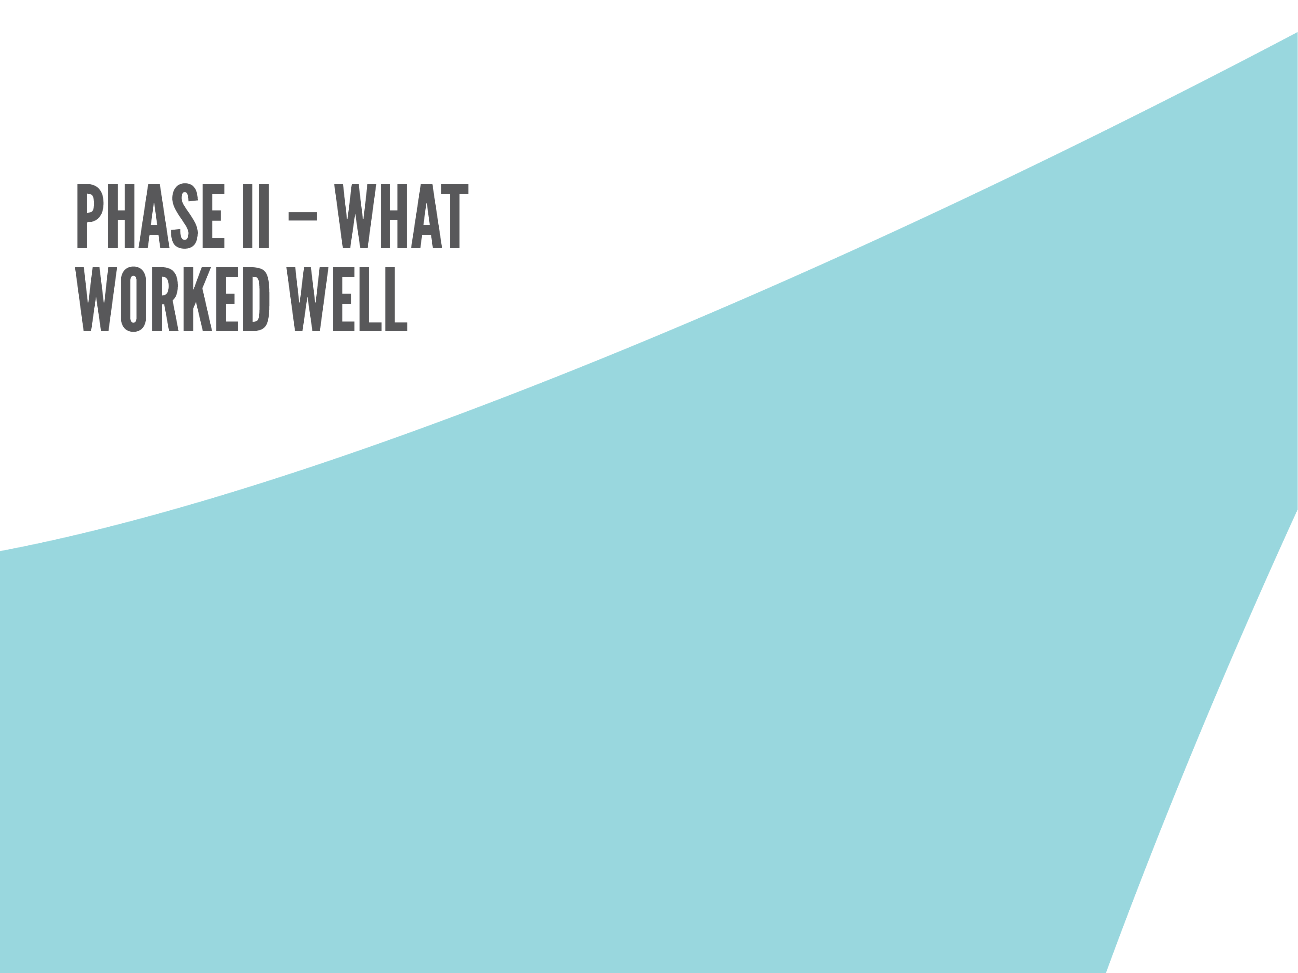
Independent reviews of readiness assessments
Face-to-face consultations worked best

Slide 10
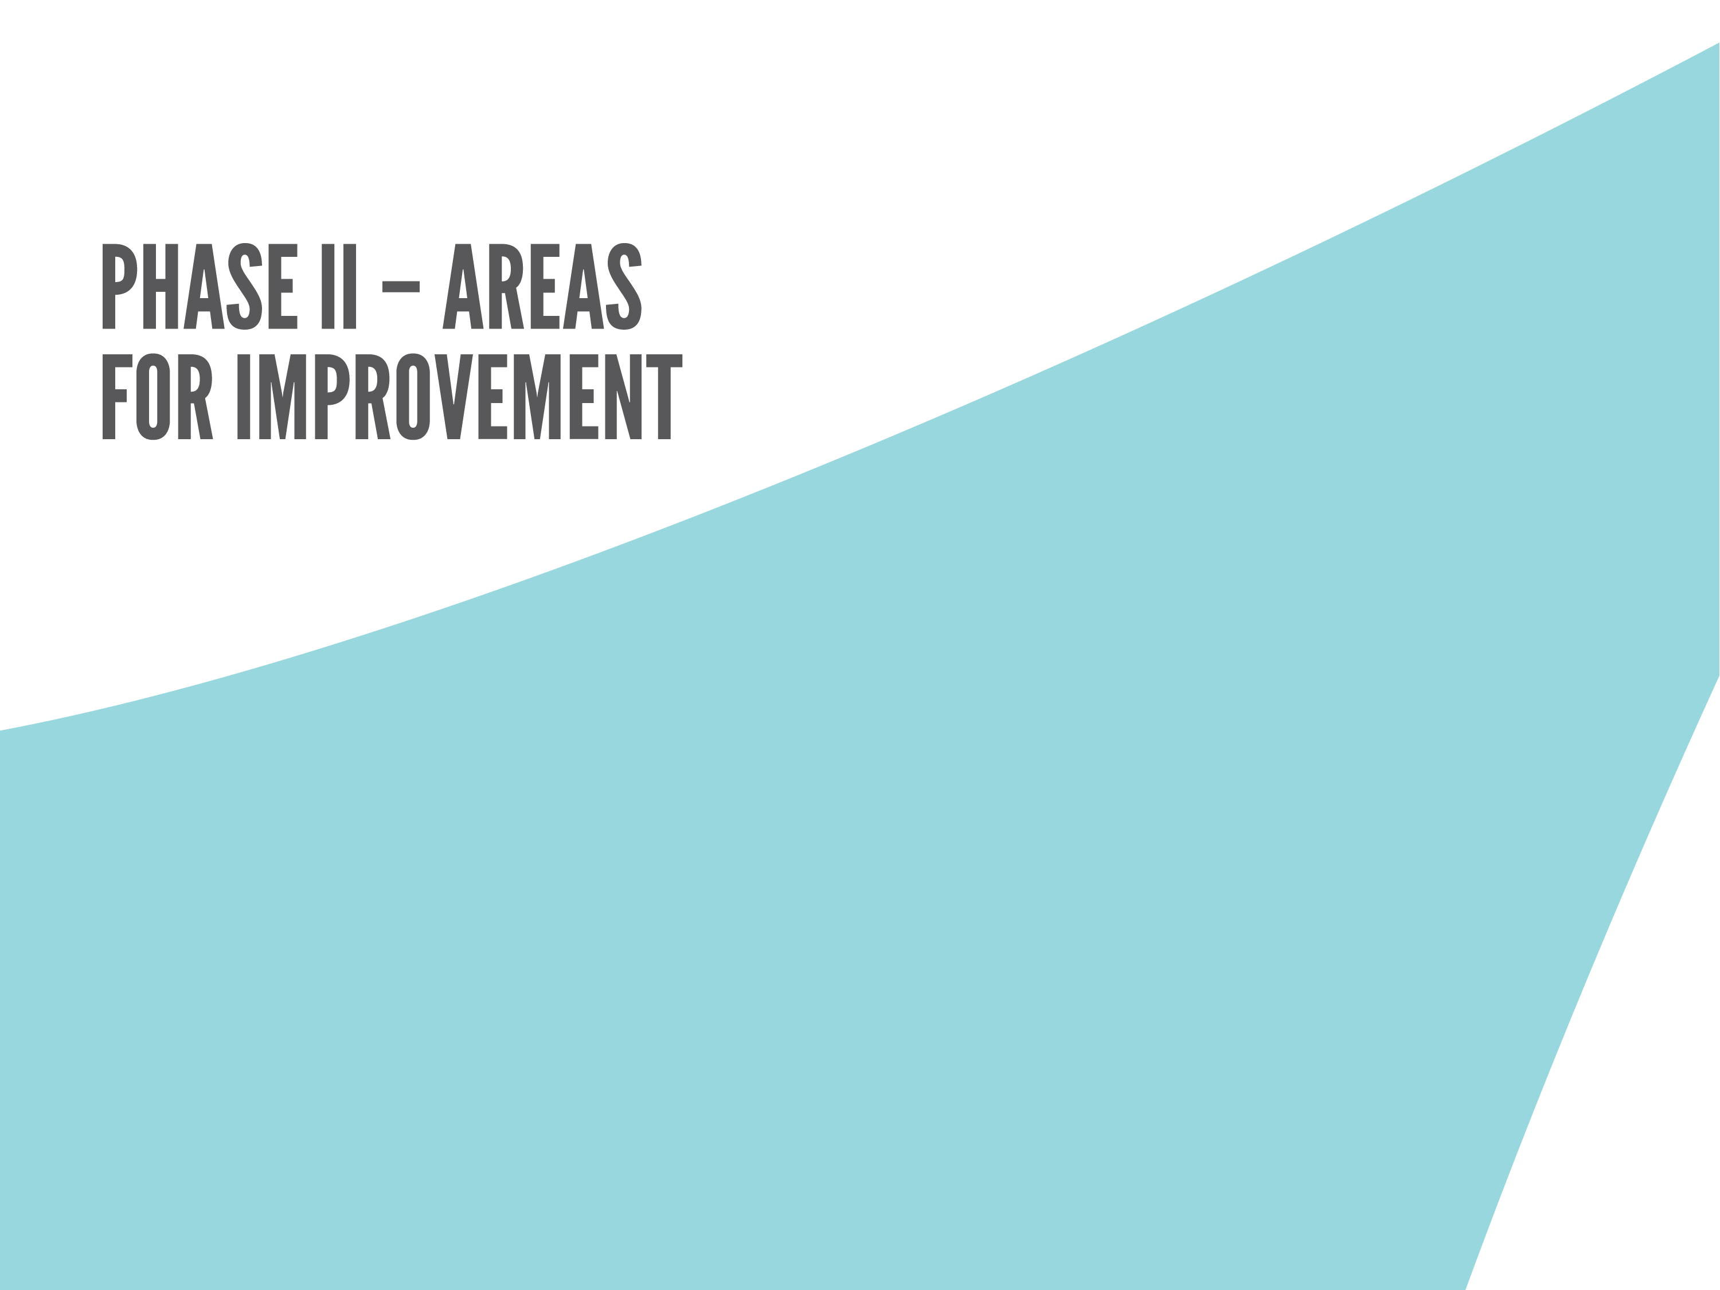
More flexibility… one size does NOT fit all
Web site accessibility and performance
More information about alternative models

Slide 11


Slide 12
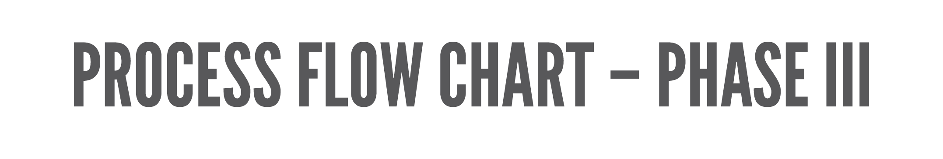

Slide 13
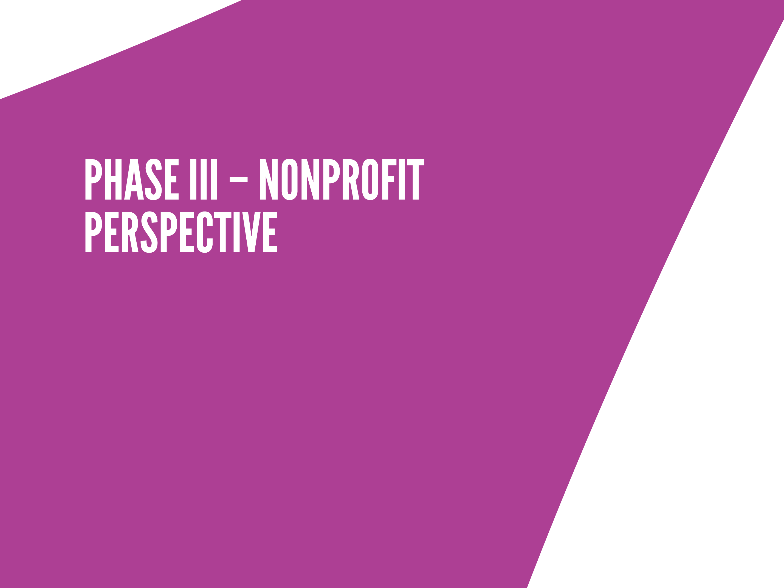
Building trust is key
Throw ego out the window
Focus on what works for the community

Slide 14

Financial, legal and human resources issues are huge
Board members rolled up their sleeves in key areas and enjoyed it

Slide 15

The timeline created a sense of urgency that kept everyone on track
Highly functioning negotiating teams

Slide 16

Financial, legal, human resources
More consultant interaction with each organization’s full board during this phase

Slide 17
QUESTION FOR THE AUDIENCE:
What strategies would you/have you used to facilitate collaboration?
BE SURE TO PICK A HAT TO CONVEY YOUR PERSPECTIVE:
Funder
Nonprofit Board
Nonprofit Executive
Consultant

