Slide 1
Instilling ELLs with a Growth Mindset through Self Advocacy
By Christine olsen

Slide 2
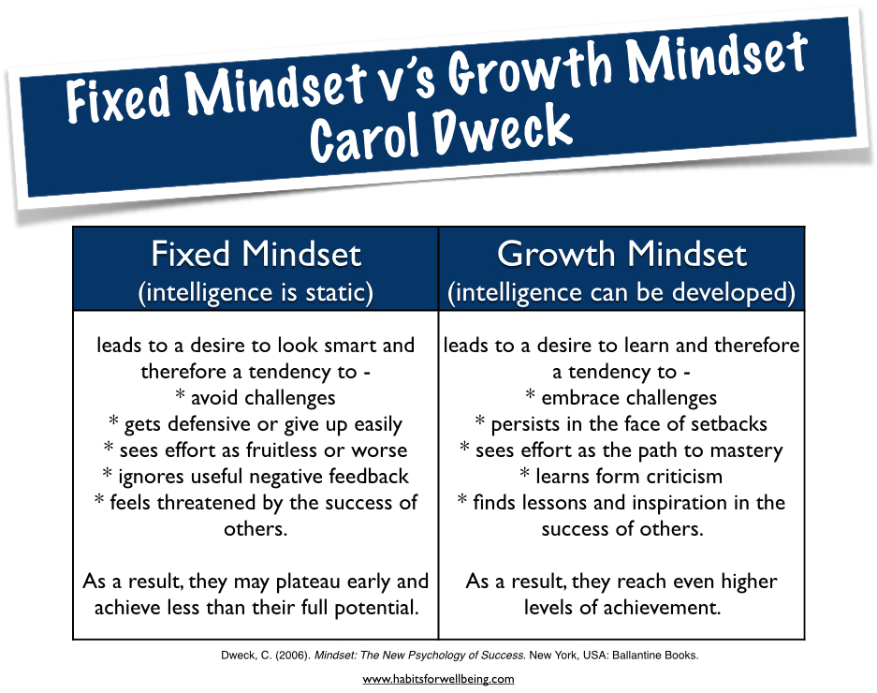
Growth Mindset

Slide 3
Developing a Growth Mindset
When you say…
“Wow, that’s a really good score, you’re so smart”
It tells me that intelligence is based on fixed, innate abilities and either I have talent or I don’t.
“Wow, that’s a really good score, you must have tried really hard.”
It tells me that intelligence is something I develop based on my effort.

Slide 4
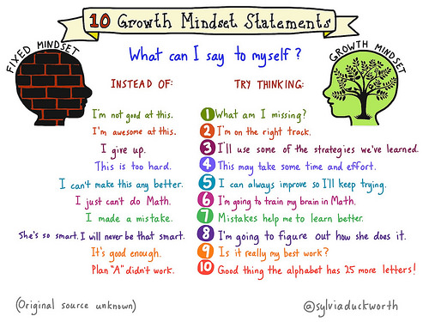

Slide 5
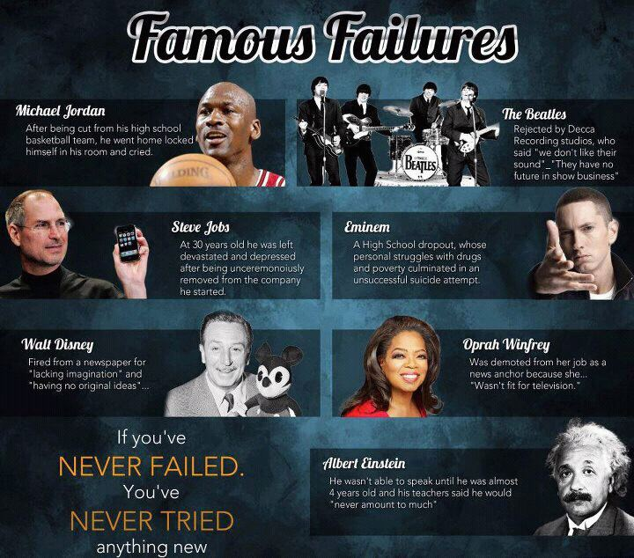

Slide 6
Closing the Achievement Gap
In one year, a kindergarten class in Harlem, New York scored in the 95th percentile on the National Achievement Test. Many of those kids could not hold a pencil when they arrived at school.
In one year, fourth grade students in the South Bronx, way behind, became the number one fourth grade class in the state of New York on the state math test.
In a year and a half, Native American students in a school on a reservation went from the bottom of their district to the top, and that district included affluent sections of Seattle.

Slide 7
Ofelia Garcia
“English language learners are in fact emergent bilinguals. That is, through school and through acquiring English, these children become bilingual, able to continue to function in their home language as well as in English, their new language and that of school. When officials and educators ignore the bilingualism that these students can and often must develop through schooling in the United States, they perpetuate inequities in the education of these children. That is, they discount the home languages and cultural understandings of these children and assume their educational needs are the same as a monolingual child.”

Slide 8
I’m an English Language Learner.
11. I’m an Emergent Bilingual.

Slide 9
How do you feel about being called an ELL?
“It makes me feel like I’m dumb”
“Like I can’t do things like everyone else.”
“It doesn't fit because it doesn’t value the languages and cultures we come from.”
“It only looks at what we don’t know.”
“It seems like no one cares that we can speak another language. The only thing that matters is that our English isn’t good enough.”

Slide 10
Students Brainstormed Alternative Labels
Bilingual Language Student
Bilingual Student
Emergent Bilingual
Multilingual Student
Emergent Multilingual Learner
Universal Language Learner
Multilingual Language Student

Slide 11
Changes in Terminology
English Language Learner (ELL) became Multilingual Student (MLS)
English as a Second Language (ESL) became Multilingual Student Association (MSA)

Slide 12
Planning
Audience: Heads of School, Head of the ESL Dept., and the Superintendent of Seven Hills
Purpose: To persuade
Claim: ESL should be changed to MSA because it represents us better
Format: PowerPoint presentation

Slide 13
Putting it All Together
Researchers: read articles looking for evidence that supported our argument. They then created powerpoint slides and wrote brief persuasive pieces based on their research.
Story Tellers: wrote a personal narrative about their experiences as an English Language Learner.
Data Collectors: created and distributed a survey to Seven Hills students. They then analyzed this data and picked out the most relevant pieces to incorporate into our powerpoint.

Slide 14
Definitions
ELL : English Language Learners
MLS: Multilingual Student
ESL: English as a Second Language
MSA: Multilingual Student Association
Being a MLS who attends MSA represents us better than being an ELL who attends ESL

Slide 15

Maintaining Two Languages
One benefit of being bilingual is that I can use both languages as thinking strategies to take my grade to the next level.
Bilingual people are fast learners and can easily succeed.
Becoming bilingual helps people to maintain strong bonds with their entire family and friends

Slide 16
Positives of Bilingual People
If you speak more than one language you are more likely to get a better job.
According to the text Benefits of Being Bilingual, it shows, “second language – an important personal skill in our increasingly diverse society”
They participate in the global community in more ways
I am proud of what we have accomplished over the past few months and I am proud to be part of MSA.

Slide 17
Statistics at Seven Hills Charter Public School
We put together a survey for 6th, 7th, and 8th graders so that we could see other opinions so that we can change the name for the whole school.
109 students in SHCPS took the survey
65% of the students said yes that they speak a different language

Slide 18
More Stats…..
66% are currently in English as a Second Language or have gone in the past
12% of the students were teased
33% of the students speak other languages daily
72% of these students who took the survey prefer the name Multilingual Student Association

Slide 19
What do you think of when you hear ESL?
“English is hard for them”
“I think they are different”
“They have trouble talking”
“Need extra help”
“Don’t know English”
“A special class for kids who need help”
“They struggle with something”
What do you think of when you hear MSA?
“I think of people from different places in the world”
“I think they are smart”
“They know how to speak more than one language”
“I think of a group of people coming together”
“Wow! A student can speak many languages.”

Slide 20
The Secret Behind Being an
ESL Student
by Marcos Santos

Slide 21
Fixed Mindset
The meaning of ELL gives students a fixed mindset
It’s based on the things you can’t do
Students feel like they don’t know enough.
People stop believing in themselves and they have a harder time.

Slide 22
Growth Mindset
The meaning of MLS gives students a growth mindset
It’s based on the things I can do
People with growth mindset overcome the negatives and fix mistakes
It makes me feel like I believe in myself and I can do anything if I work hard.

Slide 23


Seven Hills has been grateful to have the name MSA and we would like to change it for the whole country. We believe that words can change the world.

Slide 24
Results
Seven Hills officially recognizes the labels:
Multilingual Student
Multilingual Student Association
The Multilingual Students then presented at assemblies in order to educate students and teachers on the new terminology and the purpose behind the changes.

Slide 25
Impact
Less students are being teased or called names
Multilingual Students are more confident
Inclusive classroom community
Better self advocacy
More students exhibit growth mindset thinking
Higher academic achievement

Slide 26
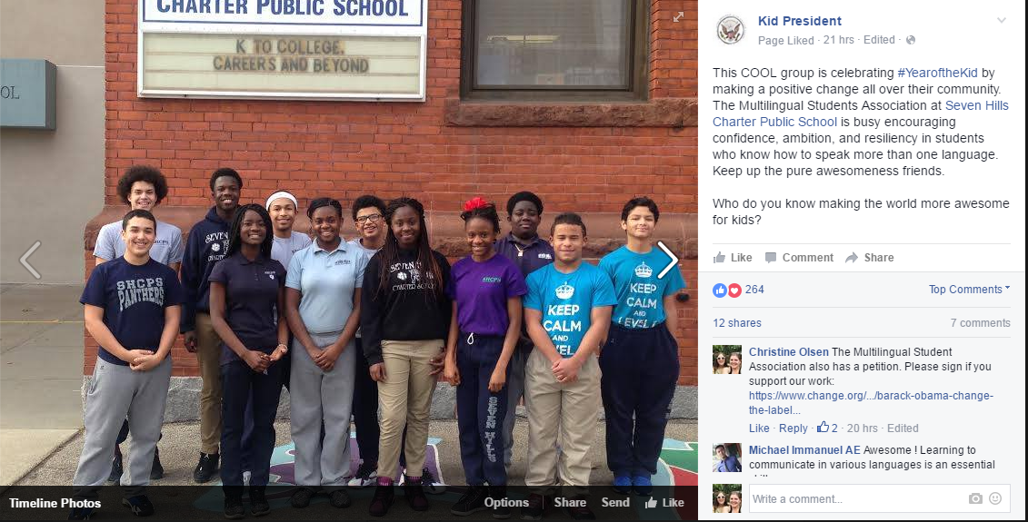
The Campaign Continues…
White House petition: 727 signatures (closed)
Change.org petition: 62 signatures and counting!
Shout out from Kid President

Slide 27
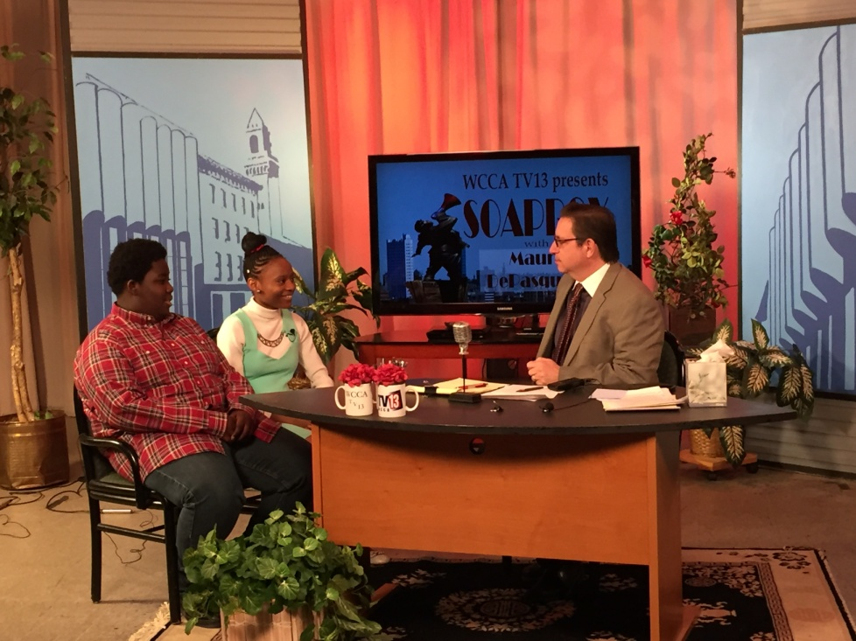
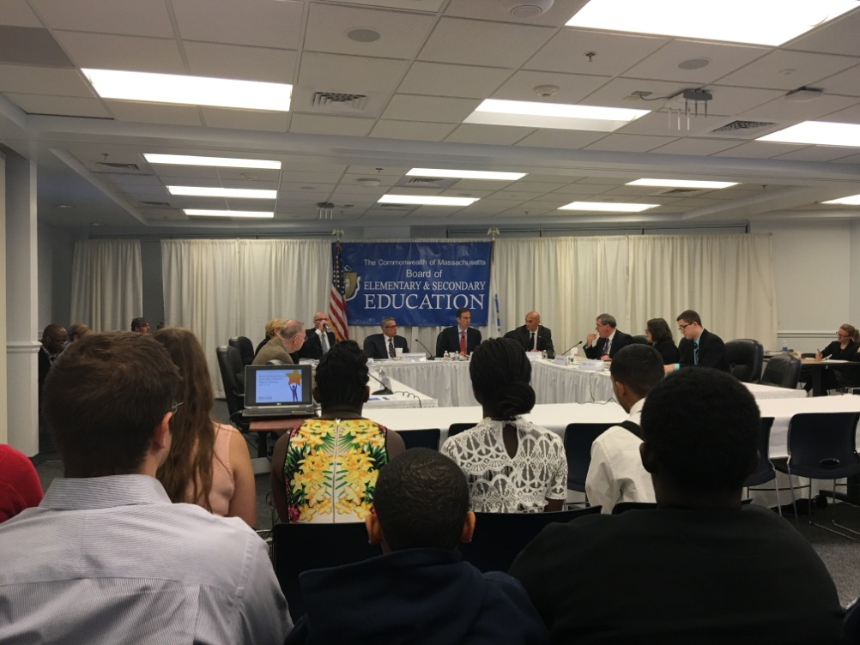
The Campaign Continues…
Manassh and Deborah were interviewed on Soapbox, WCCA TV13
Samantha, Marcos, and Lawrencia presented speeches to BESE

Slide 28
Service Learning is…
“a form of experiential education where learning occurs through a cycle of action and reflection as students. . . seek to achieve real objectives for the community and deeper understanding and skills for themselves. In the process, students link personal and social development with academic and cognitive development. . . experience enhances understanding; understanding leads to more effective action.”

Slide 29
Service Learning and Multilingual Students
“I've observed rising pride and camaraderie among multilingual students as they take their initiative to higher levels. In addition, their individual confidence in language skills and public speaking has grown by presenting to various groups along the way. This group of students exemplify the adage, "Never underestimate the power of a small group of thoughtful, committed citizens to change the world!"
- Jason Dimen, 7th Grade Math Teacher

Slide 30
We Want You!
Sign our petition
Spread the word on social media
Talk with students and administrators about adopting these strengths based labels within your own school
Try service learning within your own classroom

Slide 31
Any Questions?

