Slide 1
Two Way Immersion(TWI) and Transitional Bilingual Education (TBE) Programs in Massachusetts
Guidance for Districts who are Seeking Alternative ELL Programing

Slide 2
Bilingualism in Massachusetts?
¡ Sí, podemos ! - ¡Sí, nos puede!

Slide 3
Agenda
Two Way Immersion (TWI) and Transitional Bilingual Education (TBE)Programs in Massachusetts
World, USA, and MA
Research and Data
TWI and TBE Guidance in MA
Next Steps
Questions

Slide 4
The Status of Bilingualism in the World and United States
10 % of educated people in the U.S. are bilingual
Only 20% of Americans are bilingual
55 million Americans speak a language other than English at home
67% of children who enter U.S. schools as emerging bilinguals are born in the U.S. = U.S. Citizens
75% are concentrated in grades K-4
English learners are concentrated linguistically : 85% of these children speak Spanish
95% of the linguistic diversity is accounted for by 5 languages: Spanish, Vietnamese, Chinese, Korean, Hmong
Over half (50%) of the world’s population is bilingual
Worldwide quest to learn English is a quest for bilingualism
If you can speak Spanish and English you can communicate with 80% of the people on the planet

Slide 5
The Status of Bilingualism in MA
The number of dual language programs has increased 81% across the nation.
MA: Only 2K /81K (2.5%) English Language Learners (ELLs) attend TWI or TBE programs in MA. In 2005, 5.5% of ELLs attended TWI or TBE programs.
MA: Only 10 /1860 schools run two way programs
MA: Only 9/408 districts have two way programs
Notes:
MA: Holyoke (level 5 district) decided to keep the two way program
MA: Most recently, Southbridge (level 5 district) is planning on implementing TWI and TBE programs in their district
MA: AIR conclusion/recommendation: ELL Spanish speaking students should “…be provided instruction grouped by their first language, with first language support, through dual language instruction programs”
MA/NAEP: Low eighth grade reading results of our Hispanic students

Slide 6
Restrictive Language Instructional Policies
In November 2002, Massachusetts voters approved Question 2, a ballot initiative to replace transitional bilingual education (TBE) with sheltered English immersion (SEI)—an instructional model that teaches ELLs all academic content in English.
Local flexibility for ELE programming is limited to SEI or two way immersion without a waiver.
Changes in the law were based on an assumption that ELLs can achieve proficiency in English better and quicker in an English-only environment.
There is a need to create spaces where children are encouraged to be bilingual and where language mixing is not censored.

Slide 7
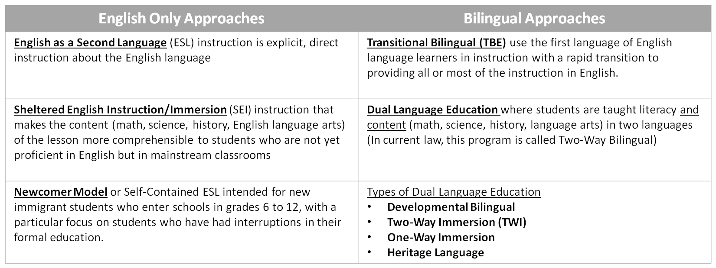
Approaches to Language Programs

Slide 8
We need a positive interpretation about bilingual learners
Interference in Action
José knows 3 colors in Spanish and 3 in English (same 3). He is labeled ‘limited’ in L1 and L2
Bill know 5 colors all in English. He is labeled as ‘average.’
Who knows more?
Freeman and Freeman

Slide 9
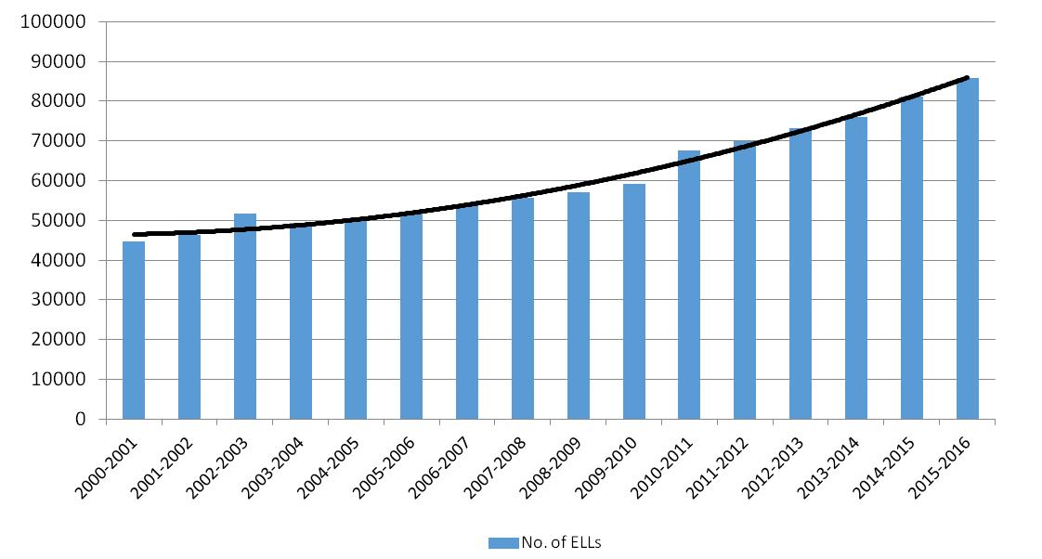
ELL Enrollment Statewide is at 85,762 and has almost doubled since 2000

Slide 10
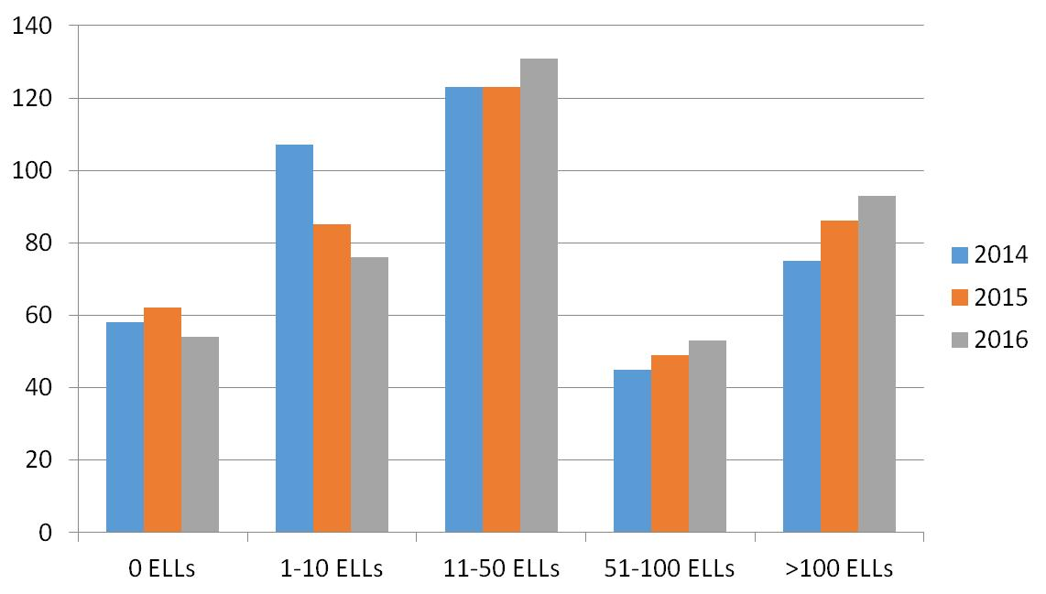
Numbers of ELLs Reported by Districts
2014-2016
Notes:
Since we know that the number of ELLs has gone up, you can see that the population is shifting from lower incidence districts to higher incidence districts.

Slide 11
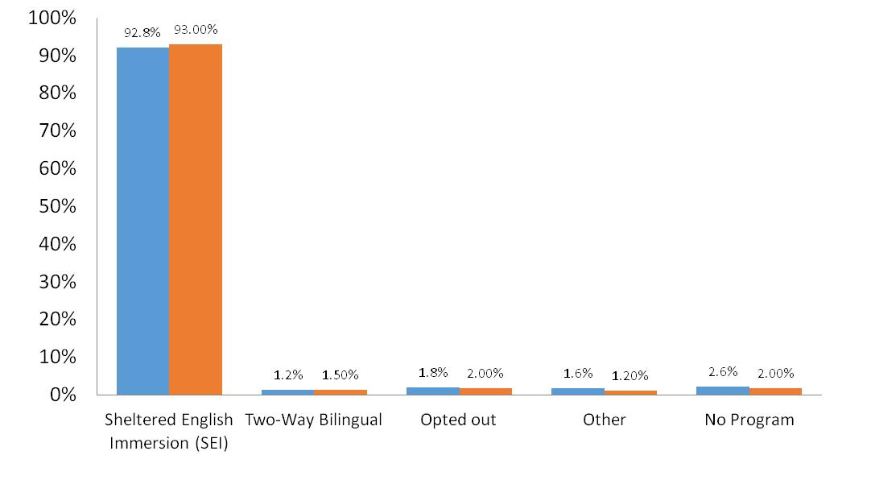
ELLs by Program Enrollment

Slide 12
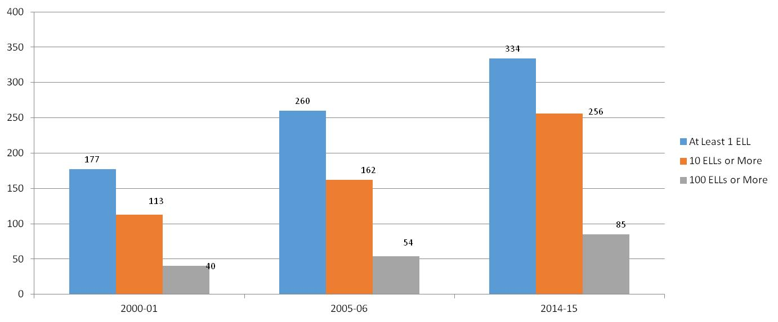
Growth of # of districts with ELLs

Slide 13
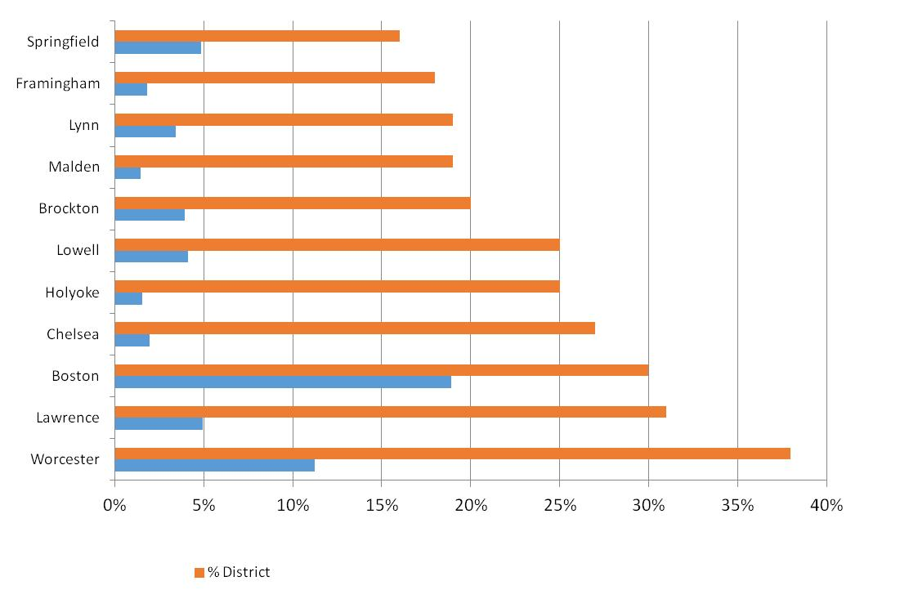
58% of MA ELLs Are Enrolled in 11 Districts (68% last year)
Boston enrolls ≈20% of all ELLs statewide
Notes:
Last year 68% of ELL were enrolled in these 11 districts

Slide 14
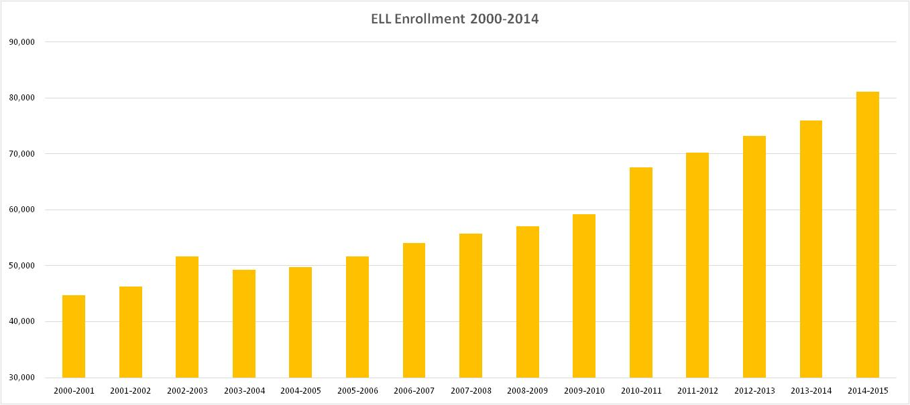
Enrollment of ELLs has increased by 81% since 2000
(a growth rate significantly higher than any other subgroup)
Notes:
Source: MA DESE, Selected Populations Report (District), 2000-2001 to 2014-2015
http://profiles.doe.mass.edu/state_report/selectedpopulations.aspx
18.5% of our students already speak a first language other than English, yet little is done to support or develop this valuable asset in our schools
Also note: Data for all students has decreased in MA while ELLs has increased

Slide 15
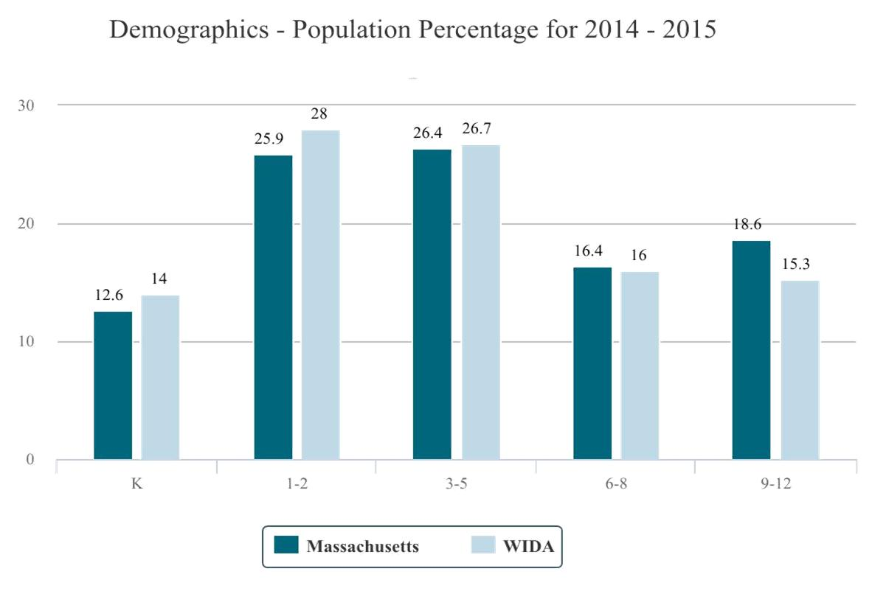
ELL Population Percentage 2014-2015
Source: 2015 ACCESS for ELLs®

Slide 16
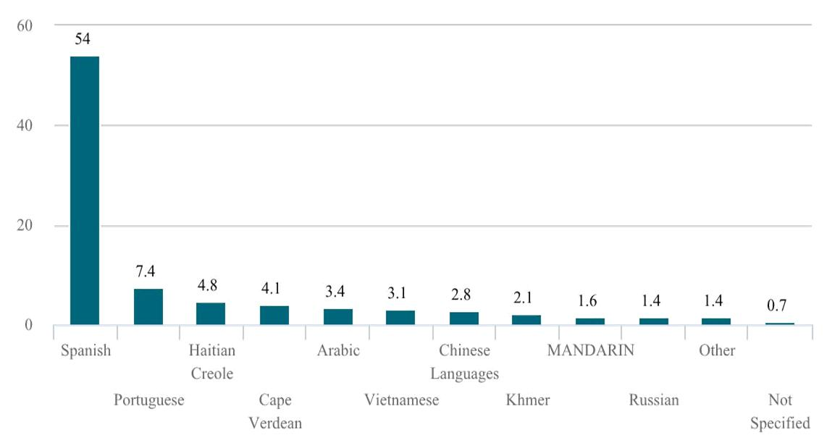
Over 70 Languages are Spoken by ELLs in MA; the Majority of ELLs Speak Spanish
Source: 2015 ACCESS for ELLs®
Notes:
Over 50% of all ELLs in MA are native Spanish speakers

Slide 17
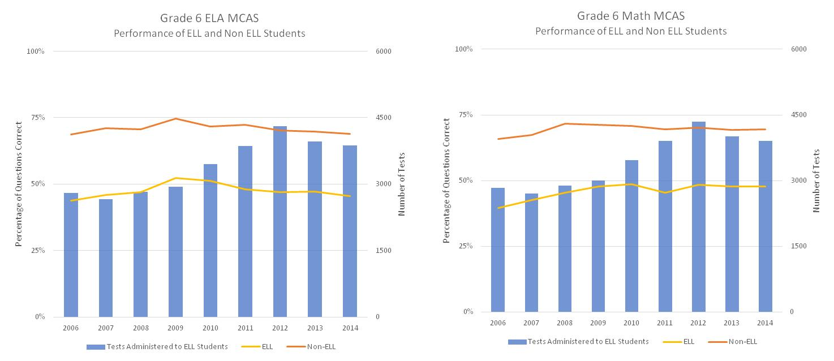
Grade 6 MCAS Achievement 2006 – 2014
Source: MA DESE, School and District Profiles http://profiles.doe.mass.edu/state_report/
Notes:
Our ELs are not doing as good as they could. We are not meeting their potential. While they may be outperforming ELs in over all lower-performing States, they are not keeping up with the performance level in our State. If the rigor is not as strong in another state, then our ELs can be seen as doing well, whereas if the rigor is higher here, we are not serving ELs well, as evidenced by their wider achievement gaps.
We are not serving ELs well in terms of allowing them to show us all of their potential

Slide 18
Amigos TWI Program, Cambridge
* A difference of >10 mSGP between two populations indicates a significant difference.
Student Growth Percentile (SGP) for All Grades Comparison of Amigos School Students with the Cambridge School District: Spring 2014. SGP- is a measure of how much a student has improved—or grown—academically from one year to the next as compared to his or her academic peers. Source: DESE DART, provided by M. Cazabon, WestEd
Notes:
This graph demonstrates how DL programs such as the Amigos are working to close the achievement “that disproportionately affect students living in poverty, students of color, students with disabilities, and students who are English language learners in our Gateway Cities.” (Executive Office of Education, August 2012)
MABE Dual Language Leadership Network Presentation July 2013
Source: Mary Cazabon, WestEd

Slide 19
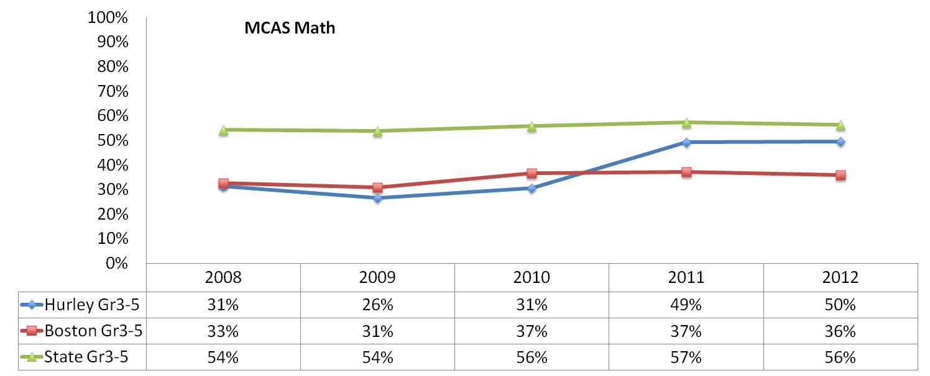
The Joseph J. Hurley K-8 TWI Program, Boston
Source: Diez, Virginia and Karp, Faye, "Two-Way Bilingual Education in Boston Public Schools: Required Features, Guidelines and Recommendations" (2013). Gastón Institute Publications.
Notes:
MABE Dual Language Leadership Network Presentation July 2013
Source: Diez, Virginia and Karp, Faye, "Two-Way Bilingual Education in Boston Public Schools: Required Features, Guidelines and Recommendations" (2013). Gastón Institute Publications. Paper 180.
http://scholarworks.umb.edu/gaston_pubs/180

Slide 20
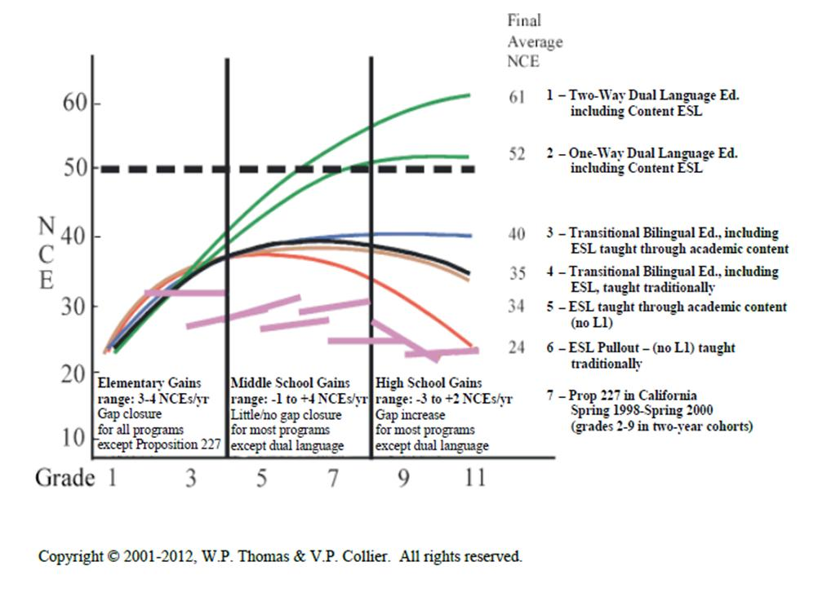
ELL Achievement on standardized tests in English reading based on 6.2 million records across U.S.
Notes:
Average Reading Performance- Native English Speakers

Slide 21
Two Way Immersion (TWI) and Transitional Bilingual Education (TBE) Program Guidance in Massachusetts: (to become public any day now.)
Defining and Implementing a Two-Way Immersion Program
Defining and Implementing a Transitional Bilingual Education Program
TWI Implementation Readiness and Planning Tools
TWI Examples from the Field
TBE Implementation Readiness and Planning Tools
TBE Examples from the Field
Instructional Strategies for Second Language Learning

Slide 22
At the same time other partner organizations are working on : the LOOK Bill
LOOK Bill Improves Education for ELLs by…
Giving School districts the flexibility to do what is best based on the educational needs of their students
Increasing parent engagement
Ensuring instructors and administers are qualified
Monitoring students and supporting current and former ELLS
Establishing the State Seal of Biliteracy
Removing regulations that inhibit and prevent the establishment of new programs for ELLs

Slide 23
LOOK Bill Improves Education for ELLs
The Look Bill will not mandate new language programs or dismantle current programs.
Instead, it will remove the barriers to selecting the best programs for Massachusetts’ student population.
Notes:
Mention High Needs group?

Slide 24
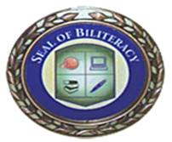
SEAL OF BILITERACY:
Recognizes graduates for proficiency in English and at least one other foreign language with a seal on the high school diploma
21 states have already adopted or are in the process of adopting a state Seal of Biliteracy
  Several states have made expanded language learning a centerpiece of their educational policy.
  Massachusetts is working toward Seal of Biliteracy. So far two districts have adopted the Seal of Biliteracy : Framingham Public Schools and Melrose Public Schools

Slide 25
Still a Challenge in Massachusetts : Dual Language Educator Licenses and Ed Prep
There is no license/endorsement for dual language educators
One educator prep program offers courses in MA (Boston College)

Slide 26
Dual Language Educator (DLE) License
Federal law requires programs that educate children with limited English proficiency to be:
1. Based on a sound educational theory;
2. Adequately supported, with adequate and effective staff and resources, so that the program has a realistic chance of success; and
3. Periodically evaluated and, if necessary, revised.

Slide 27
As we move forward…
The creation of a counter-­‐narrative for lifting the TBE/ TWI license/endorsement will not be easy. However, working together has shown that we can make a difference.
DESE is supportive of bilingualism
Devoted organizations such as MABE,MATSOL, and MAFLA advocate for bilingualism
Soon the state will have guidance for Two Way Immersion (TWI) and Transitional Bilingual Education (TBE) for Massachusetts’ schools that was put together by MABE experts in collaboration with national and local experts
Attending different in state and out of state conferences gives us opportunities to connect with and learn from others that have perfected bilingual programs

Slide 28
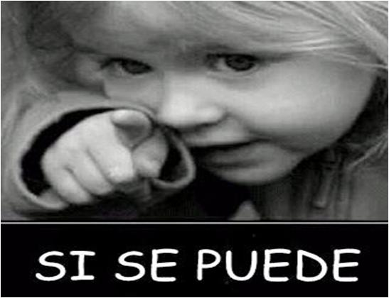
Questions
Notes:
Celic, C., & Seltzer, K. (2001). Translanguaging: A CUNY-NYSIEB guide for educators. New York, NY: City University of New York, Graduate Center. Retrieved from http://www.nysieb.ws.gc.cuny.edu/files/2013/03/Translanguaging-Guide-March-2013.pdf
Freeman, D., & Freeman, Y. (2011). Between worlds: Access to second language acquisition (3rd ed.). Portsmouth, NH: Heinemann.
García, O. (2009). Bilingual education in the 21st century: A global perspective. Malden, MA: Wiley-Blackwell.
Garcia, O. (2010). Misconstructions of bilingualism in U.S. education. NYSABE News, 1(1), 2–7.
From English language learners to emergent bilinguals. New York, NY: Teachers College.

