Slide 1
Google to the Rescue?
Tech-Savvy Strategies for Teaching Academic Vocabulary
MATSOL 2016
Friday, May 6: 8:30am–9:15am, 6 Carlisle
Christina Michaud
Boston University

Slide 2
The Problem:
Google to the Rescue? Tech-Savvy Strategies for Teaching Academic Vocabulary
Though learners can provide passable definitions of many words, they cannot use them correctly in speech or writing.
One Solution:
Search engines such as Google can help learners compare definitions and usage patterns via simple forms of corpus analysis. Learners produce more appropriate sentences for new vocabulary when using these techniques.
Notes:
As teachers we know that even intermediate- and advanced-level ESL learners in academic programs need to work on their vocabulary, yet we are often faced with learners who claim that they already "know" the words that a textbook or teacher puts on a list of target vocabulary. Though learners may be able to give rough synonyms or even passable definitions of many of these words, they falter when attempting to use the words in sentences of their own, producing sentences that are often quite far from appropriate in terms of connotation and usage.

Slide 3
Basic errors in university-level ESL learners’ vocabulary logs:
Google to the Rescue? Tech-Savvy Strategies for Teaching Academic Vocabulary
He had a hanker for a better-paying job.
Subsequent events vindicated his guilty because he shoplifted again at a department store.
It's pretty easy for me to think of something that is not relevance to the topic.
Notes:
Some show that students have the correct meaning of the word, but don’t know the part of speech, as here—we might call these word form errors

Slide 4
General Vocabulary Strategies:
Google to the Rescue? Tech-Savvy Strategies for Teaching Academic Vocabulary
Use English-language dictionaries, not (primarily/exclusively) L1/L2 translators.
Compare multiple dictionary definitions of the target word.
Pay attention to the original sentence (context) of the target word when reading.
Check dictionaries’ example sentences with the target word.
Use additional information from dictionaries, beyond meaning: part of speech, usage notes, etc.
Use good reading strategies: decide when to look up a word.
Prioritize high-frequency words and/or words on the Academic Word List (AWL).

Slide 5
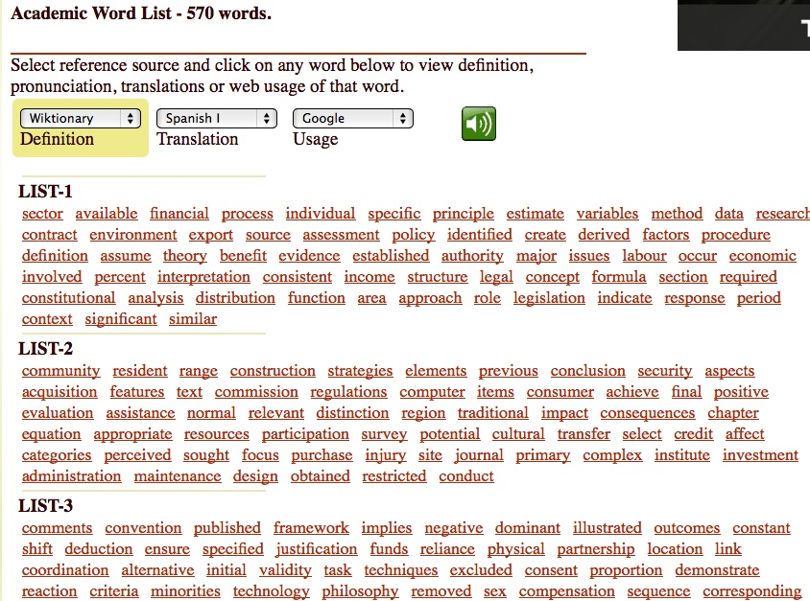
Coxhead’s Academic Word List (AWL)
Google to the Rescue? Tech-Savvy Strategies for Teaching Academic Vocabulary
Definitions, pronunciations, translations, and interactive spelling quizzes: http://www.esldesk.com/vocabulary/academic
Notes:
When you start addressing vocabulary with academic learners, you might start with their readings, in context, or you might start with the academic word list. You might move between the readings and the AWL

Slide 6
Learner Checklist: Six Things to Learn When You Learn a New Word
Google to the Rescue? Tech-Savvy Strategies for Teaching Academic Vocabulary
meaning (not just translation)
etymology (derivation and/or related words)
part of speech (noun, verb, adjective, etc.)
usage (regular/irregular, transitive/intransitive/phrasal verb, count/non-count noun, collocations)
number of syllables (x) and stressed syllable (y)
 write the stress pattern next to/on top of the word to remember how to say it: x-y (Murphy 2004)
pronunciation (consonants and vowels as well as syllables and stress)

Slide 7
Trickier errors in university-level ESL learners’ vocabulary logs:
Google to the Rescue? Tech-Savvy Strategies for Teaching Academic Vocabulary
The Taiwanese president is trying to cop out the promises he had made a few years ago.
People who have no confidence in their situations or positions can easy be snobbery.
Tom always made reverting comments that made our meetings go slowly.
Their rights have been confined and neglected by the government for too long.
It is frustrating to watch luckily vindicated criminals walk out without serving time in prison.
I conjure you sincerely to reconsider this business project.
Notes:
But even with good strategies, learners falter. We need to scaffold these strategies for them.
Could have many other sentences here too of course—we get them all the time. Sometimes students don’t know that the verb is phrasal as in #2. Sometimes they know the part of speech—snobbery is in fact a noun, as it is used as in #3, but we need a different noun in that spot, the noun for the person (snobs). Sometimes the basic meaning is right—to revert means to turn back, and a “reverting comment” could conceivably be construed as a comment that turns back, or delays, or sidetracks, the conversation, as in #4, but we just would never use the word this way.

Slide 8
The Teacher’s Dilemma:
Google to the Rescue? Tech-Savvy Strategies for Teaching Academic Vocabulary
Ignore the errors.
Correct the errors.
Don’t correct the errors, but instead write in the margin, or explain orally, the correct use of each individual word.
Mark the sentence as “awkward” and let the student correct it herself.

Slide 9
Therefore, even with good strategies,
Google to the Rescue? Tech-Savvy Strategies for Teaching Academic Vocabulary
learners still struggle, and teachers need practical ways to scaffold these strategies in the classroom.
One possible solution: Corpus Analysis
Typically focused on researchers, teachers, and upper-level language learners:
Genre-based approaches
English for Academic Purposes (EAP) and English for Specific Purposes (ESP) approaches
Systemic Functional Linguistics (SFL)
Notes:
Swales and others

Slide 10
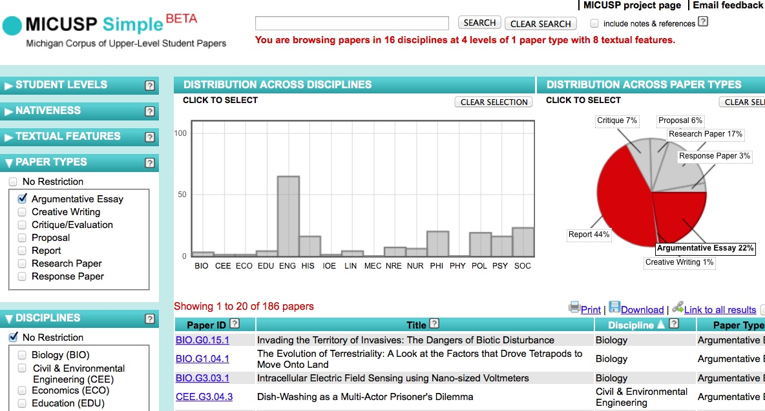
Michigan Corpus of Upper-Level Student Papers (MICUSP)
Google to the Rescue? Tech-Savvy Strategies for Teaching Academic Vocabulary
Free, searchable database of academic writing in the disciplines: http://micusp.elicorpora.info

Slide 11




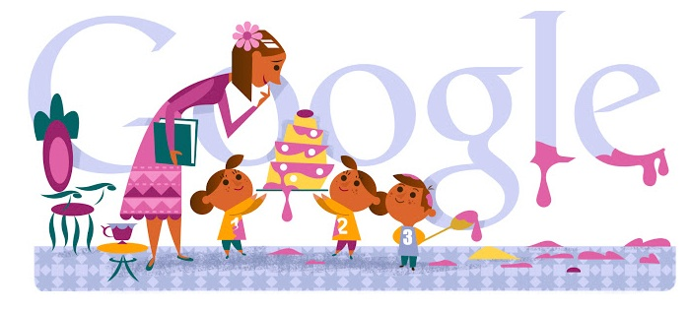

Google to the Rescue? Tech-Savvy Strategies for Teaching Academic Vocabulary
Free
Ubiquitous
Surprisingly fully-featured

Slide 12
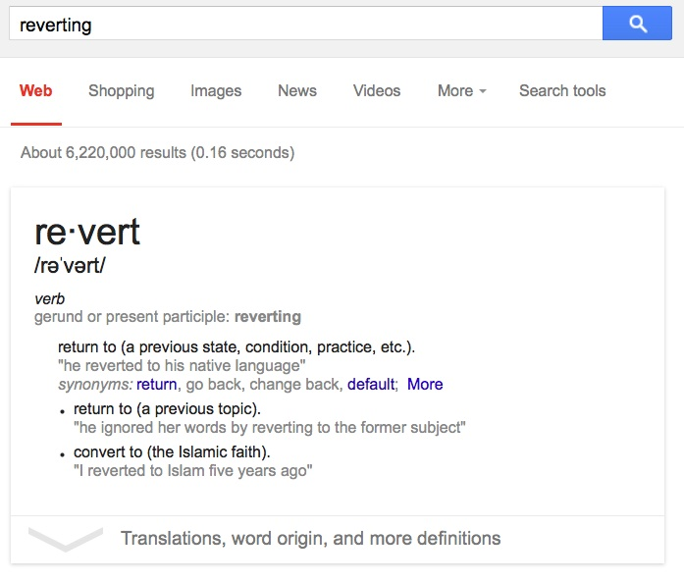
Using Google for Student Corpus Analysis:
Google to the Rescue? Tech-Savvy Strategies for Teaching Academic Vocabulary
Frequency
Connotations
Collocations
Usage

Slide 13
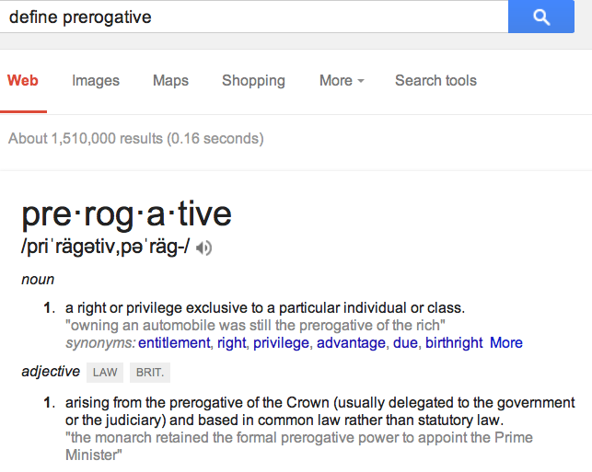
Helping Learners Analyze New Words
(example 1)
Google to the Rescue? Tech-Savvy Strategies for Teaching Academic Vocabulary
He has prerogative to do a lot of things.
It's not fair to use the prerogative to obtain a better job.
Old men should have prerogative to enter the park first.
It is such a prerogative that we can study at this great university.
He owns prerogative.
My friend, who is the son of the
vice president, has a lot of
prerogatives.

Slide 14
A closer look: “He owns prerogative.”
Google to the Rescue? Tech-Savvy Strategies for Teaching Academic Vocabulary
“owns prerogative” → 30 results
“owns a prerogative” → 6 results
“owns the prerogative” → 22,900 results
“has prerogative” → 3280 results
“has a prerogative” → 91,000 results
“has the prerogative” → 336,000 results

Slide 15
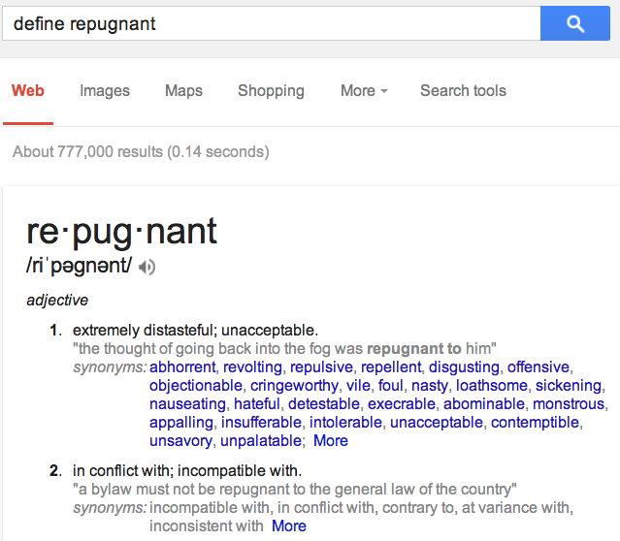
Helping Learners Analyze New Words
(example 2)
Google to the Rescue? Tech-Savvy Strategies for Teaching Academic Vocabulary
His annoying sound makes me feel repugnant.
My mother's food makes me feel repugnant.
The leftovers made me repugnant.
She found it repugnant when he
was asking if she wanted that
food.

Slide 16
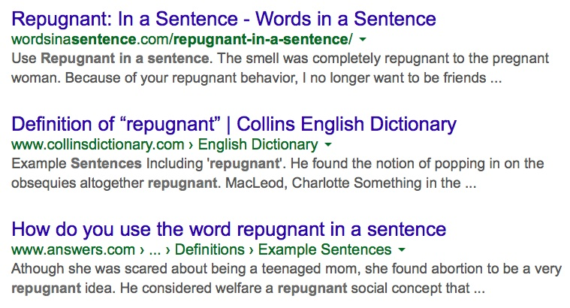
A closer look:
“The leftovers made me repugnant.”
Google to the Rescue? Tech-Savvy Strategies for Teaching Academic Vocabulary
“me repugnant” → 8590 results
repugnant
in a sentence
→

Slide 17
When (and how) should students implement these techniques?
Google to the Rescue? Tech-Savvy Strategies for Teaching Academic Vocabulary
For homework—to help with initial stages of vocabulary analysis (flipped classrooms)
For follow-up homework—to analyze errors in own/classmates’ sentences
In class, in groups—to analyze errors in own/classmates’ sentences
In class, individually during full-group discussion—to quickly access information to troubleshoot a word/concept

Slide 18
Another Benefit: Help Learners Avoid Plagiarism
Google to the Rescue? Tech-Savvy Strategies for Teaching Academic Vocabulary
Teach vocabulary itself:
“What we call plagiarism [among ESL students in academic writing classes] may more often be a result of lexical limitations, even lexical ignorance and desperation, than cultural differences or outright cheating. […] [W]hat was missing was appropriate directed vocabulary instruction to allow for proper paraphrasing and summarizing” (Folse 2008, p. 3).
Teach responsible Googling.
Copy/paste dangers
Citation specifics: https://owl.english.purdue.edu/owl/resource/747/08/
Notes:
Students WILL google, no matter what

Slide 19
Online Plagiarism Quizzes
Google to the Rescue? Tech-Savvy Strategies for Teaching Academic Vocabulary
Indiana University Bloomington School of Education https://www.indiana.edu/~istd/plagiarism_test_practice.php
Clark College Information and Research Instruction Suite http://www.clark.edu/Library/iris/quiz/plagiarism_quiz_home.php
University of Southern Mississippi http://www.lib.usm.edu/legacy/plag/acceptuse1.php

Slide 20
References:
Google to the Rescue? Tech-Savvy Strategies for Teaching Academic Vocabulary
Folse, K.S. (2008). Myth 1: Teaching Vocabulary is not the Writing Teacher's Job.” Writing Myths: Applying Second Language Research to Classroom Teaching, ed. Joy Reid et al. Ann Arbor: Michigan.
Murphy, J. M. (2004). Attending to word-stress while learning new vocabulary. English for Specific Purposes Journal, 23(1), 67-83.

Slide 21
Thank you!
Christina Michaud
Boston University cmichaud@bu.edu

