Slide 1

Laying the Groundwork for Shared Measures
Grantmakers for Effective Organizations Conference - 2016
Notes:
Set up the session
MSPWin – quickly introduce the topic
Introduce yourself
Introduce the topic and the format
Learning for improvement – challenges/pitfalls, how to navigate, and what we’re learning locally.
Will do a warm-up/quick 10 minute primer to get started, will then move to a fishbowl discussion to hear about why this work is important, challenges, and value it has/will bring, the end with an overview of MSPWin’s Blueprint for Career Pathways and hopes to build a community of practice
GEO has encouraged us to be creative with session design

Slide 2

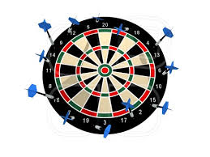
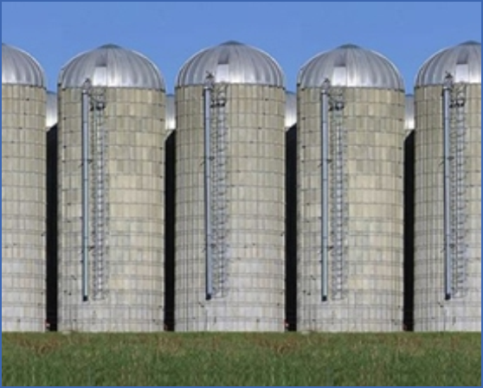
1-2-4 Warm-up
Challenges to Understanding Impact
Language trap
Hitting the target, missing the point
Program rich, systems poor
Notes:
Little primer to get the juices flowing. Common “pitfalls” to learning for improvement and understanding impact. Traps that locally we have organized to avoid – seeking to align language, get clear on common/shared performance measures, and align measures across multiple funders and funding streams.
Language trap – thinking that you’re talking the same language as your grantee/community partner – but in fact you are talking past one another. Example – competitive application that didn’t take the time to fully define “job placement.” Some grantees who defined as getting any job, some setting their own threshold of “quality of placement,” but no definition at the funding level. Led to those with the lowest bar getting awarded.
Hitting the target but missing the point – coming up with outcome measures that miss the point of programming. Workforce related example – setting the outcome measure as only “counting” jobs that pay $12/hr or more/working 20+ hours per week. One of our highest performers was meeting these measures by relocating immigrant workers to rural Minnesota to do meatpacking – leaving us to wonder – are these the types of outcomes we were really hoping for? Another example that Ruby reminded me of – getting a job may or may not lead to greater financial stability – and we should REALLY be looking at financial stability through asset building.
Program rich, systems poor. Creating crazy making for grantees we have in common. One nonprofit who shared that they were reporting on job placement in 6 different ways to 6 different funders. Often funders were unaware of this dynamic – and weren’t even fully aware of the number of grantees in common. Further complicating this issue – often participants are receiving services from multiple providers, funded by multiple sources – leaving us unclear of how these services compliment or coordinate with one another.
Take a minute to think through how you have encountered one of the traps in your work. What was it? How did it limit your ability to work effectively with your grantees? How did you navigate this trap?

Slide 3

User Experience Fishbowl
The good, the bad, and the ugly of measuring impact in our field
The Bowl:
Sharing experience as if chatting in at the local “watering hole”
Ignore the audience/those outside the bowl (keep us honest – NO PRESENTATIONS!)
OPEN Seat (jump in – the water is lovely!)
The Fish:
Ruby Lee, CLUES (Comunidades Latinas Unidas En Servicio)
Rachel Speck, Greater Twin Cities United Way
Brian Paulson, Pohlad Family Foundation
Notes:
The GOOD - Why the call for impact measurement is good/important to you/your organization/the community?
What challenges to you face from the seat you’re in to understanding and measuring impact?
What are your hopes for a “community of practice” that seeks to improve our collective ability to measure and understand impact?
Down to earth experience in measuring impact
Role we each play in measuring and understanding impact
Put yourself in the other’s seat (empathize).
Possible bowl questions/discussion beyond:
Ruby – you’ve seen both sides of this – what’s the right balance? Right approach?
What progress have we made?
Why is this important?

Slide 4
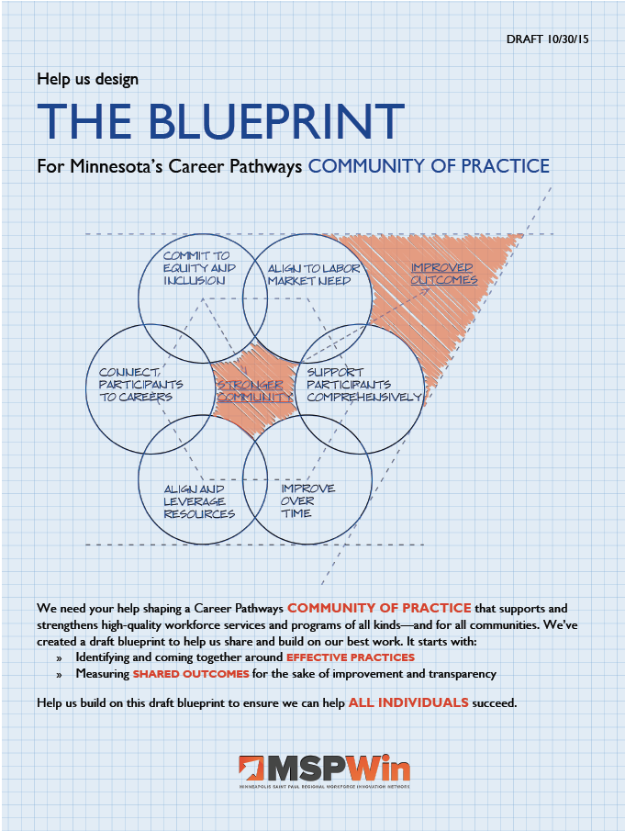
MSPWin’s Blueprint
Creating a “community of practice” to understand outcomes and practices that lead to them
Notes:
For all the reasons you’ve just heard – need for better understanding across the field of outcomes and impact, need to reduce administrative burden on providers, need to make sure we’re all collectively focused on key outcomes, and to build transparency for providers to better understand what funders are looking for – across funding streams.
Going to spend a few minutes sharing with you the process that informed what’s now known as the Blueprint, and the next steps we’re taking as a community.

Slide 5
Learning for Improvement
4.“Community of Practice”
2. Shared Measures
3.Effective Practices
1. Culture of Data
Notes:
Ecosystem of learning for improvement
Greater transparency
Build the field – connecting with similar systems of education and training
Making the case for targeted investment of public dollars
Culture of data:
Capacity building and technical assistance for agencies on continuous improvement – using data to improve their programs.
Phase I Began in 2013, co-funded by United Way and Phillips Family Foundation of MN. In 2015 Phase II added Twin Cities LISC.
Both phases 15-17 agencies participating, mostly on a volunteer basis.
External consultants who make the practices important and real to front-line staff; tapping into their own motivation
tools, resources and processes to integrate data in pursuit of program improvement.
Example of work done: workforce development, relationships with employers/companies is important for helping participants land jobs for which they’re prepared. IIMN – as a team, looked at their data on job placement and identified several employer partners that weren’t hiring as many graduates. Hypothesized that needed stronger relationship with those handful of companies. Devised and executed plan and in the next cohort of graduates, the three companies doubled the number of graduates they had hired over the previous four years. And secondly, looked at hiring wages of their graduates and saw that a few of their partners were hiring below industry average – approached them and shared their information; three employers raised starting wage by $1/hour.
Opportunity to network and build knowledge across agencies – staff are excited by this.
Results:
Increased willingness to talk and share, with each other and with funders.
Agencies are “owning” the conversation – this is their data, their choice, their focus
Shared Measures: came out of the funders’ interest in the capacity building project, and asking ourselves, beyond the capacity building, how can we support learning mindset in grantees and how can we learn as a community? Staring down some of the worst racial disparities in the nation – need to understand what’s working to help individuals and families increase their income, and for whom.
One barrier to staff “owning” the power of data is multitude of measures and forms and data points they need to collect for accountability purposes (aka, funders) → by streamlining and coming to consensus, we can support greater focus on the data that matters, and programs can also focus on data that matters to them
Diverse group of funders: public and private --- key resources for programs in this field. Almost a quorum of sorts to be able to really shift the tides. (three state agencies, largest county in the state, largest city in the state, funders’ collaborative, two community-based agencies).
Met quarterly for a year,
Results based accountability:
What are the population-level (aka, our broader community) that we care about, that represent our area of focus? Employment and Earnings disparities
Program level – how much, how well, is anyone better off? → kept the conversation focused and the list of measures manageable (ten). Two are optional – about half are reported by providers, other half is reported from the Dept. of Employment & Economic Development.
Data development agenda: what could we currently get our hands on from other sources? In workforce, with relationships, can access earnings data from the state.
Effective Practices:
Wanted something we could use to both ground conversations between grantees and funders, as well as between funders, and across the community. Way to build tools that programs could use on their own to “know” where they stacked up, where areas of opportunity could be. In other words, we know what we want to say are good outcomes/successes, but what contributes to those from a management perspective?
Enjoyed our conversations so much, and increased interest in continuing to build transparency, so continued conversations around Effective Practices.
Similar group of stakeholders, focused on what contributes to “good” outcomes?
Didn’t need to reinvent the wheel – based it on current research, but condensed it, and “vetted” it by those in the room. Identified examples of strong practices.
Pulled the practices and the measures into one document to gather feedback from the community – leaving room not just for “do you agree or not” but also, “what does your program do in the arena of leveraging community resources that might also be a best practice?” – asking for community contributions.
Gathering feedback from providers, and practitioners from other systems to build a grounding document.
Once finalized, can be used to build tools and resources to continue to support quality programs and impact for program participants.
Community of Practice:
As we began to gather feedback on the measures and practices, through The Blueprint, realized some of the dynamics around funders being behind this work – and while we have the time resources to dedicate to this, perhaps not the best drivers for implementing – needs to ultimately be owned by the whole field, not just foundations.
- So currently planning a “Community of Practice” that will offer and engage staff at multiple levels in using data to build knowledge, identify what works, and continue to move low-income Minnesotans into opportunities to move out of poverty.
One tool we think will help ground these conversations, and create focus is an outcomes dashboard that allows us all to better understand “what’s working and for whom?” – to turn the tide of earnings and employment disparities in our region and our state.
Personal value in all of this is how can we use practitioner expertise, knowledge and experience to build better policy – policy that supports moving out of poverty, not just churning through our public benefits systems.

Slide 6

Questions?
Retrieved from www.twincities.com

Slide 7
Overview of Shared Measures
Service Provider Collected and Reported | Reported from Administrative Data
Number enrolled in employment services | Number working two quarters after job start
Number received employment training | Number working four quarters after job start
Number completed employment training | Number working eight quarters after job start
Number who attained a credential | Mid-term Earnings Change (one year pre-enrollment, one year post-employment)
Number who started unsubsidized employment | Long-term Earnings Change (one year pre-enrollment, two years post-employment)
Number who retain employment for 6 months
Number who retain employment for 12 months
(optional) Number of ABE/Bridge/ELL enrollees who gain one or more Educational Functioning Levels
(optional) Number of completers who enroll in further post-secondary education within one year of completion

Slide 8
EVIDENCE-BASED PRACTICES
Support Participants Comprehensively Provide holistic support services Embed intensive career counseling and navigation Use integrated education and training methods Connect participants to Careers Guide career training with comprehensive intake and assessment Teach people how to build a career Link participant outcomes to the next step in education, training and/or employment Commit to Equity and Inclusion Leadership demonstrates a commitment to promoting equity and inclusion Deliver services in culturally relevant and responsive way Organization has established explicit equity outcomes and accountability for achieving them | Align to the Labor Market Use Labor Market Information (LMI) to shape occupationally based programming Engage multiple employers in industry clusters Embed work experiences and expect work behaviors Connect & Leverage Resources Connect to community needs Partner to provide a diversity of services Braid funding sources Improve Over Time Conduct real-time evaluation for continuous improvement Understand analysis and data Respond to evaluation with changed practice

Slide 9
Getting to Shared Measurement
Defining Success
“Shared Measures”
- Outcomes and Inputs
- Benchmarking
- Accountable to results
- Streamline reporting
Know “what works”
“Effective Practices”
- Success drivers
- Quality framework
- Consensus→Transparency
- Evidence-based practice
Grow “what works”
The Blueprint
- Broadening support
- Learning community
- Capacity building
- Making the case

