Slide 1
RISK Management: Matrix & Activity
GEO
National Conf.
May 2016

Slide 2
Risk Assessment cycle

Slide 3


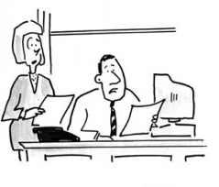

Evaluate RISK
 |  | Probability of Occurrence
 |  | High | Moderate | Low
Severity of Harm | Severe
 | Moderate
 | Low
Third Axis: Control

Slide 4
Risk Mitigation
Try to mitigate when:
Severity of Harm | Probability of Occurrence
 | High | Moderate | Low
Severe
Moderate
Low
+ Moderate to High degree of control over inputs
Mitigation techniques:
Identify potential risks
Adjust project plans, timelines, and/or budgets
Consider additional training, partners, or resources
Adjust expectations

Slide 5
Risk Contingency Planning
Try to create contingency plans when:
Severity of Harm | Probability of Occurrence
 | High | Moderate | Low
Severe
Moderate
Low
+ Low to Moderate degree of control over inputs
Examples of contingency plans:
Funder sets aside $X for contingencies
NGO budgets $X for contingencies in original project budget
Pre-identify areas of flexibility within existing timelines
Pre-identify additional resources (financial, personnel, partners, training)
Adjust expectations

Slide 6
Case Study scenario
Spark! MicroGrants
Spark is an NGO working with local communities to build civil society and implement small-scale development projects. Spark runs a 16-week intensive training for community members to build collective action decision-making skills. The training leads communities through the process of identifying community needs, selecting and planning a community-based project (such as building a school building or purchasing goats to begin a dairy market). Finally, Spark provides a ‘micro-grant’ to fund implementation of that project. They have a proven track record, and solid M&E data to back up their model.
A coffee company approach Spark to expand its work into 14 communities in Uganda, where the company sourced its coffee. The expansion is fully covered by a multi-year grant from the coffee company’s CSR department.

Slide 7
Actionable Steps
ASK about the potential risks that your grantees do or could face.
TALK with your board, staff, and grantees about your risk profile.
PLAN for risk through mitigation and contingency planning: What happens if…? Create a process for:
Communication
Decision-making
Action

Slide 8
Additional Resources
SWOT Analysis Templates/Examples
Charity Commission SWOT Analysis
New Philanthropy Capital SWOT Analysis
American Red Cross SWOT Analysis
PESTLE Templates/Examples
Charity Commission PESTLE Analysis
Development Training for Girls PEST Analysis
Risk Matrices Templates/Examples
Open Road Alliance Risk Severity Matrix
KnowHow Nonprofit Risk Classification Matrix
Blandin Foundation Risk/Reward Assessment (GEO list-serve)
Charity Commission Risk Matrix
PESTLE
Political
Economic
Social
Transportation
Logistical
Environment

Slide 9
END

Slide 10
Act: Mitigation v. contingency
Mitigation: when risks can be managed through effective planning.
Moderate to High Severity
Moderate to High Likelihood and
Moderate to High degree of influence over context
Contingency: when risks are not predictable or cannot be managed through effective planning.
Moderate to High Severity
Low Likelihood and/or
Low degree of control over context

Slide 11
Nitty Gritty
Mitigation techniques:
Identify potential risks
Adjust project plans, timelines, and/or budgets
Consider additional training, partners, or resources
Adjust expectations
Examples of contingency plans:
Funder sets aside $X for contingencies
NGO budgets $X for contingencies in original project budget
Pre-identify areas of flexibility within existing timelines
Pre-identify additional resources (financial, personnel, partners, training)
Adjust expectations

Slide 12
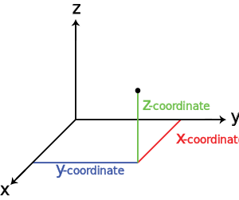
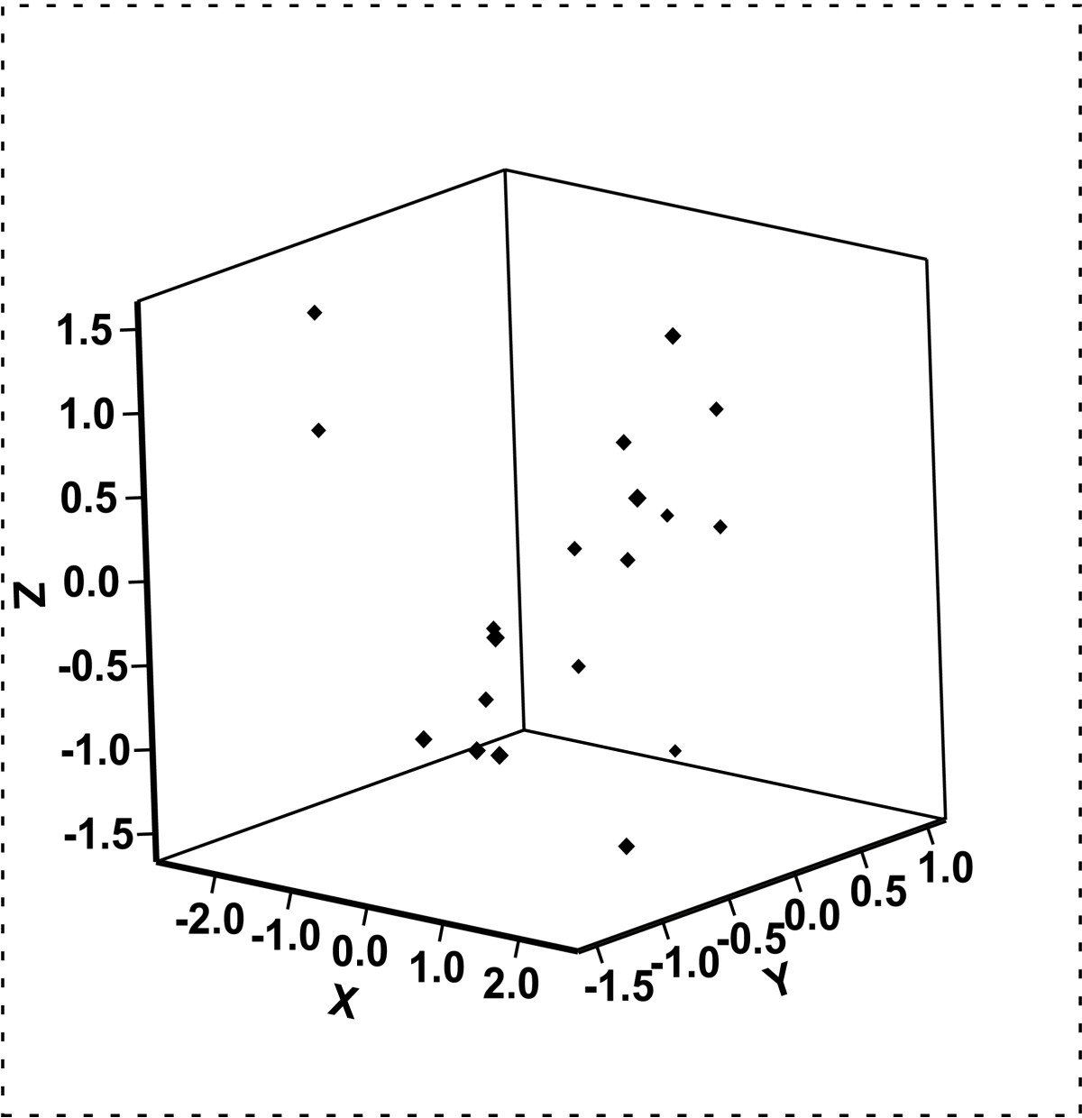
Managing Risk: Control
X = Probability Y = Severity Z = Control

Slide 13

THIS IS NOT A MATH TEST
Determining what is or isn’t in our control, and what is of high or low probability and severity is art (or experience), not science.

