Slide 1


Slide 2
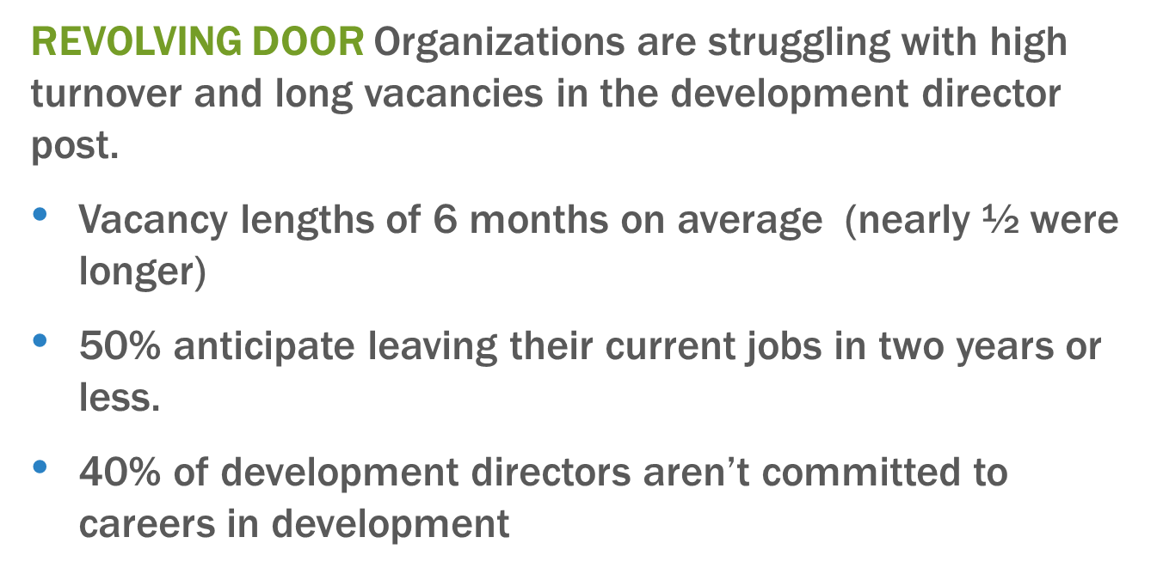
From UnderDeveloped
TWITTER: #ResetDevelopment @JeanneBellCP @HaasJrFund @MeyerFoundation

Slide 3
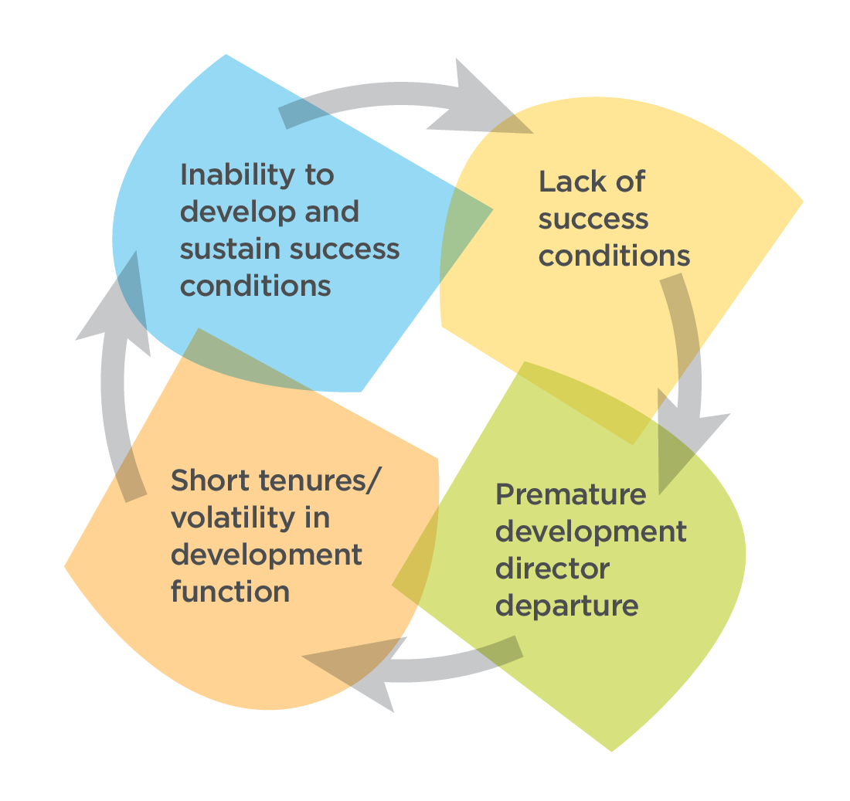
From UnderDeveloped
The Vicious Cycle

Slide 4

Fundraising Bright Spots
In-depth interviews with staff, board, volunteers, and donors of 16 social justice organizations
Together they raised over $14 million in 2014-15 from individual donors
“Regular” groups who are not caught in the “vicious cycle”
Read it here:
http://www.haasjr.org/sites/default/files/resources/Haas_BrightSpots_F2.pdf
TWITTER: #ResetDevelopment @JeanneBellCP @HaasJrFund @MeyerFoundation

Slide 5

“I encourage other organizations and leaders to feel a confidence and a comfort in focusing on what you do and how you do it and to trust that that will connect you with other likeminded people.”
TWITTER: #ResetDevelopment @JeanneBellCP @HaasJrFund @MeyerFoundation

Slide 6
Fundraising Bright Spots Mindsets
The decision to raise money from individuals—as well as the approaches used to do so—are steeped in existing organizational values.
Being genuine about who you are and what you stand for as an organization is core to fundraising success.
Fundraising is a form of organizing and power-building, not merely a strategy for financing the organization’s work.
TWITTER: #ResetDevelopment @JeanneBellCP @HaasJrFund @MeyerFoundation

Slide 7

“It’s not about someone being professional or educated in a certain way. It’s really about shedding light on the fact that we already have these skills in communities of color. It’s about making visible and lifting up the resourcefulness that we’ve always had.”
TWITTER: #ResetDevelopment @JeanneBellCP @HaasJrFund @MeyerFoundation

Slide 8
Fundraising Bright Spots Mindsets
Fundraising is not the purview of a select group of professionals, but a process, if well-supported, that anyone can engage in.
Development directors are organizational leaders focused on skill building, culture change, and systems development to support others in fundraising.
The conversation about fundraising goals and progress belongs everywhere. It’s not contained in a single department or confined to a single team.
TWITTER: #ResetDevelopment @JeanneBellCP @HaasJrFund @MeyerFoundation

Slide 9
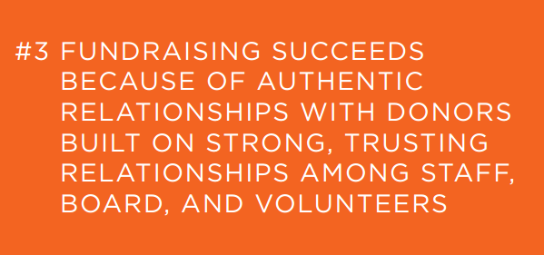
“If NCLR hired a small army of people who were very organized and less passionate, it wouldn’t come through in the same way. They hire people from our community, who reflect our community, who are really passionate about what they are doing. It’s palpable in your interactions with them.”
TWITTER: #ResetDevelopment @JeanneBellCP @HaasJrFund @MeyerFoundation

Slide 10
Fundraising Bright Spots Mindsets
“Donor” is only one aspect of the many relationships that committed supporters forge with an organization.
Authentic relationships with donors are part of a larger organizational culture that values relational rather transactional interactions with everyone.
High trust and accountability among staff and board members allow leaders to weather fundraising’s inevitable ups and downs together.
TWITTER: #ResetDevelopment @JeanneBellCP @HaasJrFund @MeyerFoundation

Slide 11
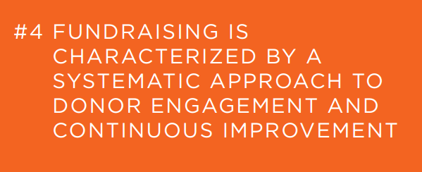
“We don’t have a singular development plan. We have a system.”
TWITTER: #ResetDevelopment @JeanneBellCP @HaasJrFund @MeyerFoundation

Slide 12
Fundraising Bright Spots Mindsets
More important than having a perfect system is working whatever system you have with a stance of rigor and continuous improvement.
Development and communications are inextricably linked; compelling communications are a powerful way to acquire, engage, and retain donors.
The use of data is not just about having a donor database. It’s also about surveying your donors; getting feedback from your fundraisers on what messages are resonating; and studying the performance of every fundraising campaign and event.
TWITTER: #ResetDevelopment @JeanneBellCP @HaasJrFund @MeyerFoundation

Slide 13
Discussion Questions:
What really stands out for you from this research and discussion?
What’s a question or idea you have about how you could effectively build the fundraising capacity of your grantees?
TWITTER: #ResetDevelopment @JeanneBellCP @HaasJrFund @MeyerFoundation

