Slide 1
How to Plan and Support Successful Meetings
Bess Rothenberg
Director, Strategy and Learning
Ford Foundation
b.rothenberg@fordfoundation.org
Josh Joseph
Senior Officer, Planning and Evaluation
Pew Charitable Trusts
jjoseph@pewtrusts.org

Slide 2

Why Are You Here?

Slide 3

Strategic Meetings Gone Wrong….

Slide 4
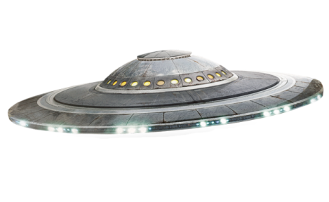
Why Am I Here?

Slide 5
You will leave today with..
Clarity on what can lead a meeting to disappoint
Practical steps that can avoid typical pitfalls
A sense of whom to involve, what to prioritize, and how to carry work forward

Slide 6


Our Approach…

Slide 7
Approach
What we’ve learned (~15 mins)
Hands on Practice (~30 mins)
What’s on Your Mind? (~30 mins)

Slide 8
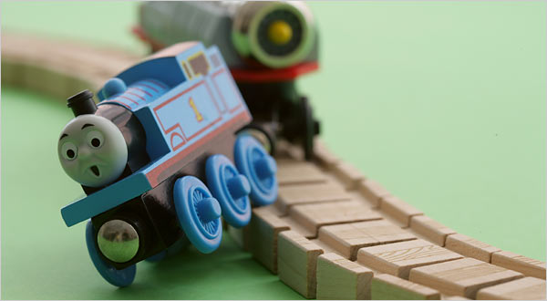
Lessons Learned: Why Meetings Go Off the Rails

Slide 9
What goes wrong…
No defined sense of purpose

Slide 10
Phrases to Fear:
If we just bring people together, it will be worthwhile.
I thought I’d have more time to devote to this, but it will be fine.
We’re smart people, we can just figure it out when we get there.

Slide 11
What goes wrong…
No defined sense of purpose
Not involving participants early

Slide 12
Common Excuses
Too much work
Fear losing control of the agenda
Anticipate conflicting feedback
Dealing with naysayers
Notes:
Getting input is seen as too much work. But a series of brief meetings has immense potential to earn you good will and a better outcome.
Some fear giving up control (“now I must do what they said”) rather than being able to show one’s own leadership and “handle” on the meeting.
Others worry it will hurt their credibility if they don’t seem to know it all
Reasons to involve others
Shows respect for participants
Know I don’t have all the answers
My meetings are better when agenda’s reflect what matters to attendees
“Managing” people does not work
It helps in setting meeting goals & clarifying priorities
Surfaces potential obstacles to progress
Increases participant interest and creates “buy in”
Helps bring potential naysayers into the tent
Actually establishes your credibility and leadership role (folks see you driving it!)
This is time well spent.
– “managing” them will not work.
What you gain:
A sense that people see themselves as reflected in and responsible for the agenda
Share a sample of input questions I ask…

Slide 13
What goes wrong…
No defined sense of purpose
Not involving participants early
No clear meeting priorities
Notes:
Istanbul example – people came together and had no time to work on anything – were stealing minutes here and there.

Slide 14
Don’t let your meeting
Be all things to all people…
…or it will be nothing to everyone
Do too much
Prevent people from actually doing work that would benefit larger priorities

Slide 15
Start with your outcomes:
What do you
want to achieve?

Slide 16
What goes wrong…
No clear sense of purpose
Not involving participant early
Not setting clear meeting priorities
Planning for an “event” not for a “change”

Slide 17
Do’s…
Make a place for closing and next steps in your meeting agenda
Remind people this is part of something larger and how it fits in
Assign people to take good notes during the meeting & share them after
Set expectations for timeframe for next steps
…and Don’ts
Don’t create too much immediate work for attendees (demoralizing)
Avoid agreeing on “new formats” for communicating

Slide 18
The “What If” Problem
What if….
…the meeting is awkward or uncomfortable
…people don’t participate, or try to take over?
…things get off track?
…we run out of time?
…they hate it…or hate me?
…etc.

Slide 19
Good Planning Shrinks
“What ifs”

Slide 20
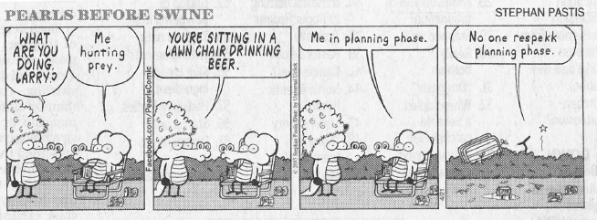

Slide 21

Case Example

Slide 22
Case Discussion Questions
What topics do you recommend as priorities for inclusion at the strategic meeting and which ones would you suggest deferring for another time?
Why?

Slide 23

When bad convenings happen to good people.
Examples of missing the mark.

Slide 24

Q & A

