Slide 1
The State of the State: Updates on OELAAA and ELLs in MA
The Office of English Language Acquisition & Academic Achievement
presents
MATSOL CONFERENCE, May 5, 2016
Paul J. Aguiar, Director, OELAAA
Robert Measel, Assistant Director, OELAAA

Slide 2
Agenda
Introduction & OELAAA Staff
Statistics
RETELL SEI Endorsement Courses
Extending RETELL (beyond endorsement courses)
District Support
Title III & Compliance
Q&A

Slide 3
OELAAA Staff
Paul Aguiar, Director
paguiar@doe.mass.edu 781-338-3538
Robert Measel, Assistant Director
rmeasel@doe.mass.edu 781-338-3801
Diana Gentile, Program Coordinator
dgentile@doe.mass.edu 781- 338- 3584
Zhaneta Liti, ELL Urban Coordinator East
zliti@doe.mass.edu 781-338-3572
David Valade, ELL Urban Coordinator West
dvalade@doe.mass.edu 781-338-6711
Sara Niño, ELL Special Education Coordinator
Sara.nino@doe.mass.edu 781-338- 3522
Melanie Manares, Title III Coordinator
mmanares@doe.mass.edu 781-338-3573
Beth O’Connell, Title III Specialist
eo’connell@doe.mass.edu 781-338-3571
Sibel Hughes, ELL Compliance Coordinator
shughes@doe.mass.edu 781-338-3569
Fernanda Kray, ELL PD & Curriculum Coordinator
fkray@doe.mass.edu 781-338-3546
Audrey Mangone, RETELL Specialist
amangone@doe.mass.edu 781-338- 3575
Leanne O’Brien, RETELL Registrar
lobrien@doe.mass.edu
Dee Doan, Business Process Manager
hdoan@doe.mass.edu 781-338- 3525
Mary Freed, RETELL Administrator
mfreed@doe.mass.edu 781-338- 3532
Notes:
Paul introduces staff and Zhaneta and David (as similar job types)

Slide 4
ELL Enrollment Statewide is at 85,762 and has almost doubled since 2000
Source: 2015 SIMS

Slide 5
58% of MA ELLs Are Enrolled in 11 Districts (68% last year) Boston enrolls ≈20% of all ELLs statewide
Source: 2015 SIMS
Notes:
Last year 68% of ELL were enrolled in these 11 districts

Slide 6
ELLs by Program Enrollment
Source: 2015 SIMS

Slide 7
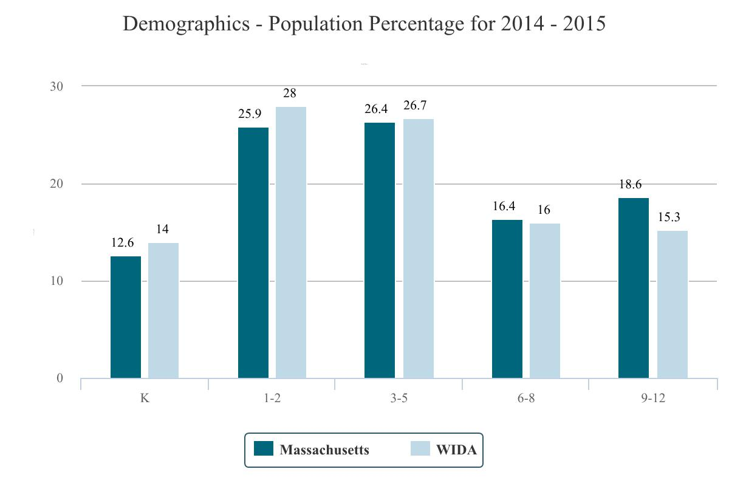
ELL Population Percentage 2014-2015
Source: 2015 ACCESS for ELLs®

Slide 8
District ELL Enrollment Profile - 2016

Slide 9
Numbers of ELLs Reported by Districts
2014-2016
Notes:
Since we know that the number of ELLs has gone up, you can see that the population is shifting from lower incidence districts to higher incidence districts.

Slide 10
Percent of District Population Profile
2014-2016

Slide 11
Graduation rates for ELLs
This calculation includes all students who were reported as ELL at least once in HS.

Slide 12
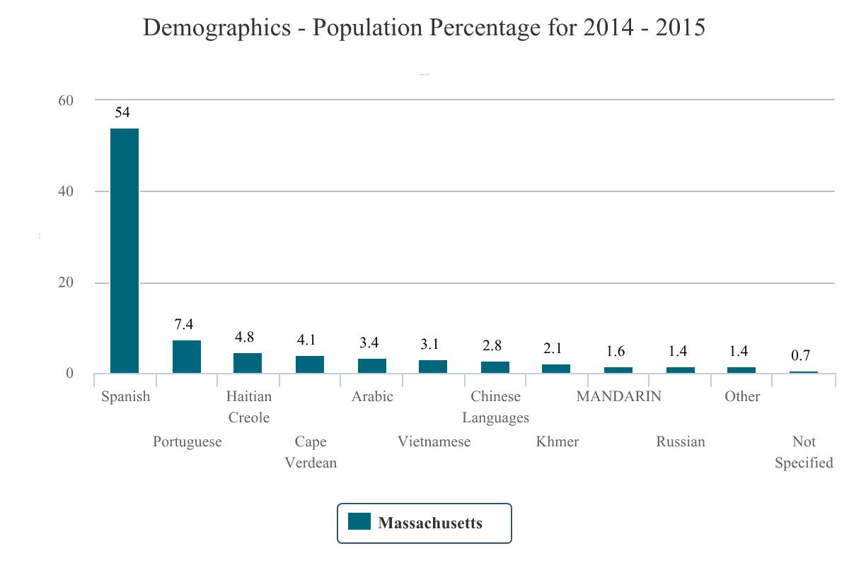
Over 70 Languages are Spoken by ELLs in MA; the Majority of ELLs Speak Spanish
Source: 2015 ACCESS for ELLs®
Notes:
12
Over 50% of all ELLs in MA are native Spanish speakers

Slide 13
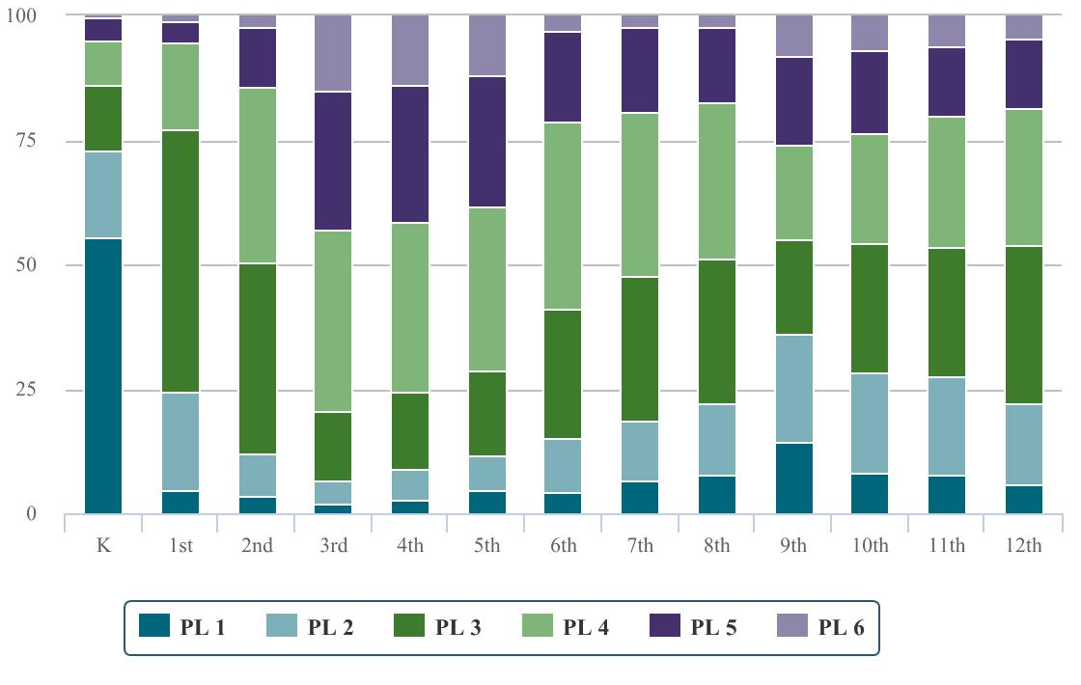
Overall Proficiency Level Breakdown by Grade

Slide 14
RETELL SEI Endorsement and Extending the Learning

Slide 15
Options to Earn the SEI Endorsement SY 2016
No-Cost SEI Endorsement for Teachers
1. Full
2. Long Bridge
3. Short Bridge
No-Cost SEI Endorsement for Administrators
Transcript Reviews
Hold an ESL License
Pass SEI MTEL Test

Slide 16
SEI ENDORSEMENT COURSES PROVIDED BY DESE
SEI ENDORSEMENT COURSES | Full SEI | Long Bridge | Short Bridge | Administrator Endorsement | Total
2012-2013 | 83 | NA | NA | 2 | 85
2013-2014 | 194 | 70 | 83 | 71 | 418
2014-2015 | 276 | 60 | 72 | 96 | 504
2015-2016 | 348 | 30 | 28 | 36 | 442
Total | 901 | 160 | 183 | 205 | 1449

Slide 17
ENROLLMENT IN SEI ENDORSEMENT COURSES
Number of Teachers or Administrators Enrolled | Full SEI | Long Bridge | Short Bridge | Administrator Endorsement | Total
2012-2013 | 2,014 | NA | NA | 44 | 2,058
2013-2014 | 5,061 | 1,769 | 2,428 | 1,711 | 10,969
2014-2015 | 7,350 | 1,360 | 1,877 | 1,913 | 12,500
2015-2016 | 10,301 | 767 | 710 | 594 | 12,372
Total | 14,425 | 3,129 | 4,305 | 3,668 | 37,899

Slide 18
Additional Providers of Courses
For-cost vendors across the Commonwealth.
An option for those who have ELLs and were not eligible to take a no-cost SEI Endorsement course, but want the skills. (e.g. Art, Music, PE, Career Development, etc.)
Open, rolling RFR to bring on new vendors as we move into 2016-2017.
Districts can apply to become providers under the current RFR.
Bridge courses will no longer be available.

Slide 19
Current For-Cost Providers
The following collaboratives are authorized to offer SEI Endorsement courses at cost:
Collaborative for Educational Services (CES)
EDCO
French River Education Center
SEEM Collaborative
South Shore Educational Collaborative (SSEC)

Slide 20
Options to Earn the SEI Endorsement SY 2017
Approved providers
(districts and vendors)
Transcript Reviews
Hold an ESL License
Pass SEI MTEL Test

Slide 21
Extending RETELL Beyond endorsement courses

Slide 22
Guidance and Supports…
Guidance:
Overall ELL Guidance
SCI Guidance
ESL Guidance
TWB/DL Guidance
SLIFE Guidance
Summer of 2016
ELL/SPED Guidance
Collaboration Guidance
Supports:
ESL Curriculum Development Training
Coaching Courses
Technical Assistance
Urbans
Level 5’s
Routine
Tutorials
Data/Reports
Smart Card
PD
Guidance

Slide 23
Relationship between guidance documents
Smart Card
Identification
Reclassification
Parent notification/ involvement
HLS
Access to content
Assessment
Collaboration
Castañeda requirements
Program eval
SCI Guidance
ELL Guidance Document
Requirements that apply to all programs and/or students.
Program decision matrix:
SEI TBE DL
ELL Subgroups:
SLIFE ELL/SPED
ESL Guidance
TBE/DL Guidance
SLIFE Guidance
ELL/SPED Guidance
Collaboration Guidance

Slide 24
Guidance and Supports…
Guidance:
Overall ELL Guidance
SCI Guidance
ESL Guidance
TWB/DL Guidance
SLIFE Guidance
Summer of 2016
ELL/SPED Guidance
Collaboration Guidance
Supports:
ESL Curriculum Development Training
Coaching Courses
Technical Assistance
Urbans
Level 5’s
Routine
Tutorials
New Data/Reports
Smart Card
PD
SUPPORTS

Slide 25
ESL MCU Project: Spring 2016…
Unit Rubric
ESL Unit & Lesson Template
ToT & Support
14 ESL Model Curriculum Units
K-12, Foundational Levels (ELP 1-3)
Clear learning goals: Collaboration Tool
Curriculum Resource Guide
How-to, scenarios, PLC, protocols formative, SWD
Operationalize broad WIDA standards in ESL
Define focus of ESL instruction
Clarify roles in a coherent, comprehensive program (ESL & SCI = SEI)

Slide 26
SEI Coaching Courses
SEI literacy coaching (developed in FY14 –offered by MATSOL for the first time in August 2015 )
SEI math coaching course (developed and piloted in FY15)
Literacy and Math courses reviewed by the DOJ
SEI content area leadership coaching course – (will be piloted in August 2016)

Slide 27
SEI Extension Coursework
Whether or not an educator has been required to obtain the SEI Endorsement, after July1,2016, under new recertification regulations, all educators with a professional license must earn 15 PDPs addressing the needs of ELLs during each re-licensure cycle.
These are not credits that will satisfy SEI Endorsement requirements. Only approved providers and the Department can offer SEI Endorsement courses.
http://www.doe.mass.edu/retell/courses.html
Notes:
ESE has approved 10 Mini courses so far submitted by different vendors ( CAST, Center for Collaborative Education , Collaborative for Educational Services, Westfield State University, and MATSOL) . DESE provides districts, schools, collaborative and individual educators information about well-designed avenues to extend SEI learning NS We are still receiving more proposals. The RFR will be open until June 2016 for vendors to submit mini course proposals to be reviewed and approved by the content experts at OELAAA. Below is a list of courses already approved:
EEC101: Introduction to Universal Design for Learning (UDL) and Variability in the Learning Context Goals
EEC102: Using the Universal Design for Learning (UDL) Framework to Analyze Existing Lessons for English Language Learners(ELLs)
EEC103: Application of Universal Design for Learning (UDL) to Instructional Practice for English Language Learners (ELLs)
EEC104: Data-Driven Instruction for English Language Learners (ELLs)
EEC105: Teaching Academic Language to Improve Content Area Instruction for English Language Learners (ELLs) in the Elementary Grades
EEC106: Teaching Academic Language to Improve Content Area Instruction for ELLs (For Middle/High School Math and Science Teachers)
EEC107: Teaching Academic Language to Improve Content Area Instruction for ELLs (for Middle/High School Humanities and Literacy/ELA Teachers)
EEC108: Understanding academic language to improve content area instruction for ELLs (differentiated by content area)
EEC109: Teaching Academic Conversations in Classrooms with English Language Learners.
EEC110: Academic English for ELLs in the Talk, Texts and Tasks of Middle and High School Mathematics and Science Classrooms

Slide 28
Data & Reports
SEI-endorsed teachers by ELL assignment
ELL assignments by teacher
Program evaluation data
ELP growth
Rate of ELP attainment
Rate of ELL reclassification
Profile of MCAS achievement for former ELLs
Graduation rate for ELLs
Rate of identification of ELLs for Special Education services
The OELAAA is also exploring additional reports and new data elements and ways in which it can support districts with the use of ELL data

Slide 29
SEI Smart Card
It is quick and easy to use
It is not part of teacher evaluation
Reviewed by the DOJ
Data from tool can be used to:
focus professional development;
allocate resources, such as materials and coaches
Identify strengths and weaknesses of current SEI practice; and
plan for ELE improvement.
Notes:
ESE has approved 10 Mini courses so far submitted by different vendors ( CAST, Center for Collaborative Education , Collaborative for Educational Services, Westfield State University, and MATSOL) . DESE provides districts, schools, collaborative and individual educators information about well-designed avenues to extend SEI learning NS We are still receiving more proposals. The RFR will be open until June 2016 for vendors to submit mini course proposals to be reviewed and approved by the content experts at OELAAA. Below is a list of courses already approved:
EEC101: Introduction to Universal Design for Learning (UDL) and Variability in the Learning Context Goals
EEC102: Using the Universal Design for Learning (UDL) Framework to Analyze Existing Lessons for English Language Learners(ELLs)
EEC103: Application of Universal Design for Learning (UDL) to Instructional Practice for English Language Learners (ELLs)
EEC104: Data-Driven Instruction for English Language Learners (ELLs)
EEC105: Teaching Academic Language to Improve Content Area Instruction for English Language Learners (ELLs) in the Elementary Grades
EEC106: Teaching Academic Language to Improve Content Area Instruction for ELLs (For Middle/High School Math and Science Teachers)
EEC107: Teaching Academic Language to Improve Content Area Instruction for ELLs (for Middle/High School Humanities and Literacy/ELA Teachers)
EEC108: Understanding academic language to improve content area instruction for ELLs (differentiated by content area)
EEC109: Teaching Academic Conversations in Classrooms with English Language Learners.
EEC110: Academic English for ELLs in the Talk, Texts and Tasks of Middle and High School Mathematics and Science Classrooms

Slide 30


Online Tutorials
SEI Course Strategies
Interpreting ELL Data
ESL Curriculum Development
Teacher Collaboration Within SEI Programs

Slide 31
Direct District Support

Slide 32
Urban ELL Coordinator Services
Direct District Support
Projects that Support the Districts’ work
Urban ELL Directors Network

Slide 33
Urban Coordinator & District Support
East: Boston, Brockton, Lynn, Fall River, New Bedford & Level 5 schools in Boston and New Bedford
West: Lawrence, Lowell, Worcester, Springfield, Southbridge and Holyoke
Technical assistance includes:
regular meetings with ELL Directors
Troubleshooting programming concerns
Site visits
Data analysis
Professional development
RETELL
As Needed: Level 3 and 4 technical assistance for other urban districts

Slide 34
Urban ELL Directors Network
Northeast | Greater Boston |  | Southeast | Central | Pioneer Valley | Berkshires
Haverhill | Boston* | Framingham | Attleboro | Fitchburg | Holyoke* | Pittsfield
Lawrence* | Brookline | Malden | Brockton* | Leominster | Springfield* | Chicopee
Lowell* | Cambridge | Newton | Fall River* | Marlborough | West Springfield
Lynn* | Chelsea | Revere | New Bedford* | Milford
Methuen | Everett | Somerville | Quincy | Southbridge*
Peabody |  | Waltham | Randolph | Worcester*
Salem |  |  | Taunton
Notes:
36 Districts invited to attend Urban ELL Directors Network Meetings. Includes 10 Commissioner’s Districts and higher incidence districts; the 4 Level 5 Schools (Dever, Holland, Parker, and Morgan) are invited to join us

Slide 35
Urban ELL Directors Network
Organize and lead the monthly Urban ELL Directors Network
Work with Title III, C&I and the Assessment office to organize the combined meetings with Urban Literacy, Urban STEM and Title III staff
The Western MA ELL Leadership Network professional learning community started in October 2015

Slide 36
Other Support to Districts
Phone calls, e-mail correspondence, and technical assistance on-site visits
Title III conference calls, webinars, technical assistance sessions/training and meetings
Low-incidence and Charter School webinars and network meetings began 2015-16
Possible ELL and Special Education Directors meetings in 2016-17

Slide 37
Title III & Compliance

Slide 38
Title III in FY16
Title III awarded to Districts $13,422,754
Included formula and immigrant grants
79 individual districts and 9 consortia received grants
136 districts served by Title III
76,059 ELLs and 8,750 immigrants served through Title III
10 immigrant grants worth $656,250
Supplemental Immigrant grant of $403,277
12 districts
9,500 Immigrants
Required activities are professional development, instruction, parent engagement
Services and professional development for private schools in the district, if they choose to participate
81,596 total ELLs in MA – Title III serves 93% of them

Slide 39
New to Title III
Title III Accountability Measures approved by USED August 2015
2014 & 2015 AMAOs released January 2016
ESSA signed December 10, 2015 – no longer holding districts accountable for AMAOs
As of SY 2017 accountability for ELLs will fall under Title I, however Title III will continue to support the improvement of ELE programs to bolster accountability for the ELL subgroup
Improvement plans replace accountability plans for Title III
Reporting elements rather than accountability measures
Web-based Monitoring System (WBMS) for Title III documentation
Notes:
Districts not held accountable for AMAOs effective immediately. Improvement plans will replace accountability plans, therefore AMAO data will still be useful. AMAO data can also be used for program evaluation and improvement.

Slide 40
Compliance/Web Based Monitoring System (WBMS)
New web based system for monitoring compliance for CPRs and Title III
Made significant changes in practice for compliance reviews including:
focus on outcomes for ELLs
self-assessment year prior to on-site visit
focus only on areas of concern during on-site
2015-16: Piloting WBMS with six districts
2016-17: All districts WBMS
2017-18: ELE program review for collaboratives

Slide 41
Q & A Comments

