Slide 1
RETELL:
Post-2016
Bob Measel
Assistant Director, OELAAA

Slide 2
Agenda
Educator Requirements prior to July 1, 2016
Educator and District Responsibilities as of July 1, 2016
District Monitoring
Requirement for PDPs
Pathways to earning the endorsement as of July 1, 2016

Slide 3





Educator Requirements prior to July 1, 2016
EL
EL
EL
EL
2013
2014
2015
2016
Cohort 1
Cohort 2
Cohort 3

Slide 4
Educator Requirements prior to July 1, 2016
Only CATs who were assigned an ELL during their districts’ cohort years are required to obtain the SEI Endorsement prior to July 1, 2016. Under 603 CMR 7.15 and 603 CMR 14.07, those CATs who were assigned an ELL at any point during their districts’ cohort years and failed to earn an SEI Endorsement by the time designated for their cohort, will not be eligible to renew, advance, or extend their educator license until they earn an SEI Endorsement (hereafter referred to as “license restrictions”).
Prior to July 1, 2016, a CAT who was never assigned an ELL during his or her district’s cohort years is NOT required to earn the Endorsement.
License restrictions do not affect an educator’s license status until such time as the educator seeks to renew, advance, or extend the license.

Slide 5

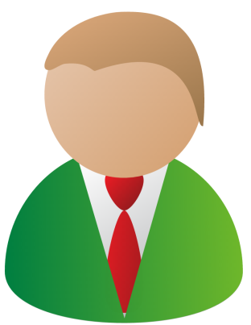
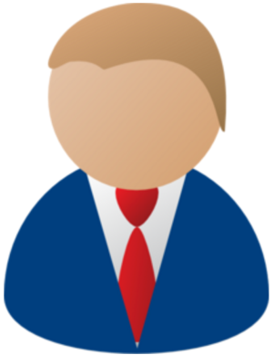

Educator and District Responsibilities as of July 1, 2016
District have a responsibility to assign ELLs only to SEI-endorsed CATs whenever possible.

Slide 6
Educator and District Responsibilities as of July 1, 2016
District have a responsibility to assign ELLs only to SEI-endorsed CATs whenever possible.
If a district assigns an ELL to a non-endorsed CAT, the district has to:
  Inform the CAT that he/she has one year to earn the endorsement
  Take all reasonable steps to ensure that the ELL is not assigned to another non-endorsed CAT in subsequent years

Slide 7
Educator and District Responsibilities as of July 1, 2016
  This could include activities such as the following:
  incentivizing teachers in subsequent grades to gain the Endorsement
  ensuring that newly hired teachers for positions in which ELLs will be enrolled are SEI-endorsed at the time of hire
  providing the SEI Endorsement course to CATs in the district so as to deepen the pool
  planning teacher schedules appropriately to assign ELLs to SEI-endorsed teachers in subsequent years

Slide 8
District Monitoring
  Starting July 1, 2016, districts will be responsible for monitoring their compliance with then effective provisions of 603 CMR 14.07 and 603 CMR 7.15(9)(b).
  The DESE will also monitor districts for compliance with the regs.

Slide 9
District Monitoring
To assist districts with their compliance responsibilities, the DESE is developing new reports that will detail:
Which unendorsed CATs have had an ELL within the last 12 months and which unendorsed administrators have been assigned to supervise/evaluate CATs who have had an ELL within the last 12 months;
Which ELLs have had an unendorsed CAT; and,
Which ELLs have had an unendorsed CAT in the past and now have unendorsed CATs again, and the names of those unendorsed CATs.

Slide 10
Requirement for PDPs
M.G.L. c. 71 sec. 38G and 38Q require each district to develop a professional development plan for all staff and establish a budget for professional development that does not exceed the district’s foundation budget.
Included in this 38Q is the requirement that districts provide training for teachers and administrators in second language acquisition techniques for recertification.

Slide 11


Requirement for PDPs
All educators with a professional license are required to earn 15 PDPs related to SEI or ESL each relicensure cycle.
Districts are free to provide whatever opportunities best meet their local needs.
Provider
ESL/SEI
PD
District
ESL/SEI
PD
PDPs
Local Needs

Slide 12
Pathways to earning the endorsement as of July 1, 2016
No-cost, state-offered courses (restricted)
District-based courses
Districts may apply to become approved providers of courses under the open, rolling RFR. They must meet all requirements of the RFR including utilizing systems that satisfy the Department’s course delivery requirements:
  online forums
  house readings and other materials
  assign work and submit assignments
  grade assignments using approved course rubrics
  create/maintain course schedules
  track attendance and participation
  maintain electronic records of all of the above for a period of seven years
For-cost courses through vendors
District-based courses
SEI MTEL
Possession of an ESL license
Transcript review

Slide 13
Q & A
Comments

