Slide 1
10 Easy Steps
To Establish a Social Skills Training Program within Your Community to Foster Post Secondary Independence
Georgia School Counselor Association
Macon, Georgia
November 2016

Slide 2
Introductions
Mary Giusti, Ed. S.
Dr. Amor Kok, Ed.D., LPC.

Slide 3

Todays Purpose
Provide ten easy to implement steps to use in order to build a social skills training program within your community for people who have Autism Spectrum Disorders and Developmental Disabilities.

Slide 4
Our Program
Meets Tuesday afternoons for six weeks in the summer.
Fully staffed by highly qualified teachers, counselor, paraprofessionals, and high school and college student workers and volunteers.
The program focuses on social skills in the home, school, community and work environments.

Slide 5
We have been able to successfully staff and run the program for the last nine summers.
We have had up to 62 participants. Summer average is around 55.

Slide 6
Importance of Social Skills
People with disabilities demonstrate social skills deficits in a number of areas including a lack of self-advocacy, an inability to communicate effectively, a difficulty in emotional regulation, and an insufficiency in fostering and maintaining peer and adult relationships.

Slide 7
People with Autism and Developmental Disabilities do not naturally learn from their interactions with others like their neurotypical, or non-autistic, peers do and require explicit direct instruction and social skills training to learn the social skills needed for life.
A social skill is not just holding a conversation or greeting someone; social skills are directly tied to a person’s emotions and self esteem.

Slide 8
Social Skills, Relationships, and Self Esteem are Interrelated
Social
Skills
Relationships
Self Esteem
Notes:
Research has proven that lack of ss causes behavior problems and decreases academic success

Slide 9
Social Skills Training
Needs to be taught in a small group through direct instruction using researched based methodologies and programs
Helps the individual to interact better with others, sympathize or empathize with their peers, and understand the unspoken cues that are expected
Helps generalize the skills to other settings and situations

Slide 10


10 Easy Steps

Slide 11
1. Investigate the feasibility within your community
The Andrew Young School of Policy Studies at Georgia State University did a feasibility study in our community in 2004.
Findings: Fayette County was among the top 20 places to live in America ..…unless you have a disability.
Despite its wealth and affluence, in the area of training, employment and support services for people with disabilities, Fayette County compared poorly to other counties in Georgia.

Slide 12
Parent Interest
School System Awareness
  Current Students
  Former Students
No other social opportunity for teenagers and young adults who have disabilities in the community with certified and trained staff members.

Slide 13

2. Present the idea to a non-profit support group
Developed a proposal
Met with Janet Smola, Director of Exceptional Operations, which is a local non-profit agency that supports people with developmental disabilities.

Slide 14



WE GOT A YES!

Slide 15
ExceptionalOps is a 501 (c) (3) Nonprofit Organization
Advocate and educate about for people with developmental disabilities
Goal is to create an environment and opportunities for people in Fayette County with developmental disabilities and their families to have choices as they live their lives in the community
Monthly meetings, newsletters and emails serve to help members get to know others with similar problems and find solutions, make new friends, become knowledgeable of their rights and services available, and become an effective catalyst for positive change. ExOps supports the Fayette Special Olympics, All-Children’s Playground, Group Home, Fayette Field of Hope, as well as assist families in obtaining scholarships for Camp Big Heart through a collaborative effort with the Line Creek Civitan Club and the Fayetteville Civitan Club.

Slide 16
3. Apply for funding through grants and donations
Local Utility Companies
Local Manufacturers
Community Foundation Grant
Community Hospital
Airline Companies
Private Donations
Invite donors to participate in program activities

Slide 17
Program Budget
Total Cost of the program is approximately $6,000
Cost to participate is $80
Scholarships are available to those who need them

Slide 18
4. Find an appropriate location
Space has to hold a number of people.
  Large group sessions and smaller breakout sessions
  Areas that students could take a break if needed
Safe for all students
Furniture has to be accessible and easy to move around activities ranging from Zumba to restaurant etiquette lessons.

Slide 19
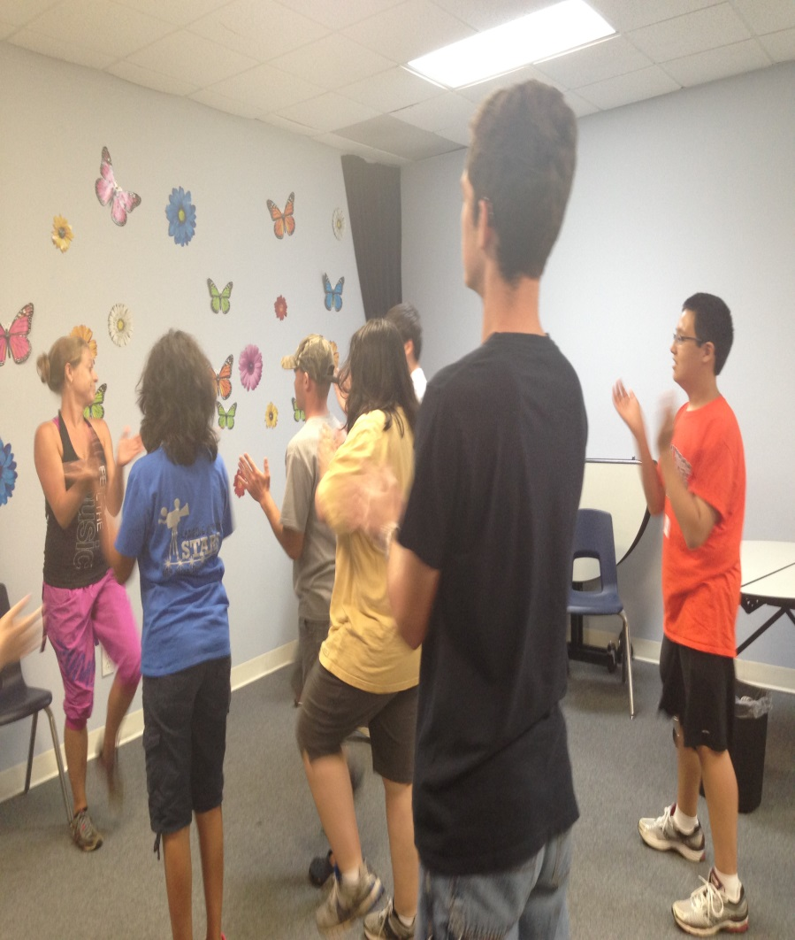
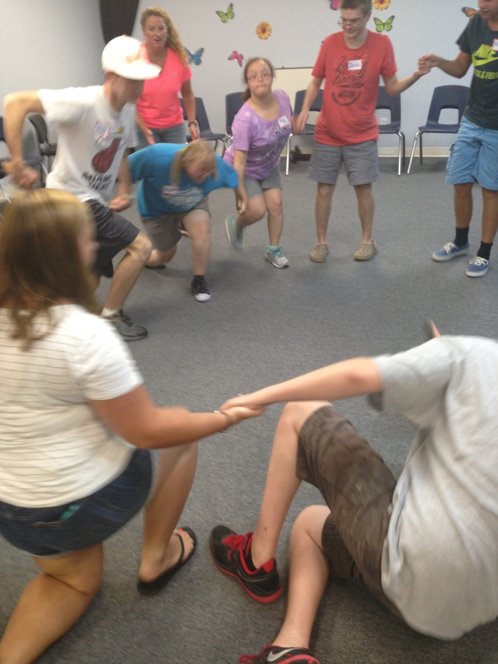
Large Group Sessions

Slide 20
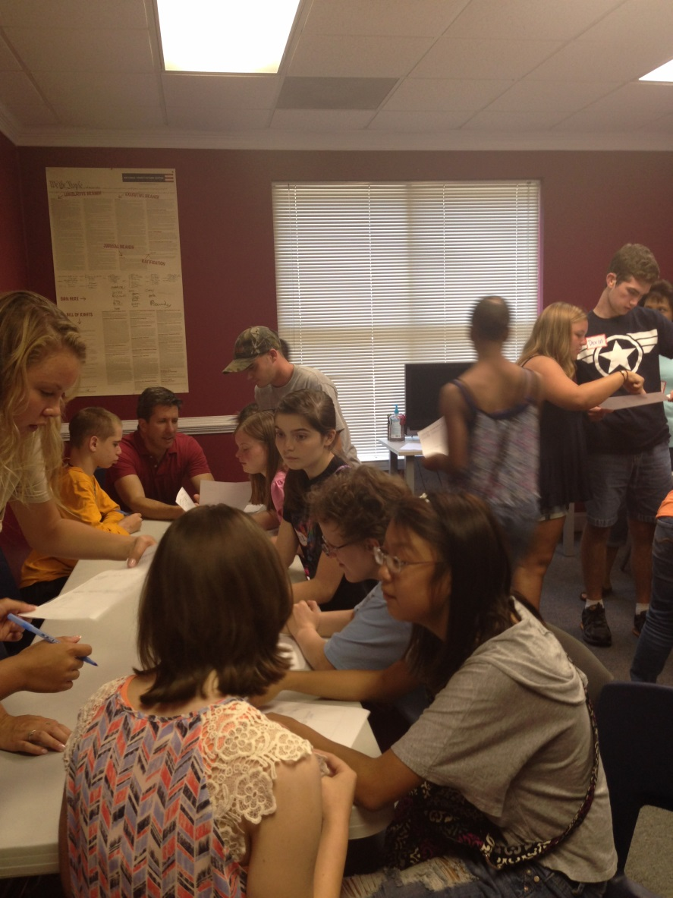
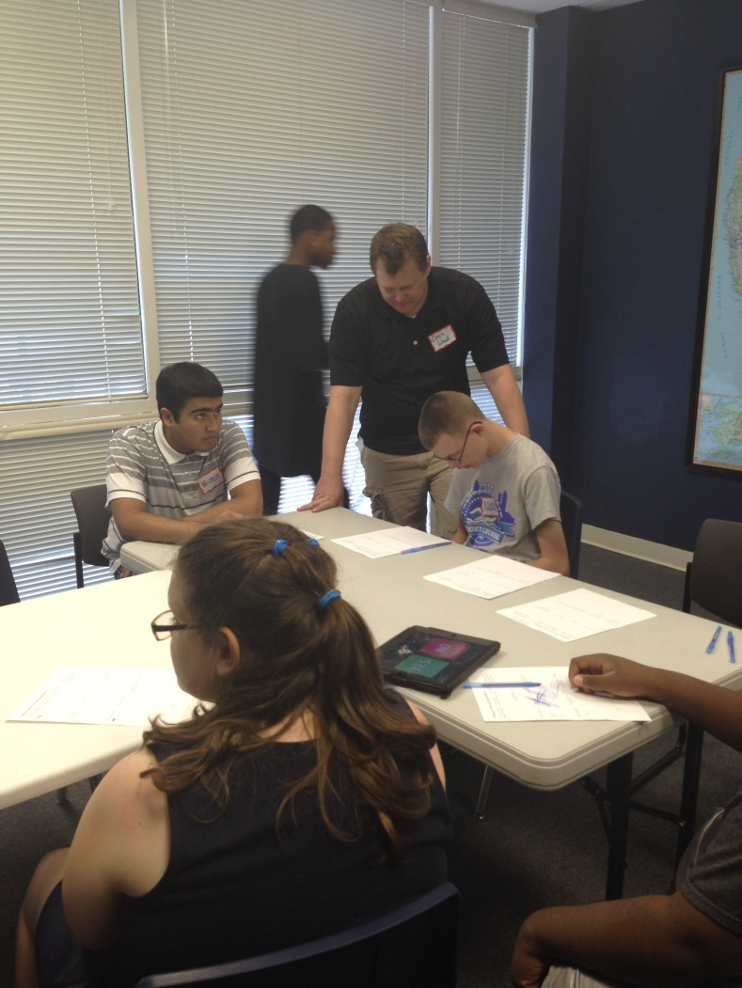
Small Group Sessions

Slide 21
5. Developing a social skills curriculum
Combination of resources from experts in social skills curriculum and our own personal lessons that we have created based on the needs of our participates.

Slide 22
Social Skills Fundamentals
Survival Skills
Listening and communicating
Following directions
Appropriate language
Ignoring distractions
Rewarding yourself
Interpersonal Skills
Sharing
Asking for permission
Joining an activity
Waiting your turn
Self-Control
Empathy
Problem Solving Skills
Advocating for self
Apologizing
Accepting consequences
Deciding what to do
Conflict Resolution Skills
Dealing with teasing
Losing , accusations
Being left out
Peer pressure
Notes:
Is one of these groups more critical than another?

Slide 23
6. Personnel
Highly-Qualified Instructors and Paraprofessionals
Counselor who is trained and certified in working with people with disabilities
High school upper classman and college students who have experience working with students with disabilities

Slide 24
7. Volunteers
We personally select adolescents to volunteer with us at a young age in order to train them to be staff members later.
  Family Members
  Siblings of students in our program
  Friends’ Kids
  Students in the school system

Slide 25

Our team of Staff and Volunteers:
We work together!
We are flexible!
We bring different skillsets to the program!
We have FUN!!!

Slide 26
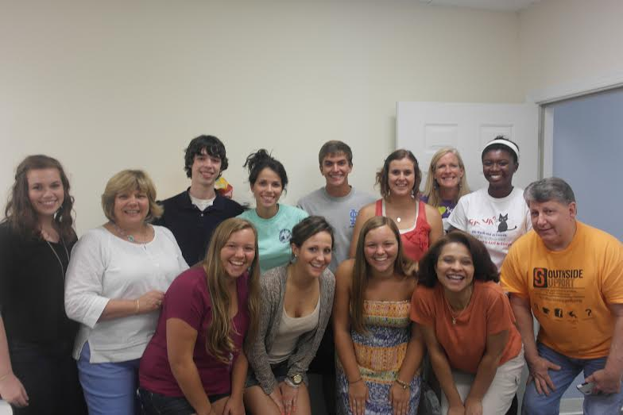

Slide 27
8. Community Partners
Seek community partners to support us in various ways:
  Donate items needed to run the program
  Provide activities to enhance social skills training

Slide 28
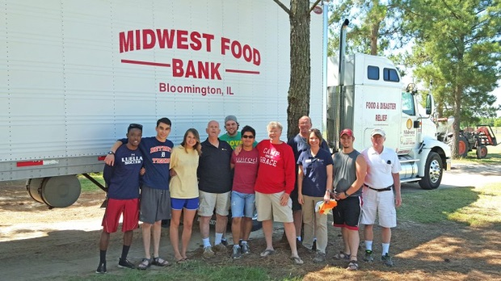
Donations Needed:
Snacks
Water
Cleaning supplies
First aid items
Office Supplies
  Pens, pencils, Sharpies, paper
  Copies
  Name tags

Slide 29
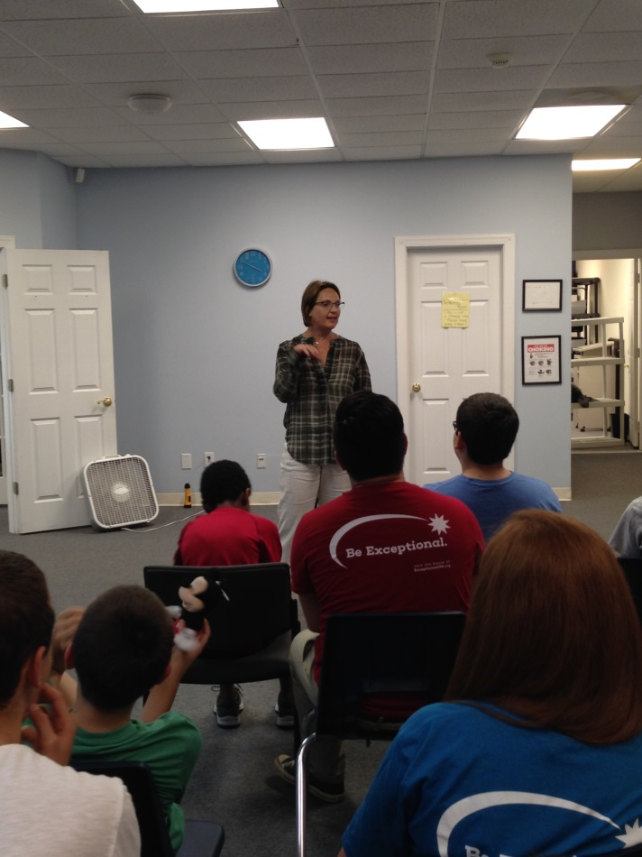
Guests
Partners to enhance the curriculum and other program guests, such as:
  Art Therapist
  Drama Teacher
  Bank Manager and Personnel
  Police Department
  Restaurant Owners
  Personal Trainers
  Human Resources Personal

Slide 30
9. Social Skills Implementation
3:30-3:45: Students arrive
  Each student checks in and puts on a name tag
3:45-4:30:
  Groups 1 & 2 participate together in the daily scheduled activity
  Group 3 participates in the daily social skills lesson
4:30-5:00:
  All groups come together for snack and chat time.
5:00-5:45:
  Groups 1 & 2 participate separately in daily social skills lesson
  Group 3 participates in the daily scheduled activity
5:45-6:00:
  All students prepare for pick up.
  All students must be checked out by a staff member

Slide 31
Organization of your groups
Create groups based on students abilities and social skill deficits
  Participants
  “Helpers”
Groups create rules and boundaries to work together
Notes:
What reinforcers could you use to motivate students ot attend if it is voluntary? If it is a part of class instruction what could be used?

Slide 32
Small Groups – Social Skill Lesson
Direct instruction in the specific skill
Visuals to reinforce skill understanding, including a handout to take home for practice
Role Playing

Slide 33
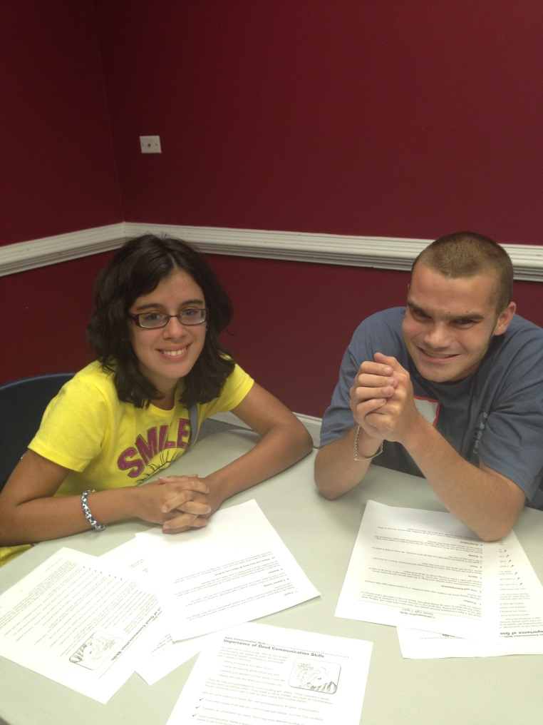
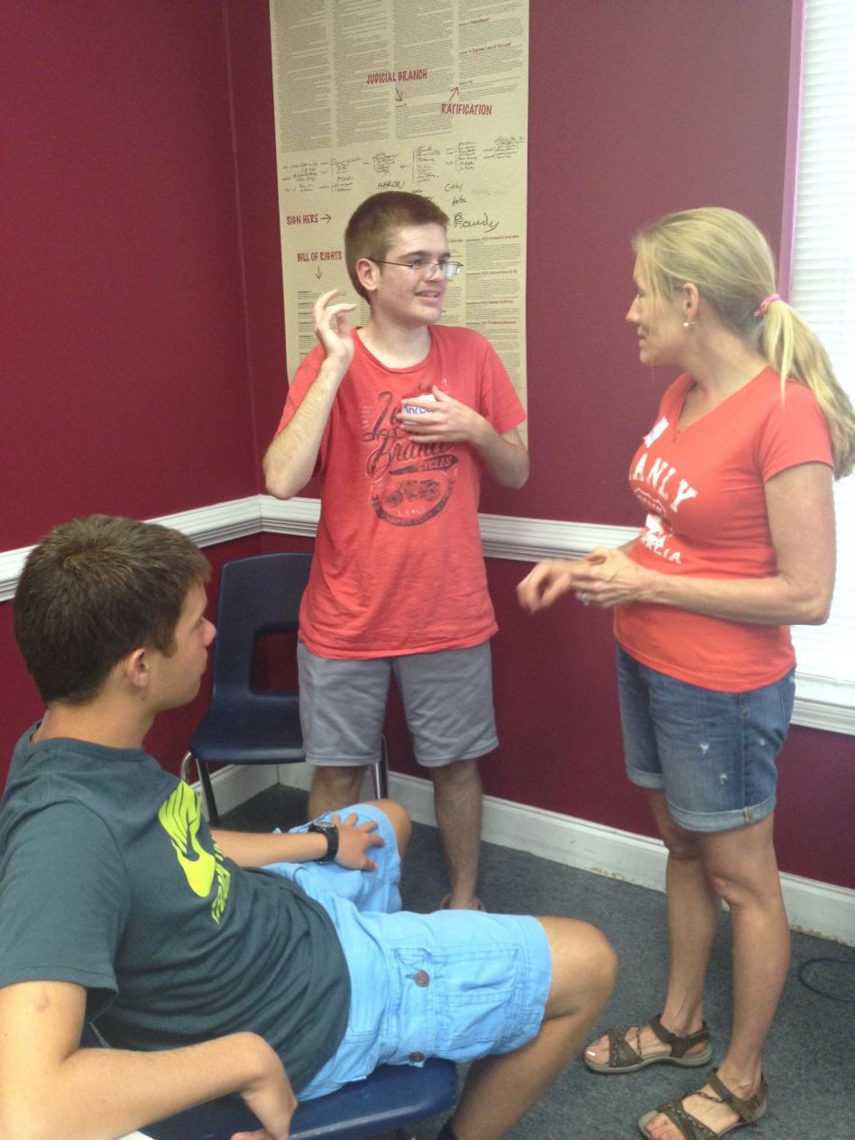
Small Talk Basics
Role Playing

Slide 34
Large Group – Daily Scheduled Activity
Etiquette and Manners
Art Therapy
How to have a Successful Interview
Zumba
Personal Finance and Banking Skills
Yoga
Team Building Skills
Stress Management Skills
Internet Safety / Social Media
Personal Safety
Dress for Success in the Work Place

Slide 35
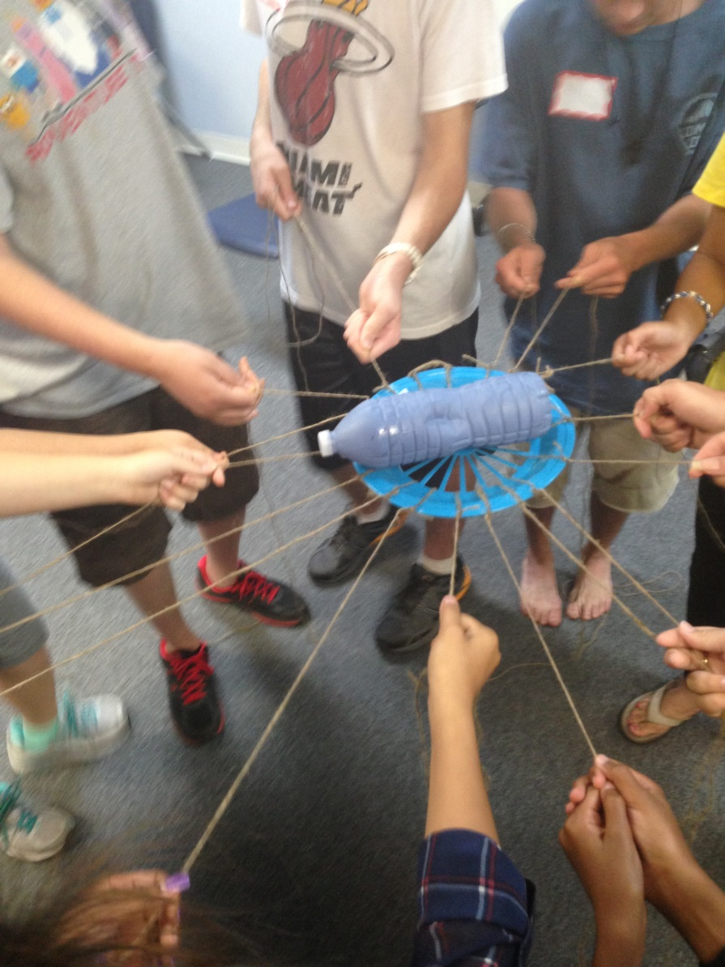
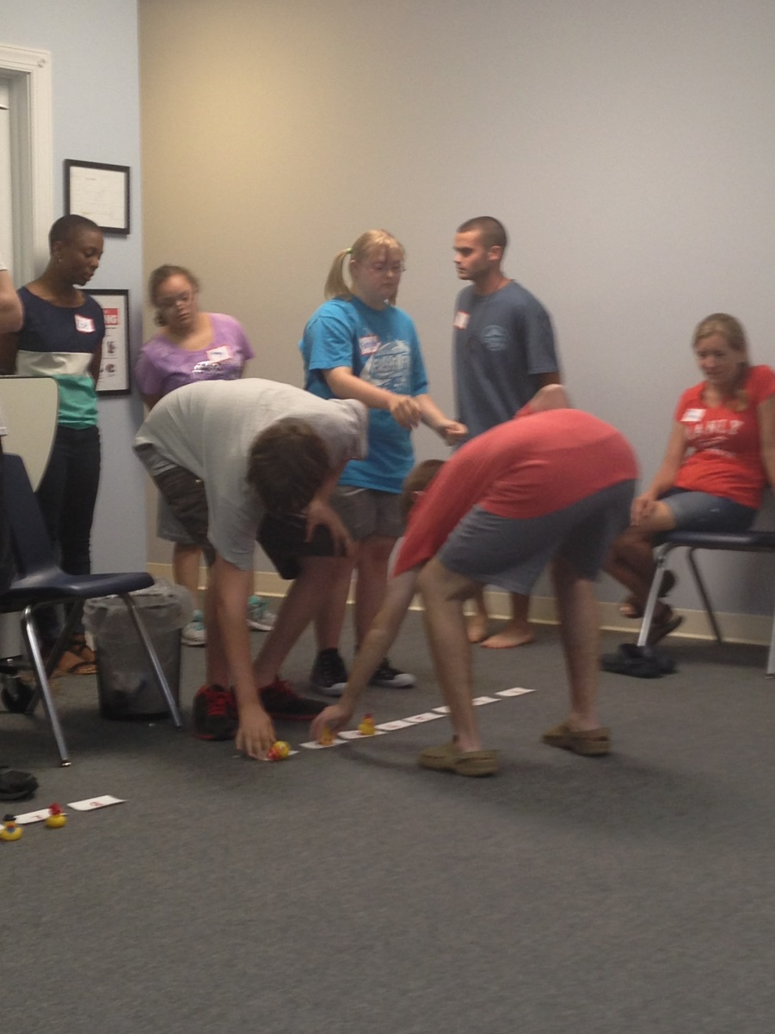
Team Building Activities

Slide 36
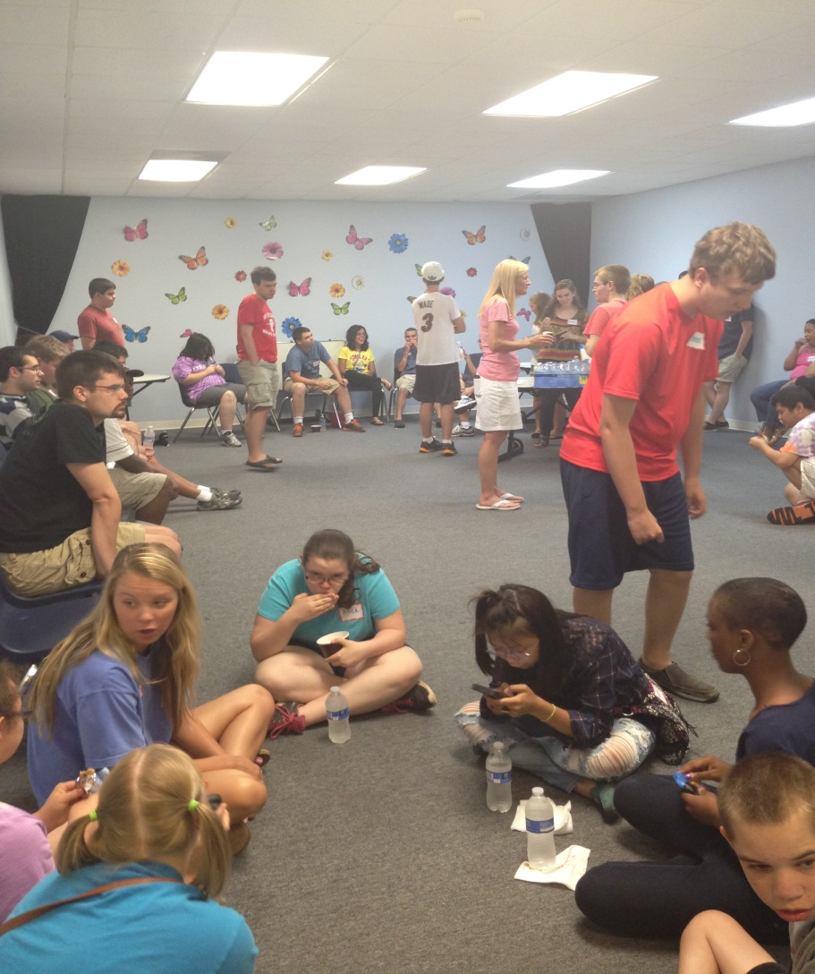
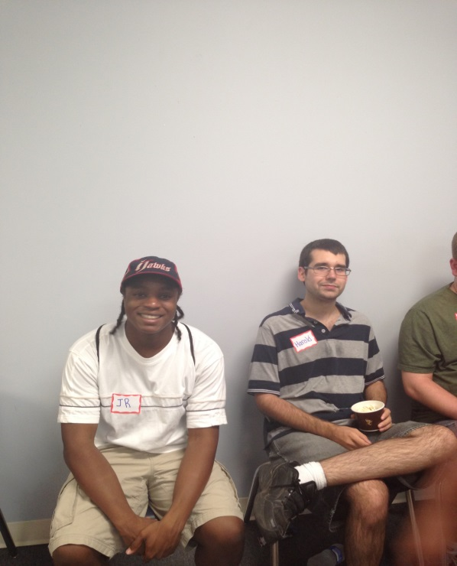
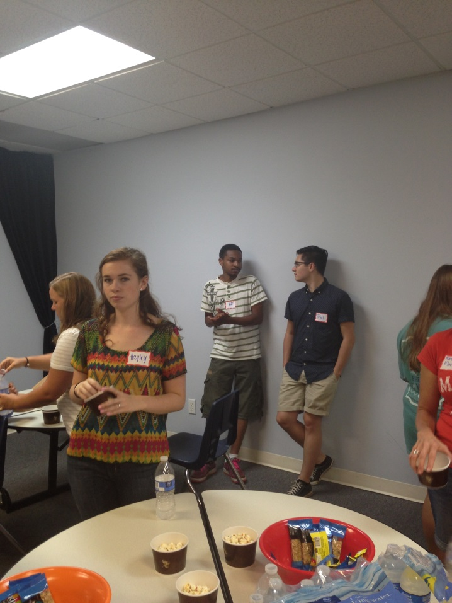
Snack Time

Slide 37
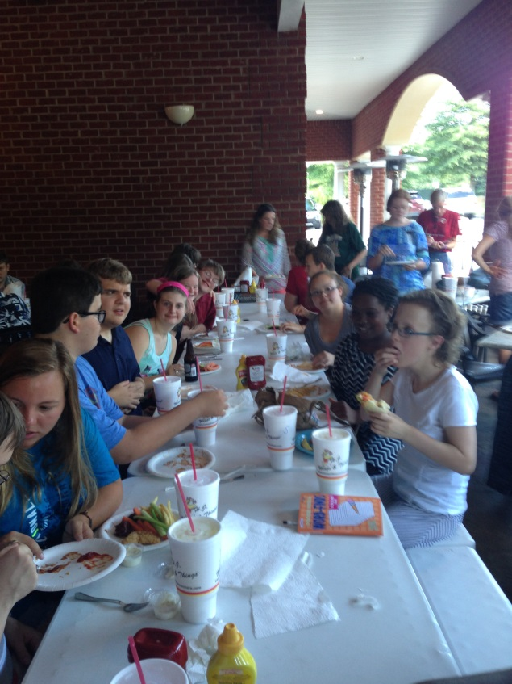

Dinner and Theater
Our last session is our big opportunity for our participants to
generalize the skills they have learned in the program.

Slide 38
10. Evaluation of the Program
Parent and student evaluations at the end of the summer
Feedback from our guests
Staff evaluations and debriefing session
Make notes of positives and negatives in order to help plan for the next summer

Slide 39
Feedback
A high school volunteer wrote a thank you note:
“Thank you for allowing me to volunteer with ExOps. It was my first and a wonderful and enjoyable experience being able to work with these teenagers and young adults”

Slide 40
A teacher from the local high school shared that upon return to school in the fall she had witnessed a student with autism being defended and referred to as a good friend by a member of the football team. Turns out the football player was a volunteer who had grown to recognize and appreciate his “new friend” through the social skills program.

Slide 41
A mother shared that she never would have thought her 18 year old child with Autism would sit through dinner and a play let alone 50 other teenagers and young adults.
Another mother shared that she enjoys talking with other parents before and after the program. It relieves the isolation that summers brings. Sometimes parents go and get coffee and catch up during the program.

Slide 42
Evaluation from our business partners
Numerous business people have thanked us for the privilege to participate in our summer program and ask to come back the next summer.
Job opportunities for our students.
Because of the program, the police department developed two internet safety comics on different cognitive levels that they now present in schools.

Slide 43
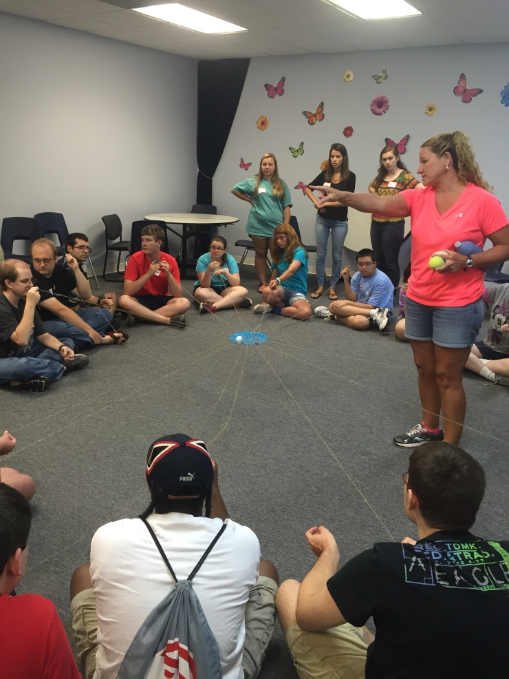
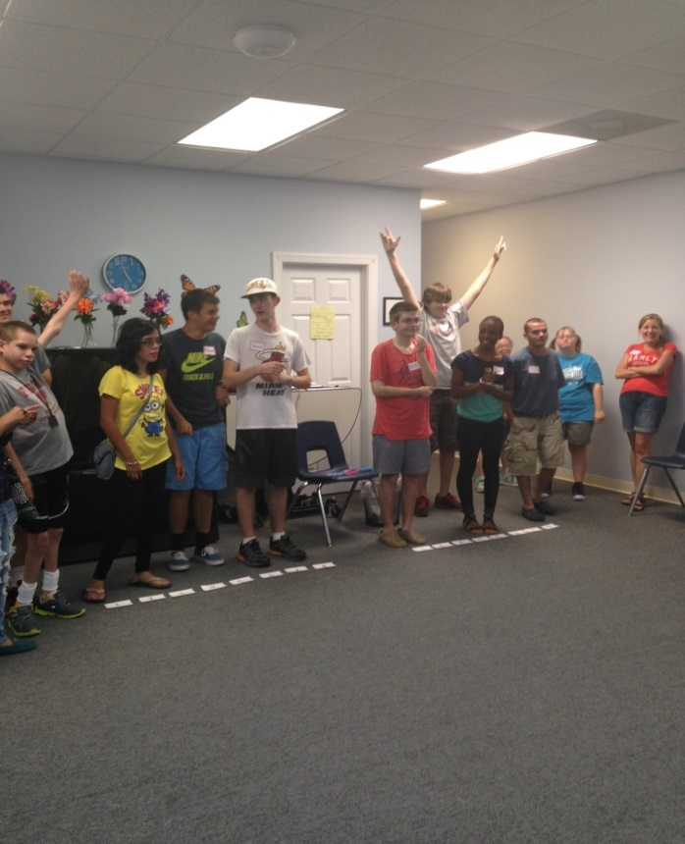
Future Goals
Year round social skills group that meets weekly in the community.

Slide 44




Post-secondary education preparation classes for students with Autism and Developmental Disabilities who are interested in higher education.

Slide 45
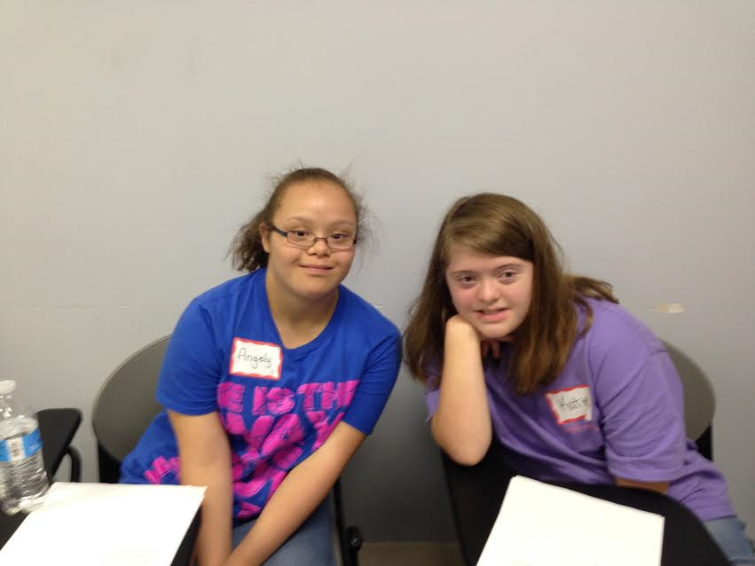
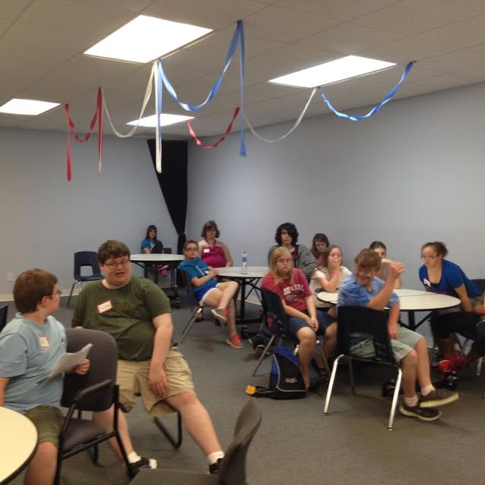
Questions?

Slide 46
Contact Information
Mary Giusti, Ed.S.
marymgiusti@gmail.com
giusti.mary@mail.fcboe.org
Amor Kok, Ed.D. LPC.
amorkok7@gmail.com
kok.amor@mail.fcboe.org

