Slide 1
The Achievement of Students identified with Special Needs in Two-Way Spanish Immersion Schools
CARLA 6th International Conference on Immersion & Dual Language Education: Connecting Research & Practice across contexts

Slide 2


Slide 3
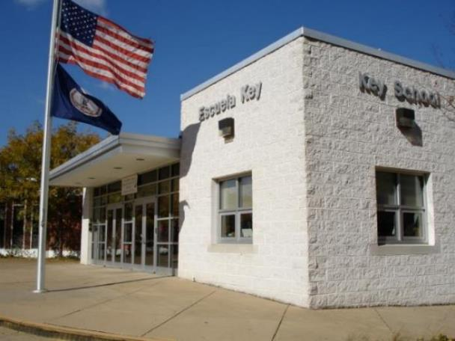
1986-2016
30 years of immersion

Slide 4
Agenda
Explain immersion program at Key School
Explain inclusion at Key School
Explain findings from my dissertation
Show 2016 data
Show that TWI/dual language programs are OK for SpEd kids

Slide 5
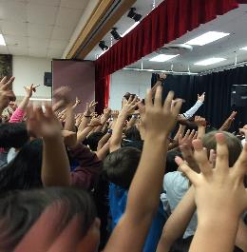
Key School ~ Escuela Key
Classes are 50/50
Time in each language 50/50
ELA, SS & PE in English
Math, Science, SLA, art & music in Spanish
Staff of 88
All but 4 are bilingual

Slide 6
Key School Demographics
1998
Total Enrollment
K-5 544
Ethnic %
  Hispanic - 59%
  White - 35%
  Black - 6%
  Asian - 0%
Free and Reduced
Lunch - 53%
Mobility - high
2016
Total Enrollment
pK-5 716
Ethnic %
  Hispanic -383- 53%
  White – 242 - 34%
  Black - 39 - 5%
  Asian - 30 – 4%
  2+ - 17 – 2%
  Other 5 - .6%
Free/Reduced Lunch - 42.5%
ESOL/HILT - 194 – 30%
SpEd – 71 – 11%
Mobility - high
Notes:
6
6

Slide 7

Field Day at Key

Slide 8
Immersion in Arlington
Escuela Key
or
Claremont Immersion (CIS)
Gunston Middle School
Wakefield SHS

Slide 9
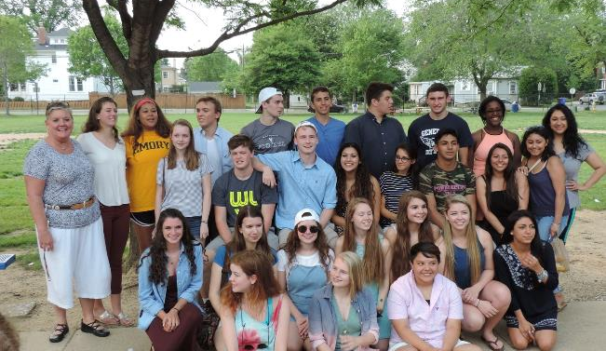
Graduating Seniors gather at Key for a reunion

Slide 10
WHAT IS SPECIAL EDUCATION?
Special Education is a service, not a place.
Special Education is specifically designed instruction at no cost to parents to meet the unique needs of a child with disabilities.

Slide 11
ELL & SpEd student Instruction
Integrate with regular ed children
Use Native speakers as language models
Provide language development and small group for reading
support team-teaching in class
need more time in the day to catch up

Slide 12
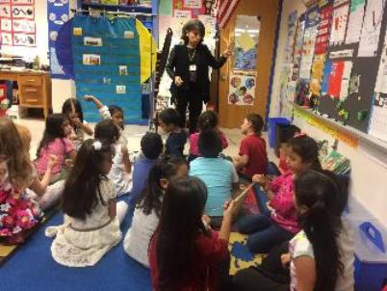
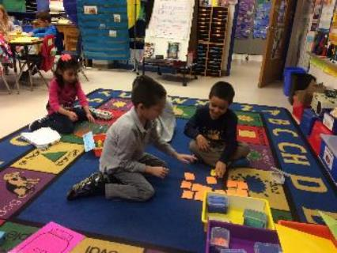
Whole group & centers

Slide 13
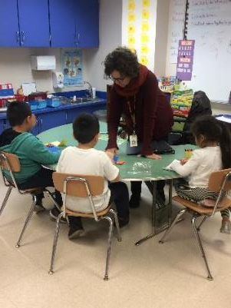
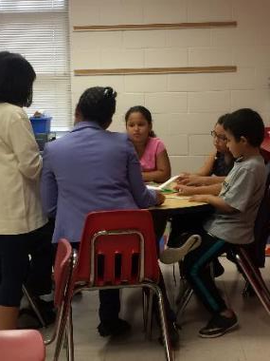
SpEd & ClassroomTeacher with small groups

Slide 14
Inclusion at Key
From 1986-1996 no SpEd students were permitted in the immersion program. It was for grade level and above students.
In 1996 I decided to make the immersion program inclusive for all students and began allowing students with special education needs to enroll in immersion during the 1996-1997 academic year.
Hiring both English and Spanish special education teachers made it possible for special education students from both native language backgrounds to participate.

Slide 15
Dissertation
Achievement of Children Identified with Special Needs in Two-way Spanish Immersion Programs
Doctor of Education
In Bilingual Special Education
May, 2009
The George Washington University

Slide 16
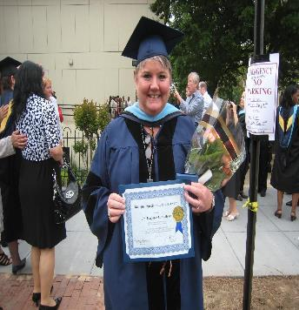
Dr. Marjorie Lora Myers
Bilingual Special Education Award
2009
The George Washington University
Washington, DC

Slide 17
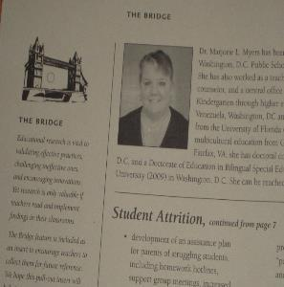
Dissertation on achievement of students with Special Needs in Immersion
CARLA
ACIE Newsletter “the Bridge” April 2011

Slide 18
Study
Looked at SpEd Students at Key and Claremont (CIS) and compared to similar SpEd students from other APS schools
Looked at
  Learning Disables (LD)
  Emotionally Disturbed (ED)
  Developmentally Delayed (DD)
  Other Health Impaired (OHI)

Slide 19
7-LD;8-ED;10-OHI ;16-DD

Slide 20
Dissertation conclusions
There was no statistically significant difference in the performance of the students in either educational environment
Conclusions are that special needs students do as well in two-way Spanish immersion as their special needs counterparts in regular English-only educational environments.

Slide 21
TWI English Only
TWI students speak, read and write in two languages.
TWI students leave school with more - Two Languages

Slide 22
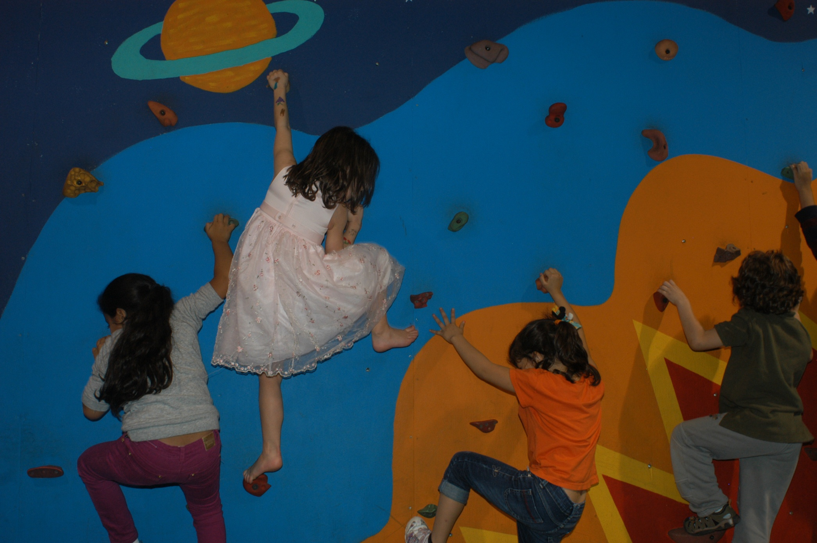
Remember – it’s about the kids
We need to close that gap….
Catching up is hard to do.

Slide 23
2016 Data for SWD
Key School ~ Escuela Key
Arlington (VA) Public Schools

Slide 24
Key School Final Accreditation Data for School Year 2016-2017
000111
Subject | School Year | Students Passing | Students Taking | SOA Adjusted Pass Rate | Accreditation Benchmark | Met Benchmark?
English | 2015-2016 | 250 | 270 | 93% | 75% | Yes
 | 2014-2015 | 244 | 269 | 91% |  | Yes
 | 2013-2014 | 269 | 347 | 78% |  | Yes
 | 3-year average | 763 | 886 | 86% |  | Yes
Mathematics | 2015-2016 | 248 | 267 | 93% | 70% | Yes
 | 2014-2015 | 259 | 285 | 91% |  | Yes
 | 2013-2014 | 225 | 280 | 80% |  | Yes
 | 3-year average | 732 | 832 | 88% |  | Yes
History | 2015-2016 | 69 | 74 | 93% | 70% | Yes
 | 2014-2015 | 84 | 90 | 93% |  | Yes
 | 2013-2014 | 166 | 194 | 86% |  | Yes
 | 3-year average | 319 | 358 | 89% |  | Yes
Science | 2015-2016 | 83 | 95 | 87% | 70% | Yes
 | 2014-2015 | 73 | 92 | 79% |  | Yes
 | 2013-2014 | 130 | 184 | 71% |  | Yes
 | 3-year average | 286 | 371 | 77% |  | Yes

Slide 25
2016 Key Immersion
SOL results
Category | Math | ELA | Soc Stud | Science
All Key | 81.1% | 81.5% | 82.1% | 82.2%
White | 93.9% | 94.9% | 92.9% | 97.2%
Hispanic | 73.2% | 69.8% | 73.9% | 68.8%
LEP | 69.9% | 67.5% | 68.4% | 61.1%
SpEd | 50% | 44% | 83.3% | 44.4%
Econ Dis | 68.3% | 67.8% | 69.4% | 63.2%
Gap Grp 1 | 71.1% | 68.2% | 68.9% | 64.4%

Slide 26
2016 CIS SOL results
Category | Math | ELA | Soc Stu | Science
All CIS | 83.8% | 84.4% | 84.9% | 87.5%
White | 93.9% | 95% | 97% | 100%
Hispanic | 76% | 71.1% | 76.6% | 77.3%
LEP | 72.5% | 64% | 80.8% | 65.4%
SpEd | 42.4% | 51.5% | 72.7% | 50%
Econ Dis | 75% | 65% | 69% | 75%
Gap Grp 1 | 70.6% | 64.8% | 78.9% | 65.5%

Slide 27
Language Comparison
Elementary Schools | Spanish | English | Other | Blank
Elem School 1 | 37% | 45% | 16% | 2%
CIS | 38% | 55% | 3% | 5%
Elem School 2 | 38% | 40% | 5% | 17%
Escuela Key | 40% | 49% | 3% | 9%
Elem School 3 | 44% | 29% | 10% | 17%
Elem School 4 | 44% | 12% | 21% | 22%
Elem School 5 | 57% | 12% | 13% | 19%

Slide 28
2016 Math (SOL Performance, Federally Adjusted)
 | All Students | Gap Group 1 (SWD, LEP, ED) | Gap Group 3 (Hispanic) | SWD | LEP | ED | White
Key | 82% | 72% | 75% | 55% | 72% | 70% | 94%
CIS | 84% | 74% | 76% | 42% | 73% | 75% | 94%
#5 | 84% | 82% | 82% | 64% | 80% | 82% | TS
#3 | 69% | 61% | 57% | 49% | 62% | 62% | 94%
#2 | 79% | 67% | 66% | 37% | 62% | 64% | 93%
#4 | 72% | 70% | 68% | 43% | 67% | 68% | TS
#1 | 85% | 79% | 80% | 61% | 84% | 83% | 85%

Slide 29
2016 ELA (SOL Performance, Federally Adjusted)
 | All Students | Gap Group 1 (SWD, LEP, ED) | Gap Group 3 (Hispanic) | SWD | LEP | ED | White
Key | 82% | 70% | 71% | 48% | 70% | 70% | 95%
CIS | 81% | 68% | 71% | 53% | 65% | 66% | 95%
#5 | 80% | 79% | 79% | 69% | 77% | 78% | TS
#3 | 73% | 66% | 68% | 62% | 66% | 66% | 91%
#2 | 80% | 69% | 68% | 59% | 64% | 68% | 93%
#4 | 75% | 71% | 67% | 48% | 70% | 71% | TS
#1 | 82% | 76% | 82% | 48% | 82% | 81% | 82%

Slide 30
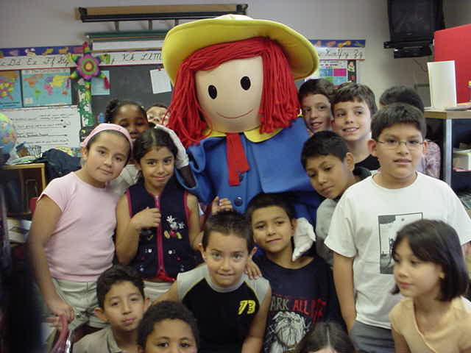
SpEd kids in immersion
Children with language and learning disabilities perform as well as comparable children in English only programs
Students of all ability levels benefit

Slide 31
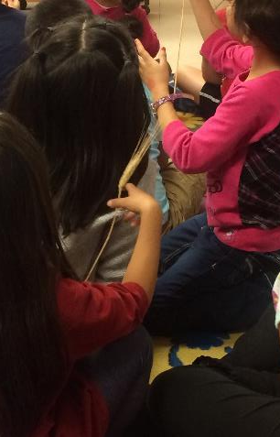
Implications
Students “at risk” need a strong academic program with supports.
Don’t take “NO” for an answer – they will succeed.

Slide 32
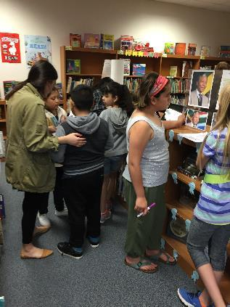
Implications
Despite being identified as a children with special needs, they can stay in TWI programs and succeed in them while reaping the benefits of an enriched education offered in two languages

Slide 33
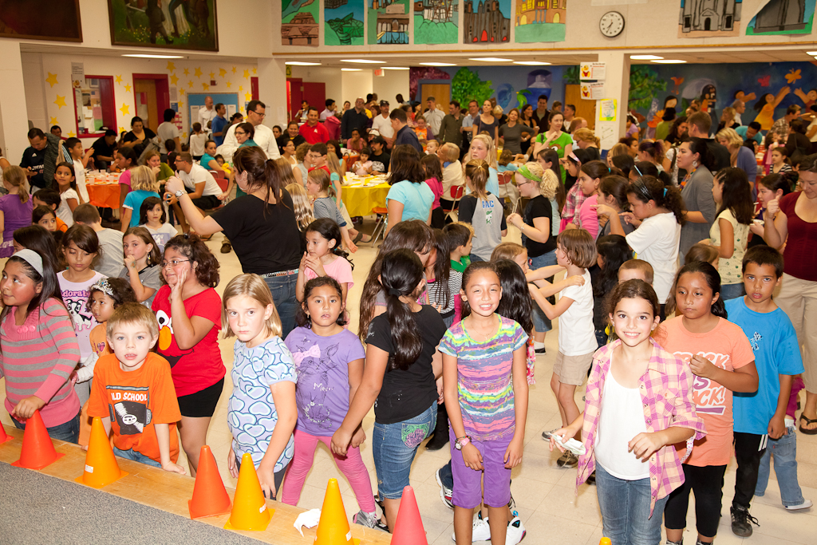
We need to be sure we have done all we can do to level the playing field for all students.
If we don’t do it, who will?

Slide 34
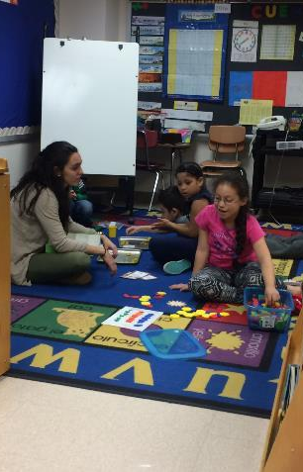
Bilingualism
Bilingualism is a gift no money can buy
Thank you for supporting dual language and immersion education for all students.

Slide 35
Presenter
Dr. Marjorie L. Myers
Principal
Key School ~ Escuela Key
2300 Key Blvd.
Arlington, VA 22201
#EscuelaKey @DrMLMyers
marjorie.myers@apsva.us

