Slide 1
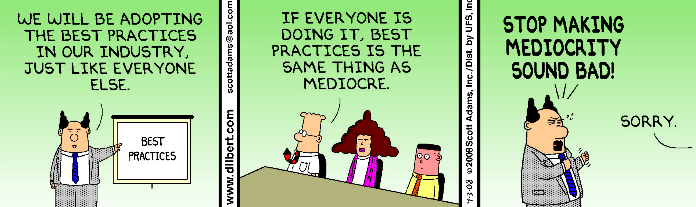
Faculty Use and Knowledge of Best Practices in the Online Environment
Notes:
What do you feel are Best Practices? What is your organization Best Practices?

Slide 2
The Challenge
Determine which best practices and principles would meet the needs of the university, faculty, and students in the development and implementation of a continuing Internet-based education program.
Notes:
The challenge in this study was to determine which best practices and principles …........

Slide 3
Purpose
Examine the pool of knowledge that faculty possess and implements in their practice of online distance education.
To ameliorate faculty gaps in knowledge and skills in light of best practices when teaching online.
Notes:
The purpose of this study was to examine the pool of knowledge

Slide 4
Site
Major university in the northeast United States
School of Health Sciences
Notes:
The site used to conduct the study was a major university in the…...

Slide 5
Guiding Question
With regard to acknowledged best practices as identified in the literature, what is the pool of knowledge that imaging science faculty at a major American university possess and implement in their practice of online distance education?
Notes:
The principle question used to guide this study was….......

Slide 6
Literature Review
Notes:
An extensive literature review was conducted. The tree branches represent some of the term used in the literature review.
The strategy for the literature search included the use of DATABASES such as CINAHL, MEDLINE, Education Research Complete, Wiley Inter Science, Science Direct, Pro Quest, Scirus, Ovid, Academic Search Complete, Google Scholar, and Ulrichsweb.

Slide 7
Theoretical Framework
Constructivism
Focuses on how people learn and think
Active process in which engagement facilitates the co-construction of knowledge and meaning
Scaffolding engenders the ability to problem solve
Learning is centered on the student and support
Notes:
The theoretical framework that guided this study was CONSTRUCTIVISM.
The constructivist theory is the most cited theoretical framework applied to Internet Based Education

Slide 8
Knowles System of Concepts
Knowles’s Andragogical Assumptions
Focuses on needs of learners
Interaction with the environment to create a synthesis of knowledge
Teacher is not the sole resource
Relevancy in learning
Prior knowledge
Notes:
Knowles System of Concepts or his Andragogical Assumptions were also part of the THEORECTICAL FRAMEWORK

Slide 9
Constructivist/Knowles’s System of Concepts
Both propagate concepts associated with learning as co-constructed by all participants
Interactivity
Prior knowledge/experience
Guidance and support
Self directed learning
Immediacy of use
Notes:
Both the Constructivist Framework and Knowles Andragogical Concepts propagate…...

Slide 10
Method
Qualitative Study
Case Study
Attempt to explore and understand current faculty knowledge regarding online instruction practices while fully immersed in the performance of their job
Limited extant documentation
Data collected through:
Semi-structured, open ended interviews
Notes:
The methodology used to carry out this study was a …..........................Qualitative Study
More precisely a CASE STUDY
A CASE STUDY WAS selected because it

Slide 11
Best Practices
Characterizes
Techniques
Procedures
Outcome
Improve results
Hamilton (2011) defines best practices as a “careful collection of relevant evidence, an action resulting in a positive outcome, and the ability to reproduce results” (p. 121).
Notes:
Before we move onto the next slide and talk about the themes that emerged there is one term I would like to define
Therefore BEST PRACTICES is characterized by techniques and procedures that bring about improved results

Slide 12
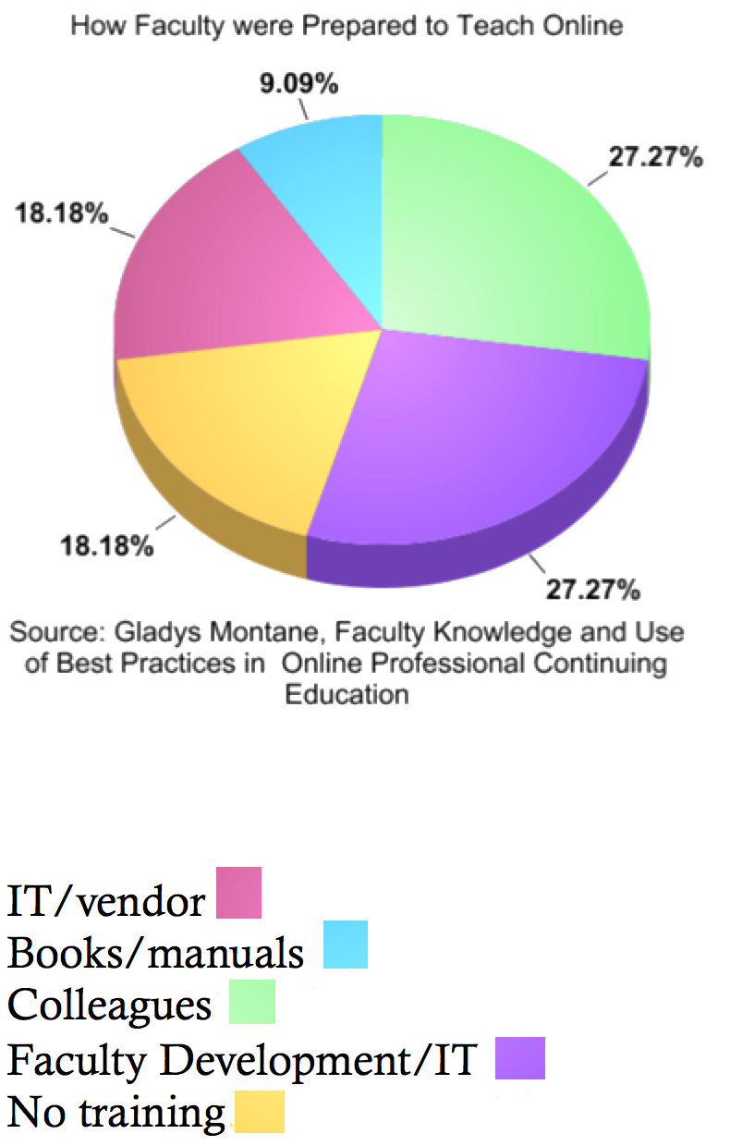
Emerging Themes
Initial Preparation for the Online Environment
Common thread needed more skills before committing to teaching online
Just-in-Time Learning
Individualized learning opportunities that reflect current knowledge
On demand learning
Knowledge of Pedagogical & Best Practices
Limited awareness
Platform Preparation/Technology
Training did not prepare participants in the use of best practices
Interaction with Students
Missed interaction with students
In Retrospect
More time to prepare the online environment
IT/vendor ☐
Books/manuals☐
Colleague ☐
Faculty Development/IT☐
No training☐
Notes:
Six emerging themes were derived from this study

Slide 13
Emerging Themes (continued)
Just-in-Time Learning
45% of the participants were self directed learners who sought out resources when, where, and as the need arose.
Knowledge of Pedagogical & Best Practices
81% of participants were not aware of best practices
Two major issues leading to this self-perceived lack of sophistication in the online learning and its associated best practices
When they began online teaching best practices were not available
Not aware of best practices
Notes:
Individualized learning opportunities that reflect current knowledge
On demand learning

Slide 14
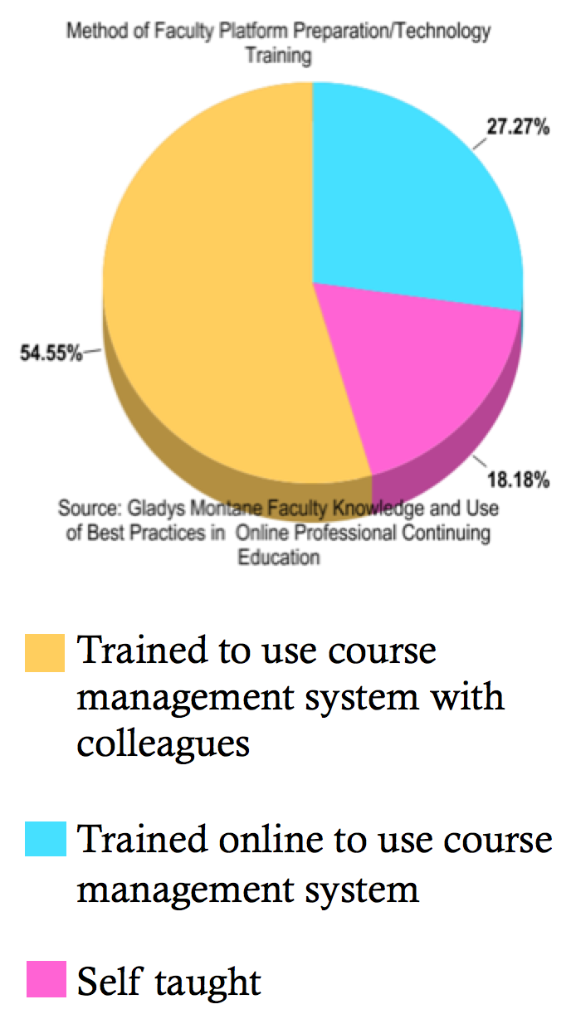
Emerging Themes (continued)
Platform Preparation/Technology
Training did not prepare participants in the use of best practices

Slide 15
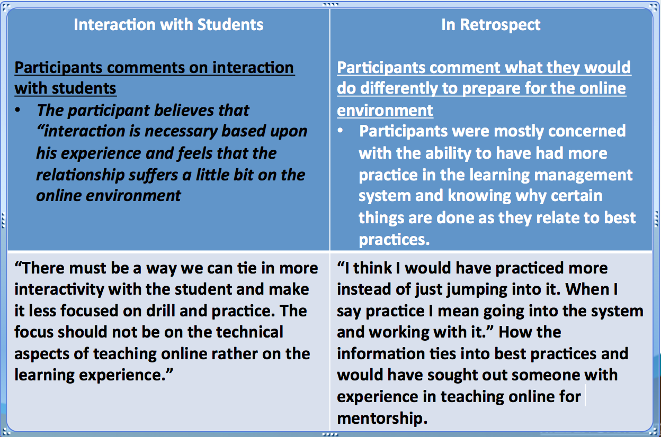
Emerging Themes (continued)

Slide 16
Strategies/Recommendations
Strategies/recommendations are grounded in the themes that emerged from the research conducted, couched in theories of constructivism and adult learner principles.
Notes:
The 6 themes led to strategies and recommendations. The strategies and recommendations prescribed ….............

Slide 17
Strategies/Recommendations (continued)
Faculty Self Assessment for Online Teaching Tools https://weblearning.psu.edu/FacultySelfAssessment/
A collaborative effort between State University of Pennsylvania and the Online Learning Consortium
Available through the “creative common licensing agreement”
Assess three areas
Technical competencies
Administrative competencies
Pedagogical competencies
Notes:
The first strategy or recommendation is the use of the FACULTY ASSESSMENT FOR ONLINE TEACHING TOOLS (PENN STATE)

Slide 18
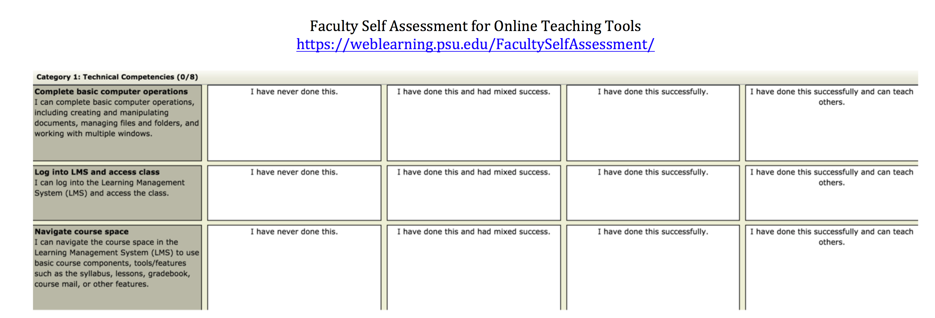
Faculty Self Assessment for Online Teaching Tools

Slide 19
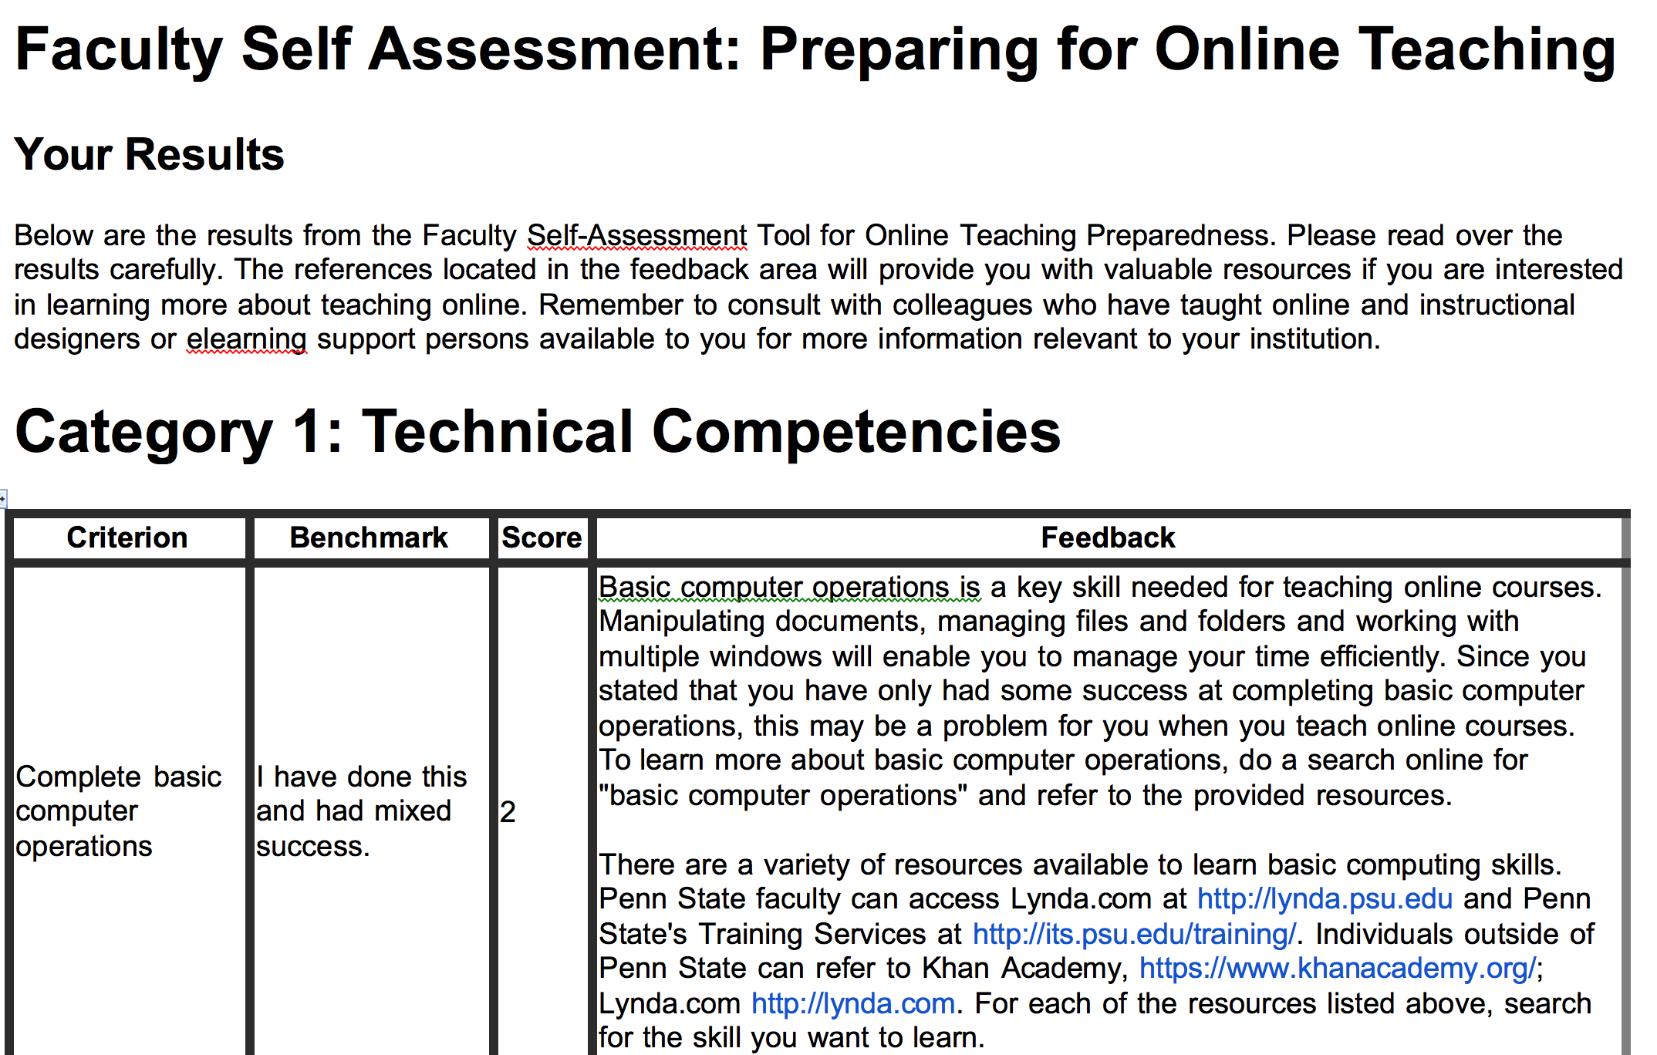
Faculty Self Assessment for Online Teaching Tools Feedback

Slide 20
Strategies/Recommendations (continued)
Lean Learning
Individualize learning opportunities that reflect participants current knowledge and is accessible on demand.
Recommendation: creation of an online professional development repository to include technology and pedagogy modules for online teaching.

Slide 21
Strategies/Recommendations (continued)
Faculty Development
Well balanced faculty development program to include:
Orientation and introduction to online learning: What does it mean to teach online?
Effective online instruction
Online best practices and pedagogy for course design
Online best practices for technology in course design
Developing an active learning plan (syllabus and objectives)

Slide 22
Strategies/Recommendations (continued)
Faculty Development
Well balanced faculty development program to include:
Implementation and use of technological tools
Tools and techniques for converting a face to face course to an online course
Learning management system: tools, functions and applications
Creating communication and interactivity: synchronous and asynchronous activities, discussions, blogging, web conferencing, etc.
Development of rubrics to assess learning
Assessment of learning with the appropriate tools to match objectives

Slide 23
Strategies/Recommendations (continued)
Implementing Adult Educational Framework
Andragogy takes into account:
Adults are self directed learners
Adults have wealth of experiences
Adults are problem centered
Faculty development maintaining the perspective of the adult learner
Consideration of learners characteristics
Content in which learning occurs
The vehicle used to deliver the training

Slide 24
Strategies/Recommendations (continued)
Instructional Designer
Help faculty redesign their face-to-face curriculum for the online environment,
Assess course needs
Recommend technologies to enhance student learning
Provide personalized feedback as courses are being constructed
Serve as an editor to maintain consistency across programs
Instill best practices
Ensure quality of online courses

Slide 25
Closing Thoughts
Strategies/recommendations are viewed as a means to make a significant difference in the manner faculty receive effective and sound training.
Effective online instructional training must incorporate:
Best practices for pedagogy
Best practices for technology
Principles of adult learning,
Mentoring of a protégée,
Online pedagogical repository
Instructional designer

Slide 26
Mediocrity is not acceptable
Faculty need to be knowledgeable in online best practices
Institutions of higher education need to meet accreditation standards
Competition in the marketplace
Notes:
Mediocrity is not acceptable remember that BEST PRACTICES are Techniques and Procedures implemented to Improve results. I most also state that Best Practice that work in one institution of higher learning will work in another .
It is the institutions responsibility to determine what will work for them.
Are any of your institutions incorporation go the suggestions/recommendation made in this study? What are your thoughts?

