Slide 1
Migrating Government Publications without Going South: Our Alma/Primo Experience
ELUNA 2017 Meeting: Schaumburg, IL
May 11, 2017
Christopher C. Brown
Reference Librarian / Government Documents Librarian
University of Denver, Main Library
cbrown@du.edu

Slide 2

University of Denver Main Library
A depository library since 1909
Historically a 75% selective depository library
Approximately 850,000 physical documents
All documents arranged by SuDocs system
100% of documents now off-site – out-of-sight (out-of-mind?)
Innovative Interfaces ILS customer since 1997
Went “live” with Alma/Primo in June, 2016

Slide 3
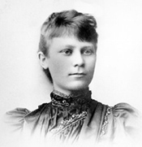
SuDocs: Superintendent of Documents Classification System
Developed by Adelaide Hasse between 1895 and 1903
Is not a subject-based system, but a provenance or issuing agency-based system
Numbers are assigned by the GPO (formerly the Government Printing Office, as of Dec. 2014 known as the Government Publishing Office)

Slide 4
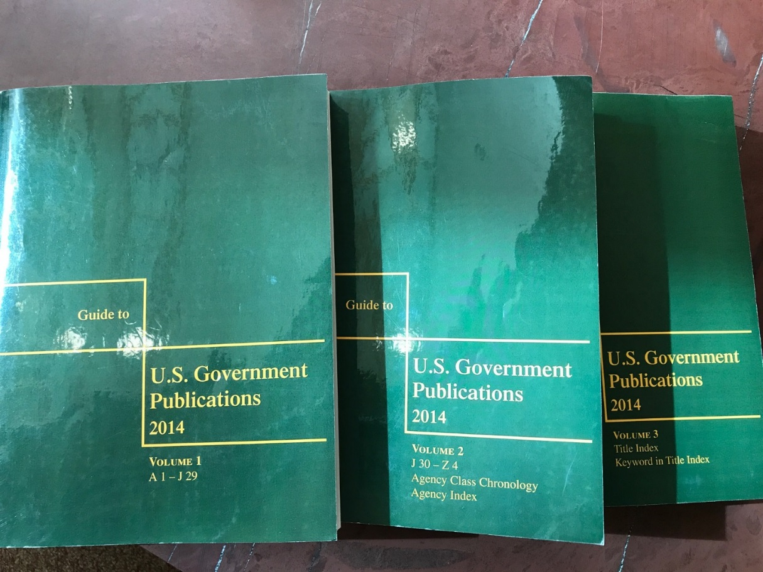
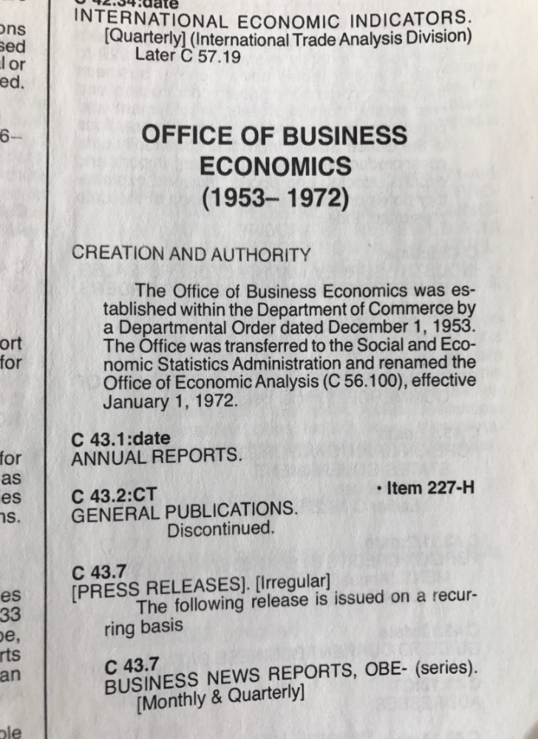
Guide to U.S. Government Publications, commonly referred to as “Andriot,” after the name of the original compiler

Slide 5
Andriot contains all SuDocs series
Andriot is comprehensive
It contains all SuDocs stems (series), not individual titles, but stems
SuDocs classification is agency or provenance based, not subject based like LCSH
As a result, some agencies change classifications over time

Slide 6
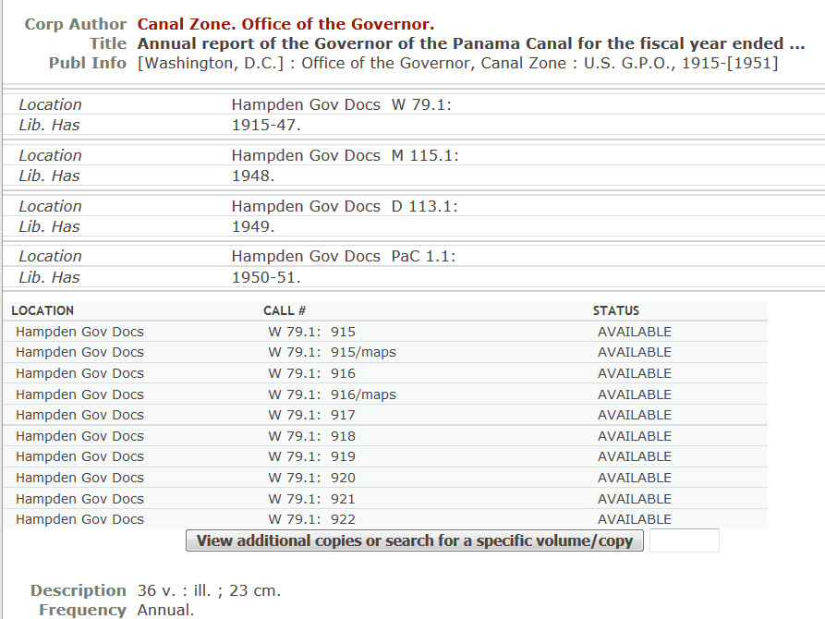
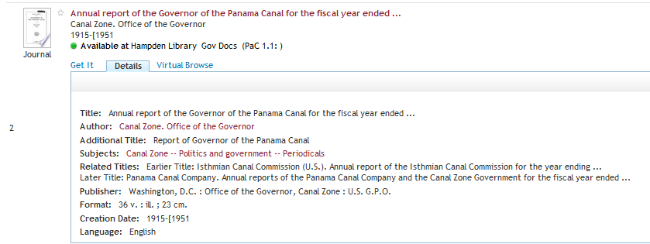
Complexities with Docs Records: Multiple Classifications Showing History

Slide 7
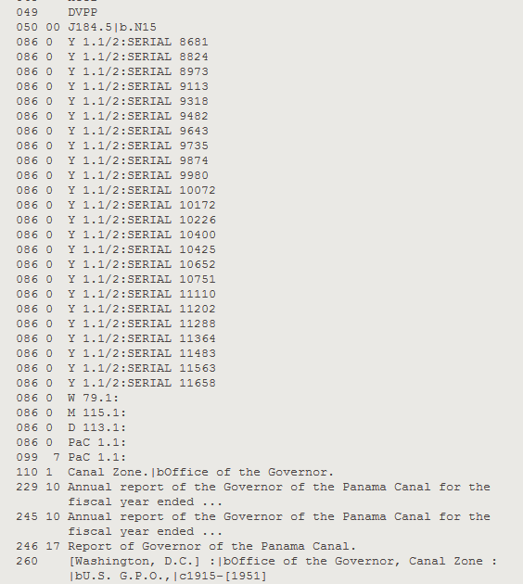
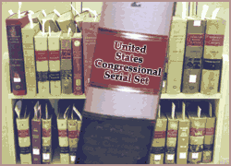
Tracking Provenance through MARC Records
W = War Dept.
M = Military Establishment
D = Defense Dept.
PaC = Panama Canal Commission

Slide 8
To SuDoc, or not to SuDoc
SuDocs assigned by a higher authority; no need to think about classification. Smaller depository libraries may want to integrate. Larger depository libraries may want to segregate.
Integrating saves the time of the user
Segregating saves time and money for library

Slide 9

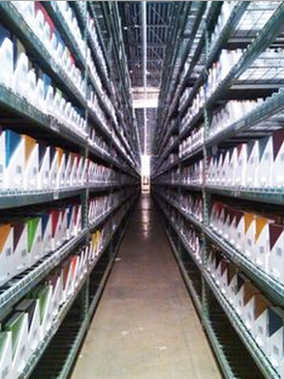
Our Problem: 100% of of GovDocs were Offsite: No Way to Browse the Docs Stacks
GovDocs previously on-site
Since 2011 100% off-site

Slide 10
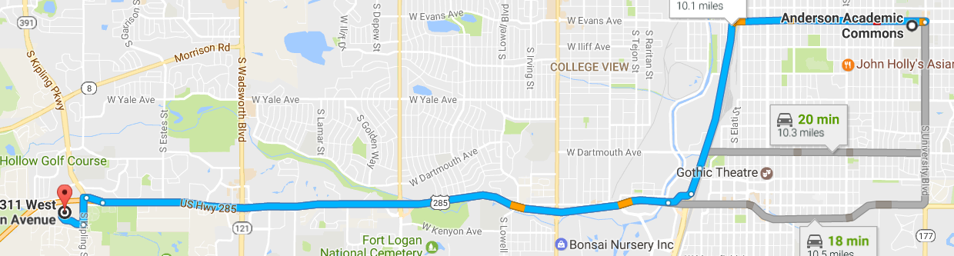
On-site vs. Off-site Docs Access
On-site (until 2011) | Off-site (2011-present)
Open stacks | Harvard-style remote storage
Shelved in SuDocs order | Shelved by size
Browsable by users; Access also by online catalog | Closed stacks; only access is via online catalog
Stored on lower level; Docs available for immediate circulation | Stored 10 miles away; Docs requestable and retrieved every 4 hours (by car)

Slide 11
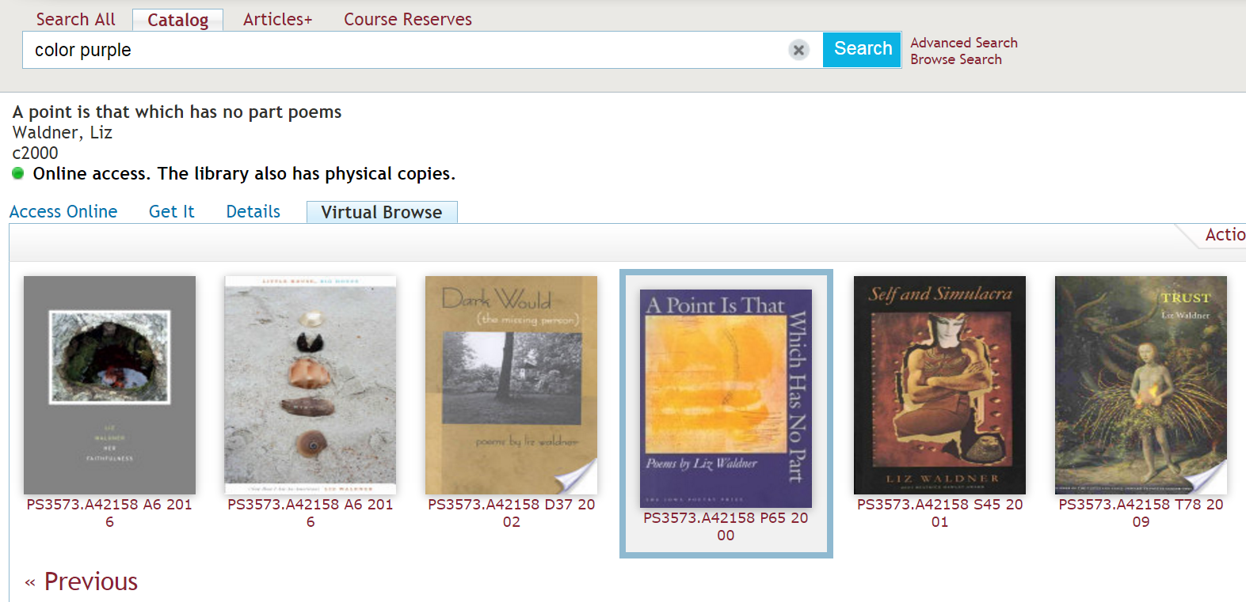
Primo has a virtual browse feature

Slide 12
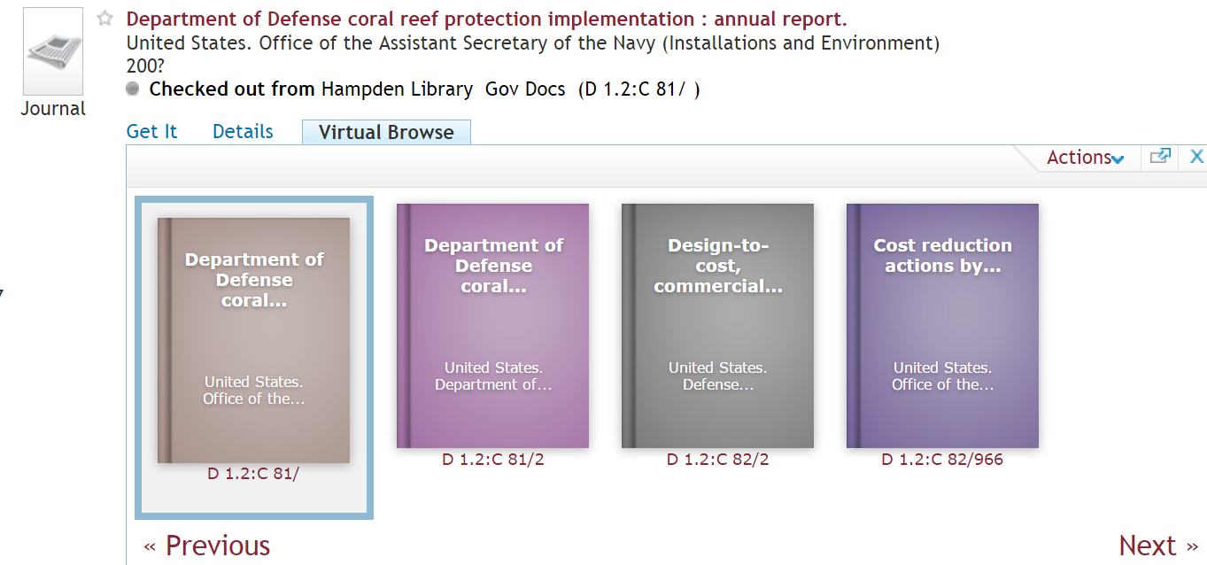
But Primo Virtual Browse for SuDocs isn’t very exciting

Slide 13
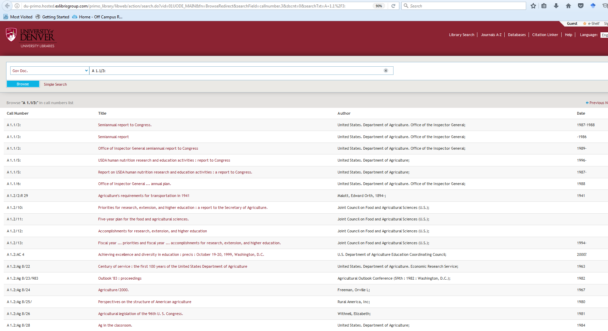
No-so-adequate Primo Browse

Slide 14
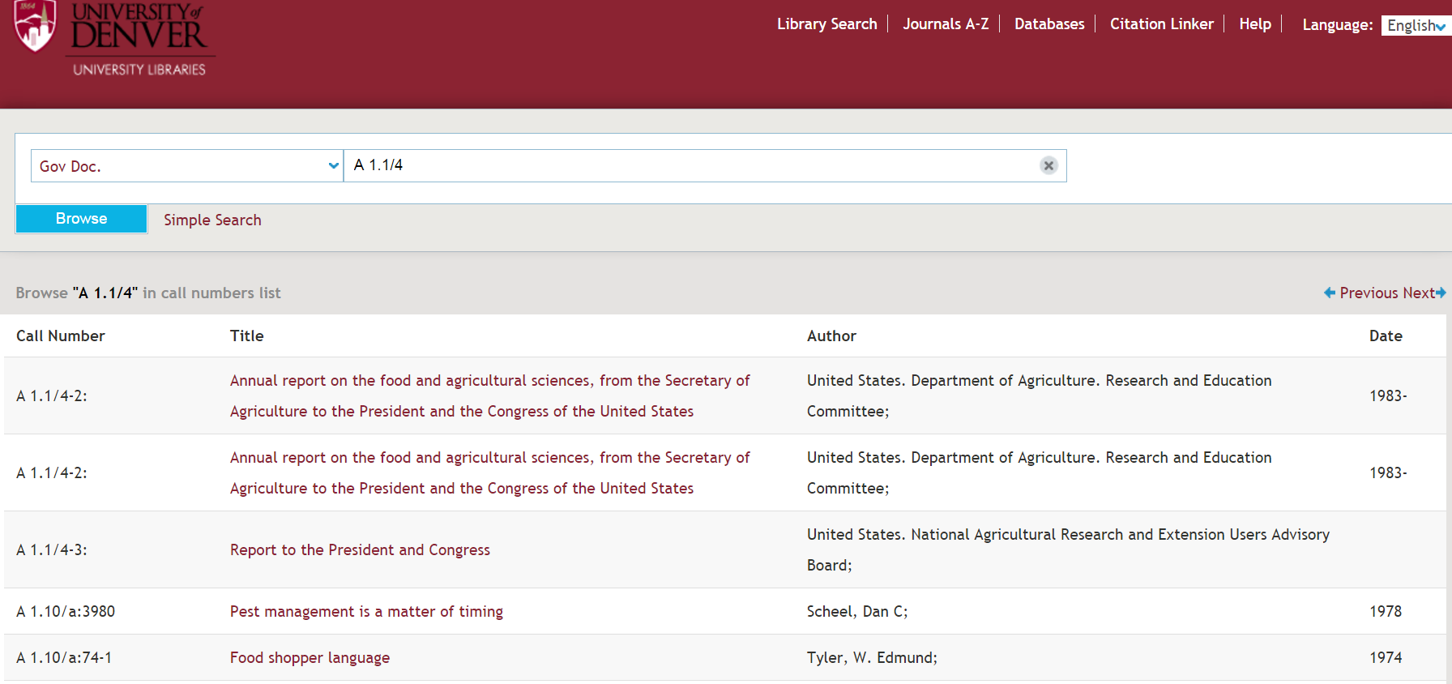
SoDocs Browse Feature
http://primo.library.du.edu/primo_library/libweb/action/search.do?fn=showBrowse&mode=BrowseSearch&vid=01UODE_MAIN

Slide 15
I couldn’t figure out how to get a SuDocs call number browse feature to work in Primo
I originally tried this: http://du-primo.hosted.exlibrisgroup.com/primo_library/libweb/action/search.do?vid=01UODE_MAIN&fn=BrowseRedirect&searchField=callnumber.3&dscnt=0&searchTxt=A+1.2
But that didn’t work as well as I wanted.
So I asked our cataloger to look into this.
Solution: Primo “deep link” in this format: query=lsr04,exact,A+1.2
http://du-primo.hosted.exlibrisgroup.com/primo_library/libweb/action/dlSearch.do?institution=01UODE&vid=01UODE_MAIN&search_scope=local_scope&query=lsr04,exact,A+1.2

Slide 16
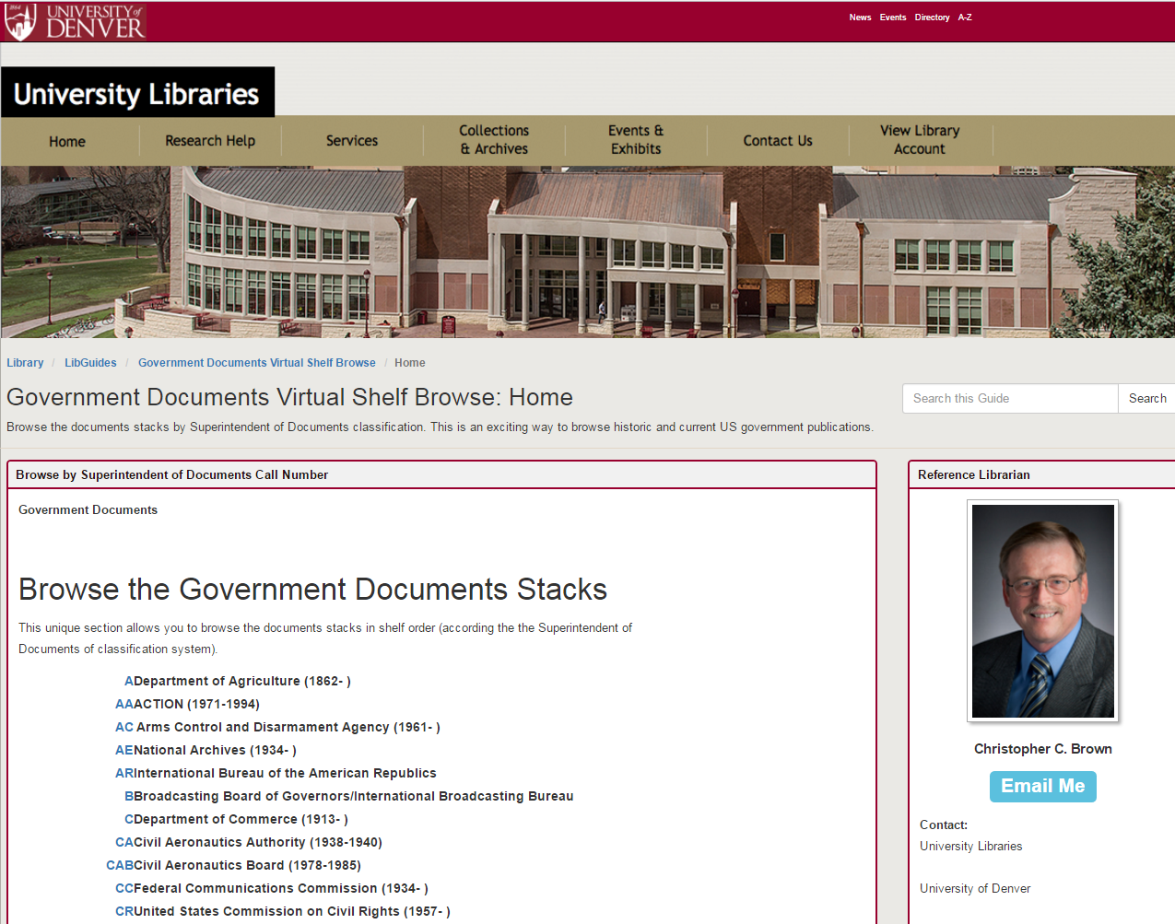
Our Solution: A Virtual Browse Tool to Browse Docs in SuDocs Order
http://libguides.du.edu/BrowseDocs
A Virtual “Andriot”

Slide 17
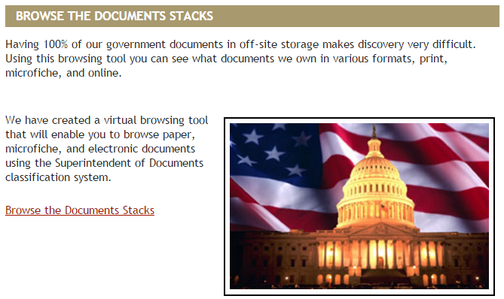
My solution was a Browse the Documents Stacks Feature

Slide 18
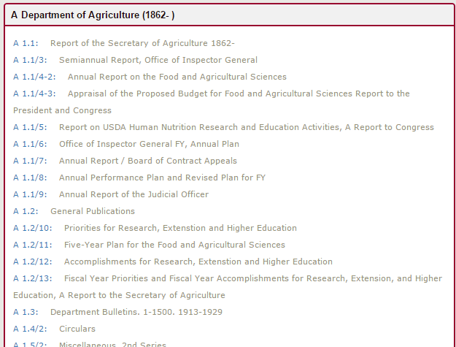
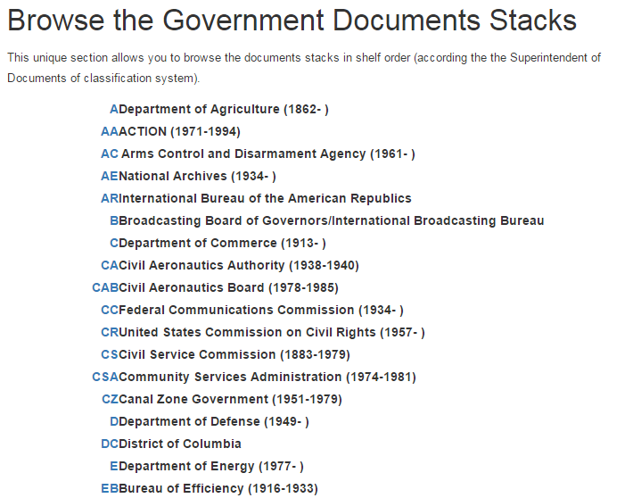
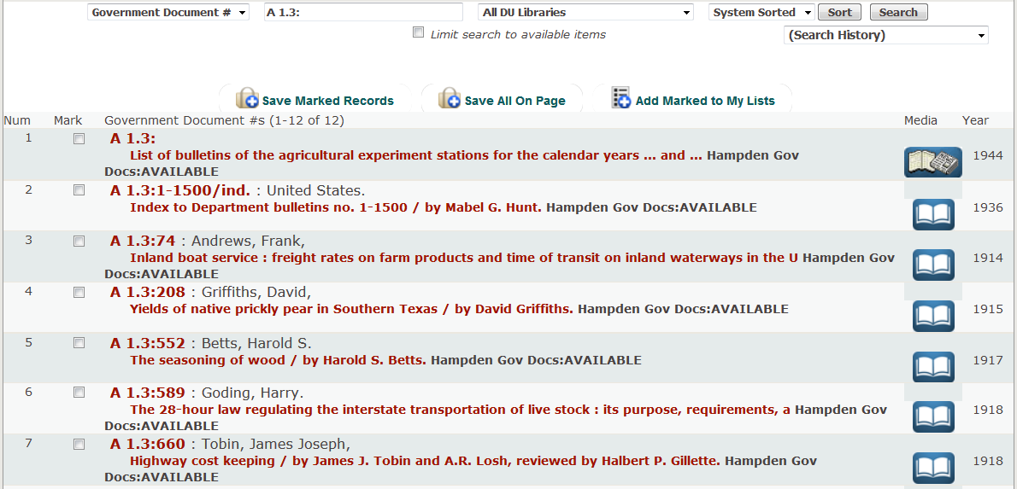
I Needed to Replicate What I Already Had

Slide 19


Tools used for this project
Microsoft Access
Springshare’s Libguides

Slide 20
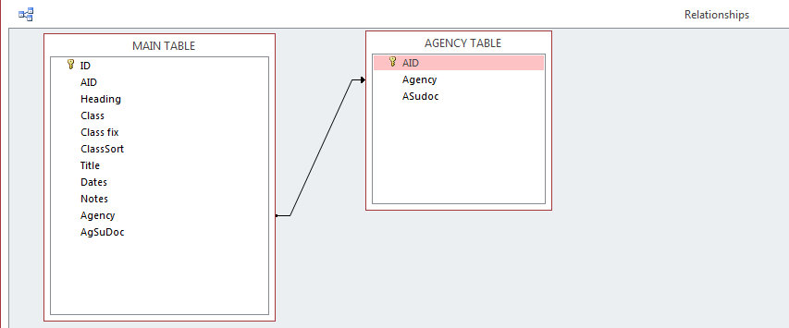
Relational Access Database Used for Project

Slide 21
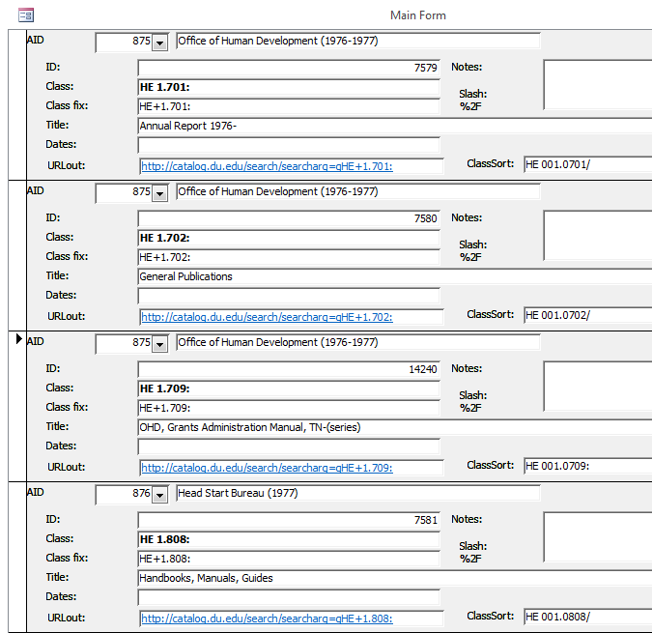
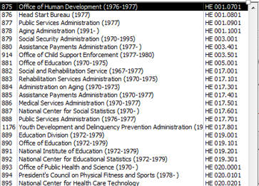
Agencies Can be Related to Document Series through Pull-Down Menu

Slide 22
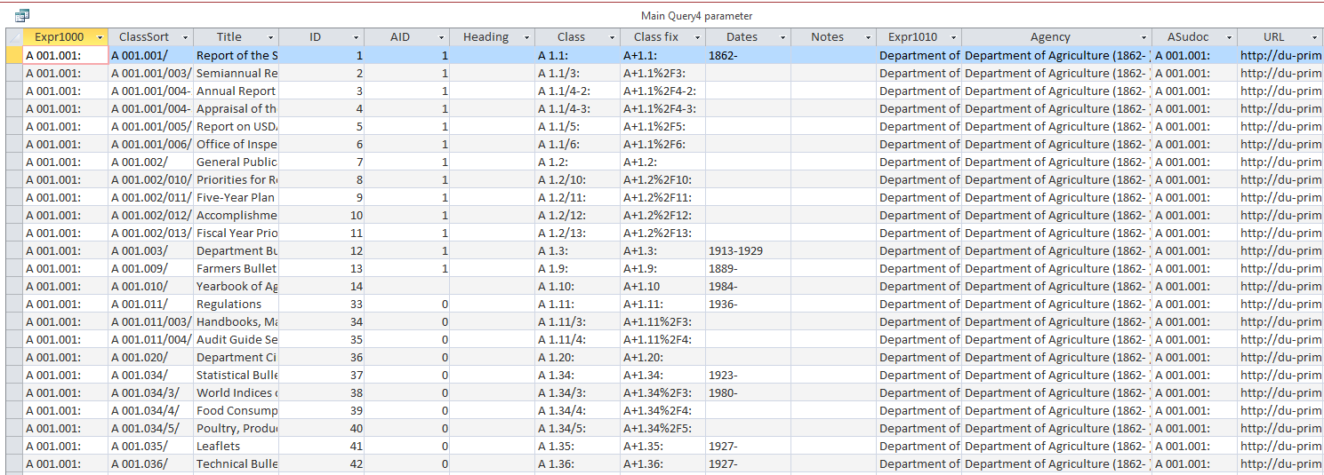
Notice the “Class fix” field: This puts the URL into the proper format for output to Primo

Slide 23
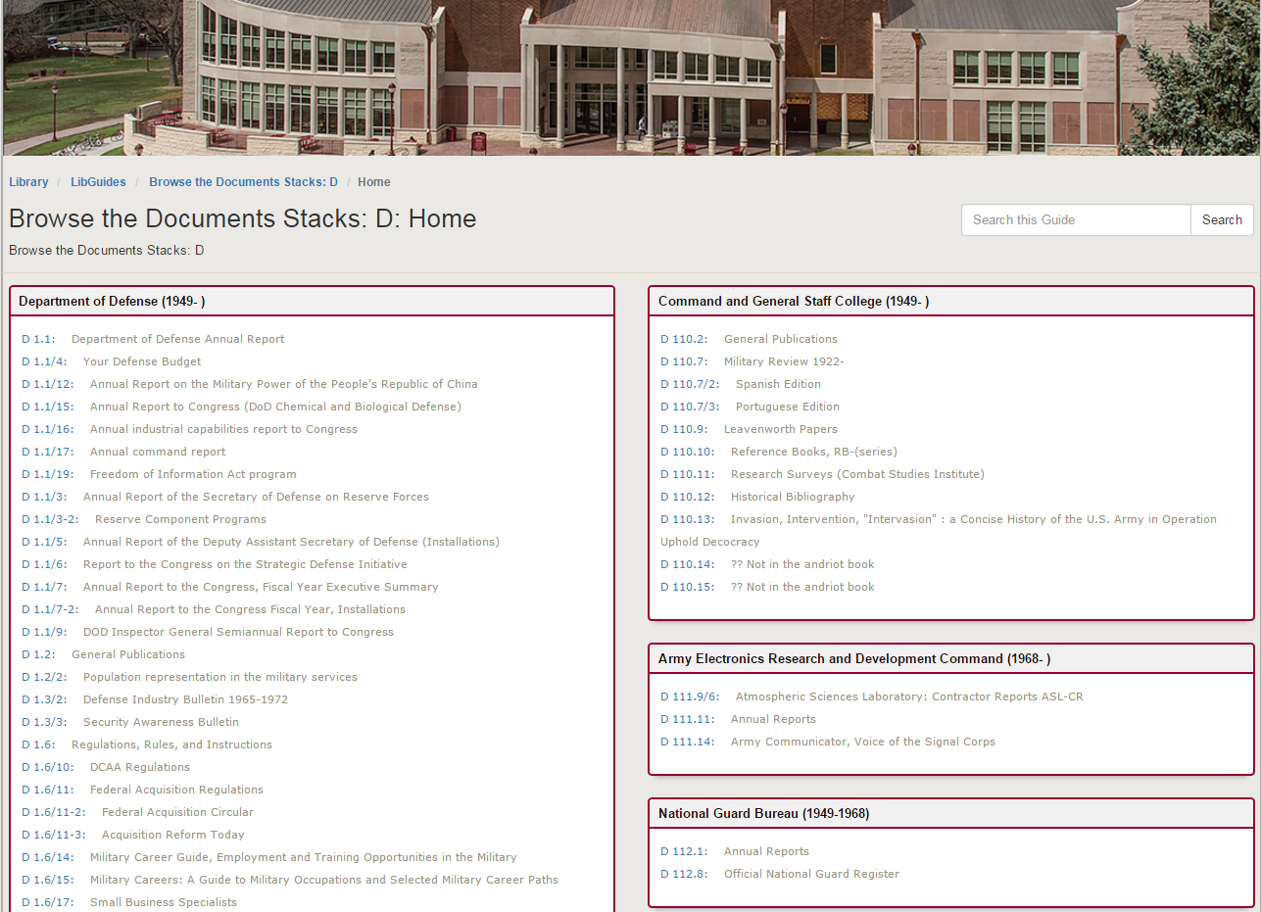
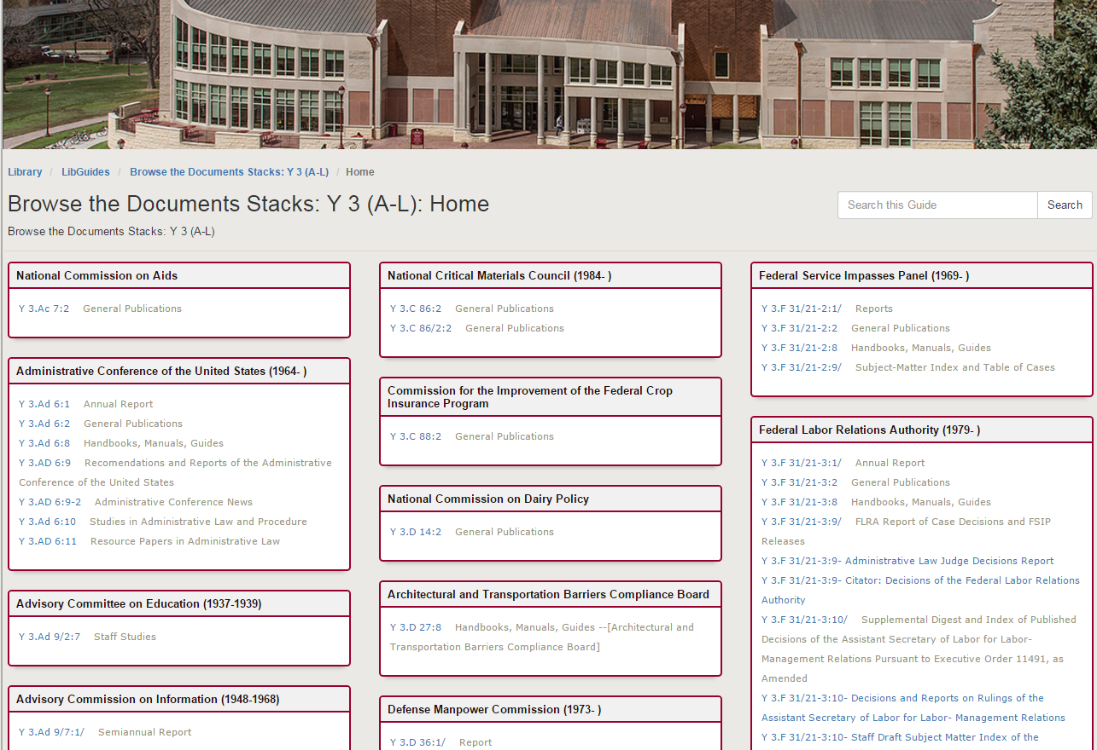
I used Libguides for the Display

Slide 24
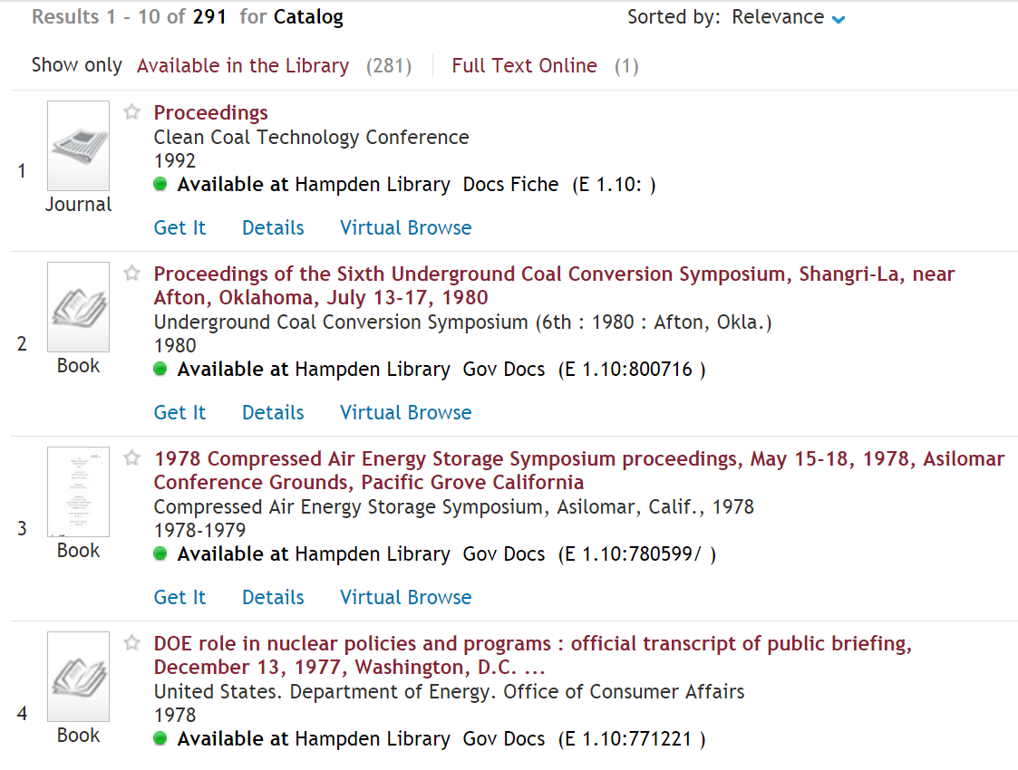
The final result: only problem is the sort

Slide 25
Primo Wish List
Primo needs to allow for indexing and searching of multiple SuDocs numbers
The sort order for browsing docs needs to include SuDocs classification number (not just relevance, date, popularity, author, and title)

Slide 26
Questions?
Christopher C. Brown (“Chris”)
(303) 871-3404
cbrown@du.edu
Play with the project here: http://libguides.du.edu/BrowseDocs

