Slide 1
Implementing Leganto powered by SIPX with Blackboard: Lessons Learned
Blake L. Galbreath
Core Services Librarian
Washington State University

Slide 2
Overview
Background Information
Why Leganto for WSU?
Implementation Hiccups
Blackboard and SIPX
Rollout and Promotion
Overall Experience

Slide 3
Background information

Slide 4
What is Leganto?

Slide 5
First Things First
What is Leganto?
Course Reserves Management System
LMS integration
SIPX integration (WSU was development partner)
Uses Primo for content search
Focus on faculty and student interaction

Slide 6
Look and Feel
Just in case
Some of you may not be familiar with Leganto, so let’s take a look first

Slide 7
Access
Usual access is through LMS - in our case, we use Blackboard
However, you can also set up Leganto to work via permalink

Slide 8
Why Leganto for WSU?

Slide 9
Better Solution for Students
Compared to current product (Docutek ERes):
Integrates with Blackboard, therefore uses campus authentication system
Modern, mobile-friendly web-design
Can house all formats (electronic, print, digital, audio...) in one place

Slide 10
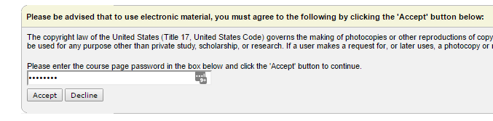
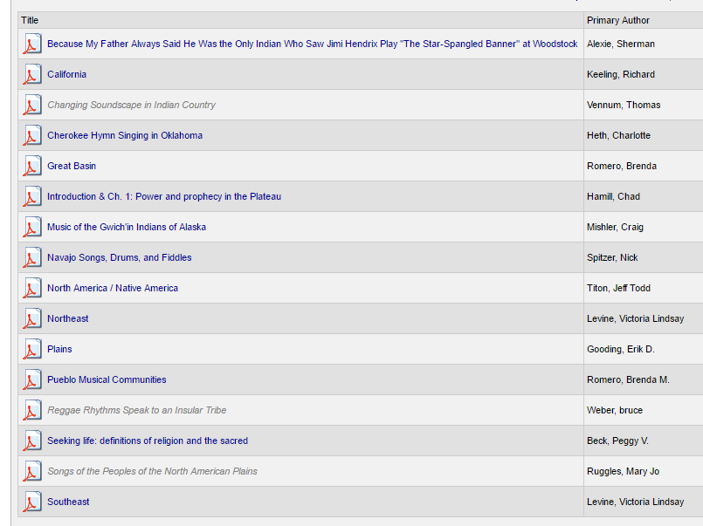
Better Solution for Students

Slide 11
Better Solution for Staff
Copyright mechanism in ERes was not working
Staff was clearing all copyright manually
SIPX offers more automated approach to copyright clearance
Can house all formats (electronic, print, digital, audio...) in one place.

Slide 12
Better Solution for Institution
SIPX offers cost-per-use model that hopefully saves money (still waiting on the numbers!)

Slide 13
Implementation hiccups

Slide 14
Blackboard

Slide 15
View as Student
In general, troubleshooting Leganto is a little difficult.
1) Alma roles
2) Need to work with Blackboard and/or Registrar

Slide 16
View as Student
Alma roles
You need Course Reserves (or Fulfillment) roles to access courses and reading lists from Alma.
However, having Course Reserves (or Fulfillment) roles prevents you from viewing the reading list from student perspective.

Slide 17
View as Student
Ideally
You would have a demo patron account that can authenticate via Central IT authentication method
AND
have Registrar add account to every Leganto course.
Unfortunately, this was not an option for us.

Slide 18
View as Student
Workaround #1
Strip your Alma account of Course Reserves and Fulfillment roles. Authenticate via permalink.
Obviously, you will have to go back and forth with this approach.

Slide 19
View as Student
Workaround #2
Ask permission of instructor and Registrar to be added to course officially.
This gives the best approximation of what a student will see.
You will then also see alerts from the class if a resource is not working.

Slide 20
View as Student
Workaround #3
Create demo patron account in Alma.
Demo account should have only PATRON role and must be an EXTERNAL user.
Have BB Admin add matching account to Leganto courses via non Central IT authentication.

Slide 21
View as Student
Why not use Student View in Blackboard?
Student View creates a temporary Blackboard account that does not exist in Alma.

Slide 22

View as Student
Idea Exchange:
Incorporate Blackboard Student View into LTI Integration
Currently, the Blackboard LTI integration does not allow instructors to use Student View to see reading lists from the student's perspective. (Doing so results in error: 400 Unknown user id.) Please allow the temporary student that is created in Blackboard to be created in Alma, thereby enabling Student View.

Slide 23
Blackboard Course IDs
Course IDs need to match exactly between Blackboard and Alma.
I initially used incorrect capitalization (e.g., 2017-spri-ONLIN-HISTORY-305-5817-LEC).
Easy workaround for this is to add correct Course ID to Searchable IDs field.

Slide 24
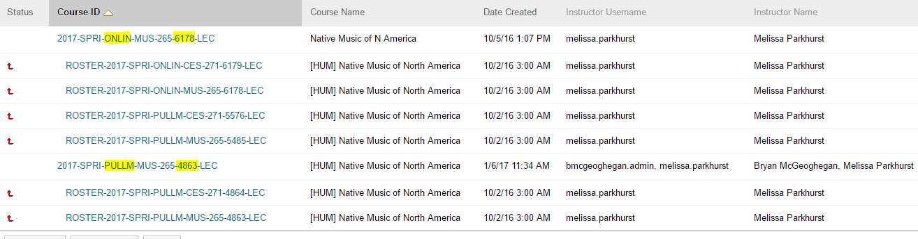
Blackboard Course IDs
Also problematic, is the fact that course IDs can be merged by the Registrar or by the Instructor.

Slide 25
Blackboard Course IDs
2017-SPRI-ONLIN-MUS-265-6178-LEC vs.
ROSTER-2017-SPRI-ONLIN-MUS-265-6178-LEC
There are also Parent Course IDs and Child Course IDs in Blackboard.
You need to map the correct parameters to ensure that the correct ID is being sent to Alma.

Slide 26
Blackboard Course IDs
Idea Exchange:
Allow LTI Integration to Pass Course ID from LMS and Create Course in Alma
Due to course merging, the Course ID in the LMS is not always obvious. Please allow the LTI integration to pass the Course ID from the LMS and automatically create the course in Alma. This would occur when the instructor adds/creates the LTI integration in the LMS and initiates the link. Of course, manual course creation on the library side should always be possible as well.

Slide 27
SIPX

Slide 28
Pretty Smooth Sailing
But, do check all of your links!
However feasible this is.
There were a few injection issues (SIPX to Alma) in the beginning, but nothing we could have prevented.

Slide 29
SIPX is Not Magic
Too bad!
I had the misconception that everything was going to be automated.
However, there is still the possibility for manual intervention when publishers don’t allow automated copyright clearance.

Slide 30
Rollout and promotion

Slide 31
Communication
Contact instructors ahead of time… but not too far ahead of time. It’s a careful dance.
Originally, I was relying on someone as a go-between. We had no volunteers.
I sent emails to instructors individually, and I received a much better response rate.
Notes:
Margy - 11/30 = 0
Me - 12/1 - 12/5 = 17

Slide 32
Communication
You need to get Instructors to add LTI link to their Blackboard space.
This is a very easy process, but I found out that some Instructors do not create their own BB spaces, but instead staff from Global Campus create for them.
Easy-to-follow instructions.

Slide 33
Overall experience

Slide 34
The Implementation Team
They were really great.
We primarily communicated via BaseCamp and bi-weekly calls.
I did have to engage in 4am emails twice to get an issue ironed out, but hey!

Slide 35
The Numbers
Spring 2017 Pilot:
14 Pilot Courses
302 Active Students
90% of students viewed reading list citations
34% of students viewed full text of citation
Notes:
https://knowledge.exlibrisgroup.com/Alma/Product_Documentation/Alma_Online_Help_(English)/Analytics/Leganto_Student_Usage
n=272
n=102

Slide 36
The Future
Need to do more testing from multiple browsers.
Need to do more testing from iOS.
We have ~60 courses using Leganto for Summer 2017.
Outreach and training planning for Fall 2017

Slide 37
Questions?

