Slide 1
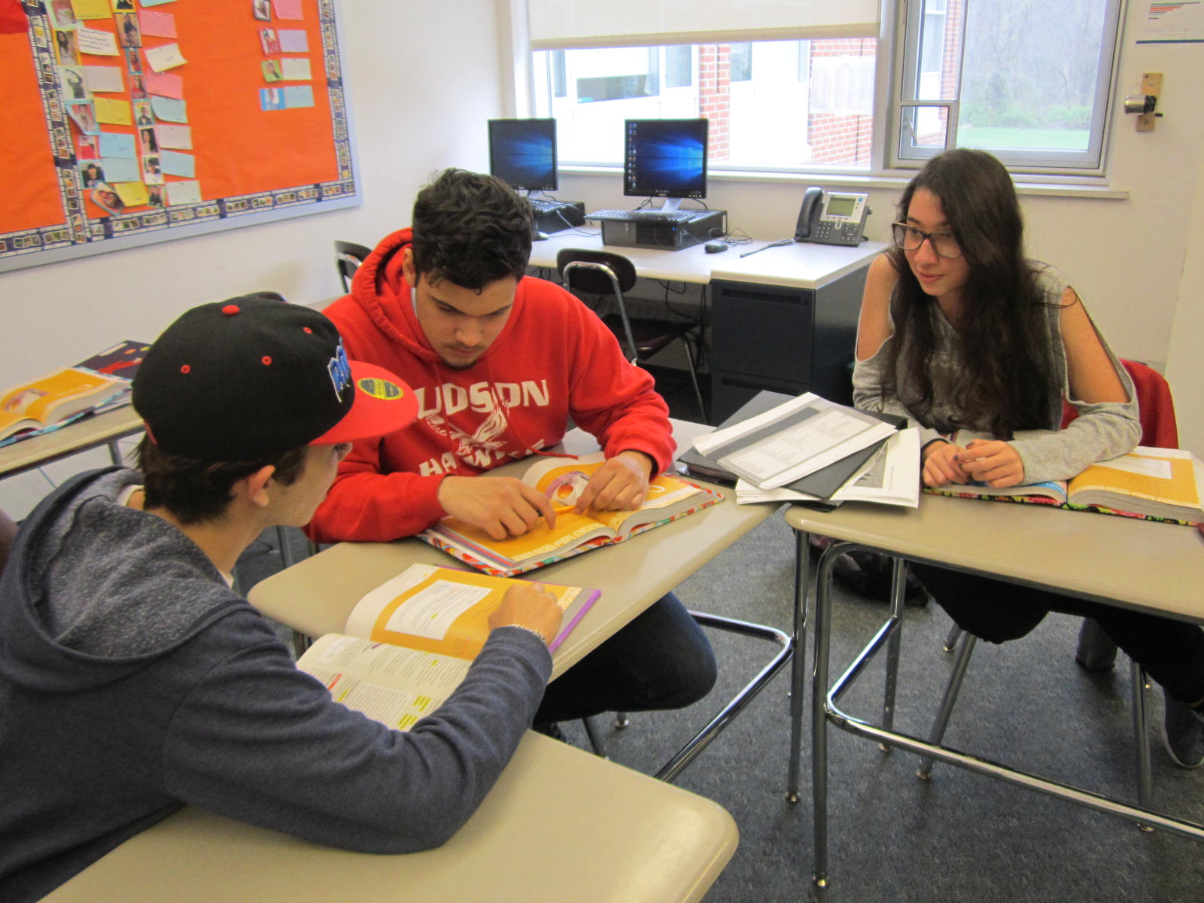
Implementing Academic Conversations to Foster Academic Language in ELs
Emily Smyth, Ed.M.
ESL Teacher, Hudson High School
Hudson, MA
June 2, 2017

Slide 2
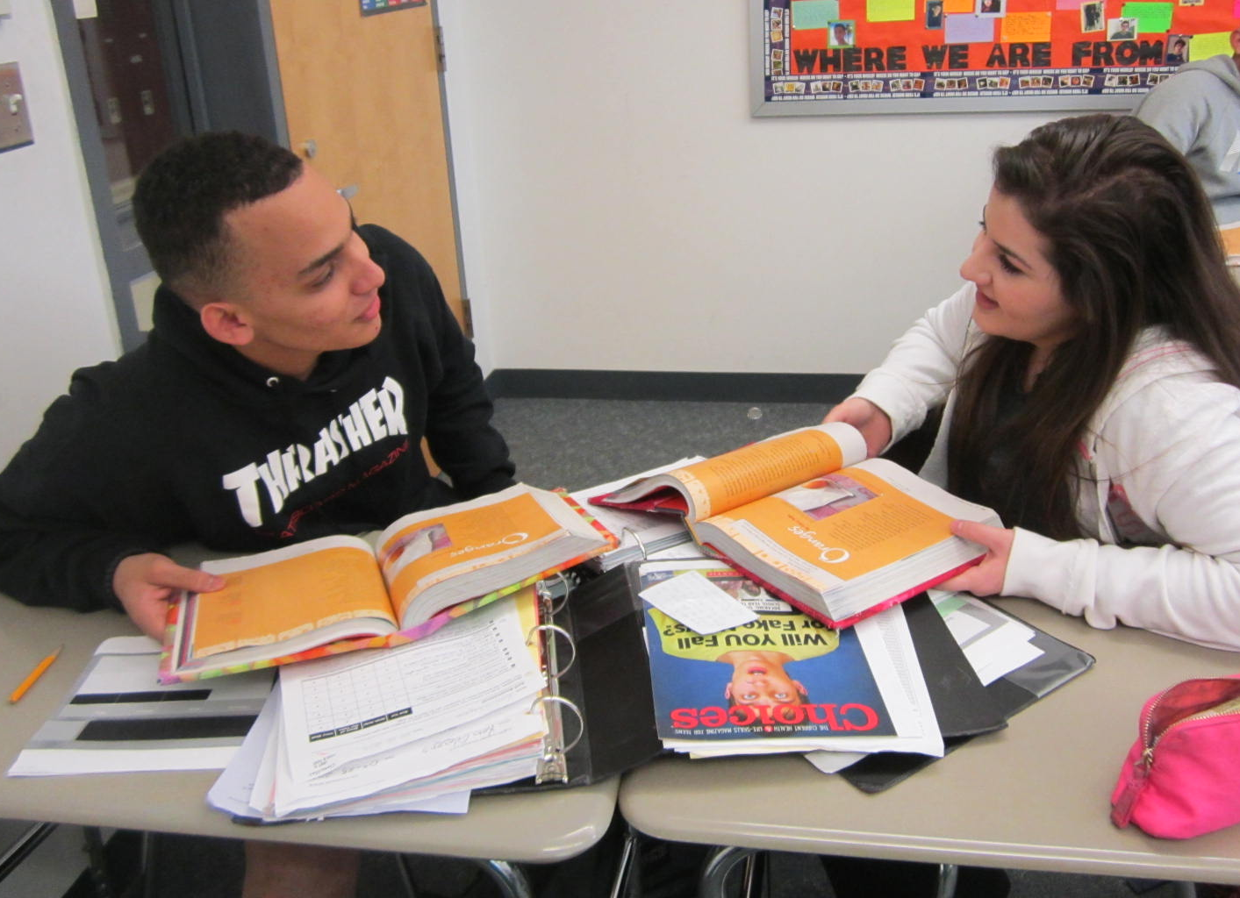
Agenda
1. My School
2. Research on Academic Conversations
3. Academic Conversation Lesson Format
4. Academic Conversation Assessment
5. Questions

Slide 3
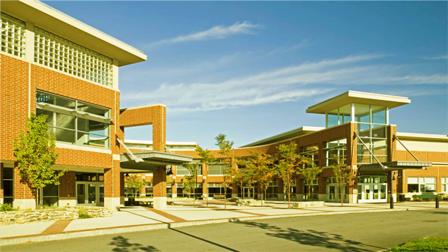

Hudson High School
934 students in grades 8-12
5% of student body are ELs
Portuguese and Spanish speakers (Brazil, Puerto Rico, and Central America)
Other nationalities: Chinese, Indian, Iraqi, Portuguese, Taiwanese
English Language Development classes levels 1-6
Academic Seminar classes (grades 8-10)
2 full-time ESL teachers

Slide 4



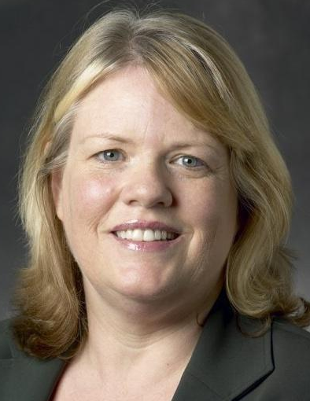
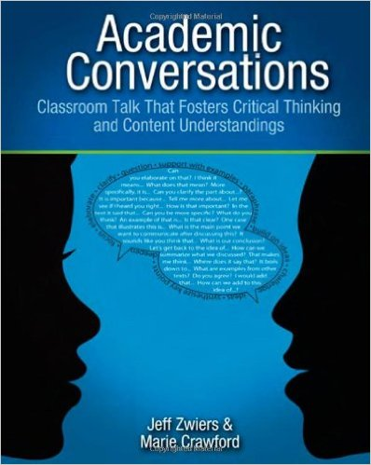

Research on Academic Conversations
Jeff Zwiers and Marie Crawford report that in many classrooms ELs are silent and most of these student centered conversations lack depth and new insight into topics discussed.
Carmen Arreaga-Mayer and Claudia Perdomo-Rivera’s study showed that ELs participated in stimulating school talk for about 4% of the school day.
Academic Conversations foster literacy, oral and communication skills. Academic Conversations build academic language and vocabulary, critical thinking, creativity, and cultural tolerance.

Slide 5
Academic Conversation
The Logistics
The Format
English Language Development 2-6 classes
Class size 3-15 students
70 minute block
Voice recorders or iPADs if you will assess (Camera app, Voice Record Pro, and Pio Smart Recorder)
3-5 assessed academic conversations per unit
Give 3 positive feedback comments.
Use an excerpt from the previous academic conversation for positive feedback and areas of improvement.
Teach the new language students will focus on.
Students will practice this new language with a partner and a prompt.
Students will record their academic conversation with a new partner using this new language and a prompt.
Students complete an exit ticket.

Slide 6

Positive Feedback
Step 1
Stayed on topic
Greeted each other
Used sentence starters

Slide 7
Would you rather live in the Western World or with the Maasai?
Step 2
Juan: I am not sure I understand the prompt.
Vini: Well, what I understand is the question asks like if you want to live different like the Maasai or Western that is what I am seeing.
Juan: So in other words, I can live in the United States or England or the Maasai?
Vini: Well, I disagree with your point about it because, I think the question asks which Western World or Maasai and how is it different- the Western World or the Maasai.
Juan: What I understand is you see the difference between the cultures…

Slide 8
Area of Improvement: Would you rather live in the Western World or with the Maasai?
Step 2
(con’t)
[Later in the conversation.]
Vini: So what is your opinion about? Would you or not?
Juan: Yeah. Yes.
Vini: My opinion is… do you see like in the left picture when Joseph is in the Western World probably. The hat. The jacket. He has a notebook. See in the background… it is really different, too.

Slide 9
Support Ideas with Examples
Step 3
Prompting
Responding
Can you give an example from the text?
Why do you say that?
What is the evidence for that?
For example…
According to…
An illustration of this could be…

Slide 10
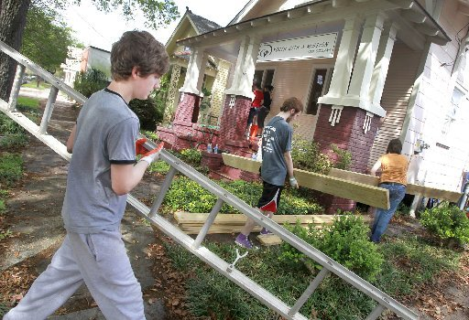
Prompt: How much should people help each other? Use the informational text, “Enabling or Disabling?” to answer the prompt.
Step 3
(con’t)
Step 1.: Thinking
Students write 2 quotes from the text on index cards.
Step 2: Sharing
Student A: Answers the prompt.
Student B prompts: What is the evidence for that?
Student A responds: An illustration of this could be…

Slide 11
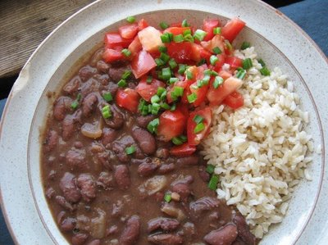
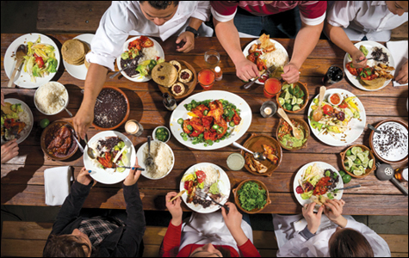
Based on “Do Family Meals Matter?” and your own experience, do you think family meals are important or are they a thing of the past? Discuss.
Steps 4 and 5

Slide 12
Exit Ticket: Which Part of today’s lesson was most helpful to you? Explain.
Step 6
reviewing the positive feedback
analyzing the previously recorded conversation
practicing the language of academic conversation
recording a conversation

Slide 13
Exit Ticket: Which part of today’s lesson was most helpful to you? Explain.
A) reviewing the positive feedback
B) analyzing the previously recorded conversation
C) practicing the language of academic conversation
D) recording a conversation
“Letter B, because it is more easy to do step by step and get the whole information.” -Marta
“Letter B, because when I said something wrong the class could help me with everyone’s ideas.” -Marius
“Letter C, because participating in a practice conversation I understand how it works.” –Suzana
“Letter C, because when I practice I can make sure if I understand what I need to do and how to do it.”
–Francisco
“Letter D, because it help me how to be connected with my partner’s ideas.” -Norberto

Slide 14

Academic Conversation Rubric English Language Development: Grades 5-12
Student: ________________________ Date: ________________________ Teacher: __________________________
Format: Pair Trio Quad Whole Class Prompt: _______________________________________________________________
 | Objectives | Building Ideas | Elaborated Turns | Nonverbal Behaviors
 | Focus on objectives (disciplinary concepts and thinking) | Build ideas in the conversation | Use clear turns with connected, academic sentences within each turn | Use appropriate nonverbal behaviors
Exemplary 4 | Turns show strong evidence of the target knowledge and thinking skill(s) of the lesson. | Turns always build on previous turns to build up an idea, meaning, or understanding; turns contribute significantly to shared creation, clarification, fortification, and/or negotiation. | Each turn is clear and, when needed, uses two or more sentences that are logically connected; sentences are academic and original. | Student uses appropriate postures, movements, and eye contact to show engagement and listening throughout the entire conversation.
Competent 3 | Turns show sufficient evidence of the target knowledge and thinking skill(s) of the lesson. | Turns usually build on previous turns to build up an idea, meaning, or understanding; turns usually contribute to shared creation, clarification, fortification, and/or negotiation. | Most turns are clear and use two or more sentences that are logically connected; sentences are usually academic and original. | Student uses appropriate postures, movements, and eye contact to show engagement and listening throughout most of the conversation.
Developing 2 | Turns show some evidence of the target knowledge or thinking skill(s) of the lesson. | Some turns build on previous turns to build up an idea, meaning, or understanding; turns sometimes contribute to shared creation, clarification, fortification, and/or negotiation. | Some turns are clear and use two or more sentences; some turns use logically connected sentences; some sentences are academic and original. | Student occasionally uses appropriate postures, movements, and eye contact to show engagement and listening during the conversation.
Emerging 1 | Turns show little or no evidence of the target knowledge or thinking skill(s) of the lesson. | Few or no turns help to build an idea, meaning, or understanding; turns rarely contribute to shared creation, clarification, fortification, and/or negotiation. | Turns rarely are clear; rarely use two or more sentences that are logically connected; sentences are rarely academic and original. | Student rarely uses appropriate postures, movements, and eye contact to show engagement and listening during the conversation.
0 | Student work is not turned in and/or does not meet the above criteria.

Slide 15

Helpful Tips
If you are new to academic conversations, don’t stray from the format you create.
Base prompts on the literature, content, or films you use in class.
Student driven work. Listen. Transcribe. Discuss. Repeat.

Slide 16
Questions
Emily Smyth, Ed.M.
esmyth@hudson.k12.ma.us
Works Cited
Arreaga-Mayer, C., and C. Perdomo-Rivera. 1996. “Ecobehavioral Analysis of Instruction for At-Risk Language-Minority Students.” Elementary School Journal 96, 245-258.
Zwiers, Jeff, and Marie Crawford. Academic Conversations. Stenhouse Publishers, 2011.
Zwiers, Jeff, et al. Common Core Standards in Diverse Classrooms. Stenhouse Publishers, 2014.

