Slide 1

A Guide to Setting to Blackboard Step-by-Step
June 2, 2017 MATSOL
Presenter: Judithann Walz

Slide 2
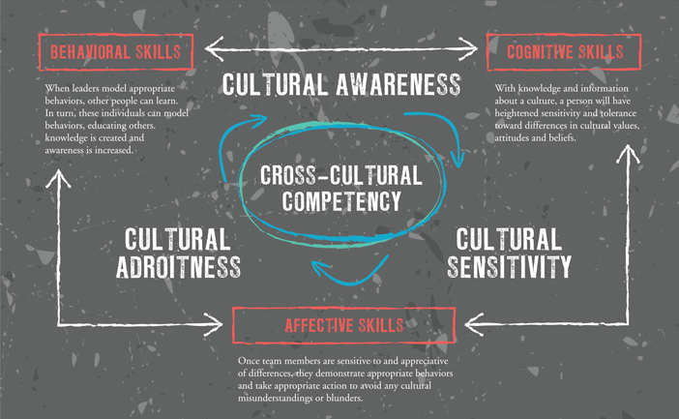
Today’s World Requires…

Slide 3
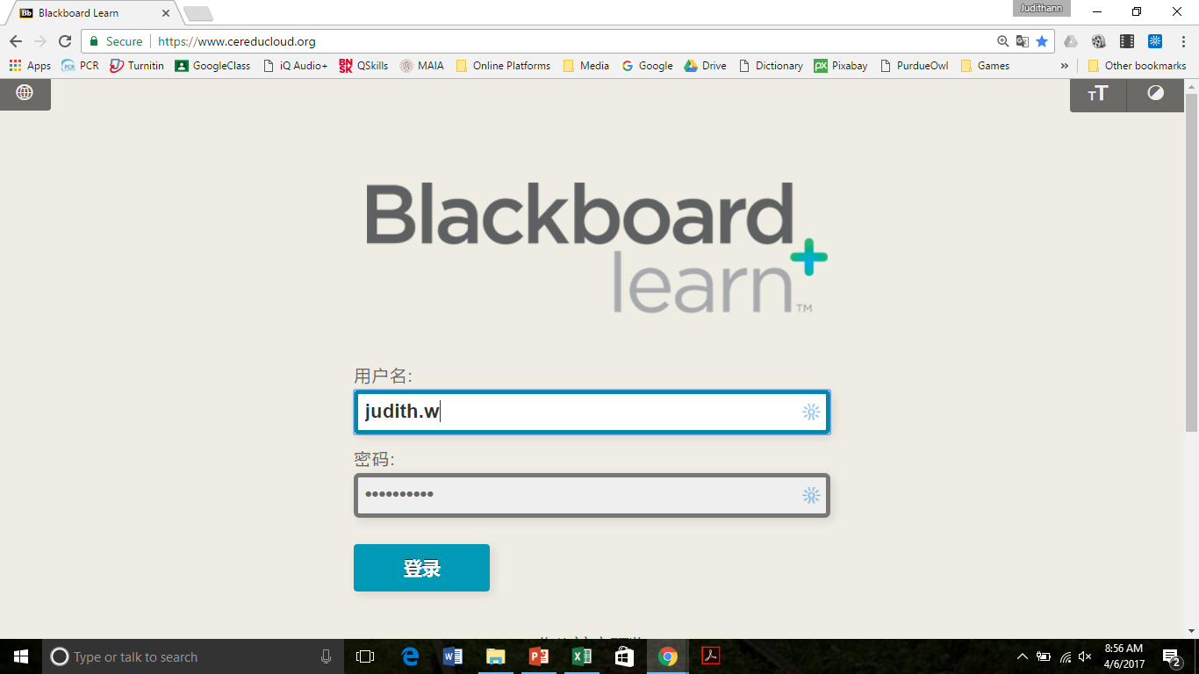
Logging In
https://www.cereducloud.org/

Slide 4
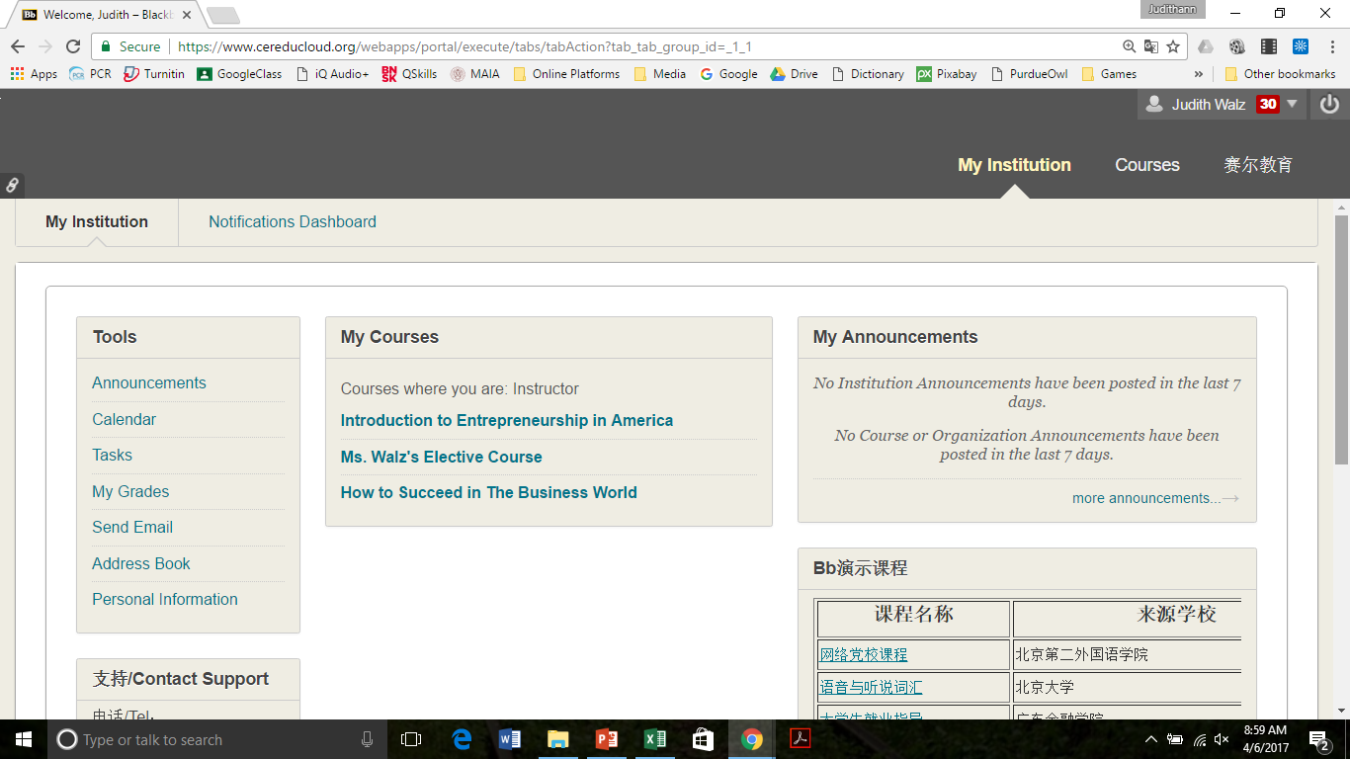
Finding My Course

Slide 5
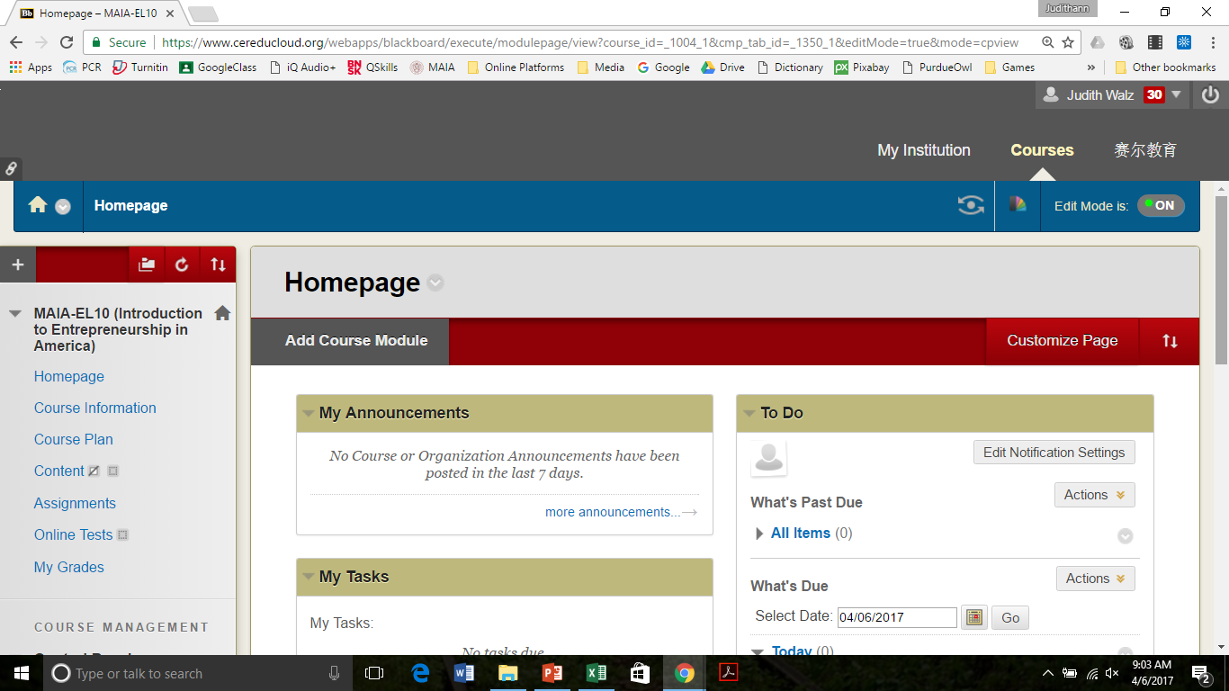
Homepage

Slide 6
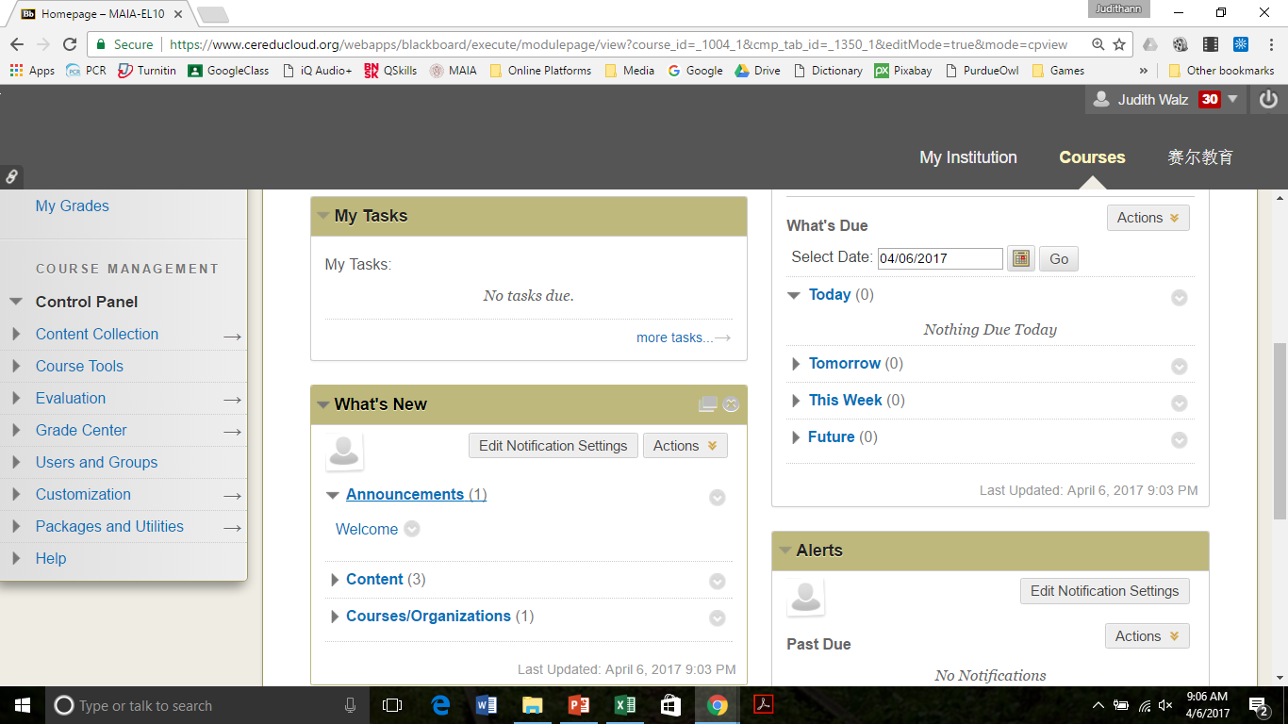
Homepage: Course Overview

Slide 7
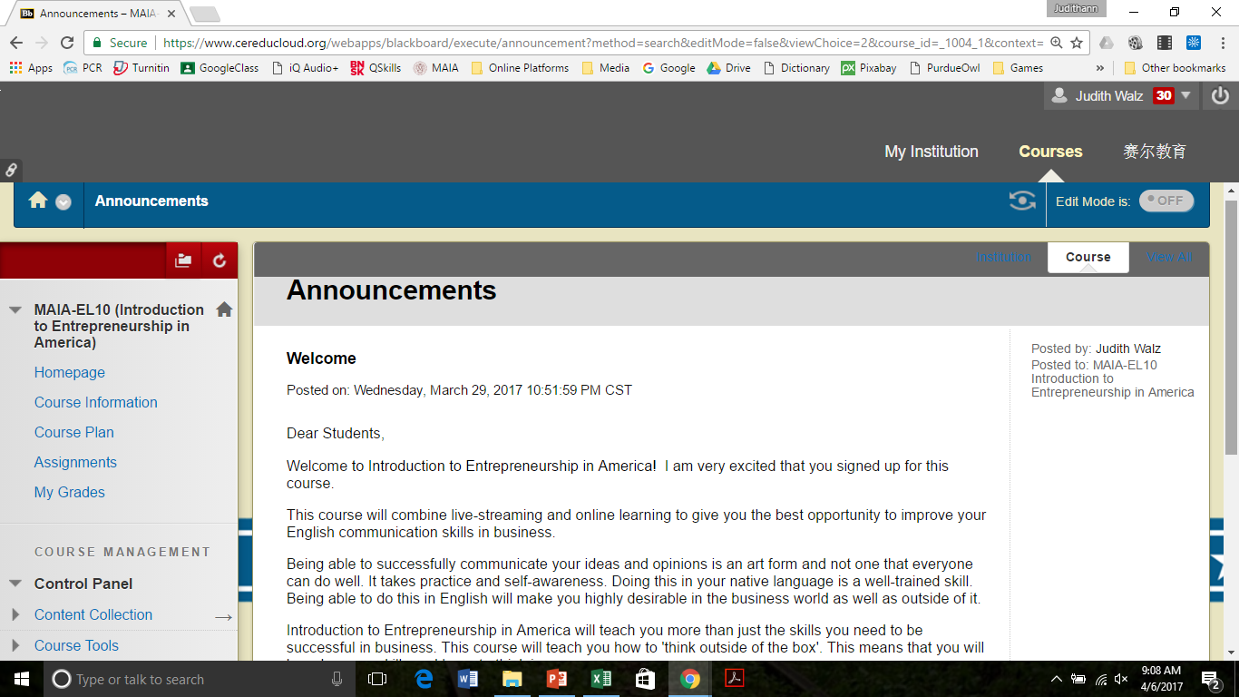
Homepage: Announcements

Slide 8
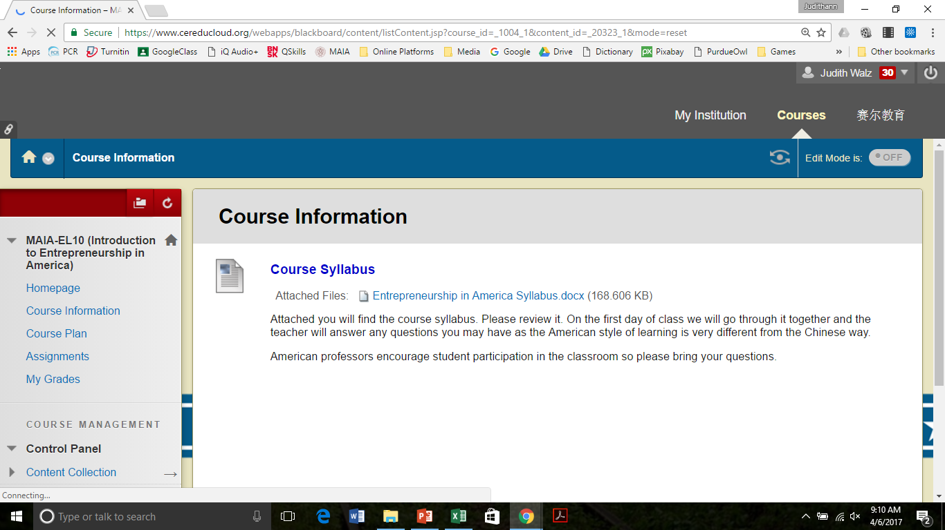
Course Information

Slide 9
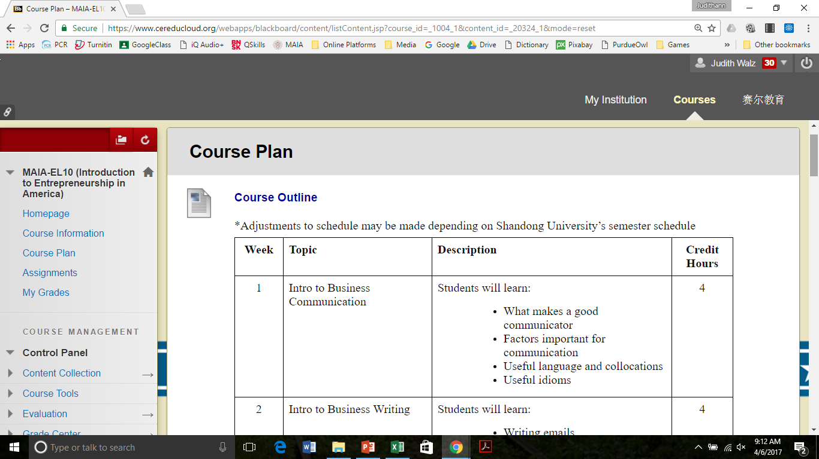
Course Plan

Slide 10
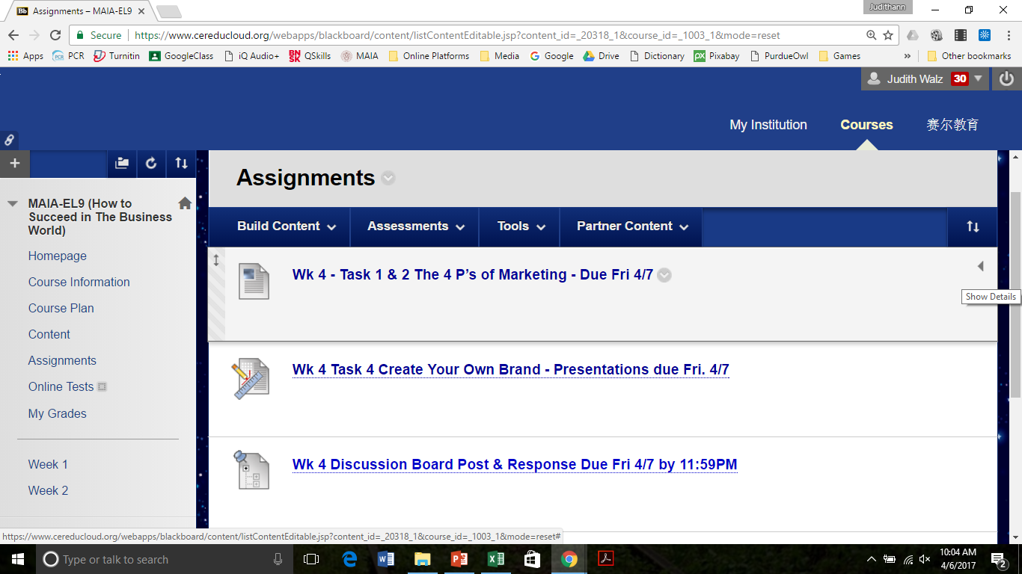
Active Assignments

Slide 11
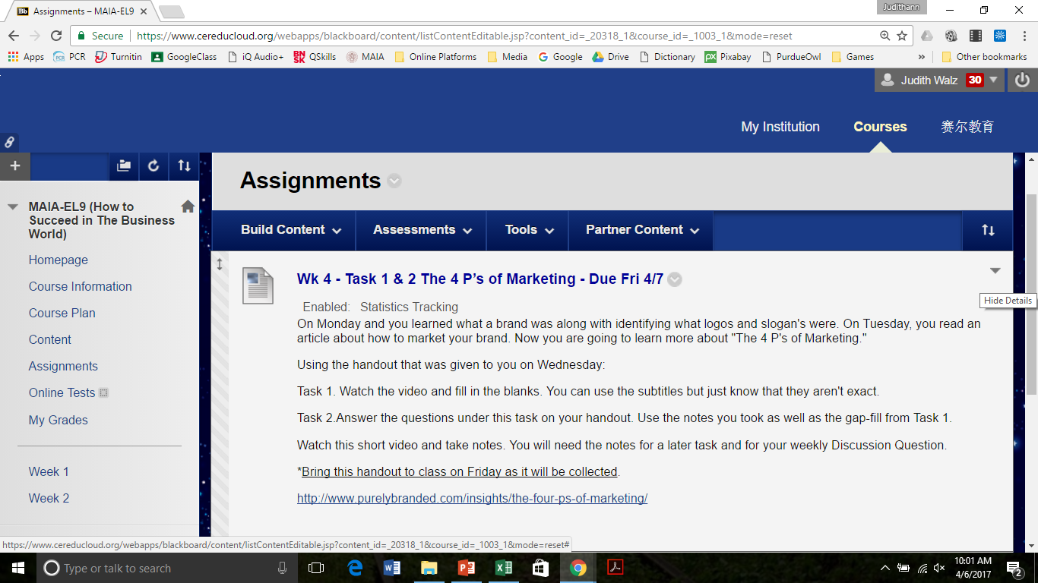
Opening an Assignment

Slide 12
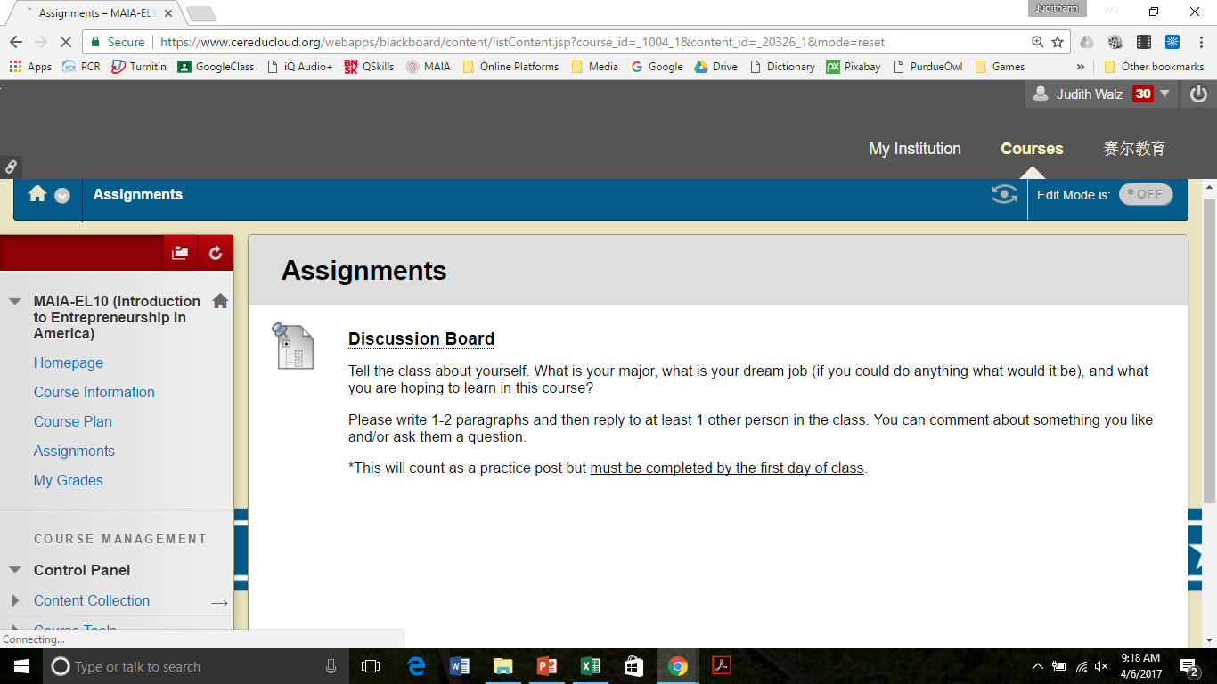
Assignments

Slide 13
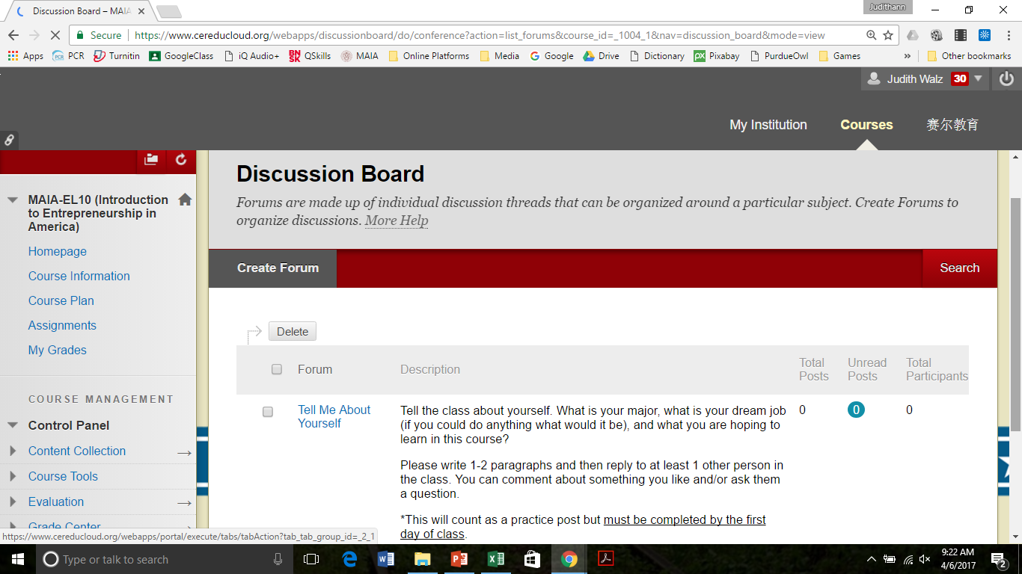
Discussion Board

Slide 14
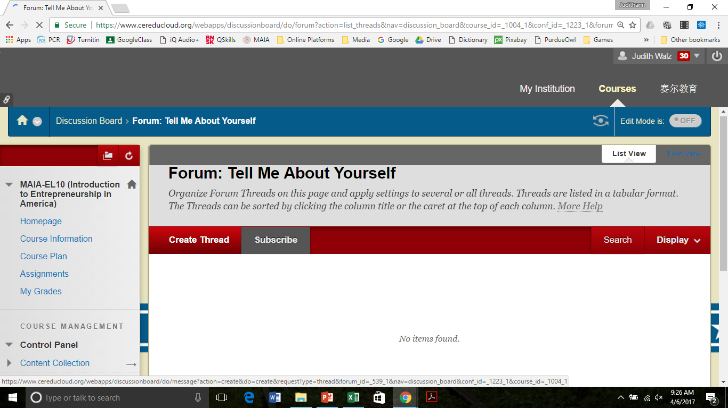
Discussion Board Forum

Slide 15
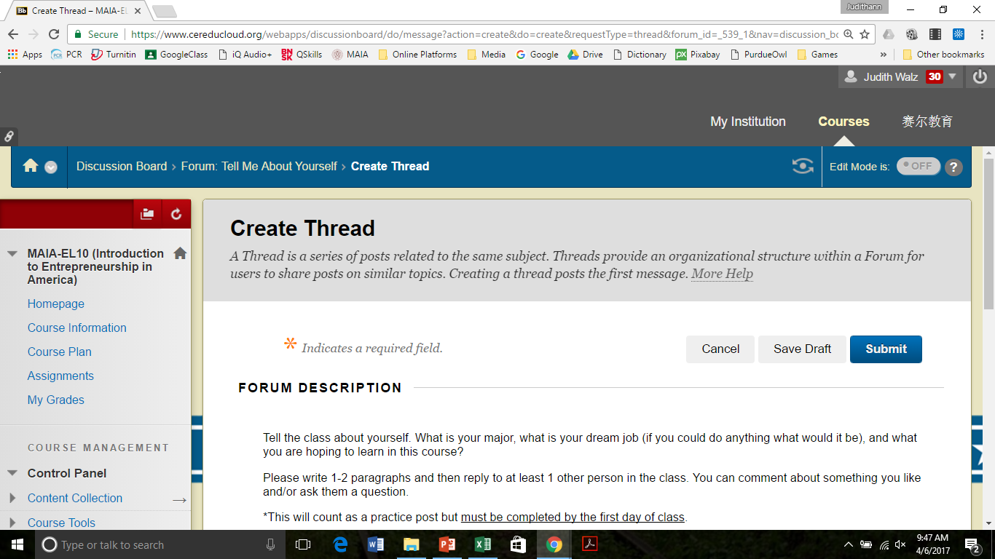
Posting a Thread

Slide 16
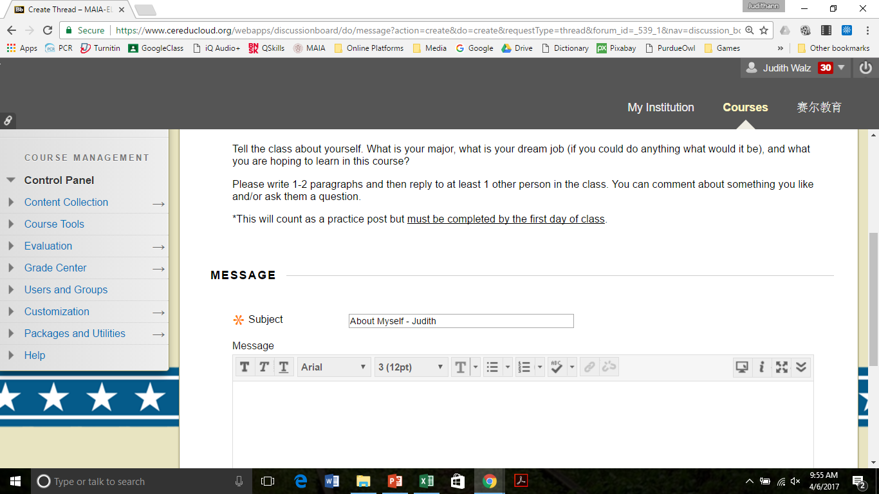
Posting a Thread Continued

Slide 17
Submitting a Post

Slide 18
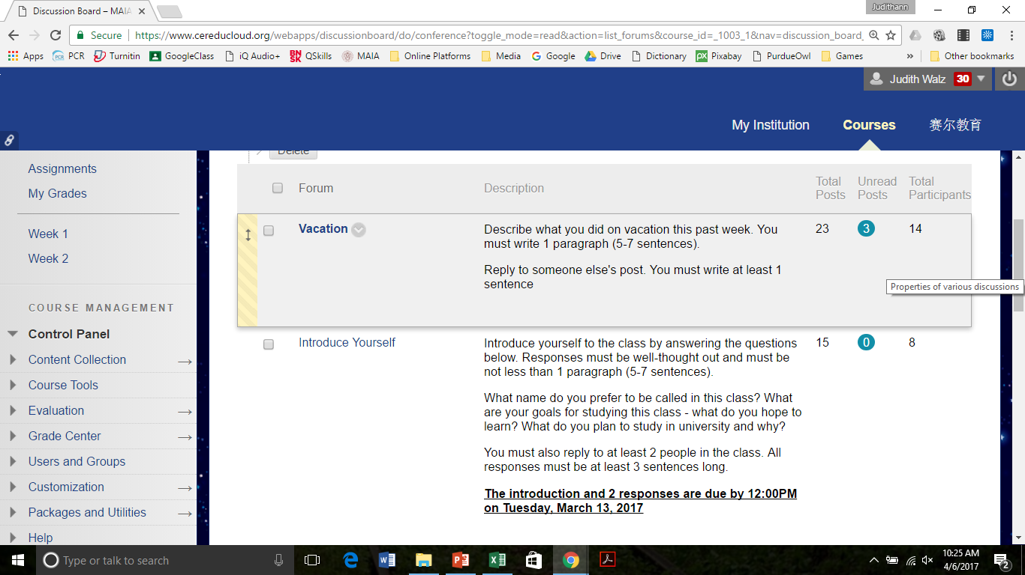
Active Discussion Board

