Slide 1
What Do You Mean?
Examining and Enhancing Classroom Talk
Josh Benjamin – June 2, 2017
Community Day Arlington Elementary School
Lawrence, MA

Slide 2
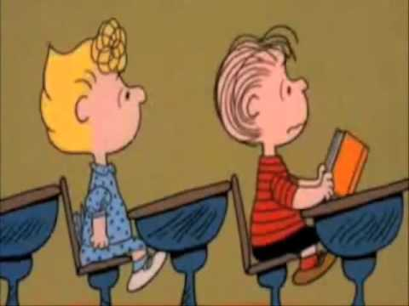
In The Average Classroom…
Teachers talk for about 44% of the school day. (Flanders 1961)
64% of verbal utterances are made by the teacher. (Smith & Higgins 2006)
What does the talk environment look and sound like in your classroom?

Slide 3
Initiation – Reply – Evaluation (Mehan 1979)
Initiation |  | Reply |  | Evaluation
Teacher asks a question (usually closed). Teacher: What direction would you go when you travel from Boston to New York? |  | Student provides short response. Student: Southwest. |  | Teacher confirms or rejects response. Teacher: Southwest. Good job.
Teacher Action | Student Action | Teacher Action | Student Action | Teacher Action | Student Action
Ask a closed question. | Listen to the teacher’s question. | Quickly choose a student and only listen for whether the answer is right or wrong; pay less attention to anything irrelevant the student says. | One student recites the answer. Other students can disengage. | Repeat student’s answer and tell if it’s right or wrong. | One student accepts evaluation. Other students stay disengaged.

Slide 4
Pre-Response – Response – Post-Response (Benjamin 2015)
Pre-response |  | Response |  | Post-response
Teacher asks a question (variety of closed, half-open, and open). Teacher: Why is it important to know about the cardinal directions? |  | Student provides confident response that reflects clear and intentional thinking. Student: It helps people tell where to go or how to get places. |  | Teacher chooses from a variety of moves to push the conversation forward. Teacher: That makes me wonder what would happen if we didn’t have cardinal directions.
Teacher Action | Student Action | Teacher Action | Student Action | Teacher Action | Student Action
Ask a variety of clear questions at the right time in the lesson. | Actively listen to the teacher’s question or prompt. | 1. Allow wait time. 2. Ensure students “track” the classmate who responds. 3. Guide turn-and-talk when appropriate. 4. Listen to everything the student says and doesn’t say. | 1. Respond with a complete sentence or multi-word answer. 2. Speak with a big voice. 3. Use exploratory talk with peers. 4. “Track” classmates when they contribute to the discussion. | Respond in a way that drives further discussion. | Listen actively and participate in the conversation as it develops.

Slide 5
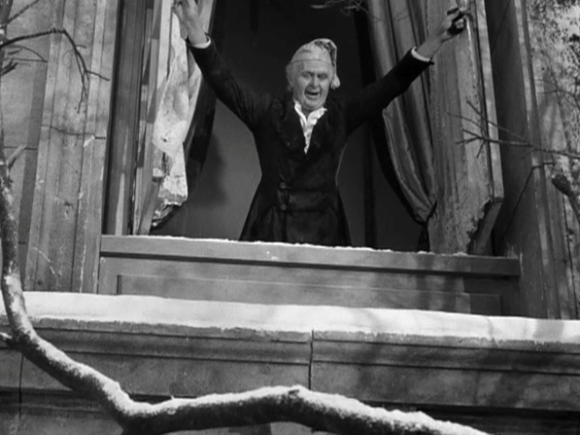
Pre-Response
Powerful (and worrying) data:
60% of teacher questions are factual (Gall 1970)
72% of questions are informational or procedural (Myhill & Dunkin 2005)
92% are not higher-order (Wragg & Brown 2001)

Slide 6
Pre-Response
Important to think about the kinds of questions we ask.
Many ways to analyze questions:
  Closed vs. Open / Closed vs. Half-open vs. Open
  Fact vs. Higher-order
  Mangerial vs. Informational vs. Higher-order
I like this one the best (Tharp and Gallimore 1988):
Assessing | Assisting
Learn about students’ schema. Why is the sun hot? Review previously learned information, concepts, and skills. What’s the sum of 29 and 4? Check for understanding. So what does it mean to infer? Build confidence. Let’s show how much we know about American leaders! What have we learned so far? | Guide thinking. Why did Munro Leaf write The Story of Ferdinand? Guide behavior. What choice will you make when you transition to centers?

Slide 7
Response
Less teacher control over this part because students are cognitively responsible for making meaning from the lesson and expressing their own thinking.
Teachers have a strong role to play in supporting the quality and content of what students say.
Students can “take the reins” here:
  Turn and Talk
  No Hands Policy
For your future viewing pleasure:
  www.youtube.com/watch?v=2ADAY9AQm54

Slide 8
Response
Wait Time (Rowe 1986)
Student responses grow 300% to 700% longer.
Student responses are more often supported by evidence and logical argument.
Students do more speculative thinking.
Students ask more questions.
Students interact with each other more and teachers talk less.
Students are less likely to fail to respond (i.e., saying “I don’t know” or being unable to answer).
Frequency of misbehavior decreases.
More students voluntarily participate in discussion.
Students have more confidence in their responses (as demonstrated by fewer answers spoken with a questioning inflection).
Achievement improves on written assessment of cognitively complex tasks.
Notes:
Josh asks question to show example of wait time.

Slide 9
Response
Blockheads (Materials: 6 blocks, paper plate)
Explain that sometimes we agree with the person we’re talking to and that sometimes we disagree.
Describe an agreement or disagreement you’ve had with someone and ask students to make connections.
Say that this activity will help us get better at using our words to agree or disagree.
Divide students into pairs and name Student A and Student B.
Give each student 3 wooden blocks and a paper plate to share as a building area.
Tell Student A to put down one block on the plate.
Explain that Student B now has two choices:
  Say “I agree with you and I’ll put my block here” as he places his own block on the plate.
  Say “I disagree with you because I think it looks better here” as he moves his partner’s block to a different location on the plate.
Explain that Student A has to accept whatever Student B does, at which point Student A can either choose to place a new block or move Student B’s block. Explain that an existing block can be moved only one time.
Students continue taking turns placing blocks and using set phrases until all 6 blocks have been placed.
Have students share with the class what happened when they agreed with their partners and when they disagreed with them.

Slide 10
Post-Response
What do you typically do after a student responds to a question?

Slide 11
Post-Response
AKA “uptake,” “follow-up,” “contingent response,” “high-level evaluation,” “contingent questioning, “the third move”
“The distinguishing characteristic of teacher questions that elicited extended student talk was found to be their contingency on previous student utterances rather than whether they were open-ended or inquired about known information.” (Boyd & Rubin 2006)
“That’s right.” vs. “What other ideas are there?”

Slide 12
Post-Response (9 Teacher Moves)
Clarify
Guide a student to help the rest of the class understand her idea.
“What do you mean?”
“Oh, so you’re saying that…?””
“Do you mean that…?”
“I don’t really understand. “Could you try saying that again?”

Slide 13
Post-Response (9 Teacher Moves)
Dig
Guide a student to produce a more elaborate response.
“Do you want to say more?”
“Tell us more.”
“Keep going.”

Slide 14
Post-Response (9 Teacher Moves)
Challenge
Guide a student to think at a higher level or in a more flexible way.
“What in the story/graph/illustration makes you think that?”
“Why do you think that?”
“Why is that important?”
“But what about _____?” (Student: Insects all have wings. Teacher: But what about ants?)
Intentionally misunderstand. (Student: 0.5 is the same as ½. Teacher: Wait, they look really different. How could that be?)

Slide 15
Post-Response (9 Teacher Moves)
Get Meta
Guide a student to articulate a cognitive process.
“How did you figure that out?”
“How did you solve that problem?”
“Josue, how did Elaine know that was the answer?”

Slide 16
Post-Response (9 Teacher Moves)
Name
Describe a student’s response in academic terms (strategies, skills, concepts, and vocabulary) that the class has learned.
“You just made a text-to-text connection when you answered that question.”
“You used evidence from the photograph to tell about the water cycle.”
“Wow, you synthesized two parts of the text to describe Wilbur’s character traits.”
“When you said the sun is a sphere, you’re thinking just like an astronomer because they also use shapes to talk about what they see.”

Slide 17
Post-Response (9 Teacher Moves)
Transfer
Invite more students into the discussion.
“Who agrees with Brayden? Brayden, please call on someone who agrees.”
“Raise your hand if you disagree with Emely. Emely, please call on someone who disagrees.”
“Thanks for sharing your important idea; let’s see what Allan thinks.”
“Mmm hmm...Gerizbeth, how about you?”
“OK...Andrea, what are you thinking?”

Slide 18
Post-Response (9 Teacher Moves)
Scaffold
Support a student to provide his best possible response.
“Remember, you can use the strategy on the chart paper to help yourself.”
“Think about the sound for th that we learned yesterday.”
Give a helpful hint.
Remind students of a step they may have missed.

Slide 19
Post-Response (9 Teacher Moves)
Model
Raise the language level by providing an alternative answer with higher level vocabulary or syntax.
“When you told us that pencils and pens are stuff you write with, we could also say they’re in the same category of things you write with. Can you try answering again with the word category?”

Slide 20
Post-Response (9 Teacher Moves)
Evaluate (to be used less often than the others)
Acknowledge whether a response is right or wrong.
“That makes sense.”
“I see what you’re saying.”
“I agree.”
“I disagree.”
“You worked really hard to answer that question.”
“You must be proud of figuring that out.”
Notes:
After slide 20, show Video 4. Ask participants which moves they notice. Ask if there were any opportunities for additional moves.

Slide 21

Post-Response

Slide 22
Thank you!
Questions?
Comments?
Contact me at:
joshua.benjamin@lawrence.k12.ma.us

Slide 23
References
Boyd, M. & Rubin, D. (2006). How contingent questioning promotes extended student talk: A function of display questions. Journal of Literacy Research, 38(2), 141-169.
Flanders, N.A. (1961). Analyzing teacher behavior. Educational Leadership, 19(3), 173-200.
Gall, M. (1970). The use of questions in teaching. Review of Educational Research, 40(5), 707-721.
Mehan, H. (1979). “What time is it, Denise?”: Asking known information questions in classroom discourse. Theory Into Practice, 28(4), 285-294.
Myhill, D. & Dunkin, F. (2005). Questioning learning. Language and Education, 19(5), 415-427.
Rowe, M.B. (1986). Wait time: Slowing down may be a way of speeding up! Journal of Teacher Education, 37(1), 43-50.
Smith, H. & Higgins, S. (2006). Opening classroom interaction: The importance of feedback. Cambridge Journal of Education, 36(4), 485-502.
Tharp, R.G. & Gallimore, R. (1988). Rousing minds to life: Teaching, learning, and schooling in social context. Cambridge, UK: Cambridge University Press.
Wragg, E.C. & Brown, G. (2001). Questioning in the primary school. London: Routledge.

