Slide 1
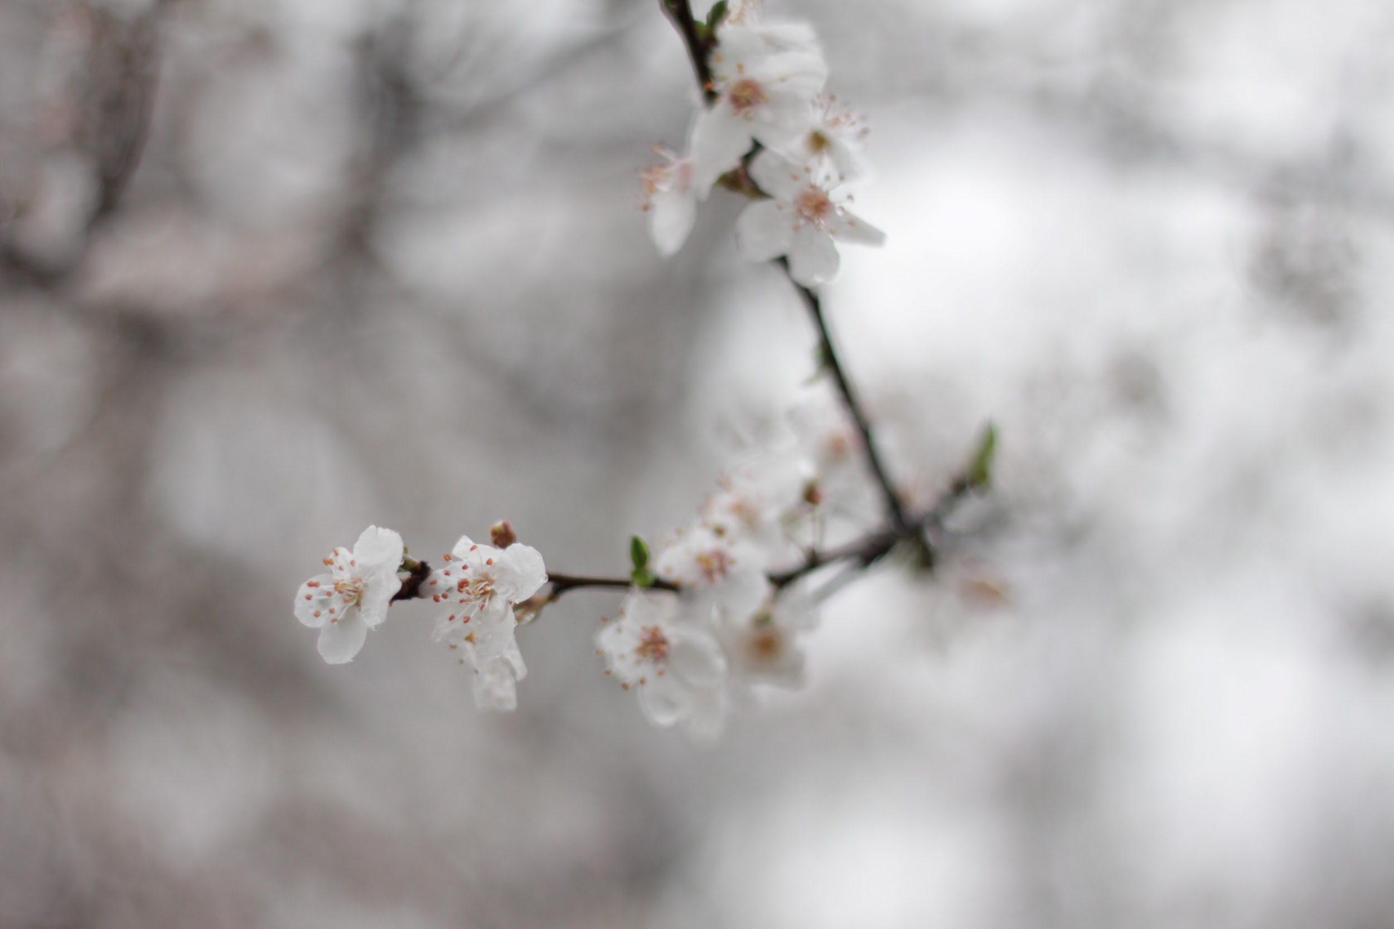
International Voices:
Creating a Literary Journal for Second Language Writers
Denise Desrosiers
Carolyn Hutton
Andrea Paquin
Kristin Raymond
University of New Hampshire
MATSOL 2017

Slide 2
Inspiration & Early Goals
Spring 2013
Many other literary journals on our campus and other campuses, mostly written by native speakers
ESL population growing exponentially: isolation, voicelessness
Writers on the boundaries need to be “written into the community”
Provide a place to celebrate/honor second-language writing
Help bring attention to second language writers on campus
Challenge biases against second language writers
Encourage students to take pride in their writing through publication in our book
Create a student-run organization allowing the editors to take on leadership roles
Asset Based Community Development
Choose integration leaders who are trusted by the community
Provide community members with as much ownership as possible
The students must assume “responsibility and power” so that they are “mobilized by relationships, not agency roles and requirements.”¹
¹Green, Mike and Henry Moore and John O'Brien. 2006. When People Care Enough to Act. Toronto, ON: Inclusion Press.

Slide 3
Identity Shifts
Norton (2013) Identity and Language Learning
Language learners are often discriminated against and seen as lesser than because of their language difficulties
Language learners often internalize this discrimination and their sense of identity shifts to accept this inferior status
Norton theorizes that language learners need to call on “identities of power” to challenge this discrimination and assert their right to equality in the target community

Slide 4
Editor's Note (Yung-Chun Lin)
"At the University of New Hampshire, the local students have limited resources and opportunities to understand the merely 8% the international students with variety in languages, religions, heritage, and art. Here at the International Voices, we devote a large amount of time to the promotion of the international cultures through arts in the forms of writing, poems, novels, and photographs."
"My passion is to foster the global awareness, which will be so beneficial to American students but also international students, on campus.Through the publishing of the book...writings lead us to explore the unexplored side of country via the experience of others."
"Most important thing, we publish a book, named “ International Voices”, distributed around campus for the students as a resource of learning.”

Slide 5
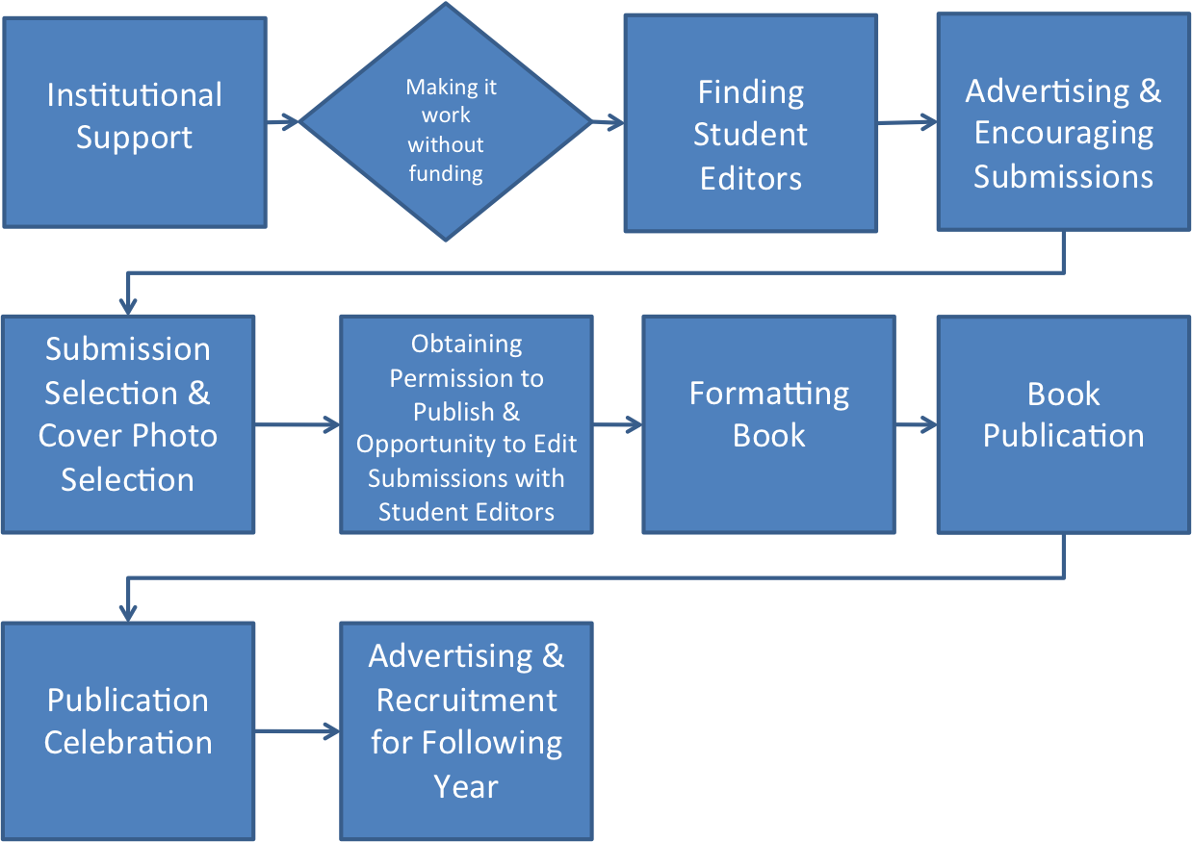
Our Process

Slide 6
Our Process

Slide 7
Institutional Support
$750/year from ESL Institute Budget
$650- Publication ‘
  60-80 copies (depending on the number of pages printed)
    25-30 copies for published students
    20-25 copies for teachers in the ESL Institute
    1-2 copies provided to campus library
    Remaining copies provided to various campus offices including OISS, English Dept., Education Dept., etc.
$100 - Celebration Party

Slide 8
Our Process

Slide 9
Making It Work Without Funding
Fundraisers
  Write-A-Thon
  Writing Competitions
Online Publication
  School website
    http://www.deltonahowl.com/about-us.html
    http://www.centurypulse.com/lit-mag-info/
  Blog
    http://blog.pshares.org/

Slide 10
Our Process

Slide 11
Finding Student Editors
Teacher recommendation based on performance in class
Announcements in ESL classes

Slide 12
Our Process

Slide 13


Advertising & Encouraging Submissions
University Day
Posters
Class Visits
  Student editors visit at teachers’ requests
  Informational PPT Presentation
Teacher Recommendations
Facebook page
Campus TV

Slide 14
Our Process

Slide 15
Submission & Cover Photo Selection
Faculty advisors collect all submissions & remove student names
  Currently: Email
  Future: Website
Editors have 2 weeks to read through and select the ones they like most
Roundtable discussion & vote for each entry
  Encourages discussion of writing, what makes writing “good” or interesting?
  Editors defend choices, but often find themselves looking at some submissions in a new way
  Valuing accented writing
  Focus on Content

Slide 16
Cloud
By: Yuqing Mao
I am in love with cloud
Moving the shadows as girls’ gloomy mood
Like a riddle which cannot be solved,
Like a girl who fall in love with a boy,
Unreal dim, but perfect
Nobody know what exactly inside
And this is why it is attractive
Unknown, but nicety

Slide 17
A Little Kindness Can Warm Others
By: Jing Zhou (Cynthia)
“My four years old cousin became the family star at this day...I felt she was so annoying to move between me and the TV. So I became angry with an unhappy face and left to my room to play games. At that night, I was waked up by a little fat hand, her face enlarged in front of me in the dark, looked at me with her bright wide-eyed. It’s her.”

Slide 18
Student Feedback to Essay Submissions
1. Turing point :
3 YES-touching story, vivid image description with details, dialogues bring the readers into the scenario of the moment.
2. Studying Aboard:
1 Yes- The structure of the essay is clear. The writer showed the challenge of being an international student and presented the daily interaction with people around him/her.
2 No- Irrelative content, No connection between paragraphs resulting in a listing of facts instead of a piece of essay.

Slide 19
Student Feedback, Continued
3.Different Kinds of TV Program:
3 No- The essay included decent examples. However, it is too general. It is hard to trigger reader’s interests. It would be better if there are more details to support the points.
4. The Top of The Jungfrau Mountain:
3 Yes- Well-developed description of the scenery from large to small, then to himself. The silence atmosphere was built from the words while people are reading it.

Slide 20
Our Process

Slide 21
Obtaining Permission to Publish & Opportunity to Edit Selected Work
Notify students whose work was not selected; provide feedback
Contact selected students and arrange a time to sign permission slip
  Unnecessary when collected online in future
Student Editors meet with selected students in a reserved space
Selected students have opportunity to sit with editors to talk about their writing
  What did they like?
  What was confusing?
  Error vs. Difference

Slide 22
Our Process

Slide 23
Formatting Book
Student names are added to selected works.
Book is organized into categories usually including narrative essays, poetry, compare/contrast essays, argumentative essays, photography, etc.
Table of contents is added.
Advisor and Editor’s notes are added.

Slide 24
Our Process

Slide 25
Book Publication
Contact publisher at UNH Printing Services (we used lulu.com our first year) and provide publisher with cover photo.
Wait for publisher to provide cover proof and check. Student editors may also want to check the proof.
After cover proof is approved, submit fully formatted text to publisher.
Wait for publisher to provide book proof and check. Student editors may also want to check the proof.
After proof is approved, wait for the full set of copies to be delivered. Copies are first dispersed at our publication party to published students.

Slide 26
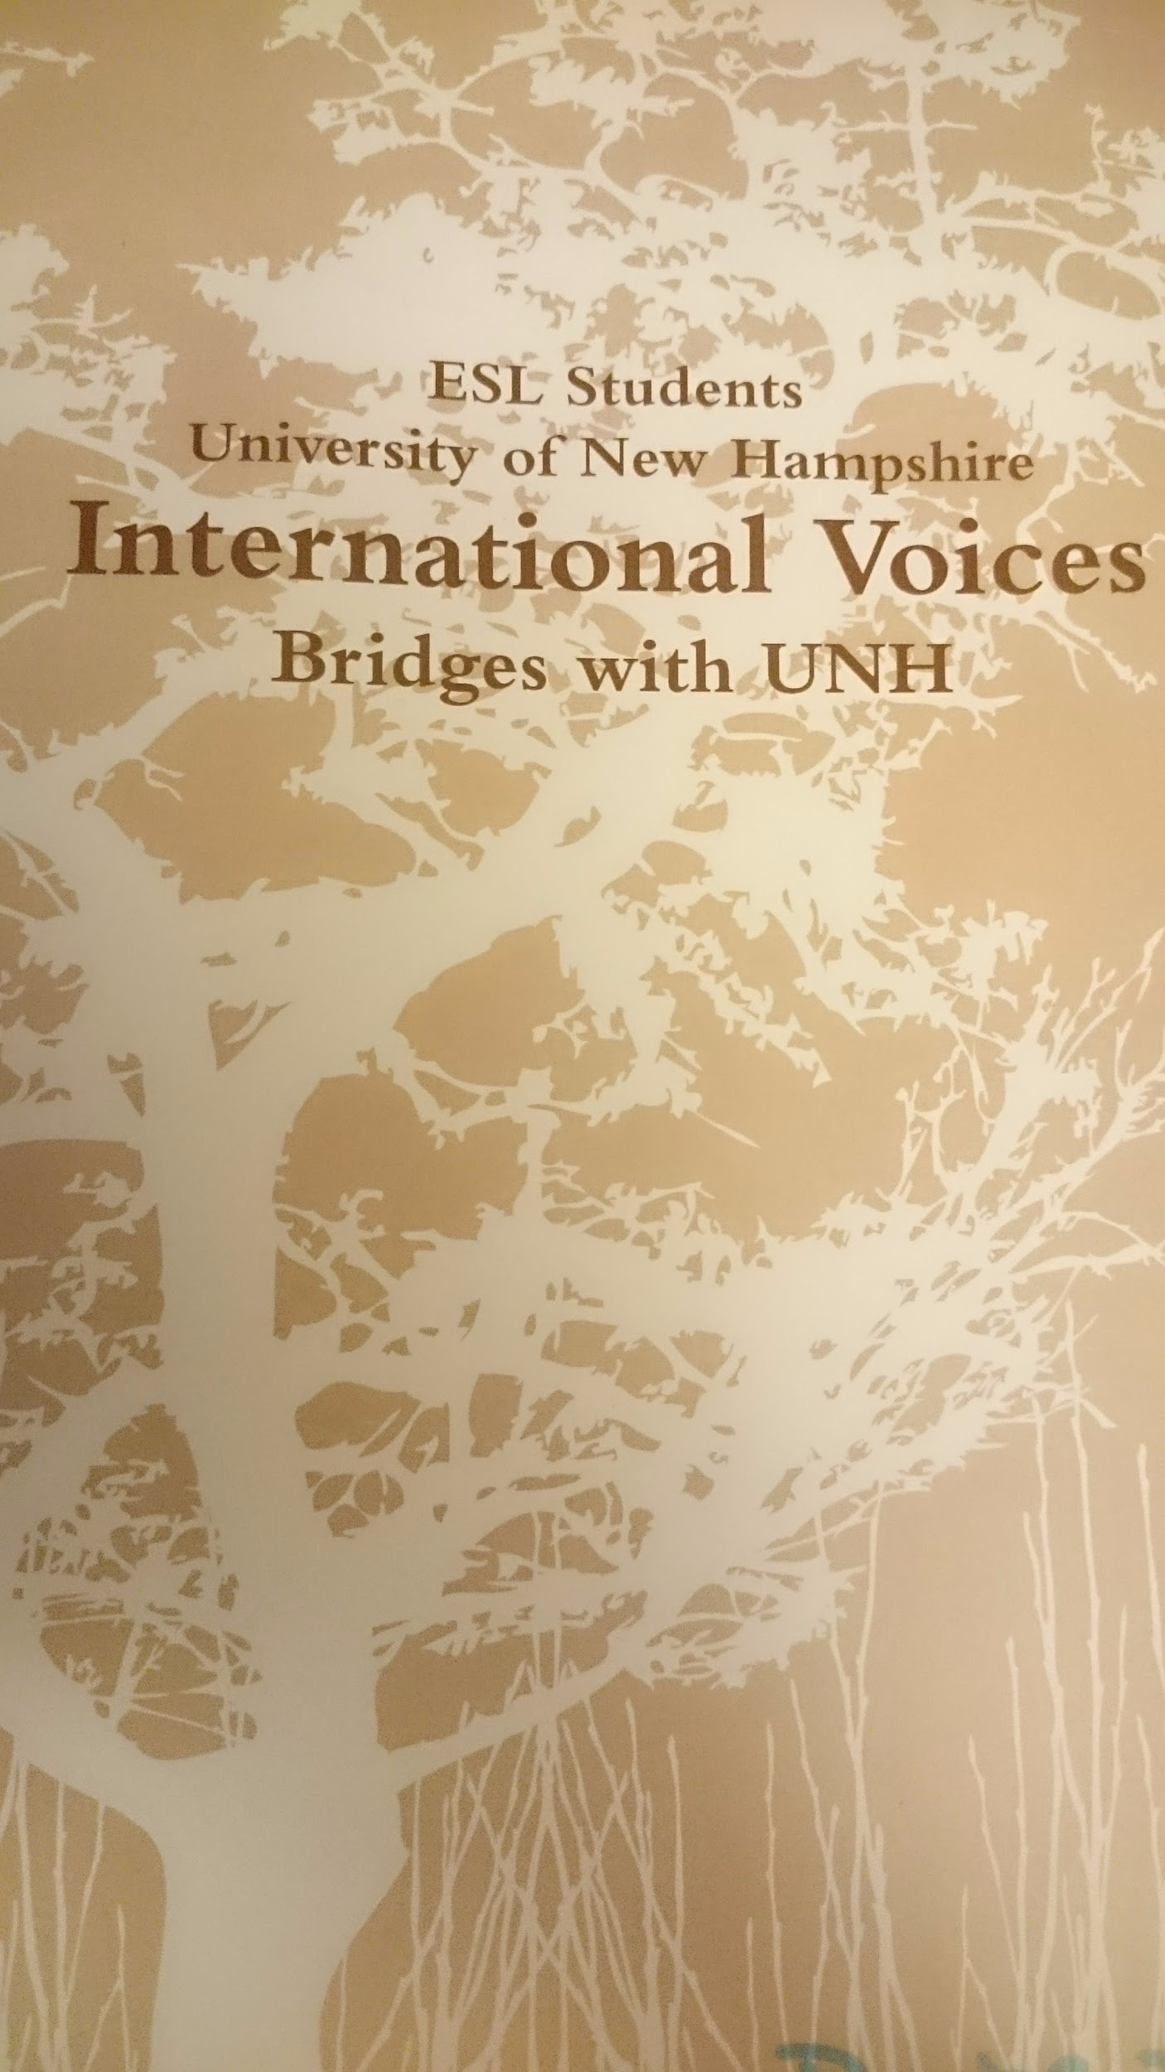
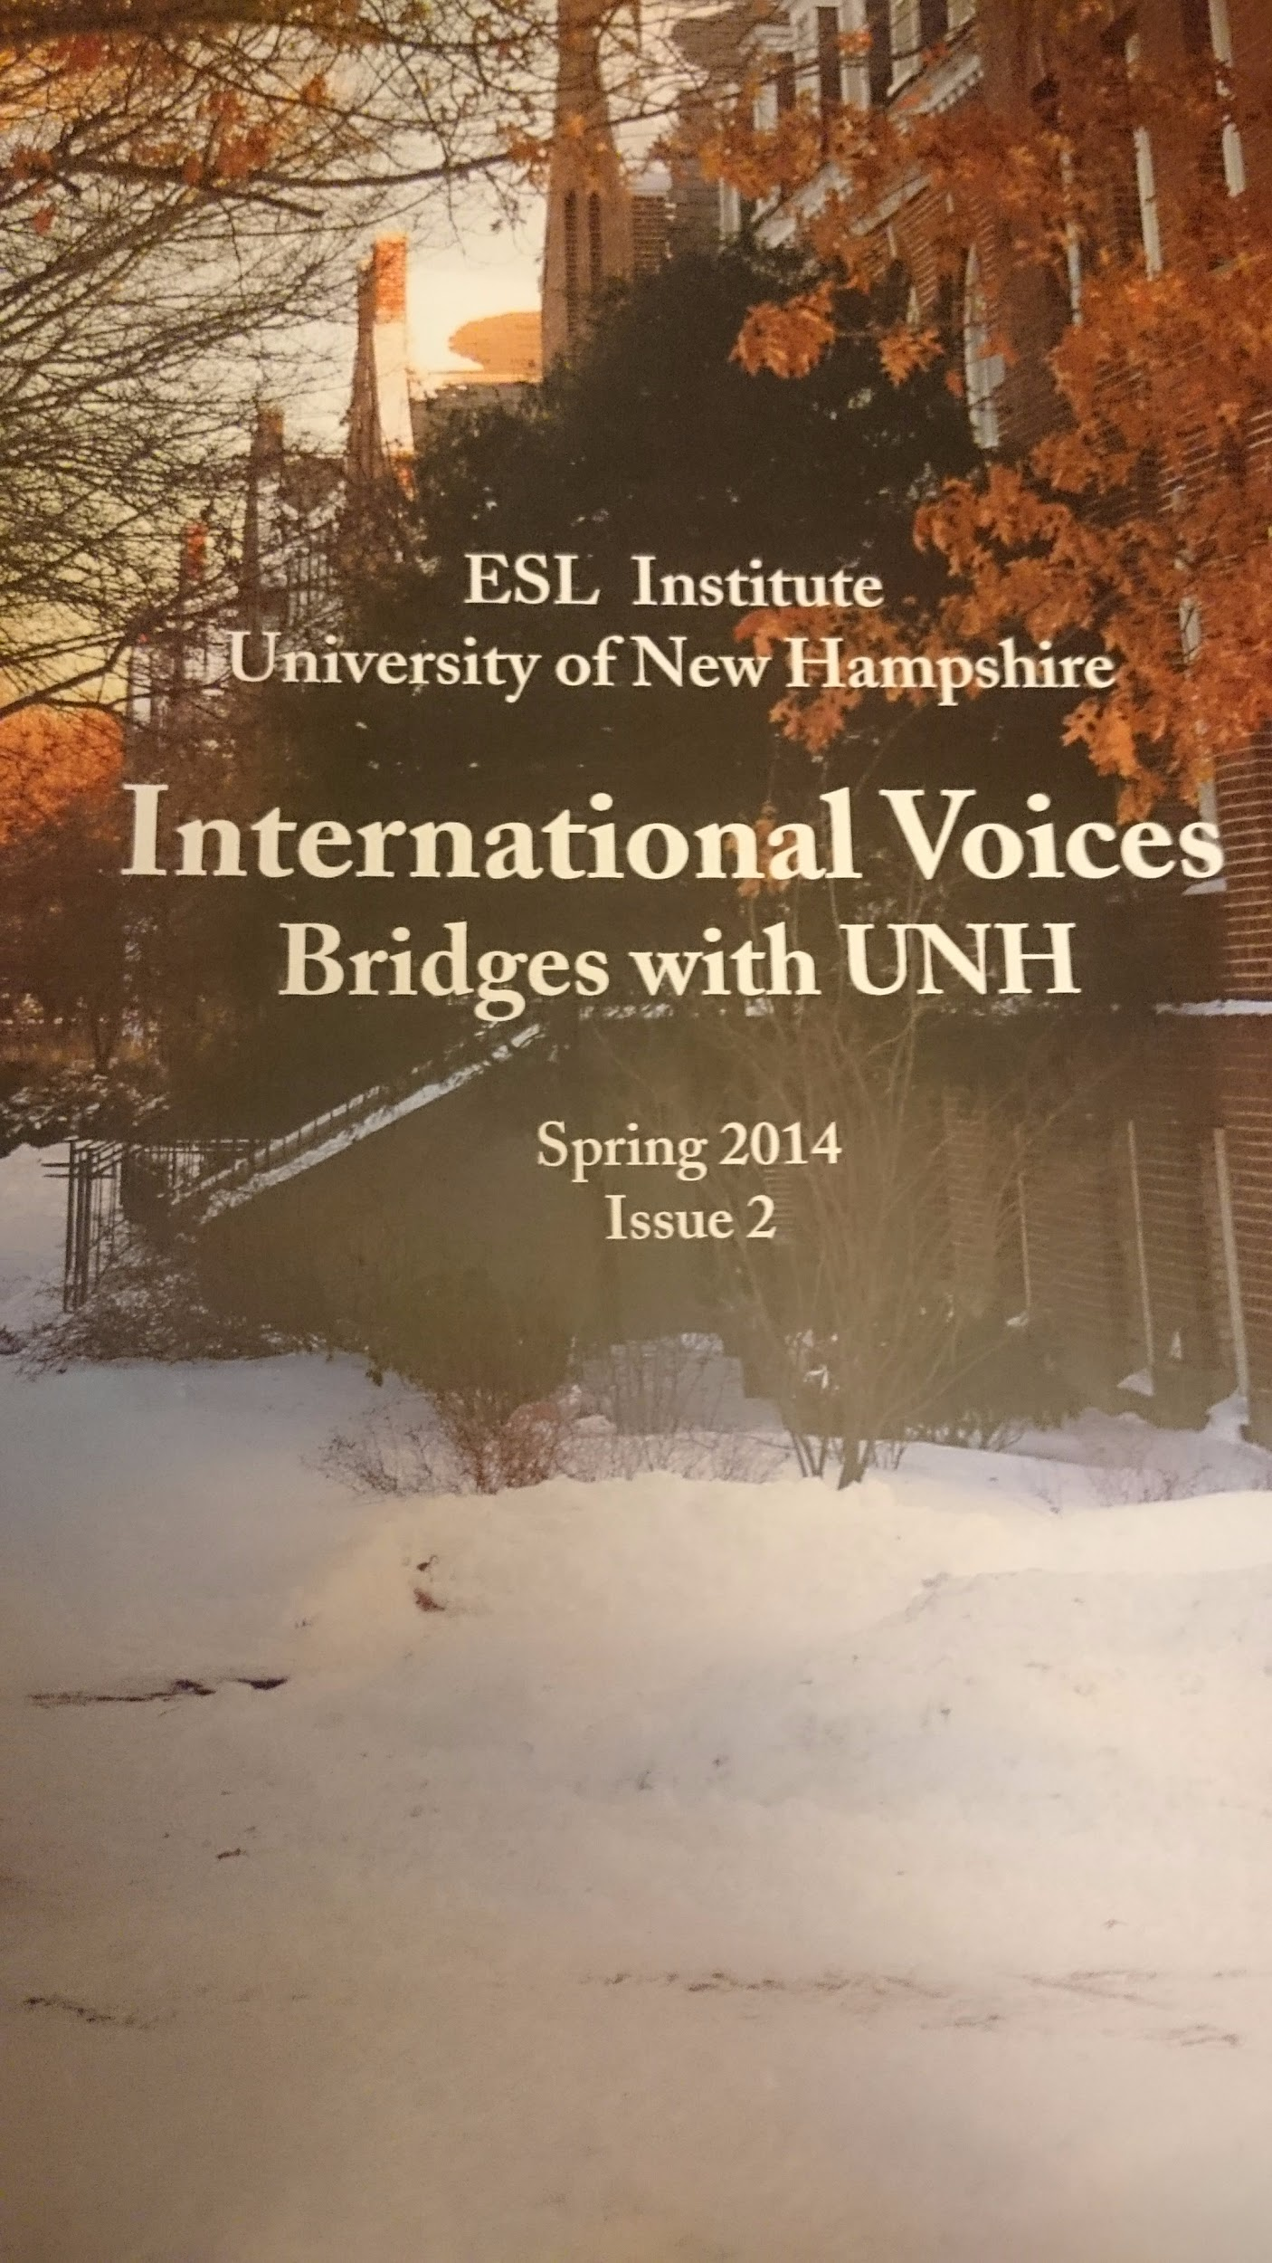
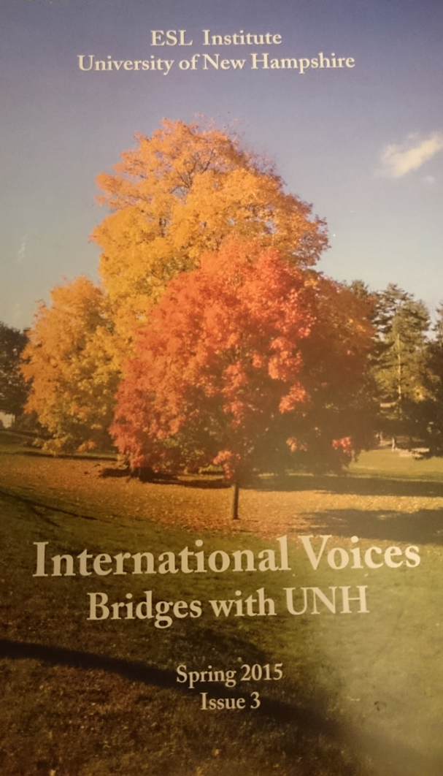
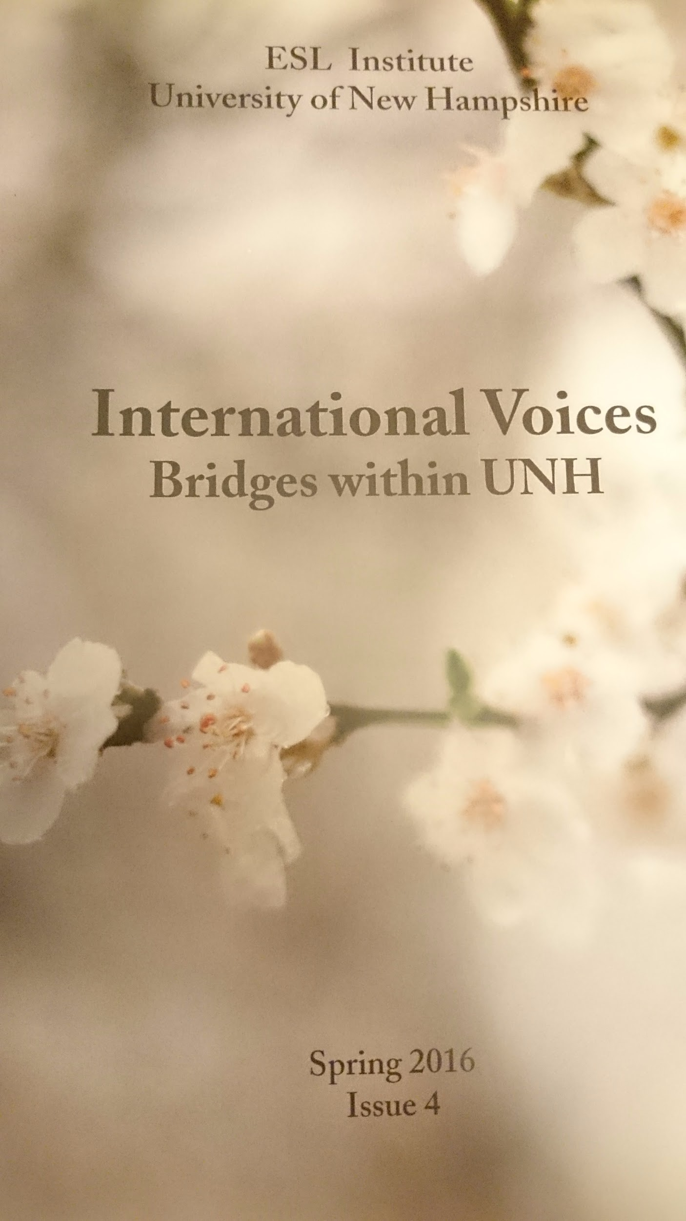
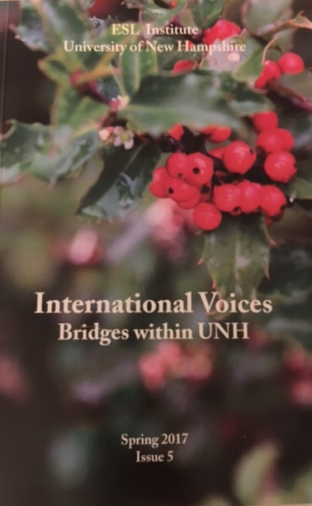
International Voices Book Covers

Slide 27
Our Process

Slide 28
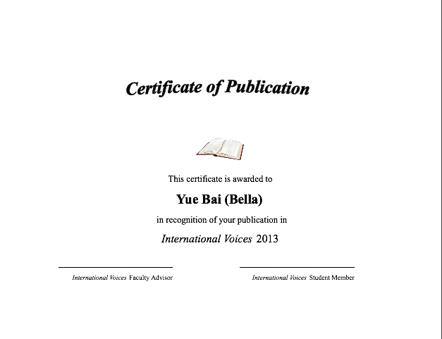
Publication Celebration
(students planned everything) Publication Party Planning strategy (ideally student-led): 4 basic components:
1. The space (scheduling, securing equipment, decorating, cleaning up afterward)
2. The publicity (advertising through email, student newspaper, Facebook, flyers, etc.)
3. The materials (journals, certificates, brochures, writing tools, refreshments)
  Certificates
  Slideshow
  Readings & talking about the writing

Slide 29
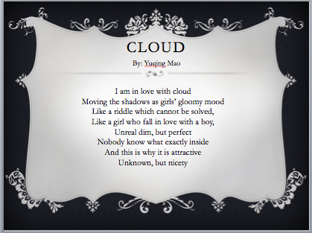
4. The Program
-Introducing journal
-Honoring writers and writing
-Recognizing staff
-Recruiting new staff, encouraging writing

Slide 30
Our Process
Notes:
Andrea

Slide 31
Teacher Reflections: Carry Over into the Classroom
Model essays​
Narrative​
Compare/Contrast​
Cause/Effect​
Problem/Solution​
Argumentative​
Research-based​
Poetry
Fiction
Photography
​
Inspiring New Lessons (Assignment Descriptions)
Jon Imber’s Paintbrush
  Looking at narrative in a new, interesting way
  Exploring perspective
Iraq War / Syrian Civil War Photographs
  Integrated Skills
  Research-based
  Making connections: analyzing fiction and applying it to real life

Slide 32
Teacher Reflections:
Observation of student editors evaluating work for the journal through discussion, reading aloud, interpreting, negotiating
A new way of seeing peer editing in the classroom. Students create “works” of writing meant to be read by an audience. Classmates see themselves as editors honoring each others’ writing and helping each other to produce meaningful and readable writing FOR A PURPOSE.
Notes:
Carolyn

Slide 33
Carry Over into the University
More attention to and respect for ESL writing in the university.
The publication was featured in the UNH newspaper.
After the first publication, the editors of a campus publication Transitions began to question why more ESL writing was not included in their publication. Their next edition included an ESL writer.
Having international student writing models in the Transitions text makes international students in first year composition class feel more equal and valued as writers and members of the university community.

Slide 34
Student Reflections: Sriyaa
“As an editor it was like living someone’s life for the short period of time and understand what it felt like to be in their shoes.
The other thing I had the honor to witness was how different people wrote about their experiences, social norms and the way they handled a situation.
I have indeed enjoyed ticking this dream off my bucket list and have managed to improve my English skills in the process.
I must say college magazines are precious, not only do they offer a platform to showcase writing skills and bubbling creativity but they also raise awareness about cultural differences.”

Slide 35
Student Reflections
"Some students think, even me that our writing is not good as American students' writing. They want to be like them. But now I know even our writing styles are different from American writing styles, we can write good stories."
"We have more ways to think about, to structure our writing."

Slide 36
Identity Shifts
Meet Mark:
Repeating beginner class for second time
Poor grades
Poor attendance
Low self-confidence
Poem selected for publication
At celebration, student editor praises poem as “his favorite in the book”
Student praised by teacher and classmates
Has book with publication to take home to show family
Meet Casey:
Struggling student
Internalizing identity of weak writer/weak student
Work was chosen for publication
Later joined the group as an editor
Confidence increased greatly as she took on the identity of writer and editor

Slide 37
Questions and Comments

Slide 38
Contact Us!
Kristin.raymond@unh.edu
Denise.desrosiers@unh.edu
Andrea.paquin@unh.edu
CHillHutton@gmail.com

