Slide 1
Critical Reading for EFL Learners: Strategies for Engagement and Analysis
MATSOL 2017 CONFERENCE
June 2, 2017
Christina Michaud
Boston University
cmichaud@bu.edu
Notes:
This seminar addresses ways to teach L2 learners to be active, critical readers of literary texts. We will demonstrate how to teach better reading and vocabulary acquisition strategies, facilitate effective discussions of readings, and guide learners toward more in-depth analysis of the text.
The move from summary to analysis is a notoriously difficult move for learners, especially given the academic language the task of analysis demands of them in their L2. Drawing on current and classic research on schema theory, reader response theory, and identity politics and its relation to the classroom, as well as fifteen years of experience teaching in the field, the presenter will walk participants through an understanding of four interrelated components that can maximize learners’ critical readings skills: reading strategies, vocabulary acquisition strategies, discussion strategies, and analysis strategies. Participants will use the tools presented here to discuss and analyze common classroom challenges: the student who puts in effort, but always manages to misinterpret a text; the student who persistently remains (stubbornly? perhaps not) at a superficial level of understanding; and the student who actively resists critical reading and deeper analysis. Examples of handouts and student-produced texts will be shared at every step, and specific learner outcomes will be addressed and integrated into the discussion. Participants will leave with checklists to use when planning reading lessons and assessing learner output in essays and classroom discussions.

Slide 2
Introduction
“Active” or “Critical” Reading
Notes:
What are they? Why do they matter?

Slide 3
Four Interconnected Areas of Focus
Reading Strategies
Vocabulary Strategies
Analysis Strategies
Discussion Strategies
Notes:
PASS AROUND HANDOUT NOW

Slide 4
Part 1: Reading Strategies
Goals: reading comprehension
critical response

Slide 5
Reading Comprehension?
Example 1:
"With hocked gems financing him, our hero bravely defied all scornful laughter that tried to prevent his scheme. Your eyes deceive you, he had said, an egg not a table correctly typifies this unexplored planet. Now three sturdy sisters sought proof forging along - sometimes through calm vastness - yet more often over turbulent peaks and valleys. Days became weeks as many doubters spread fearful rumors about the edge. At last, from nowhere, welcome winged creatures appeared, signifying momentous success.”
From Dooling, D.J. & Lachman, R. (1971). Effects of comprehension on retention of prose. Journal of Experimental Psychology, 88, 216-22.

Slide 6
Reading Comprehension?
Example 2:
"A newspaper is better than a magazine. A seashore is a better place than the street. At first it is better to run than to walk. You may have to try several times. It takes some skill, but it's easy to learn. Even young children can enjoy it. Once successful, complications are minimal. Birds seldom get too close. Rain, however, soaks in very fast. Too many people doing the same thing can also cause problems. One needs lots of room. If there are no complications, it can be very peaceful. A rock will serve as an anchor. If things break loose, however, you will not get a second chance.”
From Bransford, J. D. & Johnson, M. K. (1972). Contextual prerequisites for understanding: Some investigations of comprehension and recall. Journal of Verbal Learning and Verbal Behavior, 11, 717-726.

Slide 7
How to Make and Fly a Kite
“A newspaper is better than a magazine. A seashore is a better place than the street. At first it is better to run than to walk. You may have to try several times. It takes some skill, but it's easy to learn. Even young children can enjoy it. Once successful, complications are minimal. Birds seldom get too close. Rain, however, soaks in very fast. Too many people doing the same thing can also cause problems. One needs lots of room. If there are no complications, it can be very peaceful. A rock will serve as an anchor. If things break loose, however, you will not get a second chance.”
From Bransford, J. D. & Johnson, M. K. (1972). Contextual prerequisites for understanding: Some investigations of comprehension and recall. Journal of Verbal Learning and Verbal Behavior, 11, 717-726.

Slide 8
Columbus and the New World
"With hocked gems financing him, our hero bravely defied all scornful laughter that tried to prevent his scheme. Your eyes deceive you, he had said, an egg not a table correctly typifies this unexplored planet. Now three sturdy sisters sought proof forging along - sometimes through calm vastness - yet more often over turbulent peaks and valleys. Days became weeks as many doubters spread fearful rumors about the edge. At last, from nowhere, welcome winged creatures appeared, signifying momentous success.”
From Dooling, D.J. & Lachman, R. (1971). Effects of comprehension on retention of prose. Journal of Experimental Psychology, 88, 216-22.

Slide 9
Interactive-Schematic Model of Reading Comprehension
“Using literature to teach culture may be the most direct way to teach culture, but it certainly implies thorough background preparation and may, in fact, not be the best way to teach language.” (565)
[We must attend to the] “reading difficulties caused by the mismatch of the background knowledge presupposed by the text and the background knowledge possessed by the reader. A schema-theoretic view of reading suggests the pervasive effects of such a mismatch and requires our being sensitive to these reading difficulties on a more global level.” (565-566)
Carrell, P.L. & Eisterhold, J.C. (1983). Schema theory and ESL reading pedagogy. TESOL Quarterly 17, 553-569.

Slide 10
Example Text 1: Jamaica Kincaid’s “Girl”
“Wash the white clothes on Monday and put them on the stone heap; wash the color clothes on Tuesday and put them on the clothesline to dry; don't walk barehead in the hot sun; cook pumpkin fritters in very hot sweet oil; soak your little cloths right after you take them off….
“….but what if the baker won't let me feel the bread?; you mean to say that after all you are really going to be the kind of woman who the baker won't let near the bread?”
Kincaid, Jamaica. “Girl.” The New Yorker 26 Jun. 1978: 29. Print.
Notes:
What do you know about Jamaica Kincaid?
What feels foreign to you about this text?
What feels familiar to you?
What would be helpful to know, or to be thinking about, before reading this?
How DID you read this? Did you start at the beginning and plow right on through? did you look up every single word you didn’t know, immediately?

Slide 11
Reading Strategies for Comprehension and Engagement
Pre-reading strategies
Activate/increase background knowledge
Predict
Scan
Active reading strategies
Annotate
Approach new vocabulary strategically
Post-reading strategies
Reflect
Check yourself
Engage

Slide 12
Part 2: Vocabulary Strategies
Goals: uninterrupted reading comprehension
active vocabulary acquisition for target words

Slide 13
Vocabulary Triage
Words to “learn” from a glossary
Words to “learn” from context
Words to “learn” from active use

Slide 14
CHECKLIST: Six Things to Learn When You Learn a New Word
meaning (not just translation)
etymology (derivation and/or related words)
part of speech (noun, verb, adjective, etc.)
usage (regular/irregular, transitive/intransitive/phrasal verb, count/non-count noun, collocations)
number of syllables (x) and stressed syllable (y)  write the stress pattern next to/on top of the word to remember how to say it: x-y
pronunciation (consonants and vowels as well as syllables and stress)

Slide 15
Example Text 2: Excerpts from Chimamanda Ngozi Adichie
“If we do something over and over again, it becomes normal.... If only boys are made class monitor, then at some point we will all think, even if unconsciously, that the class monitor has to be a boy. If we keep seeing only men as heads of corporations, it starts to seem “natural” that only men should be heads of corporations....
“And I would like today to ask that we should begin to dream about and plan for a different world.... And this is how to start: we must raise our daughters differently. We must also raise our sons differently. We do a great disservice to boys in how we raise them. We stifle the humanity of boys. We define masculinity in a very narrow way....
“We teach boys to be afraid of fear, of weakness, of vulnerability....
“But if we start raising children differently, then in fifty years, in a hundred years, boys will no longer have the pressure of proving their masculinity.....”
Adichie, Chimamanda Ngozi. We Should All Be Feminists. New York: Anchor, 2014. Print.

Slide 16
Syllables-Stress Marking System
normal
monitor
unconsciously
corporations
natural
different
differently
disservice
stifle
humanity
masculinity
vulnerability
2-1
3-1
4-2
4-3
2-1
2-1
3-1
3-2
2-1
4-2
5-3
6-4 → Stress the syllable before the -ity
Murphy, J. M. (2004). Attending to word-stress while learning new vocabulary. English for Specific Purposes Journal, 23(1), 67-83.
Notes:
parts of speech—adjective, nouns, attention to derivational morphology

Slide 17
Corpus Analysis for Active Vocabulary Acquisition (student sample sentences)
The masculinity is very difficult for boys when they are growing up.
Many humanities know that girls and boys should be equal.
The Boston Marathon bomber committed a disservice to many people that day.

Slide 18
1. The masculinity is very difficult for boys when they are growing up.
noun
(usually) uncountable → no plural
(usually) abstract → no definite article

Slide 19
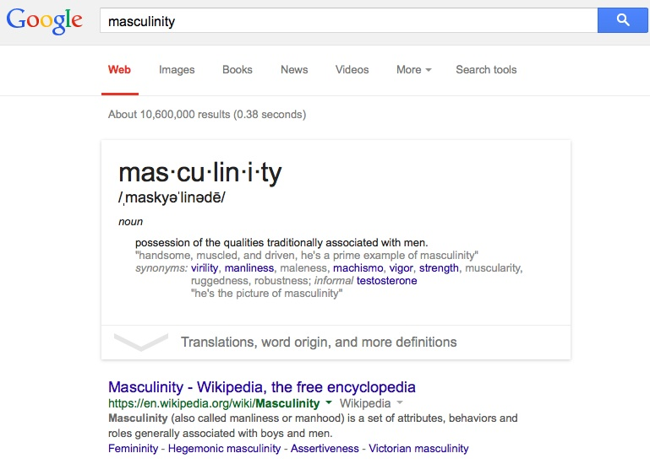
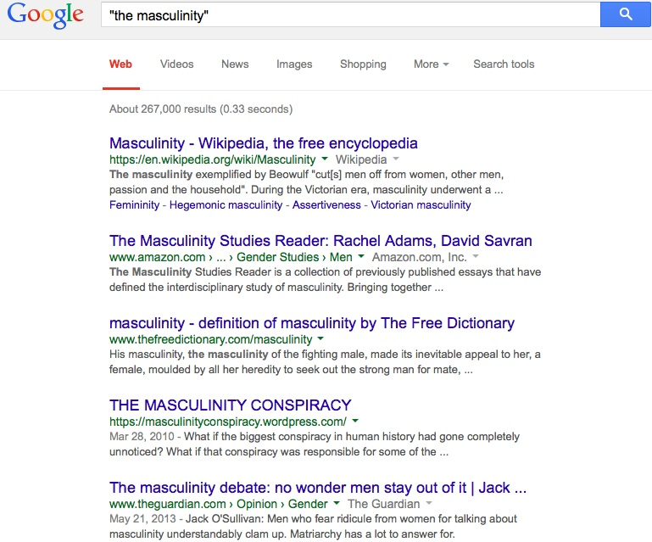

Slide 20
2. Many humanities know that girls and boys should be equal.
noun
(in this meaning) uncountable → no plural
(usually) abstract → no definite article

Slide 21
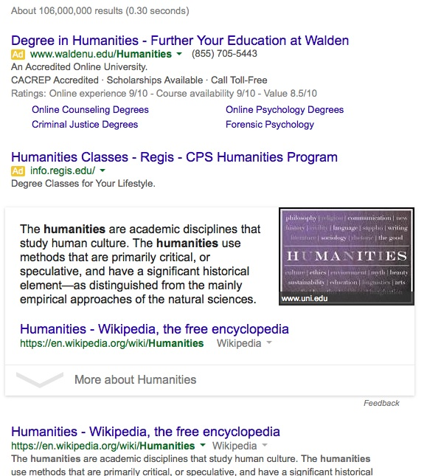
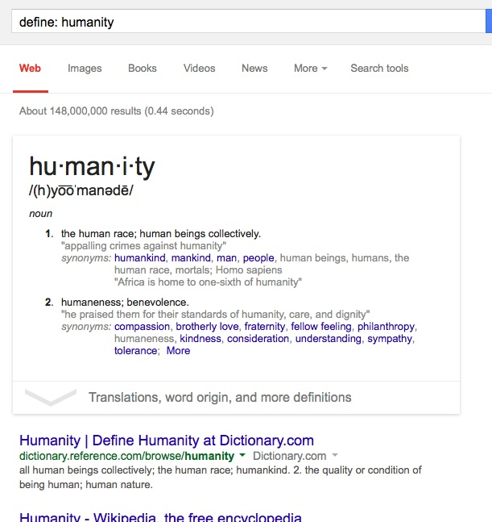
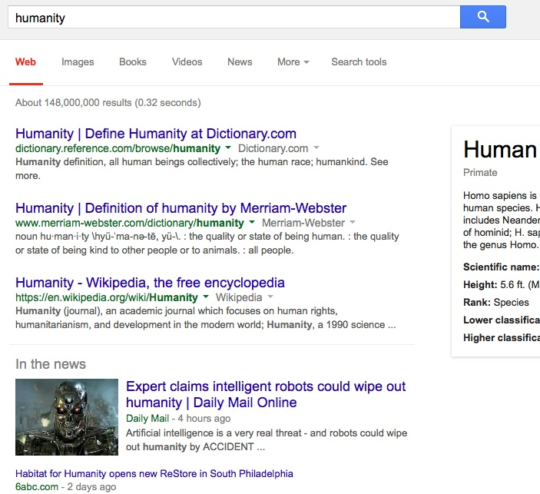

Slide 22
3. The Boston Marathon bomber committed a disservice to many people that day.
noun
countable → indefinite article okay
collocation/usage → do a disservice to s.o.
connotation/level of intensity

Slide 23
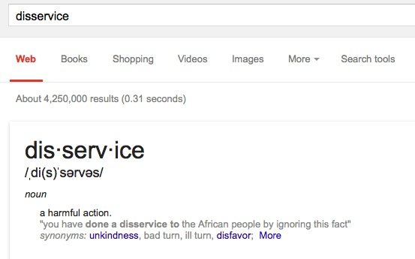
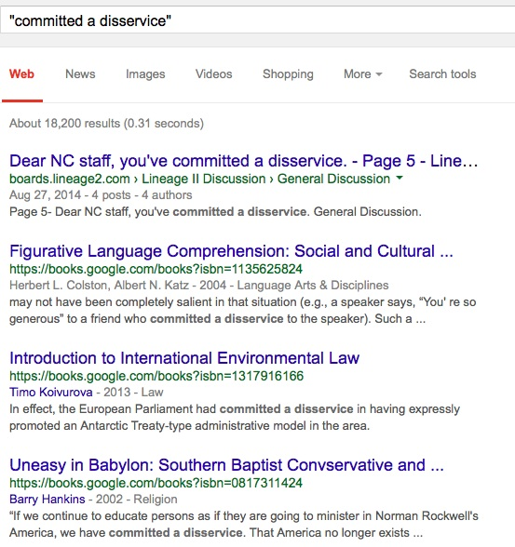
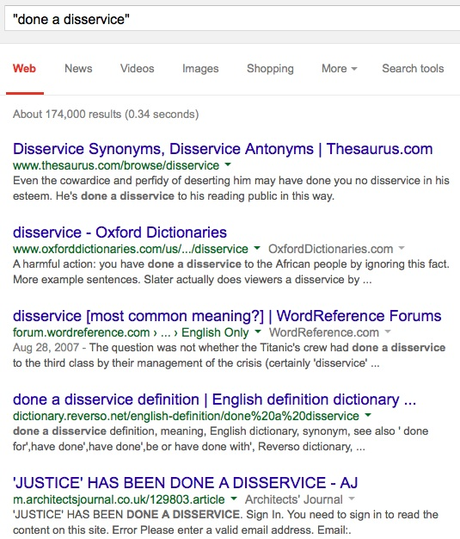
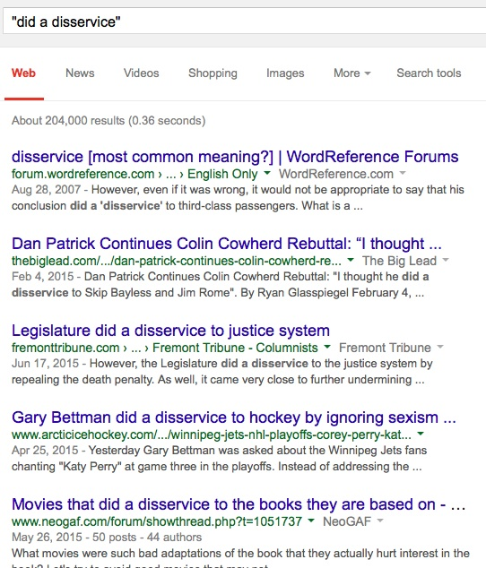

Slide 24
Part 3: Analysis Strategies
Goals: moving beyond summary
using evidence from the text

Slide 25
What is “analysis”?
What kinds of things do people analyze?
Solutions or chemical compounds
Evidence at a crime scene
Statistics
Texts

Slide 26
Example Text 3: Excerpt from Eva Hoffman
“I’ve become obsessed with words. I gather them, put them away like a squirrel saving nuts for winter, swallow them and hunger for more. If I take in enough, then maybe I can incorporate the language, make it part of my psyche and my body. I will not leave an image unworded, will not let anything cross my mind till I find the right phrase to pin the shadow down.”
Hoffman, Eva. Lost in Translation: A Life in a New Language. New York: Penguin, 1989. Print.

Slide 27
Two Kinds of Analysis of Texts
Analysis of content/theme
Analysis of style/rhetoric

Slide 28
Classroom Challenges
Superficial readings/resistance to critical reading
Misinterpretations of the text
Giant leaps from the text to other topics

Slide 29
Sample Student Text
Prompt: What do you think of Michelle Alexander’s argument that the current US system of prisons is inherently racist? Where does she make you consider this issue in a new way? Where do you have more trouble accepting her argument? Why?
Alexander said that reagan use the power of median to target black neighborhood as the primary drug den when crack cocaine haven't become prevalent. The entire "war on drug" policy should not just target the intermediary. The consumer should also be legally responsible for their actions. Yet the police are more interested in picking out black people. I know nothing about CIA's efforts on allowing illegal drugs to be smuggled into the US, but I won't be surprised about it since they had been experimenting mind control drug on homeless US citizens before in mk ultra. American police exercute about one thousand "criminals" on the street each year, yet the US government still has the audicity to criticize China for its capital punishment of death sentances. I believe that criminals do not learn their lession in a typical US prison where sexual assults run rampant.

Slide 30
Sample Student Text
Prompt: What do you think of Michelle Alexander’s argument that the current US system of prisons is inherently racist? Where does she make you consider this issue in a new way? Where do you have more trouble accepting her argument? Why?
Alexander said that reagan use the power of median to target black neighborhood as the primary drug den when crack cocaine haven't become prevalent. The entire "war on drug" policy should not just target the intermediary. The consumer should also be legally responsible for their actions. Yet the police are more interested in picking out black people. I know nothing about CIA's efforts on allowing illegal drugs to be smuggled into the US, but I won't be surprised about it since they had been experimenting mind control drug on homeless US citizens before in mk ultra. American police exercute about one thousand "criminals" on the street each year, yet the US government still has the audicity to criticize China for its capital punishment of death sentances. I believe that criminals do not learn their lession in a typical US prison where sexual assults run rampant.
Notes:
IN BLACK—WHAT’S IN THE TEXT.

Slide 31
Part 4: Discussion Strategies
Goals: student-centered discussions
oral references to textual evidence

Slide 32
Learner-Generated Discussion Questions
Excellent questions for discussion
are not yes/no or either/or questions.
are not factual questions with answers in the text.
are clear to your classmates, not overly vague.
are grammatically correct.
Notes:
Criteria I share with students

Slide 33
Goal-Driven Discussions
At the end of this class, students will be able to:
Form a discussion question about the text according to our shared criteria
Answer a discussion question with an opinion/interpretation statement of their own.
Cite an example from the text to support their opinion/interpretation.
Refer to the page and paragraph number correctly when referencing an example from the text.
Respond to other students’ opinions/interpretations in appropriate ways.

Slide 34
Behind the Scenes: Goals for Discussions of Texts
What do you want the students to get out of the discussion?
What will the discussion look like on the surface level?

Slide 35
Example: First discussion of Blackbird House by Alice Hoffman
Goals: By the end of this discussion, students will be able to:
Voice any questions they have about the text (assessment)
State what strategies they are currently using to address any vocabulary needs in the reading, and assess how well these strategies are working for them (review, assessment)
Share their initial reactions to the text and give at least one reason/example for their reactions (assessment, argument practice)

Slide 36
Example: First discussion of Blackbird House by Alice Hoffman
Goals: By the end of this discussion, students will be able to:
Give 1-2 descriptors of Hoffman’s writing style and give specific examples of these (analysis, argument practice)
Analyze a paragraph of “vivid description” and give examples of techniques Hoffman uses to make her description “vivid” (analysis, argument practice)

Slide 37
Example: First discussion of Blackbird House by Alice Hoffman
How are you finding the reading so far?
What problems are you running into?
How’s the level of vocabulary?
What questions do you have about the text?
What do you like about the text so far?
What do you think of Hoffman’s writing style?
What kinds of words help a writer write “vividly”?
Where do you see her “vivid descriptions”?
Let’s look at one example of this. . .

Slide 38
Example: First discussion of Blackbird House by Alice Hoffman
“The May gale had surprised them, as it had surprised everyone else who was fishing in the Middle Banks. One moment there’d been a sea of glass, the next a sea of mountains. They did the best any crew might have done; even Isaac managed as well as could be expected as they tried to drive leeward. But in the force of the storm, the sloop broke apart, and there was nothing anyone could have done. It happened not slowly, but all at once, as though a giant had picked them up and crushed them with a single stroke. Everything splintered; everything broke; everything was devoured by the sea. Things that couldn’t be were. Things that should never have happened were there before their eyes. Vincent knew how bad it was when his brother threw the blackbird into the sky, threw him with both hands….” (p. 17)

Slide 39
thank you!
Christina Michaud
Boston University
cmichaud@bu.edu
Notes:
This seminar addresses ways to teach L2 learners to be active, critical readers of literary texts. We will demonstrate how to teach better reading and vocabulary acquisition strategies, facilitate effective discussions of readings, and guide learners toward more in-depth analysis of the text.

