Slide 1
Creating Culturally Responsive Classroom Culture & Instruction

Slide 2
Norms
Be comfortable with being uncomfortable
Be okay with no closure
Use “I” statements
Assume nothing. Ask clarifying questions.
Be open
Make the implicit explicit

Slide 3
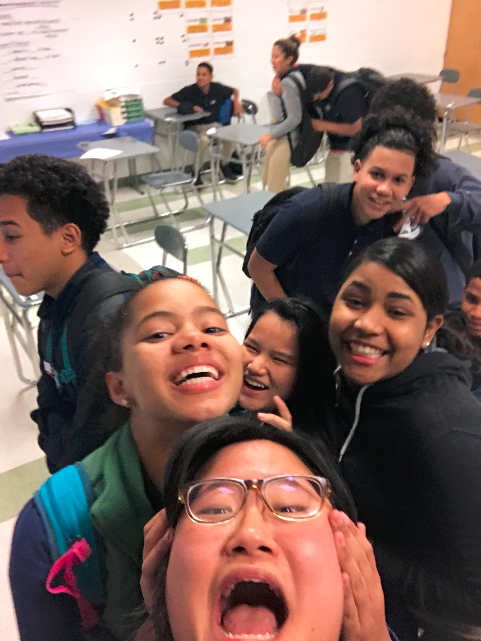
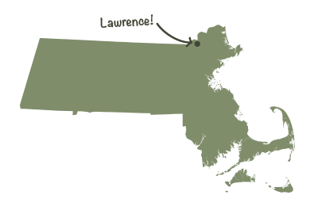
Esther Jeong
ESL Curriculum Design Lead &
Lead Teacher @ 9th Grade Academy @ Lawrence High School

Slide 4
Agenda
What I will be learning/doing today…
Culturally Responsive Pedagogy
Spectrum Activity
Analyze Unit Plan

Slide 5


Culturally Responsive Pedagogy
Academic Rigor
Maintaining high expectations of our students to become academically successful
Cultural Competence
Utilizing a student’s culture as a vehicle for learning
Critical Consciousness
Developing a student’s sociopolitical consciousness that allows them to critique and dismantle the status quo or current social order
Creating a Climate for Linguistically Responsive Instruction. By: Arthi B. Rao & P. Zitali Morales

Slide 6
Most teachers
Are focused on and successful in creating academic rigor but struggle in building cultural competence because...

Slide 7
Requires identifying individual subconscious biases
Requires time to listen and learn from the community
Often prioritized less than academic rigor
Most teachers don’t share the same racial or socioeconomic background as our students
The Culturally Responsive Teacher By: Ana Maria Villegas and Tamara Lucas

Slide 8
“The vast majority of teachers in the United States are white, middle class, and monolingual English speaking. In most cases, their lives differ profoundly from the lives of their students...To make productive instructional use of this information, teachers must possess two fundamental qualities: they must have sociocultural consciousness and hold affirming views toward diversity.”
- Villegas & Lucas, 2007
The Culturally Responsive Teacher By: Ana Maria Villegas and Tamara Lucas

Slide 9
Spectrum Activity
10 minutes long
Stand somewhere along the spectrum that best fits your opinion
Be courageous, honest and actively listening

Slide 10
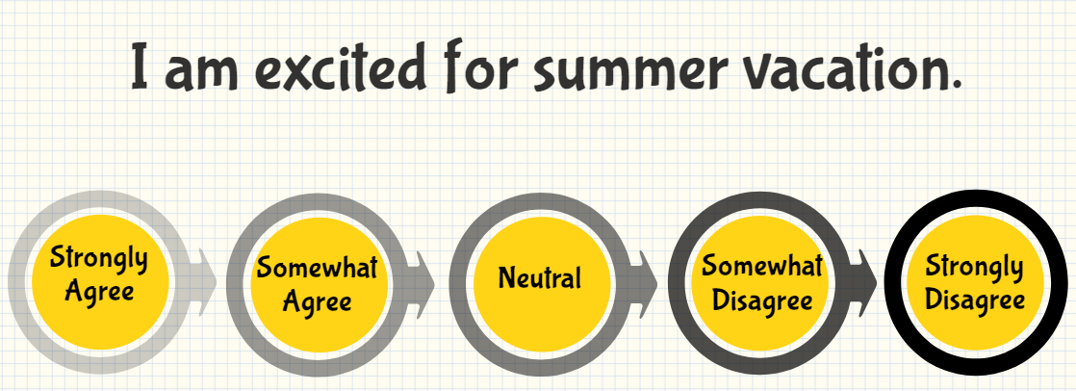

Slide 11
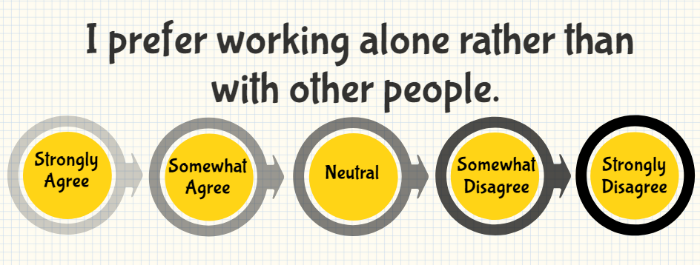

Slide 12
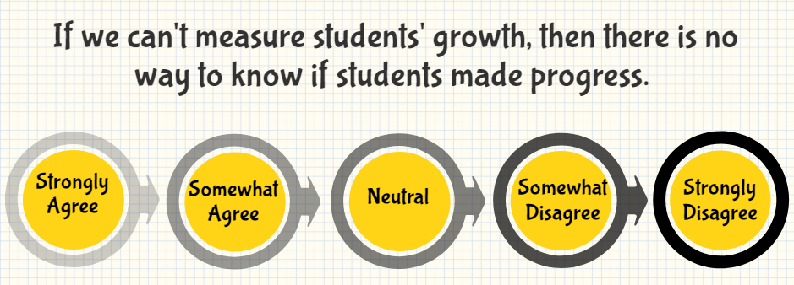

Slide 13
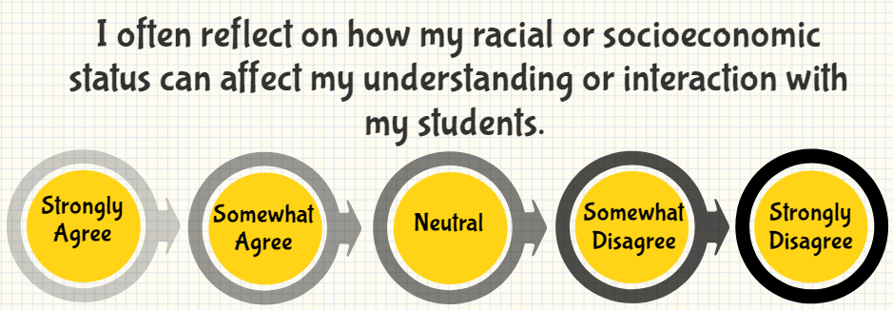

Slide 14
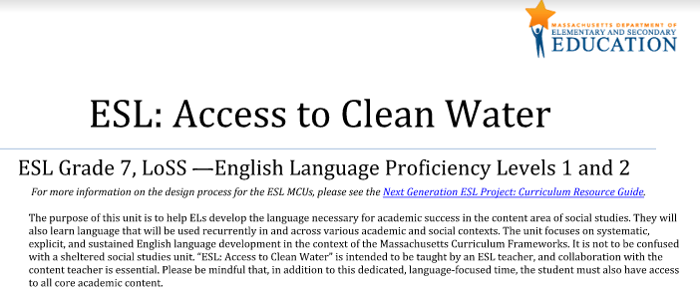
Culturally Responsive Example
Google: DESE ESL MCU
Click on the first link
Enter your information & a link will be sent to your e-mail

Slide 15
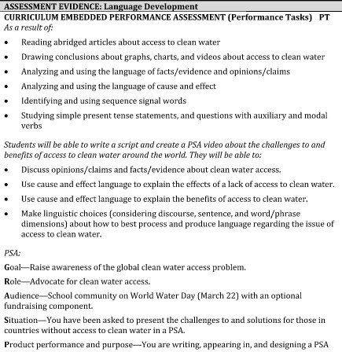
1) "access to clean water"
- Students will be exposed to resources informing them about the injustice in having access to clean water (cultural competence)
2) "cause and effect language"
- Students are taught explicit language that will make them successful in their other content areas (academic rigor)
3) "PSA"
- Students are developing a critical consciousness by raising awareness of the global clean water access problem

Slide 16
Key Points
REFLECT: Always thinking about how your actions and mindsets are sending implicit or explicit messages to students that either validate or invalidate their identity
Look at DESE’s MCU to get a grasp of what it looks like in execution.
If you think you’ve “got it,” then you DEFINITELY don’t.
Really listen to your students.

Slide 17
Thank you!
Questions:
estherjny@gmail.com

