Slide 1
Fulfilling the mission of helping all students meet their postsecondary goals: Special considerations for students with disabilities
Hydi Kalmin, M.Ed Tapestry Public Charter School, GA
Colin Dunnigan M.A., St. Andrew's Episcopal School, MS
Richard Hazelton, J.D. Hotchkiss School, CT
SACAC New Orleans April 2018

Slide 2
Goals of the Session
Why is this topic time sensitive and important to college counseling?
Learn about the unique needs of students with a variety of documented disabilities and potential barriers to receiving a college education
Look at the Importance of partnerships and vocational support for students with special needs
Examine the role of the counselor and admissions counselor in the postsecondary application process
Inclusion at work: Tapestry Public Charter School’s post-secondary counseling program
Two real life examples of high school seniors preparing for postsecondary education from the viewpoint of a college counselor parent
Conclusion and Next Steps: Q&A from the audience

Slide 3
Who are the students we are talking about?
Developmental
  Autism spectrum disorder, Asperger’s Syndrome (now part of ASD),
  Fetal Alcohol Syndrome
  Cerebral Palsy
  Down’s Syndrome
Physical
  Vision Impaired
  Hearing Impaired
  Loss of Mobility
  Other Physical Disabilities
Emotional
  Depression
  Anxiety
  Other Psychological Disorders
Cognitive/Behavioral
  Learning Disabilities, Cognitive Impairment, Speech and Related Disorders

Slide 4
Opening Activity. What are some of the needs and challenges of high school students transitioning to college or the workplace?
List three needs on the LINED side of the index card and write ALL STUDENTS
What unique challenges and needs face students with disabilities in this same situation?
Use the UNLINED Side and list two or three unique challenges

Slide 5
Challenges and Needs
Students with special needs: Same challenges/needs as all students, but also…
Self-Disclosure
Mental Health
Medical management
Self-care
Barriers to campus access
Tutoring options
Specific Campus Resources
Executive Functioning Needs
IDEA vs IEP/504
Social Skills Training
Personal Safety
Transition to College Life
All students:
Independance and Time Management
Distance from Home
Self-Care (laundry, living on own, meals, finding resources, budgeting)
Self-Advocacy in classes
Juggling demands of school and work
Meeting new friends and learning new city
Role of Parents
Sexual/Dating Relationships and Identify Development
Becoming involved on campus
Career Development
Course Selection
Learning Campus Resources

Slide 6
What do we know? Research on College Counseling Students with Disabilities
Taken from a 2014 article in the Hechinger Report: Only 25% of students who received help for their disabilities in high school acknowledge in college that they need the same assistance, according to the National Center for Learning Disabilities.
31% of youth with disabilities attend college in the first two years after high school, according to a 2005 report by the U.S. Education Department
While 94 percent of high school students with learning disabilities get some kind of help, just 17 percent of learning-disabled college students do.
“Many students [with learning disabilities] first get to college and really want to do it on their own,” said Sarah Williams, an East Carolina University professor of special education .“They’re really tired of the whole system.”
Link:
https://www.bls.gov/opub/ted/2015/people-with-a-disability-less-likely-to-have-completed-a-bachelors-degree.htmAmong people age 25 and older in 2014, 16.4 percent of people with a disability had completed at least a bachelor’s degree. By comparison, 34.6 percent of people with no disability had completed at least a bachelor’s degree.
https://nces.ed.gov/fastfacts/display.asp?id=64

Slide 7
University Services for Students with Disabilities
Wide Range of Services for Students with Disabilities
Issue of Self-Disclosure and Self-Advocacy
Section 504 vs IEP
Disability Services: Standard Accommodations, books on tape, tutoring, “accommodations letter” delivered to student
TRIO Student Support Services: Counseling, accommodations, tutoring, financial aid, other services
Peer Mentoring, Support Groups, Counseling, Dorm Aide, Specialized programs (often for fee) providing additional support, pre-college programs
Specialized universities for students with learning disabilities (Landmark College, Lynn University, Beacon College are just three examples)
Post-Secondary Inclusive Programs (non-degree) focusing on vocational skills and the college experience

Slide 8
Tapestry Public Charter School (Atlanta, GA)
Public Charter High School in Doraville , GA (close to the Atlanta ,GA perimeter)
Opened its doors in 2014. Students selected by lottery open to all residents of Dekalb County School System.
The mission of Tapestry Public Charter School is to offer an inclusive, individualized learning environment that is academically engaging, both for neurotypical students and those on the autism spectrum, and to create a positive school culture that empowers all students to take possession of their innate talents and become creative builders of their own future.
Approximately 50% of students are on the Autism Spectrum or have other diagnoses (learning, emotional , physical disabilities). Currently we have 221 students serving grades 6-11 and we will add a senior class for the first graduating Class of 2019 (22 students)
One full time counselor/two part time counselor
Process of creating a college-bound curriculum and assist with transition services and postsecondary goals
Senior Internship and Transition Consortium
Teaching Self-advocacy and awareness of disability
Next Steps

Slide 9
Counselor Training : Are we ready and able?
University training programs do not spend a great deal of time teaching college counseling to graduate students
Most experience is “on the job”
Courses in special education or identifying developmental disabilities and counseling students with emotional, physical, or cognitive disabilities
Special Education Department versus Counseling Department
Knowledge of College Admissions Counselors : College Fair Example
Need for increased knowledge and awareness

Slide 10
College search for student with physical disability
Morgan Dunnigan - Class of 2017
St. Andrew’s Episcopal School
Ridgeland,MS

Slide 11
Background
● Born September 1999
● No health issues
● Itching/Tingling began in neck late spring 2005, blamed on psychological issue, skin issue, misdiagnosed by multiple physicians

Slide 12
Background
MRI Thursday, Decemeber 8, 2005 (age six) reveals tumor C2 – C6
Surgery set for Monday, December 12, 2005
Morgan wakes up paralyzed morning of surgery; tumor is removed, non-cancerous, quadriplegia

Slide 13
Background
Leaves hospital in Winston-Salem, NC on January 10, 2006, transfers to Kennedy Krieger Hospital next to Johns Hopkins
Walks out May 4, 2006
Ends first grade in Virginia with her class

Slide 14
Background
Walks with crutches short/mid-range distances
Wheelchair for classes beginning in 9th grade
No bowel/bladder function; became fully bathroom independent late in high school
Defined as “weak and uncoordinated” which she finds insulting
Does not sweat

Slide 15
Physical status
Fall risk
Slow with most manual tasks; dressing herself is laborious; cutting meat challenging as left hand struggles
Wears left hand brace at night to keep fingers more flexible
Orthotics in shoes; limited shoe assortment
Entitled to extended time on tests (rarely uses)

Slide 16
The college search
Where should she look?
Needs an adaptive campus & willingness of people on campus to make accommodations & be inclusive
Weather matters: cold is misery but heat could kill
Family/Friend support could be important
What else is important to know?

Slide 17
Academics - status at end of junior year
5 on AP English Language, AP U.S. History, AP Calculus AB, and 4 on AP Physics 1
Choir 9th & 10th grade, Speech & Debate 11-12

Slide 18
Academics
4.1 GPA
35 ACT (33, 32 in winter/spring junior year)
English Literature 660
Math Level II 730
U.S. History 720

Slide 19
Academics
Senior year schedule:
AP English Literature
AP Calculus BC (second semester)
AP Statistics

Slide 20
Academics
AP Human Geography/ Contemporary Issues
AP U.S. Government
AP Spanish
Speech and Debate

Slide 21
So where should she look?

Slide 22


Slide 23


Slide 24
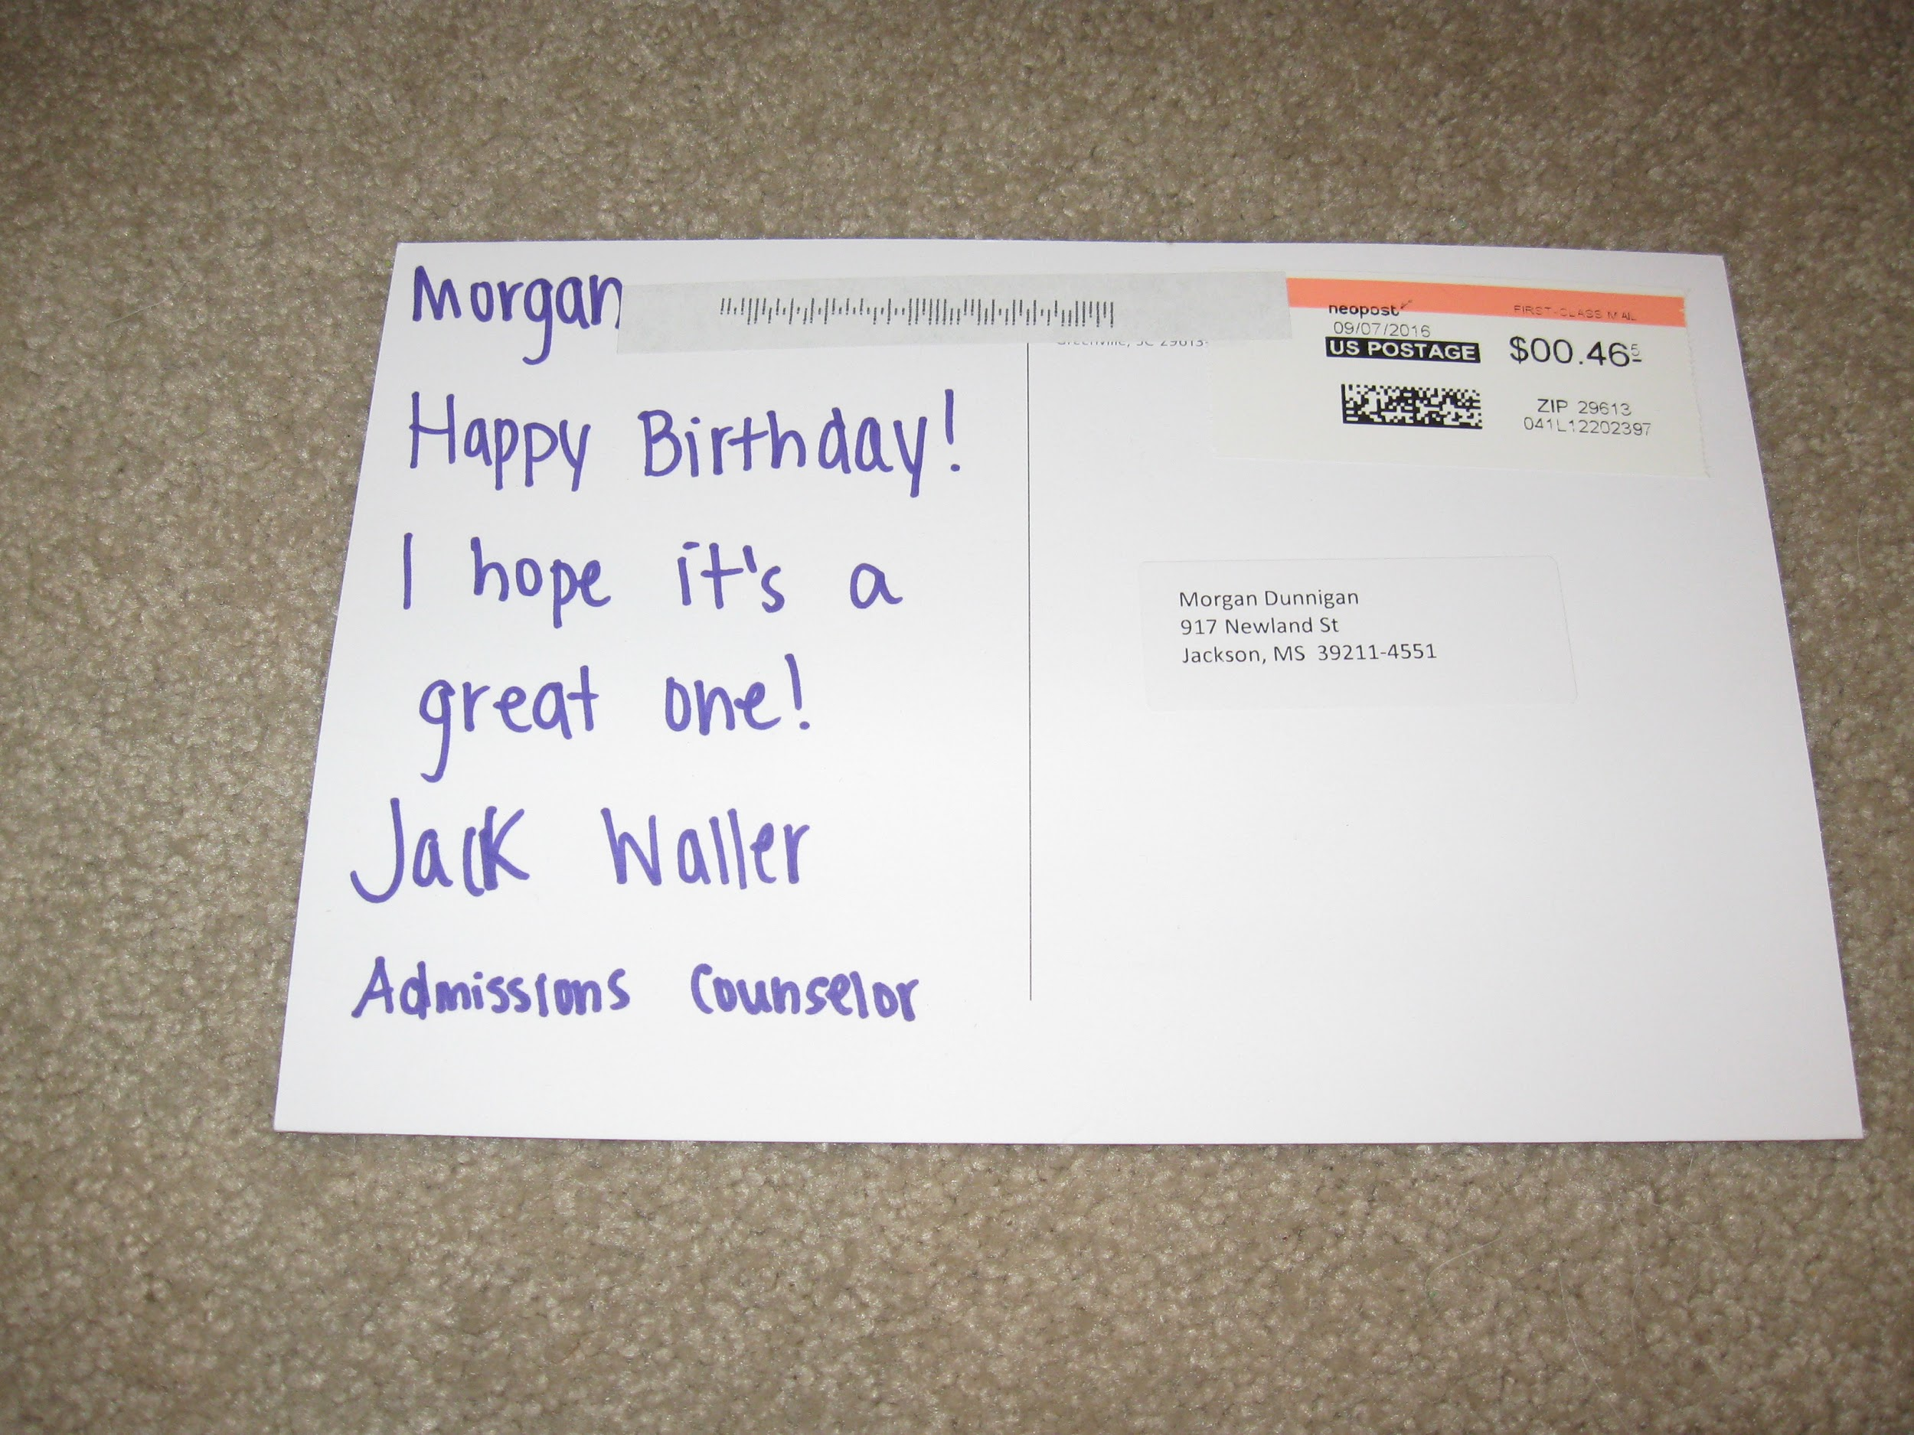

Slide 25


Slide 26
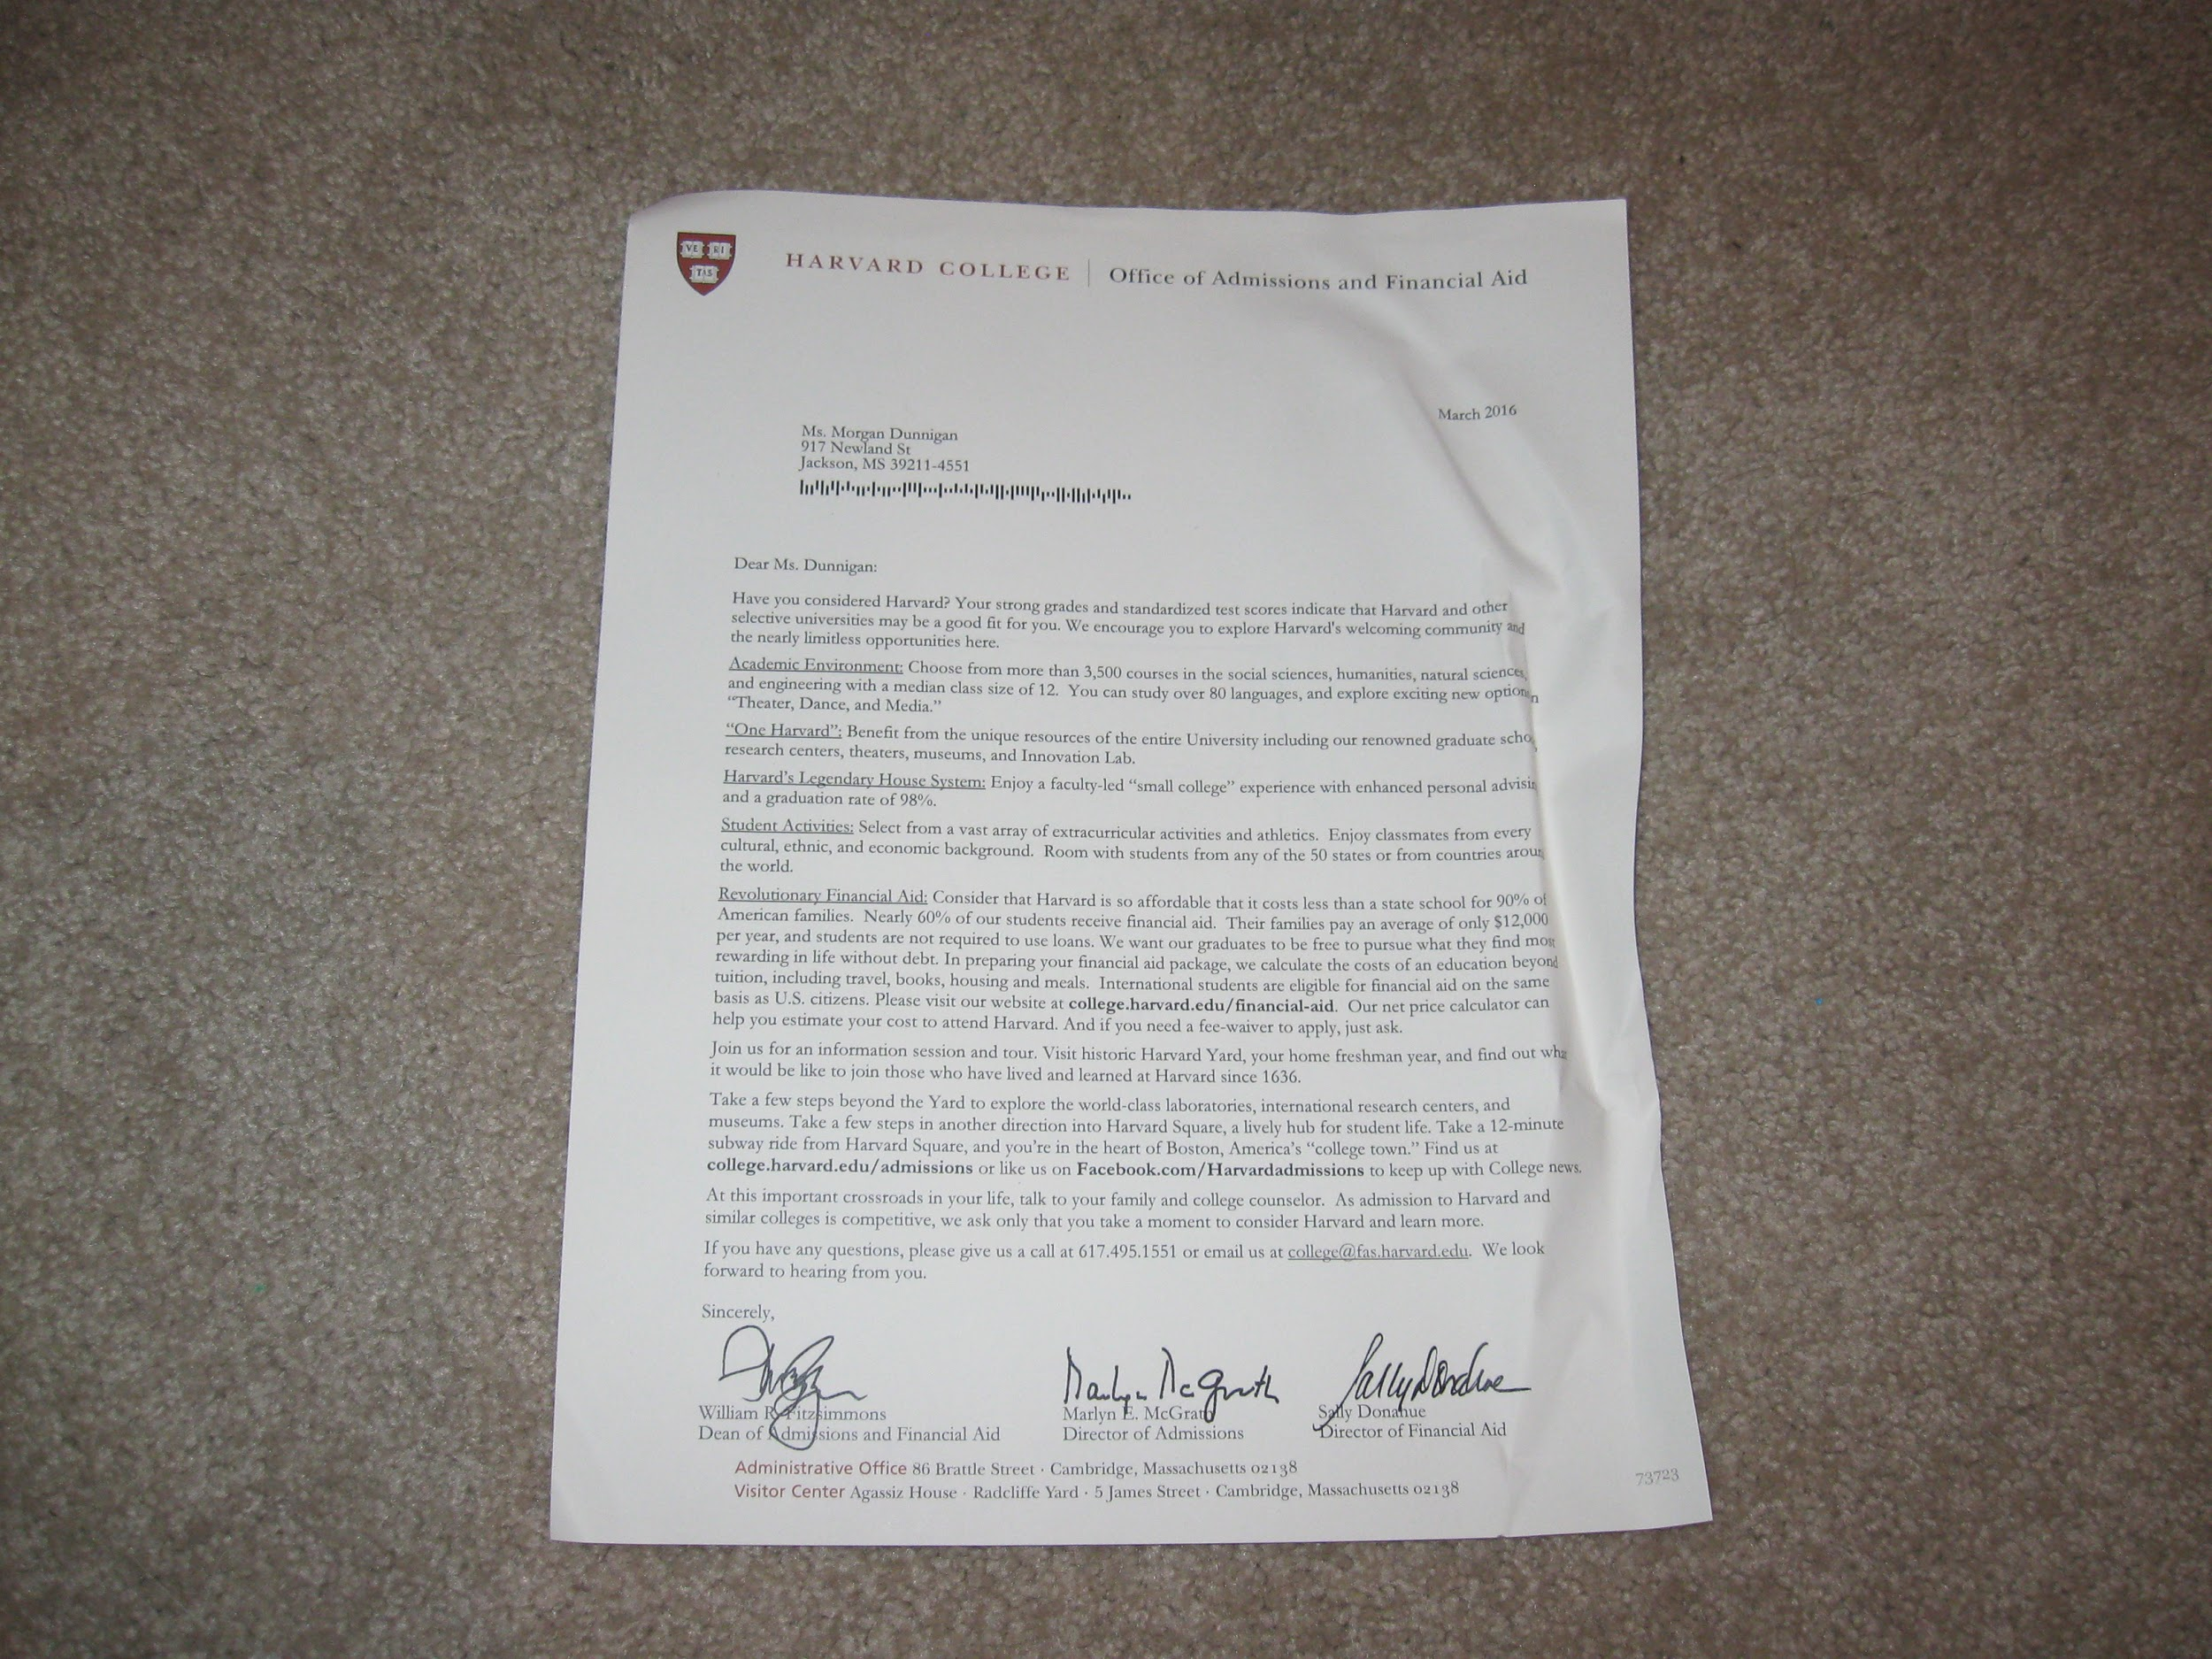

Slide 27


Slide 28
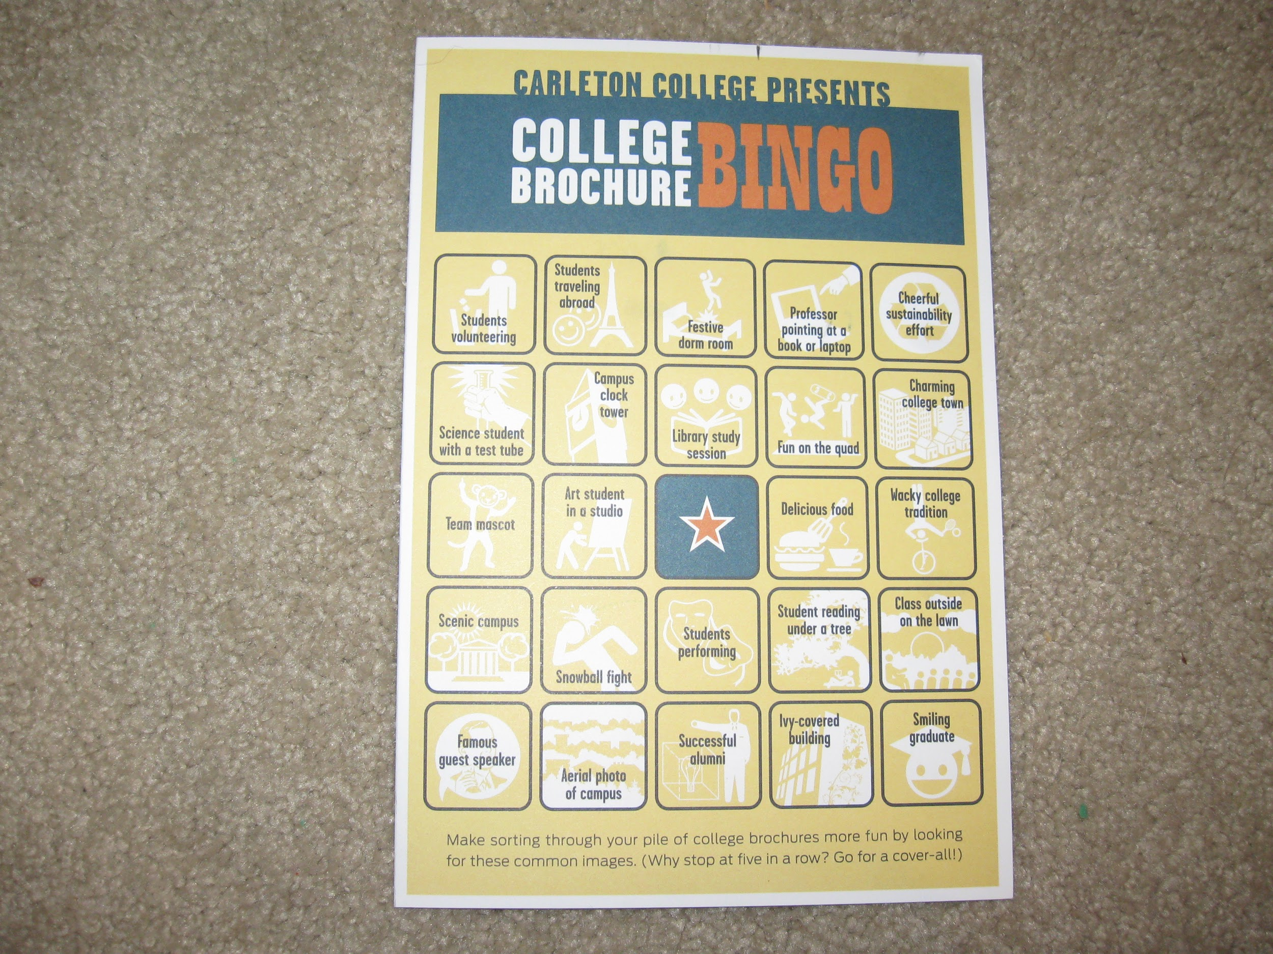

Slide 29
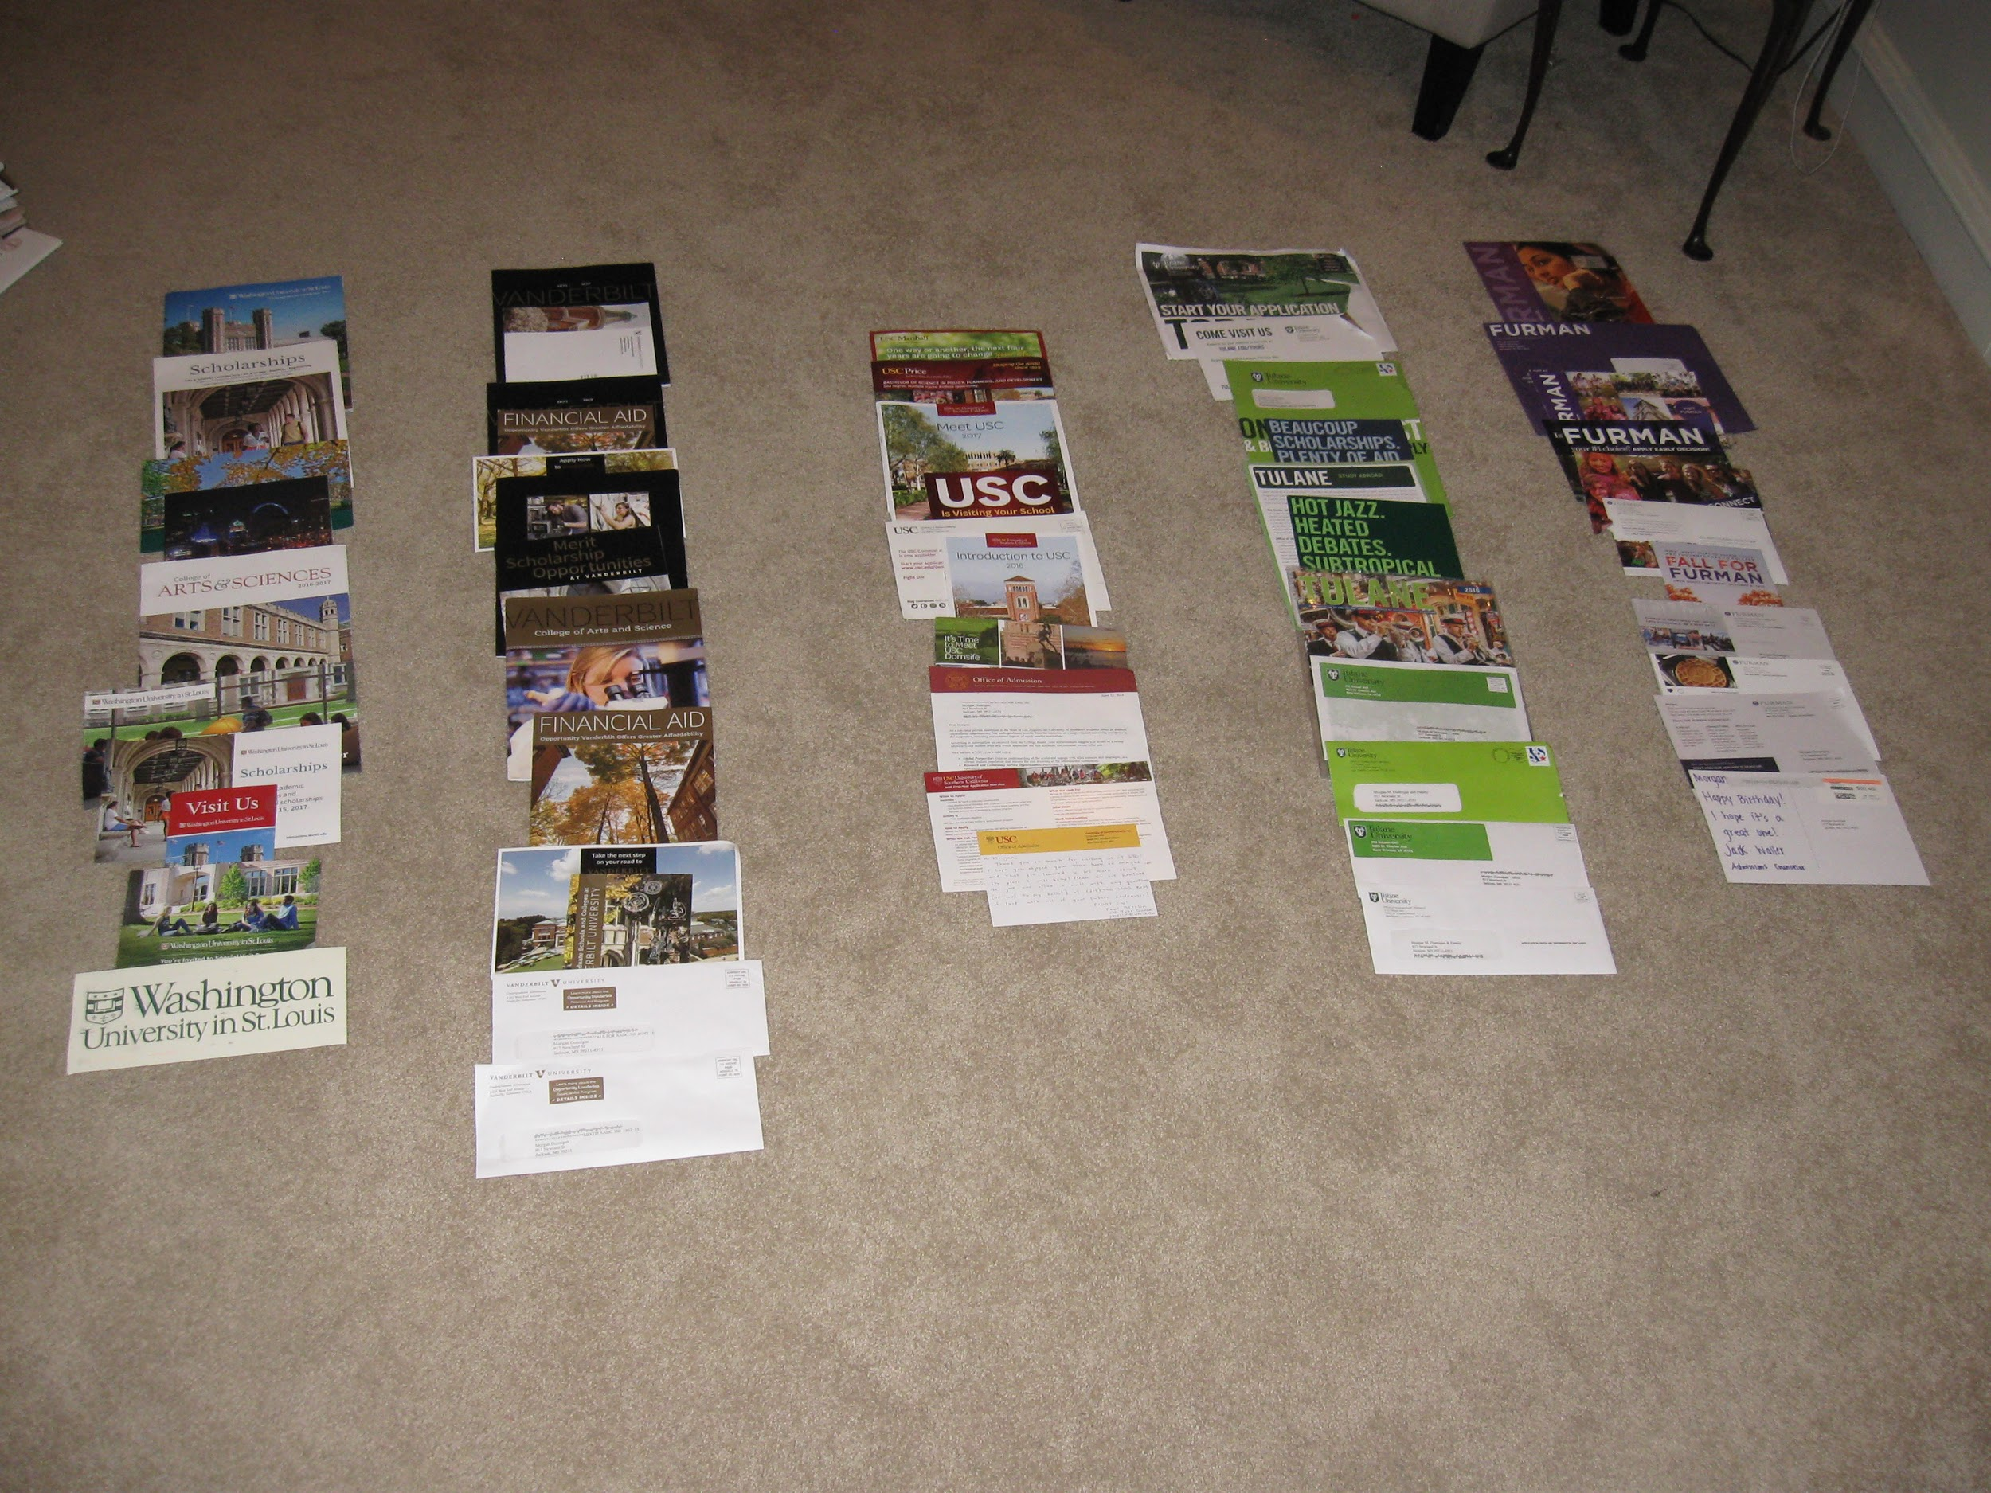

Slide 30
Colleges she visited - Southeast/Virginia
Rhodes College
Vanderbilt University
Emory University
Furman University
Davidson College
Elon University
University or Richmond
College of William and Mary
University of Richmond

Slide 31
Colleges she visited - California
Pomona College
Scripps College
Claremont McKenna College
Occidental College
University of Southern California
Stanford University

Slide 32
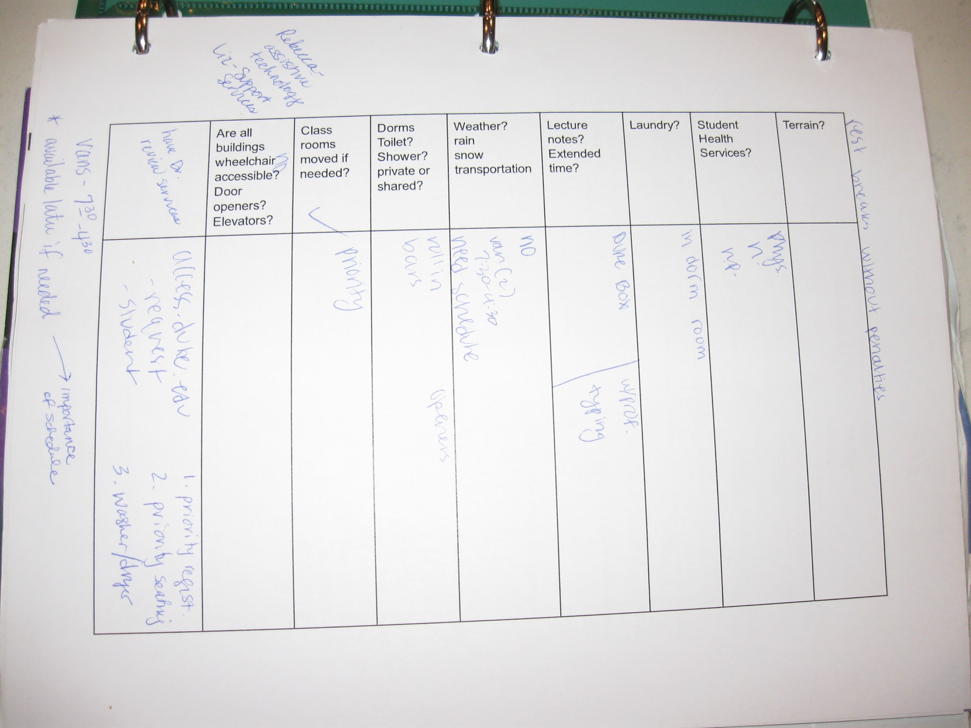

Slide 33
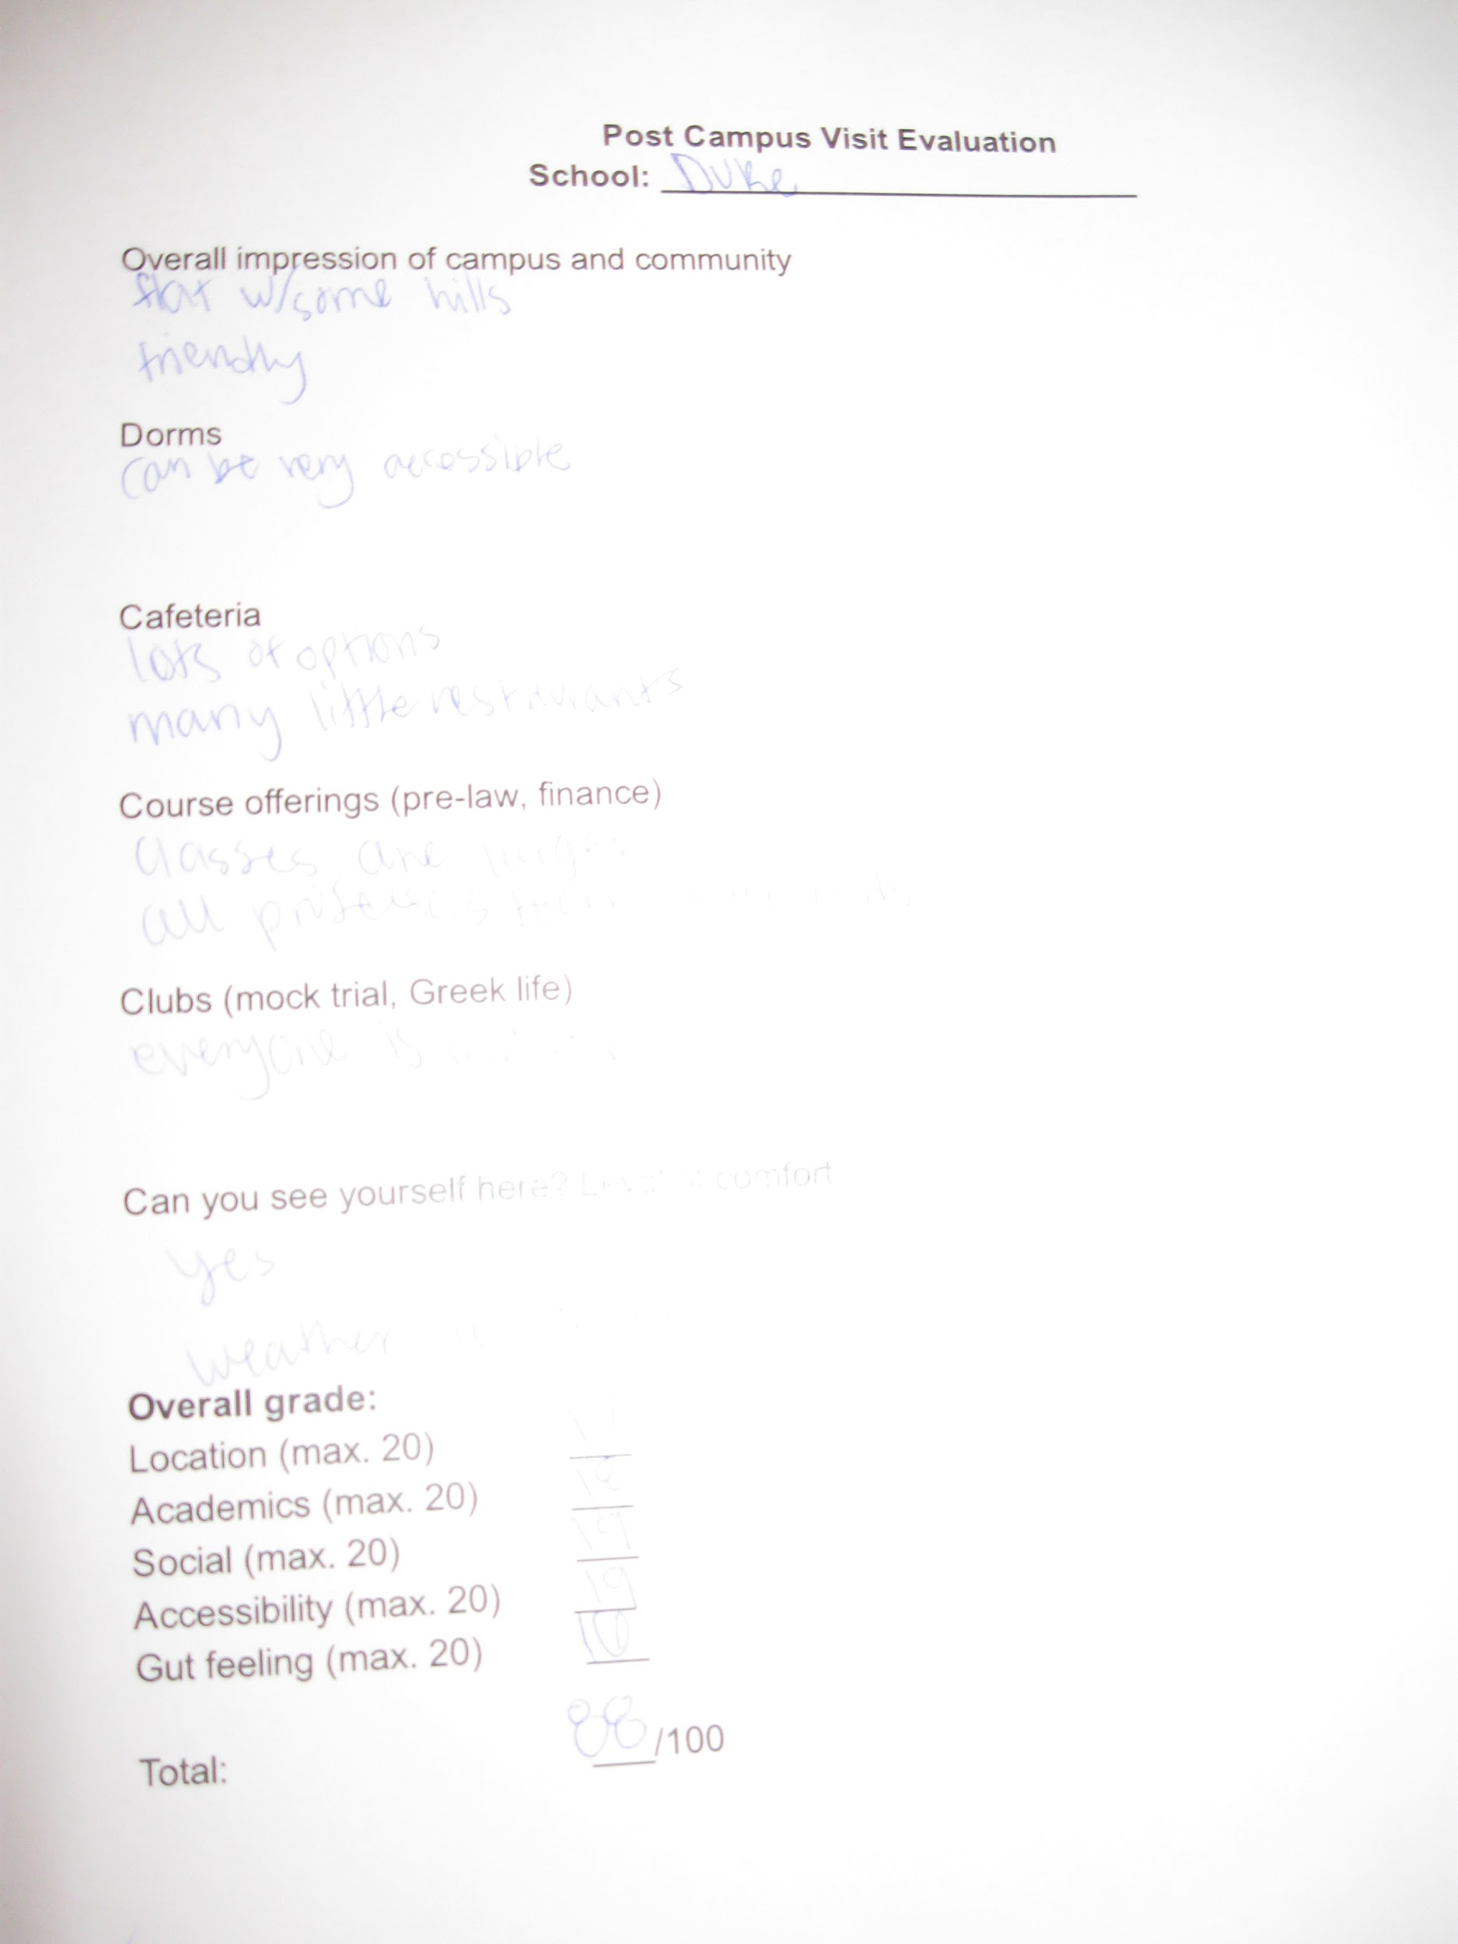

Slide 34
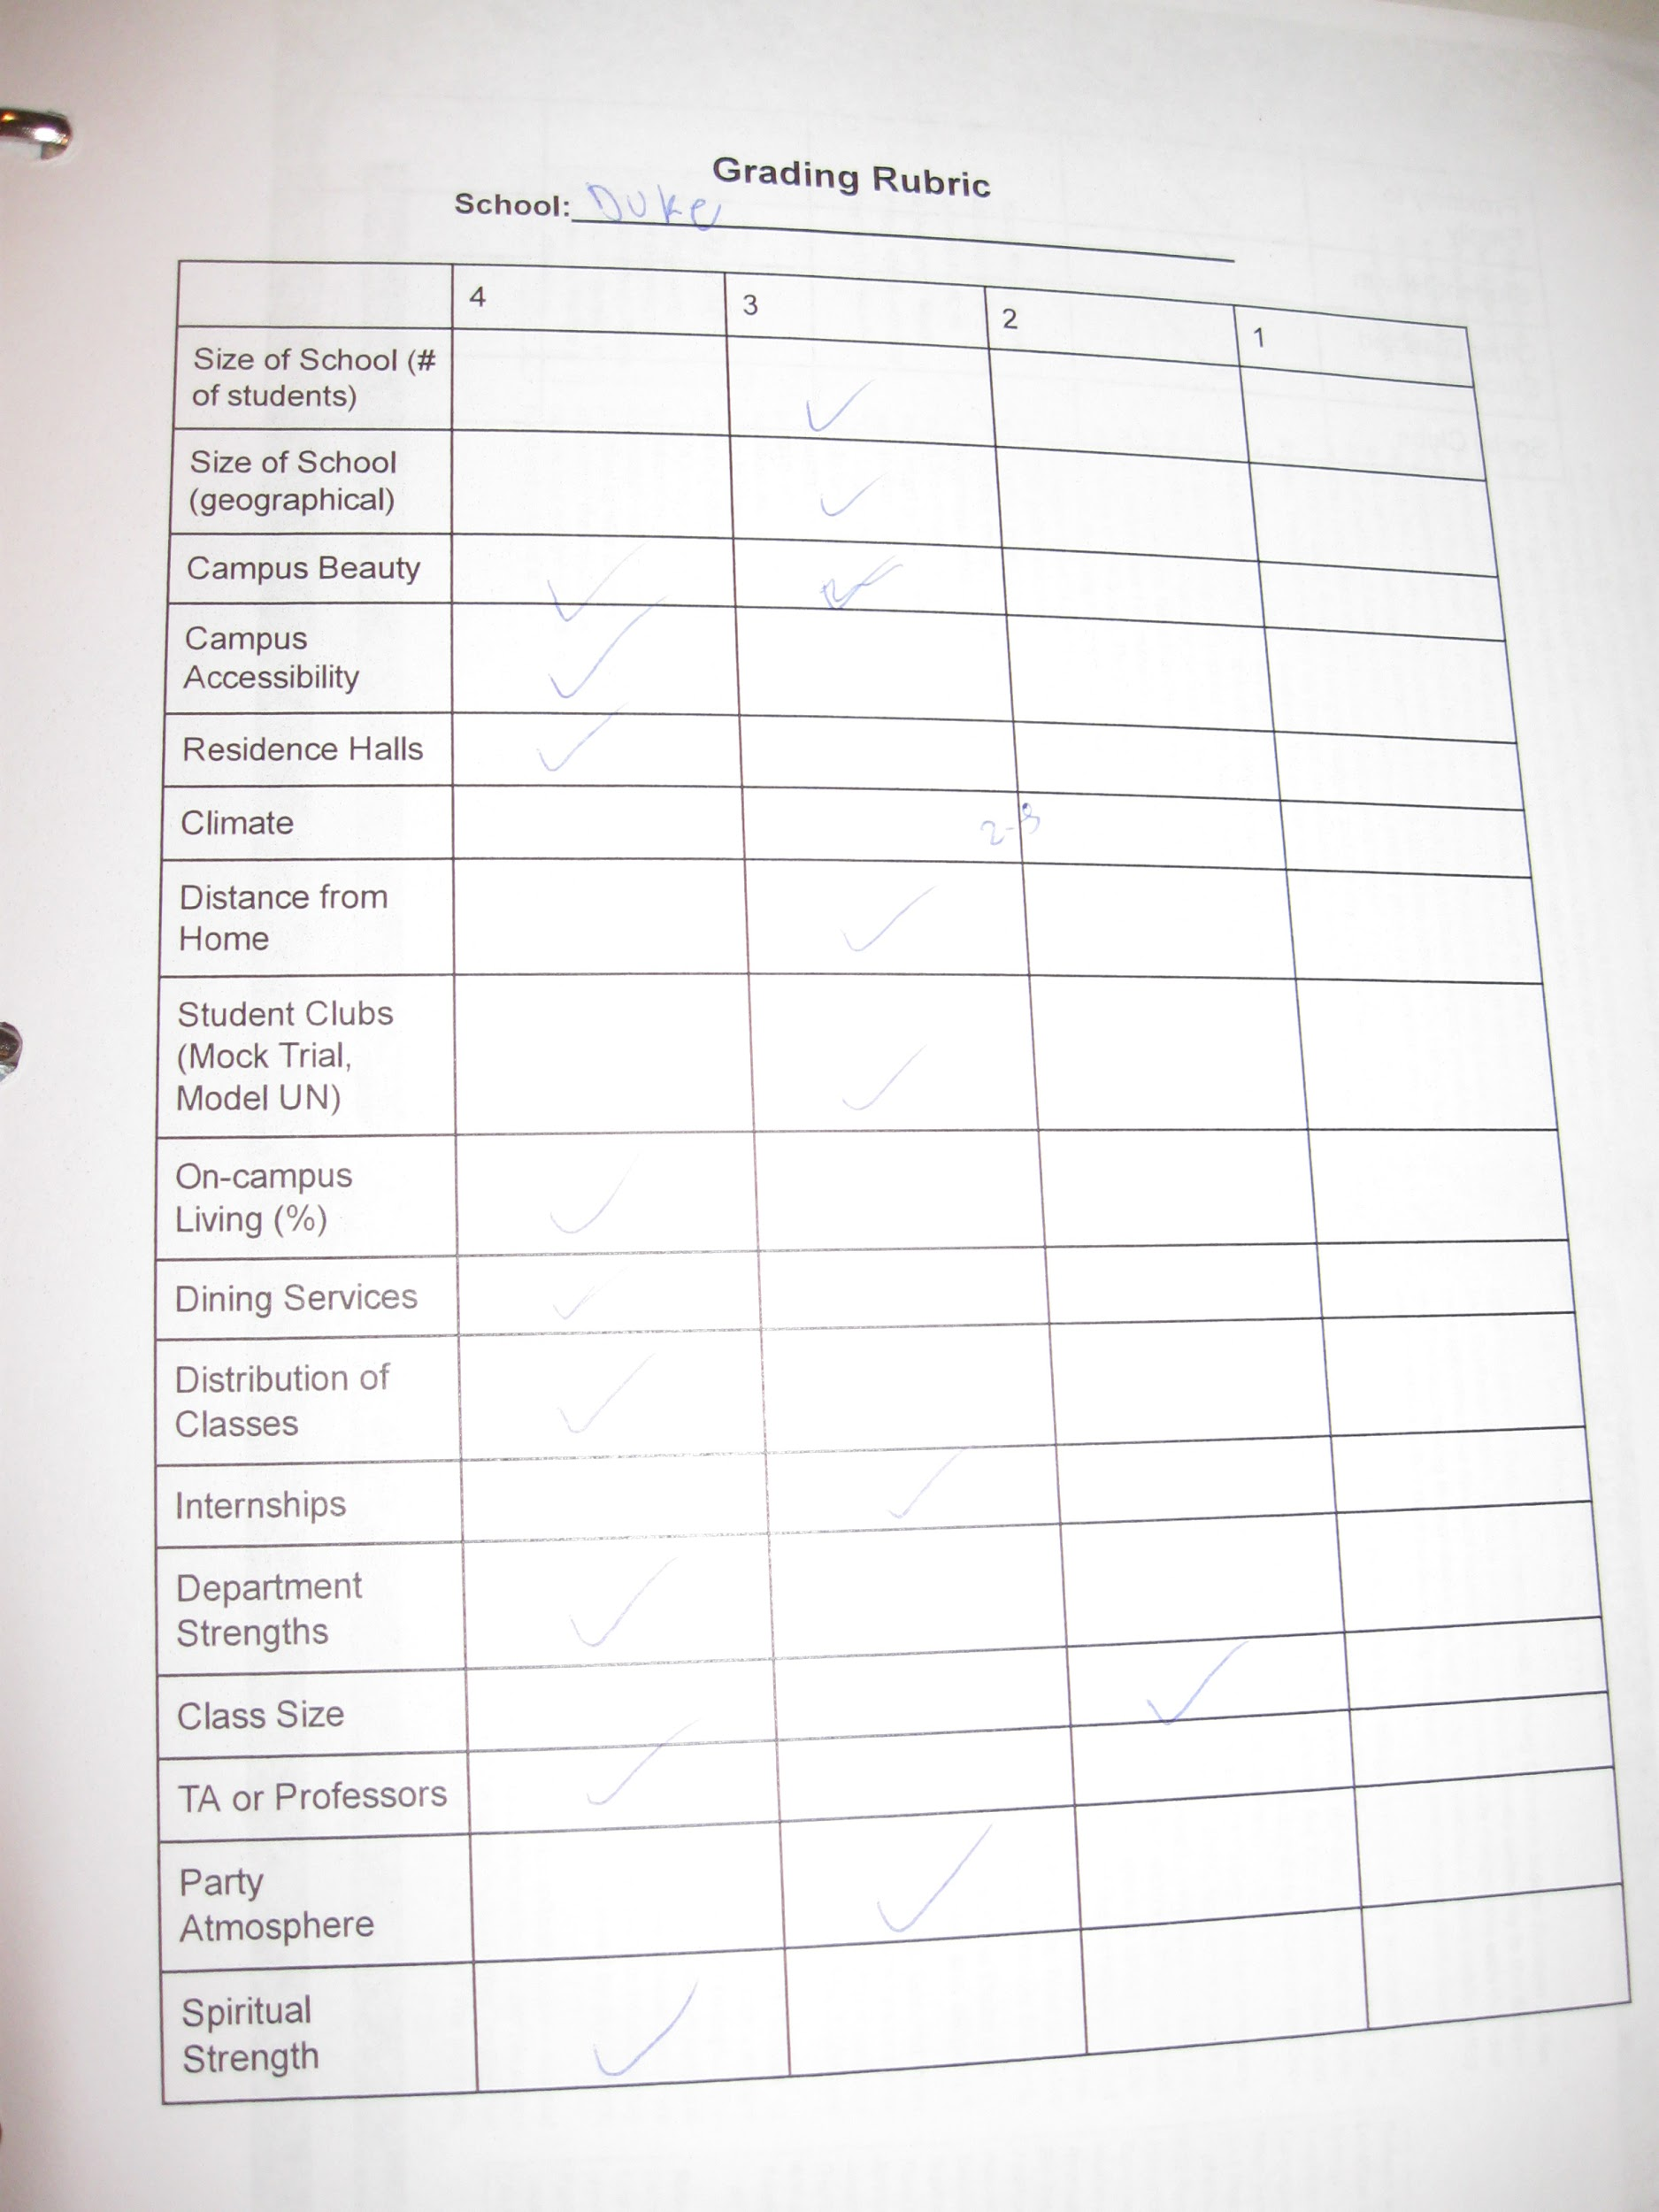

Slide 35


Slide 36
Colleges eliminated based on visits
Vanderbilt - getting around campus, city life
William and Mary - accessibility
Occidental - large hill in center of campus

Slide 37
College almost eliminated after visit
Davidson - tour guide used stairs with entire group while Morgan, mom, and grandmother were only ones told to use ramp every time

Slide 38
What’s the takeaway?
If someone on your tour is handicapped, use the ramp!

Slide 39
Colleges eliminated on second visit
Pomona, Claremont McKenna - American Airlines lost wheelchair, had to use a rented, broken scooter, smelled marijuana first time, felt that being two flights away/absence of family/friends was too much

Slide 40
Amazing thing Claremont McKenna did
No ADA room on campus, the college had an architect draw up how they would renovate a space to have a bathroom & be properly accessible

Slide 41
Revisits to Duke, Davidson
Met with paralyzed student at Duke whose room was renovated to create room for an aid; quote from university: “Whatever you need, we will make it happen.”

Slide 42
Revisit to Duke, Davidson
Spent night at Davidson, felt closeness of community, applied early decision

Slide 43
Main takeaways
● Who on your campus works with students with physical disabilities?
● Have you been around your campus in a wheelchair? Is it really accessible?

Slide 44
Main takeaways
● Who is nearby to support the student with a disability? What if wheelchair breaks….twice? What if student gets the flu? What if student needs to see a doctor?

Slide 45
Main takeaways

Slide 46
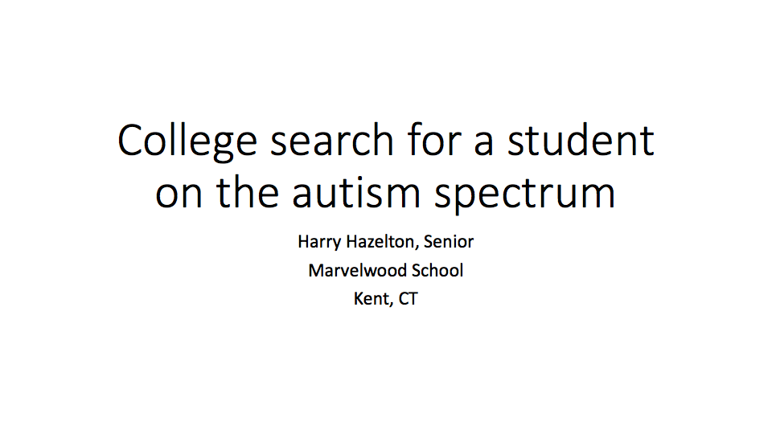

Slide 47
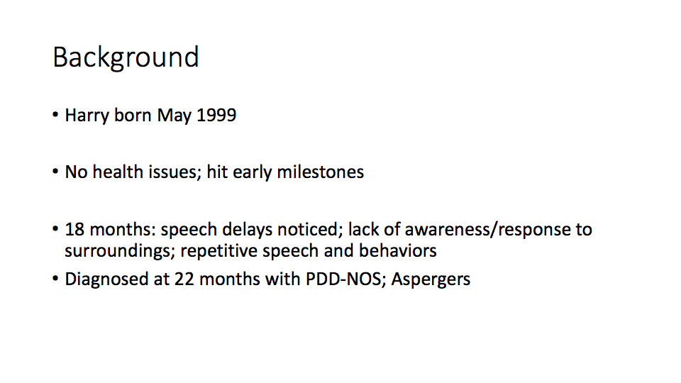

Slide 48
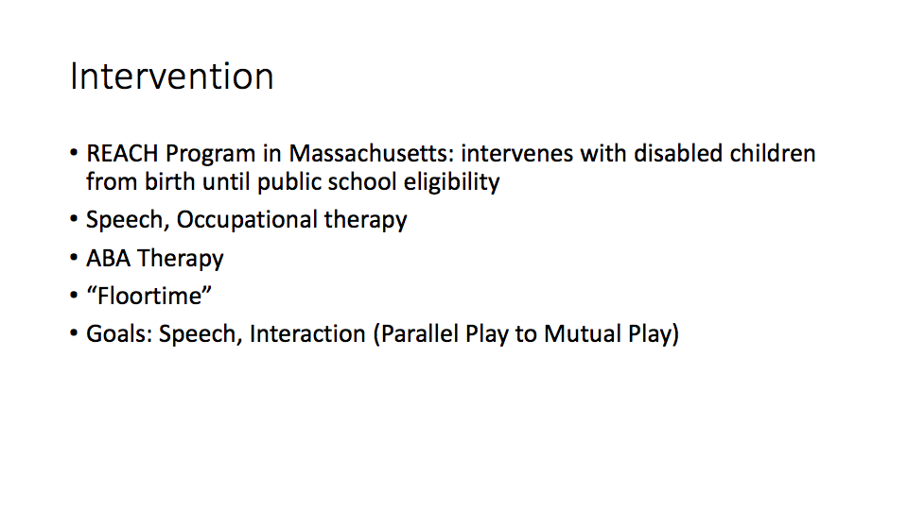

Slide 49
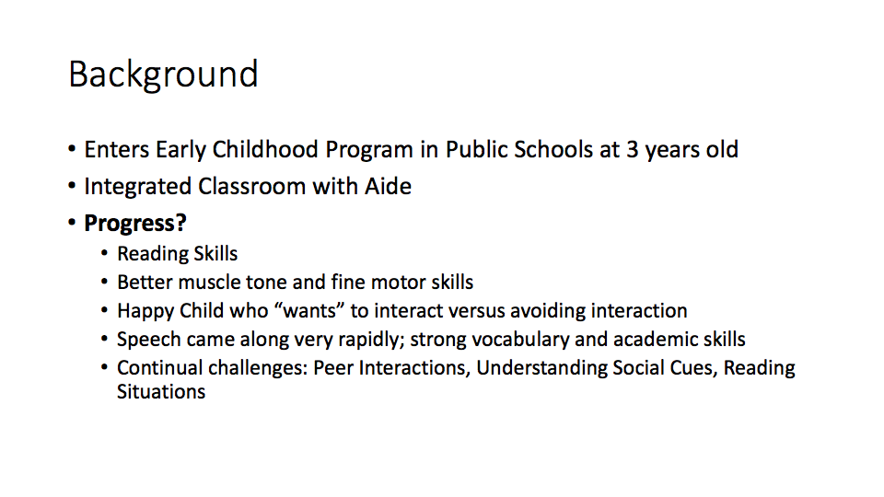

Slide 50
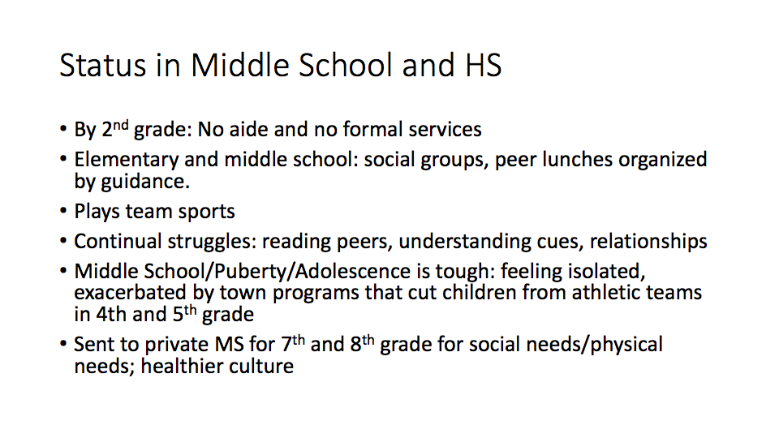

Slide 51
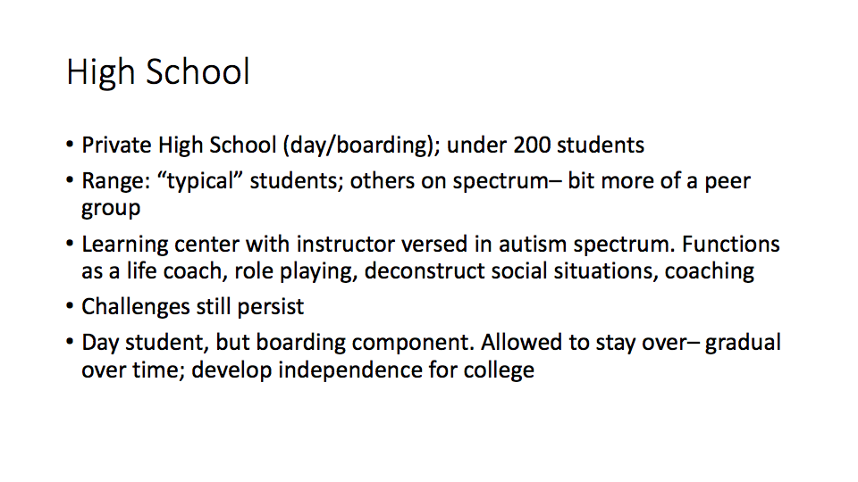

Slide 52
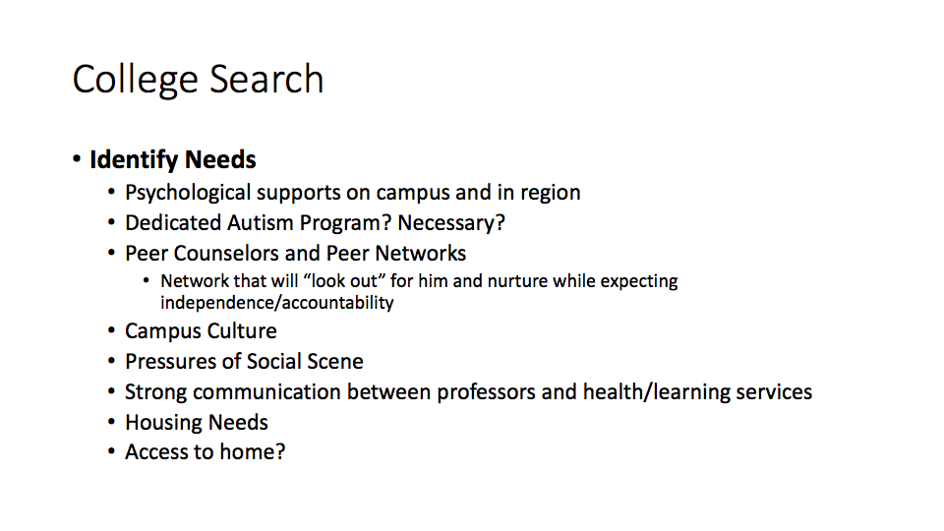

Slide 53
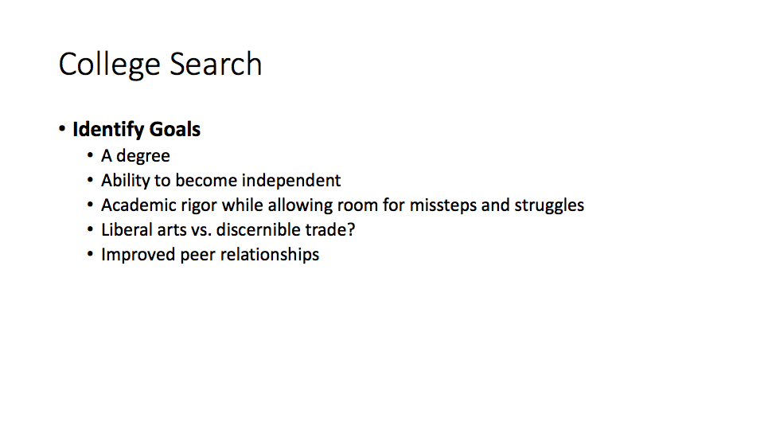

Slide 54
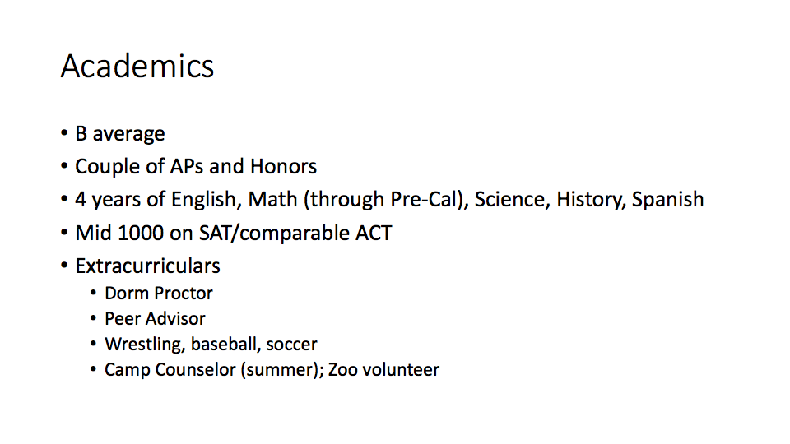

Slide 55
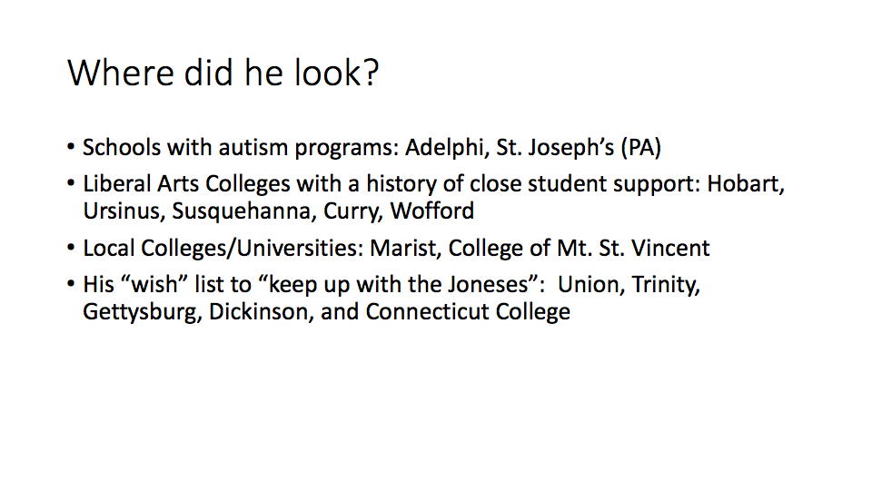

Slide 56
Resources and References
Freedman, S. (2010). Developing College Skills in Students with Autism and Asperger’s Syndrome. Philadelphia, PA: Jessica Kingsley Publications
Kravets, M. and Wax, A.F. (2016). The K&W Guide to Colleges for Students with Learning Disabilities, 13th Edition. MA: Princeton Review.
Krell, M. and Perusse, R. () Providing College Readiness Counseling for Students with Autism Spectrum disorders . American School Counselor Association, Volume 16, 1. http://journals.sagepub.com/doi/pdf/10.1177/2156759X1201600104
Promoting Disability-Friendly Campuses to Prospective Students: An Analysis of University Recruitment Materialshttp://dsq-sds.org/article/view/673/850

Slide 57
Resources
Students with Disabilities: Preparing for Postsecondary Education https://www2.ed.gov/about/offices/list/ocr/transition.html
Section 504: The Law and Its Impact on Higher Education http://www.ldonline.org/article/6126/
Best value colleges for students with disabilities
https://www.bestvalueschools.com/rankings/students-with-learning-disabilities/
18 best colleges for students with learning disabilities
https://blog.prepscholar.com/the-18-best-colleges-for-students-with-learning-disabilities

