Slide 1

Email Branding for a Multi-Institutional Instance of Alma
Ryan Buller- University of Denver
Micah Saxton- Iliff School of Theology

Slide 2
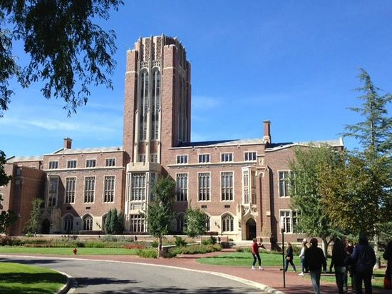
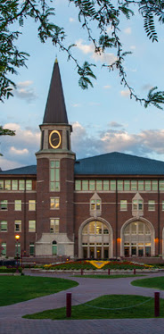
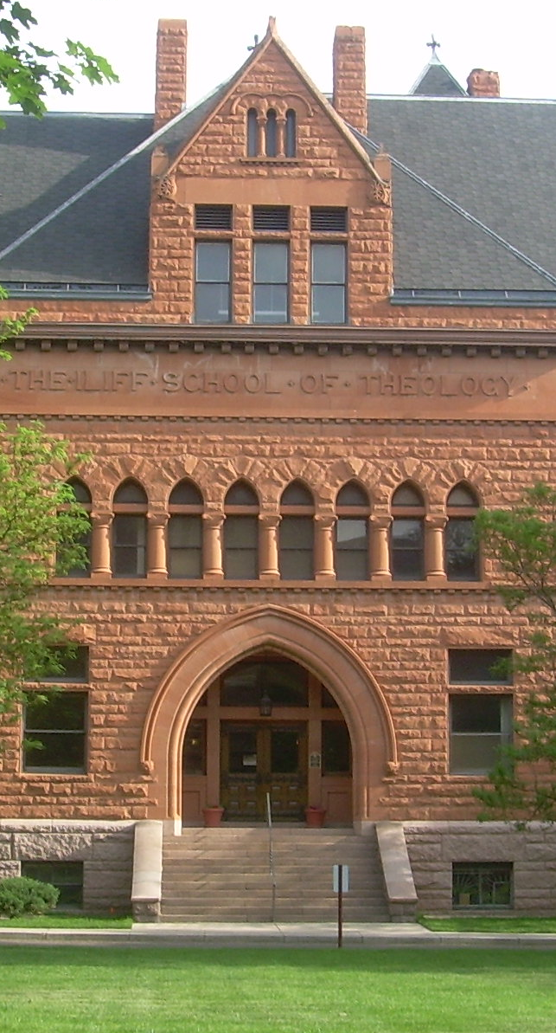
Three Institutions- One Alma

Slide 3
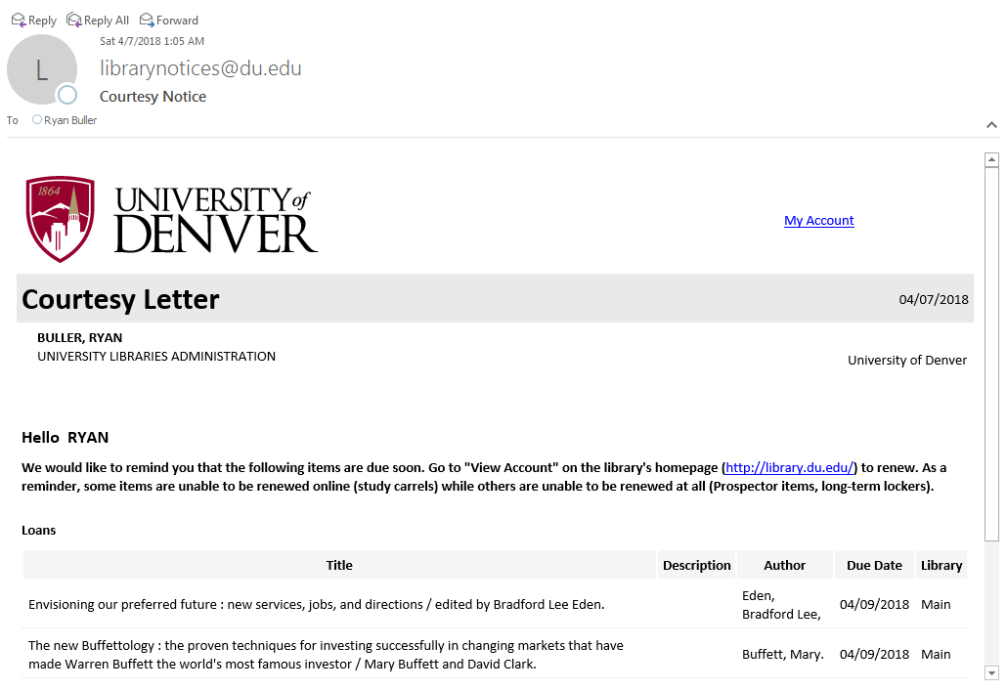


The Problem

Slide 4


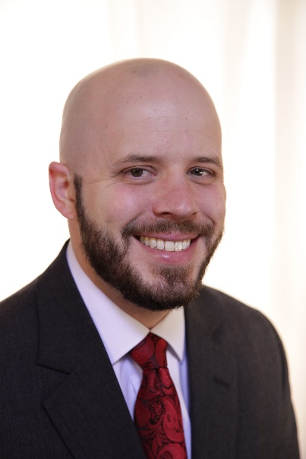
Who worked on the problem
Michael- Iliff
Micah- Iliff
Ryan- DU

Slide 5
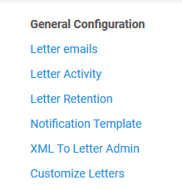
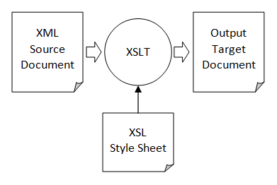
Overview of notices
Image Source:
http://anupamshakya.blogspot.com/2014/04/transform-xml-file-using-xslt-in-python.html

Slide 6
What needed to be done

Slide 7
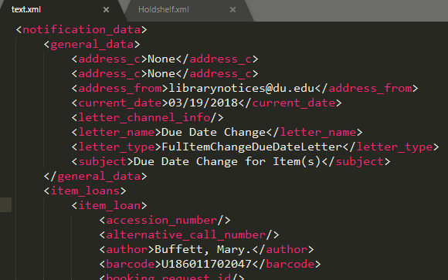
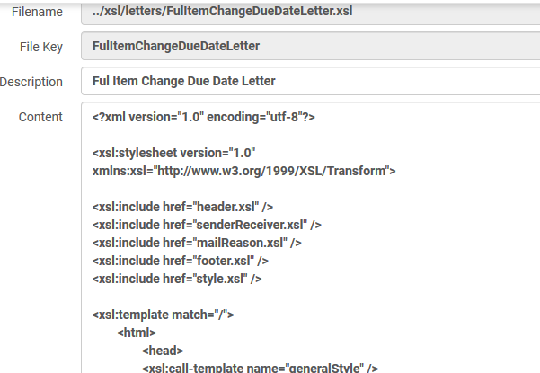
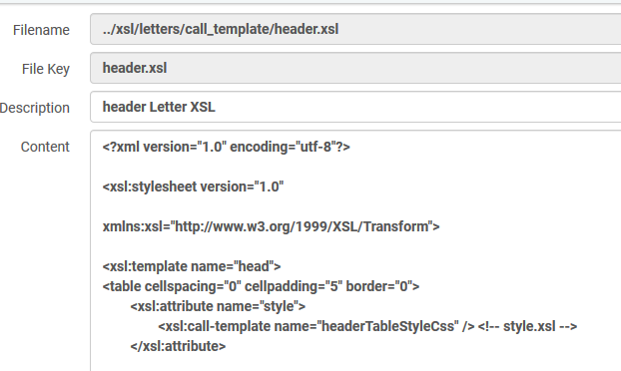
Structure of email notices

Slide 8
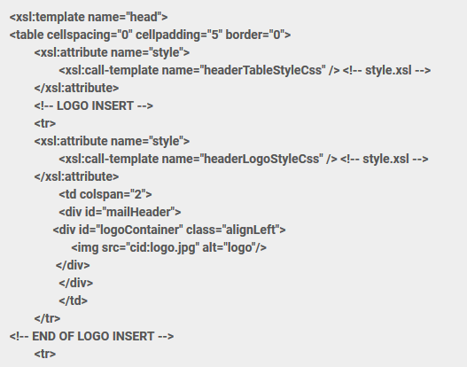
Header XSLT-default

Slide 9



Tools used for project

Slide 10
How to differentiate?
How to determine who would get what branding
  Based on patron’s home library
    Pro- provides expected branding to patron
    Con- doesn’t direct patron to the people who could help them in case of questions or concerns
  Based on owning library for the material
    Pro- branding associated with library the material belongs to
    Con- confusing for patrons; which branding when there are items from multiple libraries on one notice

Slide 11
Using XML to identify branding
Determined value to differentiate patrons and what branding/URL needed to be inserted in the notice.
<xsl:variable name="usergroup">
<xsl:value-of select="notification_data/user_ for_printing/ user_group"/>
</xsl:variable>

Slide 12
First approach…of many
Define variable outside of conditional logic
Looking at an elegant solution
Way beyond our skill level
Could get it to validate with external tools, but not within Alma.

Slide 13
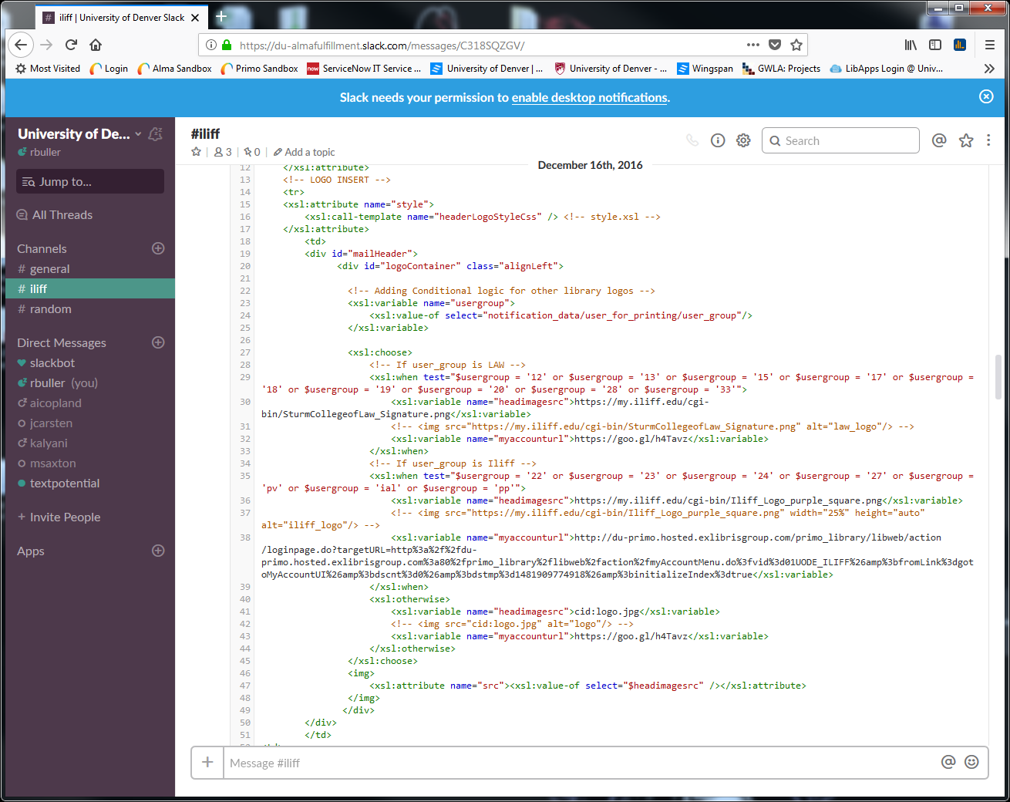
Second approach

Slide 14
Second approach continued

Slide 15
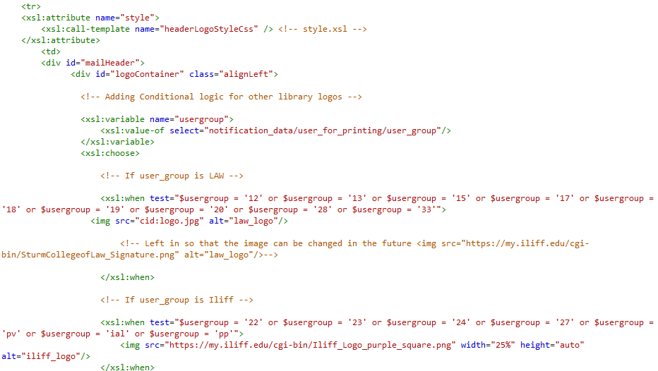
Third approach

Slide 16
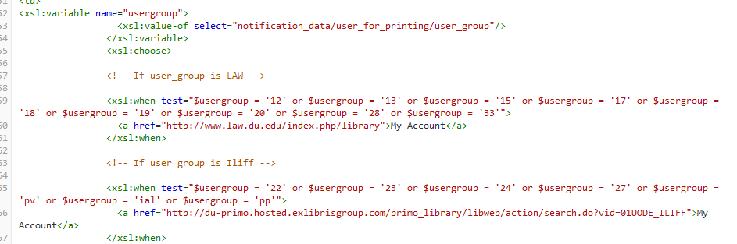
Third approach continued

Slide 17
Success!
Overdue, hold shelf, borrowing activity letters all working!
  Correct branding based on patron’s home library
  Correct URL for patron to log into their account
BUT…
Realized a week or so after implementation that some notices not sending with the correct branding/URL
Determined that the path we were using to identify what library a patron belonged to was not present in all XML

Slide 18

Fixed issue-XPath

Slide 19
Success!
All patron notices sending out!
BUT…
Non-patron emails from the system started to fail

Slide 20
Changed variable
Syntax in header indicated that there must be a value in the field for the determined Xpath.
When the path did not exist, the system didn’t know what to do.
Changed syntax to allow for when the path does not exist in the XML.

Slide 21

Success…and it still works!
This Photo by Unknown Author is licensed under CC BY-ND
Sort of…

Slide 22
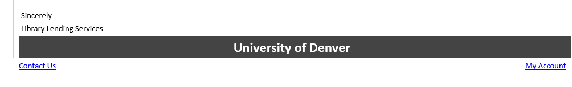
All done…
Until Micah dropped a bomb on me while working on this presentation

Slide 23
Questions?
Contact Information
Ryan Buller
  University of Denver
  Ryan.Buller@du.edu
Micah Saxton
  Iliff School of Theology
  Msaxton@iliff.edu

