Slide 1
On TRAC to Success
Creating a Multi-Institution, Statewide Fulfillment Network
Notes:
Intro by Todd
Welcome to “On TRAC to Success”, a summary of how nine Iowa academic libraries utilized Alma/Primo to create a multi-institution, statewide fulfillment network.

Slide 2
Presenters
R. Todd Vandenbark, Information Literacy & Technology Librarian, Wartburg College todd.vandenbark@wartburg.edu
Brian Thompson, Systems Librarian, The University of Iowa Libraries brian-thompson@uiowa.edu
Dawn Mick, Access Services Librarian, Iowa State University mickd@iastate.edu
Greg Davis, Assistant Director for Assessment & Planning, Iowa State University davisgr@iastate.edu
Andrew J. Welch, Librarian for Discovery Services & Technology, Drake University andrew.welch@drake.edu
Notes:
(Todd)
My colleagues and I are going to share our experiences and insights on how we made it possible for our patrons to search one another’s library catalogs, order items to be sent to any of our institutions for pickup, and allow for walk-in borrowing.

Slide 3
About TRAC and Fast TRAC
Two Rivers Alma Collaborative
Creighton University Drake University
Grand View University Grinnell College
Hawkeye Community College Iowa State University
St. Ambrose University University of Iowa
University of Northern Iowa Wartburg
Allen College
Notes:
TRAC or Two Rivers Alma Collaborative began with nine of the 11 schools you see here.
One school, Allen College, began the process with us but because of staffing shortages, was unable to fully participate and had to drop from the project.
Now that the project has fully launched and been in operation for awhile, we re-named ourselves FastTRAC.

Slide 4
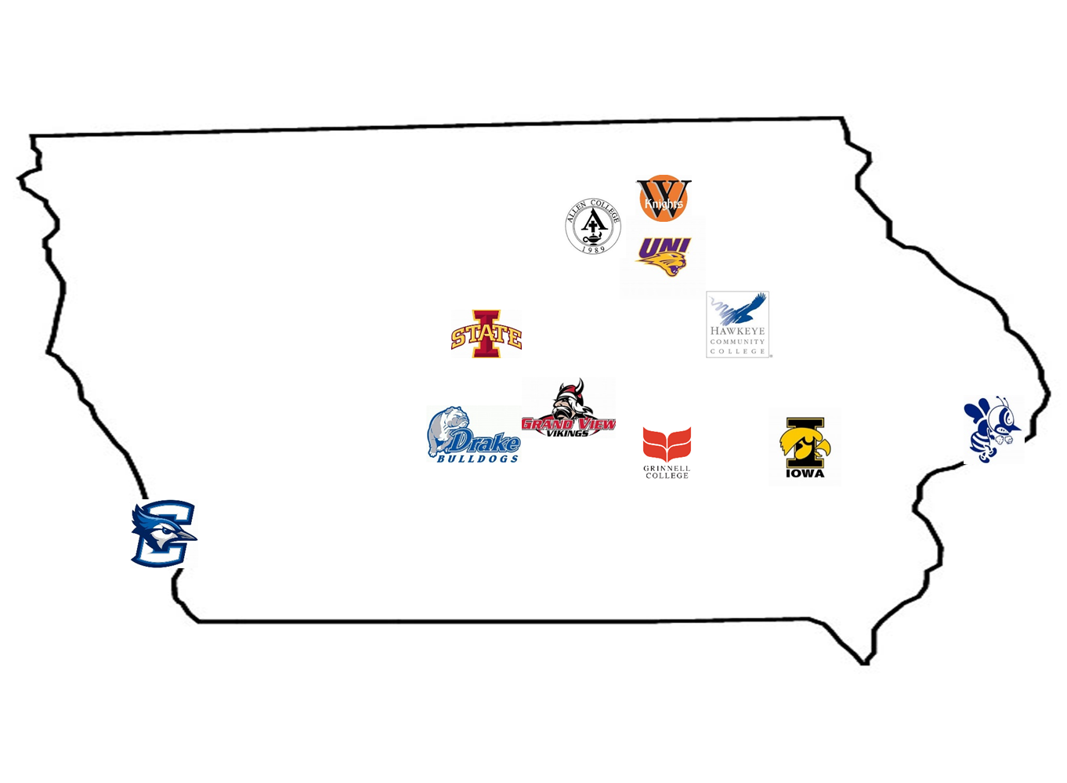
Notes:
As you can see, the schools are located across Iowa and into Nebraska.

Slide 5
Outline
Laying the Groundwork
Implementation
Looking Forward
Do’s and Don’ts for Others
Q & A
Notes:
Todd slide
We will discuss:
How the foundation was built on the experiences of four libraries’ group purchase of, and migration to Alma Primo.
The process of implementing the shared fulfillment network
Our future plans and hopes for this network
The do’s and don’ts we learned
Answer your questions as time permits.
We’ve included everything we plan to say in the Notes part of our slides, so if you don’t catch it all, you can download the slideshow to find it.

Slide 6
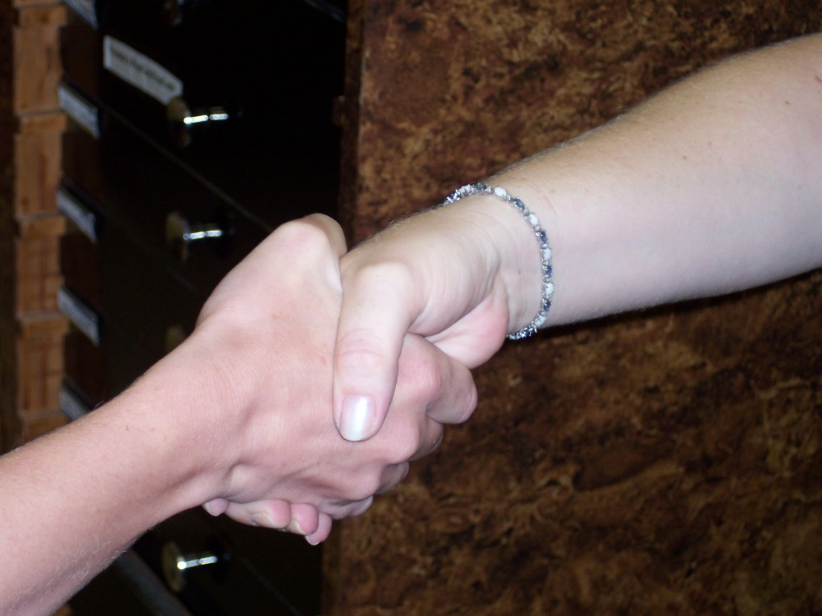
Laying the Groundwork
Building on CVLC’s experience migrating to Alma
Flexibility & Compromise
Opportunity to Build New Professional Networks
Collaboration → Satisfaction
Results in Positive PR for All
Notes:
Be flexible and compromise when needed in terms of setting up policies, procedures, etc.
Enjoyed getting to know other staff from other libraries, and sharing the ups & downs of setup, training, implementation.
Same for TRAC
Our respective administrators usually love to share with legislators, accreditation agencies, etc. that their library/institution is partnering with others. So, it is a positive PR thing for us, our library but also our institutions.
Todd’s slide

Slide 7
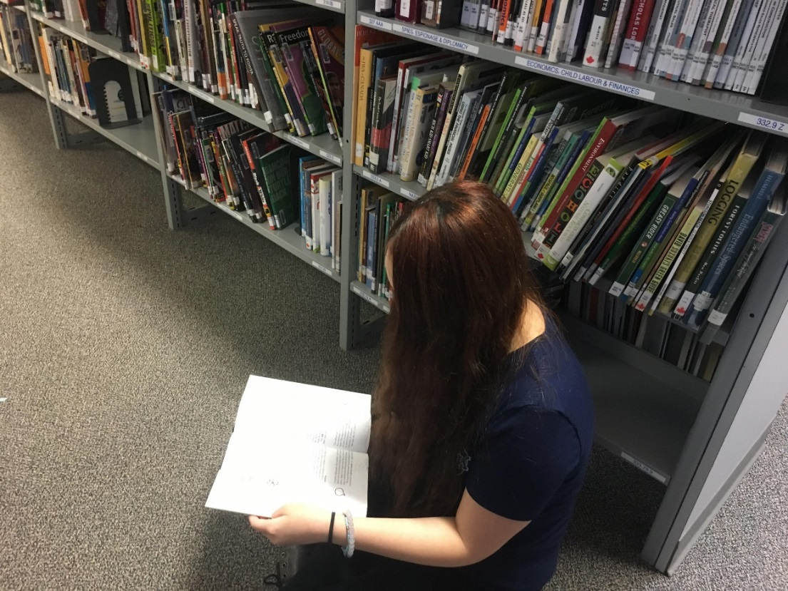
Laying the Groundwork (continued)
Pre-planning
Consider fines, lending periods, renewals
Item location(s) and material types
Notes:
Coming up with agreement amongst all institutions was needed rather quickly and often this can take a long time. But, quick compromises were put into place after some discussions. One example was loan length. One institution wanted a very short loan (28 days) while another wanted very long loans (120 days) that would be the same as another resource sharing project they were involved with. A compromise was made to set the length to 90 days.
Needed to decide what type of items we would agree to loan. Just long term loans? Would we limit by material types?
Would have forms to fill out that Ex Libris provided (Dawn will discuss further) and then over the summer of 2017 had weekly calls with Ex Libris staff for about two months to have them configure the network on the servers and work with our Collaborative.
Brian’s slide

Slide 8
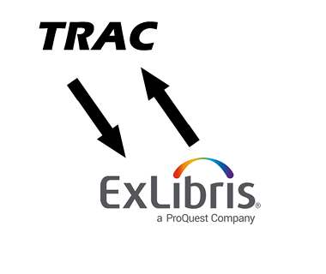
Laying the Groundwork (continued)
Communication with Ex Libris
Forms: FN Configuration
Group fulfillment details and policies
Create FN User group
Account information to be shared between institutions
Limitations & Challenges
Creating Primo search scopes
Notes:
Dawn’s slide
As part of our preparation, we had to fill out Fulfillment Network forms, discovered some limitations and challenges to our perceptions of the Fulfillment Network, as well as creating search scopes for use by our respective discovery layers.

Slide 9
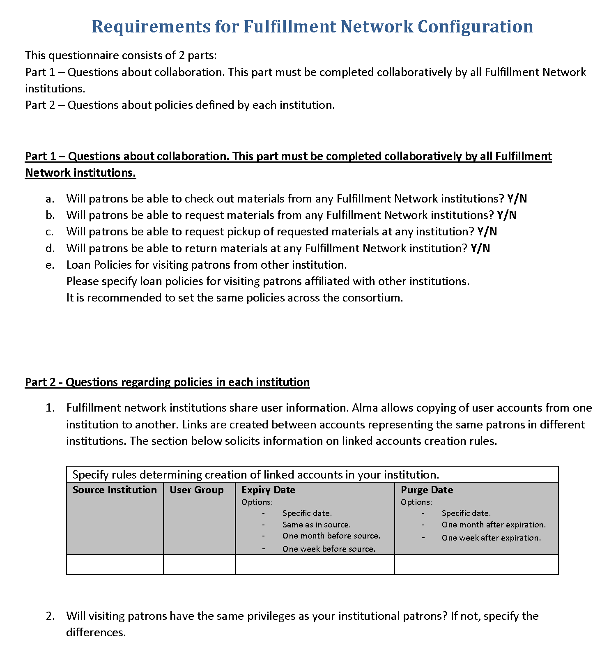
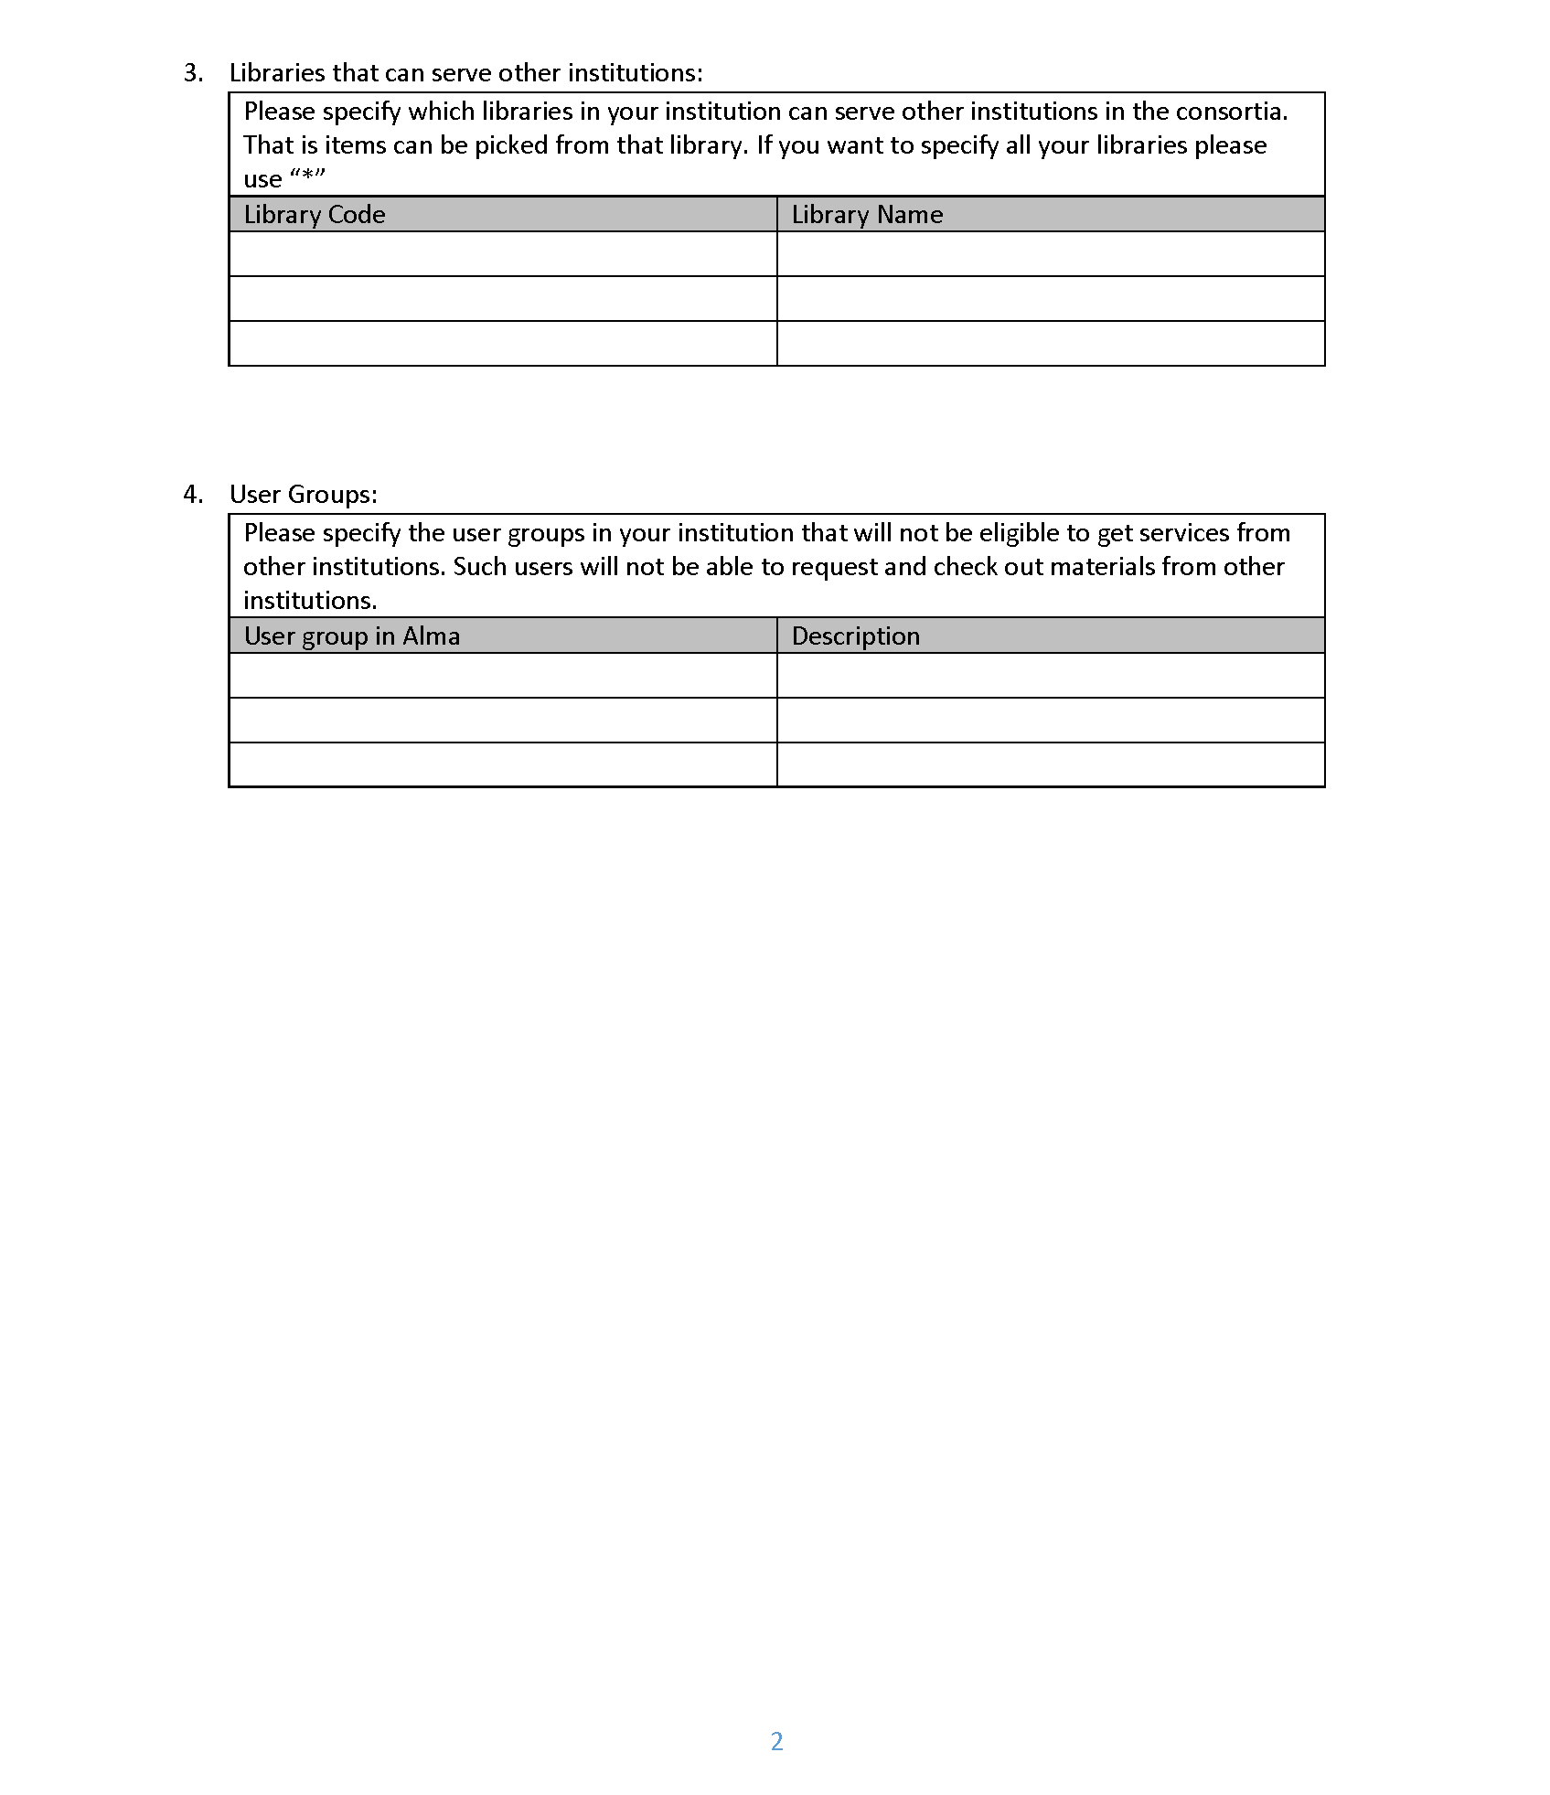
Requirements for Fulfillment Network Integration
Part 1
Part 2
Notes:
Dawn’s slide
In mid-March 2017, ExLibris gave the TRAC participants the Fulfillment Network Form, parts 1 and 2: https://www.dropbox.com/s/ascdszrsid7qm7r/FN_Questionnaire.docx?dl=0
Part 1 required institutions (as a group) to answer questions about check out, requesting, pickup, and return options at member institutions. Each institution filled out the form, providing their preferred choices for each item, and as a group, we compared notes.
Part 2 required individual institutions to create a user group defined as the “Fulfillment Network user,” as well as the expiration and purge dates of users in the FN user group. Individual institutions also needed to select which user groups would be excluded from Fulfillment Network privileges, as well as what branch or individual libraries at their institution would be included as part of the Fulfillment Network.
In late April, 2017, we were also given an addendum: https://www.dropbox.com/s/mhju3qmr5oii38v/FN_Questionnaire%20-%20Addendum.docx?dl=0
Requiring us to determine the account information we wished to share between institutions (e.g. Name, email address, physical address, etc.)

Slide 10
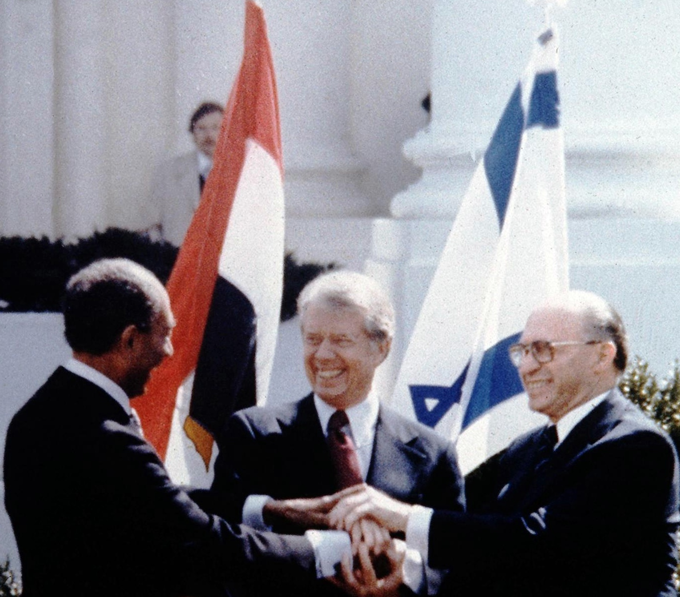
Part 1:
Agreements must be reached!
Notes:
Dawn’s slide
While we didn’t need Camp David-level negotiation, reaching agreements on loan length, fines, and replacement policies did require compromise, and no one got exactly what they wanted. For example, in addition to the variation on the length of loans, there was also much discussion on replacement cost. Some institutions wanted a fixed dollar amount, such as $150, while others wanted to go with market price. A group of representatives from most of the institutions met at ELUNA 2017 and came up with some initial agreements. These were taken back to the group at large, discussed and voted on at the end of May, 2017. We agreed to the following:

Slide 11
Final agreement
90 day loan period | No daily fines
No renewals | “Lost” at 30 days overdue
No recalls from borrowing library, only holds | Default billing price of $100 (Charged amount may vary)
Block users with one billed item
Notes:
Dawn’s Slide
As you can see, we agreed to a 90-day loan period, no daily fines, no renewals, holds only, a standard billing entry of $100 (this is entered in Alma loan rules as the standard amount, but may vary if the actual charge is different), and users are blocked at one billed item.
However, while we were able to agree on the initial policies needed for implementation, we still have policies and procedures to work out regarding billing. For example: if a billed item isn’t returned or paid for, at what point is the borrowing institution responsible for reimbursement?
Also of concern were blocks and notices.
If a patron is blocked at one FastTrac institution, will the other institutions see that? The ability to copy Network blocks became available during a subsequent release, so that question has been resolved.
Notices – since the home institution doesn’t receive any of the notifications sent to our patrons, and we can’t see them under the Attachments tab in the patron’s account, we wanted to have the home institution copied on the notifications. That option is not available at this point; however, with the advent of the network activity tab, we can see what the patron has checked out at a TRAC institution.

Slide 12

Part 2:
Who’s In?
Who’s Out?
Notes:
Dawn’s slide
Part 2 of the ExLibris forms required each institution to decide which, of their local user groups, would be part of the Fulfillment Network, as well as the expiration and purge dates of these accounts. We also had to specify which libraries in each institution could serve walk-in patrons and as a pickup location. I believe all of the institutions chose to restrict access to those users who had full privileges at their libraries, generally students, faculty, and staff. As Andrew will explain, these forms and the information requested on them, had some limitations and challenges that we didn’t anticipate…

Slide 13

Communicating with Ex Libris
Excluding select user groups, libraries, and locations
?
!
User Groups
Identified on questionnaire
Successfully excluded from fulfillment network
Libraries
Identified on questionnaire
Not initially excluded from discovery
Locations
Not identified on questionnaire
Not initially excluded from discovery
Notes:
Andrew’s slide
During our discussions with ExL about Resource Sharing vs. Fulfillment Network, we were assured by ExL that we would be able to exclude libraries and locations from the fulfillment network view in Primo that were either not participating or already a non-requestable Fulfillment Unit. This was important, as we didn’t want patrons to discover items at another institution, only to realize that the item is actually not requestable. What we failed to do is ask what mechanism would be used for these exclusions; would it be a configuration in Alma or Primo? Would Ex Libris need to do the configuration, or would each library be able to manage it themselves?
The forms Dawn mentioned covered Libraries and Patron Groups, but we realized after ExL created our Primo view that excluded libraries were still discoverable. At about that same time, we realized that we hadn’t yet done anything to exclude non-requestable Locations from discovery, and we were told that Ex Libris was investigating whether that was possible (yikes!). Luckily, it was, and it was just a matter of each institution providing ExL with a list of Locations to include, and they were able to make it happen fairly quickly, but in retrospect this information should have been gathered as part of the Questionnaire.
The takeaway: check with the ExL implementation team early and often about which user groups, libraries, and locations will be included in (or excluded from) the fulfillment network.

Slide 14
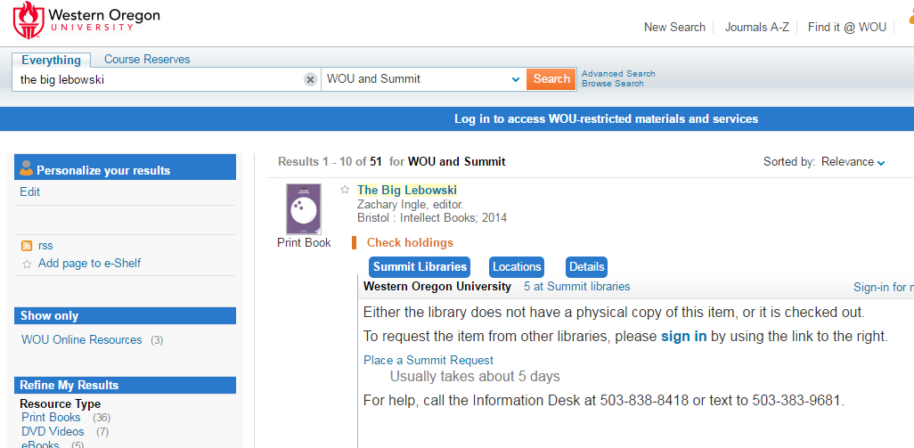
Search Scope and De-duplication
We thought we were getting this
Notes:
Andrew’s slide
One of the biggest surprises for me, and I know some others were surprised as well, is that, while we can search all TRAC libraries with a single scope, the results themselves are not de-duplicated. So if each library owns a copy of the same edition of Tom Sawyer, 8 separate results for Tom Sawyer appear in the results list. Looking back at the materials Ex Libris presented to us, I think the reason for my confusion is that the examples and screenshots were from Network Zone partners. Ex Libris showed an example of a request where the user selected the lending institution from a dropdown menu, and then specifically mentioned that a future release would allow us to automatically assign the lending institution via rota. However, only after our Primo environment was released to us for testing did we discover that deduplication and FRBRizing was outside the scope of our project and would require additional project work and charges.
Not wanting to delay the fulfillment network, TRAC decided to move forward, see whether the discovery interface presented problems for users (or created unbalanced request loads for any institutions), and save the de-duplication discussion for the future. As we add libraries to Fast TRAC, the duplication will become even more noticeable.

Slide 15
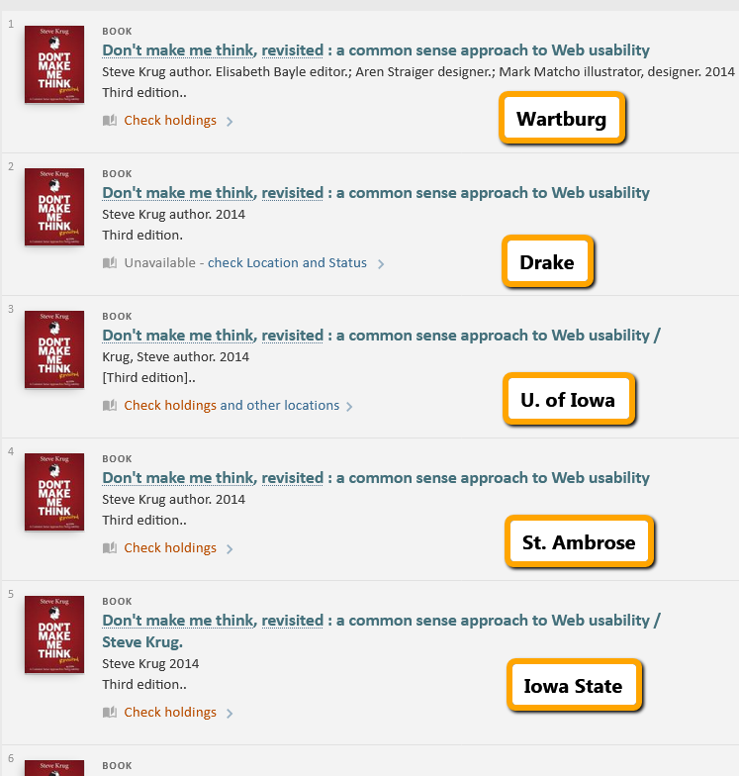
Instead…
Notes:
Andrew’s slide

Slide 16
Search Scope and De-duplication
Initially, each institution was its own scope. Combining them was an easy fix.
Confusion about how combined results would appear in Primo.
As we add more libraries to Fast TRAC, the issue will grow.
TRAC will decide whether to pursue a de-duplication project.
Notes:
Andrew’s slide

Slide 17
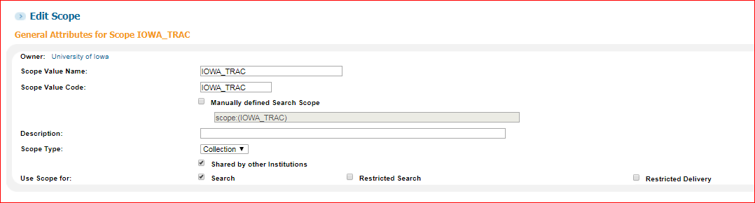
CREATing primo search scopes - SCOPe Definition
Notes:
Brian’s slide
Create Scope
Be sure to check “Shared by other institutions”
Should then be able to view other institution’s search scopes (e.g. ISU_TRAC, DRU_TRAC, etc.)

Slide 18
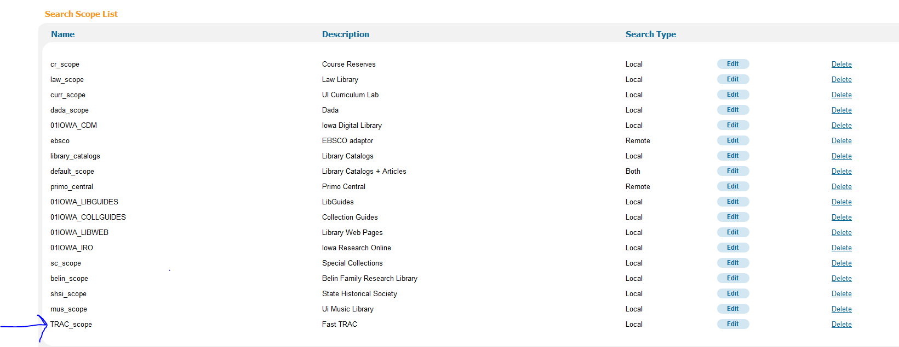
CREATing primo search scopes - Search SCOPe Definition
Notes:
Brian’s slide
Create a search scope value in your view
Either create new or add to existing search scope

Slide 19
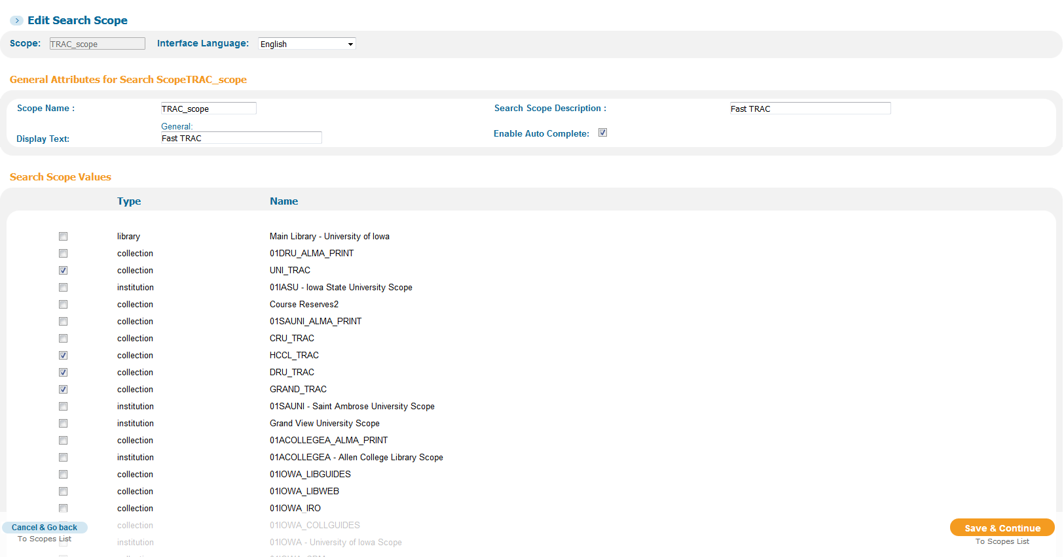
CREATing primo search scopes - Search SCOPe Definition (CONt.)
Notes:
Brian’s slide
1. Be sure to add each scope from other institutions

Slide 20
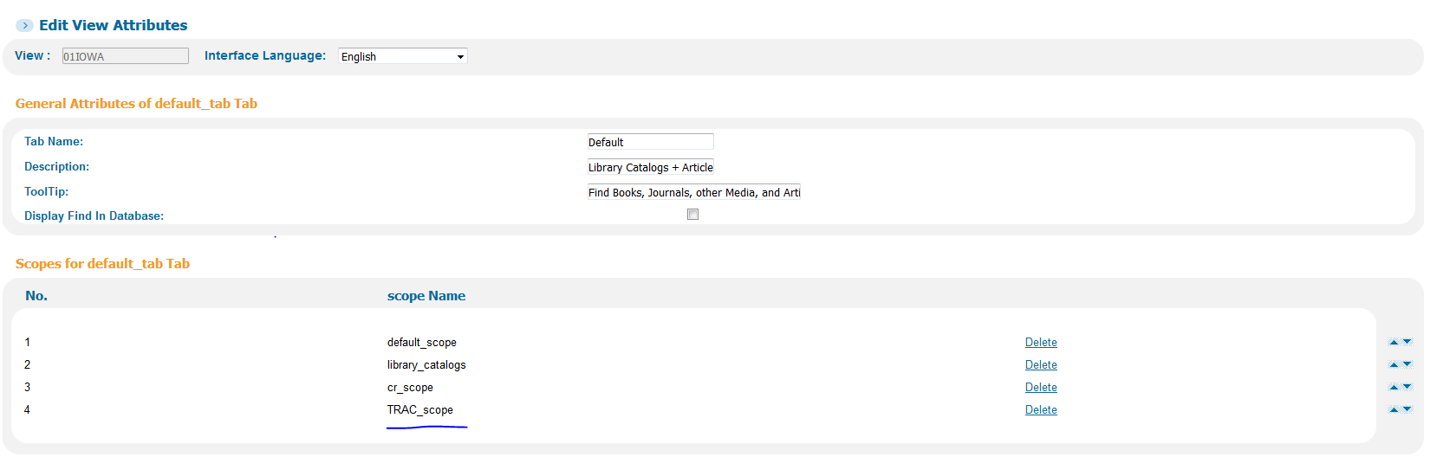
CREATing primo search scopes - Add to view
Notes:
Brian’s slide
1. Add to view

Slide 21
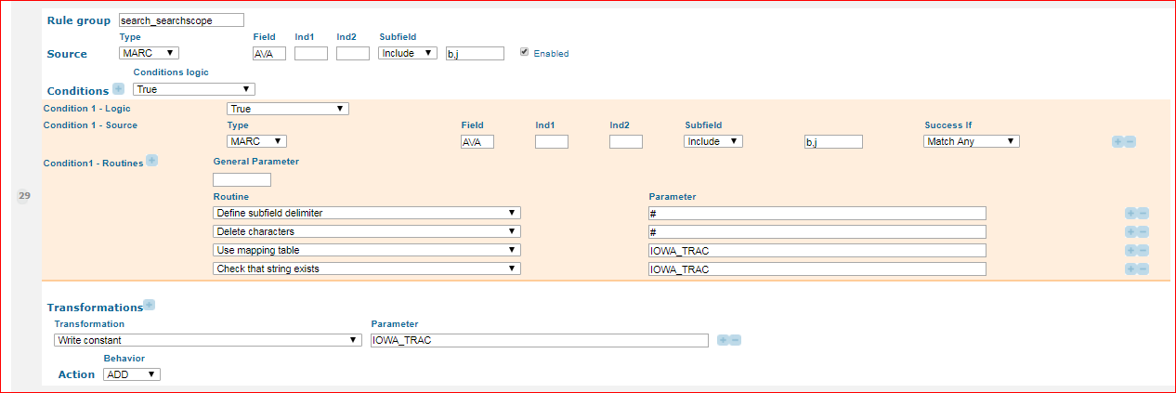
CREATing primo search scopes - Normalization Rule
Notes:
Brian’s slide

Slide 22
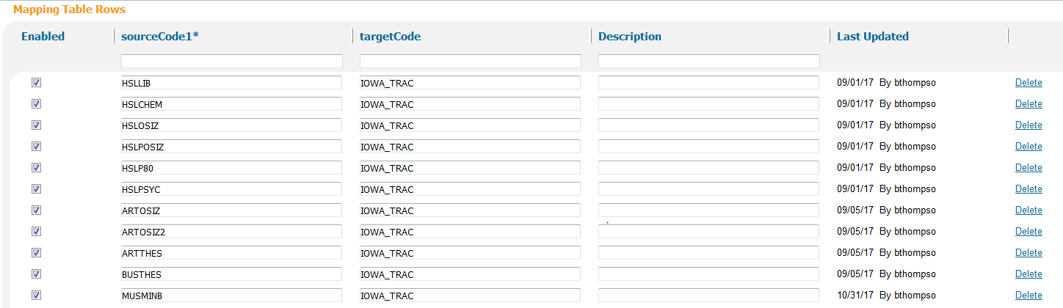
CREATing primo search scopes - Mapping Table
Notes:
Brian’s slide

Slide 23

Laying the Groundwork (cont’d)
Inter-institution communication and concerns
Shareable patron information
ID cards & characters
Insufficient staff for one small library
Notes:
Dawn’s slide
In late April 2017, ExLibris gave the TRAC group an addendum to determine which patron information to share when setting up linked accounts, such as name, phone number, physical address, etc. As with the policies in the Part 1 paperwork, there was a variety of answers. However, at Iowa State, once we passed our original recommendations (first name, last name, email address and phone number) to our central IT department, they had concerns about linked accounts sharing too much PII. They approved sharing of first and last name and email address only. The rest of the TRAC group was willing to agree to those terms so that Iowa State could remain involved.
ID card issues: Wartburg & UNI used the exact same card format (9-digit ID followed by 2-digit lost card code). Prior to Alma our ID numbers had an institution abbreviation appended to each patron record. Then the card readers were hard-coded to add that abbreviation at card swipe. This had to be undone by our ITS department.
Finally, Allen College had a staffing cut (from 2 people to 1) and had to drop from the project. Their institution scope is still available for those who wish to go there in person, though some schools have chosen to remove it.

Slide 24
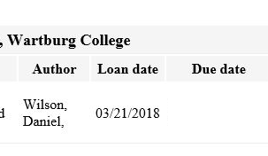
Implementation
Testing
Issues encountered
Letters & missing information
Default pickup institution
Seeing activity in other institutions via Alma: inconsistent
Request link missing for some
Workflows
Notes:
Multiple presenters
Bugs we found -- Brian & Todd
Letters & missing due date information. XML in Fulfillment letter is different than others. -- Todd
Missing loan due date: we were setting up our fulfillment network in the summer of 2017 and this “known issue” was set to be resolved in Q4 of 2017 by Ex Libris.
One institution (Hawkeye) missing title, loan date and other information. After several attempts by an Ex Libris representative to fix the letter for Hawkeye, resetting it to the default restored everything they were missing except the loan due date.
Default Pickup Institution = Patron doesn’t work as documented. - Brian
See activity in other institutions via Alma: not consistent across our institutions
Request link not

Slide 25
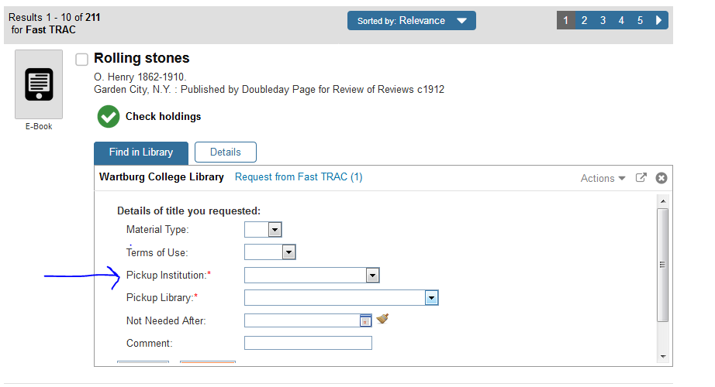
Issues with defining pickup institution
Notes:
Defining the pickup institution as the patron’s institution for the default did not work. Here, it should show ‘University of Iowa’ as the pickup institution as the patron is a U of Iowa patron.
Iowa submitted SI #00460093 on bug with Ful_Network_Default_Pickup_Inst. setting. It has been sent to development, no update since last fall.

Slide 26
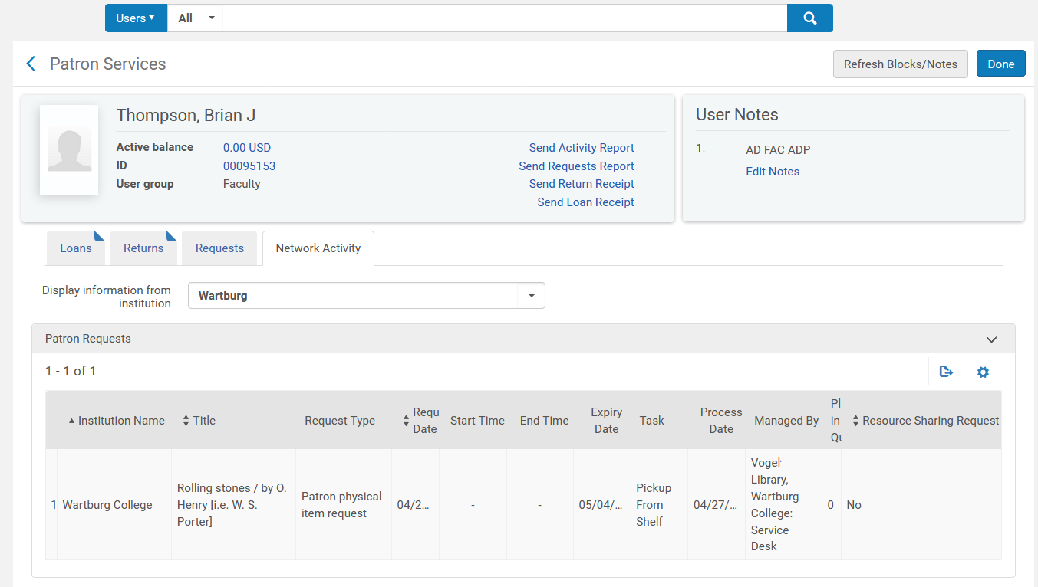
Inconsistency viewing patron activity from other institutions – view from ‘Manage Patron Services’
Notes:
Here, the loans and requests from other institutions can be viewed. This was not initially there last summer, but added in the November. It has been very helpful for staff in tracking issues with loans and requests done via the fulfillment network.

Slide 27
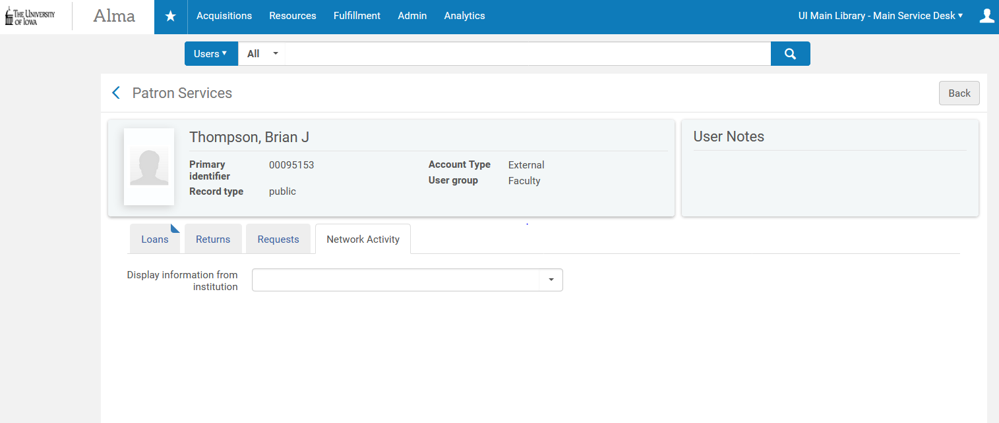
Inconsistency viewing patron activity from other institutions – view from User record
Notes:
Here, the drop-down menu is empty and no institutions are listed.
This inconsistency was reported by Iowa as SI # 00487062 – fix scheduled for May 2018 release. FN not setup in sandbox, so can’t test just yet.

Slide 28
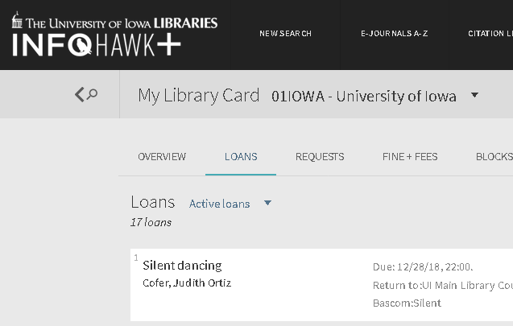
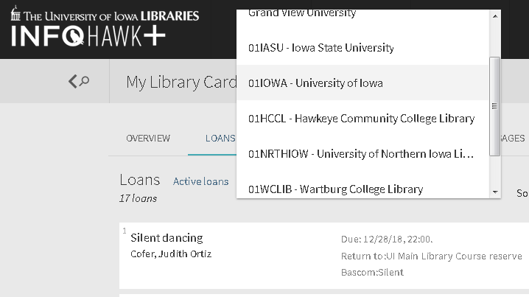
Viewing loans in New UI
Notes:
In the new Primo UI, it is not easy to identify that you can change institutions to see what you have on loan or request with them.
Other sites, such as Wartburg have addressed through CSS.

Slide 29
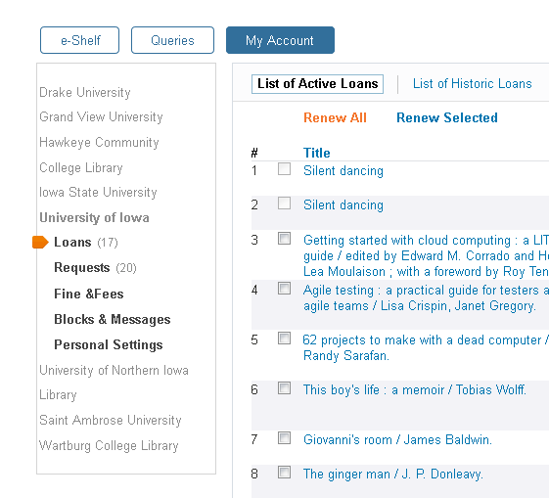
Viewing loans in New UI (Cont.)
Notes:
In the classic UI, you still needed to look at each institution separately, but was clearer to initially see.

Slide 30
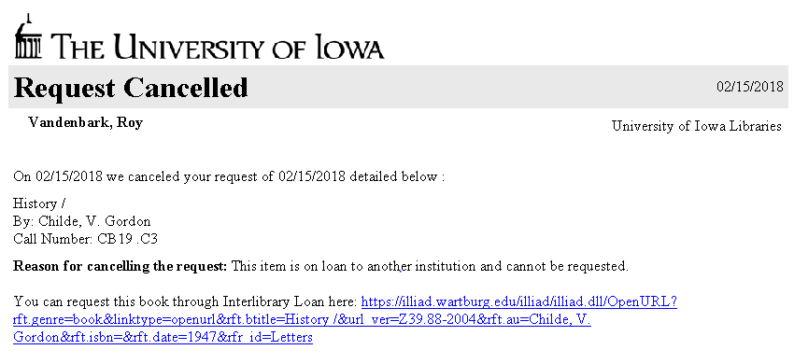
Cancelling letters
Notes:
Added some code to default letter so that if a TRAC request was cancelled, that a link would be there to send a request to the appropriate ILL unit and not the unit of the institution cancelling the request. For ILLiad users, the form will be prepopulated. A few sites though just have a basic web form and are currently just linking to the form.
Other issues: library facet names that were too common had to be redone – format issue at Iowa because of localnormalization rule for pbooks from Primo Central.

Slide 31
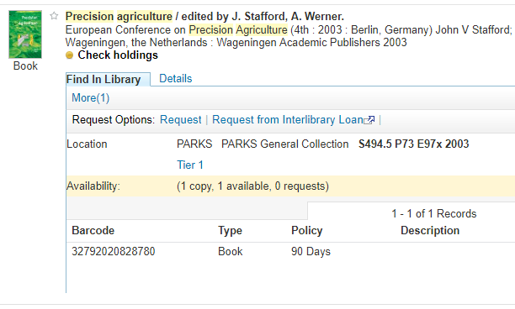
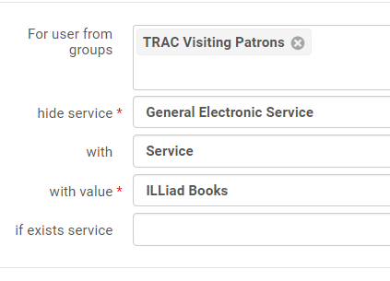
Request Links
Display Logic Rule fix:
Yep!
Nope
Notes:
Andrew’s slide
We did have some issues during testing where the Request link in Primo wasn’t being offered when we thought it should be. Some of these turned out to be for legitimate reasons, like a test user’s Patron role had expired, or a Display Logic rule needed to be adjusted. In at least one situation, the problem stemmed from a user’s credentials not getting passed for authentication, and ExL was able to resolve that pretty quickly.
The placement of the Request link also caused some confusion.
We also found that Display Logic Rules for things like Interlibrary Loan services needed to be edited to account for the new user group.

Slide 32
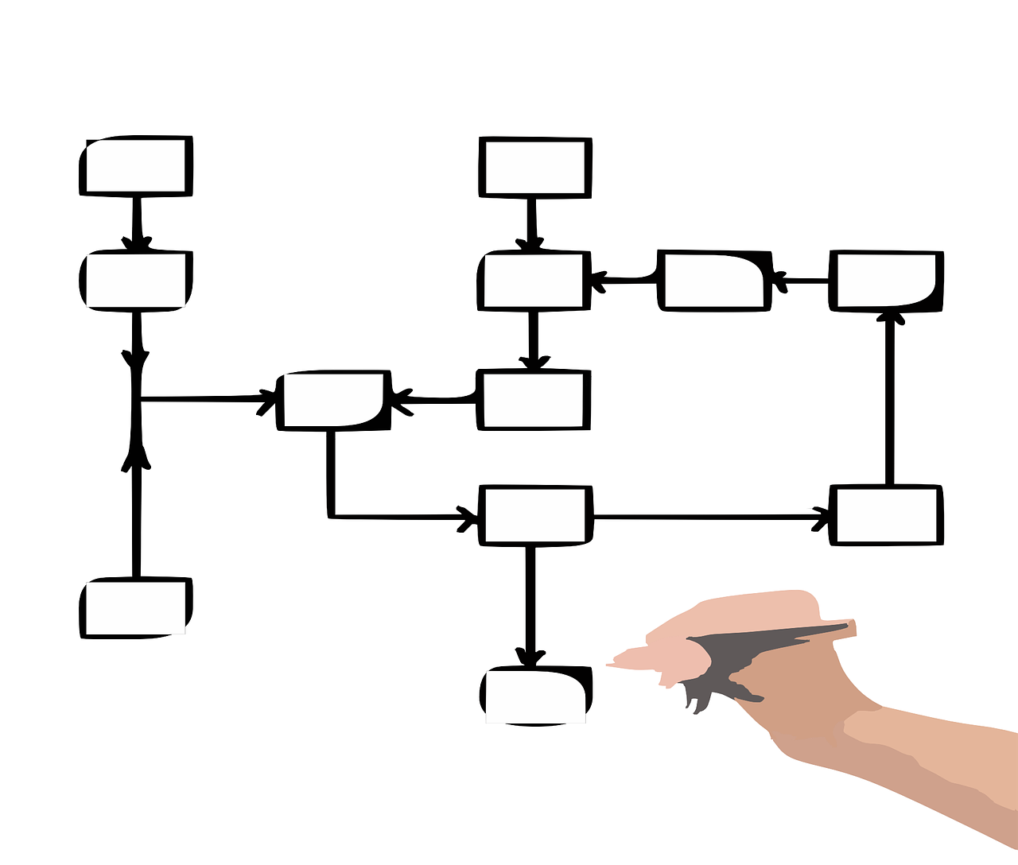
Workflow
Notes:
Dawn’s slide
Implementing the Fulfillment Zone didn’t negatively impact workflows all that much. For most of the FastTrac institutions, ILL units handle the pulling and lending of these requests and receiving items from the lending institutions, while the Circulation units check out the books to borrowing patrons. At Iowa State, we ran into a bit of an issue because the Circulation unit is on a completely separate floor. I didn’t want to have our ILL students running to a different floor to pull these pull slips from the printer, since it is completely out of the workflow they use for everything else. Due to Alma’s printing configuration, we couldn’t print pick slips to both our ILL printer AND our Circulation printer. We tried using the Resource Sharing Library as a printing location, but that messed up marking the item as In Transit. Our workaround for this was to export the Print Slip Report as an Excel file and create a mail merge document that was formatted similar to our ILLiad pull slips, but marked as a FastTrac item so that our students would process them correctly. This has worked well for our needs, but wasn’t something we anticipated before implementation.

Slide 33
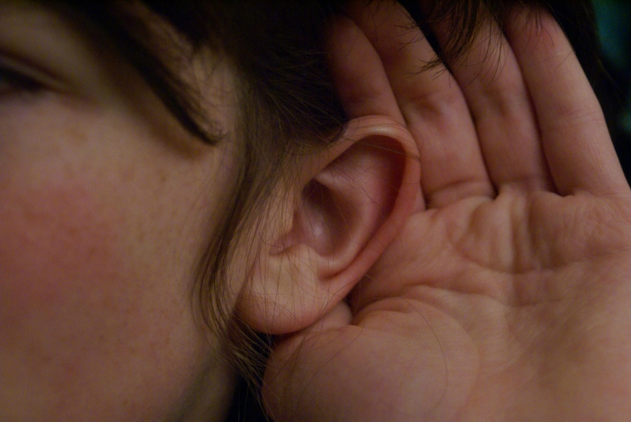
Implementation: Go-Live
“Soft” rollout
Classes & word-of-mouth primarily
Other options: signage, meeting announcements, flyer to new faculty, newsletter in bathroom stalls
All: training
Notes:
Dawn’s slide
Most institutions chose to take a “soft” approach to rolling out this new service, with many planning more formal efforts in the fall of 2018.
Other approaches included: social media, announcements at faculty meetings, signage, even flyers in the bathroom stalls.
After a recent vote, the service was formally named FastTrac, and most institutions are planning on a larger promotion during Fall 2018.

Slide 34
Training
Walk-In Borrower workflow @ UIowa
Check Out Procedure
Lending workflow @ UIowa
Branches
Main Library
Notes:
Created local documents at Iowa that we then shared with others that were both a step-by-step process of handling TRAC requests and loans, as well as information to handle problems that could arise (e.g. barcodes that won’t match up with patron from other institution).
Created separate documents for handling walk-in borrowing and handling requests that needed to be delivered.
Brian’s slide

Slide 35
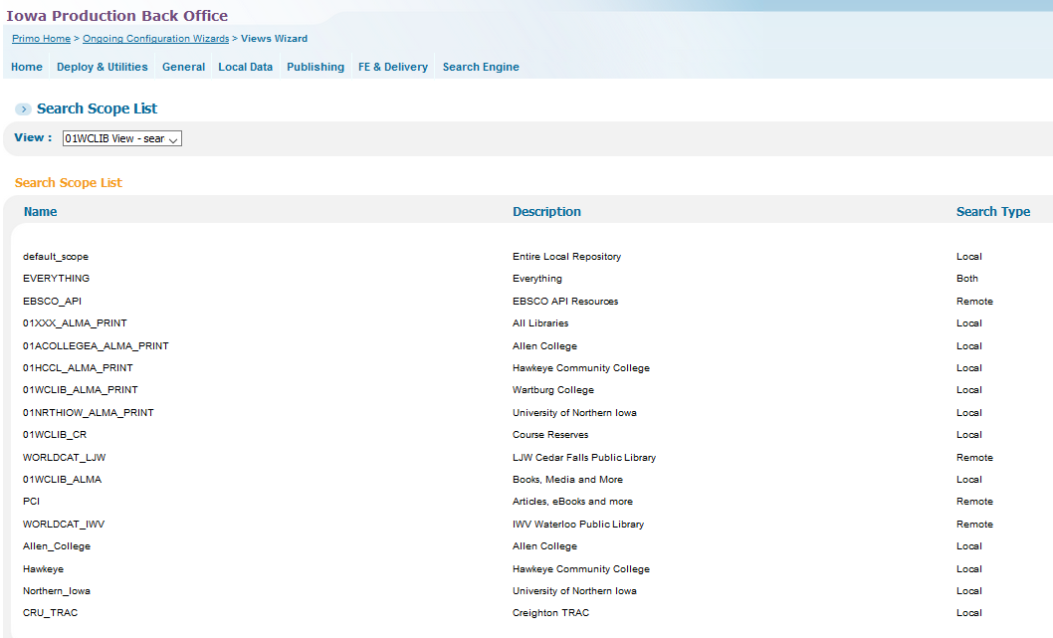
Implementation: Current Status
Current status
Fulfillment Report
Primo searching stats
Notes:
Greg’s slide

Slide 36
Consolidated TRAC Resource Sharing Report
Process:
Notes:
Greg’s slide

Slide 37
Information available
Fulfillment metrics
Notes:
Greg’s slide

Slide 38
Information available
Lending distribution across TRAC institutions
Notes:
Greg’s slide

Slide 39
Information available
Return Due Day metric
Notes:
Greg’s slide

Slide 40
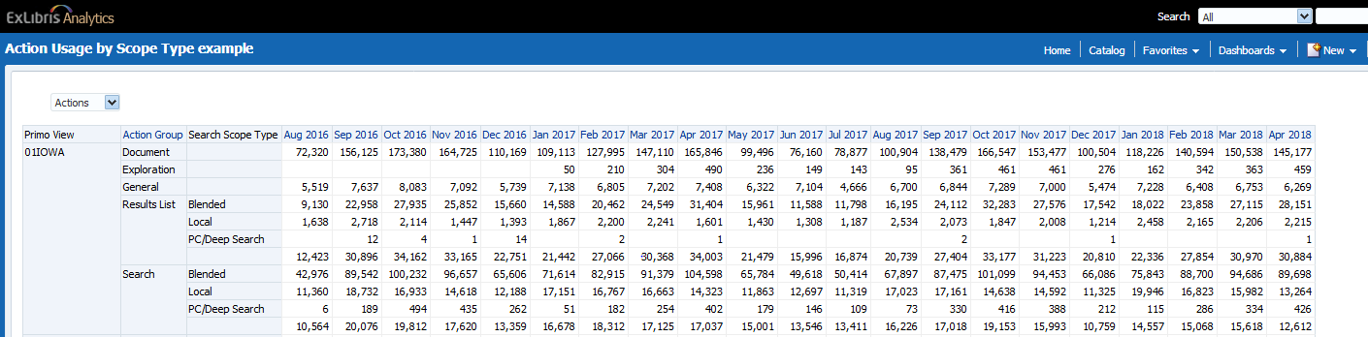
Primo searching stats
Notes:
Unable to run stats by search scope within view
Can only run by search scope type within view
Idea Exchange - https://ideas.exlibrisgroup.com/forums/308176-primo/suggestions/32978050-search-slot-scope-profile-usage-in-primo-analytics
SI # 00489792
Brian’s slide

Slide 41
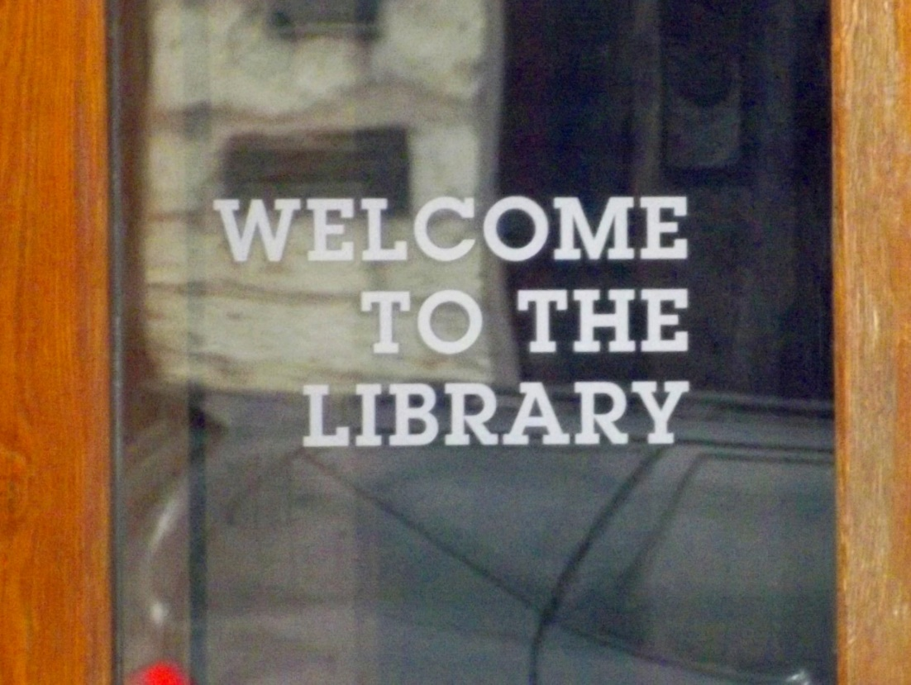
Looking Forward
Next Steps
Deduplication & search scopes?
Adding new members
Notes:
Andrew first and then Brian
As mentioned earlier, TRAC will need to consider whether to launch a deduplication project with Ex Libris.

Slide 42


New Members
Notes:
Creighton would like to go live this fall, might have to wait until winter break
Grinnell is just moving to Alma and Primo – unclear how soon they will join
Brian’s slide

Slide 43
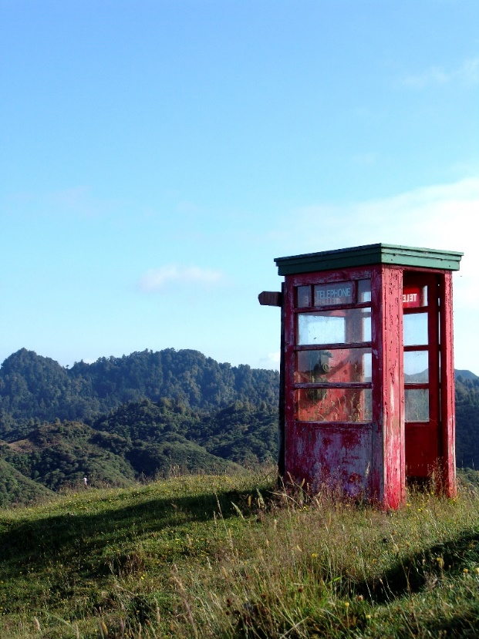
Advice to other groups
Planning
Loan periods, fines/fees: be flexible
Communication:
Bring your IT department in early
FTP server for Alma
Authentication and student management systems
Shared knowledge & skills
Notes:
Todd’s slide
Planning: be flexible about loan periods, fines/fees, etc., which Dawn has already covered.
Communication
Bring your IT department in early
Programming with different student management systems and Alma
Alma needs an FTP server for the handoff of patron information through “integration profiles”, which more than one institution had to create from scratch.
Different institutions had different standards about what PII (personally identifiable information) to share.
More than one institution had to implement new authentication systems to interact with Alma and local student management systems (ex: ADFS at Hawkey & Wartburg), systems that IT staff were unfamiliar with and, in some cases, resistant to.Shared knowledge & skills: larger institutions with more manpower to dedicate to troubleshooting have been invaluable in their support of smaller libraries with fewer staff
Shared knowledge & skills: larger institutions with more manpower to dedicate to troubleshooting have been invaluable in their support of smaller libraries with fewer staff

Slide 44
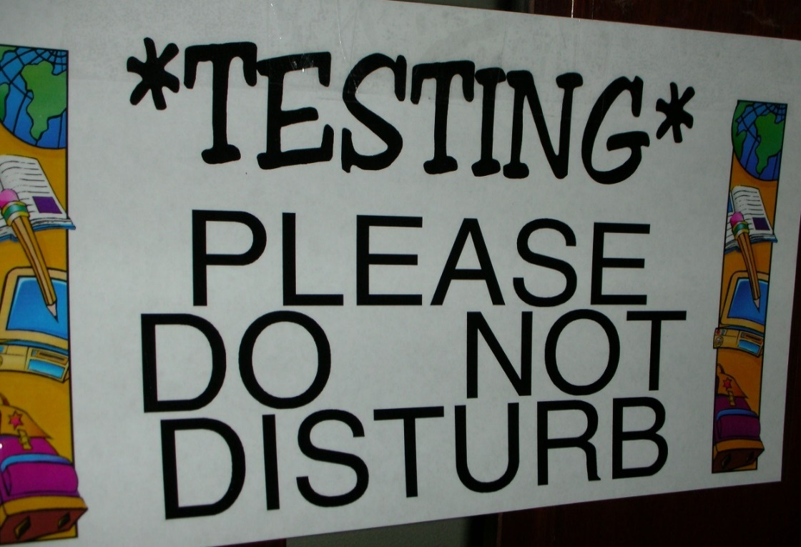
Advice to other groups
Testing
Brainstorm all possible scenarios
Test every possible letter you will use
Conduct usability testing if possible
Notes:
Todd’s slide
Testing
Brainstorm & test as many scenarios as possible
Send actual items so each library can test its entire workflow. Virtual testing insufficient.
Test every possible letter you will use, and come to consensus on their minimum content. Modify slips so:
Destination institution is at the top
(On Hold Shelf Letter) Item Being Held letter to put in bold and large letters the pickup location, so patrons know exactly where to pick up their items.
Conduct usability testing if possible

Slide 45
Q & A

Slide 46
Resources
Alma Analytics Institution level report Located in the Alma Analytics Shared Folders Shared Folders>Community>TRAC>Reports>TRAC Visiting Patron Detail Report
Excel macro enabled template with VBA macros
Link to Excel file: https://iastate.box.com/v/TRACTemplate

