Slide 1

Communication +
Collaboration in the
Orbis Cascade Alliance
Molly Gunderson | Holli Kubly | Anne Pepitone | Cassie Schmitt

Slide 2
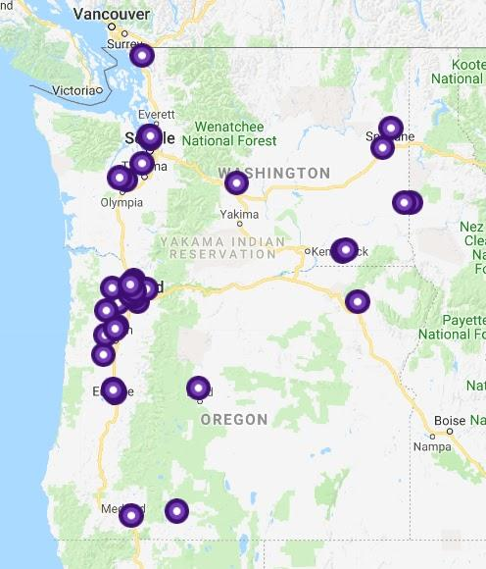
Orbis Cascade Alliance – Background
“The Orbis Cascade Alliance enables member libraries to advance institutional missions through collaboration and innovation.”
Notes:
Cassie 39 Members: Private & Public Colleges, Universities, Community Colleges in Oregon, Washington, and Idaho
Through our programs we serve 280 colleges, universities, archives, museums in Oregon, Washington, Idaho, Montana, Alaska, Hawaii, and Utah serving over 275,000 students and faculty
We are a non-profit corporation - founded in 1993. We currently have 11 FTE and it’s important to note we have, no central funding so all of our funds come directly from membership dues.

Slide 3
C to C
Collaborate
to
Customize
Do things together where we are substantially the same
Free up resources so members can fully realize their unique qualities
=
=
Notes:
The Alliance is member-driven, meaning members define priorities and participate in all the work of the Alliance.

Slide 4
Organizational Structure
Council
Board
Finance Team
D
Discovery & User Experience Team
Resource Sharing & Fulfillment Team
Shared Content & Tech Services Team
Systems Team
Unique & Local Content Team
Standing Groups
Project Groups
Notes:
Cassie; Council governs the Alliance and has 1 representative from each member.
The Board is elected from Council and provides overall guidance to the staff and the organization.
Teams are appointed each year to fulfill the mission and goals of the Alliance.
Teams appoint standing and project groups to carry out work.

Slide 5
Program Areas
One Program Manager for each area:
Discovery and User Experience
Resource Sharing and Fulfillment
Shared Content and Technical Services
Systems
Unique and Local Content
Notes:
Cassie: Our program areas in services run across a wide range of activities including providing resource sharing and managing a courier service, jointly purchasing electronic materials including journals and ebooks, managing Archives West a finding aid portal for archival and manuscript collections, and managing a shared ILS with Alma with a Network Zone and shared discovery with Primo. In our structure we have program managers who work with members in their area to further Alliance goals and work to build shared systems, workflows, and policies.
Some Alliance programs are opt-in, while others are Alliance-wide. Non-members participate in selected services on a fee basis.

Slide 6
Anatomy of a Team
Team Name
Alliance Staff
Team Chair
Members
Institutional Representatives
Council Rep
Activities
One from each institution
Notes:
Holli
Teams are led and made up of members and staffed by Alliance Program Managers.
Guide consortia work in their area based on Member input
Team members use background and experience to inform the team’s efforts to work for the good of the entire membership
Develop documentation, training and support for Members
Teams are interconnected; work on projects together

Slide 7
Communication Tools
Email
Listservs
GoToMeeting
Slack
Trello
Google Drive
Github
Notes:
Holli

Slide 8
Open Calls
Monthly meetings from each Program Area
  Networking
  Training
  Creating policy
  Best Practices
  Workflow
  Show and Tell
Notes:
Anne

Slide 9
Challenges
Geographically spread out
Never enough documentation
Member engagement
  Ebbs and flows in participation
  Differing levels of expertise, depending on personnel at member libraries
  Despite this, we get a great deal accomplished!
Notes:
Anne

Slide 10
In-Person Opportunities
Summer Meeting
Special topic days
  Summit and Fulfillment Day
  Primo Day
  Archives & Manuscripts Service
One-off trainings
  Analytics Training
  Accessibility
  Copyright
Notes:
Molly

Slide 11
Outreach
Mentorship Program pilot in Resource Sharing & Fulfillment this year
Alliance staff reach out to members
Informal conversations between members
Notes:
Molly

Slide 12
Discussion Panel
Molly Gunderson
Access Services Manager
Portland State University
mgun2@pdx.edu
Holli Kubly
Web Services Librarian
University of Oregon
hkubly@uoregon.edu
Anne Pepitone
Resource Discovery & Library Management Systems Coordinator
University of Washington
annepep@uw.edu
Cassie Schmitt
Program Manager
Discovery & User Experience
Orbis Cascade Alliance
cschmitt@orbiscascade.org

