Slide 1
Practical Applications for Teaching Academic Writing to ESL/ELL Students: A Teacher vs. Student Perspective
MAtSOL Spring 2018
Presenter: Judithann walz
Co-presenters: Haru Huang & Zhaoyu wei

Slide 2

Overview
Project Objectives
Survey Results
Student Challenges
The Writing Process
Recommendations
Summary

Slide 3

Project Objectives
Provide practical applications for teaching academic writing to ESL/ELL students to prepare them for the demands of university in America
Provide recommendations on how to better help students master academic writing

Slide 4
Areas Students Struggled In

Slide 5
Demographics of ESL/ELL Learners

Slide 6
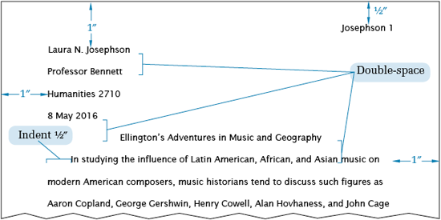
Common Student Challenges I
The MLA Style Center: https://style.mla.org/formatting-papers/

Slide 7
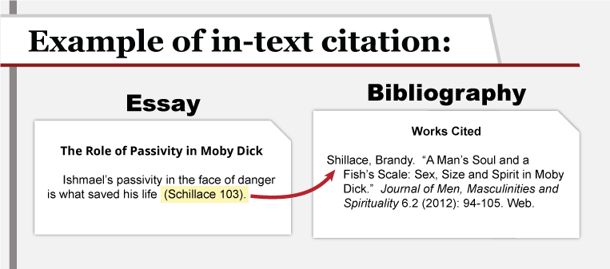
Common Student Challenges II
Universities Libraries: http://guides.library.unlv.edu/cite

Slide 8

Common Student Challenges III
How to express idea correctly in English
Every time write a few words, then delete them and rewrite again
Feel that have used the word too much or have imperfect grammar
Learners have no confidence in writing

Slide 9
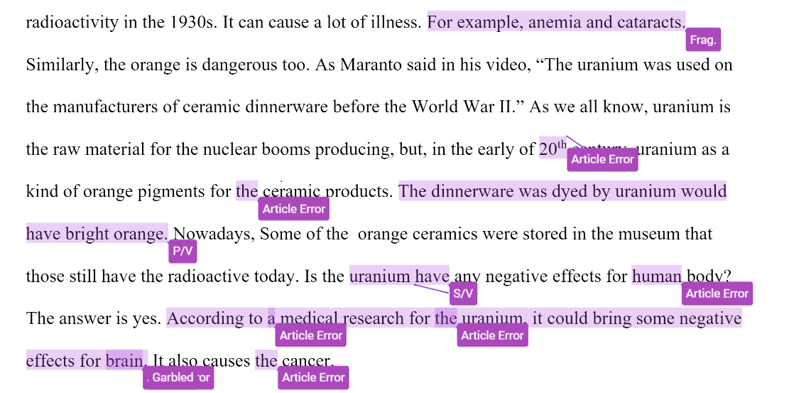
Common Student Challenges IV
Students do not know the meaning of articles
Students do not know when they need to use them

Slide 10
The Writing Process
“A good style must first be clear” Aristotle, The Art of Rhetoric, 350 B.C.E.

Slide 11
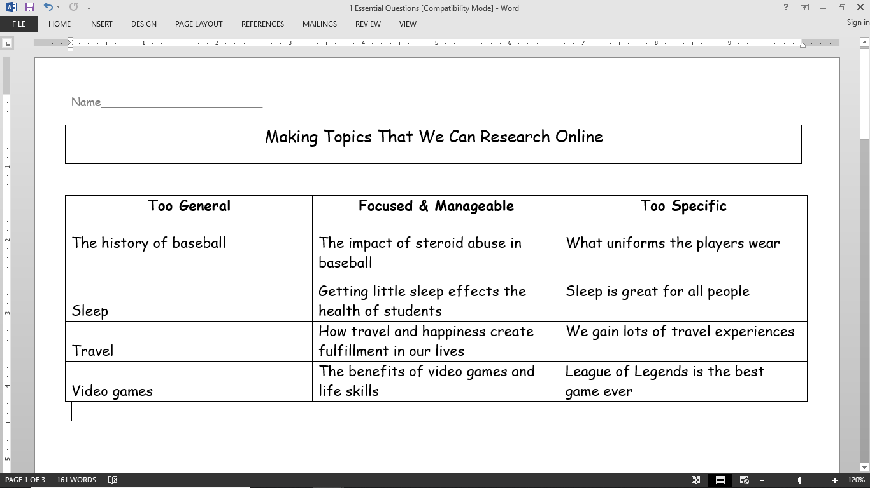
Essential Question

Slide 12
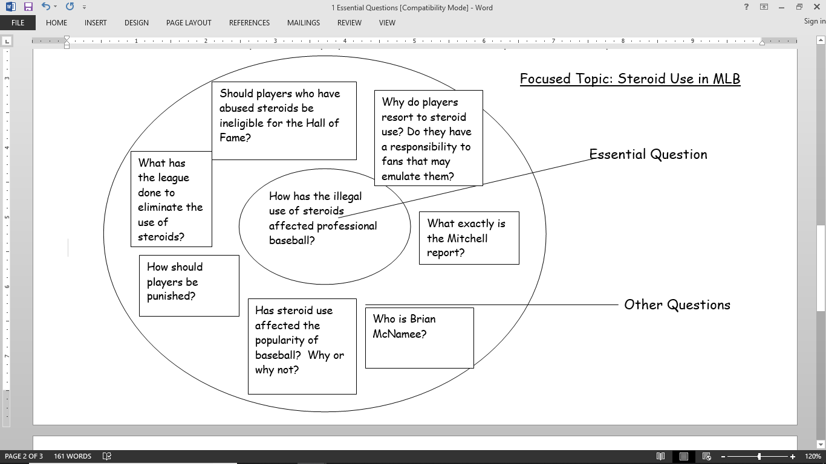
Brainstorm

Slide 13
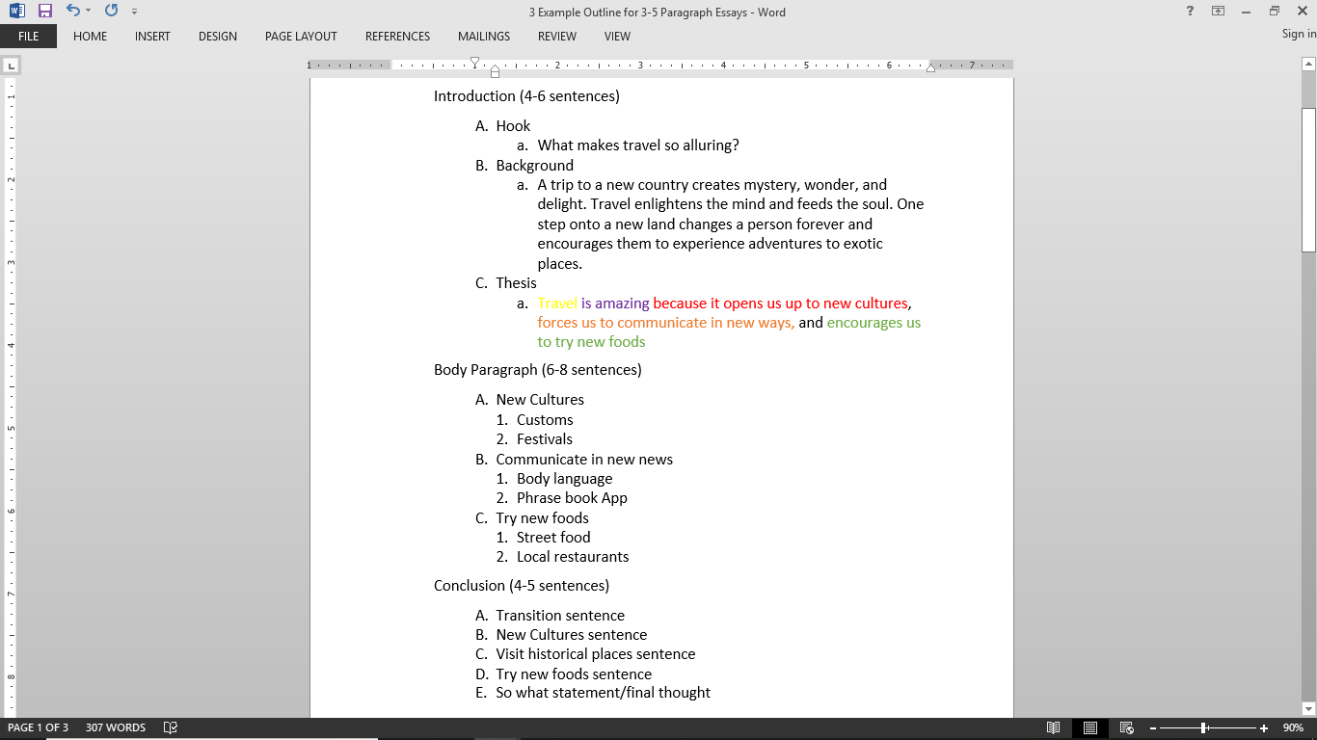

Slide 14
Identifying Academic Articles
Author(s)
Title of an article/journal
Date
Website name
Publisher
Website URL
.edu, .gov, .org, .com such as journals, newspapers, peer-reviewed articles (these are published university written articles from students for students), books in print or as a PDF, etc.

Slide 15

How to Research Online
Thesis
Travel is amazing because we experience new cultures, visit historical places, and try new foods.
Google
Academic articles on/about________
Journal articles on/about_________

Slide 16
The Approach: Color Coding
Thesis is broken up into colors
Each color starts a body paragraph
Each part is summarized in the conclusion
Thesis: topic + opinion + 3 main ideas
Travel is amazing because it opens us up to new cultures, forces us to communicate in new ways, and encourages us to try new foods.

Slide 17
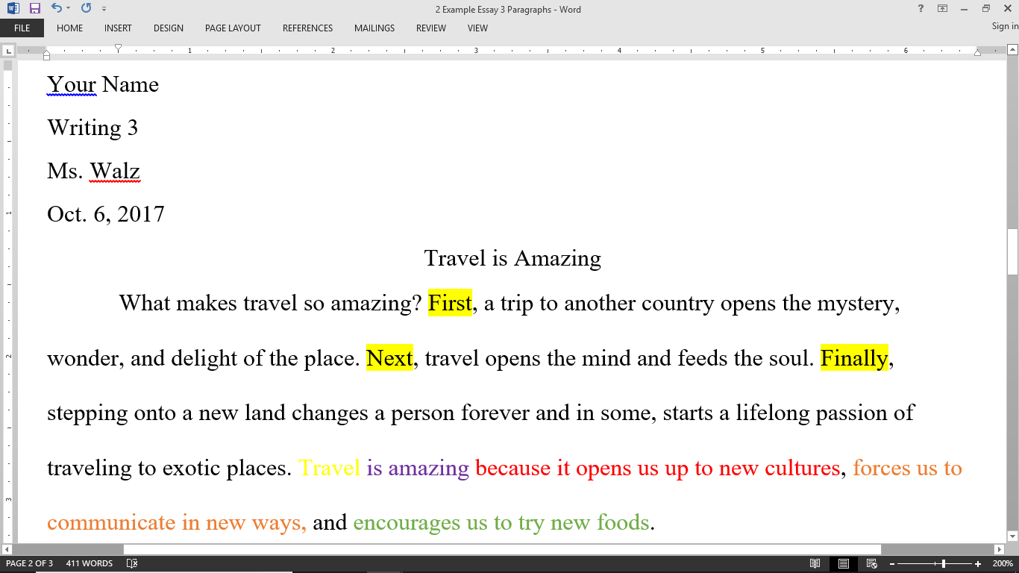
The Approach: Color Coding

Slide 18
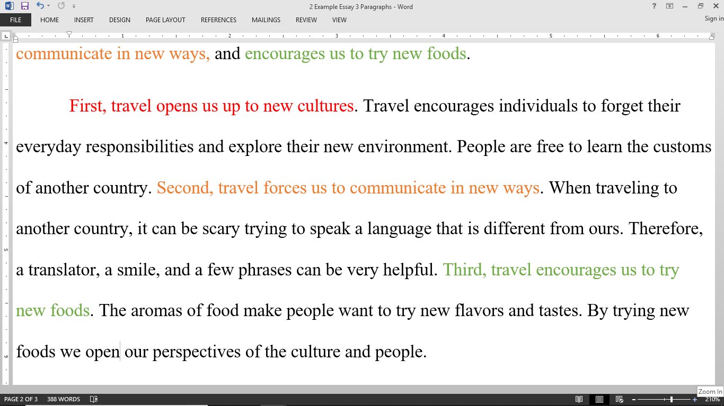
The Approach: Color Coding

Slide 19
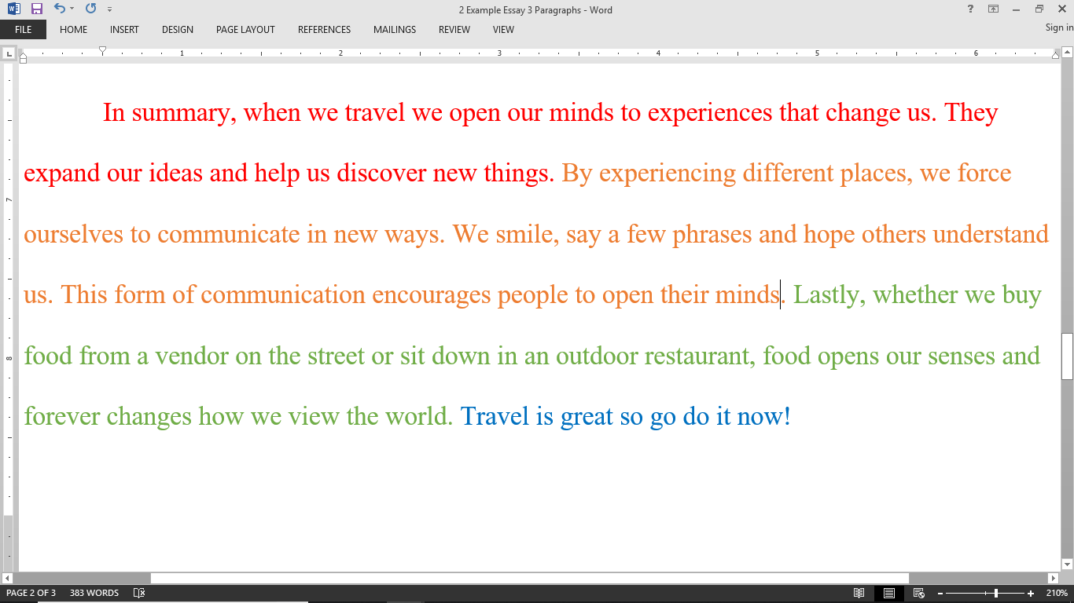
The Approach: Color Coding

Slide 20

Recommendations

Slide 21
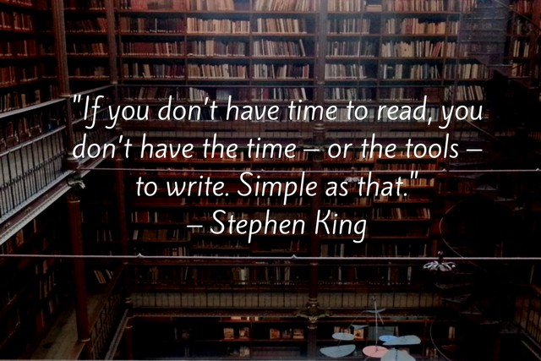
Advice to Teachers
Encourage students to read in English
Students write short reading reports
Teachers can create more activities for article practice
Conversation + brainstorming = writing

Slide 22
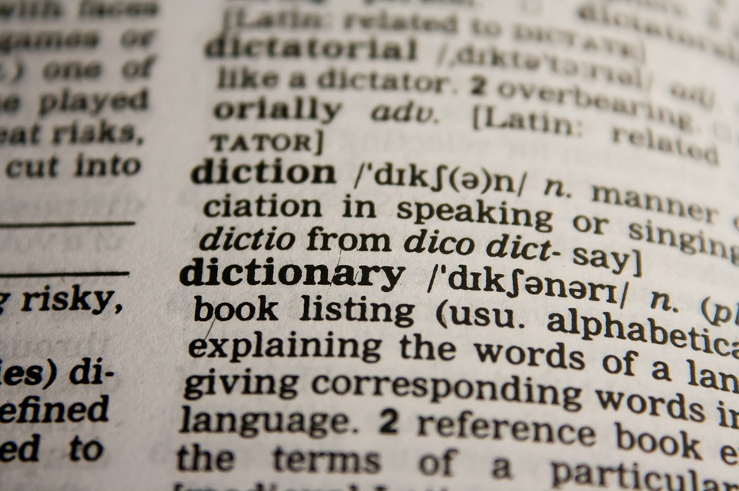

Advice to Teachers Continued
Students love big words
Teachers spend time on vocabulary
Teach larger words and how to use them
Teachers can create more activities for article practice
Conversation + brainstorming = writing

Slide 23

Contact Information
Judith Walz: judith.w@maia.edu
http://www.maia.edu/

Slide 24
Contributors
Students at Massachusetts International Academy
Name | CEFR Level for Writing | University Major | University Level
Amy Zhao | C1 | Finance | Graduate
Wendy Wang | C1 | MBA | Graduate
Shiwei Tong | B2 | Biochemistry | Graduate
Jack Wen | C1 | Computer Science | Graduate

Slide 25
Works Cited
“Formatting a Research Paper.” The MLA Style Center, style.mla.org/formatting-papers/.
Russel, Tony, et al. “MLA Formatting and Style Guide.” Purdue Online Writing Lab, 28 Mar. 2018, owl.english.purdue.edu/owl/resource/747/01/?_ga.
“Student Academic Success Center.” Student Academic Success Center, The Regents of the University of California, Davis Campus, 24 Oct. 2017, success.ucdavis.edu/services/aggie-grammar-guide/Appendix%20Academic%20Idioms%20and%20Phrases.html.
Pixabay, pixabay.com/en/search-seo-internet-marketing-1355847/.
ProWritingAid. “The 10 Writing Quotes That Shape My Writing Process.” The Writing Cooperative, The Writing Cooperative, 14 Nov. 2017, writingcooperative.com/the-10-writing-quotes-that-shape-my-writing-process-f551d8c64c5e.
“Writing Quotes.” BrainyQuote, Xplore, www.brainyquote.com/topics/writing.

