Slide 1
Using Anticipation Guides to Promote Oral and Writing Skills
By Dr. Laurie Zucker-Conde

Slide 2
Anticipation Guides
Teachers regularly use anticipation guides T F
Few teachers use anticipation guides. T F
1. Anticipation guides support reading. T F
2. Anticipation guides support all domains. T F
Notes:
Read and think about which statement you agree with more. Turn and discuss with your elbow partner. Be sure to introduce yourself!

Slide 3
What is an Anticipation Guide?
A reading comprehension strategy used to activate students’ prior knowledge and interest
Questions that incite oral discussion and create a purpose for listening, speaking, reading, and writing
Notes:
Social and academic language development supports the goals of the Common Core, the Massachusetts Frameworks, and WIDA. Jeff Zwiers work on Constructive Conversations helps make the features of academic discourse explicit.

Slide 4
Anticipation in the Classroom
Teachers already use questions to activate students’ prior knowledge throughout lessons
Typically in classrooms we see: Turn and Talk, K-W-L charts, predictions during Read-Aloud, or longer T/F Guides for readings
Questions can be cursory, IRE, assume vocabulary skills, or do not generate discussion
Notes:
Cursory: We’re going to read about butterflies. Have you ever seen a butterfly? Initiate, Respond, Evaluate questions: What are the stages in the butterfly cycle?

Slide 5
Purposeful Anticipation
ELs need scaffolding to anticipate!
ELs need multiple practice opportunities to apply vocabulary and conventions to discourse
ELs need to share their experience and perspective
Teachers need to balance the need to cover topics with the need to build language skills
Notes:
Scaffolding includes vocabulary instruction and sentence starters and frames, so that ELs can orally participate. Anticipation guides promote lower-risk oral engagement and generate interest or build background knowledge prior to reading. Through this social language practice, students will also build their academic language skills.

Slide 6
Dialogue Protocol
Dialogue Protocols support student interaction and content learning
Think-Pair-Share, Reciprocal Teaching, and Jigsaw Reading are examples
Anticipation Guides can also be a Dialogue Protocol that supports constructive conversations, close reading, and writing
Notes:
Students need multiple practice opportunities with protocols to do them well

Slide 7
Topics and Theme
Choose topics for Anticipation Guides that connect to students’ experience and culture
Teach and practice vocabulary and Constructive Conversations/Accountable Talk moves
Connect to a larger theme, text(s), writing
Revisit opinions or suppositions orally or in exit tickets
Notes:
To make the AG a valuable dialogue protocol, students need practice in CC expectations.

Slide 8
Language Functions in A.G.
WIDA functions of ARGUE and EXPLAIN (Compare) are emphasized
Use topics that encourage cultural comparison
Use topics that enable students to take a position that requires personal experience or evidence to support
Use recursive processes with texts that take different positions
Notes:
Family relationships and responsibilities, school life, weather, money, timely topics. Instead of using anticipation guides to isolate independent reading comprehension, we are choosing texts that encourage the development of oral and written discourse

Slide 9
Zwiers Model
Constructive Conversation is recursive, building, and supports academic language development
Creating, clarifying, building/fortifying, evaluating are functions emphasized
Anticipation Guides are another “dialogue protocol” that supports oral discourse and reading comprehension with practice
Notes:
Jeff Zwiers has presented at MATSOL a number of times, and many of his instructional tools are available online. Do you use Constructive Conversations or Accountable Talk in your school? Functions
are emphasized through sentence starters

Slide 10
Model Oral Skills
Teach active listening skills
Teach sentence starters from Zwiers/ Accountable Talk chorally and a few at a time
Have students analyze brief transcripts for academic language/ CC starters
Practice in pairs and use fishbowls on low-risk topics
Post language to use or give out cards
Tell them what you heard and noticed
Notes:
Jeff Zwiers has presented at MATSOL a number of times. You can find his conversation map online, and many examples of sentences starters in his tools. There are also many examples of sentence starters for constructive conversations. Model oral skills before Anticipation Guides or readings. There is a typical sequence to present and embed through ongoing practice. Let’s take a minute to look at the CC Map and a transcript of a student conversation.

Slide 11
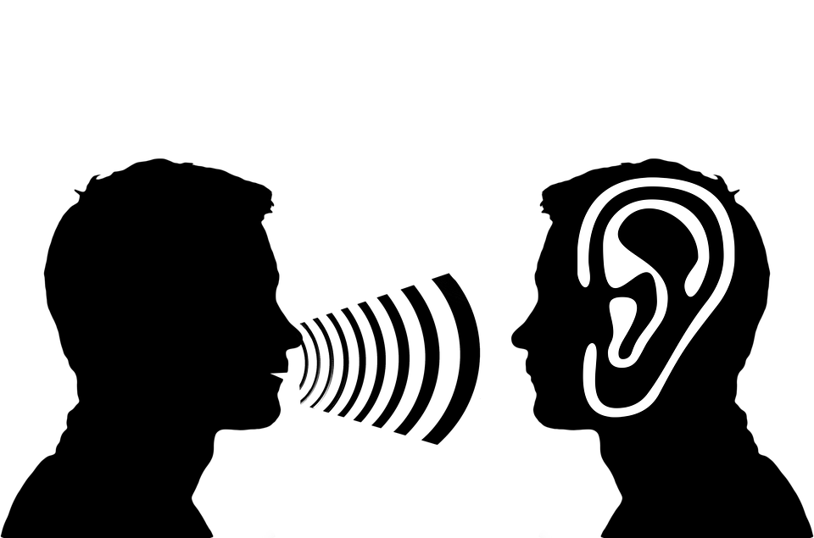
Active Listening Practice
Model with greetings or posted conversation
Students describe body language
Students practice
Students model
Listening rubric
Notes:
Students describe how they know someone is actively listening. Generate a rubric based on student’s descriptions of good listeners.

Slide 12
Active Listening
My body faces the speaker
I make eye contact
I sit up straight
I nod to show I’m listening
I smile
I can rephrase (I heard you say …)
Notes:
I heard you say and I wonder why

Slide 13
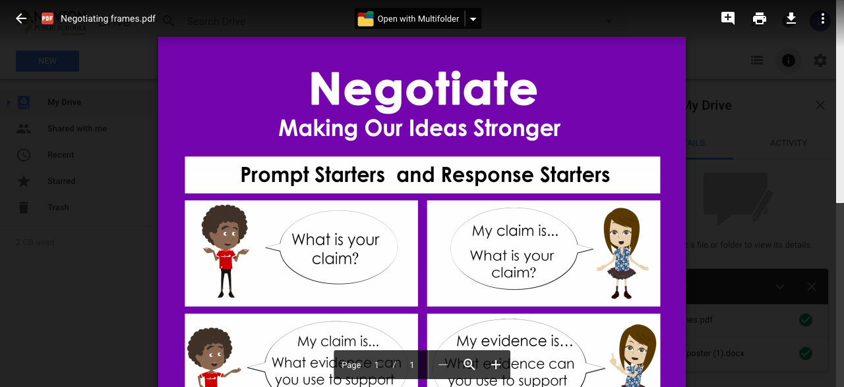

Slide 14
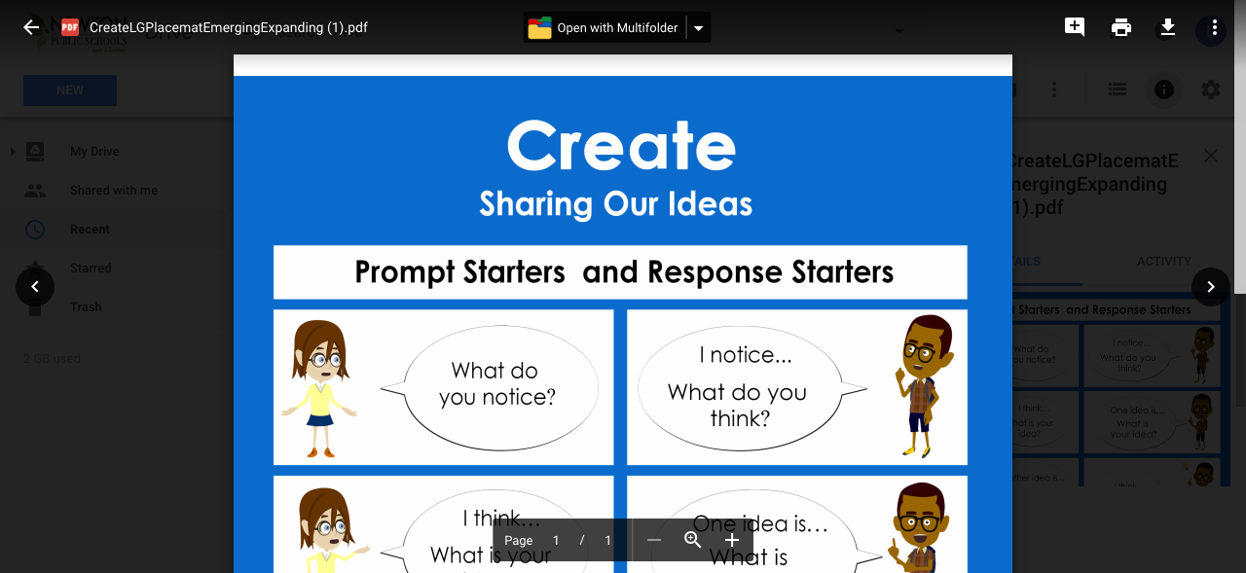

Slide 15
Getting Ready
Initiate through open-ended questions
Ask students to practice asking a partner with sentence starters: (choral practice)
In my opinion . . .I know this because
I heard you say _____ and I agree/disagree
I heard you say _____ and I wonder why
At first I thought ______ and I now I think*
Fishbowl
Notes:
For example, is X a good/bad (kind/selfish) character? How do you know?/ Should students wear uniforms to school?/ Do you think that students can change gun laws in the United States? Students need to learn these expectations before using Anticipation Guides

Slide 16
Scaffold the Anticipation Guide
Pre-teach vocabulary in the Anticipation Guide
Try to use at least one term or new word that will appear in the reading in the Anticipation Guide
Have student practice orally in pairs, quads, or with three different people
Praise students who build on others’ ideas, or who change their minds based on evidence*
Notes:
Give students multiple opportunities to use the language, listen, and practice
This is a challenging skill for young people.

Slide 17
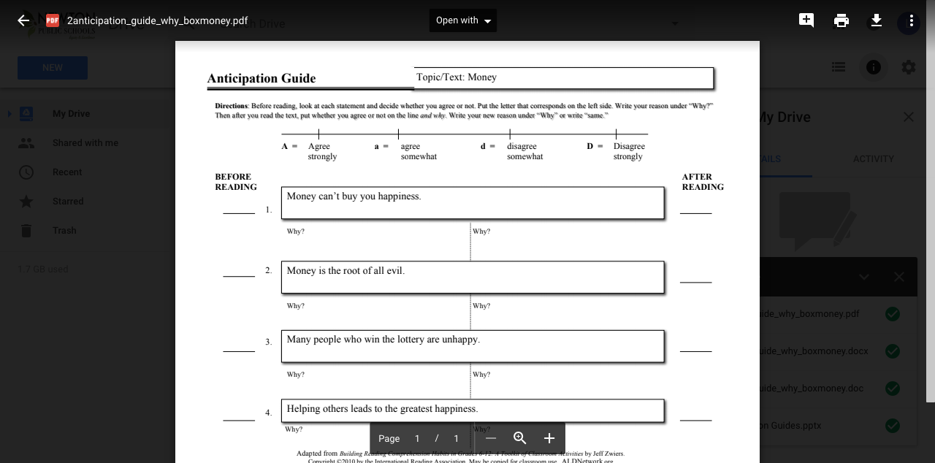
Example of Anticipation Guide
Notes:
This is Jeff Zweir’s template for anticipation guides. It’s very helpful because students fold the template. They are encouraged to speak to three people before reading. There is a typical sequence to present and embed through ongoing practice. Let’s take a minute to look at the CC Map

Slide 18
Example of Text
Title: _________________________________________________________________
A song from the Beatles, the famous English pop group, told us that money can’t buy us love. Many people also believe that money cannot buy happiness. In fact, there is an expression that says that money is the root of all evil. However, a new study from Cambridge University suggests that money can buy you happiness. Researchers conducted a study on the spending habits of customers in a bank. They compared what the bank customers bought with their personality. The research team compared the personalities of 625 people with a list of how they spent their money. The conclusion of the study was that what people buy can lead to happiness, but only if they buy the right things.
LOTS MORE at http://www.breakingnewsenglish.com/1604/160411-money-happiness.html Copyright Sean Banville 2016
Notes:
This is the first paragraph of an adapted text from an article Money Can Buy Happiness, from BreakingNewsEnglish. Let’s take a minute to look at the CC Map and try our own AG. Try to use some of our starters in your conversations with two people.

Slide 19
An Excerpt of an Article
One common way to get students to talk more is to use 'turn and talk'. I see a lot of teachers instructing their students to 'turn and talk' about this and about that. And in many many cases, students turn to each other not quite knowing what to do.
We need to go beyond 'turn and talk' to model, support and expect deeper conversations using extended discourse across all content areas. We need to structure oral language interactions more explicitly for authentic, language-rich instruction. How do we do that?
Notes:
This is from an online blog post by Sarah Ottow in your Works Cited.

Slide 20
Examples to Explain and Compare
Weather, climate, climate change
Holidays, rites of passage
Schools around the world; schools in the past and present; homework
Healthy foods
Bedtimes; how much time for sleep
Recycling; technology for zero waste
Jobs of the future
Notes:
These topics can lead to opinions, but tend to be more informative in nature and enable students to use their background knowledge to share

Slide 21
Examples of Opinion Topics
Should students wear uniforms to school?
Do zoos help protect endangered species?
Should Chinese be the language of the future?
Video games are unhealthy for children
Social media use can cause positive change
Do standardized improve learning?
Should we repeal the Second Amendment?
Notes:
Students often will have strong opinions to share and a purpose to read to see if their opinions are supported in the reading to come

Slide 22
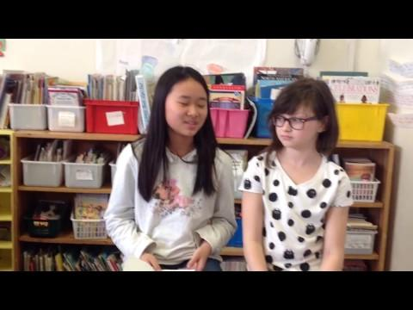
Practicing with Starters

Slide 23
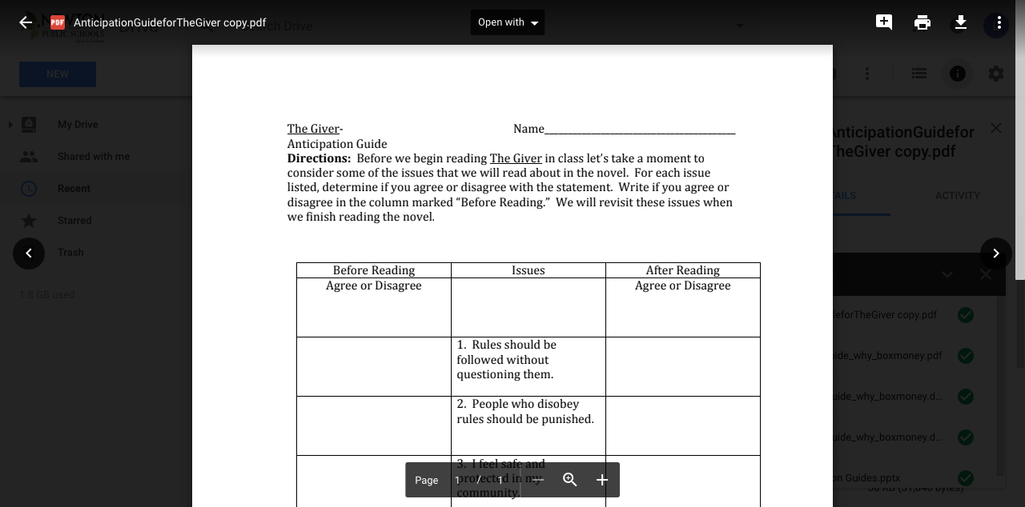
Other Anticipation Guides

Slide 24
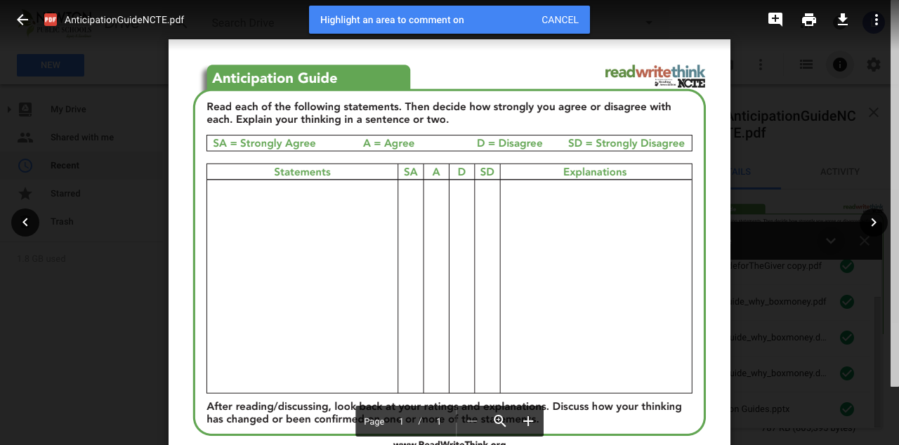
Anticipation Guide Example

Slide 25
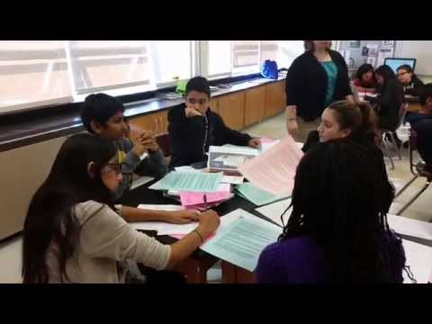
Constructive Conversations

Slide 26
Pizza Argument with Grade 3
http://reddingschools.net/constructive-conversations/

Slide 27
Works Cited
The Constructive Conversation.11/16/14.Uploaded by Erica Naughton.
https://www.youtube.com/watch?v=kR45a9wCcv0
Ottow, Sarah. Going Beyond Turn & Talk: Academic Conversations for ELLs. Confianza,
https://ellstudents.com/blogs/the-confianza-way/going-beyond-turn-talk
The Pizza Argument with Grade 3.
http://reddingschools.net/constructive-conversations/
Zwiers, J. and Crawford, M. Academic Conversations. Stenhouse, 2011.
Zweirs, J. and Hamerla, S. The The K-3 Guide to Academic Conversations. Corwin, 2018.
Zweirs, J. jeffzwiers.org/tools

