Slide 1
A routine to teach complex sentences in the SEI science classroom
Miguel Hernando
Chelsea High
mhernando94@msn.com

Slide 2
Using complex sentences to do science:
As the rollercoaster goes up the hill, kinetic energy is transformed into potential energy.
Both the dolphin and the cow have a humerus, which the whale shark does not have.

Slide 3
What are complex sentences?
A complex sentence is like a simple sentence in that it consists of only one main clause, but unlike a simple sentence it has one or more subordinate clauses functioning as an element of the sentence. (Greenbaum and Quirk, A Student’s Grammar of the English Language, Longman)

Slide 4

The speed of the car is 16 m/s.

Slide 5
Cellular respiration consumes oxygen and photosynthesis produces oxygen.

Slide 6

As the concentration of catalase increases, the rate of oxygen production increases.

Slide 7
English subordinating conjunctions
Common subordinating conjunctions are: after, (al)though, as, before, if, since, that, until, when, whereas, while, once, so, as soon as, provided that, that.
There are many more….

Slide 8
3 Reasons why you should teach complex sentences in SEI science.

Slide 9
1. Complex sentences are crucial to describing important scientific facts
Many scientific facts are relations between facts:
Correlations
Causation
Explanation
Sequencing
Complex sentences are the prime linguistic vehicle to express relations between facts.

Slide 10
1. Complex sentences are crucial to describing important scientific facts
As the pressure of a gas increases, its temperature increases too, given constant volume.
Mixing substances 1 and 2 resulted in a precipitate, while mixing substances 1 and 3 produced no precipitate. This means substance 2 is the silver chloride.
In figure 1, speed increases as time increases.
Parasitism is a relation in which the first organism benefits from the second, while the second gets hurt.

Slide 11
2. WIDA performance definitions 2012
 | Reading and Listening | Speaking and Writing
Level 5 Bridging |  | A variety of complex grammatical structures matched to purpose
Level 4 Expanding | Complex grammatical structures | Compound and complex grammatical structures
Level 3 Developing | Compound and some complex grammatical structures | Simple and compound grammatical sentences with occasional variation
Level 2 Emerging | Compound grammatical structures

Slide 12
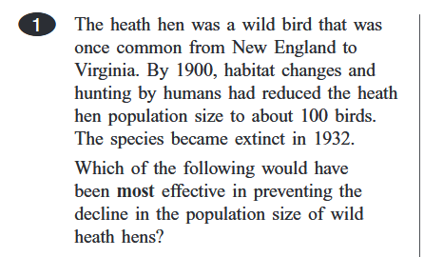
3. Feb 2108 MCAS, question 1

Slide 13
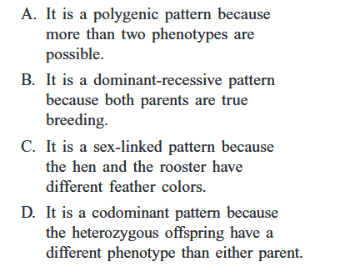
Feb 2018 Biology MCAS, question 2

Slide 14
3 Reasons why you should teach complex sentences in SEI science.
Complex sentences are crucial to describing important scientific facts.
WIDA specifically mentions complex sentences in the performance definitions.
High school science MCAS is loaded with complex sentences that students have to decipher.

Slide 15
Science Program at Chelsea High

Slide 16
Bridge Academy and Chelsea High
Chelsea High is an urban high school with a very large proportion of native Spanish speakers and low income students.
Bridge Academy is a school-within-a-school that serves ELL students.
Level 1-3 students take core classes in a separate setting. They learn content along with language. They take electives with the rest of the school.
Level 4-5 students are mainstreamed for all their classes.

Slide 17
Beginner ELL students: Science 1 and/or 2
Science 1 and Science 2: Semester-long classes serving primarily new arrivals. One is Physics-based, another is Biology-based.
Almost all students are recent arrivals.
Class is aligned to grade level standards, but class does not prepare students to take the STE MCAS.
Most students take just one of the two classes. Science 1 and 2 run on alternate years in case a student needs to repeat (a few do).
Instruction focuses on content, the language of science, and scientific skills.

Slide 18
In Science 1 and Science 2, heavy emphasis on description and interpretation of data tables.
Make sentences using models:
The number of boys in block 1 is 13
Block 1 has 13 boys
Student work:
The number of girls in block 3 is 9.
In the block 2 has 22 boys.
Block | Number of Boys | Number of Girls
1 | 13 | 8
2 | 22 | 11
3 | 6 | 9
4 | 5 | 11

Slide 19
WIDA level 2 science students: SEI Biology
While most students in the class are WIDA level 2, a few are WIDA level 1, and a few are WIDA level 3.
Students in this class take the Biology MCAS at the end of the year.
Many, but not all, students in this class, have taken either the Science 1 or Science 2 classes the previous year.
SEI Biology is a full-year class.

Slide 20
Performance assessments
At Chelsea High we use Performance Assessments, where students apply scientific content and skills to an authentic problem.
Two main examples are scientific inquiry reports and arguments.

Slide 21
Lesson planning routine for complex sentences
Create an authentic opportunity for students to use a complex sentence.
Identify a complex sentence for your topic
Vocabulary and Content Strategy.
Application of content.
Simple sentence practice.
Teach complex sentence.
Complex sentence practice.
Use complex sentence for an authentic purpose.

Slide 22
Example 1: WIDA level 1 students describe a meal.
(Science)

Slide 23
1. Create an authentic opportunity to use a complex sentence
Performance Task: Given two meals, make a claim about which meal is better for you and write an argument to defend your claim.

Slide 24
Step 2: Identify a complex sentence
Meal #1 has a Big Mac, which has proteins and carbohydrates and has 620 calories.

Slide 25
3. Vocabulary and Content
Vocabulary strategies for proteins and carbohydrates:
Visuals to provide examples of each
Practice for students classifying different foods into proteins and carbohydrates.
Very short but grade-level texts providing definitions based on the main function of proteins and carbohydrates.
Vocabulary strategy for calories:
Very short but grade-level text providing definition of calorie.
Practice with a website to search for the number of calories of different foods

Slide 26
4. Application
Application: Students fill out a survey about what they ate the day before.
They then identify the composition of each food and the number of calories in their diet using the materials from the day before.

Slide 27
5. Practice with simple sentences: Describe this data
 | Breakfast | Lunch | Snack | Dinner
Food | A yogurt | Spaghetti | An apple | Pizza (2 slices)
Carbohydrates or proteins? | Carbohydrates and proteins | Carbohydrates | Carbohydrates | Carbohydrates
Calories | 180 | 400 | 80 | 800
Total calories | 1460
By this point of the lesson, students understand this table, but do not yet know how to write sentences describing it.

Slide 28
5. Practice with simple sentences: Modeling
For breakfast, Cristobal eats a yogurt
A yogurt has both carbohydrates and proteins
A yogurt has 180 calories
 | Breakfast
Food | A yogurt
Carbohydrates or proteins? | Carbohydrates and proteins
Calories | 180

Slide 29
5. Practice with simple sentences: Student work
For lunch,Cristobal eat spaghetti.
The spaghetti has carbohydrates.
The spaghetti has 400 calories.
 | Lunch
Food | Spaghetti
Carbohydrates or proteins? | Carbohydrates
Calories | 400

Slide 30
5. Practice with simple sentences: Extended practice
 | Breakfast | Lunch | Snack | Dinner
Food | A yogurt | Spaghetti | An apple | Pizza (2 slices)
Carbohydrates or proteins? | Carbohydrates and proteins | Carbohydrates | Carbohydrates | Carbohydrates
Calories | 180 | 400 | 80 | 800
Total calories | 1460
By this point of the lesson, students understand this table, and can describe it using simple sentences. They do not yet know how to put the elements together to make a complex sentence.

Slide 31
6. Teach the complex sentence
For breakfast, Cristobal eats a yogurt
A yogurt has both carbohydrates and proteins
A yogurt has 180 calories
→ For breakfast, Cristobal eats a yogurt, which has both carbohydrates and proteins and has 180 calories.

Slide 32
6. Teach the complex sentence: Model the process.
For breakfast, Cristobal eats a yogurt
A yogurt has both carbohydrates and proteins
A yogurt has 180 calories
+ For breakfast, Cristobal eats a yogurt. A yogurt has both carbohydrates and proteins. A yogurt has 180 calories
→ For breakfast, Cristobal eats a yogurt, which has both carbohydrates and proteins and has 180 calories.

Slide 33
6. Teaching the complex sentence: Contrastive analysis with L1
For breakfast, Cristobal eats a yogurt, which has both carbohydrates and proteins and has 180 calories.
Spanish:
Para el desayuno, Cristóbal come un yogurt, que tiene carbohidratos y proteínas y tiene 180 calorías.

Slide 34
6. Teaching the complex sentence: Contrastive analysis with L1
For breakfast, Cristobal eats a yogurt, which has both carbohydrates and proteins and has 180 calories.
Haitian Creole:
Pou manje maten, Cristobal manje yon yogout ki gen tou de idrat kabòn ak pwoteyin e li gen 180 kalori.

Slide 35
7. Practice with complex sentence: Student work.
for lunch Maria Rosa eats spaghetti , which has carbohydrates and has 400 calories.
For snack, Maria Rosa eats apple,which has carbohydrates and has 95 calories.
for the snack eat an apple because have carbohydrates and carbohydrates have 80 calories.
for dinner Maria Rosa eat pizza which has carbohydrates and 800 calories.

Slide 36
8. Use complex sentence for an authentic purpose
Which of two meals is better for you?
Figure out what type of meal and number of calories is best for them.
Analyze the meals for composition and calories.
Describe each meal using complex sentences.
Make a claim about which meal is better for you.
Defend the claim with evidence.

Slide 37
8. Use complex sentence for an authentic purpose: Student work --- Description paragraph
The meal number one consists of three different types of food. First, Maria Rosa eat fried chicken, which has 360 calories and it has proteins. Second, Maria Rosa eats french fries ,which has 240 calories and has carbohydrates . Third , Maria Rosa eats salad , which has 150 calories and has carbohydrates . The total number of calories is 750 calories.

Slide 38
8. Use complex sentence for an authentic purpose: Student work --- claim and evidence paragraph
The meal number one is better for me because this meal has 750 calories and I need 600 calories. In addition this meal has carbohydrates and proteins it is better for me because I need proteins and carbohydrates for me.

Slide 39
Example 2: Discuss energy changes in a rollercoaster

Slide 40
Performance Assessment
Using an applet, students design a rollercoaster.
Design the rollercoaster with the most energy changes that can safely get to the end. Convince other students that your rollercoaster is the best, referring to features from your rollercoaster

Slide 41
Target sentence
When the cart is going up the loop, kinetic energy decreases while potential energy increases.

Slide 42
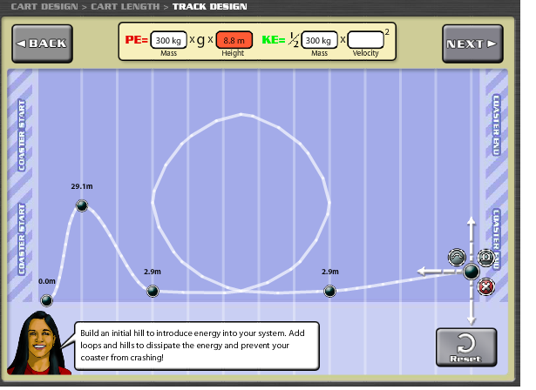
Rollercoaster design applet

Slide 43
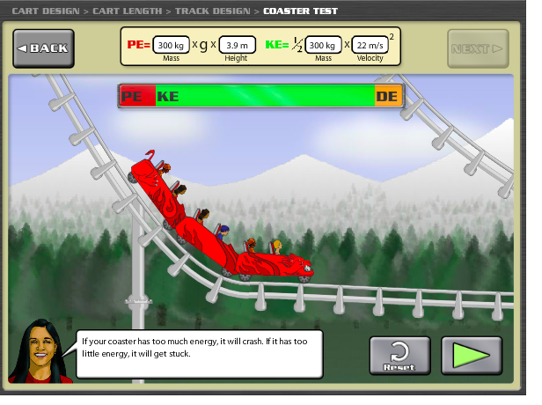
Kinetic and Potential Energy

Slide 44
Simple sentences
At the top of the initial hill, the rollercoaster has potential energy
At the bottom of the initial hill, the rollercoaster has kinetic energy

Slide 45
Student work
When the cart is going up the initial hill, kinetic energy decrease while potential energy increase.
When The cart goes up in the final ramp kinetic energy decreases while potential energy increases
When the car goes up to the final ramp .kinetic energy decrease while quetiatal energy increases.
When The roller coaster climbs up the initial hill climb up in the roller coaster the kinetic energy is too strong and low the potential energy potential

Slide 46
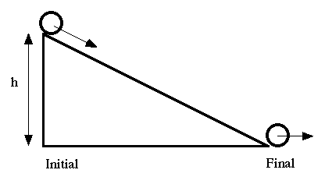
Example 3. Find which factor influences more the speed of a rolling ball.

Slide 47
Target sentence.
When the height of the ramp is 32 cm, the speed of the ball is 56 cm/s.
When the height of the ramp is 16 cm, the speed of the ball is 28 cm/s.

Slide 48
Student data: Determine which factor affects more the speed of a ball
Number of experiment. | Ball. | Book. | Height | Distance. | Speed. | Time.
Experiment #1. | Steel ball | 4 | 32 cm | 1oo cm. | 89.2cm/s. | 1.12 second
Experiment #2 | Golf ball | 4 | 32 cm | 100 cm. | 51.0 cm/s. | 1.96 second.
Experiment #3 | Steel ball | 2 | 16 cm | 100 cm | 55.55 cm/s | 1.80 s
Experiment #4 | Golf ball | 2 | 16 cm | 100 cm | 53.19 cm/s | 1.88 s

Slide 49
Student work
When the height is 32 cm, the speed is 89.2 cm/s.
When the height is 16 cm, the speed is 55.55cm/s.
When the ball is steel,the speed is 89.2 cm/s.
When the ball is golf, the speed is 53.19 cm/s.

Slide 50
Example 4: Determining evolutionary relationships (Biology, WIDA level 2)
(6 days)

Slide 51
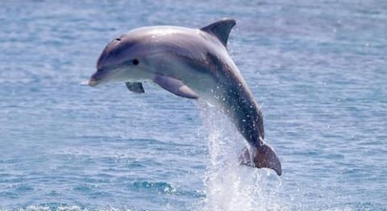
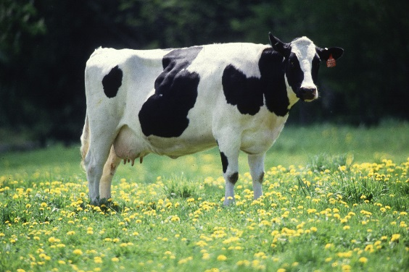
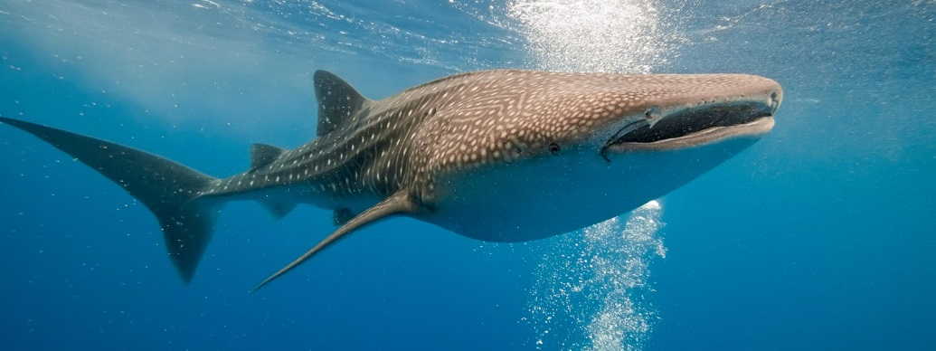
1. Performance assessment
Given a trio of animals, which two animals are most closely related by evolution?
Students must make a claim and write an argument to support their claim.

Slide 52
2. Identify complex sentences
Both the dolphin and the cow have a humerus, while the whale shark does not have a humerus.
Both the dolphin and the cow have a humerus, which the whale shark does not have.

Slide 53
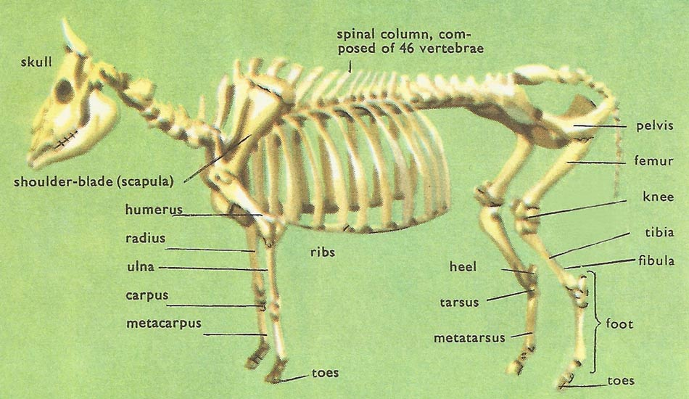
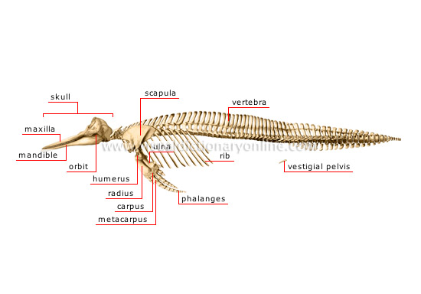
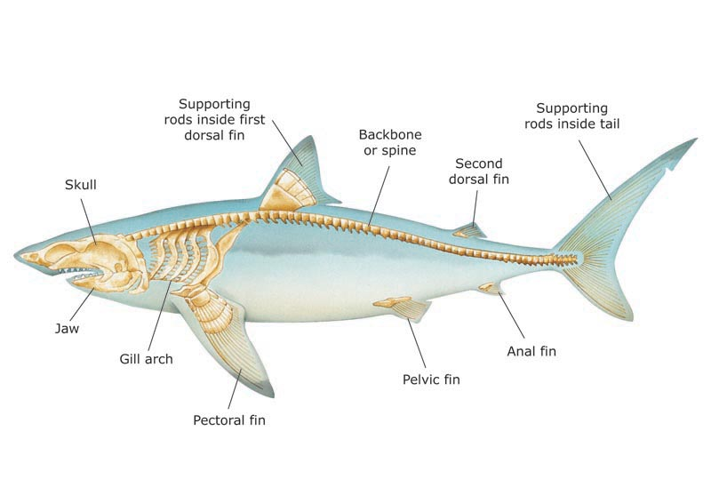
3. Vocabulary: Compare skeleton printouts

Slide 54
4. Content: Record data about structural similarities
Comparative Anatomy | Characteristics
Animal | ulna | stermum | radius | humerus | olecranon | rids
Manatee | yes | yes | yes | yes | yes | yes
Elephant | yes | yes | yes | yes | yes | yes
whale shark | no | no | no | no | no | no
I assume that by this point, this student has understood the concept of homologous structure, and has realized that the manatee and the elephant are closely related, while the whale shark is more distant. But the student does not yet have the linguistic tools needed to describe this evidence.

Slide 55
5. Practice with simple sentences.
I skipped this step, as I determined that my level 2 students were proficient with simple sentences. I went directly to teach the complex sentence.
However, if students had not been proficient at simple sentences, I would arranged an activity that required students to write sentences like:
The Manatee has ulna.
The Elephant has ulna.
Both the Manatee and the Elephant have ulna.
The whale shark does not have ulna.

Slide 56
6. Teach the structure of the complex sentence: Modeling the process.
Both the salamander and the crocodile have 4 limbs, while the fish does not have 4 limbs.
The fish has fins, which the salamander and the crocodile do not have.
Animal | Limbs | Fins
Salamander | 4 | No
Crocodile | 4 | No
Fish | 2 | Yes

Slide 57
6. Teach the structure of the complex sentence: L1 Contrastive analysis
Both the salamander and the crocodile have 4 limbs, while the fish does not have 4 limbs.
Spanish:
Tanto la salamandra como el cocodrilo tienen 4 extremidades, mientras que el pez no tiene 4 extremidades.
Haitian Creole:
Tou de salamand a ak kwokodil la gen 4 branch, pandan ke pwason an pa gen 4 branch.

Slide 58
7. Complex sentence practice: Student work
Both the cow and the dolphin have a ulna, while the shark does not have a ulna.
Both the cow and the dolphin have a carpus, while the shark does not have a carpus.
Both the cow and the dolphin have a metacarpus, while the shark does not have a metacarpus.
Both the dolphin and the cow have a rib, while the shark does not have a ribs.
All the dolphin, the cow and the shark have a skull.

Slide 59
7. Complex sentence practice: Student work 2
Dolphing, cow, and Shark have a skull.
Dolphing have maxila while the cow and shark does not have a maxila.
Dolphing and cow have mandible while the shark does not have a mandible.
Cow and shark does not have vestigial pelvis while the Dolphing has a vestigial pelvis.
Dolphing and cow have Phalanges while shark does not have phalanges.

Slide 60
8. Use complex sentence for an authentic purpose
The task offered students 3 animals. They needed to pick the two animals that were more closely related by evolution. Steps needed:
Analyze anatomical evidence.
Library research on reproductive evidence and other features.
DNA comparison using BLAST.
Make a claim.
Defend the claim using evidence.
Make and refute a counterclaim.

Slide 61
8. Make and defend a claim about evolutionary relationships: Student work.
Manatee is more closely to elephants than to whale sharks. Three evidences that support this claim are comparative anatomy , reproductive biology , and DNA sequences.
Comparative anatomy is my first evidence that manatee and elephant are more closely related. Specifically, both the manatee and elephant have sternum, radius , ulna , while the whale sharks do not have sternum, radius or ulna, also only the whale sharks have supporting rods inside first dorsal fin, which the manatee and elephant do not have.

Slide 62
8. Use complex sentence for an authentic purpose: Student work.
The dolphin is more closely related with the cow more than shark. three evidences that support this claim are comparative anatomy, reproductive biology, and DNA sequences.comparative anatomy is my first evidence that Dolphin and cow are more closely related. Specifically, they both dolphin and cow have seven type of part those are ribs,phalanges,metacarpal,mandible,humerus,scapula,carus, similar those are mandible, humerus, phalanges,scapula, rib, metacarpus, but the shark does not have those kind of part.

Slide 63
Conclusion: Teaching complex sentences at WIDA levels 1 and 2. Why does it even work?
 | Reading and Listening | Speaking and Writing
Level 5 Bridging |  | A variety of complex grammatical structures matched to purpose
Level 4 Expanding | Complex grammatical structures | Compound and complex grammatical structures
Level 3 Developing | Compound and some complex grammatical structures | Simple and compound grammatical sentences with occasional variation
Level 2 Emerging | Compound grammatical structures

Slide 64
Conclusion: Teaching complex sentences at WIDA levels 1 and 2. Why does it even work?
 | Reading and Listening | Speaking and Writing
Level 5 Bridging |  | A variety of complex grammatical structures matched to purpose
Level 4 Expanding | Complex grammatical structures | Compound and complex grammatical structures
Level 3 Developing | Compound and some complex grammatical structures | Simple and compound grammatical sentences with occasional variation
Level 2 Emerging | Compound grammatical structures
Secondary students need to know complex sentences to do science. We cannot wait until a student reaches level 3 or 4 to teach complex sentences.
Secondary students may already know complex sentence grammar from their L1. The transfer to L2 is not that hard.

Slide 65
Practice
Figure out some complex sentences for a subject that you teach.
Share with your partner.
Share with the whole room?

Slide 66
Questions?
Create an authentic opportunity for students to use a complex sentence.
Identify a complex sentence for your topic
Vocabulary Strategy.
Content Strategy.
Simple sentence practice.
Teach structure of complex sentence.
Complex sentence practice.
Use complex sentence for an authentic purpose.

