Slide 1

Analyzing the Language Demand of Classroom Assessments
Stephanie Garrone-Shufran, PhD
Annah Coddington
Michaela Lonati
Molly Malinowski
Merrimack College
School of Education and Social Policy
MATSOL Conference
Framingham, Massachusetts – 2018

Slide 2
Presentation Overview
The Course and The Assignment
Students’ Experiences
Molly
Annah
Mick
Practice - Design Supports
Application - Analyze an Assessment
Debrief

Slide 3
The Course
Assessment of English Language Learners - Fall 2017
Required in ESL Licensure Program (Graduate)
11 students - all working in field
Use course goals to redesign course assessments
2 Course Goals
Analyze assessments to determine the knowledge and skills necessary to understand and complete tasks
Create assessments appropriate for learners at various proficiency levels as described in the WIDA documents.

Slide 4
The Assignment
Analysis of Classroom Assessment (due mid-semester)
Course Goal: Analyze assessments to determine knowledge and skills necessary
Disentangle language from content
State cognitive and language functions required to complete tasks
Course Goal: Create assessments for learners at various WIDA levels
Analyze before create - Creation of assessments later in course
Design supports to assist ELs at various levels to be successful on chosen assessment

Slide 5
Analysis of Classroom Assessment
What is the content knowledge students would need to have to complete this assessment successfully? Be specific.
What language features (word, sentence, and discourse level) do students need to understand/use to complete this assessment successfully? Consider both receptive and productive domains.
Describe the supports and accommodations that would be required for ELs at two WIDA levels to be successful. Explain your choices.
Reflection: What about analyzing the assessment did you find easy? What did you find challenging? What new insights did you gain into this assessment? How does what you learned influence your future instruction and assessment of ELs?

Slide 6
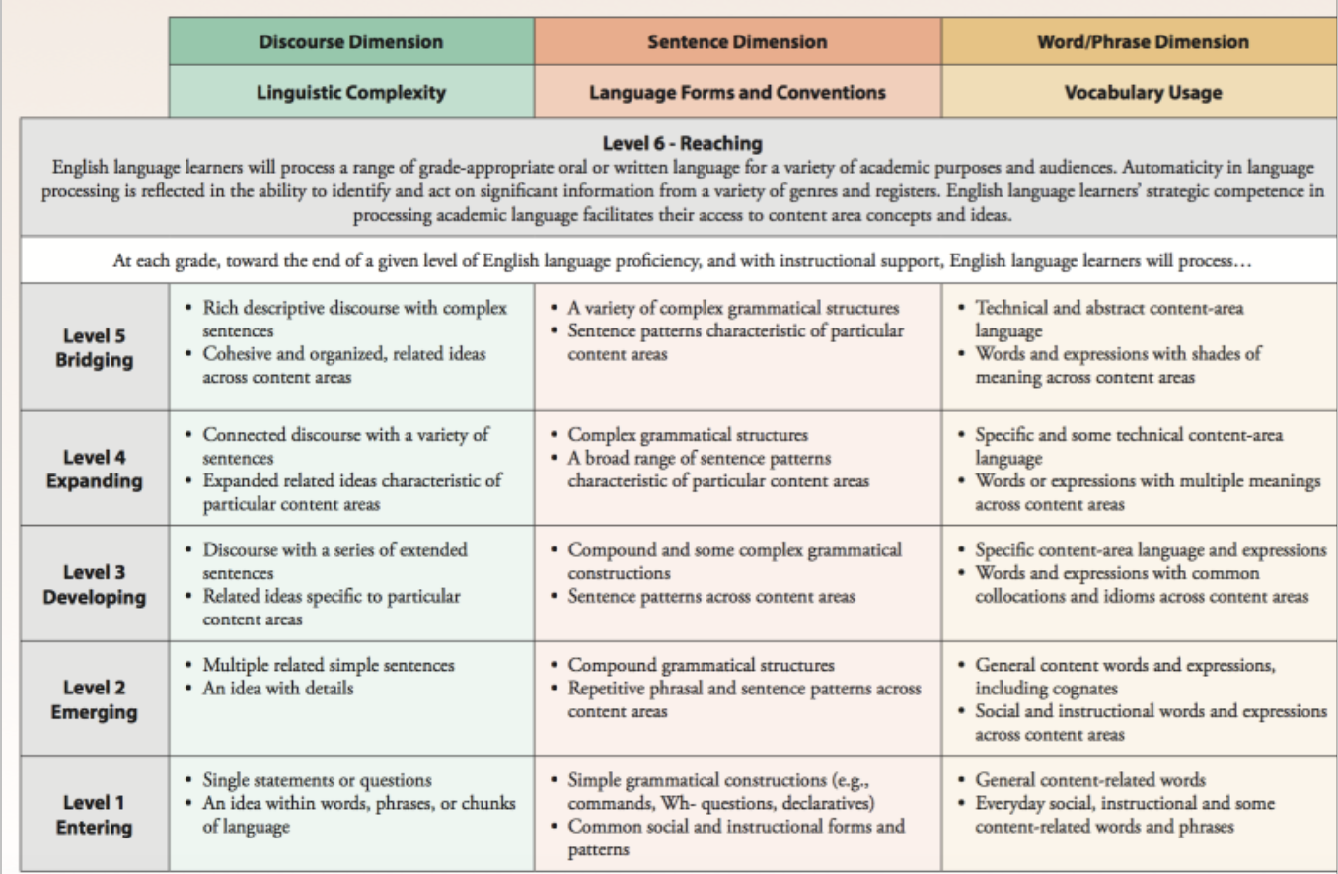
Using WIDA to Design Supports
What supports would students need at each level to be successful in completing the assessment?

Slide 7
Analyzing Classroom Assessments

Slide 8
ELA 2nd Grade Molly

Slide 9
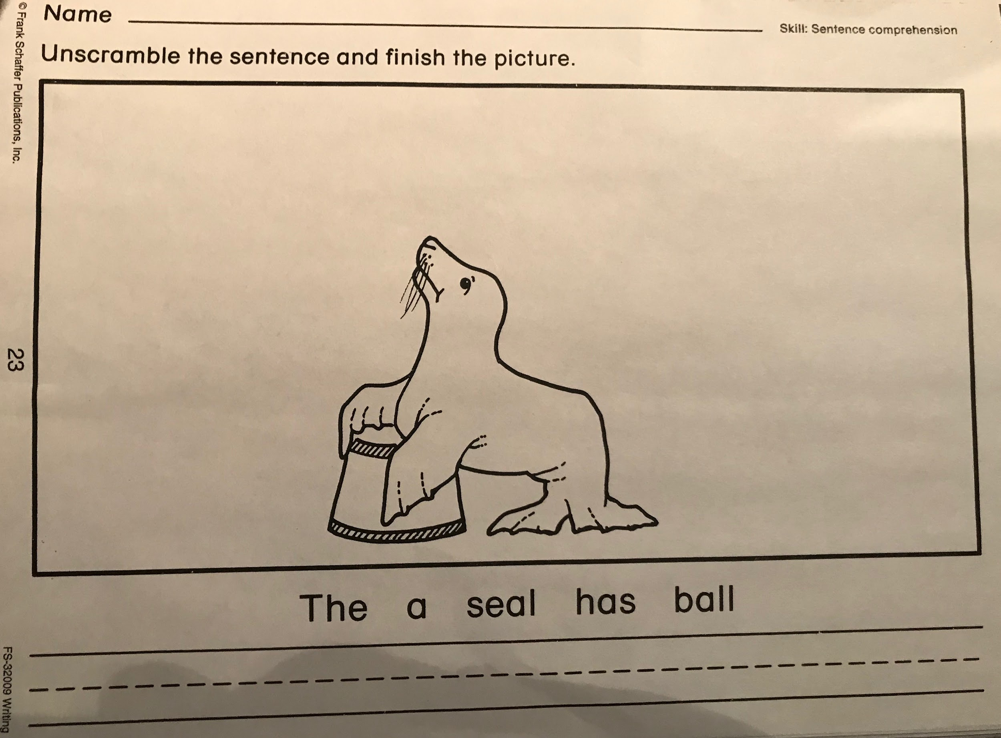
Unscrambling the Sentence

Slide 10
Unscrambling the Sentence
Content Knowledge Needed |  | Language Knowledge Needed
Seal |  | Word Level: Sight words (a, has, the)
Ball |  | Word Level: Vocabulary - ball and seal
How to draw seal/ball |  | Word Level: Directions which include words such as sentence, unscramble, finish, and picture
Syntax |  | Sentence Level: Order of words to form a sentence
Period goes at the end of a sentence
Capital letter at the beginning of a sentence
How to write letters in tiers
Definition of unscramble
What a sentence is

Slide 11
Unscrambling the Sentence
Supports - Level 1
Based on the WIDA CAN-DO Descriptors, level 1 students are able to label pictures, and copy information.
Supports:
Reading directions out loud
Cut out words to paste for labels while the teacher says the words and points to the pictures
Auditory words in the correct order
Teacher Model

Slide 12
Unscrambling the Sentence
Challenges
How to differentiate for Level 1’s without just giving them the answers
Background knowledge on circuses
Insights
Not just a quick check-in assessment that I thought it would be
More preparation
More content knowledge students need to know
Writing out/brainstorming all the information students need to know displayed the amount of preparation needed to give this assessment

Slide 13
ELA 4th Grade Annah

Slide 14

Sylvie is from France. She plays the flute. She speaks French and English. Pedro is from Mexico. He plays the trumpet. He speaks Spanish and English. Hamisi is from Kenya. She plays the violin. She speaks Kiswahili and English.
Talk About It
Describe the children in the orchestra. How are they similar? How are they different?
Language Function: DESCRIBE Remembering/Knowledge
Language Function:
COMPARE
Analyzing/Analysis

Slide 15
SUPPORTS
To describe To compare/contrast
Student | Country Key Word: From | Instrument Key Word: Plays | Languages Key Word: Speaks
Sylvie | France | Flute | French and English
Pedro | Mexico | Trumpet | Spanish and English
Hamisi | Kenya | Violin | Kiswahili and English
Sentence Frame:
______plays the _______ but ______ plays the ________.
Sylvie plays the flute but Pedro plays the trumpet.
Level 2:
Students at Level 2 are working towards producing multiple related sentences. They will use a sentence frame to structure their responses. This will help structure the students’ language response.
Level 4:
Students at Level 4 are able to expand on related ideas. They will use a word bank as an entry point for students to then expand on related issues

Slide 16
Social Studies 3rd Grade Mick

Slide 17
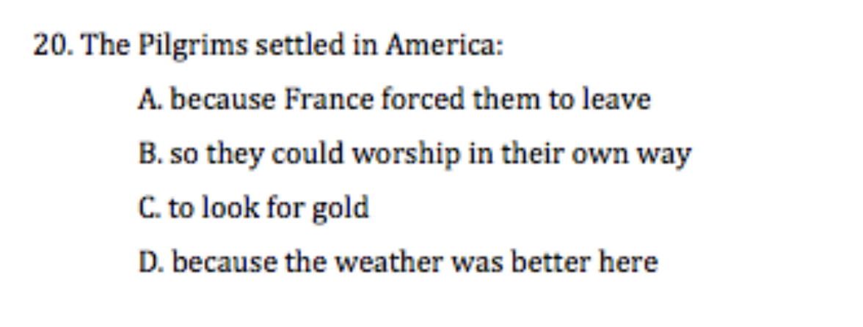
Pilgrim and Wampanoag Unit Test
12 Fill in the Blanks
7 Short Answer
4 Multiple Choice

Slide 18
Short Answer
14. Pick TWO parts of a deer and tell what each was used for by the Wampanoag.
Content |  | Language
Parts of a deer Uses of deer parts by Wampanoag |  | Name deer parts Explain how they were used in complete sentences
15. What was the Mayflower Compact? Why was it important?
Content |  | Language
Mayflower Compact Results of the Compact |  | Identify the Mayflower Compact Explain the importance

Slide 19
Content Knowledge
Identify
who the Wampanoags and their leaders were
the Wampanoags’ ways of life
who the Pilgrims and their leaders were
the Pilgrims’ ways of life
the Pilgrims’ reason for leaving England and the laws and self-government they created in Plimouth
Analyze
differences in ways of life between the Pilgrims and the Wampanoags
differences in ways of life between the Pilgrims and themselves

Slide 20
Language Features
Word Level
Define vocabulary words when given the definition of mishoon, colony, wampum, Pilgrim, Wampanoag, government, wetu, longhouse, meetinghouse, powwow, sachem, and tribe
Sentence Level
Create a complete sentence
Explain how parts of a deer were used by the Wampanoag
Explain why the Pilgrims ended up arriving in Plimouth
Identify and explain the importance of the Mayflower Compact
Name who John Carver and William Bradford were
Compare two ways their lives and the lives of a Pilgrim child were the same
Compare what school was like for the Pilgrims and the Wampanoags
Compare two ways a Wampanoag wetu and a Pilgrim house are different

Slide 21
Social Studies is a very content language heavy subject.
How do we make that accessible to English Language Learners?

Slide 22
Practice

Slide 23
Practice - Design Supports
Your student Phillip has to take the social studies test. He is a wida level 2 in reading and writing.
Choose one question from the assessment and design support(s) to help Phillip successfully answer the question.
We will discuss your choices and your experience designing supports.

Slide 24
Using WIDA to Design Supports

Slide 25
Application

Slide 26
Analyze an Assessment
Your Assessment: Living and Non-Living Things
Your Task:
What is the content knowledge students would need to have to complete this assessment successfully? Be specific.
What language features (word, sentence, and discourse level) do students need to understand/use to complete this assessment successfully? Consider both reading and writing.
What supports should a teacher provide for ELs?
Feel free to work together!

Slide 27
Debrief
Your thoughts on the analysis activity?
Any questions for us?
Thank you for your attention!

