Slide 1
Arts, Literacies, & Languages:
Culturally Responsive Literacies with Emergent Bilingual Children
By Dr. Amanda Claudia Wager & Camille Marie Garcia
MATSOL 2018
Notes:
Good afternoon. Buenas Tardes. Gooiemiddag.
I would like to acknowledge that we are on the traditional territory of the Nipmuc people’s who are descendants of the indigenous Algonquian peoples of Nippenet, 'the freshwater pond place', where Framingham now resides. As an individual with settler and immigrant status, as well as being an outsider to this community, I give much gratitude to have this opportunity to share our research, strategies and ponderings on this land today.
Introduce ourselves; a bit about our backgrounds

Slide 2
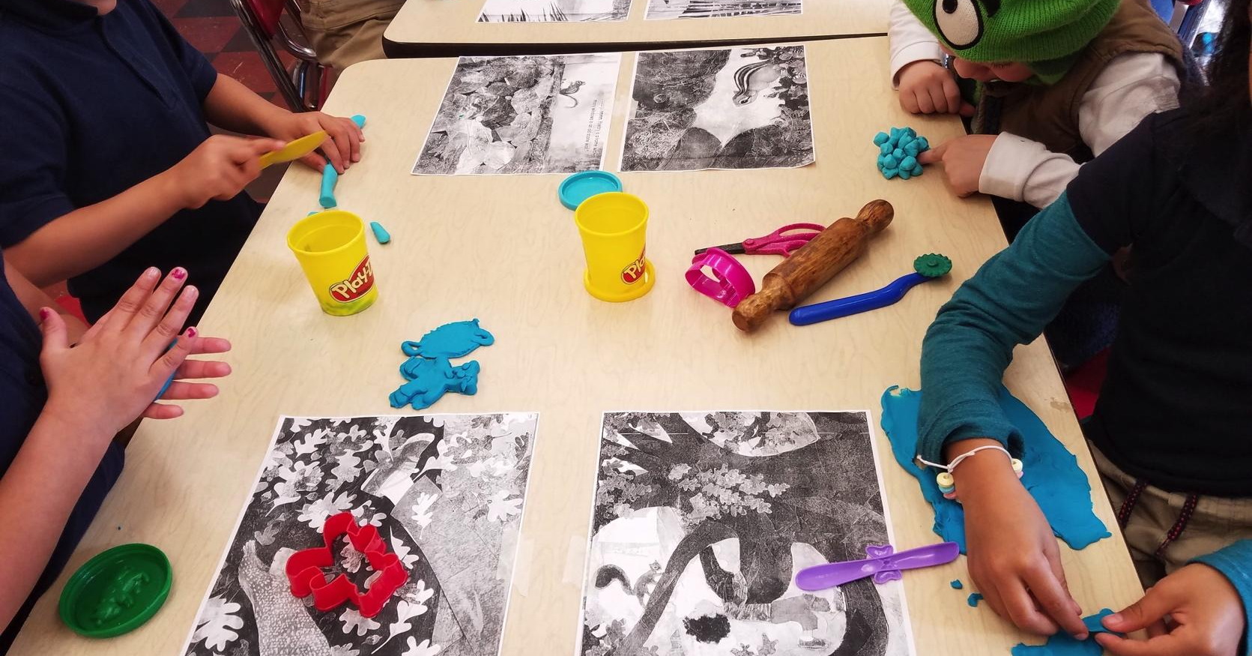
How does Art Serve as Voice for Emergent Bilingual Learners?
Notes:
Camille: poetry with kindergartners ELD 4 & 5
Amanda: Explain story about living on a desert island
So, how does art serve as voice for these populations of emergent bilingual learners? Borrowing a metaphor from Seeking Educational Equity and Diversity (SEED) director Emily Style (1996), art is an expressive form that is simultaneously a “window and mirror”. It is through art that we are able to access and honor authentic stories, lived experiences, and knowledge of diverse peoples. For students who are in process of learning a new language in a new land, while still holding on to their native language, the ability to investigate, reflect and share this knowledge through rich multimodal literacies (i.e. through textual, gestural, visual, spatial, audio, and digital ways) that are not oral-language-dependent, is crucial (Franks, 2008). Applying a critical lens through the arts engages students through a wide range of literacies as they make meaning dependent on social, cultural and historical contexts (Ajayi, 2015; Schroeter & Wager, 2016).

Slide 3
Arts, Literacies, & Languages
Arts
multiple entry points into the curriculum, tangible scaffolding, sense of belonging, bridge from home to school, contribute cultural knowledge & linguistic background knowledge
Literacies
as a sociocultural practice; multiliteracies, new litreacies studies, & multimodality
Languages
comprehensible input, ZPD, student agency in learning, biliteracy, home language, school retention
Notes:
Amanda
The arts not only provide multiple entry points demanding complex problem-solving skills, but also provide tangible scaffolding for language learning and academic success. The arts create fertile ground for inspiring a sense of belonging in school, cognitive growth and communication. The arts also call on students to draw from and contribute their cultural knowledge and linguistic background as they enhance their communication skills.
Why the arts? The arts are an integral part of our lives that represent our values, connect us with one another, provide avenues for research and learning, stimulate our imagination, and provide us with a sense of agency to create positive impact in our communities and the larger world. In addition to the richness of the process, a final product/performance also plays an important role in community building. Communities, families, staff and teachers gather for exhibitions and performances, providing an opportunity not only to celebrate the community members’ artful accomplishments, but also to engage all participants in teaching and sharing their knowledge and culture in both schools and the larger community.
Literacies. Literacy as a sociocultural practice encompasses the myriad of different spaces of student lives: homes, schools, playgrounds and similar public and private spaces. As well, literacies include the diverse representations that students use to interpret and represent their daily lives, such as through the modes of visual arts, song, dance, and drama. Informed by social semiotic theories that emphasize how the relationship between form and meaning is socially constructed with texts. these concepts have recently been explained through the pedagogical theories of multiliteracies, new literacies studies, and multimodality, which are a direct response to our growing multilingual and multimodal world with respect to technology, globalization and the many English language variations spoken today. Multimodality brings these ideas together to consider how each element, or mode that we use to ‘read the world’ (Freire & Macedo, 2005) is situated historically, culturally, and socially, and contributes to the entire meaning of the text; the text now being a body, a book, a visual piece of art, a comic, a song. These meanings are made and mixed through various modes of meaning-making, such as gesture, gaze, image, sound, speech, writing, body posture, music, and so on. Multimodality places emphasis on how the many different modes within any given text intersect, interrelate, are interpreted, and remade, to make up new meanings.
Language Acquisition. Language is at the heart of teaching and learning because all classrooms and community settings are language-learning environments for both primary English speakers and emergent bilingual learners. Educators use knowledge of language as communicators, evaluators, educated human beings, and as agents of socialization. Drawing from Krashen’s theory of comprehensible input, we see language acquisition being built and expanded upon input that is already understood at a certain proficiency level—much like Vygotsky’s Zone of Proximal Development—and that students acquire language best through interaction in a non-threatening and low anxiety environment. Engaging pre-existing knowledge encoded in family languages encourages a deep understanding of concepts and factual knowledge for emergent bilinguals. The arts promote this kind of cross-language transfer and give students agency over their learning process while supporting biliteracy. Since there are a wide range of language variations represented in North America, teachers can benefit from pedagogically sound and culturally sensitive methods for helping students learn academic English in schools and other community settings while honoring home languages and cultures.
Fostering bilingualism: The hArt of literacy development with emergent bilingual learners. Imagine, when you speak Spanish and English, and then add Mandarin, you will be able to converse with most of the people on this planet! Engaging the home language in school as a learning and teaching tool gives emergent bilingual students an academic advantage. This, in turn, creates access and accelerates both content area and basic literacy skills (Cummins, 2000). Teaching materials inclusive of home language and culture enhance proficiency in both the language of home and that of academic English (Kioko, 2015). This invitation to engage in the learning process with all that each student has to offer inspires a sense of belonging in school, to the extent that researchers have found a direct correlation between bilingual education and staying in school (Feinberg, 2002). Home language, then, is an asset, a valuable treasure worth preserving and enhancing, not only for families and cultural communities, but also to support cognitive development and academic achievement. As artists and educators, we are critically positioned as agents of multiliteracies to support students in communicating in rich ways across a wide range of contexts.

Slide 4
Guiding Questions
How can a culturally responsive arts-infused curriculum be used in public elementary school classrooms with English Learners to improve English Language Development, as well as to build Culturally Responsive Skills among students?
How do visual literacies help build culturally responsive skills?
How do art and dialogue strengthen identity and consequently promote learning?
Notes:
Amanda read Guiding Questions
Camille address notes:
Often, teachers are tasked with mitigating instruction that is historically accurate with one that is simultaneously, culturally/linguistically sensitive to the individual student demographics. With culturally and linguistically sustaining practices, educators are becoming more aware and intentional about the historical and cultural contexts within which stories are told, as well as the accuracy and relevancy of those chosen texts in today’s classrooms. With that being said, indelible historical and cultural truths must be told with great care. By infusing art and dialogue into teaching, teachers facilitate the kind of learning that students authentically construct. In doing so, educators design learning experiences that give students access and agency, which is one of BPS’ Essentials of Learning.

Slide 5
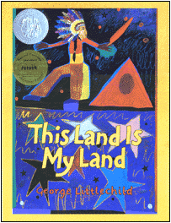
Through his own words and paintings, acclaimed Native artist George Littlechild takes us back in time to the first meeting between his Plains Cree ancestors and the first European settlers in North America
Notes:
10 minutes in.
Camille tells story first.

Slide 6
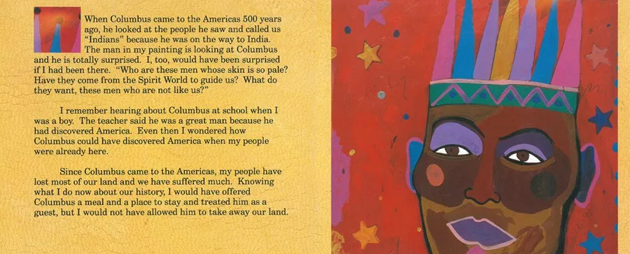
Tasks 1-3:
SWBAT listen to, and turn & talk about the reading of a possible encounter between Christopher Columbus & a Native American.
SWBAT identify the emotion depicted in the image, and generate 1 or 2 questions he may have had for the European.
SWBAT draw a portrait of Christopher Columbus and generate 1 or 2 questions he may have had for the Native American

Slide 7
SCAFFOLDS for Tasks 1-3 (ELD Levels 1-2)
1. Teacher may use a Preview/Review strategy (in students’ L1) to give Newcomers access to the content before and after the lesson.
2. Teacher may provide a translated version of the page for Newcomers to use during the lesson.
SCAFFOLDS for Tasks 1-3 (ELD Levels 3)
1. Teachers may preview key vocabulary words with students, such as: perspective, Columbus, ‘Indians’, painting
2. Teachers may use sentence stems to help students write questions (in L1 or L2) like: Who are... Why have you… How come…?

Slide 8
Tasks 4 - 6:
SWBAT turn to a partner and practice role playing as Christopher Columbus and a Native American, with the goal of trying to answer the question from each perspective, using prior knowledge.
SWBAT act out each part, while sharing their pictures with the audience.
SWBAT act out parts in front of the class, reflecting on their experiences as they connect with history’s undoing.

Slide 9
SCAFFOLDS for Tasks 4 - 6 (ELD Levels 1-2)
1. Teacher may group students homogeneously by L1, to reduce emotional filters and allow students to use their own language to demonstrate understanding of perspective.
2. Teacher may have students translate for each other as needed, to give every student access to the learning.
SCAFFOLDS for Tasks 4 - 6 (ELD Levels 3)
1. Teachers may help students generate a list of words/phrases that might be used for generating and answering student questions.
2. Teachers may use sentence stems to help students ask questions orally (in L1 or L2) like: Who are... Why have you… How come…?

Slide 10
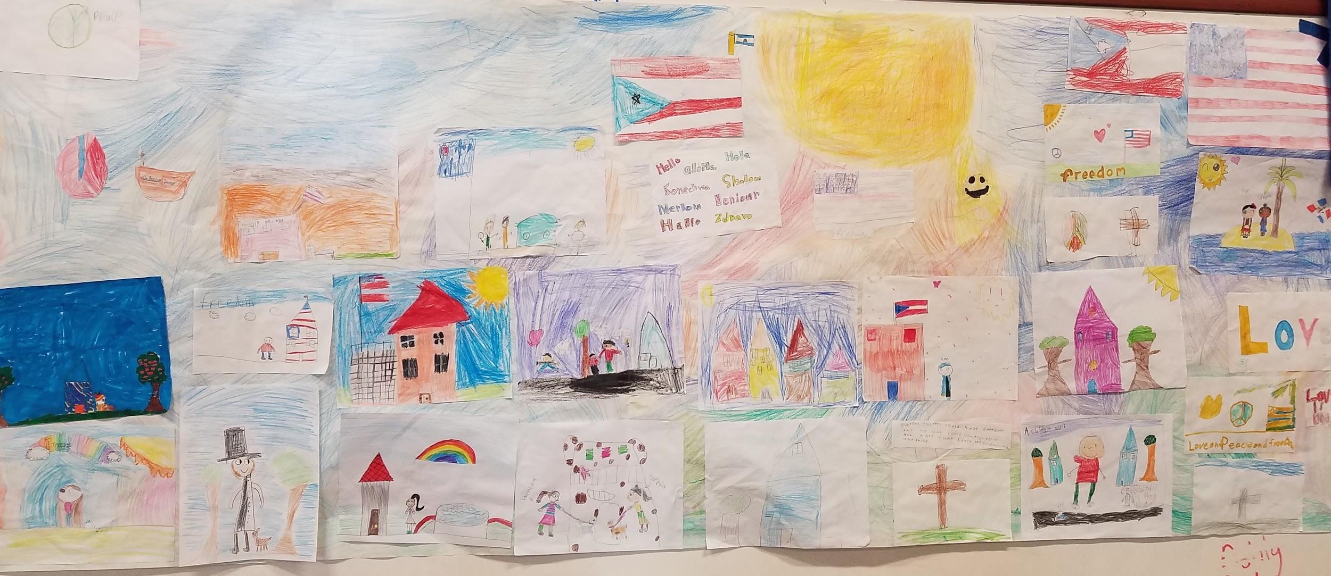
Students used different forms of art & dialogue to connect their stories to and explore their project’s driving questions with greater breadth and depth: ‘What does it mean to be free?’ and ‘How can my perspective stand out in a culture of shared values?
FREEDOM TO BE ME - Mural
By 3rd Grade Bilinguals

Slide 11
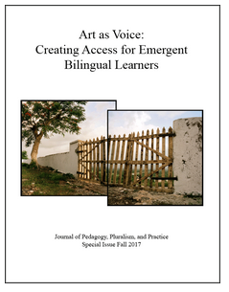
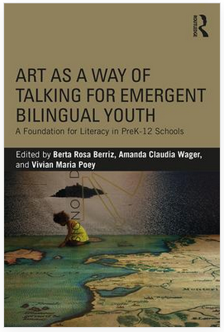
more resources:
https://digitalcommons.lesley.edu/jppp/
Notes:
last chapter of JPPP

Slide 12
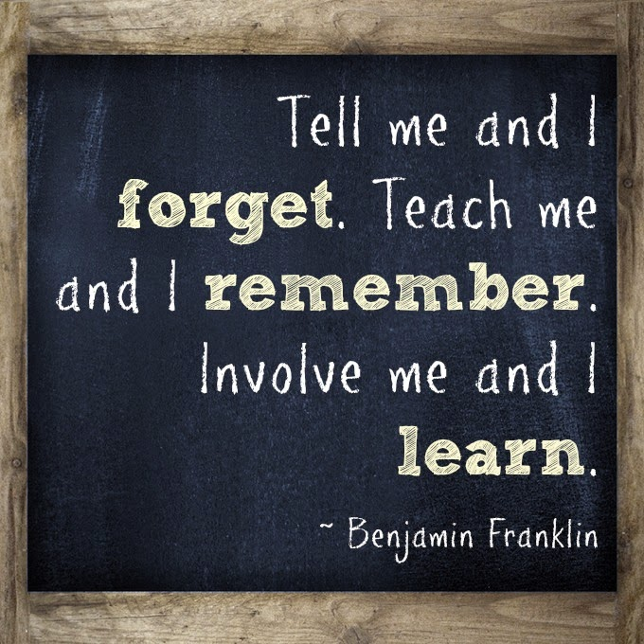
Notes:
Camille - To me, when we infuse arts into literacy learning, we are automatically engaging students in the process. To engage is to involve, and hence to LEARN!

Slide 13
thank you. gracias. dank je wel.
Amanda Claudia Wager
awager@lesley.edu
Camille Marie Garcia
cgarcia3@lesley.edu

