Slide 1
English Learners at Community Colleges: Improving ESL Services
KUANG LI & NICK DAVID
BOSTON UNIVERSITY

Slide 2

Different Perspectives
Community college EL teachers and administrators
Community college EL researchers

Slide 3

Important Terms
LM: Language/Linguistic Minority, comes from a home where a language other than English is spoken
EL: English Learner, placed in ESL coursework (lower English proficiency)
ESL: English as a Second Language, used to denote courses designed for EL populations

Slide 4

LM and EL US Population
US Language Minority Population:
  60.5 million, 20.7% of population (Ryan, 2013)
Enrolled in ESL coursework
  K-12: 9.3% (Kena et al., 2016)
  College: 8.3% (Kena et al., 2016)

Slide 5

Community College Domestic ELs
International/Domestic, University/Community College
Researcher areas of focus
  Race (e.g. Wood & Turner, 2011)
  First Generation (e.g. Pascarella, Wolniak, Pierson, Terenzini, & Schuh, 2003)
  Immigrant (e.g. Vernez & Abrahmase, 2003)
  Low Socioeconomic Status (e.g. Attewell, Heil, & Reisel, 2011)

Slide 6

EL Status as Inherently Transitory
ELs classification and reclassification (Slama, 2012, 2014)
Differing placement policies/practices
  Among and between high schools (Menken, Kleyn, & Chae, 2012)
  Between states (ESSA, 2015)
  Between high schools and colleges (Bunch & Panayotova, 2008)

Slide 7
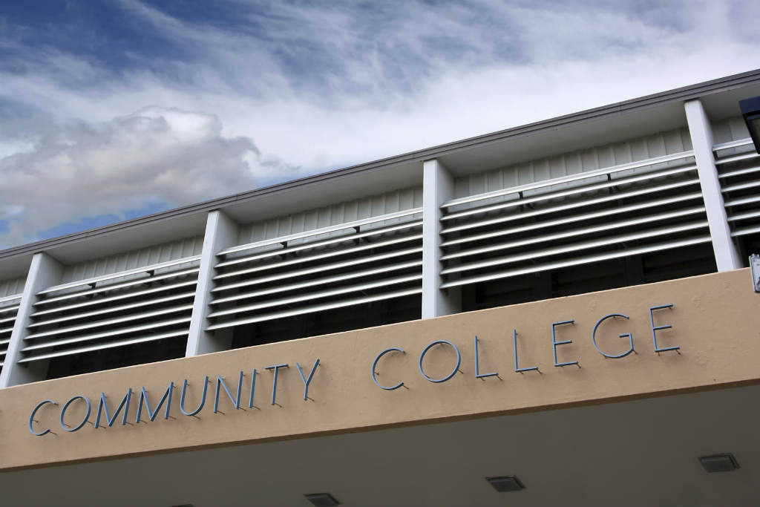
ELs and College Going Nationwide
Why ELs attend community colleges (Conway, 2010; Walpole, 2003)
  Lower cost, open enrollment
(ELS 2002) Kanno and Cromley, 2015
  ELs (31.3%/19.0%)
  EP (34.6%/34.6%)
  NS (26.9%/44.8%)

Slide 8
ELs and College Going: MA
MA ELs (2017-2018) (DESE)
  16.3% of kindergarteners
MA ELs (2013-2014) (DESE)
  5.7% of all high school graduates
  62.9% go on to college
  59.6% of MA ELs who attend college go to community colleges (37% of total ELs)

Slide 9

Community College Student Risk Indicators
Racial Minority (Attewell, Heil, & Reisel, 2011)
First Generation College Attender (Ma, Pender, & Welch, 2016)
Low Socioeconomic Status (Attewell et al., 2011)
Non-Traditional Status (Juszkiewicz, 2016)
  Older student
  Part-time enrollment

Slide 10

Unique EL Risk Factors
High School Academic Preparation
Limited Academic Literacy Acquisition
EL Placement Policies
ESL Course Offerings

Slide 11
High School Academic Preparation
Low HS academic preparation not a significant negative predictor of CC student graduation generally (Attewell, Heil, & Reisel, 2011)
Low HS academic preparation is a significant negative predictor of CC EL student graduation (Kanno & Cromley, 2016)
Interrupted Education and Long-Term ELs (Olson, 2010; Umansky, 2016)
Students placed in undemanding coursework (Callahan & Humphries, 2016)
ELs less likely to associate with college-going peers (Kanno & Kangas, 2014)

Slide 12

Limited Academic Literacy Acquisition
Limited writing genre exposure and practice (Harklau, 2000; Ruecker, 2015)
Limited writing feedback (Ruecker, 2015)
Limited reading and vocabulary exposure and practice (Crosby, 2009)

Slide 13


EL Placement Policies
ACCUPLACER and COMPASS severe misplacement (Belfield & Crosta, 2012)
  33% ACCULPACER
  27% COMPASS
Students placed in lower level ESL coursework unlikely to progress to credit bearing coursework, let alone graduate (Patthey-Chavez, Dillon, & Thomas-Spiegel, 2005)

Slide 14
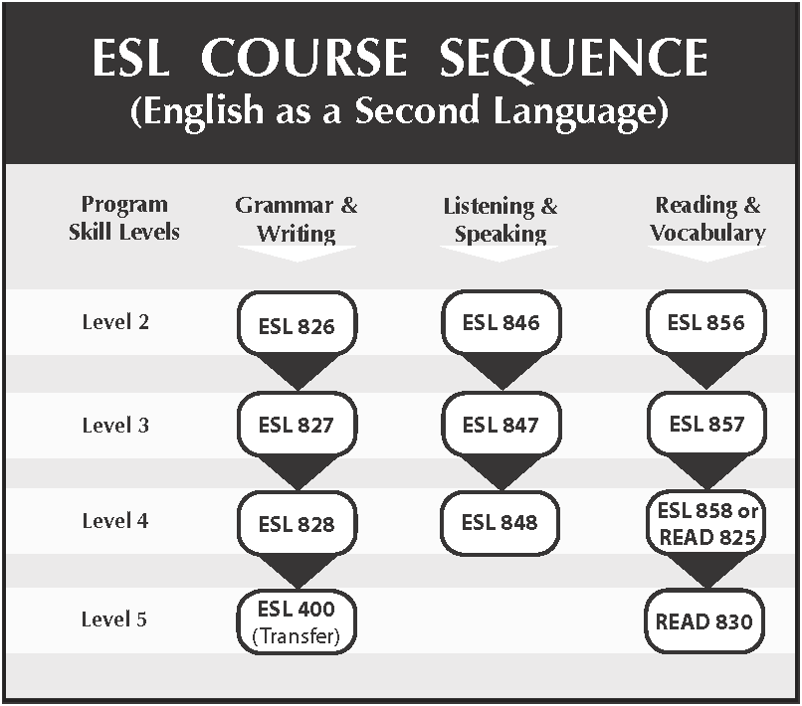
ESL Course Offerings
Courses often not offered for college credit
  TESOL (2012)
  CCCC (2001)
Courses often organized by skill area (Bunch, Endris, Panayotova, Romero, & Llosa, 2011; Bunch & Kibler, 2015)

Slide 15

Ideas for Teachers and Administrators
International ELs are different from domestic ELs and have different needs
4 skills instruction versus content-based instruction (Bunch & Kibler, 2015)
Domestic ELs often need the content instruction they would have gotten in high school if that hadn’t been enrolled in ESL coursework (Bunch & Kibler, 2015)

Slide 16

Bridging the Gap to College Work
Work on bridging the gap between ESL programs and college coursework
The longer the course sequence in ESL, the less likely students are to move on to college work (Patthey-Chavez et al., 2009)
Figure out what these students’ goals are: just English proficiency, or college graduation

Slide 17

Making Their Time in ESL Count
Offering ESL courses for college credit (CCCC, 2001; TESOL, 2012)
Having ESL courses serve as adjunct coursework for GE courses
Offer for credit content courses in the students’ first language if there is a predominant L1 group (Artiaga, 2013)

Slide 18

Challenges CC ESL Programs Face
Varied domestic EL student backgrounds
Some students not fully literate in L1
Some had interrupted educations
Many are non-traditional students
Many have significant family and work responsibilities
Many are attending part-time
Many are first generation college attenders
Etc.

Slide 19

Challenges ESL Programs Face
College administrative decisions to cut back on ESL programs and resources
Program administrator and staff trying to oversee and coordinate ESL programs while simultaneously having to justify them

Slide 20
How Do We Define EL Success?
Belcher (1988)
Complete the highest level of ESL
Remain enrolled, even if they did not finish ESL
Leave the institution in good standing
Goldrick-Rab (2010)
Establish a baseline

Slide 21
Journey to a Bachelor’s Degree
ESL
(Dev. Ed.)
College-level courses
Transfer &
study at a 4-yr uni.
BA attainment

Slide 22
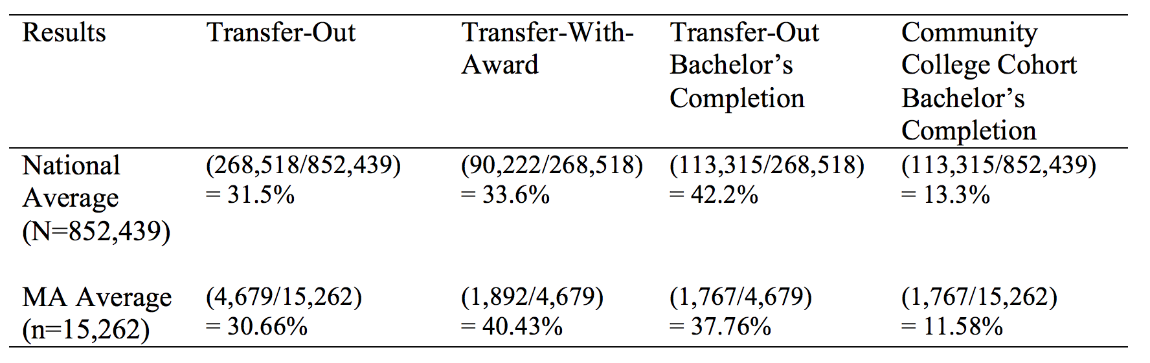
Calculated from Shapiro et al. (2017)

Slide 23
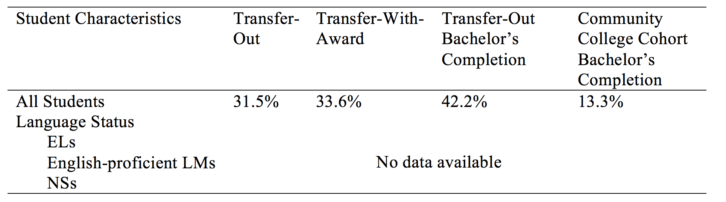

Slide 24
Who Are ELs in CCs?
U.S.-educated ELs
Younger immigrants
Older immigrants
International students
(Chang, 2016; Llosa & Bunch, 2011)

Slide 25
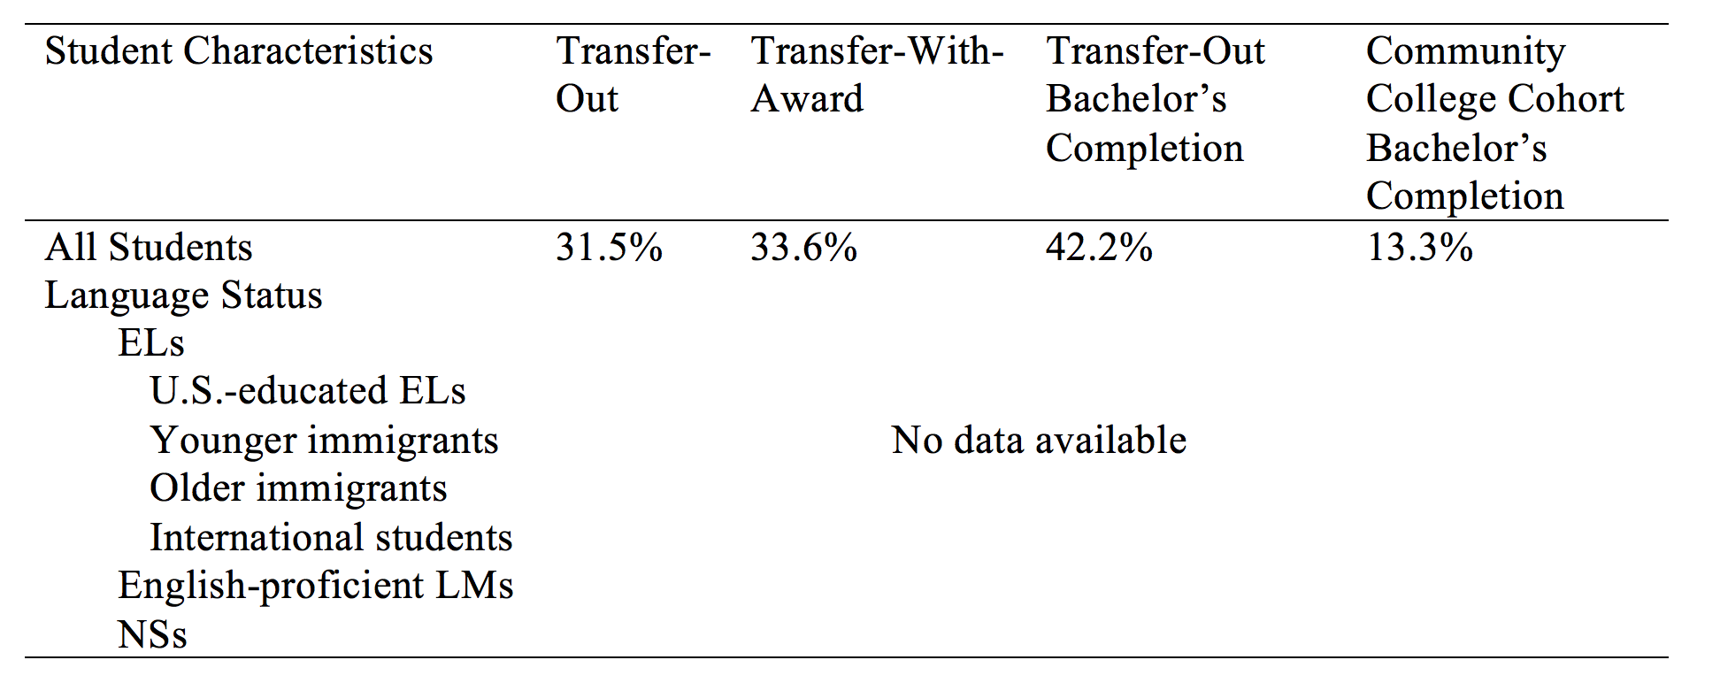

Slide 26
Summary
Journeys from ESL to a bachelor’s degree for ELs in general (Needed)
  Subgroups of ELs’ journeys from ESL to a bachelor’s degree (Needed)
Subgroups of ELs in terms of their ESL (Available)

Slide 27
Theoretical Frameworks for Studying CC ELs
Group 1
Multidimensional framework of academic English literacy
Group 2
Theory of social reproduction
Funds of knowledge
Critical race theory
Community cultural wealth model
Anti-deficit achievement framework
Group 3
Socio-academic relations
Student engagement
Involvement
Theory of validation
CCSSE’s benchmarks

Slide 28
Multidimensional Framework of AEL
Linguistic dimension
  Phonological component
  Lexical component
  Grammatical component
  Sociolinguistic component
  Discourse component
Cognitive dimension
  Background knowledge
  Higher-order thinking
  Metalinguistic abilities
Socio-Cultural/Psychological dimension
  Beliefs
  Values
  Attitudes/motivations
(Scarcella, 2003)

Slide 29
Social Reproduction (Bourdieu, 1986)
Funds of knowledge (Rios-Aguilar, Kiyama, Gravitt, & Moll, 2011)
Anti-deficit achievement
(Harper, 2010)
Capital:
Aspirational
Linguistic
Familial
Social
Navigational
Resistant
Community cultural wealth model
(Yosso, 2005)
Critical Race Theory (Patton, Renn, Guido, Quaye, & Forney, 2016)

Slide 30
Theory of validation
(Rendon, 1994)
Student faculty interaction
Student student interaction
Student engagement
(Tinto, 1993)
Socio-academic relations
(Leki, 2007)
CCSSE’s Benchmarks
(CCSSE, 2003)
Involvement
(Astin, 1985)

Slide 31
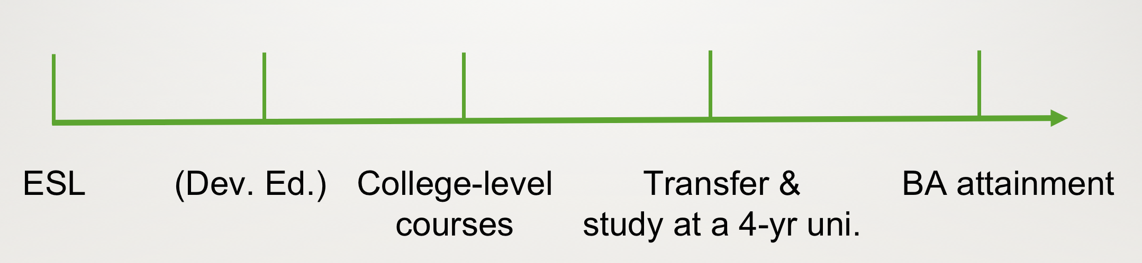
Research Methods to Study ELs in CCs
Two main data collection methods
  Interviews (Retrospective accounts)
  Transcripts
Three data analysis methods
  Use available theoretical frameworks
  Grounded theory analysis
  Transcript analysis
Study time varies
  Several months
  Several years

Slide 32
Future Research: Kuang Li
ELs’ overall experiences in community colleges
CC ELs’ journeys from ESL to a bachelor’s degree
CC ESL teachers’ perceptions of ELs’ journeys
?
In the near future
EL
If enroll in 2018

Slide 33

Future Research: Nick David
Community college ESL course offerings through examining course catalogs
Looking for variation within and between states
Being able to identify innovative practices

Slide 34
Kuang Li: kuangli@bu.edu
Nick David: nedavid@bu.edu
Thank you!

Slide 35
Discussion Questions
Do you notice different learning needs among your ELs (i.e., U.S.-educated ELs; younger immigrants, older immigrants; and international students)?
What knowledge about transfer might your students need even though they are now in ESL?
What transfer-related content could be added to your ESL curriculum?
Notes:
Back up

Slide 36
References
Artiaga, M. D. (2013). A portraiture of six Hispanic women's academic pursuit in a community college setting: A qualitative study (Doctoral dissertation). Retrieved from ProQuest Dissertations Publishing. (UMI No. 3574483)
Astin, A. W. (1985). Achieving educational excellence: A critical assessment of priorities and practices in higher education. San Francisco, CA: Jossey-Bass.
Attewell, P., Heil, S., & Reisel, L. (2011). Competing explanations of undergraduate noncompletion. American Educational Research Journal, 48, 536-559. doi:10.3102/0002831210392018
Belcher, M. (1988). Success of students who begin college by enrolling in English as a second language (Research report No. 88-90). Miami, FL: Miami-Dade Community Coll., Fla. Office of Institutional Research.
Belfield, C., & Crosta, P. M. (2012). Predicting success in college: The importance of placement tests and high school transcripts. (Working Paper No. 42). New York, NY: Columbia University, Teachers College, Community College Research Center.

Slide 37
References (Continued)
Bourdieu, P. (1986). The forms of capital. In J. G. Richardson (Ed.), Handbook of theory and research for the sociology of education (pp. 241-258). Westport, CT: Greenwood Press.
Bunch, G., Endris, A., Panayotova, D., Romero, M., & Llosa, L. (2011). Mapping the terrain: Language testing and placement for US-educated language minority students in California's community colleges. Report prepared for the William and Flora Hewlett Foundation. Available at http://escholarship.org/
Bunch, G. C., & Kibler, A. (2015). Integrating language, literature, and academic development: Alternatives to traditional English as a second language and remedial English for language minority students at community colleges. Community College Journal of Research and Practice, 39, 20-33. doi:10.1080/10668926.2012.755483
Bunch, G. C., & Panayotova, D. (2008). Latinos, language minority students, and the construction of ESL: Language testing and placement from high school to community college. Journal of Hispanic Higher Education, 7, 6-30. doi:10.1177/1538192707310507

Slide 38
References (Continued)
Callahan, R. H. & Humphries, M. H. (2016). Undermatched? School-based linguistic status, college going, and the immigrant advantage. American Educational Research Journal, 53, 263-295. doi:10.3102/0002831215627857
Community College Survey of Student Engagement [CCSSE]. (2003). About the survey: Overview. Retrieved from http://www.ccsse.org
Chang, Y. (2016). Discourses, identities and investment in English as a second language learning: Voices from two U.S. community college students. International Journal of Education and Literacy Studies, 4(4), 38-49. doi:10.7575/aiac.ijels.v.4n.4p.38
Conway, K. (2010). Exploring persistence of immigrant and native students in an urban community college. The Review of Higher Education, 32, 321-352. doi:10.1353/rhe.0.0059
Crosby C. (2009). Academic reading and writing difficulties and strategic knowledge of Generation 1.5 learners in M. M. Roberge, M. Siegal, & L. Harklau. (Eds.), Generation 1.5 in college composition: Teaching academic writing to U.S.-educated learners of ESL (pp. 105-119). New York, NY: Routledge.
Every Student Succeeds Act (ESSA). (2015). Every Student Succeeds Act of 2015, Pub. L. No. 114-95 § 114 Stat. 1177 (2015-2016).

Slide 39
References (Continued)
Goldrick-Rab, S. (2010). Challenges and opportunities for improving community college student success. Review of Educational Research, 80, 437-469. doi:10.3102/0034654310370163
Harklau, L. (2000). From the “good kids” to the “worst”: representations of English language learners across educational settings. TESOL Quarterly, 34, 35-67. doi:10.2307/3588096
Harper, S. R. (2010). An anti-deficit achievement framework for research on students of color in STEM. New Directions for Institutional Research, 148, 63-74.
Juszkiewicz, J. (2016). Trends in community college enrollment and completion data. Washington, DC: American Association of Community Colleges.
Kanno, Y., & Cromley. J. C. (2016). English learners’ high school academic preparation, community college enrollment, and eventual bachelor’s degree attainment. Manuscript in preparation.
Kanno, Y., & Cromley, J. C. (2015). English learner’s pathways to four-year colleges. Teachers College Record, 117, 1 44.

Slide 40
References (Continued)
Kanno Y., & Kangas, S. E. (2014). ‘‘I’m not going to be, like, for the AP’’: English language learners’ limited access to advanced college-preparatory courses in high school. American Education Research Journal, 51, 848-878. doi:10.3102/0002831214544716
Kena, G., Hussar W., McFarland J., de Brey C., Musu-Gillette, L., Wang, X., . . . Dunlop Velez, E. (2016). The condition of education 2016 (NCES 2016-144). Washington, DC: U.S. Department of Education, National Center for Education Statistics. Retrieved from: https://nces.ed.gov/pubs2016144.pdf
Leki, I. (2007). Undergraduates in a second language: Challenges and complexities of academic literacy development. New York, NY: Lawrence Erlbaum Associates.
Llosa, L., & Bunch, G. (2011). What’s in a test? ESL and English placement tests in California’s community colleges and implications for US-educated language minority students. Retrieved from http://escholarship.org/uc/item/10g691cw
Ma, J., Pender, M., & Welch, M. (2016). Education pays 2016: The benefits of higher education for individuals and society. Washington, DC: The College Board.

Slide 41
References (Continued)
Menken, K., Kleyn, T., & Chae, N. (2012). Spotlight on “long-term English language learners”: Characteristics and prior schooling experiences of an invisible population. International Multilingual Research Journal, 6, 121-142. doi:10.1080/19313152.2012.665822
Olson, L. (2010). Reparable harm: fulfilling the unkept promise of educational opportunity for California’s long term English Learners. Retrieved from Californians Together website:. https://www.californianstogether.org/reparable harm-fulfilling-the unkept-promise-of educational-opportunity-for-californias-long-term-english-learners
Pascarella, E. T., Wolniak, G. C., Pierson, C. T., Terenzini, P. T., & Schuh, J. H. (2003). Experiences and outcomes of first-generation students in community colleges. Journal of College Student Development, 44, 420-429. doi:10.1353/csd.2003.0030
Patthey-Chavez, C., Dillon, P., & Thomas-Spiegel, J. (2005). How far do they get? Tracking students with different academic literacies through community college remediation. Teaching English in the Two-Year College, 32, 261-277.
Patton, L. D., Renn, K. A., Guido, F. M., Quaye, S. J., & Forney, D. S. (2016). Student development in college: Theory, research, and practice. Somerset, MA: John Wiley & Sons.

Slide 42
References (Continued)
Rendon, L. I. (1994). Validating culturally diverse students: Toward a new model of learning and student development. Innovative higher education, 19(1), 33-51.
Rios-Aguilar, C., Kiyama, J., Gravitt, M., & Moll, L. (2011). Funds of knowledge for the poor and forms of capital for the rich?: A capital approach to examining funds of knowledge. Theory and Research in Education, 9(2), 163- 184.
Ruecker, T. (2015). Transiciones: Pathways of Latinas and Latinos writing in high school and in college. Logan, UT: Utah State University Press.
Ryan, C. (2013). Language use in the United States: 2011. American Community Survey Reports (Publication No ACS-22). Retrieved from https://www.census.gov/prod/2013pubs/acs-22.pdf
Scarcella, R. (2003). Academic English: A conceptual framework. Berkeley, CA: University of California Linguistic Minority Research Institute.

Slide 43
References (Continued)
Shapiro, D., Dundar, A., Huie, F., Wakhungu, P. K., Yuan, X., Nathan, A., & Hwang, Y. (2017). Tracking transfer: Measures of effectiveness in helping community college students to complete bachelor’s degrees (Signature Report No. 13). Herndon, VA: National Student Clearinghouse Research Center.
Slama, R. B. (2014). Investigating whether and when English learners are reclassified into mainstream classrooms in the United States: A discrete-time survival analysis. American Educational Research Journal, 51, 220-252. doi:10.3102/0002831214528277 Slama, R. B. (2012). A longitudinal analysis of English proficiency outcomes for adolescent English language learners in the United States. Journal of Educational Psychology, 104, 265-285. doi:10.1037/a0025861
TESOL (2012). Position statement on academic and degree-granting credit for ESOL courses in postsecondary education. Retrieved from https://www.tesol.org/news-landingpage/ 2012/06/27/position-statement-onacademicand degree-granting-credit-for-esol-courses-in postsecondaryeducation#sthash.SqFiBuDF.dpuf
Tinto, V. (1993). Leaving college: Rethinking the causes and cures of student attrition (2nd ed.). Chicago, IL: University of Chicago Press.

Slide 44
References (Continued)
Umansky, I. M. (2016). To be or not to be EL: An examination of the impact of classifying students as English learners. Educational Evaluation and Policy Analysis, 38, 714-737. doi:10.3102/0162373716664802
Vernez, G., & Abrahmase, A. (2003). How immigrants fare in U.S. higher education. Santa Monica, CA: RAND Corporation.
Walpole, M. (2003). Socioeconomic status and college: How SES affects college experiences and outcomes. The Review of Higher Education, 27, 45-73. doi:10.1353/rhe.2003.0044
Wood, J. L., & Turner, C. S. V. (2011). Black males and the community college: Student perspectives on faculty and academic success. Community College Journal of Research and Practice, 35, 1–17. doi:10.1080/10668926.2010.526052
Yosso, T. J. (2005). Whose culture has capital? A critical race theory discussion of community cultural wealth. Race, Ethnicity, and Education, 8(1), 69-91. doi:10.1080/1361332052000341006

