Slide 1

Learning in Public and Transparency
Grantmakers for Effective Organizations Conference – March, 2012 – Seattle, WA
Beth Kanter, Beth’s Blog
Photo: fortuitousalacrity
Notes:
Learning in Public
Foundations spend millions of dollars each year on evaluation and learning activities, yet they rarely make evaluation results public. And often foundations make decisions based on these results without consulting key stakeholders or asking for their help in interpreting evaluation findings. There is an alternate approach emerging: sharing what an organization learns while it is in the process of learning — “learning in public.” Using the David and Lucile Packard Foundation’s Organizational Effectiveness program evaluation as an example, this session will examine the emerging practice of conducting evaluation activities in a public space — online and in real time, to maximize feedback from stakeholders and benefit not just an individual foundation’s work, but the field a whole
http://www.flickr.com/photos/fortuitousalacrity/3032749872/sizes/l/in/photostream/s a whole.

Slide 2

Who is in the room?
Type
Role
Evaluation
Stand up, Sit Down
Photo: senorhans
Notes:
http://www.flickr.com/photos/senorhans/3085290475/
Do work with a ..
A foundation
A nonprofit
A consulting organization that does capacity building and/or evaluation
Other
Your Job:
Board member
Executive Director
Program Officer
Evaluation Staff for foundation
Evaluation consultant
Knowledge Management or Learning Officer
Communications
Other
Evaluation
How many of you do evaluations your grant strategy or program? Stand up
How many of you base your program design decisions on that evaluation info?
How many of you present evaluation findings to internally to boards or staff?
How many of you present evaluation finding to grantees, colleagues, and others?
How many of you present the exact same report/level of detail of program evaluation to both external/internal audiences?
How many of you have a standard procedure to make program evaluation all results public, including what didn’t work well?
How many of you have involved external stakeholders in reviewing or analyzing the data you’ve collected for a program analysis to help generate insights?

Slide 3

Hold a Sign Spectragram
AGREEREE
NEUTRAL
DISAGREE
Photo:fotologic
Notes:
Photo Credit fotologic
To get the discussion flowing, we going to do a modified spectragram – because we don’t have room to line up …
I’m going to read a statement and then ask for a couple of volunteers to come up, hold the sign that matches whether they agree or disagree with the statement, and then share with us why.

Slide 4

I Love Chocolate
NEUTRAL
DISAGREE
AGREEREE
Photo: eszter
Notes:
Photo:
http://www.flickr.com/photos/eszter/68153223/sizes/o/in/photostream/
Demo Question
I love chocolate
(Kathy hold AGREE sign) – Say that you love all chocolate, white chocolate, milk chocolate, dark chocolate, chocolate in your coffee, chocolate covered pretzels, expensive chocolate, cheap chocolate, I just love any and all chocolate.
(Jared hold DISAGREE sign) – Say that you hate chocolate, not so much because you don’t like the taste, but you are allergic to chocolate and if you eat you’ll end up with a deadly allergic reaction
I will hold the neutral sign and interview myself and say that I like chocolate, but it has to be dark chocolate 75% coco and made in Switzerland. I won’t touch white chocolate or milk chocolate.

Slide 5
When it comes to evaluation and strategy development, there’s no such thing as “too transparent.”
AGREEREE
NEUTRAL
DISAGREE
Notes:
“When it comes to evaluation and strategy development, there’s no such thing as ‘too transparent.’” ???
Conducting program evaluation activities in a public space – online and in real-time – has a higher cost than benefit.
Asking grantees, colleagues, and others for meaningful input is a crucial piece of any evaluation or strategic development process.
Asking key stakeholders for their help in interpreting program or strategy evaluation findings provides helpful insights to interpreting the findings.

Slide 6
Conducting program evaluation activities in a public space – online and in real-time – has a higher cost than benefit.
AGREEREE
NEUTRAL
DISAGREE
Notes:
Asking grantees, colleagues, and others for meaningful input is a crucial piece of any evaluation or strategic development process.
Asking key stakeholders for their help in interpreting program or strategy evaluation findings provides helpful insights to interpreting the findings.
Conducting program evaluation activities in a public space – online and in real-time – has a higher cost than benefit.

Slide 7

What is transparency?
What is learning in public?
How do they differ?
Photo: Andy Beal
Notes:
Let’s define transparency first …
For a nonprofit to be transparent means that it is open, accountable, and honest with its stakeholders and the public. Transparency exists to a lesser or greater extent in all organizations. Greater transparency is a good thing, not just because it is morally correct, but because it can provide measurable benefits. "Disclosure" is a component of transparency, and means releasing the information you have to and want to. "Transparency," on the other hand, can often mean releasing information that you don't have to.
When organizations work in a transparent way, they consider staff, board, and the people in their networks as resources for helping them to achieve their goals. This is not about being transparent for transparency sake; working transparently is an opportunity to improve the results of organizations’ programs. Transparent and open organizations are clear about what they do, and they know what they are trying to accomplish. They are enriched by outside feedback.
And yes, the notion of transparency is a bit scary. Consultant Vincent Stehle, Executive Director of Grantmakers in Film and Electronic Media, expressed the uncomfortable aspect of transparency by putting it this way, “We want to be transparent except when it matters.” And noted academic Brad Rawlins, Chair of the Department of Communications at Brigham Young University writes, “Transparency will expose your organization’s weaknesses, and areas that need improvement. Hiding these does not make them go away. Positive feedback that everything is okay, when it isn’t, only reinforces the debilitating behavior. Sure, transparency might make an organization feel uncomfortable, but it will also motivate it to improve.”

Slide 8
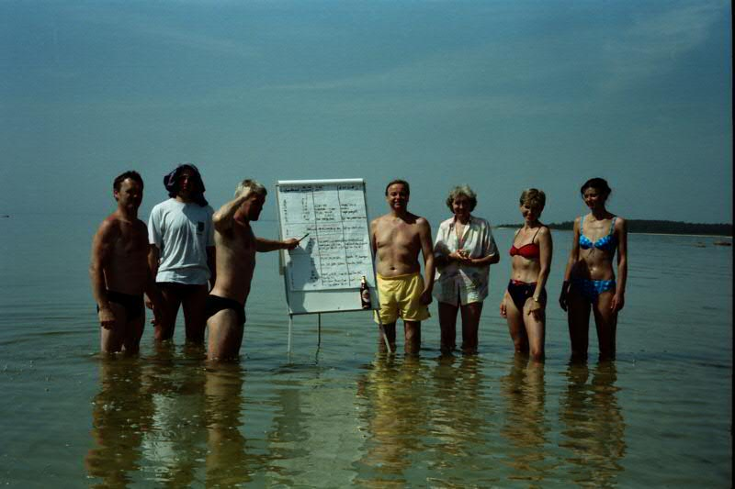
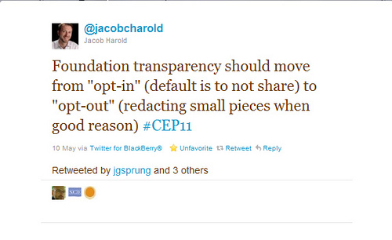
Transparency does not mean “sharing private or confidential information”
Photo: uncornedmarket

Slide 9
The Four Dimensions of Transparency
Substantial
Accountable
Absence of secrecy
Participation
Learning in Public
Notes:
In my next book, “Measuring the Networked Nonprofit, my co-author and I spent devoted a chapter to measuring transparency – a practice in an embryonic stage. But it required that we think unpack what transparency includes …..
Substantial – The organization provides information that is truthful, complete, easy to understand, and reliable.
Accountable – The organization is forthcoming with bad news, admits mistakes, and provides both sides of a controversy.
Absence of secrecy – The organization doesn’t leave out important but potentially damaging details, the organization doesn’t obfuscate its data with jargon or confusion, and the organization is slow to provide data or only discloses data when required.
These four components of transparency are tested by the following questionnaire
Participation – The organization asks for feedback, involves others, takes the time to listen, and is prompt in responding to requests for information.
It is this participation where public learning takes place ….

Slide 10
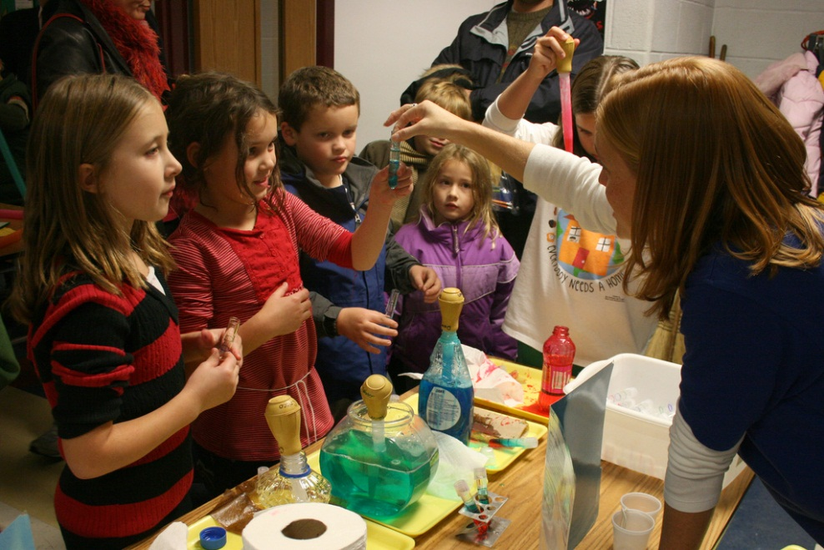
Learning in Public: What, How, Examples
Good Data
Apply It
Organize It
Sense
Making
Photo: gsfc
Notes:
http://www.flickr.com/photos/gsfc/6385412591/
When I think about Learning in Public in this context – as a method for doing an evaluation of a program or strategy, I think about kids science fair experiments ---
Good experiments, are grounded in evidence and data collection around which you are trying to make sense.
It can use crowdsourcing, but not the data collection or the opinion – it is crowdsourcing the analysis so you can more easily discover the “Ah Ha” insights.
These experiments are not secret experiments, but there is a broad continuum of being totally open and closed ….
The learning questions are focused and strategic
Some steps ..

Slide 11


Slide 12
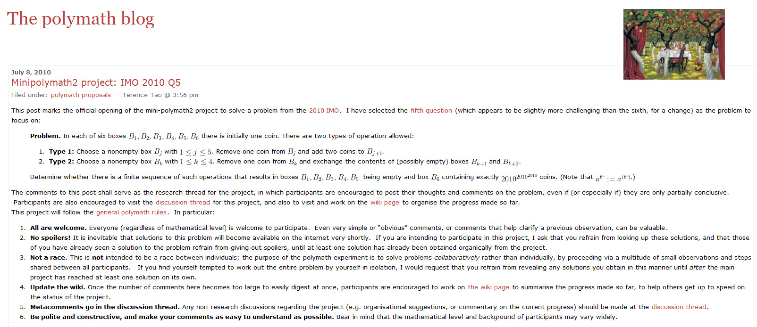

Slide 13
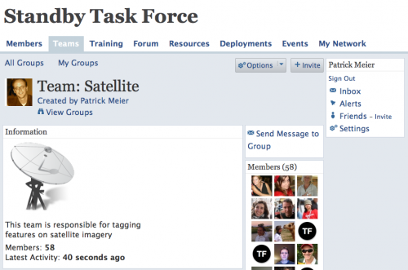
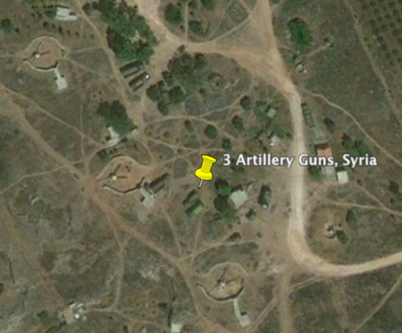
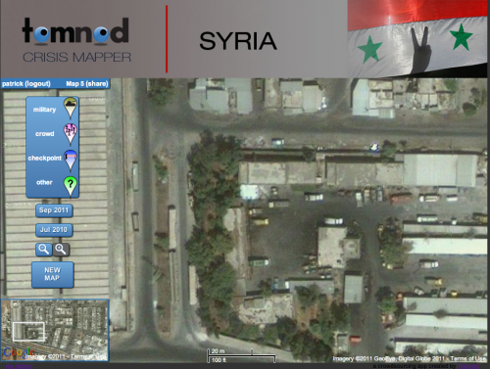
Notes:
Here’s another example. These is crowdsourced satellite imagery analysis of key cities in Syria to identify evidence of mass human rights violations .. That’s how Amnesty International USA’s Science for Human Rights used public learning. The “crowd” can indeed scan and tag vast volumes of satellite imagery data when that imagery is “sliced and diced” for micro-tasking.
http://irevolution.net/2011/09/16/help-crowdsource-satellite-imagery-analysis-for-syria/

Slide 14
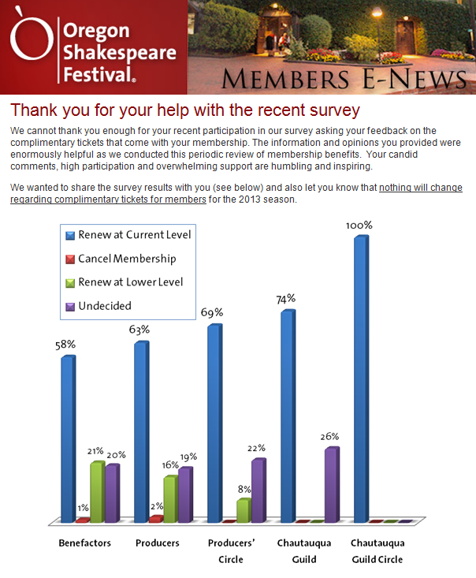

Slide 15
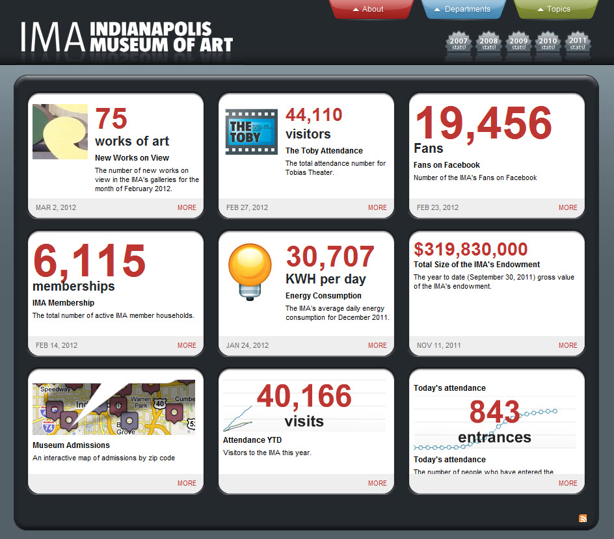
Notes:
Let’s look a some quick examples of public learning in the nonprofit world before Kathy and Jared share their in-depth case study

Slide 16
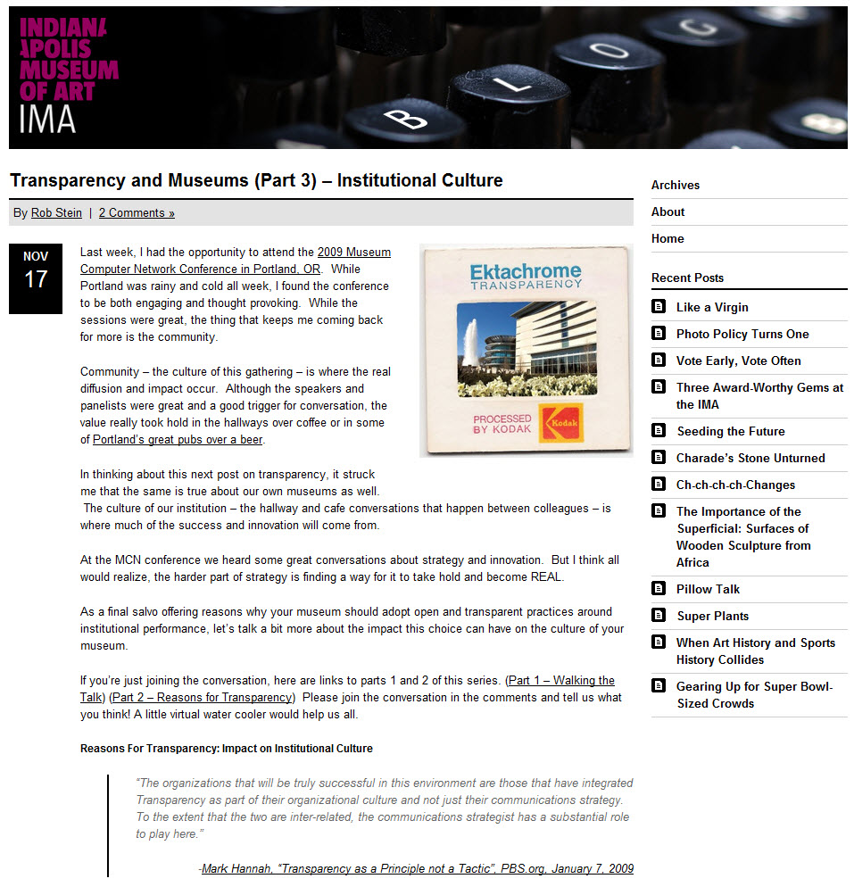

Slide 17
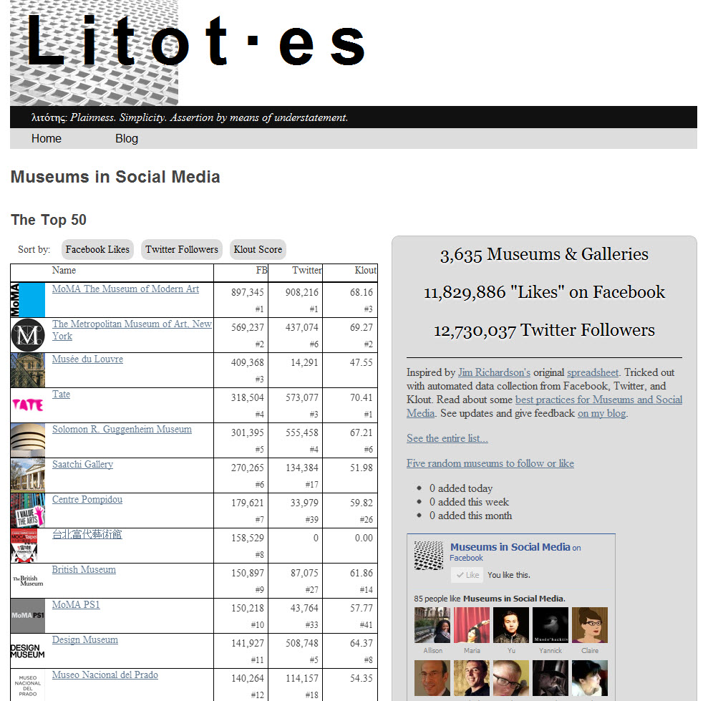
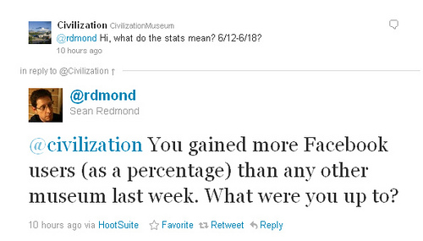
Notes:
This is a benchmarking dashboard for museums and social media – a peer group of social media people from museums
They’re tracking some social media metrics – which are public – but makes this a form of public learning is that they’re using the data to ask questions of one another and learn about practice.
This is a more open model.

Slide 18
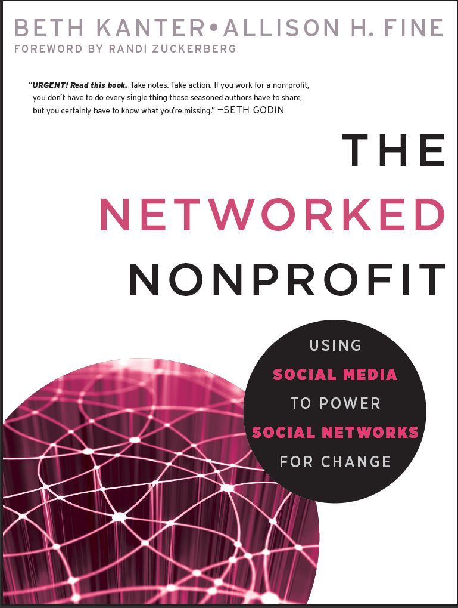
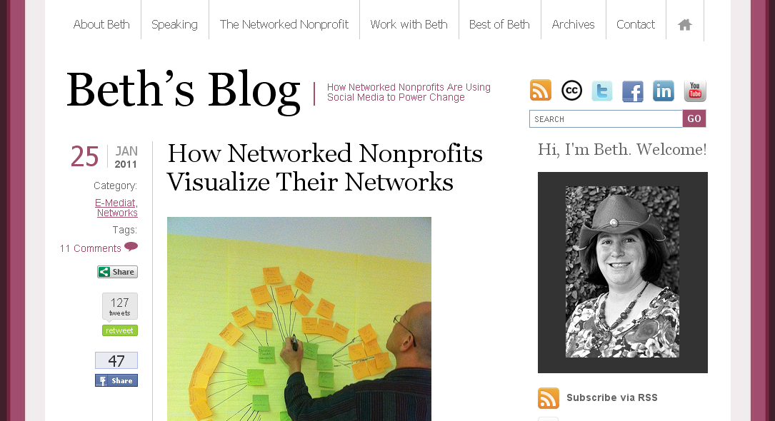
Thank you!
Beth’s Blog: http://www.bethkanter.org
Twitter: @kanter
Facebook: http://www.facebook.com/beth.kanter.blog

