Slide 1
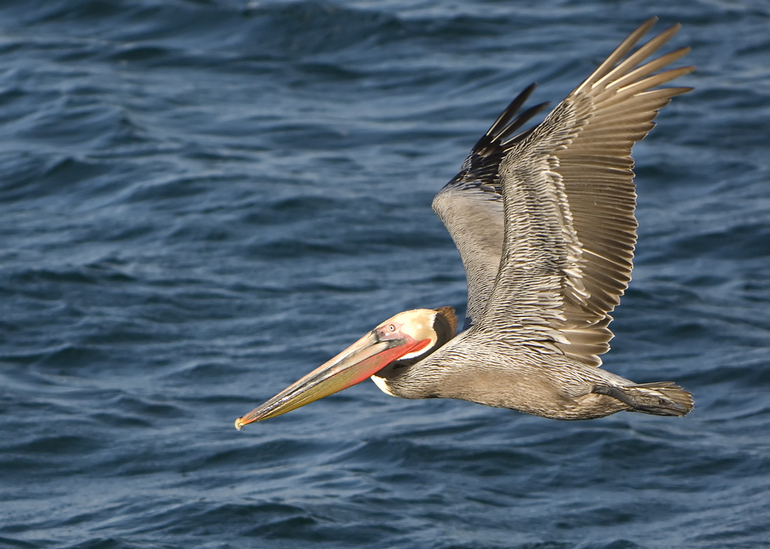

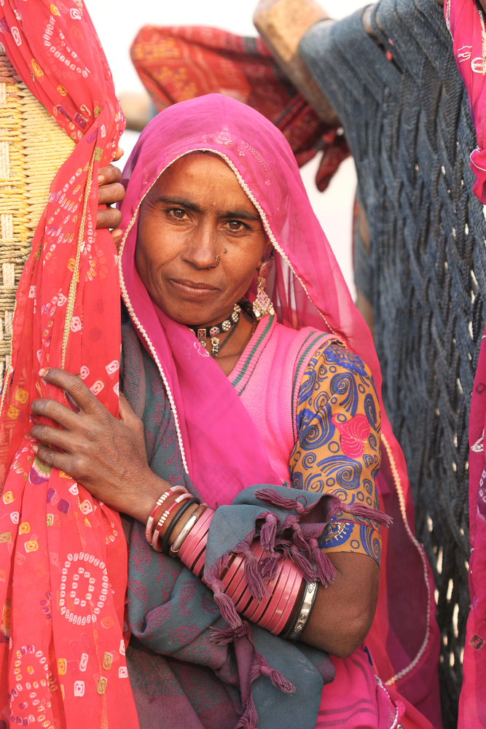
The David and Lucile Packard Foundation
Learning in Public: The OE Experiment
Kathy Reich

Slide 2
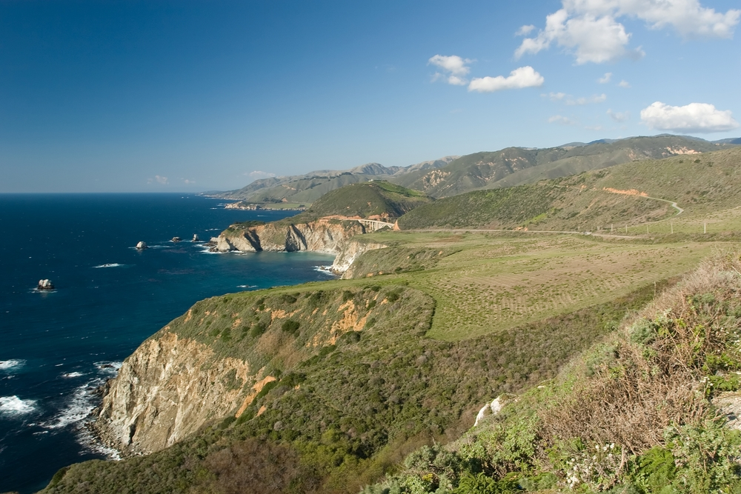
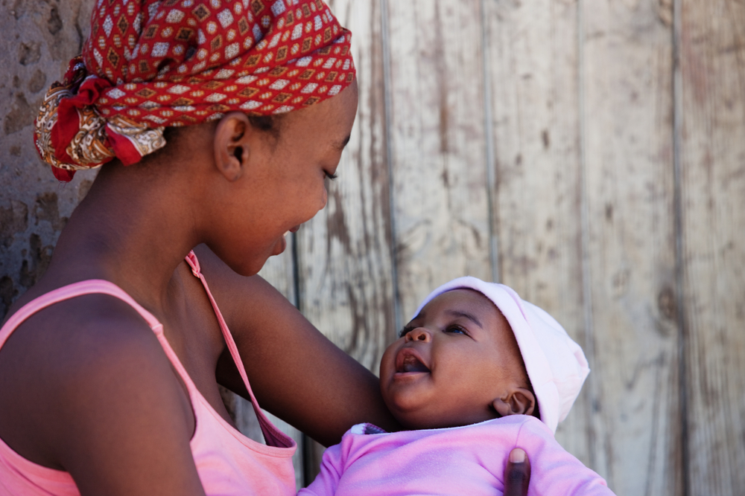
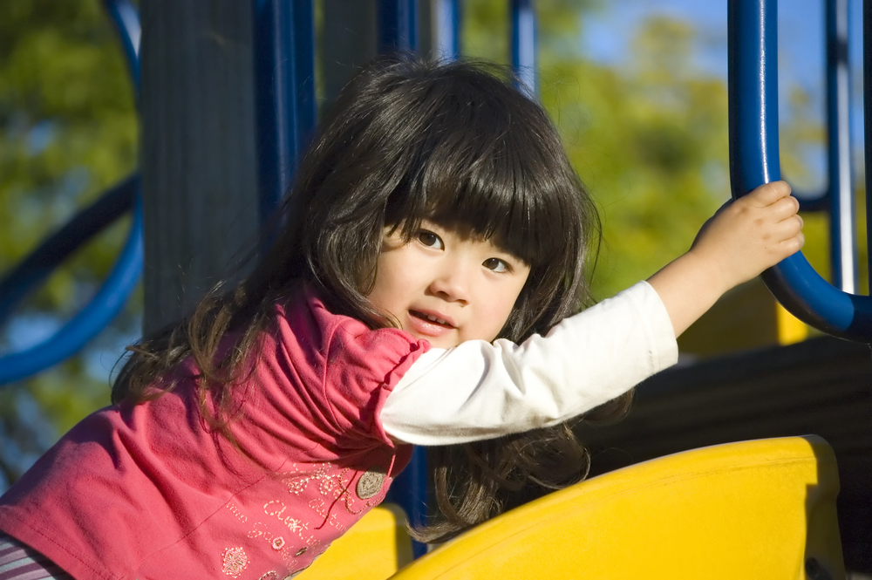
Main Program Areas
CONSERVATION
& SCIENCE
POPULATION
& REPRODUCTIVE HEALTH
CHILDREN, FAMILIES & COMMUNITIES
Notes:
We work on the issues our founders cared about most:
Conserving and restoring the earth's natural systems, and enabling the creative pursuit of science
Advancing reproductive health
Improving the lives of children
One tool to achieve these goals: The Organizational Effectiveness program.
The Packard Foundation has been making OE grants since the mid-1980s, and our model hasn’t changed dramatically in that time. The OE fund offers current grantees of the Packard Foundation the opportunity to undertake projects that transform their organizations in sustained and meaningful ways. Our grants support a variety of capacity-building efforts for grantee organizations and networks. Grant funds are primarily used to cover the cost of outside consultants.

Slide 3
The Goldmine
First evaluation of Organizational Effectiveness program in a decade
Purposes:
  Evaluate for learning and program improvement
  Disseminate lessons learned in an engaging, transparent way
Notes:
The Goldmine Research Project is the first evaluation of the Packard Foundation’s Organizational Effectiveness (OE) grantmaking in more than a decade. The purposes of the project are to 1) evaluate the Foundation’s OE grants for the purposes of learning and program improvement; and 2) disseminate lessons being learned in an engaging and transparent way.
We evaluate each grant at its close, and we know a few things about our effectiveness. We know, for example, that more than 90 percent of OE grantees report that they meet their grant objectives. We know that in the Center for Effective Philanthropy’s Grantee Perception Report, an anonymous survey of our grantees conducted every two years, OE grantees report that the Packard Foundation has a much greater positive impact on their organizations than Foundation grantees that only receive program or general operating support grants.
We have not done a full-scale review of our program and its grantmaking approaches in about 10 years. In the meantime, a lot of folks in the organizational development field—consultants, grantees, and other funders—have been telling us that we’re sitting on a “goldmine” of data and learning about our grants.
So in 2010, we went back to 274 of our grantees, whose grants had closed between 2007 and 2009, with a detailed survey to ask them the long-term results of their OE grants. 169 grantees responded to the survey—over a 60% response rate. We wrote an RFP to find an evaluator who could help us make sense of the data, and are delighted to have partnered with TCC Group (www.tccgrp.com) on this project.

Slide 4
Learning in Public
Share data before final analysis is complete
Engagement: Invite others to share input and feedback, and use that input to inform the final analysis
Model transparency in philanthropic sector
Notes:
Beyond wanting to learn and share more about the effectiveness of our grantmaking, we had another goal in mind for the Goldmine project. We wanted to experiment with learning in public—sharing data as TCC made it available to us, and actively asking others for their input and feedback before any of TCC’s work became enshrined in a final report.
Two aims in mind as we launched Learning in Public. One was simply about transparency. You may have heard that foundations get a lot of criticism for not sharing their decisionmaking processes or what they are learning. This was our attempt to open our file cabinets.
Second aim was to see if, by including extensive public input, we could improve the final product—in a sense, use crowd sourcing to produce richer, deeper, more relevant evaluation findings.

Slide 5
Learning in Public
Two roundtable discussions with funders at sector conferences
Packard Foundation program officers focus group
In-person session with 40 organizational development consultants
Webinar with almost 40 grantees and other funders
Blog posts
Targeted questions on list serves
All raw data posted on wiki: http://packard-foundation-oe.wikispaces.com/OE+Goldmine+Research+Project
…All before TCC Group completed its work on the project and wrote a final report

Slide 6
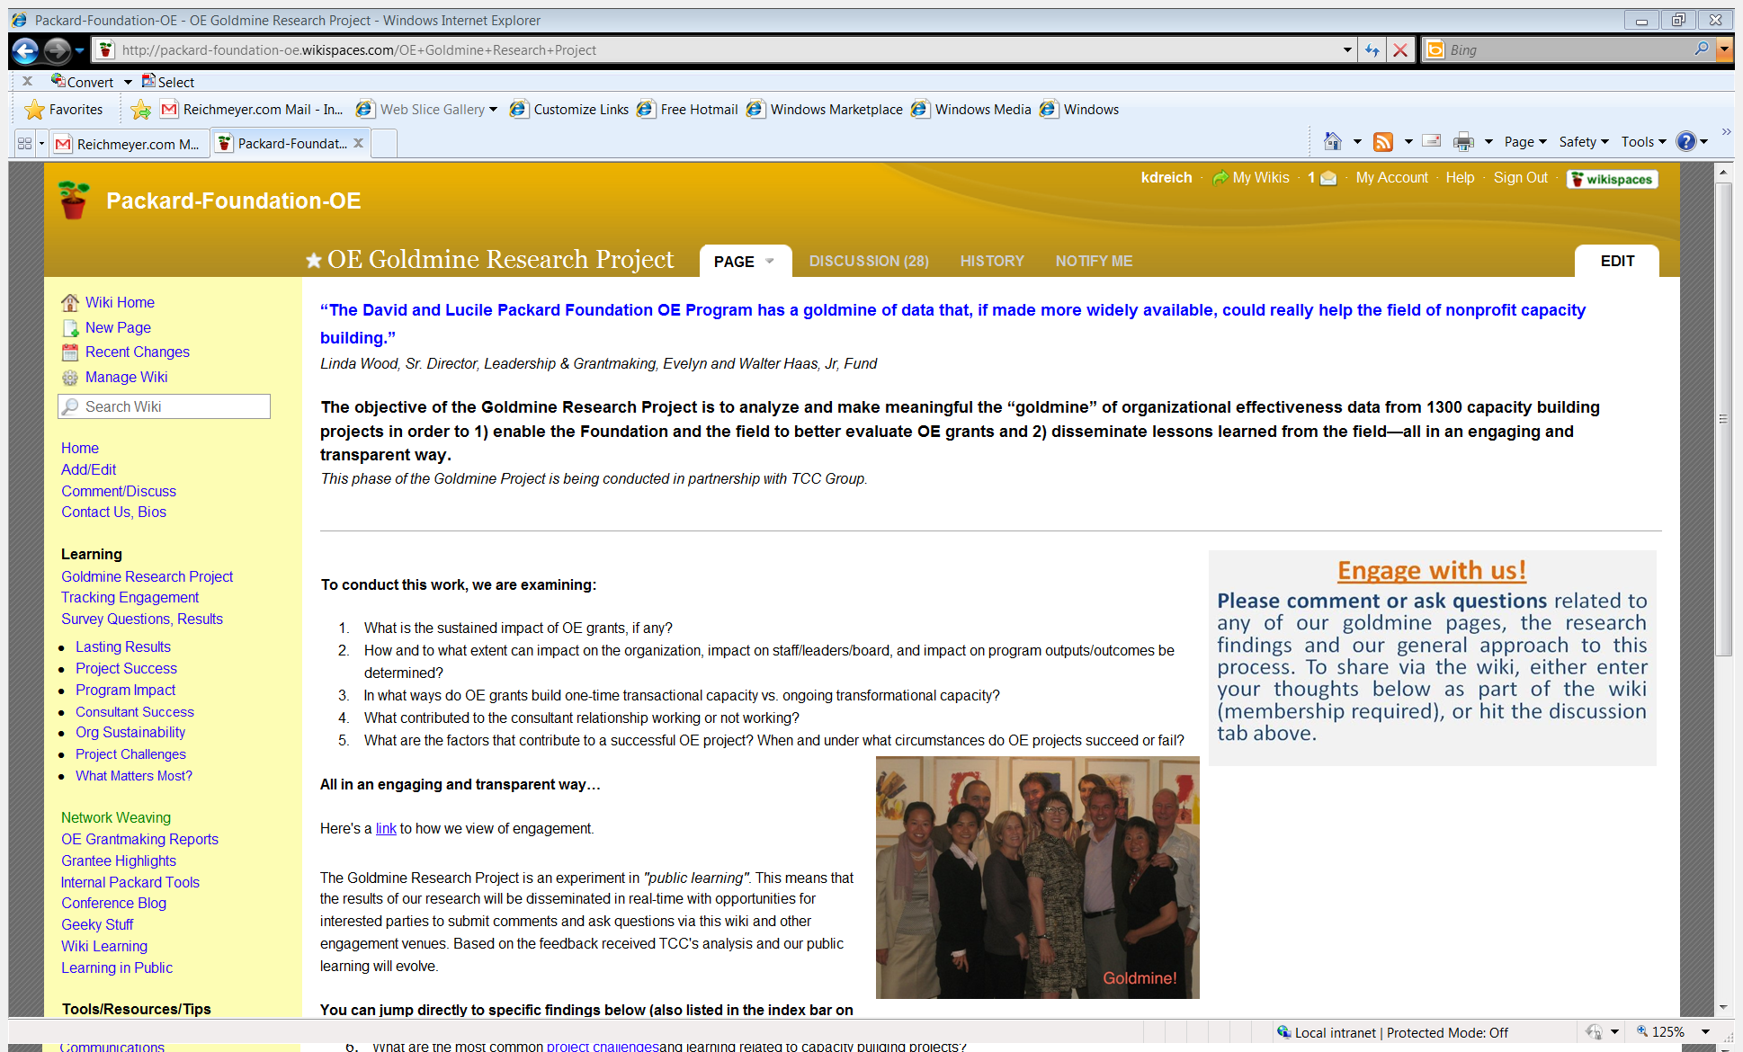
http://packard-foundation-oe.wikispaces.com/OE+Goldmine+Research+Project
Notes:
Now I will turn things over to Jared, who will talk about TCC’s approach to the Learning in Public experiment and what we all learned along the way.

Slide 7
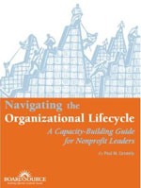
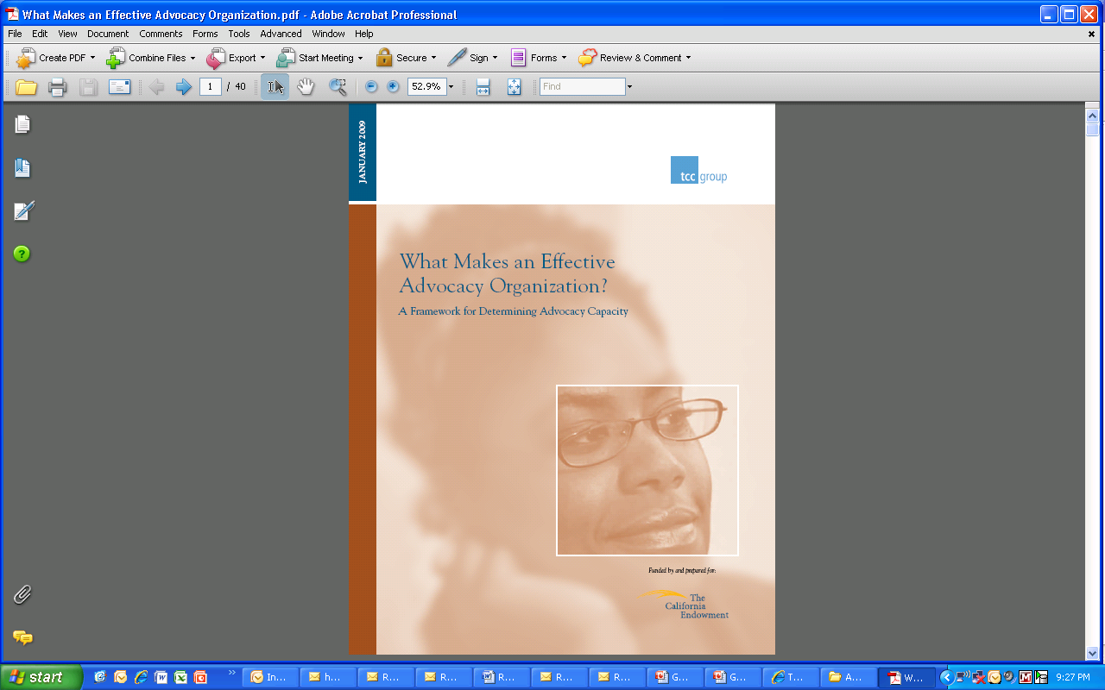
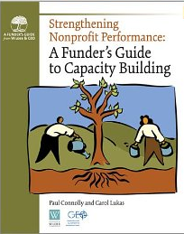
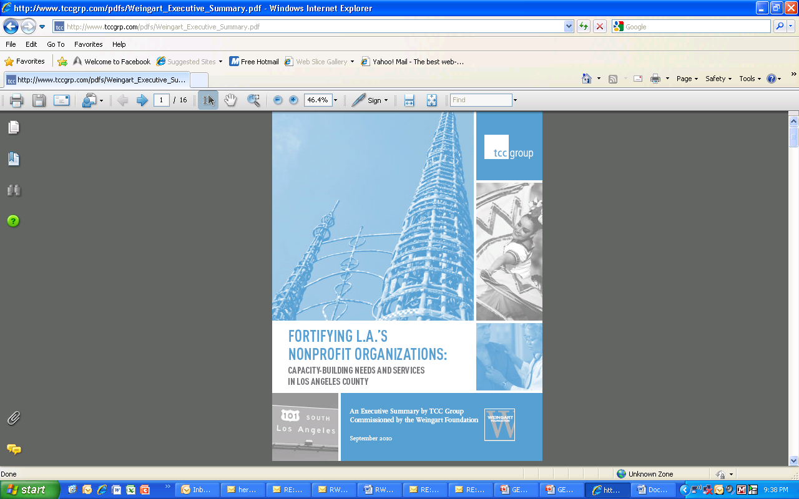
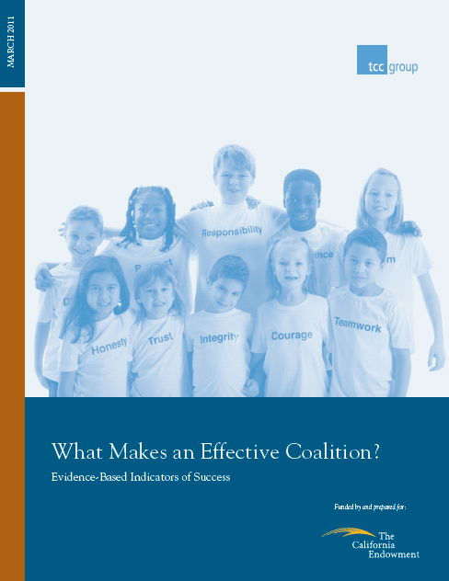
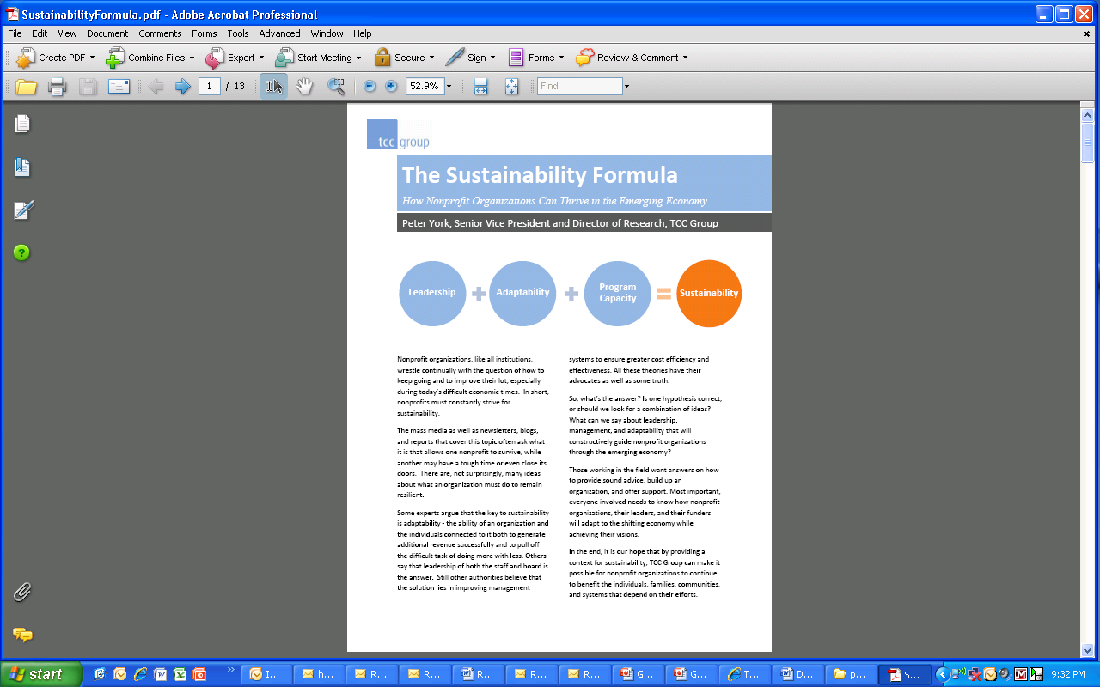
TCC Group
Notes:
Founded in 1980
Three offices: New York, Philadelphia, and San Francisco
Areas of focus: planning, implementation, and evaluation
Three practice areas:
Nonprofit
Corporate Community Involvement
Philanthropy

Slide 8
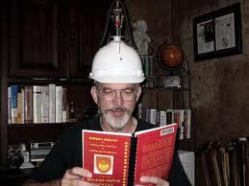
What did we think we were doing?
Research and learning
Use a wiki
Inform the research questions
Inform the analysis of data (fill in gaps and crowd-source)
Increase engaged discussion around data
Disseminate findings more easily and in “digestible” pieces
Notes:
Survey development incorporated input from multiple stakeholders to ensure the tool was appropriate and met Packard’s needs
Clear criteria to select survey participants
High response rate (62%); survey sample was representative of all OE grants

Slide 9

What is the Quality of your data?
Strengths of the Goldmine data:
Multiple inputs to survey development
Clear criteria to select participants
High response rate (62%); survey was representative of all OE grants
Additional data sets mapped to survey
Notes:
Survey development incorporated input from multiple stakeholders to ensure the tool was appropriate and met Packard’s needs
Clear criteria to select survey participants
High response rate (62%); survey sample was representative of all OE grants

Slide 10
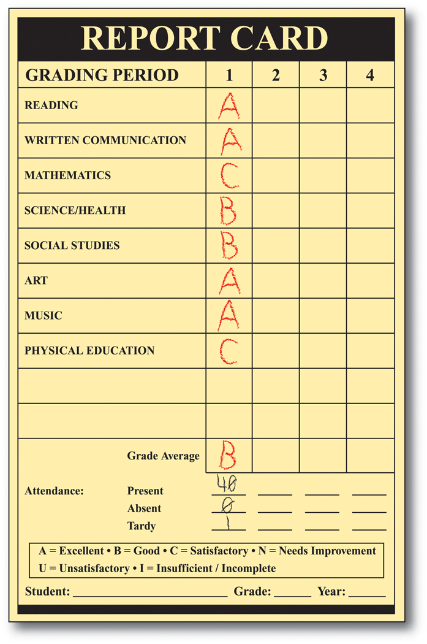
What are the limitations of your data?
Challenges of Goldmine data:
Individual vs Multiple grants
Number and diversity of grant objectives
Large amounts of qualitative responses to open-ended questions
Some survey questions not specific enough to capture discrete capacity elements
Analysis constrained by the scales used in the survey
Notes:
Challenges can be a great place to start identifying where learning in public can help.
Respondent’s ability to isolate and evaluate individual grant experience because of multiple grants and/or multiple objectives
Coding large amount of qualitative responses to open-ended questions
Some survey questions not specific enough to capture discrete capacity elements
Analysis constrained by the scales used in the survey

Slide 11
What did we Learn about Learning In Public?
LIP is EXCITING and provides some real opportunities to enhance the VISIBILITY of specific data and issues
LIP needs CLEAR OUTCOMES attached
The level of EFFORT of doing LIP was very high from start to finish and required dedication of the whole team
The benefit to the research was LIMITED
Scary for researchers to put out information along the way
Notes:
This process forced us to share “partial conclusions” in public before we had a chance to thoroughly analyze the data and develop a comprehensive understanding of the results, including contradictions between different data points and multiple ways to address such contradictions.

Slide 12


What did we Learn about Learning In Public?
Expected Response
Actual Response
What worked:
Feedback: Real-time interactions with researchers around findings (e.g., in-person discussions, webinar)
Posterity/Reference/Depth: Wiki.
The greatest interest was generated when the two forms were used in tandem.
Notes:
Unrealistic expectations about interest in data analysis and interpretation.

Slide 13
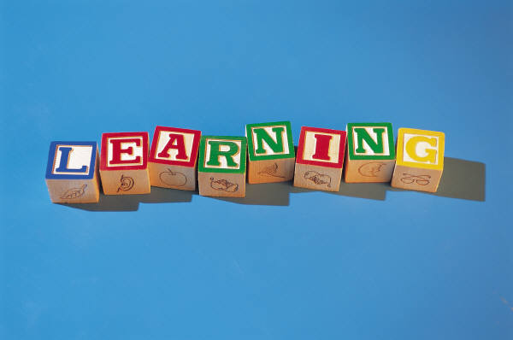
Be clear on the purpose of Learning (value of transparency, get buy-in, get information, etc.):
  Who?
  How?
  Why?
  Cost/Benefit?
Emphasize Active versus Passive learning activities
Focus on learning from results, rather than getting to results
Be aware of resources necessary
Controversy isn’t bad, as long as framed in learning lens

Slide 14
Now it’s Your Turn: Table Talk
_____________________________________________________
Discuss the Practice.
What do you think about Learning in Public? Benefits? Drawbacks? What would you need to put it into practice in your own work?
2. Model the Practice: Help us Learn in Public!
TCC recommends that the Packard Foundation make multi-year grants that adopt a more holistic approach to capacity building.
  Under what circumstances do such grants work well?
  Ingredients for success?
  What advice and analysis would you have for foundations considering a move into multi-year capacity building grantmaking?
Notes:
Now it’s your turn to help us learn in public.
Spend next 30 minutes discussing the following at your tables. Please take notes on the easels. We’ll do a quick popcorn report-out, but if you want to be sure that we respond to your questions/feedback, please include your email address in your notes.

Slide 15
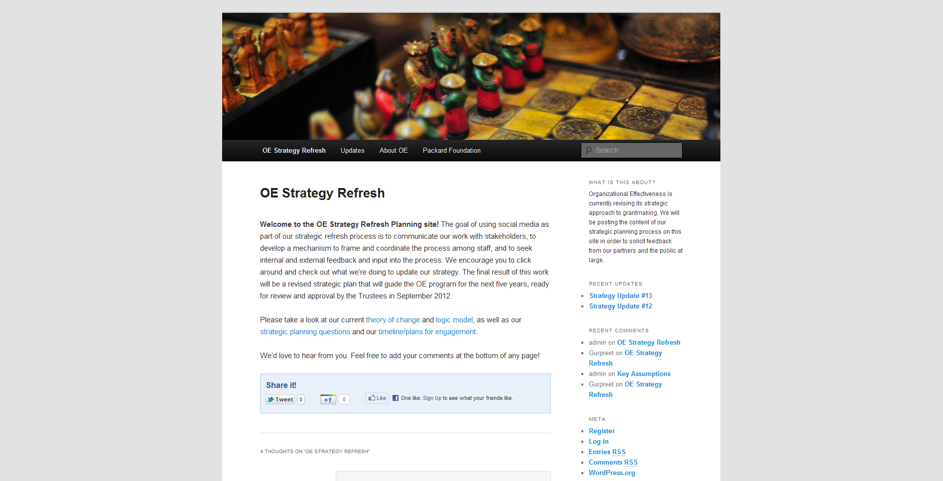
Learning in Public: The Next Phase!
Notes:
Quick popcorn report back—what do you like about Learning in Public? What concerns you?
Ok, so here’s where the Packard Foundation is going with this appraoch. We’ve learned from our first LIP experiment—right-size your workload and your expectations, be clear about when and where you want feedback, and try lots of different channels.
We’re now looking ahead. OE is just launching a new strategic planning process, and we hope to present a refreshed strategy to our board in September 2012.
Once again, we plan to be open and transparent in the process, and to solicit feedback from grantees, other funders, and the public at large through a series of thoughtful engagement opportunities.
These will include Webinars, in-person meetings—and a new social media strategy!
The goal of using social media as part of our strategic refresh process is to communicate our work with stakeholders, to develop a mechanism to frame and coordinate the process among staff, and to seek internal and external feedback and input into the process.
Throughout the next few months, we’ll be posting targeted discussion questions on our wiki. We’ll also post a full draft of the strategy this summer, for review and comment. If you’d like to keep up to date on our progress, sign up on the email list circulating around the room.

Slide 16
Contact
Kathleen Reich
Director of Organizational Effectiveness Grantmaking
The David and Lucile Packard Foundation
kreich@packard.org
Jared Raynor
Director of Evaluation
TCC Group
jraynor@tccgrp.com
PeiYao Chen
Associate Director of Evaluation
TCC Group
pchen@tccgrp.com

