Slide 1
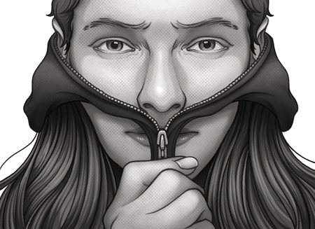
Coping with Loss Throughout Transition
Presentation by Fawn Oates, M.A.
TransNational Advocacy

Slide 2

Grief
Social support is only given to those who are recognized as having experienced loss and who act in accordance with the norms.
Disenfranchised Grief
  When you aren’t seen has having experienced loss
There is loss in any transition.
  We have to leave some things behind as we embrace new things.
Feeling a sense of loss DOES NOT mean you are making a mistake.

Slide 3
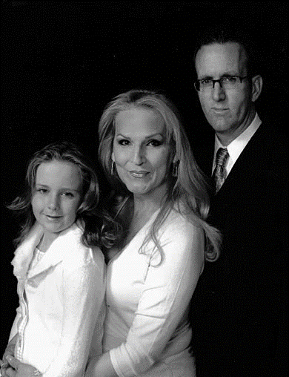
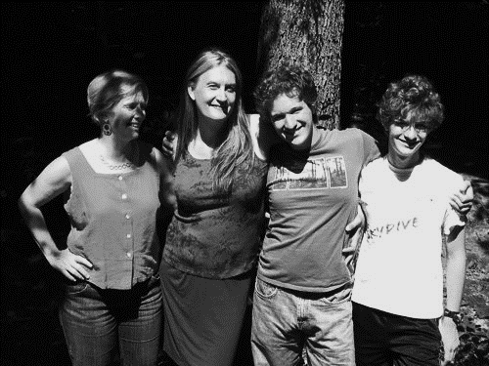
Seven behaviors of the coping process
Robert Kavanaugh (1972)
*Remember! Friends and family will go through the same process, just later on!

Slide 4


Shock and Denial
The belief that there is NO WAY that we could really be transgender, let alone have to go through transition.
First response often: “It can’t be true!”
With time, our experience of shock diminishes, but we find new ways to deny reality.

Slide 5

Disorganization
One may feel totally out of touch with the reality of everyday life
May feel like you’re in a daze, not really there…
In extreme cases, psychological amnesia or dissociation develops

Slide 6
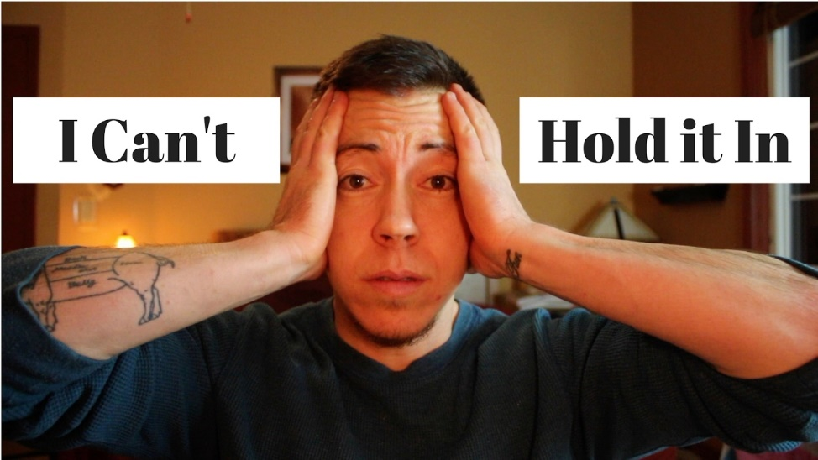
Volatile Reactions
Whenever our identity and social order face the possibility of destruction, there is a natural tendency to feel angry, frustrated, helpless and hurt
The volatile reactions of terror, hatred, resentment, and jealousy are emotional manifestations of these feelings.
May include severe fear reactions, feeling like others are going to do you harm. Often based in reality!
Fighting with friends and family is common
May feel particularly sensitive

Slide 7
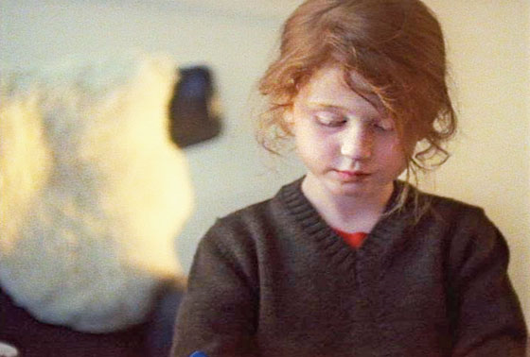

Guilt
Psychologist often believe that guilt is anger and resentment turned in on oneself and often results in depression.
May be encouraged to feel guilty for disrupting people’s lives or expectations.

Slide 8
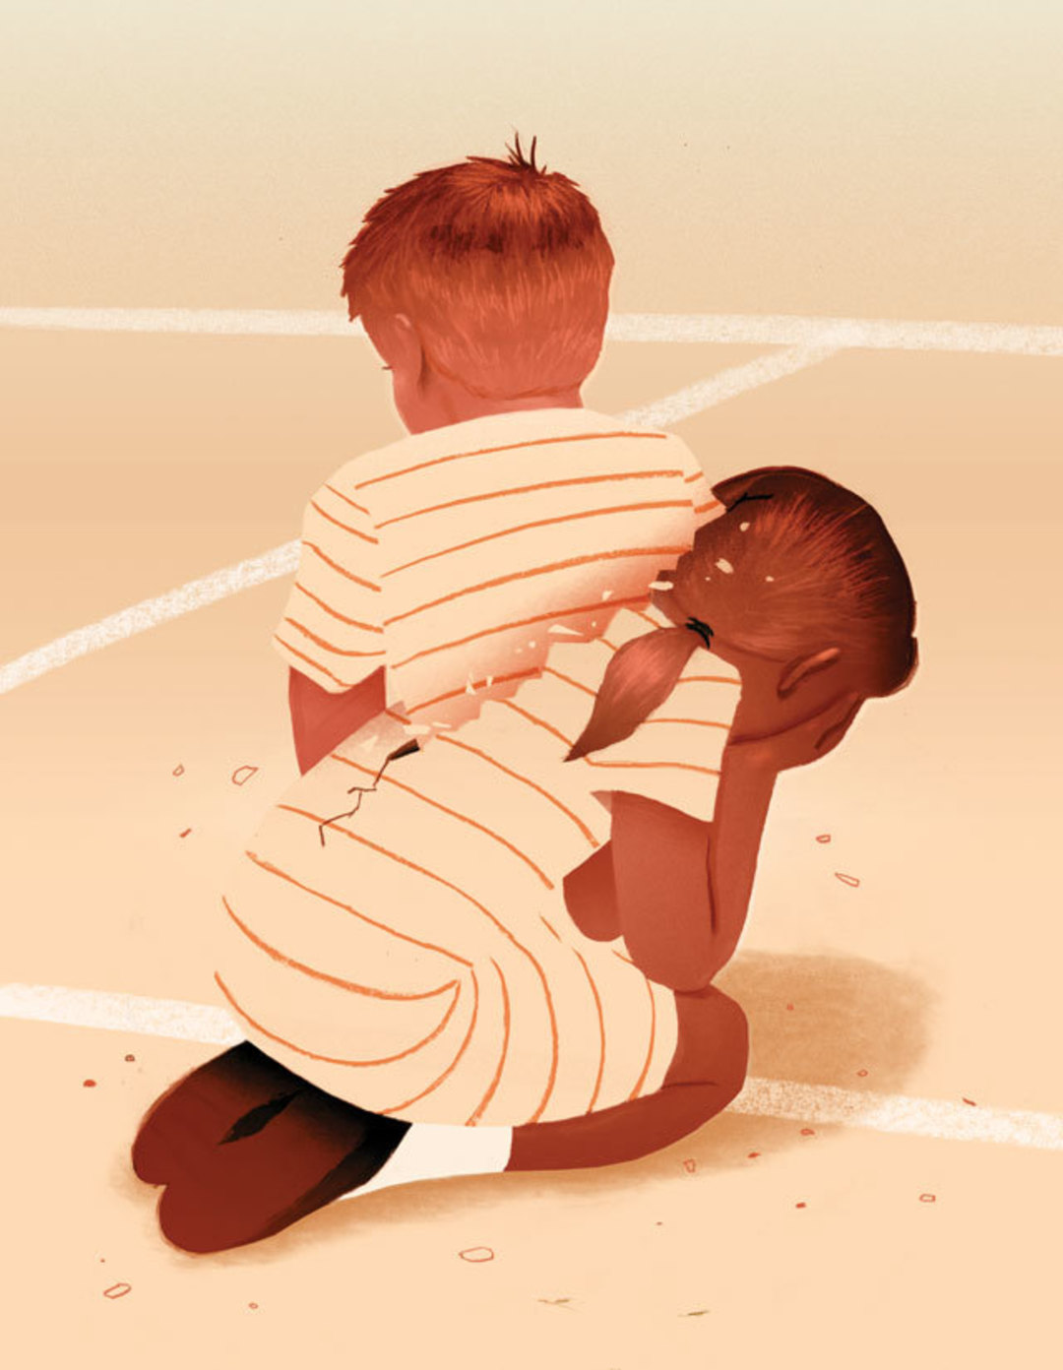
Loss and Loneliness
Feelings of loss and loneliness can creep in as denial subsides.
The full experience of the loss does not hit all at once.
Loss becomes more evident as transition becomes more serious.
We know the pros and cons of our current reality, but don’t know what this new life will be like.

Slide 9

Relief
Relief is one of the most common emotions post-transition.
If other people in our lives are in a different stage, this can be hard for them

Slide 10



Reestablishment
The process of change involves extensive adjustment and time.
Can experience any of the stages at any time and something may trigger previous stages
Can be an emotionally transformative experience
  Post Traumatic Stress vs. Post Traumatic Growth
Have to ask:
  What have I lost?
  What do I have left?
  What have I gained?

Slide 11
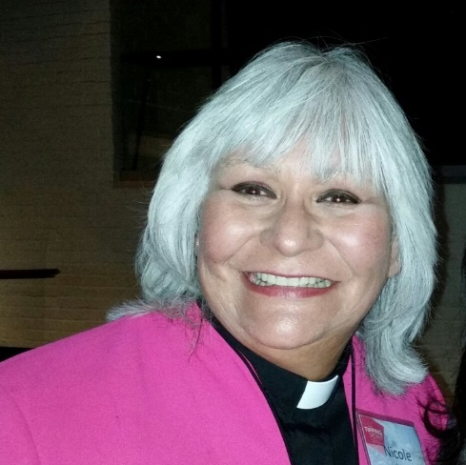
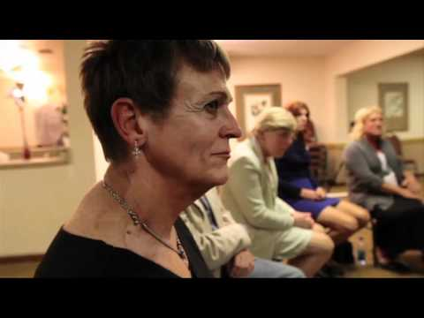
Coping With Loss
    Homework ideas:
        How could you express your emotions of loss?
        Who can you talk to with the least amount of judgment?
        Make a list of what you have lost and what you have gained.
        Think about a symbolic way to honor those losses and say goodbye.
        Think about the meaning of your struggle. What have you learned?
Support from others
  Expression of emotions
  Talking to friends and family
  Support groups
  Therapy
  Faith / Meaning
  Time

