Slide 1
Intertwining Services Funding with Policy Initiatives to Achieve Systems Change
Becky Hayes Boober, Ph.D.
Lynda E. Frost, J.D., Ph.D.
Karen W. Linkins, Ph.D.

Slide 2
3 examples of intertwining services funding and policy initiatives:
Hogg Foundation for Mental Health
Maine Health Access Foundation
California Endowment

Slide 3
Lynda E. Frost, J.D., Ph.D.
Hogg Foundation for Mental Health

Slide 4
Key Activities in Texas
2006: Hogg Foundation $2.6 million collaborative care grant program – 5 grantees, 3-year grants
2008: Integrated health care conference with over 400 attendees
2009: Integrated health care learning community begins
2010: Report of Integration of Health and Behavioral Health Workgroup
2011: Collaborative agreement with DHHS/OMH
2012: Collaborative Family Healthcare Association annual conference

Slide 5
Lessons Learned from Collaborative Care Grant program
IHC can be implemented with good clinical outcomes in varying clinical settings in impoverished communities
Care provided and outcomes varied widely
Early and intensive follow-up is key; need to allocate sufficient staff
Organizations with no pre-existing MH personnel created strongest IHC teams
Depression outcomes were markedly superior among Spanish-dom. clients

Slide 6
Additional Lessons Learned
Collaborative care is not the best model for all settings and organizations
Once a program is established, it does not necessarily require additional funding to sustain
Clear leadership is helpful, but clinical staff buy-in may be just as important
Financial barriers can be resolved

Slide 7
Lessons Learned from
IHC Learning Community
Staff training, esp. BH and PC cross-training is essential
“Champions” are a great asset
Team-building, development of trust, relationship-building should come early
Billing and financial sustainability are major concerns
Technology issues can pose barriers
The learning community can provide an impetus and accountability

Slide 8
Additional Lessons Learned
Extensive planning and technical assistance is needed to implement change
Additional staff often are not essential
It can be difficult to identify useful tools for participants (website, TA calls, coaching, webinars)

Slide 9
Integration of Health and Behavioral Health Workgroup Recommendations
1. Create a State Healthcare Integration Leadership Council.
2. Create and support a focus on healthcare integration in Texas.
3. Support local healthcare integration planning.
4. Address systemic barriers to healthcare integration.
5. Encourage adoption of confidential health information technology and information sharing.
6. Develop systems for meaningful and functional outcome measurement and tracking.
7. Support routine health and behavioral health screening during patient assessments.
8. Develop policies to address training, continuing education and workforce needs.
9. Implement integration efforts as part of federal health reform requirements.

Slide 10
USDHHS Office of Minority Health
Vision to eliminate behavioral health disparities through integration of behavioral health and primary care services for racial and ethnic minorities and limited English proficient (LEP) populations
Initiated collaboration with Hogg Foundation for Mental Health in 2010
Purpose: Define and recommend cultural and linguistic competency elements, strategies and approaches to incorporate into existing models of integrated healthcare delivered to racial and ethnic minorities and LEP populations and identify effective strategies for implementing changes

Slide 11
USDHHS OMH / Hogg Foundation
Activities and Deliverables
Literature review
Stakeholder interviews
Web-based survey of providers and consumers
National consensus meeting
Consensus report
Large Texas-based conference
National funders meeting
Issue brief for funders

Slide 12
Becky Hayes Boober, Ph.D.
Maine Health Access Foundation

Slide 13

Notes:
Best of intentions often have unforeseen consequences.
Example: Last minute/middle of night legislative action to create $1 million in savings by shifting payment rate for hospital-based outpatient care for a couple of specific programs to Section 65 (BH) reimbursement rates.
Broad language seemed to instruct MaineCare rule making to shift all Section 45 outpatient to Section 65. Would have eliminated sufficient funding to sustain integrated care in Maine. It was a square wheel.
In this session, we’ll talk about specific strategies you can use to prevent these type of policy changes and to support expansion of integrated care. We’ll share our work in Maine as a sample case study; You’ll hear from three different perspectives: practice-based policy influence; employer-based policy influence; and state and national policy strategies. Then, you’ll have an opportunity to take some of the ideas you hear and develop your own plan for impacting policies. Feedback on your paln.

Slide 14
Maine Case Study
Maine Health Access Foundation $10 million investment in Integration Initiative (2006 – Now)
Stakeholder and public input phase
3 rounds of grants, up to 3-years each
Over 100 practice sites, 150 partnering organizations, 43 grant projects
Evaluation, Learning Community, TA

Slide 15
Integrated Care as Leverage
Expanding access to quality, patient-centered care:
Greater access to mental health services without stigma;
Increased health care system receptivity to alternate payment models (reforms);
Enhanced patient engagement;
Cost containment

Slide 16
Maine Case Study: Policy
Common issues encountered
2009 Policy Committee convened
  Common definition of elements
  Policy Work Plan
  Shared responsibility to implement plan
  Policy, reimbursement consultant contracts
  Examined key leverage points (employers)

Slide 17
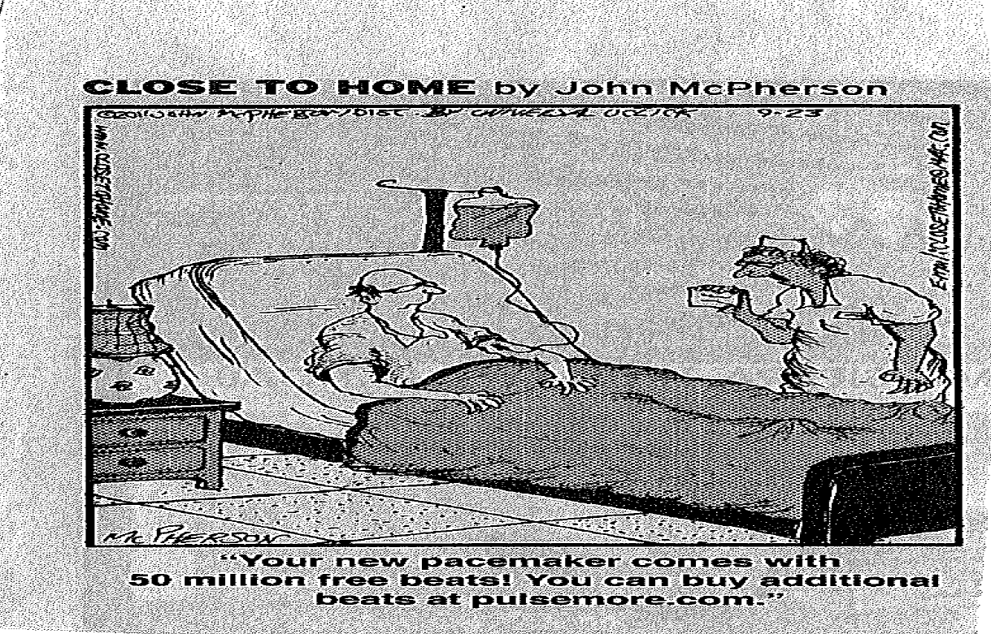
Notes:
How resolved initial example ($1 million cost savings). Committee met with MaineCare regulatory writer to determine how it was being interpreted (very broadly) and stopped process. Worked with MaineCare leadership and ME Hospital Assn. to identify alternative strategies to save $. MHA carried the water to get modification in supplemental budget. Individuals/orgs told the compelling story of IC to their local legislators.

Slide 18
Advocacy Strategies
Build relationships.
Be proactive.
Tell a compelling story.
  Human element (sans drama)
  Data
  Cost effectiveness
  Resulting outcomes
Notes:
Relationships—key, so can access when policy decision is needed. They need to know they can trust you.
Proactive—Convince them about integrated care before policy decisions are being made at midnight on appropriations committee, etc.
Story—Human element (but legislators are now wary of exploiting people in need to tell their sad stories.)

Slide 19
Advocacy Strategies
Embed into other key endeavors. (Expands your partners.)
Identify key leverage points (employers).
Know what will work in your jurisdiction (i.e., state).
  Texas, legislation
  Maine, relationships
Partner
Notes:
Maine—1) #2 point—one payer was denying credentialing for new LSCWs being added to PC Practices—said already had all they needed in network. Employer (Tom) was establishing contract with that payer so he worked with them to understand the importance of this work and of opening the network to accommodate. Timing was perfect.
2) #3 Know what will work: Recently, MeHAF called before a legislative committee to describe our work. Middle of deficit and severe budget cuts. They thirsted for money sources. Not the time to mention our endowment amount or they would fixate on $ amount and not hear rest of story. Instead, fram endowment as 1/10 of 1% for all health care spending in Maine annually.
3) Partner—Middle of night state budget process, line added to shift Section 45 hospital outpatient mental health services to Section 65. MaineCare policy writer interpreted it as it was written—very broadly. Would have eliminated feasibility of integrated care in PCP. Worked with DHHS policy makers to see potential alternatives. Drafted key messages. Worked with Maine Hospital Association, who carried message.

Slide 20
MeHAF Initiatives related to Integrated Care
Integrated Care
$10 million
43 grants
100+ sites
150 partner organizations
Payment Reform/
Cost Containment
$2.6 million
16 grants
# Community Care Teams
HIT (Health InfoNet)
BH HIT Integration
$3.2 million
Notes:
Embed it in almost all our newer initiatives.

Slide 21

Maine’s Medical Home Movement
~ 540 Maine Primary Care Practices
82 NCQA PCMH Recognized Practices
~100 MaineCare Health Home Practices
Payer:
Medicaid
14 FQHCs CMS APC Demo
Payers:
Medicare
Medicaid
Commercials (Anthem, Aetna, HPHC)
26 Maine PCMH Pilot Practices
20 Pilot Phase 2 Practices
Payer:
Medicare
Notes:
Through a grant to Quality Counts, embedded it into the PCMH pilots in Maine as a required core principle. Now, proposed to be expanded by MaineCare to all practices qualified as health homes.

Slide 22
State of Maine Initiatives (Including DHHS)
Section 1703 waiver
Recovery ME
ACO State Employees’ contracts
Value-based Contracting
CDC
Health Homes/ PCMH
Grants (AHRQ, MeHAF)
Health InfoNet
Maine Health Management Coalition (Quality Indicators)
Aligning Forces
Notes:
Embedded in state efforts to contain costs, improve quality of care. (2 systems transformation grants to DHHS)
Tom will discuss ACO

Slide 23
Federal Initiatives Implemented in Maine
Accountable Care Act
Quality Initiatives
Payment Reform
Expanded Coverage
Funding
Pioneer ACO (EMMC)
SAMHSA
Leading Change Priorities
1 Health Home grantee
Center BH HIT grant
CMS
FQHCs APC Demo;
Waivers;
PCMH (Medicaid)
Innovations Grants
AHRQ
Academy
Grants
HRSA
Expansion in FQHCs
Office of National Coordinator
Beacon grant
HIT support
Notes:
As federal initiatives are rolled out in Maine, IC is included.
AHRQ—Maine rep on Academy

Slide 24
Embedding Integrated Care into Maine’s Transforming Health System Reforms
ACA
MeHAF IC Grants
540 Maine Primary Care Practices; 53 Community Behavioral Health Agencies; 30 SA Agencies
Payment reform grants; ACOs
ACOs: Pioneer and Employer-Based
Community Care Teams
82 NCQA PCMH Recognized Practices
~100 MaineCare HH Practices
Beacon
SAMHSA Health Home
BH HIT Support
and grant
14 FQHCs CMS APC Demo (Medicare)
Section 1703
26 Maine PCMH Pilot Practices + 20 new
DHHS Value-based contracting
FQHC expansion
AHRQ Academy

Slide 25
Policy Development:
Less Silver Bullet;
More Silver Buckshot.

Slide 26
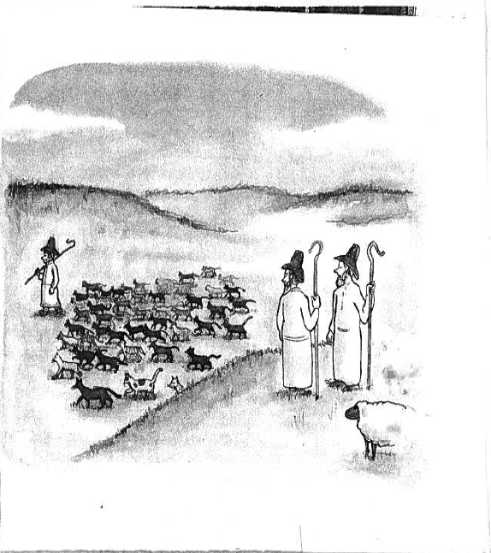
The Kid’s good.
The New Yorker. March 21, 2011

Slide 27
Karen W. Linkins, Ph.D.
Desert Vista Consulting

Slide 28

In Support of the Field: IBHP Background and Goals
Launched in 2006 by the Tides Center and The California Endowment to accelerate the integration of behavioral health services at primary care community clinics throughout California
Goals:
Improve behavioral health treatment access
Reduce stigma of seeking mental health services
Improve patient outcomes
Strengthen collaboration between mental health and primary care providers

Slide 29
Building and Supporting Connections Across the Field
Grants
Build and Support a Learning Community
Policy and Advocacy Work
Training and Technical Assistance
Partnerships and Collaborations

Slide 30
Lessons Learned:
Clinical:
  Higher Quality
  Improved Access
Operational:
  Requires Customization
  Not One-Size-Fits-All
Financial:
  Lower Health Care Costs

Slide 31
1115 Medicaid Waiver Behavioral Health Group’s Menu
Five Core Elements
  Care Management
  Data Management and Information Exchange
  Consumer Engagement
  Clear Designation of Person-Centered Health Care Home
  Performance Measures
Five Domains to Track Best Practices
  Clinical
  Operational/Administrative
  Financial
  Oversight
  Population-Specific Considerations

Slide 32
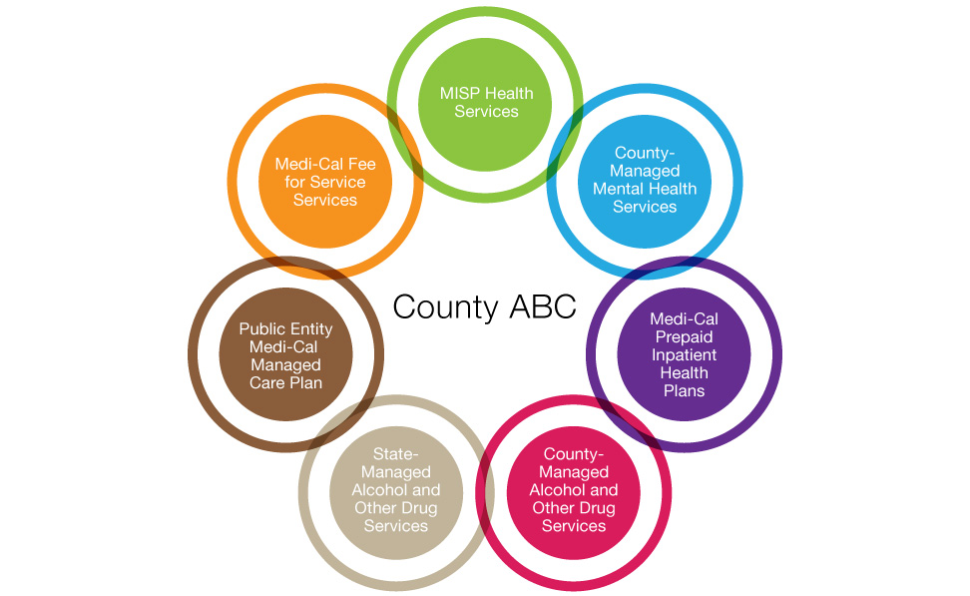
Identify and Address Funding Barriers
Notes:
Talking Points: All Health Care is Local: varied Primary Care/Mental Health/Substance Use Ecosystems have evolved in California communities
Six sets of issues were identified by the Integration Policy Initiative (Volume II) as a result of studying these “ecosystems”
Some things currently can’t be funded by PC, some can’t be funded by MH, some can’t be funded by SU

Slide 33
Importance of Using a Systems Change Framework for Planning
Helps to articulate a clear vision and goals
Clarifies assumptions and expectations across stakeholder groups
Creates a common language for discussing the desired changes
Helps to design and establish a roadmap and timeline for the intervention
Clarifies and prioritizes goals and gaps that need to be addressed
Facilitates evaluation design, communication, and policy development

Slide 34
Systems Change Frameworks
Strong Field Framework (James Irvine Foundation)
Building Blocks of Systems Change*
* Linkins, KW and Brya, JJ (2008) Understanding and Measuring Systems Change: A Framework to Demystify the Process. Desert Vista Consulting White Paper. www.desertvistaconsulting.com.

Slide 35
Strong Field Framework
Building a Field:
  Community of organizations & individuals working towards a common goal using common approaches

Slide 36
Defining the Field
Common Goal:
  Issue trying to influence?
  Target population?
  Desired outcome(s)?
Common Approach
Community of Organizations and Individuals
  Primary actors supporting/affiliated?
  Any skeptics or critics?

Slide 37
Assessing the Field to Identify Strengths & Weaknesses
Five Components
  Shared Identity
  Standards of Practice
  Knowledge Base
  Leadership and Grassroots Support
  Funding and Supporting Policy

Slide 38
Shared Identity
Is there a common purpose and set of core values in the community (organizations and individuals)?

Slide 39
Standards of Practice
Codified standards of practice?
Evidence-based or exemplary models of practice?
Resources to support implementation?
Credentialing or professional development for practitioners/leaders?

Slide 40
Knowledge Base
Credible evidence of outcomes
Research/researchers to advance practice
Knowledge/data collection, analysis, debate, and dissemination

Slide 41
Leadership & Grassroots Support
Influential leaders/organizations across key segments of the field
Broad base of support from key constituencies

Slide 42
Funding & Supporting Policy
Policy environment supports & encourages model practice
Diverse, but organized funding streams (public, philanthropic, and corporate)

Slide 43
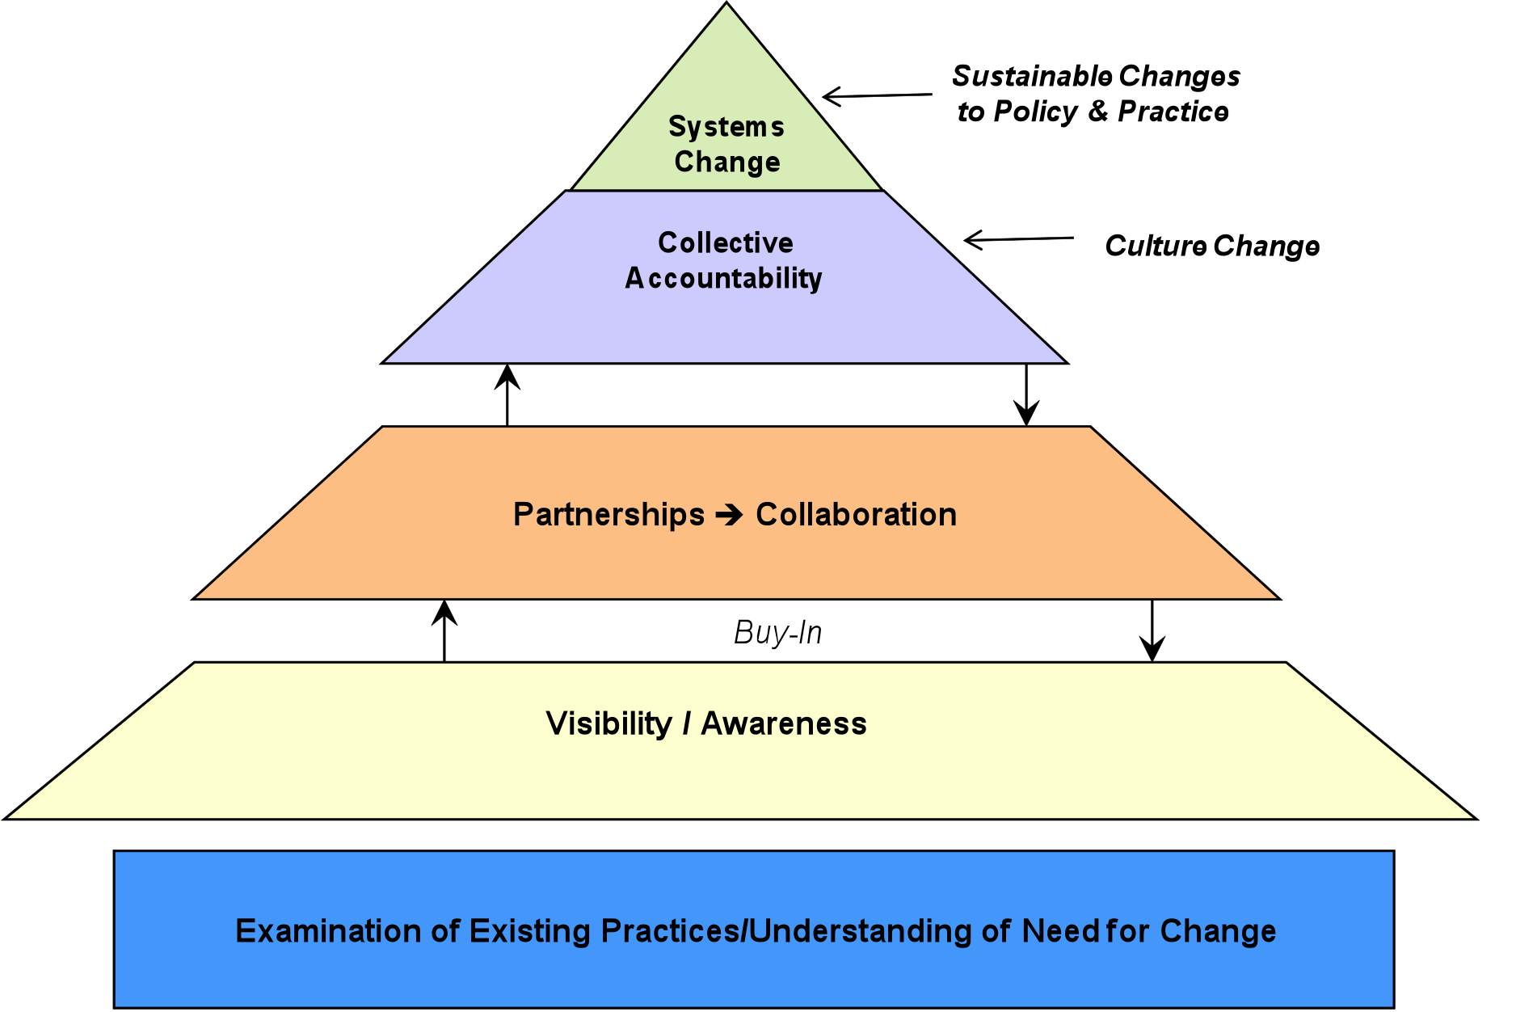
Building Blocks of Systems Change
Notes:
Systems change is not a linear process; it is a developmental progression that is influenced by contextual factors, strength of partnerships, and knowledge about how to make systems change happen
5 Building Blocks to successful systems change

Slide 44
Domain 1: Understanding the Problem
Goal is to gather and analyze information on the needs of the target population(s), gaps in service capacity, and access barriers
Critical to the planning process is to:
  Identify and involve relevant stakeholders who need to be at the table
  Be honest about existing power structures
  Identify leaders and resources
  Identify potential barriers and challenges that will influence the context and expectations of change
  Determine readiness for change across partners

Slide 45
Domain 2: Visibility and Awareness
Goal is to build awareness of the problem and generate momentum for change with an ever broader audience
Convene stakeholders and community members to share plans and gather feedback -- “proof of concept”
Dialogue with formal and informal partners to engage all levels of staff – from leadership to frontline– in understanding goals and need for change

Slide 46
Domain 3: Partnership and Collaboration
Goal of this domain is to strengthen existing and build new partnerships
Why do we need partners?
  Patient/Consumer identification and outreach
  Patient/Consumer engagement to ensure access
  Offer broader expertise, skill sets, and capacities to project
Why is collaboration critical to achieving change?
  Facilitates program/project implementation
  Reduces fragmentation of service delivery
  Enhances access to services
  Improves efficiency

Slide 47
Domain 4: Collective Accountability
Goal of this domain is to advance beyond the interests of each individual organization to focus, collectively on the broader issues affecting the health of the community.
To focus on the community’s interests, collaborative partners must address issues related to:
  History of fragmentation and silos
  Organizational cultures and missions
  Competition for funding

Slide 48
Domain 5: Sustainable Systems Change
At this stage, changes in policies, service delivery, culture, and practice are sustained within the organization and across partnering agencies.
What’s important to keep in mind during the planning process is to identify:
  What the desired systems change looks like – or what the system would look like as a result of the change
  What needs to be true to achieve the desired change

Slide 49
Using Conceptual Frameworks
Conceptual backdrop for the planning, implementation, and assessment phases of a project/intervention
Reminder of the different phases a project moves through to reach the goal of sustainable systems change
Offers milestones to consider in designing a roadmap and timeline for the intervention

Slide 50
Key Questions
In your initiative, how would you combine services funding and policy work?
How would you apply the Strong Field Framework and the Systems Change Framework?
What outcomes are you trying to influence?

Slide 51
Thank you for your participation!
Feel free to contact us:
Becky Hayes Boober, Ph.D.
bhboober@mehaf.org
Lynda E. Frost, J.D., Ph.D.
lynda.frost@austin.utexas.edu
Karen W. Linkins, Ph.D.
karen@desertvistaconsulting.com

