Slide 1

Cross Hormone Considerations
Kevin Hatfield, MD
Friday August 10, 2018
509 Olive Way #900
Seattle WA, 98101

Slide 2
Session Objectives
Brief overview of cross hormone effect on different body systems
Changes both desirable and problematic
Lab value ranges and how they change
Managing medication with finesse

Slide 3


What influences Hormone impact?
Age at first exposure
Intrauterine development
Age at subsequent exposure
Peripubertal
Adolescence
Adulthood
Hormone dosing/dominance
Low & Slow
Here We Go!
Length of exposure
Genetics

Slide 4
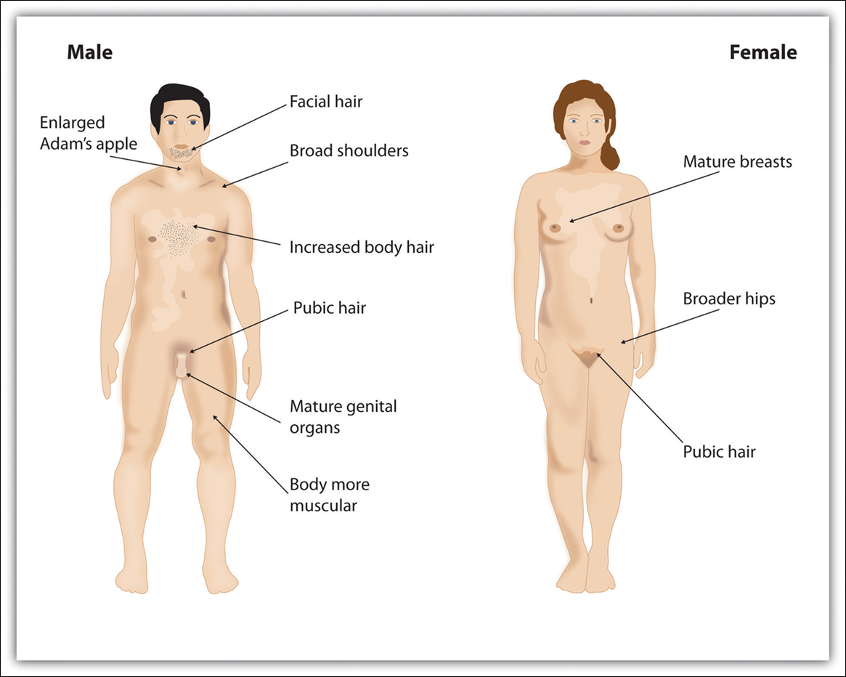
How is hormone dominance observed:
Frontal bossing
Body Odor
Oily skin
Softer Skin

Slide 5
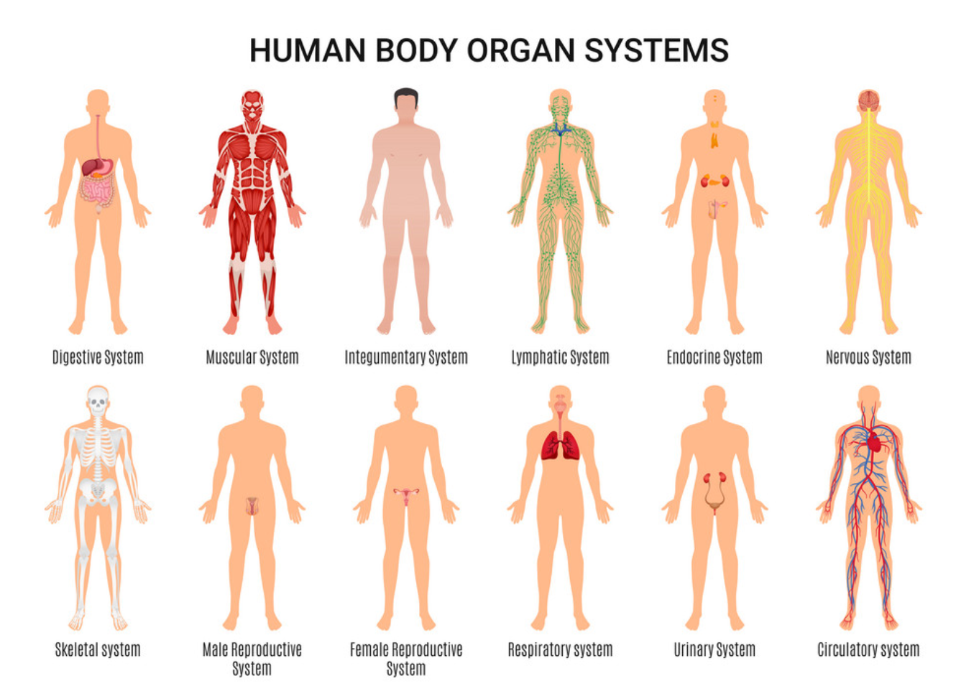
Systems influenced…

Slide 6


Contextual changes
Desirable
Un-desirable
Breast Growth
Muscle mass
Reduced fertility
Libido/function
Fat distribution
Hair distribution
Emotional State
Appetite
Breast Growth
Muscle mass
Reduced fertility
Libido/function
Fat distribution
Hair distribution
Emotional State
Appetite

Slide 7
Lab value alterations
Estrogen Testosterone
Dominant Dominant
Hemoglobin 12-15 g/dL 13-17 g/dL
Hematocrit 36-45% 39-51%
Total Iron 50-170 μg/dL 65-175 μg/dL
Iron Binding 269-535 μg/dL 252-460 μg/dL
BUN 7-19 mg/dL 8-26 mg/dL
Creatinine 0.57-1.11 mg/dL 0.72-1.25 mg/dL
Prolactin 3-24 ng/dL 3-18 ng/dL
Estradiol 10-650 pg/mL <47 ng/dL
Testosterone 14-55 ng/dL 220-720 ng/dL
DHT 4-22 ng/dL 30-85 ng/dL

Slide 8
Hormone Prescribing Finesse
Estrogen Issues
Testosterone Issues
Erectile function
Emotional state Δ
Breast growth
Poor T suppression
Migraine Flares
Clot risk
Androgenic Alopecia
Emotional state Δ
Acne
Weight gain
Vaginal Atrophy
Bleeding/spotting
Clot Risk

Slide 9

When do you check Labs? What Labs do you check? Why do you check labs?
Will you marry me?
Estradiol Oral 4-6 hours after SL, or SQ Nadir
Testosterone SQ Nadir often, peak rarely, Topical Gel? Good luck!
Hematocrit Q3 months on T, Annual on E
BMP Q3-12 months on Spiro
LFT Q12 - just because?
Prolactin Pre hormones; post E dosing?
DHT Q3-6 months selectively

Slide 10
Estrogen Delivery Options
Estrogen Type | Low Dose | Usual Starting | Highest dose | Cash Cost (generic) | Frequency | Notes
Sublingual/Oral | 0.5mg | 1 mg | 8 mg | $4-$16 per month | Twice daily | SL preferred
Patch | 0.25 mcg | 50 mcg | 400 mcg | $25-$100 per month | Weekly or Twice weekly | Poor adhesion, allergy, lint halo
Custom Cream | 2.5 % | 5 % | 20% | $15-$80 per month | Daily or Twice Daily | Specialty Pharmacy
Valerate Injection | 2 mg | 4-8 mg | 20 mg | $20-$40 per month | 7 or 10 or 14 days apart | Injection training needed
Cypionate Injection | 0.5 mg | 1 mg | 2 mg | $20-$40 per month | 7 or 10 or 14 days apart | Injection training needed

Slide 11
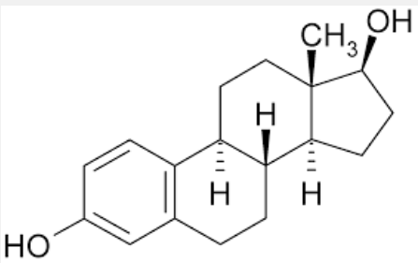
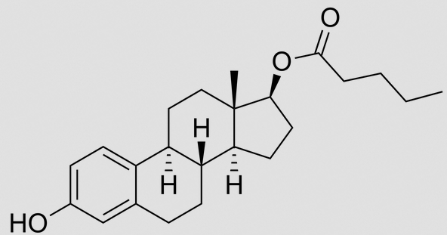
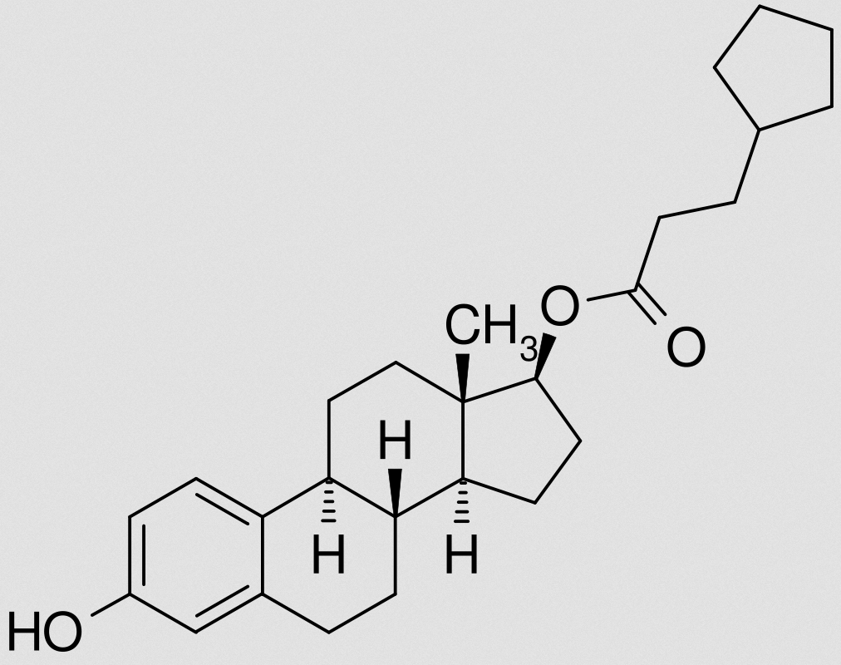
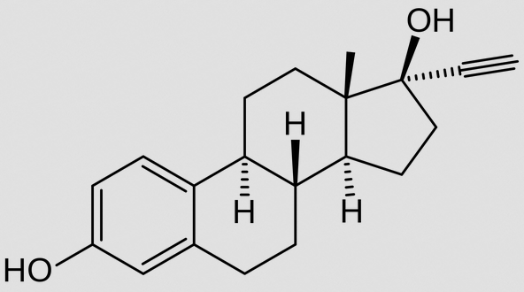
Estrogen ½-Life & Risks by Type Beta Valerate Cypionate Ethinyl
Type of Estrogen | Half Life | Blood Clot Risk | LFT Δ | Cancer Risk | Migraines or Mood Changes
Beta-Estradiol – ‘Bio-Identical’ (SL) | 8 - 18 hrs | 1:10,000 to 1:250 | Rare | No observed increase | Possible
Estradiol Valerate Injection | 4 - 5 days | 1:1,000 to 1:250 | Rare | No observed increase | Possible
Estradiol Cypionate Injection | 8 – 10 days | 1:1,000 to 1:250 | Rare | No observed increase | Possible
Ethinyl Estradiol po ‘Birth Control Type’ | 15 - 30 hours | 1:50 to 1:25 | Rare | Possible Increase | Possible

Slide 12
Estrogen Enhancers / Testosterone Blockers
Name | Dosing range & frequency | Cost (Cash) | Benefit | Risk
Spironolactone aka Aldactone | 50-200mg Taken Daily or Divided Twice Daily | $4-$16 per month | Reduced Nuisance Hair Growth, Acne Breast Development? | Elevated Blood Potassium, Lightheadedness, Increased Urination
Finasteride aka Propecia Proscar | 1-5 mg daily | $9-$16 per month | Reduced DHT, hair preservation Breast growth? | Weight gain, Light headedness
Dutasteride aka Avodart | 0.5 mg daily | $25 per month | Reduced DHT, acne, hair preservation Breast growth? | Weight gain, Light headedness
Bicalutamide aka Casodex | 50 mg daily | $20 per month | Potent Pure ‘T’ receptor Blocker | 1% risk of Hepatitis, interstitial pneumonitis, Photosensitivity
Cyproterone Acetate aka Androcur | 10-50 mg daily | (Not available in USA) | Testosterone reduction at level of brain, reduced T activity in body, improved breast development, 10 mg reduces T by 50-70% | 10-30% Transaminitis, Glucocorticoid suppression, depression, clots
Notes:
Inhibition of 17α-hydroxylase and 17,20-desmolase, enzymes in the androgen biosynthesis pathway, which in turn results in decreased testosterone and dihydrotestosterone (DHT) levels.^{[79][85][86][87]} Though, its inhibition of these enzymes is said to be relatively weak.^{[31]}
Inhibition of the conversion of estradiol to estrone, resulting in an increase in the ratio of estradiol to estrone.^{[100]} This is important because estradiol is approximately 10 times as potent as estrone as an estrogen.^{[101]}

Slide 13
Progesterones
Name | Dosing range & frequency | Cost (cash) | Benefit | Risk
Medroxyprogesterone aka Provera | 0.5 mg – 10 mg daily | $8 - $12 per month | Mood, Breast Development, Curves | Weight gain, fatigue, mood
Micronized Progesterone aka Prometrium | 100mg – 200mg at bedtime | $30-$55 per month | Mood, Breast Development, Curves | Weight gain, fatigue, mood
Norethindrone | 5 mg daily | $35 per month | Unclear | Blood Clots?
Norgestrel | 0.075mg daily | Discontinued in USA | Unclear | Blood Clots?

Slide 14
Testosterone Delivery Options
“T” Type | Low | Usual Dose | Max | Cost | Dosing | Notes
Transbuccal | 15 mg BID | 30 mg BID | 60 mg BID | >$650/m | BID | Buccal adhesive
Patch | 1-2 mg | 4 mg | 8 mg | >$530/m | Daily | BIG! Peel-off, linty halo
Gel 1% or 1.62% | 12.5 mg | 50 mg | 100 mg | >$120/m | Daily | Pump or packet Transfer to partner?
2% Axillary Gel | 30 mg | 60 mg | 120 mg | $600/m | Daily | Messy/Sticky
Custom Cream | 2.5 % | 5 % | 20% | $15-$80/m | Daily | Specialty Pharmacy (vehicle matters!!!)
Cypionate or Enanthate SQ | 20 mg | 60 mg | 200 mg | $5-$20/ month | Weekly | Home SQ Injection
Undecanoate IM Injection | 750 mg | 750 mg | 750 mg | $800/10w | Q10 Weeks | One size fits all OFFICE ONLY - IM injection
Testo/Stearic acid pellets | 75 mg | 375 mg | 1125 mg | $800-$1200 /3-4months | Q3-4 Months | Office ONLY- Trochar Assisted Insertion

Slide 15
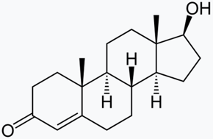
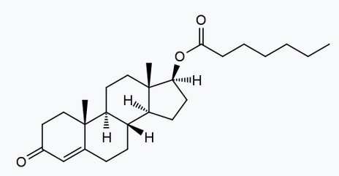
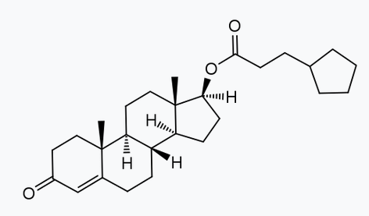
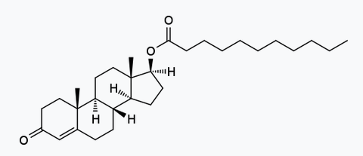
Testosterone ½-Life & Risk by Type Bio Enanthate Cypionate Undecanoate
Type of Testosterone | ½-Life | Dose Frequency | LFT Δ | Cancer Risk | CAD/AMI Risk | Blood Clot Risk (higher w/ polycythemia) | Lab / Mood Changes
Bio-identical | 4-6 hours | N/A | Rare | Not Observed | Baseline | 1:3,000/yr | N/A
Enanthate | 4.5 days | Q7 Days | Rare | Not Observed | Slight Increase | 1:1000/yr | Likely/Possible
Cypionate | 8 days | Q7 Days | Rare | Not Observed | Slight Increase | 1:1000/yr | Likely/Possible
Undecanoate | 20 days | Q70 Days | Rare | Not Observed | Slight Increase | 1:1000/yr | Likely/Possible

Slide 16
Managing Testosterone Side Effects etc. Medication ½-Life, Cost and Purpose (Consider Flexible Dosing)
Medication / strength | Half-Life | Dose/ Frequency | Cash Cost #90 tablets | Purpose | Action
Finasteride 1 mg, 5 mg tab | 5-7 hours | 1 - 2.5 mg Daily | $14-$20 | Prevent Alopecia (Block DHT) | 5α-Reductase Inhibitor
Dutasteride 0.5 mg cap | 28 days | 0.5 mg Daily - Weekly | $35 | Prevent Alopecia (Block DHT) | 5α-Reductase Inhibitor
Anastrazole 1 mg tab | 2 days | 0.5 mg TIW | $21 | Lower E₂ if too high | Blocks T conversion to E
Letrozole 2.5 mg tab | 2 days | Daily | $22 | Lower E₂ if too high | Blocks T conversion to E
Exemestane 25 mg tab | 1 day | Daily | $350 | Lower E₂ if too high | Blocks T conversion to E

Slide 17
Managing Other Testosterone Side Effects etc. Medication ½-Life, Cost and Purpose ( for particular needs )
Medication / strength | Half-Life | Dose/ Frequency | Cash Cost #90 tablets | Purpose | Action
Prasterone / DHEA 6.5 mg insert | 38 minutes (DHEAS 15 hours) | 6.5 mg Inserted Daily | $540 | Reduces dryness / fragility | Local conversion into Estrogens/ Androgens
Ospemifene 60 mg oral tab | 26 hours | 60 mg daily | $620 | Reduces dryness / fragility | SERM acivity on mucosal tissue
Estrogen ring 2 mg insert | n/a | 2 mg Q 90 days | $450 | Reduces dryness / fragility | Local release of Estrogen to mucosa
Etonorgestrel 68 mg implant | n/a | 1 implant Q 3 years | $900 | Contraception | Prevents Ovulation
IUD options progestin/Cu | n/a | Q 3 or more years | $900+ | Contraception | Prevents Conception

Slide 18
QUESTIONS?
Kevin.Hatfield@Polyclinic.com

