Slide 1
Google Analytics and Digital Images:
A Tale of the Great Smoky Mountains
Gayle Baker and Ken Wise
Electronic Resources & Libraries
April 2, 2012

Slide 2
Outline of Talk
Project background information
Google Analytics
Initial results

Slide 3
Lib Value project
Sponsored by IMLS
Value of digital collections
  (survey / web logs / interviews)

Slide 4
Great Smoky Mountains (GSM) Regional Collections
William Cox Cochran Photograph Collection
From Pi Beta Phi To Arrowmont
Albert “Dutch” Roth Collection
Thomson Brothers Digital Photograph Collection

Slide 5
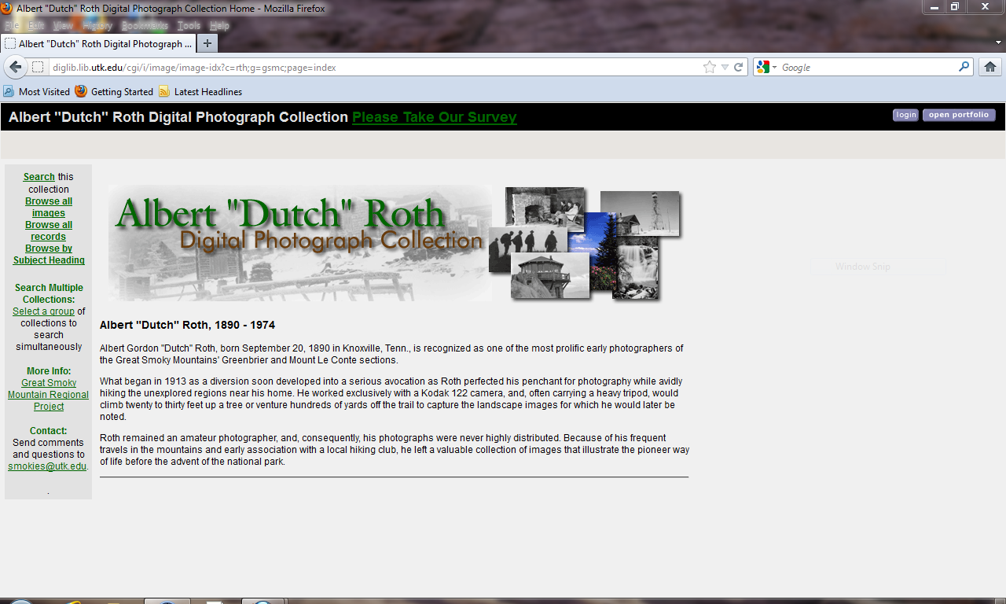
Albert “Dutch” Roth

Slide 6
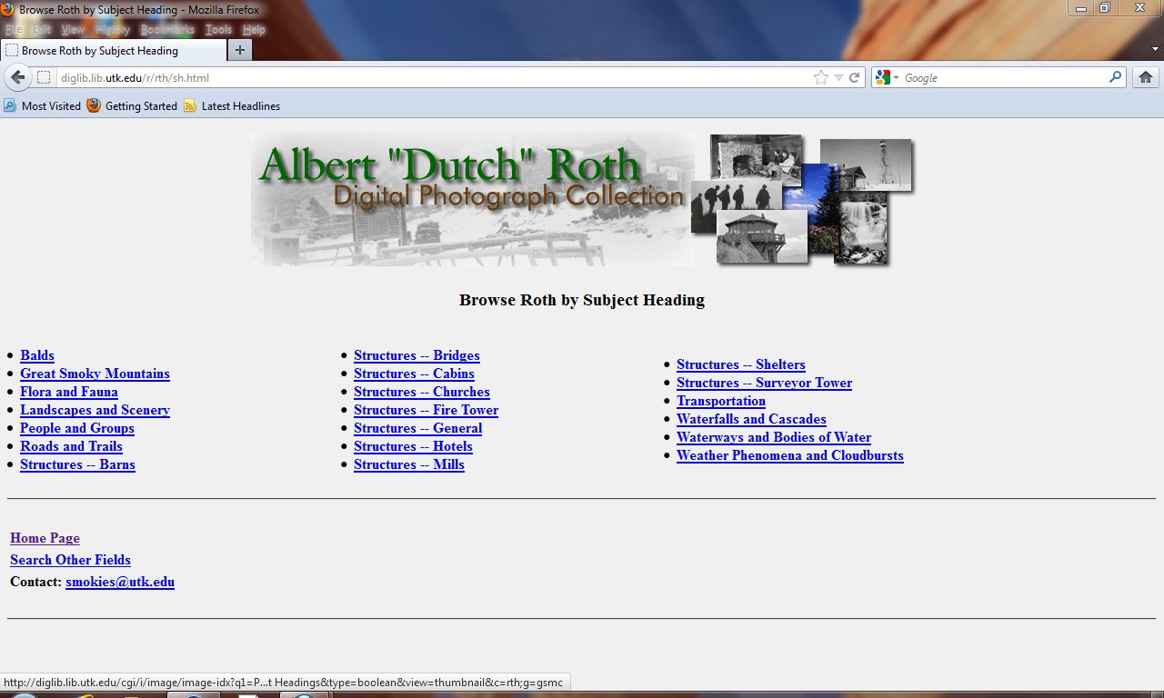

Slide 7
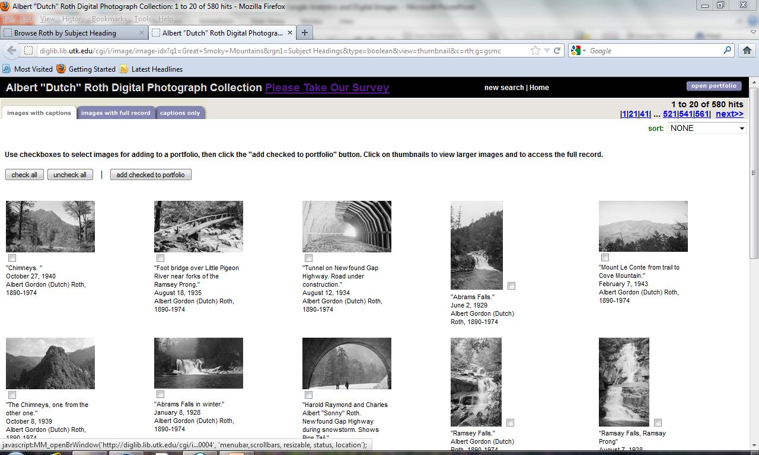

Slide 8
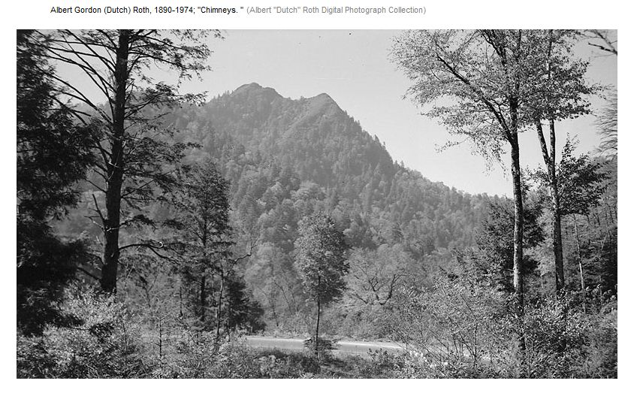

Slide 9
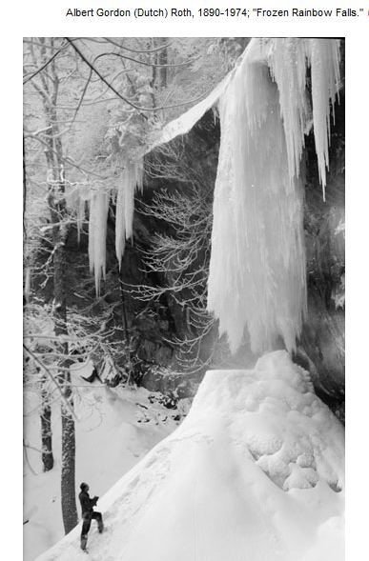

Slide 10
Google Analytics
Javascript on web header
Tracking via cookie
Data stored at Google
Analysis via www.google.com/analytics

Slide 11
Pros/Cons
Pro
  Free
  Wide array of useful reports
Con
  Not web log
  Only records when Javascript is encountered
  Does not record when cookies are not allowed
  Visitor category may not be correct (new/returning)
  Privacy concerns

Slide 12
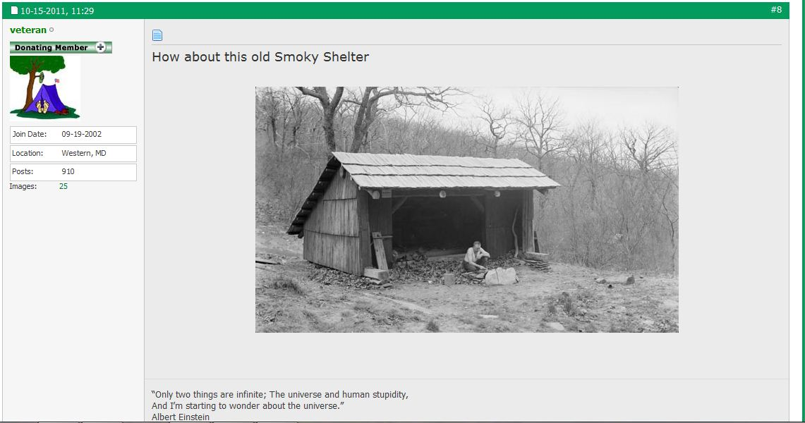
Link to image from outside URL
http://diglib.lib.utk.edu/cgi/i/image/getimage-idx?view=image;entryid=x-roth0169;viewid=ROTH0169;cc=rth;c=rth;quality=600&sid=59704086fa1ba530791d7bb88c7c51e2

Slide 13
GSMRC Goals: 1/3
Major Goal/Purpose of the collection: These collections represent unique historical images of people and places in the Great Smoky Mountains. They should be of interest to hikers, naturalists, historians, etc. in Tennessee and the surrounding states.
Users should be able to:
  Access the GSMRC homepage
  Select the collection(s) of interest
  Search or browse for images
  Link directly to individual images from other websites

Slide 14
GSMRC Goals: 2/3
We would like to have information about GSMRC users and how they use the website:
  Referring URL
    .com, .edu, .gov, etc.
    search engine
    blog
  Location of user
    On campus
    State
    Country, if not US
  New/returning visitor

Slide 15
GSMRC Goals: 3/3
Information about use of site at the:
  Collection-level
  Image-level

Slide 16
Useful Reports
See pdfs

Slide 17
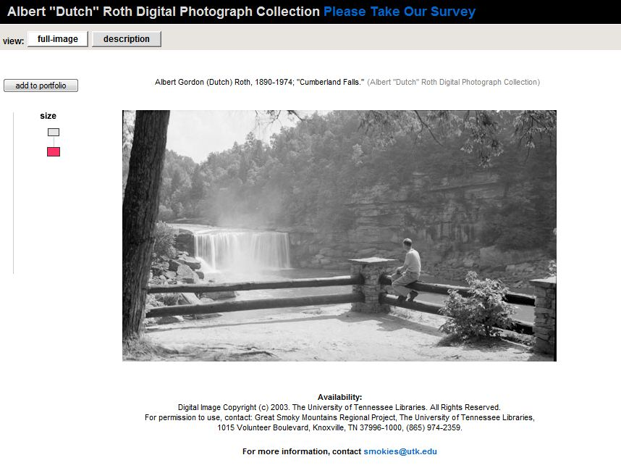
Top Content Viewed

Slide 18
Quantitative & Qualitative
To understand, need qualitative info to …

Slide 19
Selected Bibliography
Harley, D., & Henke, N. (2007). Toward an effective understanding of website users. D-Lib Magazine, 13(3/4), Retrieved from http://www.dlib.org/dlib/march07/harley/03harley.html
Herold, I. H. (2010). Digital archival image collections: Who are the users?. Behavioral & Social Sciences Librarian, 29(4), 267-282. doi:10.1080/01639269.2010.521024
Lee, H. J. (2011). Google analytics for digital library evaluation. (Unpublished master's thesis, Hogskolen i Oslo. , Oslo, Norway) Retrieved March 5, 2012 from https://oda.hio.no/jspui/bitstream/10642/987/2/Lee_Hsin_Ju.pdf .
Marek, K. (2011). Web analytics in the library. Library Technology Reports, 47(5).
Turner, S. J. (2010). Website statistics 2.0: Using Google Analytics to measure library website effectiveness. Technical Services Quarterly, 27(3), 261-278.
Wang, X., Kochtanek, T., & Borwick, J. B. (2010, October). Comparing image users and uses with web analytics. Poster presented at ASIST 2010, Pittsburgh, PA. Retrieved March 13, 2010 from http://www.asis.org/asist2010/proceedings/proceedings/ASIST_AM10/submissions/397_Final_Submission.pdf.

Slide 20
URLs of Interest
Great Smoky Mountains Regional Collections:
http://www.lit.utk.edu/digitalcollections/gsm.html
LibGuide for GSM Regional Project:
http://libguides.utk.edu/content.php?pid=180511&sid=1518963
LibValue site:
http://http://libvalue.cci.utk.edu/node/2

Slide 21
Special Thanks
Joseph Agreda
Mark Baggett
Paul Cummins
Bridger Dyson-Smith

Slide 22
Questions?
Gayle Baker – gsbaker@utk.edu
Electronic Resources Coordinator
Ken Wise – kwise@utk.edu
Humanities Reference Librarian

Slide 23
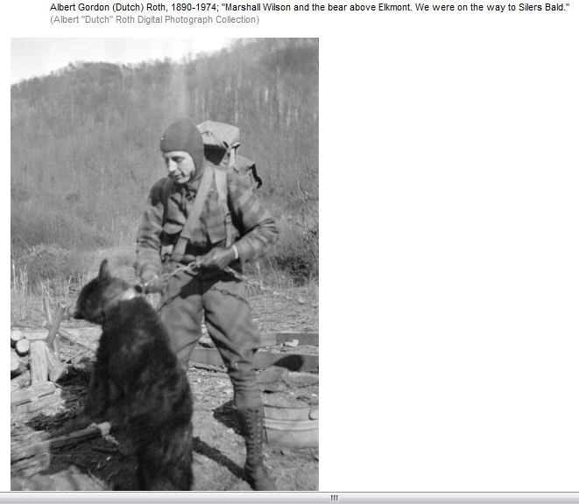

Slide 24
