Slide 1
Autism Spectrum Disorders: Essentials for School Counselors
Jennifer Branscome, Ph.D. & Katharine Adams, Ph.D.
Valdosta State University
Georgia School Counselor Association Annual Conference
11/9/2018

Slide 2
Session Learning Goals
Participants will:
Gain an understanding of the basics of autism spectrum disorder including diagnosis, symptoms, etiology, and risk factors.
Gain an understanding of best practices in working with autism spectrum.
Learn about empirically-supported interventions which can be used by school counselors when working with autism spectrum disorder within the school system.

Slide 3
Overview of Autism Spectrum Disorder
Autism Spectrum Disorder (ASD) is a developmental disability that adversely affects a student's educational performance and significantly affects developmental rates and sequences, verbal and non-verbal communication, and social interaction and participation.
ASD can be associated with intellectual disability, difficulties in motor coordination and attention and physical health issues
About 40 percent have average to above average intellectual abilities.

Slide 4
Symptom severity varies considerably in each individual on the autism spectrum.
One child may not have the same symptoms and may seem very different from another child with the same diagnosis.
The characteristics of autism typically last throughout a person’s lifetime, but can change considerably over time and through interventions.
ASD is typically evident prior to the age of 3, although milder cases may not be evident until later
Overview of Autism Spectrum Disorder (7:39)
The World of Autism (1:00)

Slide 5
Etiology
The cause of ASD is unknown, but evidence suggests a genetic basis to the disorder
The genetic contribution to ASD ranges from 50 – 95%
In identical twins, if one child has ASD, then the other will be affected about 36-95% of the time
In non-identical twins, if one child has ASD, then the other is affected about 0-31% of the time.
Parents who have a child with ASD have a 2%–18% chance of having a second child who is also affected
Influence of genetic mutations (spontaneous or inherited) on brain development, the way brain cells communicate, or the severity of symptoms.

Slide 6
Although the exact cause of ASD is not known, we do know what does NOT cause the disorder
Vaccines*
Parenting style (e.g., refrigerator mom)
Nutritional factors (e.g., gluten)
Taking antidepressants during pregnancy
Too much TV
*See the American Academy of Pediatrics' page “Vaccine Safety: Examine the Evidence” for a summary of research on vaccines and ASD

Slide 7
Prevalence
Overall, 1 in 59 children have ASD (1.7% of the population)
Boys are 4 times more likely to be diagnosed with ASD than girls
1 in 38 boys
1 in 152 girls
ASD is reported to occur in all racial, ethnic, and socioeconomic groups
Most common in Caucasian people (1 in 58), least common in Asian and Pacific Islanders (1 in 74)

Slide 8
Risk Factors
Increased risk of ASD associated with
Family history of ASD
Biological sex
Presence of other disorders (e.g., Down syndrome, fragile X syndrome, tuberous sclerosis, or other genetic and chromosomal disorders)
Prematurity
Pregnancies spaced less than one year apart
Children born to older parents are at a higher risk for having ASD.

Slide 9
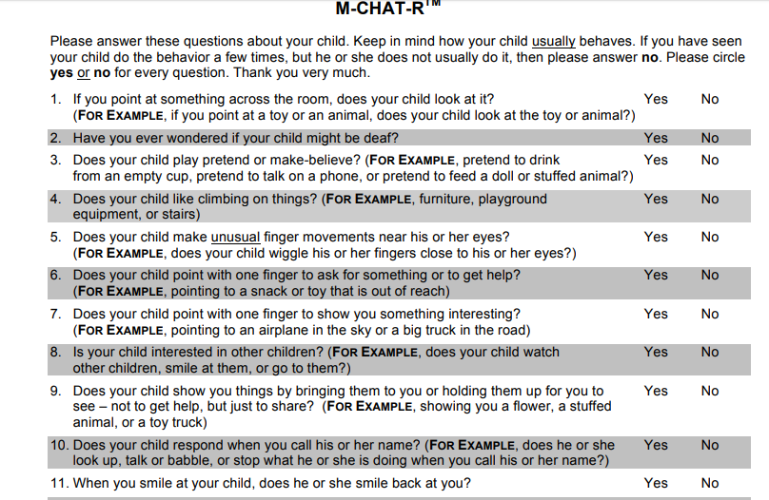
Evaluation
Evaluation of a person with ASD may include some combination of the following:
Developmental history/parent interview,
Standardized screening tests (e.g., M-CHAT),
Comprehensive ASD measure (e.g., the Autism Diagnostic Observation Schedules),
Achievement testing,
Cognitive testing, and
Observations

Slide 10
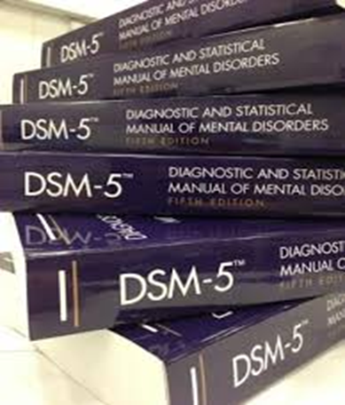
Diagnosis
Diagnosis is made using the Diagnostic and Statistical Manual of Mental Disorders, 5th Ed. (DSM-5)
Within the schools, diagnosis may be made by the school psychologist
A diagnosis ≠ eligibility for special education services via IDEA
IDEA is based on the DSM criteria
A child’s educational performance must be significantly negatively affected for eligibility

Slide 11
In 2013, the Diagnostic and Statistical Manual of Mental Disorders-5 was published with significant changes to how ASD is conceptualized and diagnosed
4 developmental disorders from the DSM-IV were collapsed into 1 disorder in the DSM-5 called Autism Spectrum Disorder
Childhood Disintegrative Disorder
Autistic Disorder
Asperger’s Disorder
Pervasive Developmental Disorder, Not Otherwise Specified

Slide 12
Even though ASD can be diagnosed as early as age 2 years, most children are not diagnosed with ASD until after age 4 years.
Symptoms must be present in the early developmental period
May not become fully manifest until social demands exceed limited capacities, or may be masked by learned strategies in later life
Studies have shown that parents of children with ASD notice a developmental problem before their child’s first birthday.
Concerns about vision and hearing were more often reported in the first year,
Differences in social, communication, and fine motor skills were evident from 6 months of age.

Slide 13
Diagnostic Criteria
Deficits in social-emotional reciprocity,
B. Restricted, repetitive patterns of behavior, interests, or activities, as manifested by least two of the following, currently or by history
Stereotyped or repetitive motor movements, use of objects, or speech
Deficits in nonverbal communicative behaviors used for social interaction,
Deficits in developing, maintaining, and understanding relationships
Highly restricted, fixated interests that are abnormal in intensity or focus
Insistence on sameness, inflexible adherence to routines, or ritualized patterns of verbal or nonverbal behavior
Hyper- or hyporeactivity to sensory input or unusual interest in sensory aspects of the environment
A. Persistent deficits in social communication and social interaction across multiple contexts, as manifested by the following, currently or by history

Slide 14
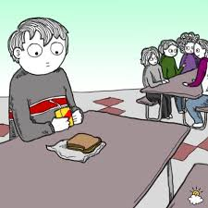
Symptoms
Two Faces of Autism (4:20)
Social Differences in Children with ASD
Doesn't keep eye contact or makes very little eye contact
Doesn't respond to a parent's smile or other facial expressions
Doesn't look at objects or events a parent is looking at or pointing to
Doesn't point to objects or events to get a parent to look at them

Slide 15
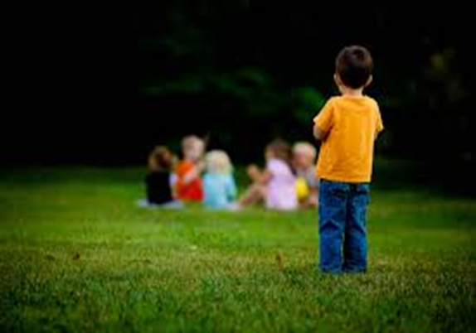
Doesn't bring objects of personal interest to show to a parent
Doesn't often have appropriate facial expressions
Unable to perceive what others might be thinking or feeling by looking at their facial expressions
Doesn't show concern (empathy) for others
Unable to make friends or uninterested in making friends

Slide 16
Communication
Doesn't point at things to indicate needs or share things with others
Doesn't say single words by 16 months
Repeats exactly what others say without understanding the meaning (often called parroting or echoing)
Doesn't respond to name being called but does respond to other sounds (like a car horn or a cat's meow)
Refers to self as "you" and others as "I" and may mix up pronouns

Slide 17
Often doesn't seem to want to communicate
Doesn't start or can't continue a conversation
Doesn't use toys or other objects to represent people or real life in pretend play
May have a good rote memory, especially for numbers, letters, songs, TV jingles, or a specific topic
May lose language or other social milestones, usually between the ages of 15 and 24 months (often called regression)

Slide 18
Behavioral Differences (Repetitive & Obsessive Behaviors) in Children with ASD
Rocks, spins, sways, twirls fingers, walks on toes for a long time (past 5 years old), or flaps hands (called "stereotypic behavior")
Likes routines, order, and rituals; has difficulty with change
Obsessed with a few or unusual activities, doing them repeatedly during the day
Plays with parts of toys instead of the whole toy (e.g., spinning the wheels of a toy truck)

Slide 19
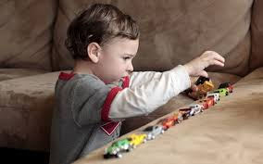
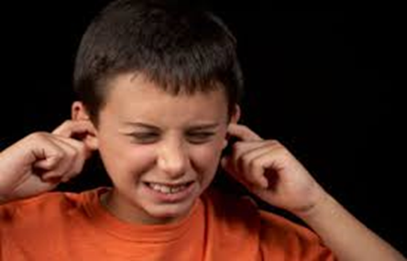
Apparent indifference to temperature or pain
May repeat words or behaviors over and over again
Ex: saying the same word from a sentence repeatedly
May be very sensitive or not sensitive at all to smells, sounds, lights, textures, and touch
Unusual use of vision or gaze
Lining up toys
Autism “Awareness” – 10 Things You Should Know (4:54)

Slide 20
At School
Activities that are often challenging for students with autism include:
Multi-step directions and activities
Following verbal directions
Organization skills and following the schedule
Changes in schedules and transitions
For students with sensory issues, group instruction, assemblies, and PE class can be difficult

Slide 21
Younger Children
Circle time
Sitting,
Listening and processing auditory information,
When verbal replies are required
Centers time
Less structured,
Understanding of expectations,
Working purposefully on their own
Centers time
Lower structure
Clarity of expectations
Free play
Social skills
Cooperative play
Verbal skills
Little structure

Slide 22
Older Children
Longer classroom lectures
Sitting and listening to auditory information for extended period
Independent work
Less structure
Understanding of expectations if unclear
Following directions

Slide 23
The School Counselor and ASD
School counselors can help support the academic and social/emotional needs of students with ASD in numerous ways (e.g., individual counseling, social skills groups, consultation)
In addition to providing ASD-appropriate counseling, 2 ways school counselors can help students with ASD is to dispel myths/misperceptions and to provide resources for teachers and other school personnel who work with students on the spectrum

Slide 24
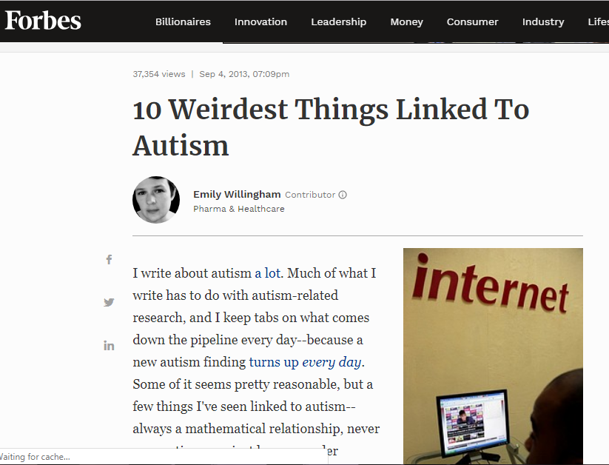
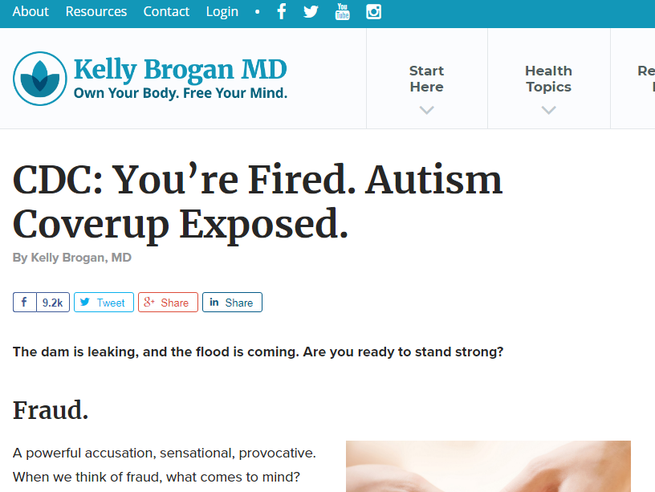
Misperceptions and Myths
ASD is at the same time very well known and not well known at all
Movies, news stories, social media stories all contribute to misunderstanding of the disorder
An important part of advocating for students on the spectrum is providing accurate information and/or education about ASD to school staff and others

Slide 25
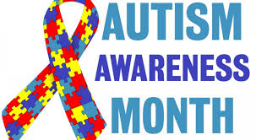

A variety of methods can be used
Handout of facts and/or myths
Autism Awareness Month
“Hallway” moments
Social media
Community outreach activities

Slide 26
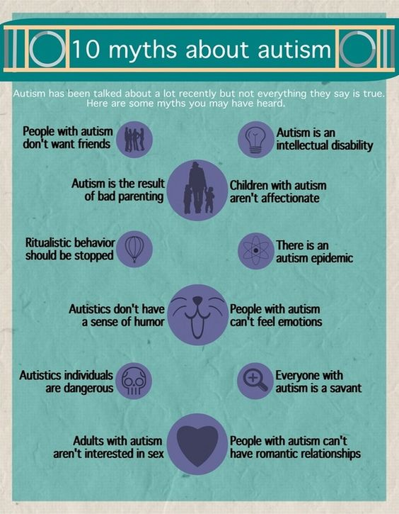
Information on the school’s or your own webpage
Professional development presentations
Classroom lessons for students

Slide 27
Common ASD Myths
Autism is acquired (e.g., vaccines, food, heavy metals)
People with autism don’t like other people or don’t want friends
People with ASD cannot speak
People with ASD all have intellectual disabilities
ASD is caused by bad parenting
People with ASD have “savant” skills/are like “Rainman”
ASD is caused by eating certain types of food (e.g., gluten)
The number of people with ASD is increasing (i.e., an “epidemic”)
ASD can be cured

Slide 28
Resources for Teachers
Develop a library of resources that can be used and shared with teachers and other school personnel (e.g., School Community Took Kit)
Resources will vary according to individual situations and need
Examples:
Instructional techniques
Community support agencies
Professional development materials
Contact information for reputable organizations and sites that provide information and resources on ASD

Slide 29
http://www.gadoe.org/Curriculum-Instruction-and-Assessment/Special-Education-Services/Pages/Autism.aspx

Slide 30
Example: Classroom, Instructional, and Student Strategies
Establish clear routines and habits to support regular activities and transitions. Alert the student to changes in routine, staffing, etc., in advance, whenever possible.
Provide written rules or pictures of expectations of behavior in the classroom, including “unwritten” conventions if necessary.
Minimize the use of “negative” communication strategies (e.g., sighs, repeatedly saying things like “don’t” and “stop”)
Consider and allow for the needs/supports for class presentations (e.g.,, visual supports or a power point presentation for a child with impaired expressive language skills).

Slide 31
Make sure that activities such as field trips, class presentations, assemblies, and plays are addressed ahead of time with the student and other personnel involved
Have a place the student can go briefly when feeling overwhelmed to regroup
Do a functional behavior assessment and develop a behavior plan, making sure to include the student in the process
Consider allowing more time or an alternate setting for testing
Supply study guides ahead of tests

Slide 32
During reading lessons, provide a specific structure to questions when expecting an answer for comprehension to minimize vagueness and maximize effective assessment of knowledge
When teaching writing, use visual prompts (e.g., word bank, pictures)
Teach students common idioms or expressions
Collaborate with the student’s special education staff to modify curriculum, supports such as visuals, communication access, organizational tools, and directly teach study skills (note taking, time management, etc.)

Slide 33
Treatment
Treatment of students with ASD will vary depending on their particular needs
The majority of treatment of ASD is conducted within the school setting and can include a combination of occupational therapy, physical therapy, speech therapy, special education, and counseling services
Most empirically-based approaches to treatment involve using behavioral and cognitive-behavioral techniques

Slide 34
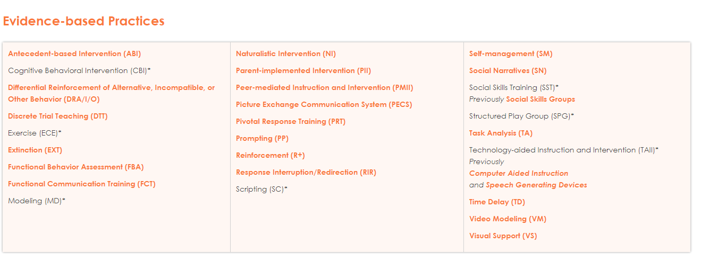

Slide 35
Example: Social Skills Training
Social skills training is a common approach to helping students with ASD in both the individual and group setting and can include teaching concepts such as:
How to recognize social cues and respond appropriately
Turn-taking in a conversation
Empathy and perspective-taking
Learning how to play with a friend (4:58)
Big Bang Theory: The Friendship Algorithm (5:00)

Slide 36
Example: Scripting Implementation with Video Modeling
Outline what steps are needed to model the skill or situation you will be targeting. (Make sure the level and length of steps are appropriate for the child you are working with.)
Practice these steps with the child repeatedly before the skill is used in the actual situation.
Systematically fade the script as the skills generalize successfully in the actual situation.
Taking out the trash (:44)

Slide 37
Other Treatments
Outside of the school setting, types of treatments can generally be broken down into the following categories:
Behavior and Communication Approaches
Dietary Approaches
Medication
Complementary and Alternative Medicine

Slide 38
Examples of behavior Treatments
Applied Behavior Analysis (ABA)
Well-supported treatment. ABA encourages positive behaviors and discourages negative behaviors in order to improve a variety of skills. The child’s progress is tracked and measured. Different approaches to ABA exist.
Sensory Integration Therapy
Sensory integration therapy helps the person deal with sensory information, like sights, sounds, and smells. Sensory integration therapy could help a child who is bothered by certain sounds or does not like to be touched.
Positive Behavior Support (PBS).
PBS aims to figure out why a child does a particular problem behavior. It works to change the environment, teach skills, and make other changes that make a correct behavior more positive for the child. This encourages the child to behave correctly.

Slide 39
Dietary Approaches
These /interventions call for changes in diet. Such changes include removing certain types of foods from a child’s diet and using vitamin or mineral supplements. Dietary treatments are based on the idea that food allergies or lack of vitamins and minerals cause symptoms of ASD. Some parents feel that dietary changes make a difference in how their child acts or feels.
Little support so far for efficacy of dietary treatments.

Slide 40
Medication Treatment for Autism
Currently, there is no medication that can cure ASD
Some medications can help treat certain symptoms associated with ASD, especially certain behaviors.
Research shows that medication is most effective when used in combination with behavioral therapies.
Risperidone is used to treat irritability and is currently the only FDA-approved drug for the treatment of specific autism symptoms

Slide 41
Selected Resources
Georgia Department of Education
General information about ASD and professional development resources
Autism Society of Georgia
General information about ASD.
IRIS Center at Vanderbilt University
This site has a wealth of information about ASD, professional development, empirically-based treatments, and more.
Autism Speaks
Advocacy organization which provides information and resources on ASD.
School Community Tool Kit (available from Autism Speaks)
Information and resources for anyone working with students with ASD in the schools.

