Slide 1

16+ Lifehacks to Improve Our Wild Admissions & Recruitment Lives
Friday, May 3, 2019 | 2 p.m.

Slide 2
Presenters | Contact us at
Nick Orban University of Maryland, College Park (MD) | norban@umd.edu
Christopher Wild Goucher College (MD) | christopher.wild@goucher.edu

Slide 3
LEARNING OBJECTIVES
1
  Professional Development
2
  Increasing Individual Efficiency
3
  Improving Recruitment and Self-Care

Slide 4
Recruitment and Travel Hacks

Slide 5

1. Loyalty Matters
ALWAYS join loyalty programs:
Airlines & Hotels (obviously)
Don’t forget the less obvious:
Airport Parking (FastPark)
Rental Car Agencies
Restaurants
Uber

Slide 6

2 & 3: Travel Planning
2. Smart Travel Planning
New to a territory? Map it!
3. Decide your hotel philosophy:
Which camp are you in?
Option 1: Stay closest to your first appointment each day
Option 2: Stay at one central hotel during your whole trip

Slide 7
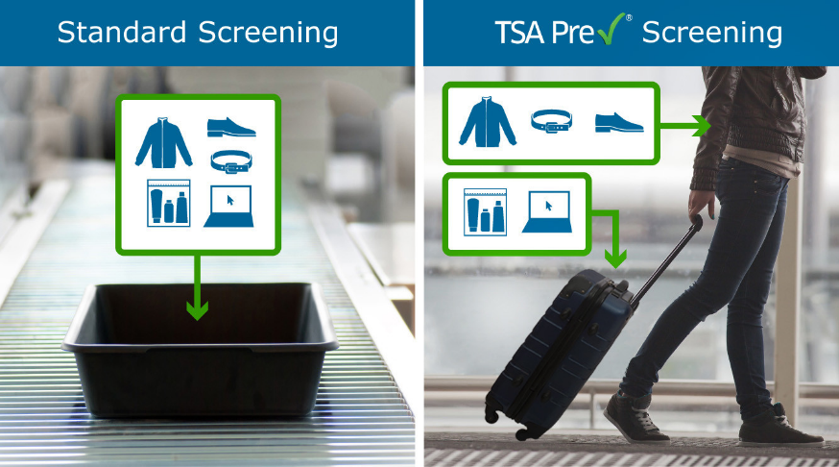
4. Skip The Line
Get TSA Pre-Check or Global Entry
Skips lines
Avoid headaches
(Even if your institution won’t pay for it, it is worth every penny.)

Slide 8

5. General Travel Advice
Smart Luggage
Lounge Access
Get a cord carrying case
Pictured: (AmazonBasics Hard Carrying Case for 5-Inch GPS - Black)

Slide 9
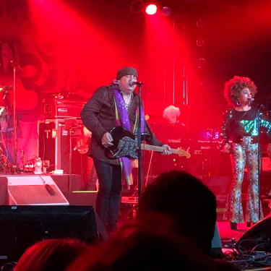
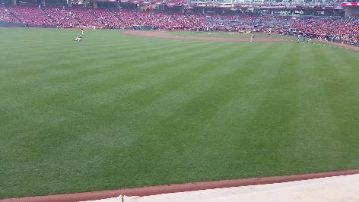
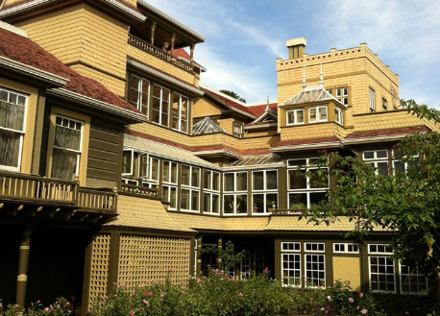

6. Enjoy the Journey
Make time for self-care
Do something fun!
Go to a local eatery
See a concert or some sports ball
Take in the local attractions
Like Netflix? Get an Amazon Fire Stick
Don’t overbook yourself

Slide 10




7. Your car will be your friend...
...so listen to podcasts or audiobooks because radio is is just difficult.

Slide 11
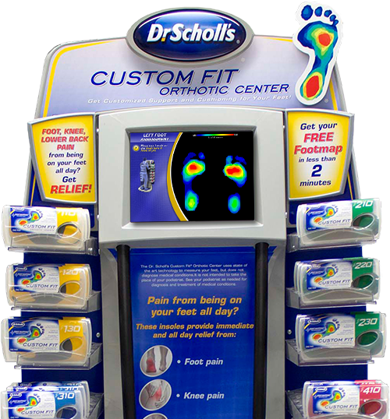
8. Be kind to your feet and back...
...and get a good pair of shoes!
(don’t forget the inserts!)

Slide 12
Reading/Office Hacks

Slide 13

Application Reading
9. Read by School
10. Don’t save the weird transcripts for the end
Looking at you, NYC and Florida

Slide 14


Improve Your Office Life
11. Organization Structure
Labels
Colors
12. Standing Desks
OMG SO GOOD
Plus, healthy

Slide 15

13. Set Up Work/Life Balance
Make sure you have a clear divide between work time and down time
Create a healthy balance

Slide 16
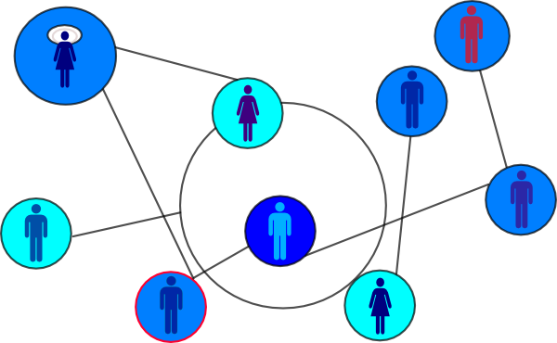
14. Build Your On-Campus Network
Your professional network is a powerful tool for recruitment

Slide 17

Use Your {BLANK} Days
15. Reading Days
Get away from the office
Remove distractions
16. Vacation Days
Get away from the office
Remove distractions

Slide 18
What’s Your “Why”?
17. What’s Your Why
Why are you here?
Why do you do what you do?
18. Professional Development
Conferences (duh)
Webinars
College Admission Counseling facebook group

Slide 19
QUESTIONS?

Slide 20
THANK YOU for attending this session!
We’d love to hear from you!
Please submit a session evaluation via the conference mobile app or from www.pcacac.org.

