Slide 1
The Evolution of Enrollment Management Marketing
Where Technology and Tradition Meet
Geoff Broome
Senior Enrollment Solutions Consultant
Capture Higher Ed

Slide 2
How did this all begin?

Slide 3
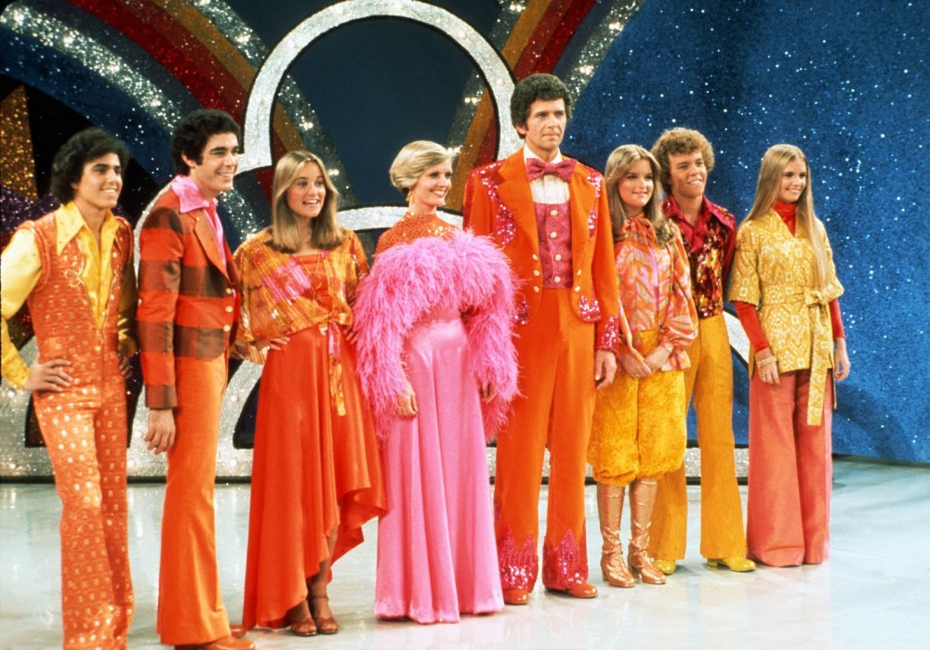
The History of Enrollment Management Marketing
Started in the 1970’s
How to communicate with potential students?
Fundamental strategies to increase enrollment
Notes:
Strategic Enrollment management started in the 1970’s. Before this period there was little data based strategy to enrollment.

Slide 4
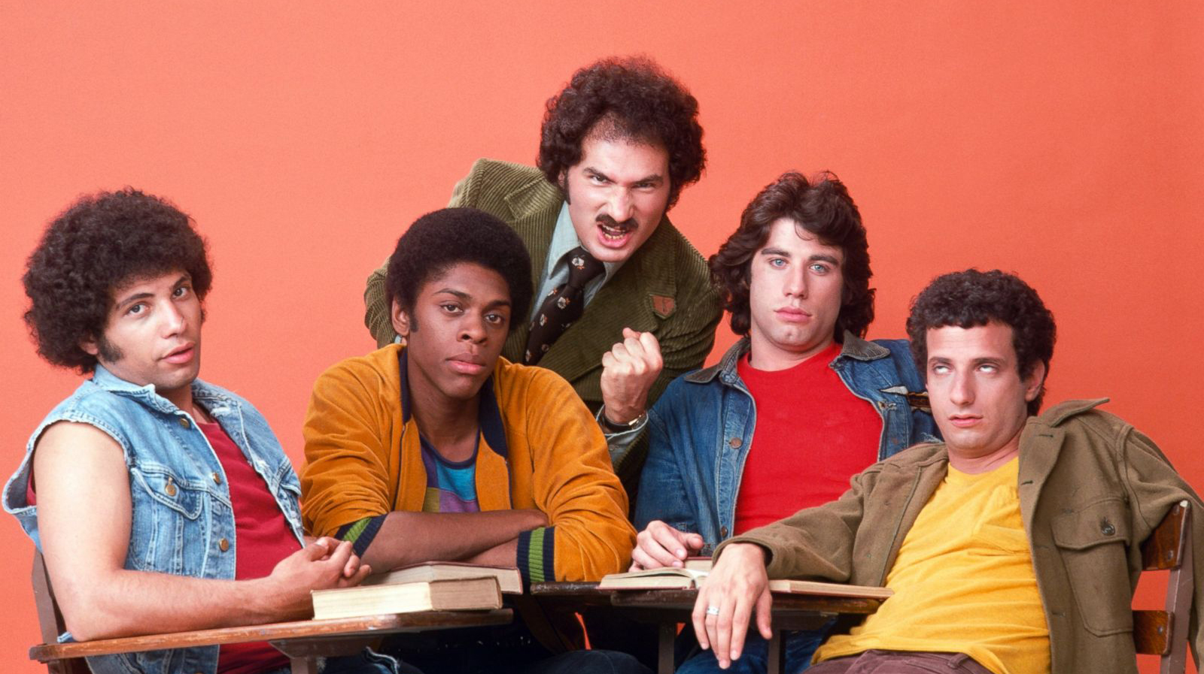
The History of Enrollment Management Marketing
Pen, Paper, Primitive
Paper surveys by Boston College
Notes:
In the 1970’s Boston College set out to use data to help influence their marketing tactics. The days of guessing were over. They first decided to send out paper surveys to ask questions like: who or what got them interested in Boston College

Slide 5

The History of Enrollment Management Marketing
First Banner Ad
Built and deployed in the 1990's.
There were only 30 million people on the internet at this time.
Notes:
There was 30 million people on the internet in the 90's.
There is zero branding on this ad—No one knows it's ATT It's likely that it was also only served on a few sites, making the impressions very low.
There are 3.8 BILLION people on the internet today.

Slide 6
Where are we today?

Slide 7
Where are we today?
Behavioral Intelligence
Marketing Automation
Data Modelling
Industry Expertise
Customizations

Slide 8
Where are we today?
The Capture Solution
Capture Behavioral Engagement (CBE)
Envision
Marketing Automation
Data Modelling
Account Management
Industry Expertise
Technology Partner Integrations
Customizations

Slide 9
Evolving your Enrollment Management Marketing Program

Slide 10
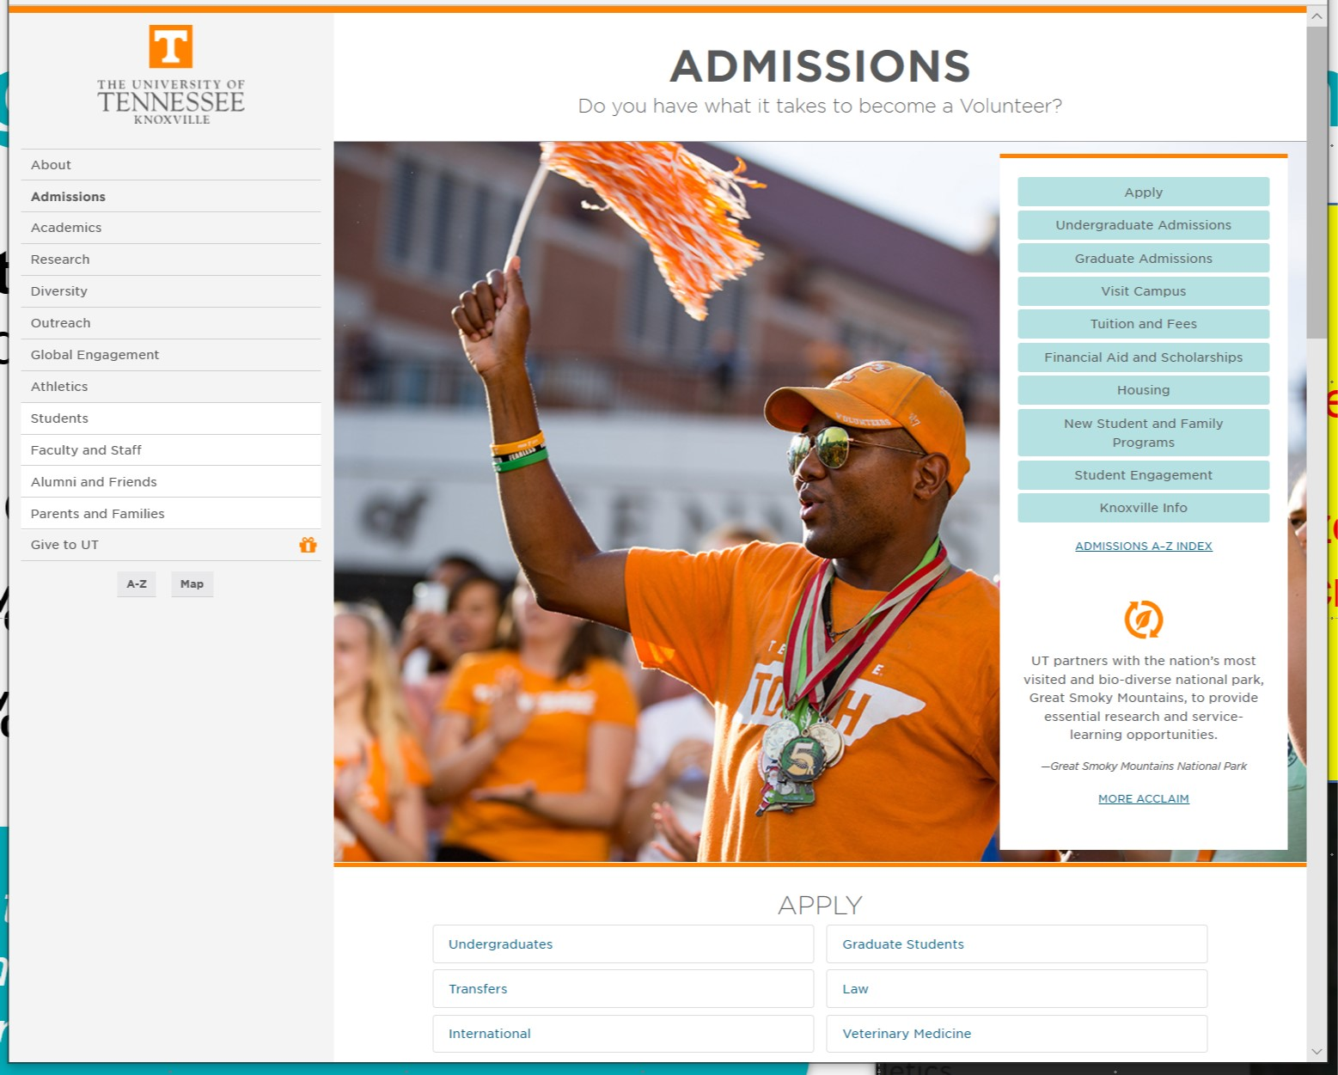
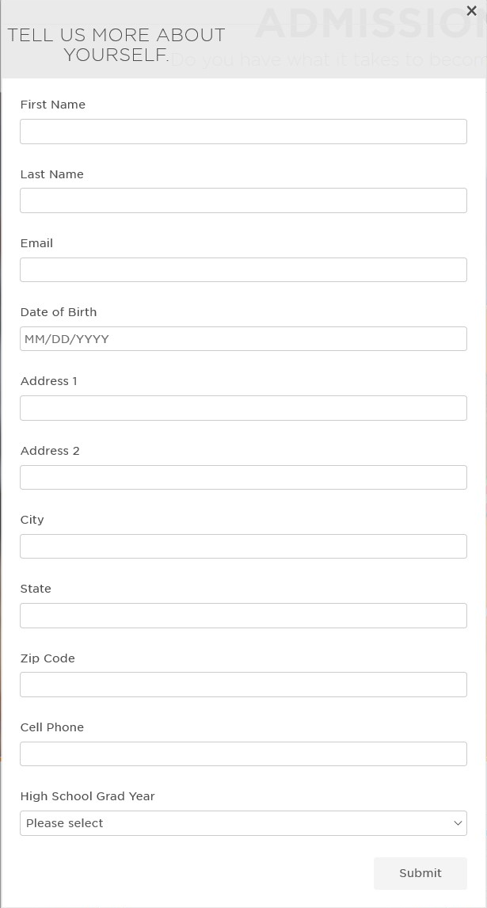
Finding (and getting to know) the right students
University of Tennessee, Knoxville
Served to anonymous visitors who:
Visit 2 admissions pages and
Visit 2 academics pages
Ongoing. Results after 27 months.
300k Unique Impressions
30k | 10% Forms Submitted
24k | 80% Stealth Inquiries / Not in Pool
Students that complete a Progressive ID Form are 5x more likely to enroll than traditional inquiries.

Slide 11
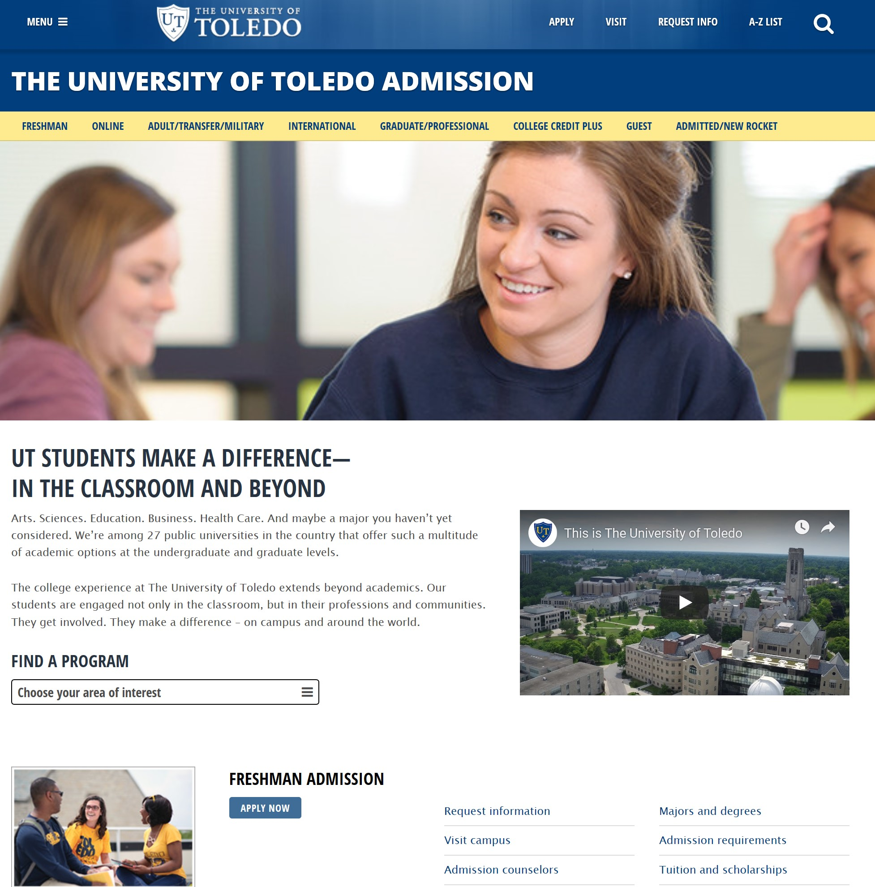

Making the personal connection
University of Toledo
Ohio residents
Non-Commuters
Living <25 miles from campus
11 months
59k Unique Impressions
10k Clicks | 17% Click Through Rate 1,900 | 19% Applied
1,600 | 85% Admitted
860 | 54% Enrolled

Slide 12
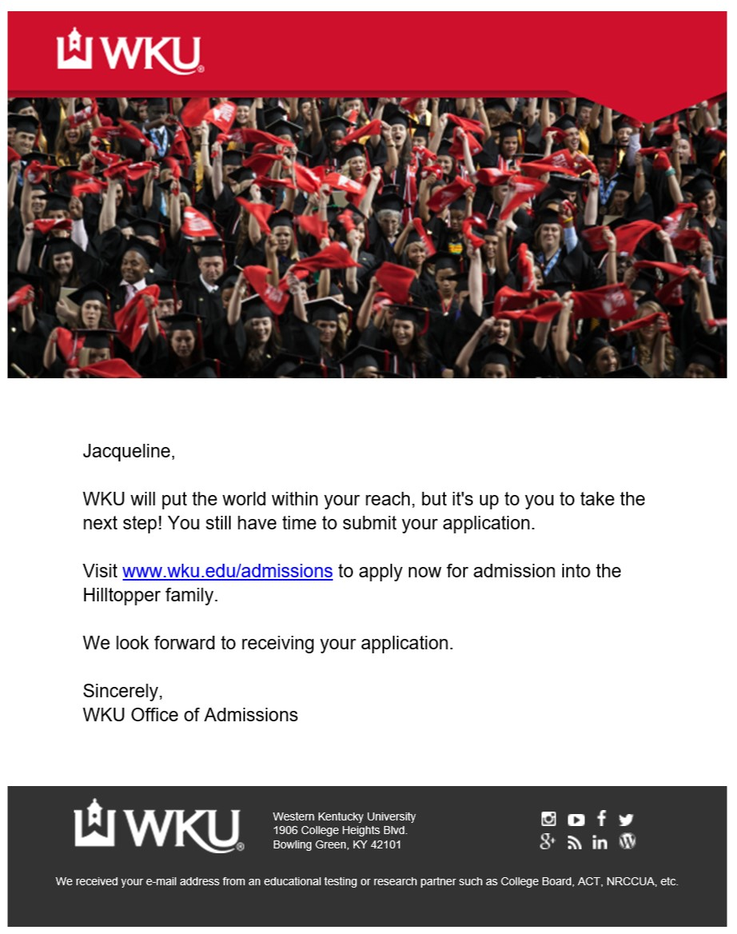
Maintaining Momentum
Western Kentucky University
7 month campaign
Identified, Non-applicants in US
Visited Admissions and Financial Aid pages
Email triggered 30 minutes after site visit
5,000 emails triggered
516 | 10% Recipients applied

Slide 13



Digital Advertising
Household IP Targeting
With 100% accuracy you can reach student households based on their IP address
Retargeting
Students are visiting your site everyday. Keep your school top of mind by serving tailored targeted ads.
Geo-IP Targeting
Serve your ads to specific locations, such as feeder or competing institutions.

Slide 14
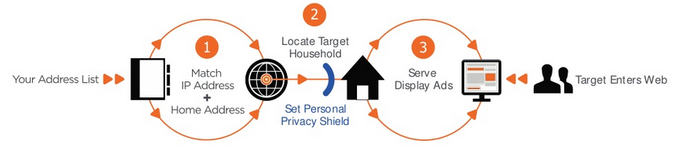
Digital Advertising: IP Targeting
Small private liberal arts university in the south:
316 Deposited Students clicked on HHIP!
Patent-pending technology to target ads at a household level based on IP address
More accurate targeting = less waste and higher ROI

Slide 15
Let’s review

Slide 16
The Evolution of Enrollment Management Marketing
Pen, Paper, Primitive
Don’t forget the intent of where it all began
Where we are today
Seize the opportunity to evolve your engagement management marketing program
Analog origins, Digital destinations, Student-centered strategies
Celebrate your successes!

Slide 17
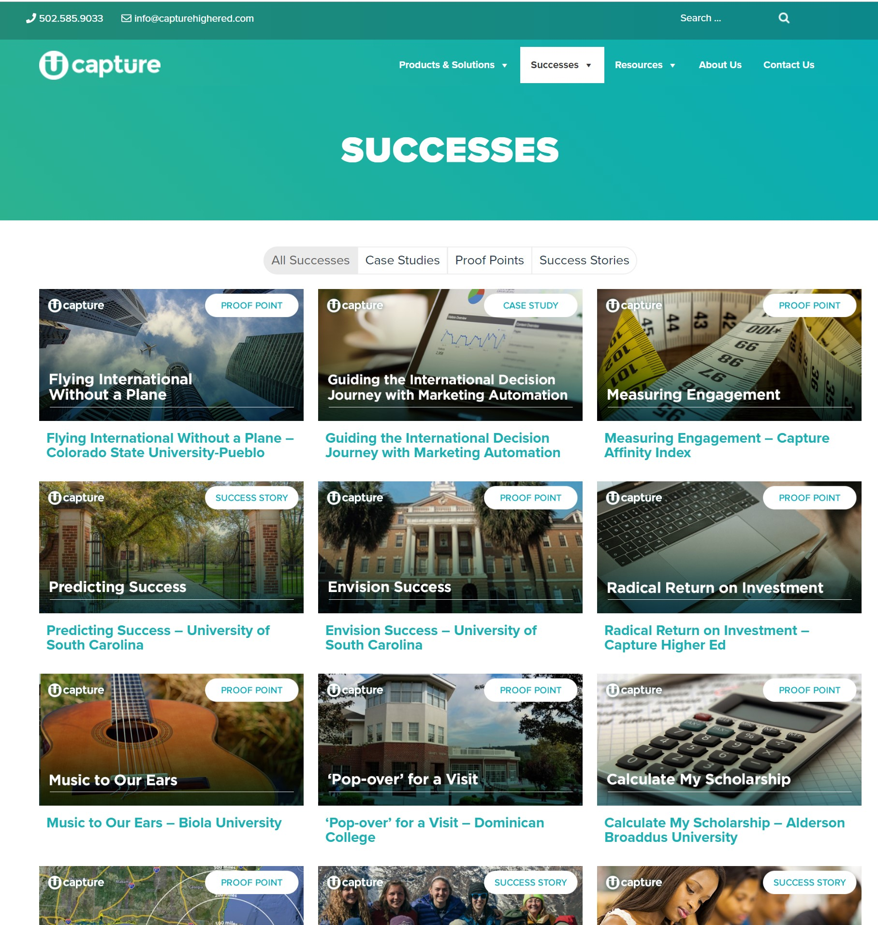
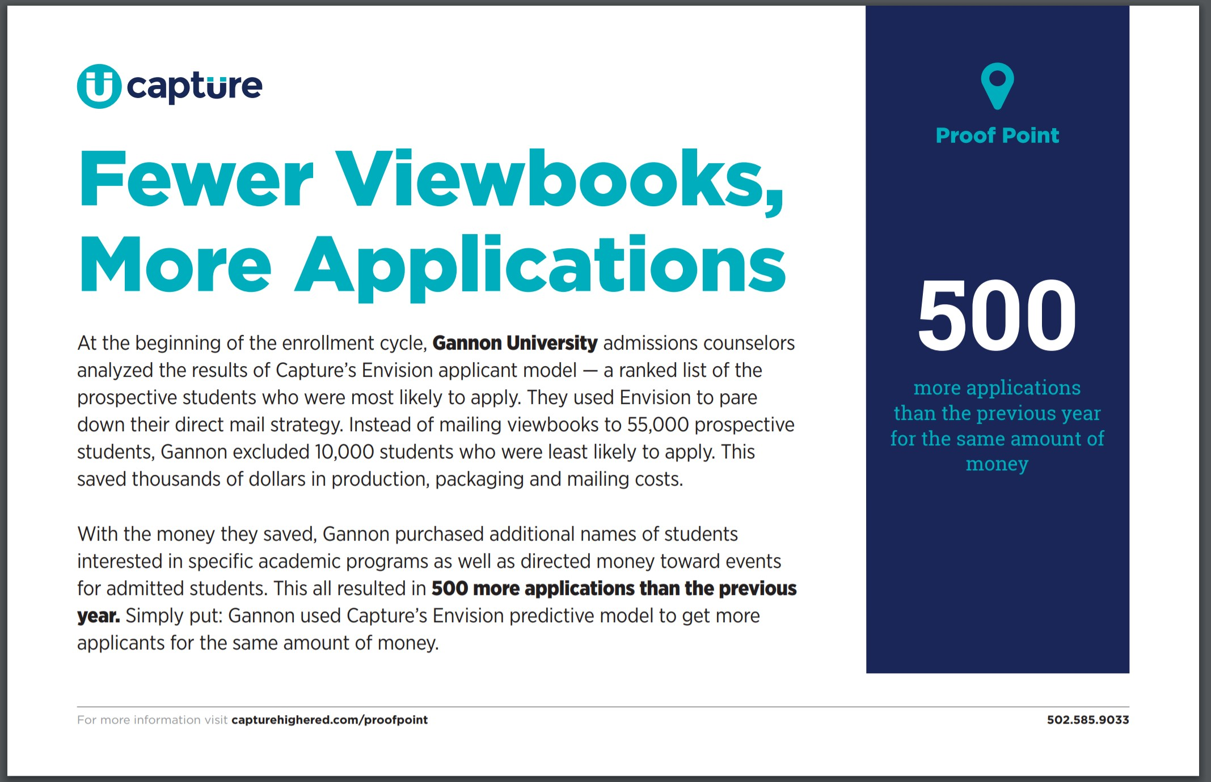
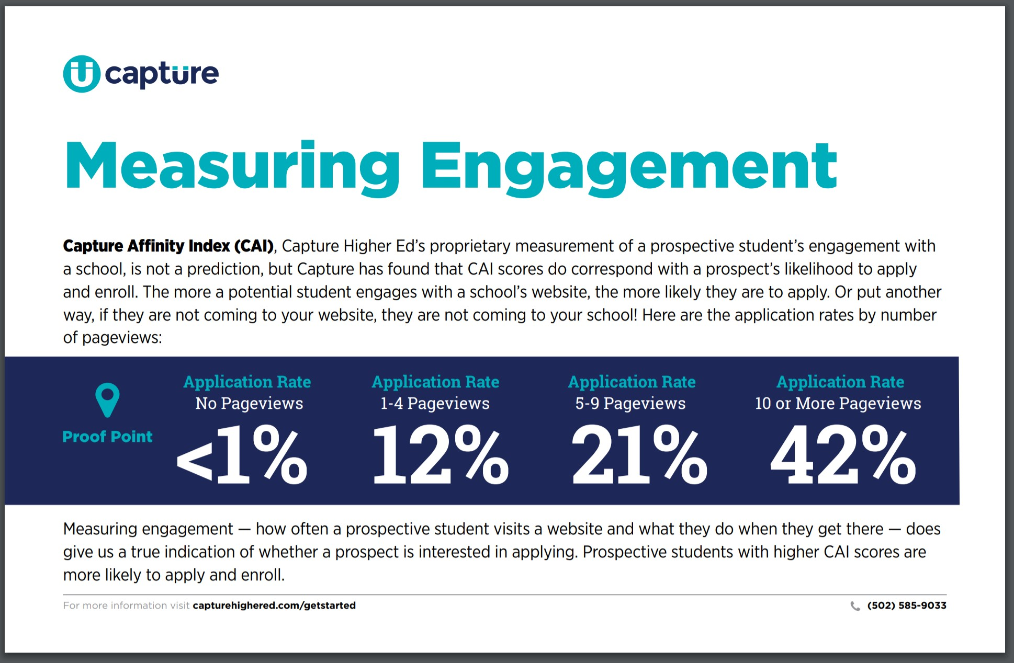
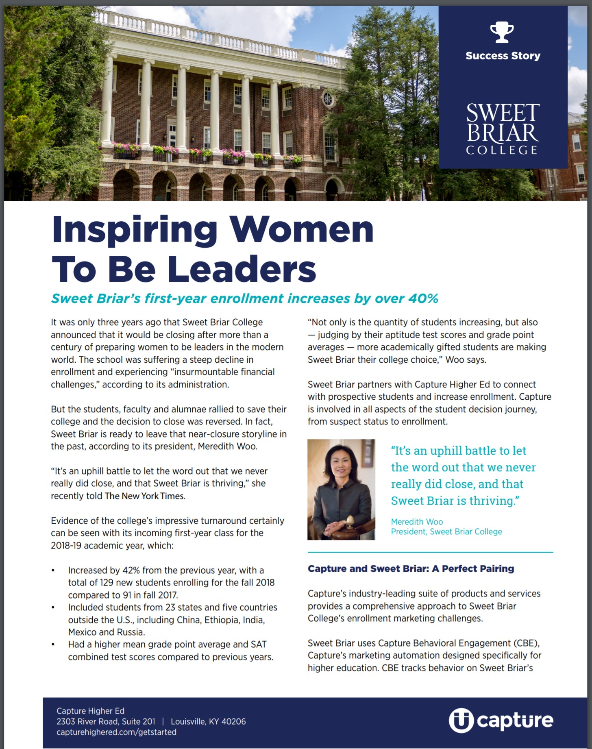
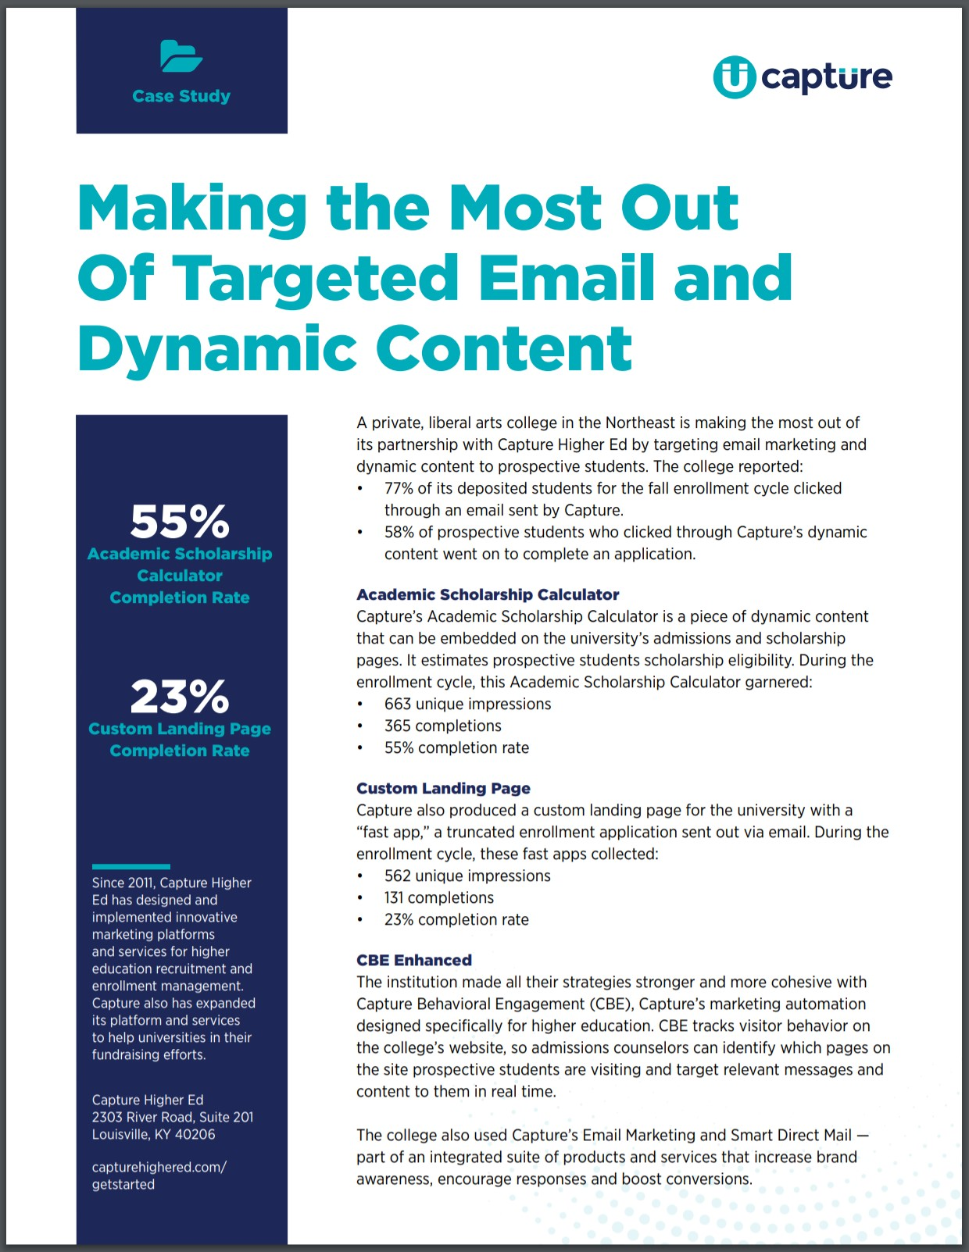
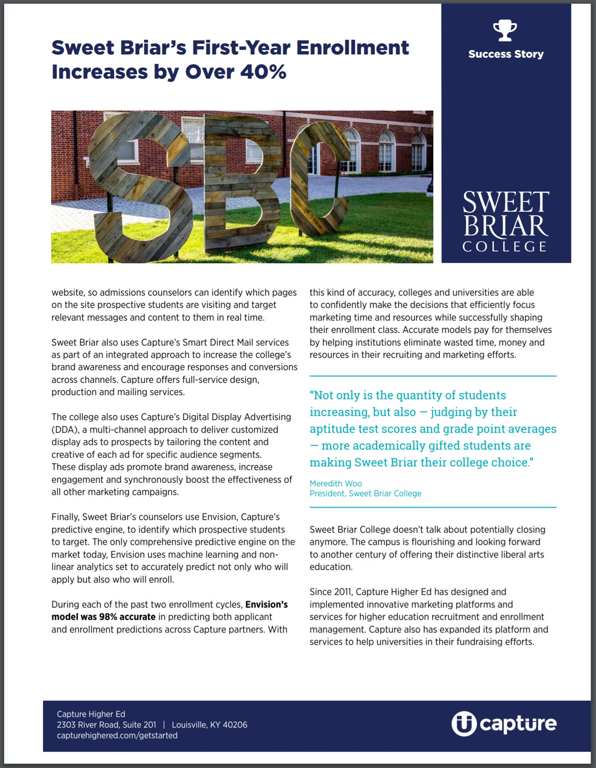
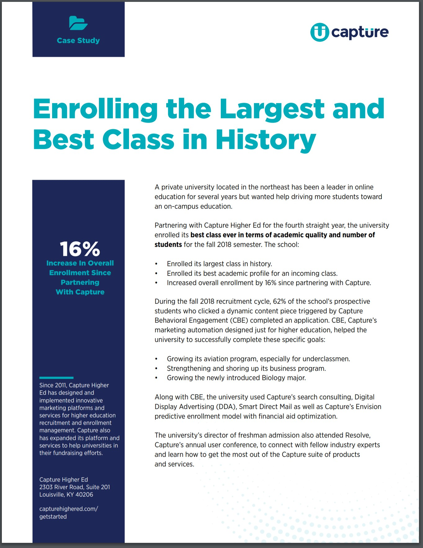
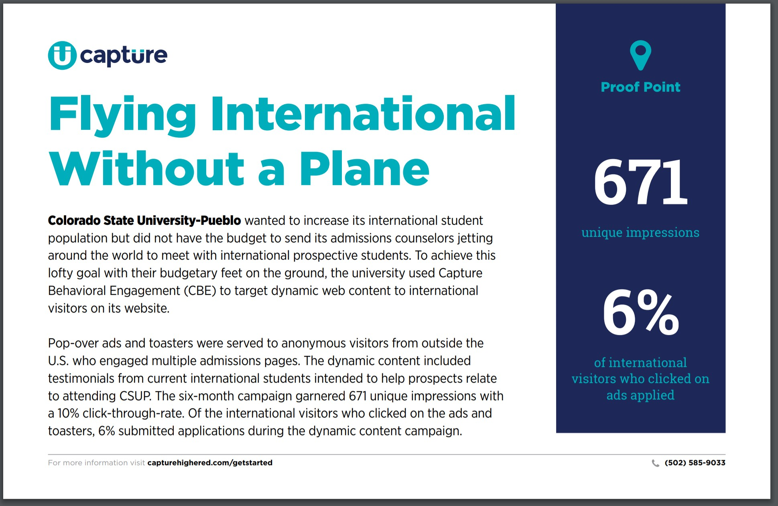
Partner Successes | capturehighered.com/successes
Proof Points
Success Stories
Case Studies

Slide 18
The Evolution of Enrollment Management Marketing
Thank you! Questions?
Where Technology and Tradition Meet
Geoff Broome
Senior Enrollment Solutions Consultant
Capture Higher Ed

