Slide 1
Looking at ELL Dropouts
2018 Overview

Slide 2
Dropout Rate
5,408 of the 291,139 students enrolled in 9-12 dropped out in 2017-18
1,496 of 19,680 EL students enrolled in 9-12 dropped out in 2017-18

Slide 3
ELL 4 Year Graduation Rate
1496 EL students in Massachusetts public high schools dropped out in 2017-18
These numbers are also reflected in a low graduation rate historically compared to all other subgroups

Slide 4
ELL 4 Year Graduation Rate
There is also great variability in racial ethnic EL populations
Hispanic EL’s are 57% of the high school EL population

Slide 5
ELL 5 Year Graduation Rate
Often EL’s need more time to acquire academic English proficiency and content area skills and are better captured in a five year graduation rate

Slide 6
ELL 5 Year Graduation Rate

Slide 7
Changing High School Enrollments
While overall high school enrollment rates are level and even dropping over the past couple years the percentage and number of EL students is increasing

Slide 8
Who are the 1,496 English Learner Dropouts?
EL Dropouts by Race/Ethnicity
When do EL’s Drop out
English Learner Students dropout at slightly higher percentage at 9th grade but it is fairly even
The large majority (78%) of English learner dropouts are Latino.

Slide 9
Who are the 1,496 English Learner Dropouts?
Poverty is common among EL Dropouts
EL boys dropout
at higher rates
A little over half of EL dropouts are coded as economically disadvantaged, the number reported is likely low due to the nature of the “econ dis” indicator and immigration status
Nearly two thirds of English learner dropouts are male

Slide 10
EL Student Population (and dropouts) are concentrated in relatively few districts
1,074 or 72% of English learner dropouts attended high school in ten districts
Boston
Lynn
Lawrence
Brockton
Springfield
Worcester
Chelsea
Phoenix Charter Academy (District)
Waltham
Everett
1,298 or 87% of EL dropouts attended high school in 25 districts
Malden
Lowell
Holyoke
Fall River
Phoenix Academy Public Charter High School Springfield (District)
Revere
Milford
Somerville
New Bedford
Woburn
Peabody
Southbridge
Weymouth
Fitchburg
Framingham
23 school districts had 10 or more English Learner dropouts

Slide 11
Signs of things to come: Chronic Absenteeism
Over a third of English learner students miss 10% of school or more

Slide 12
Signs of things to come: Academic Preparation
Only a quarter of EL students scored proficient or higher on the 10th grade MCAS (used here as a proxy for being “on grade level”

Slide 13
Signs of things to Come: 9th grade passing all courses
Only a little over half of EL’s pass all their ninth grade coursework
Our EWIS research shows that students passing all of their ninth grade courses are 14 times more likely to graduate on time.

Slide 14
English Learner Suspension Rates
EL suspensions are declining but remain higher than the state average

Slide 15
9th to 10th Grade Promotion
About a quarter of EL’s repeat ninth grade

Slide 16
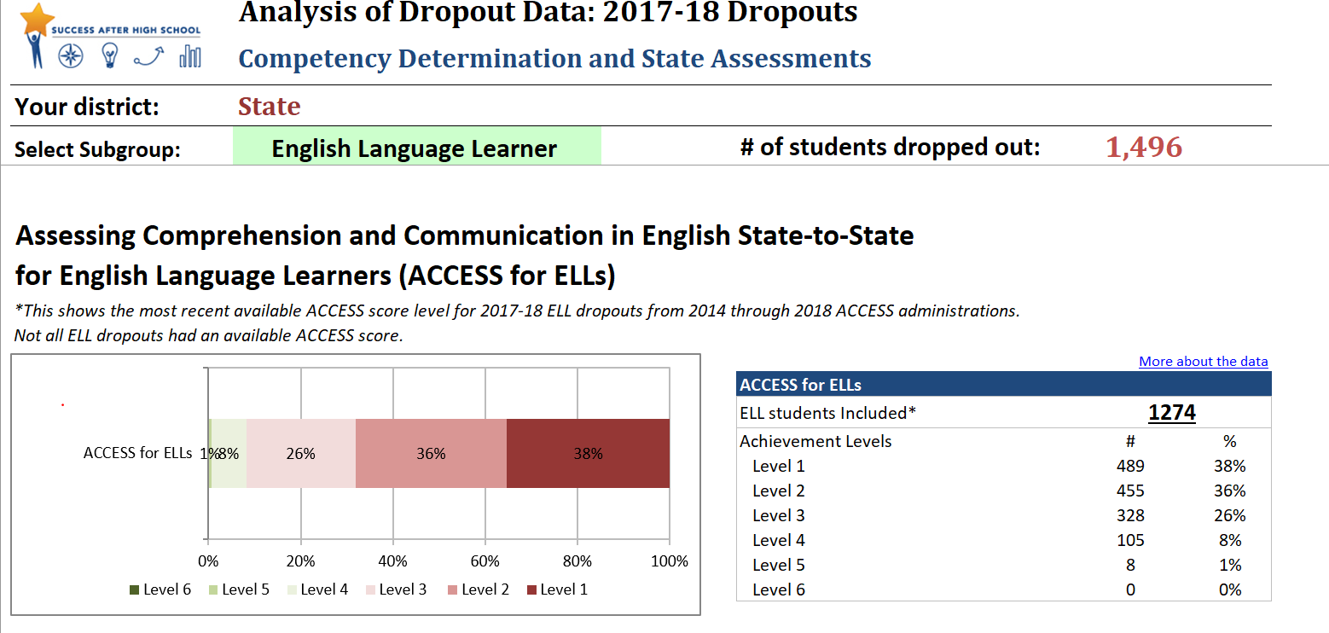
English Language Acquisition
http://www.doe.mass.edu/ccr/ewi/tool.xlsx

Slide 17
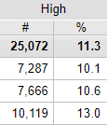
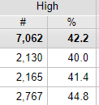
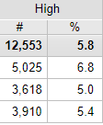
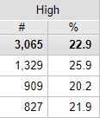
Signs of things to Come: Early Warning Indicators
Being at high risk denotes a low chance of reaching the outcome without intervention
Grades 7-9 | High school ready Passing grades on all 9th grade courses
Grades 10-12 | High school graduation Meeting all local and state graduation requirements
All | EL
All | EL

Slide 18
Using EWIS in Dropout Prevention
EWIS Risk Levels are …
the likelihood of missing an academic milestone – without interventions
calculated for each student
based on prior year data from statewide collections
transitional – reflecting the beginning of each school year
Taken together, the data collectively form a risk Level.
High Risk | At Risk for not reaching the upcoming academic milestone ~25% of students at high risk meet the academic milestone
Moderate Risk | Moderately at risk for not reaching the upcoming academic milestone ~60% of students at moderate risk meet the academic milestone
Low Risk | Likely to reach the upcoming academic milestone ~90% of students at low risk meet the academic milestone
Notes:
[1 min]
Based on these data, we assign students to a risk level – high, moderate or low
High risk students are AT RISK
only 25% may meet it
75% won’t meet it
Moderate – 60% may meet it
40% won’t
Low – most meet this – 10% won’t
For example –
One ac milestone = passing all grade 9 courses –> we know that students who do not pass grade 9 courses have x likelihood of not graduating form high school

Slide 19
EWIS Milestones
State Results
60% MCAS 54% PARCC 2015
55% MCAS x PARCC 2015 71% ELA, 62% math
79% 2016
87.5% 4 yr 2016
69% of HS grads 2015
67% of college goers 2014
88% of college goers 2014
Model | Grade Level Groupings | Academic Milestones | State Outcomes | Where?
K-12 Milestones | Grades 1-3 | Reading by the end of third grade Reaching proficiency or higher on 3rd grade ELA State Assessment | 60% MCAS 2015 | Profiles
 | Grades 4-6 | Middle school ready Reaching proficiency or higher on 6th grade ELA and math State Assessments | 55% MCAS 2015 | Profiles
 | Grades 7-9 | High school ready Passing grades on all 9th grade courses | 79% | Success after HS DART
 | Grades 10-12 | High school graduation Meeting all local and state graduation requirements | 87.5% | Profiles
Postsecondary Milestones |  | College Enrollment Enrolling in postsecondary education | 69% of HS grads | Success after HS DART & EDWIN
 |  | Academic Readiness Enrolling in credit-bearing courses without developmental education | 67% of college goers
 |  | College Persistence Persisting in second year of postsecondary education | 88% of college goers
Notes:
Give summary below → then refer to #s on tables – outcomes
Maybe one that you feel is most pressing / feel responsible for → flag/star that one and use it throughout the day
Now what are the ‘academic milestones’?
Let me give you time to take this in. Lots here.
For early elementary …. Late elem … middle school moving into 9th grade … and HS.
and we also know that these early milestones are steps on a path to HS graduation.
we call this the K-12 Model.
they build on each other – and they’re also meaningful & actionable across grades
for example, if we tell a 2nd grade teacher that a student is not on track for HS grad – doesn’t feel meaningful; but if we say they’re not on track for reading by end of 3rd grade – does
And new this year,
We also have a postsecondary model, for grades 10-12.
this model generates risk levels for students at risk of 3 college success milestones
Why are these important? [animate]
we’re just not where we want to be as a state, for these milestones
For our postsecondary model → these may be students NOT at risk of HS grad; these kids are in good shape for graduating.
BUT they may be at risk of not enrolling in college, or not being academically ready for college.
So our postsecondary model opens up a NEW way of looking at our students and their needs – through the POSTSECONDARY lens
Find these: first 3 – profiles; next – SAHS DART

Slide 20
The Student List (EW601) show details for individual students
Student ID info
Student info
Indicators in the risk model
School Name | Grade | Last Name | First Name | SASID | Risk Level | Attend Rate | Suspension | Retained | School Move | Low Income | SPED Level | Gender | Urban Residence | Overage | Title1 Schoolwide | ACCESS for ELLs | ELA MCAS 2014 | Math MCAS 2014 | Math Course Perf | ELA Course Perf | Sci Course Perf | SS Course Perf | Non-Core Course Perf | Previous Year Risk Level | Race/Ethnicity | ELL | ELL Program | Special Education Placement
Any High School | 9 | Aardvark | Arnold |  | High | 98% | 0 | No | No | Free | None | Female | Yes | No | Yes | 1.8 | - | - | Pass | Pass | Pass | Pass | Pass | N/A | Hispanic or Latino | Y | Enrolled in sheltered English immersion | Not a Special Education Student, age 6-21
Any High School | 9 | Bailey | Billy |  | High | 90% | 0 | No | No | Free | Moderate | Female | Yes | Yes | Yes | None | Needs Improvement | Warning | Pass | Pass | Fail | Fail | Fail | High | White | N | N/A | Full Inclusion special education services outside the general education classroom less than 21% of the time
Any High School | 9 | Colorado | Carlos |  | High | 88% | 0 | No | No | Reduced | None | Female | Yes | No | Yes | 2.6 | - | - | Pass | Pass | Pass | Pass | Pass | N/A | White | Y | Enrolled in sheltered English immersion | Not a Special Education Student, age 6-21
Any High School | 9 | Denton | Daisy |  | High | 99% | 0 | No | No | Free | None | Male | Yes | Yes | Yes | None | Proficient | Needs Improvement | Pass | Pass | Fail | Pass | Fail | High | Hispanic or Latino | N | N/A | Not a Special Education Student, age 6-21
Any High School | 9 | Everett | Elena |  | High | 74% | 0 | No | Yes | Free | None | Female | Yes | No | Yes | None | Needs Improvement | Warning | Pass | Pass | Pass | Pass | Fail | High | White | N | N/A | Not a Special Education Student, age 6-21

Slide 21
DISCUSSION
What are questions you have, what information do you have, what do you need
What are some causes of this specific issue in your school or district
What are some possible interventions you may use
How will you know if they worked?
Do you have all the right people in the room to have this discussion?

Slide 22
FOCUS TOPICS For Dropout Prevention
Attendance
Behavior/Suspensions
MCAS Competency Determination Requirements
English Language Acquisiton
Course Performance/Credit Accumulation
9th grade performance
And overall, school climate/ecology and student engagement/belonging

Slide 23
Thank You!
Nyal Fuentes nfuentes@doe.mass.edu
http://www.doe.mass.edu/ccr/

