Slide 1
Say What??
Boosting Academic Talk in the Classroom
Kait Remick Zanzerkia Molly Ross
EL Teacher SEI Instructional Coach
Randolph Public Schools

Slide 2
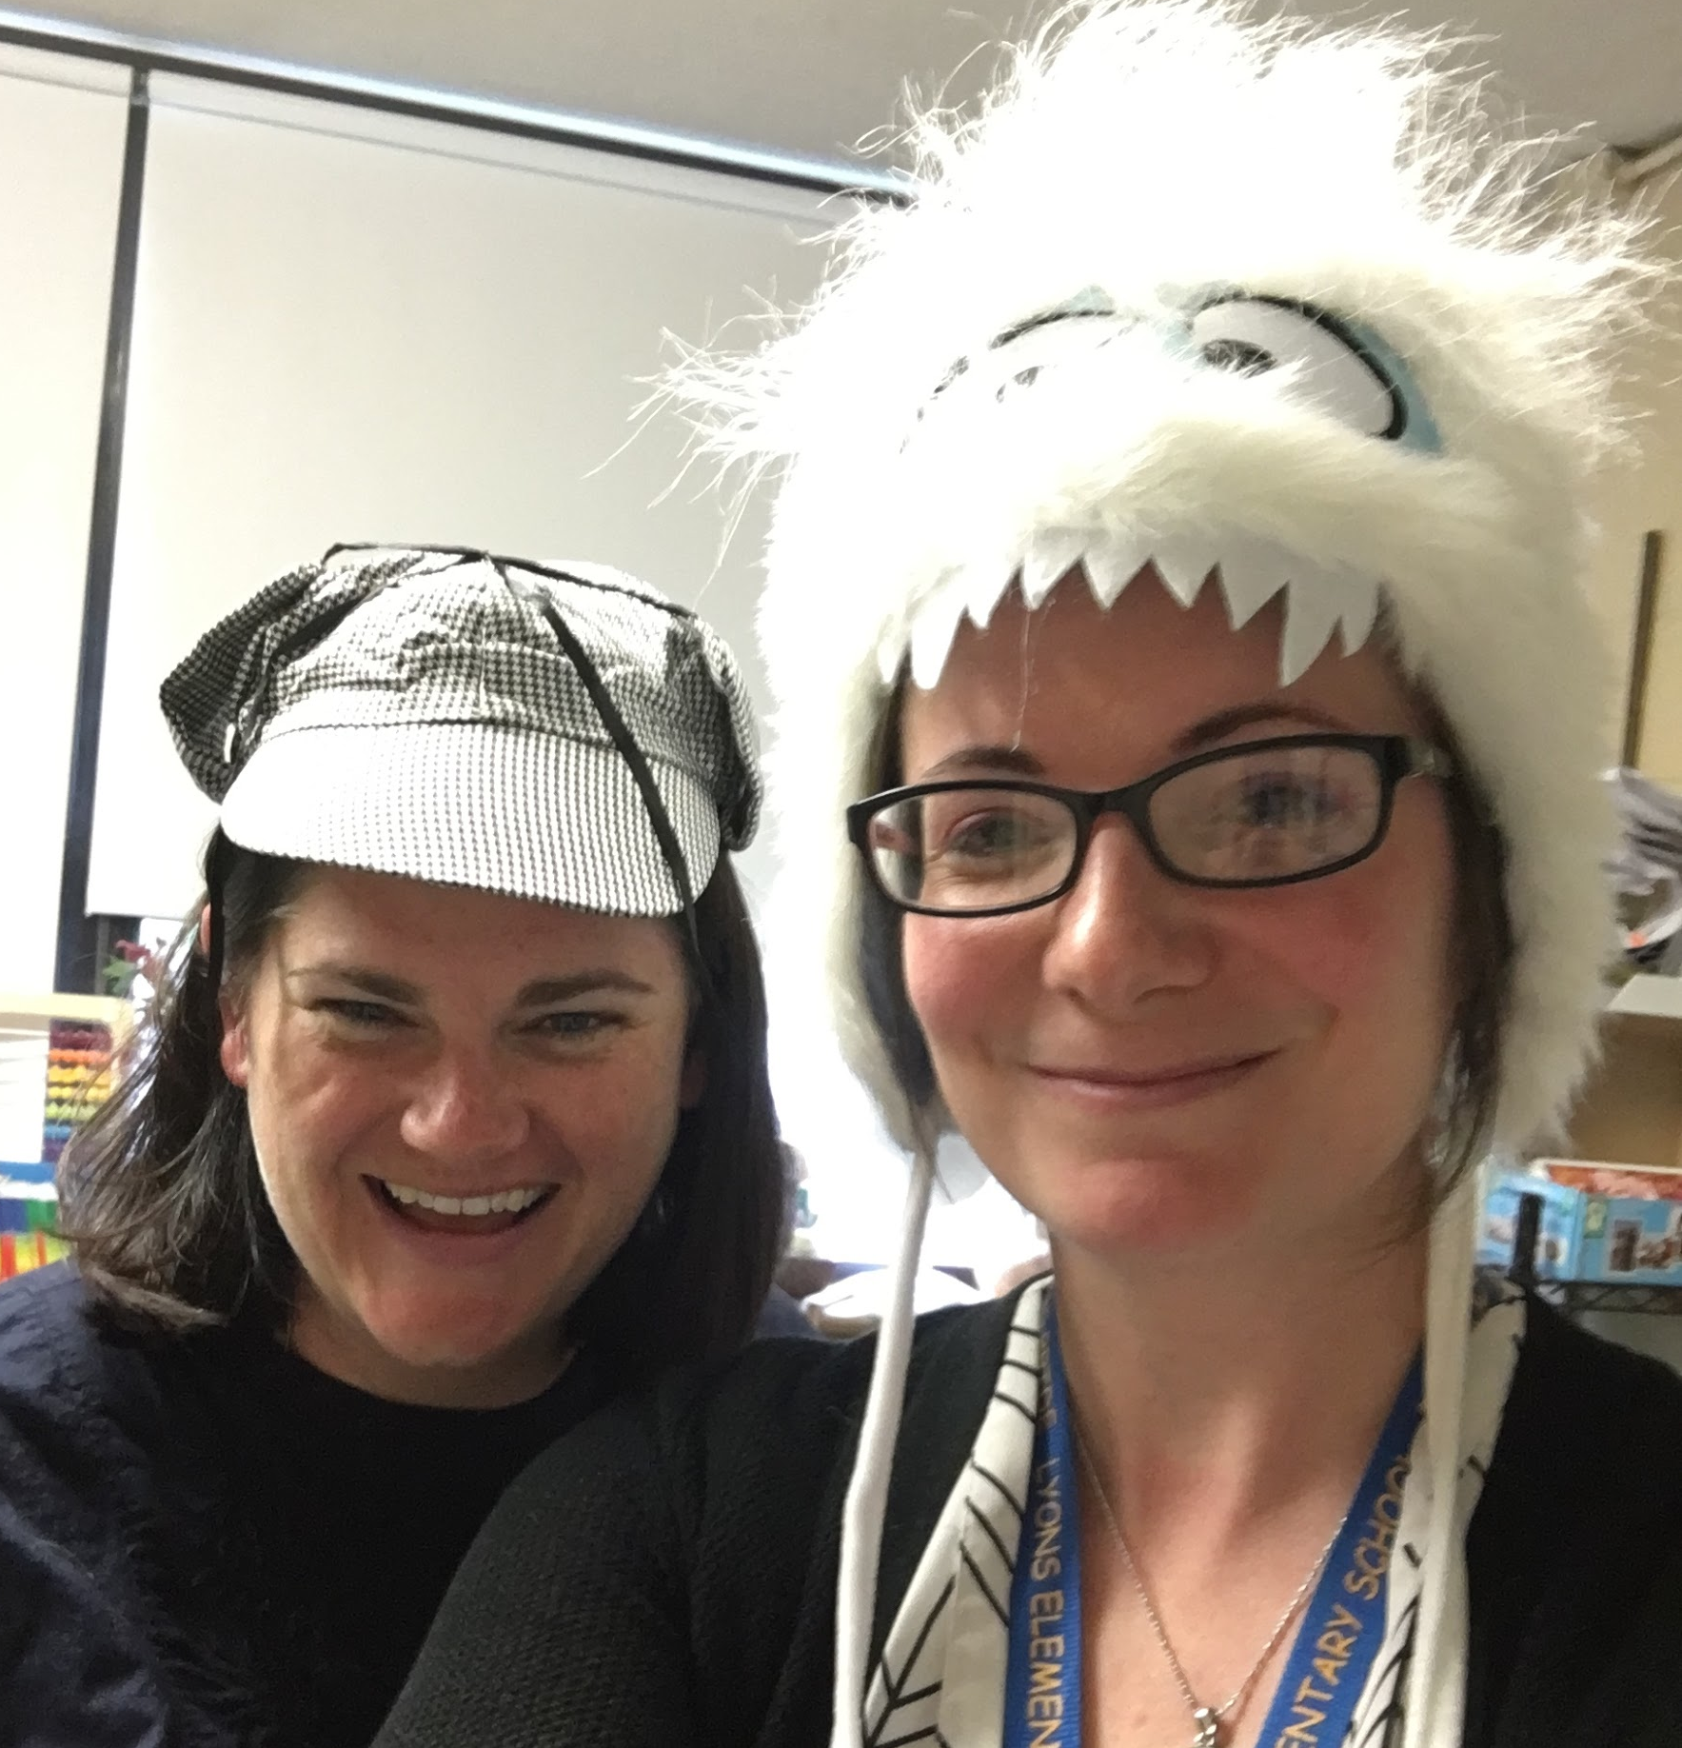
Who are We? (Our Story)
Molly Ross
  SEI Instructional Coach - Randolph, since 2018
  EL teacher - Malden and Rockland, since 2010
  Adjunct Lecturer - BU
  Wearer of many hats: Educator, Therapist, Potter
Kait Remick Zanzerkia
  EL Teacher - Randolph Public Schools since 2013
  EL field since 2007
  Recent grad of BSU with a Masters in TESOL
  Also a Wearer of Many Hats: Scholar, Teacher, ELD Consultant, Miracle Worker
Notes:
Highlighted consultant because often times I find myself being asked by other teachers how they can better support the learners in their classrooms.
In our district - we had several PDs around incorporating more discourse opportunities in our classroom
Observed - Turn and Talk and cooperative learning opportunities present

Slide 3
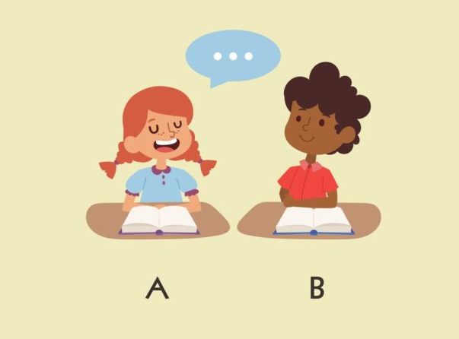
The Problem: Scenario 1
…?
Image retrieved from https://www.continentalpress.com/blog/using-turn-and-talk-encourage-ells/
Notes:
One student does all the talking.
One student is an extrovert and one is an introvert.
One student is lower in English proficiency and may know what they want to say but not how to say it.
Ways around this - students can take teacher-directed turns or accountability checks such as asking students to tell one great idea their partner said - but how to help ELs (and all students) engage in discussion?

Slide 4

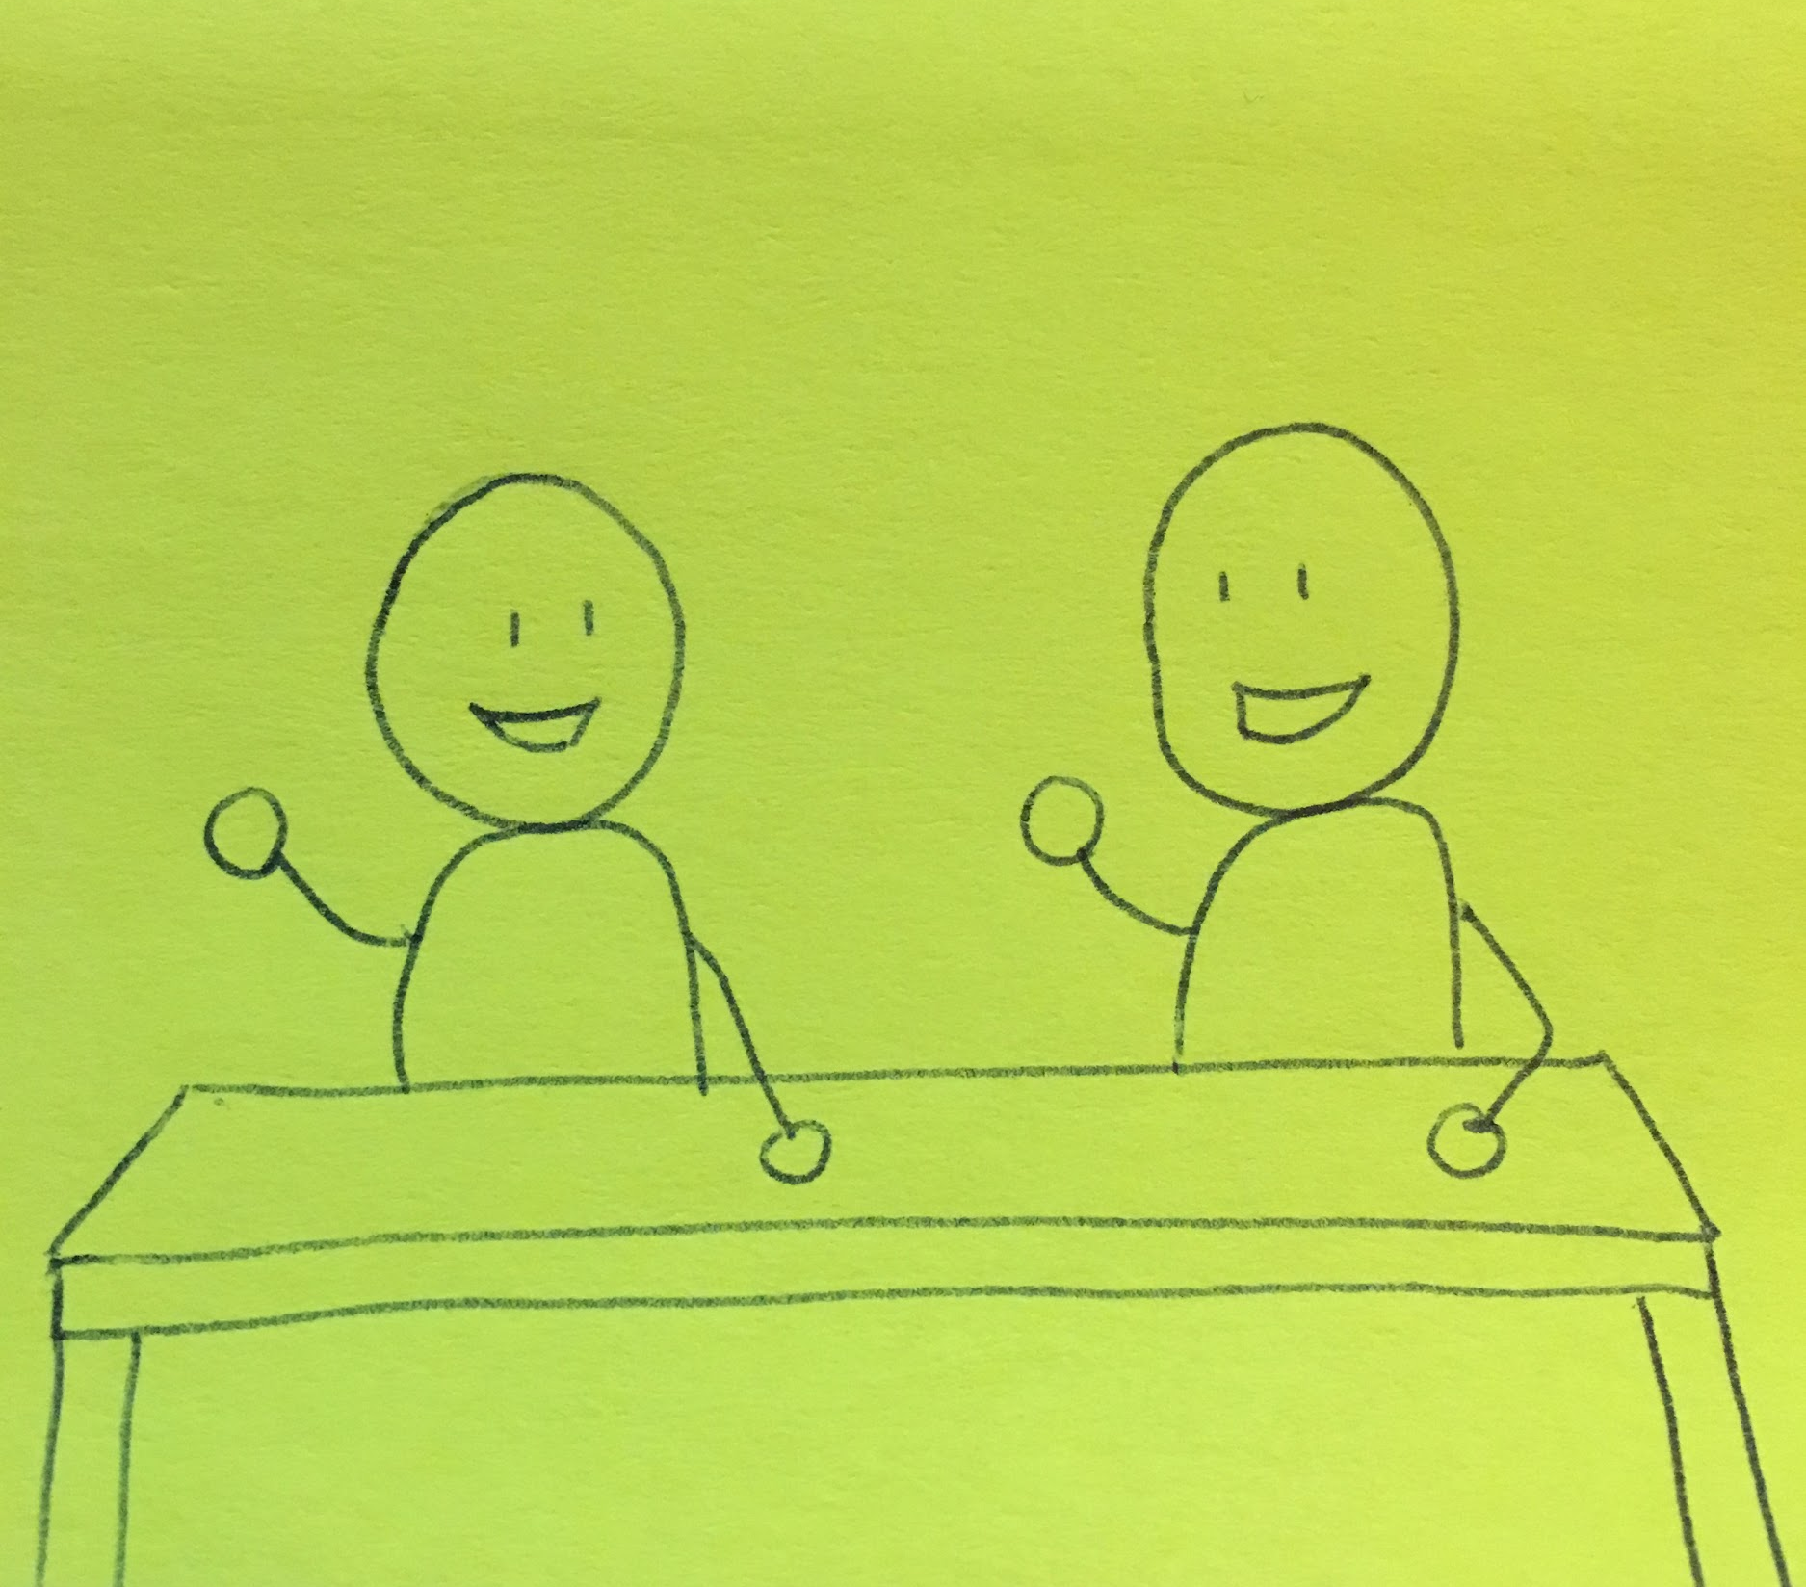



The Problem: Scenario 2
Notes:
Students are engaged in talking - but are mostly using social language (or are entirely off topic)
Discovered that teachers were doing an excellent job creating opportunities for student talk - but weren’t as confident in structuring the language of those opportunities so that students were consistently practicing academic talk.
Decided to create this workshop first as a district PD with a focus on providing practical strategies that would help teachers structure the language use in their classroom.

Slide 5
The Question
How do we structure student-talk opportunities so that all students are engaged in using academic language?

Slide 6
Agenda
Academic Language Functions and Forms 101
The Strategies:
  Sentence Starters and Language Frames
  Visual Word Banks and Checklists
  Using Digital Tools
  Ask/Answer/Add: Academic Conversations
Questions and Reflections

Slide 7
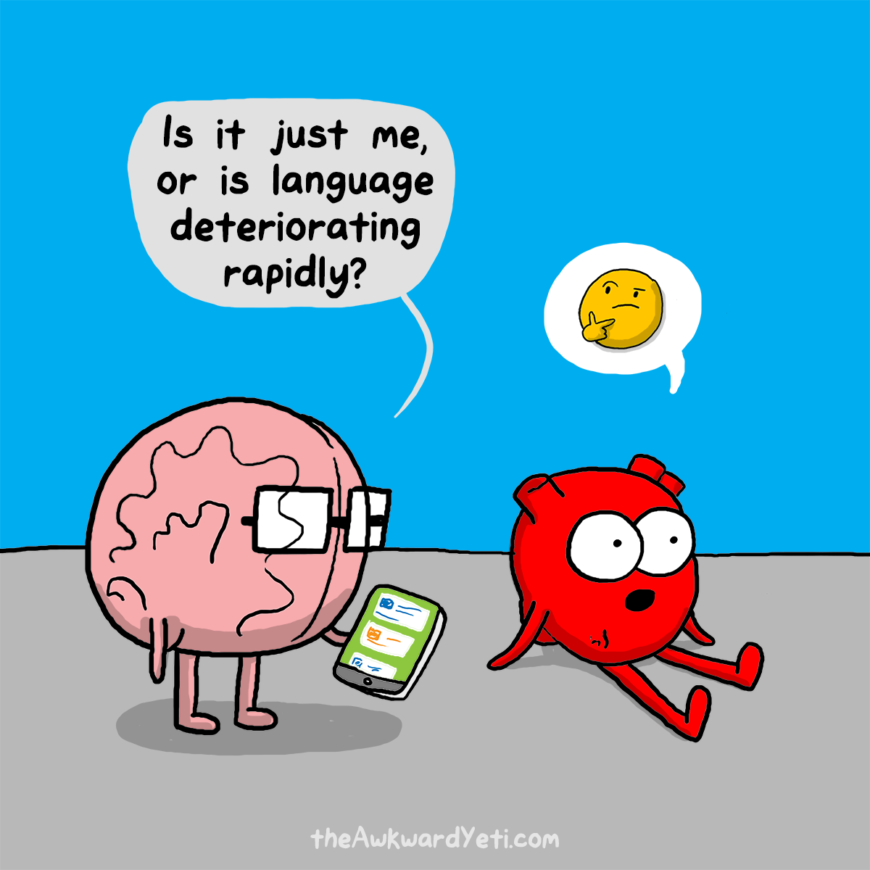
What is Academic Language Anyway?
“The set of words, grammar, and discourse strategies used to describe complex ideas, higher-order thinking processes, and abstract concepts,” (Zwiers, 2014, p. 22).
Language Function: refers to what students do with language as they engage with content and interact with others for a specific purpose.
Language Forms: deal with grammatical structures as well as academic vocabulary
Image retrieved from http://theawkwardyeti.com/comic/language-emoji/
Notes:
Building Academic Language
Jeff Zwiers - champion of academic language, defines it as…
When considering the strategies, we focused mainly on these two aspects of AL:
Function: Describe + Example: Asking students to compare and contrast
Form: Describe + Example: Using words like same/different, similar, in contrast.
This is where most of the strategies focus ** - considering what functions… thinking about what forms…. Planning ways to support student use of those forms.

Slide 8
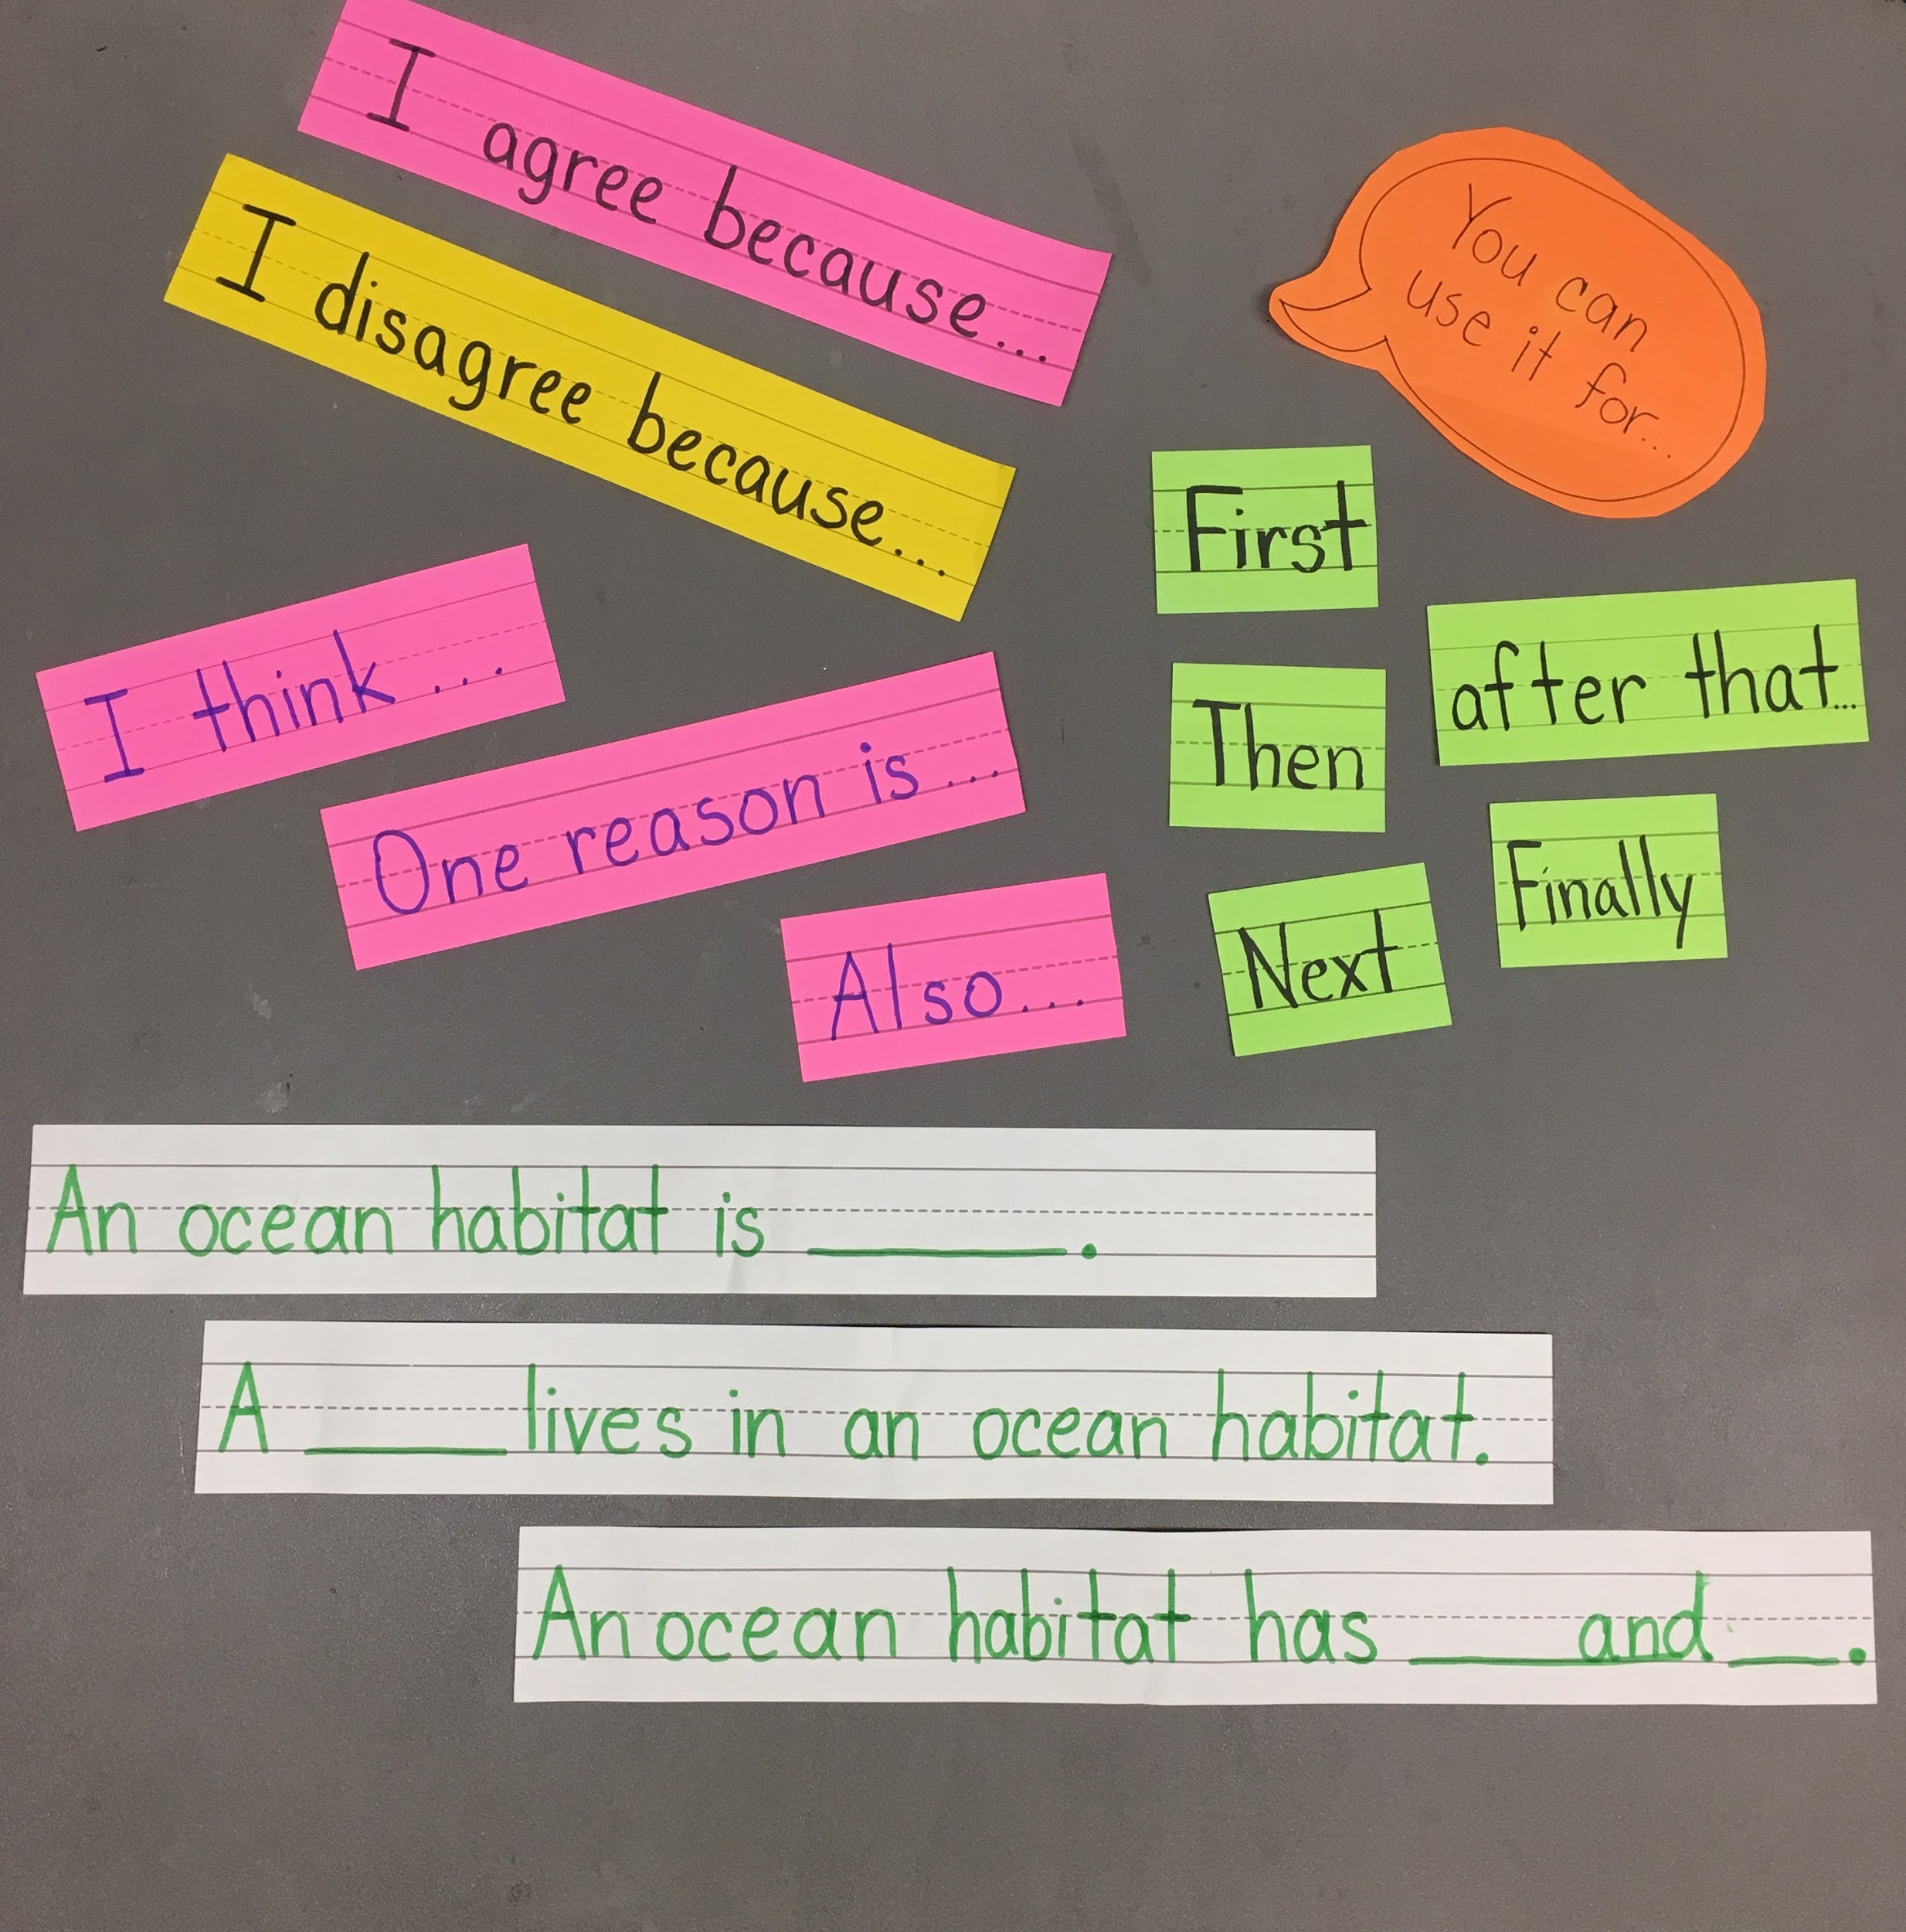
Sentence Starters and Language Frames
What are they?
Why are they helpful?
  Provide structure for academic phrases and sentences
Examples of Use:
  TTQA: Turn the Question Around
  Rephrasing
  Academic Phrase Word Wall
Compare/Contrast
They are the same because...
They are different because...
Cause/Effect
___ happened because ___
As a result,...
Notes:
Focus is on using academic structures and forms to help phrase their ideas.
TTQA (language cards in K - starting with social language, moving to academic with gotogethers) + Splat and Compare/Contrast (Math)
https://www.samebutdifferentmath.com/early-numeracy
Quick practice with oral sentence frame: repeat after me style (ttqa)
Or, more structured with a posted sentence frame and modeled practice.
Academic Talk phrases word bank on the wall - point to the sentence starter they should use
However you choose to do it the point is to provide students with the structure you want them to use and engage them in routine opportunities to practice it - orally. They will be better able to make the connections to writing later. (Point out handout)

Slide 9
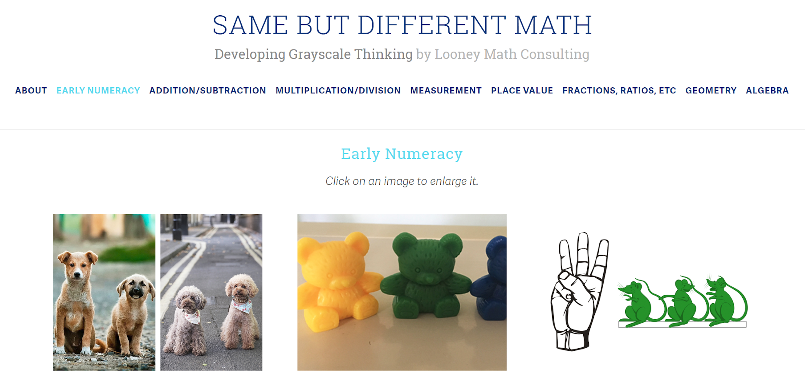
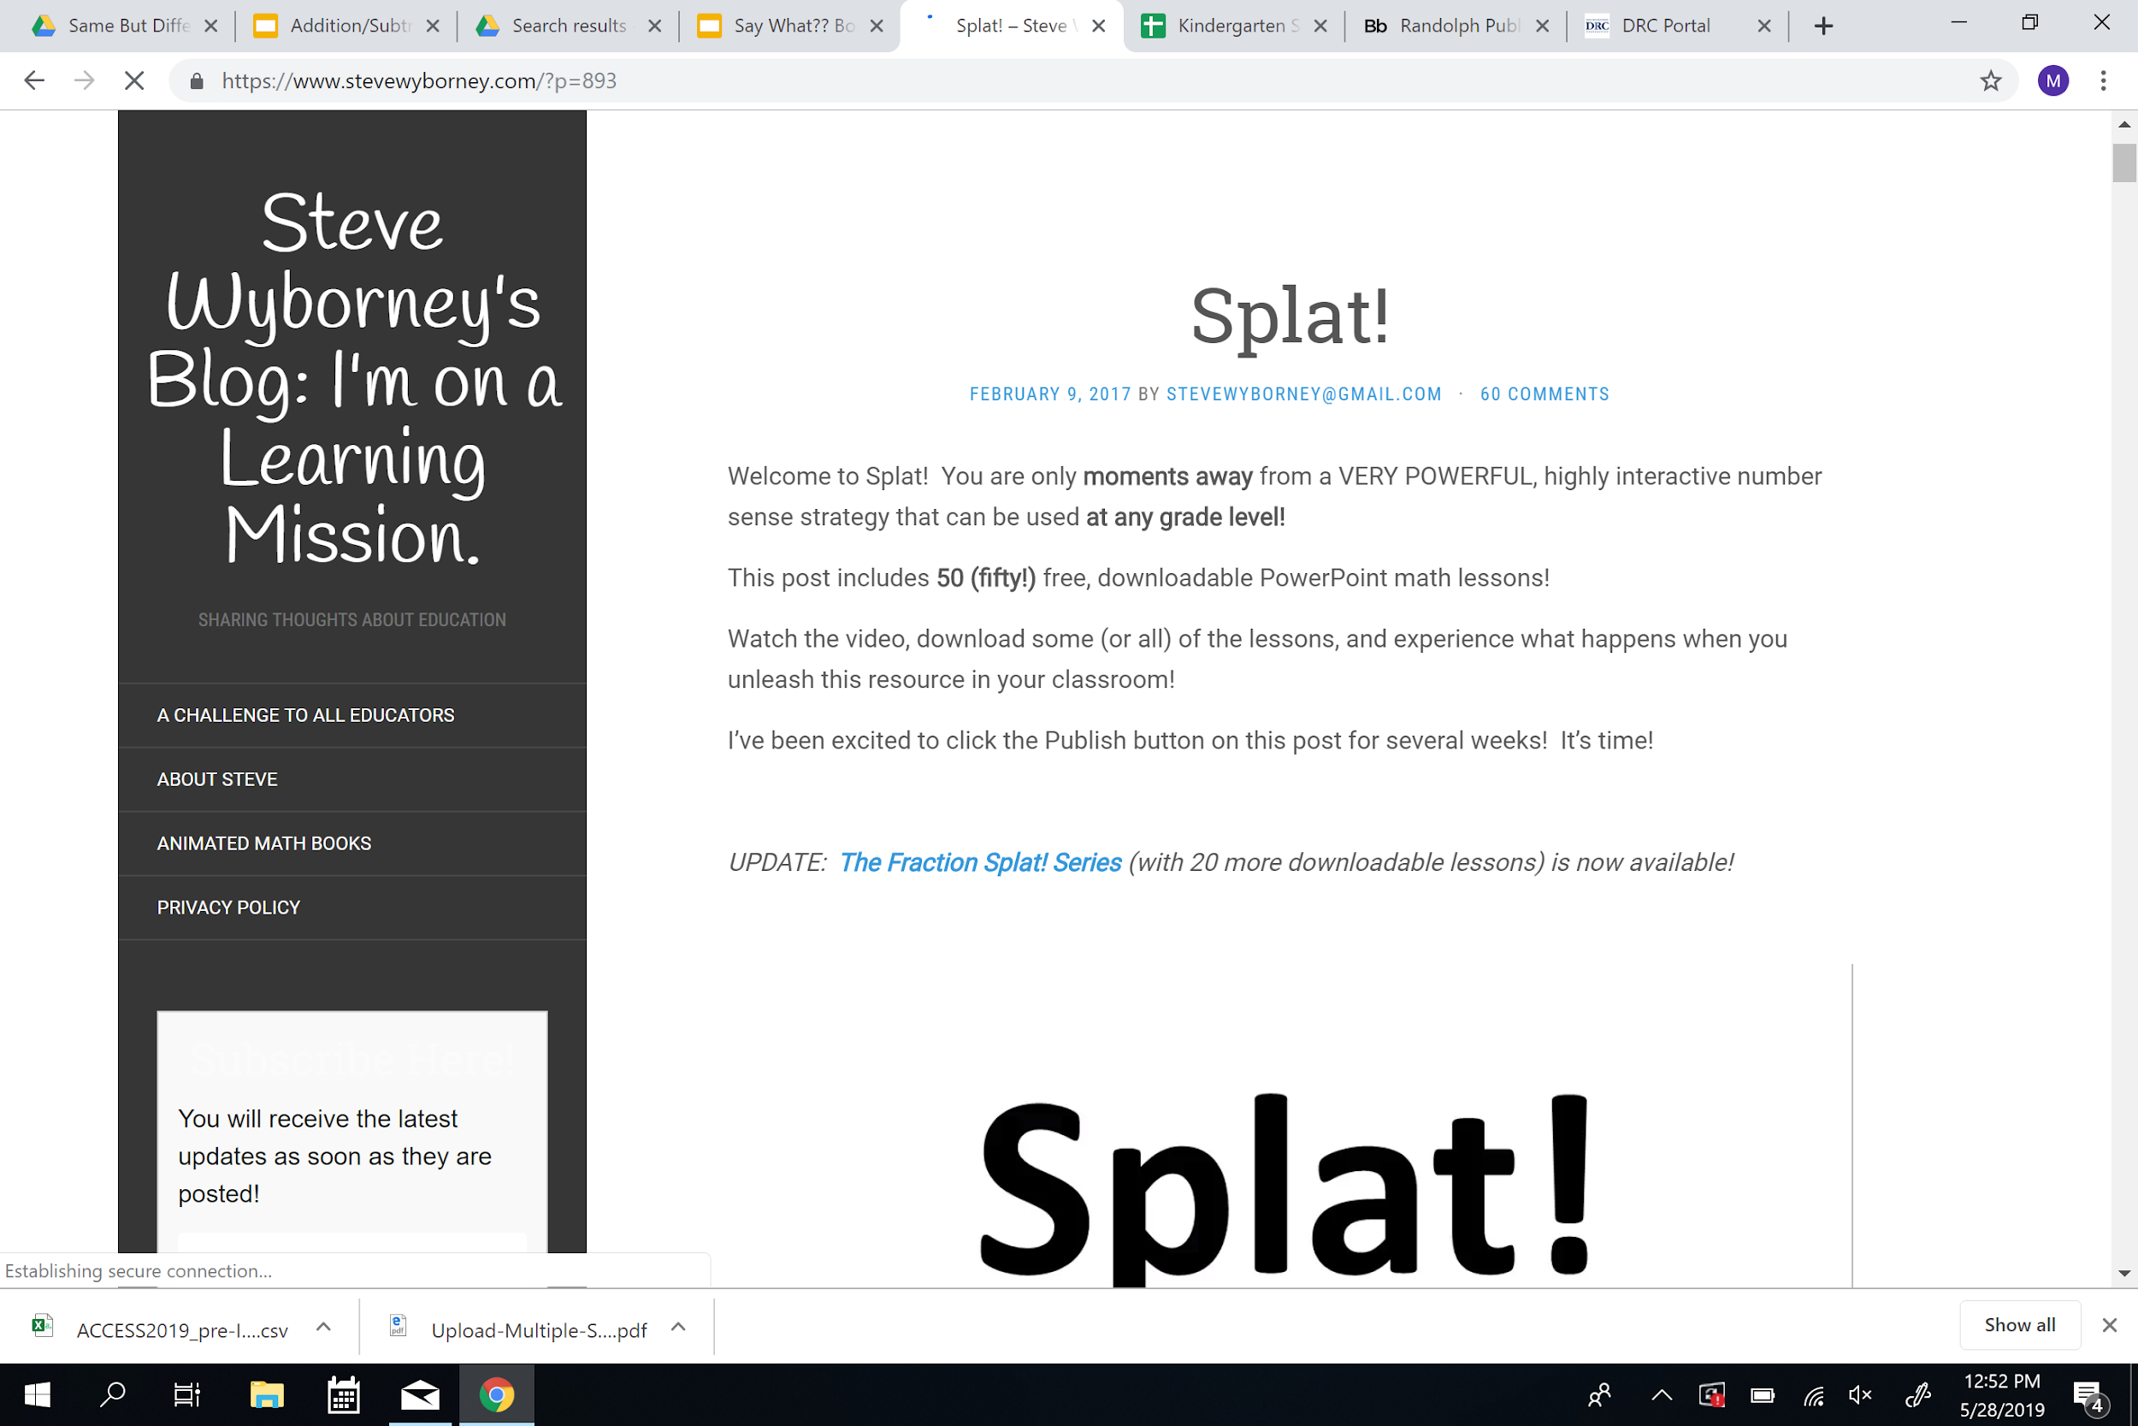
Sentence STarters: Math Discourse
https://www.samebutdifferentmath.com/early-numeracy
https://www.stevewyborney.com/?p=893

Slide 10
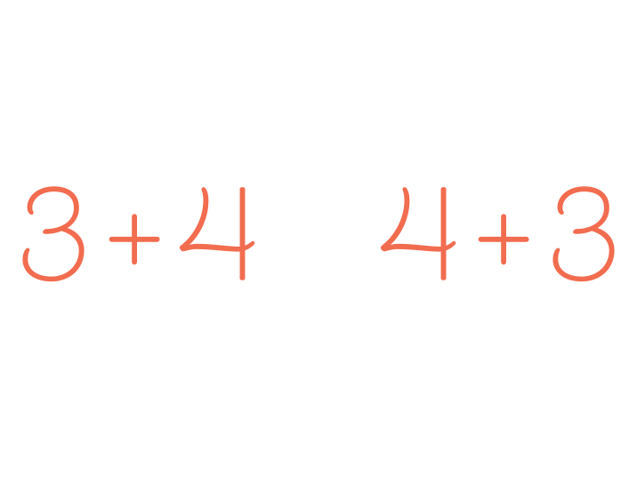
They both ______. The left is _____ but the right is ______.
They are the same because ____. They are different because ____.
left right

Slide 11
How many blue shapes do you see?
5
I see _____ shapes.
Splat!
There are ______ shapes under the splat.
I know because _____.
How many shapes are under the splat? How do you know?
How else could you know?
I also know ____.
Let’s look under the splat to see how many shapes are there.
What can we learn from this picture?
We can learn that ___.
www.stevewyborney.com
Steve Wyborney

Slide 12
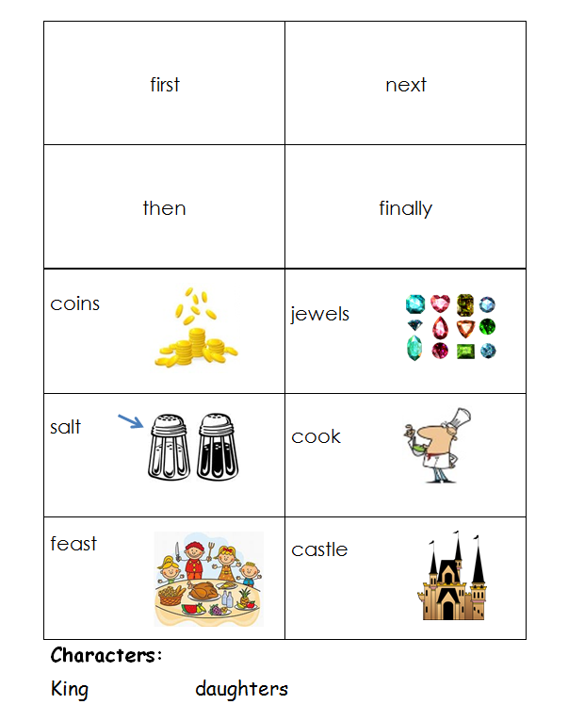
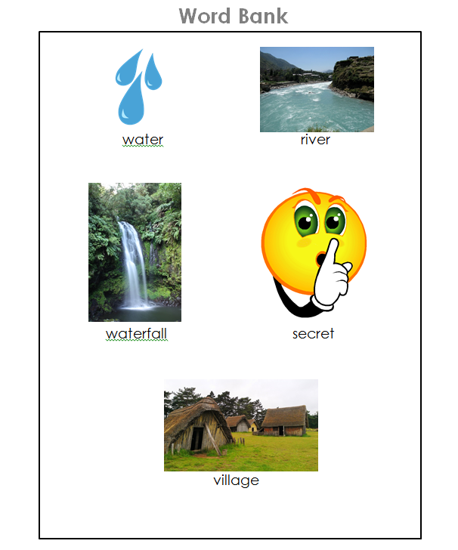
Word Banks and Checklists
What are they?
  A checklist of vocabulary words
Why are they helpful?
  Help students focus on using target vocabulary words
Examples of Use:
  Retell
  Math Chat
  Academic Vocabulary
Notes:
Focus on using academic/target vocabulary.
Retell Story Strips with visual vocab example (+ sentence starters)
Math chat (different versions with examples)
Various ways to add accountability

Slide 13
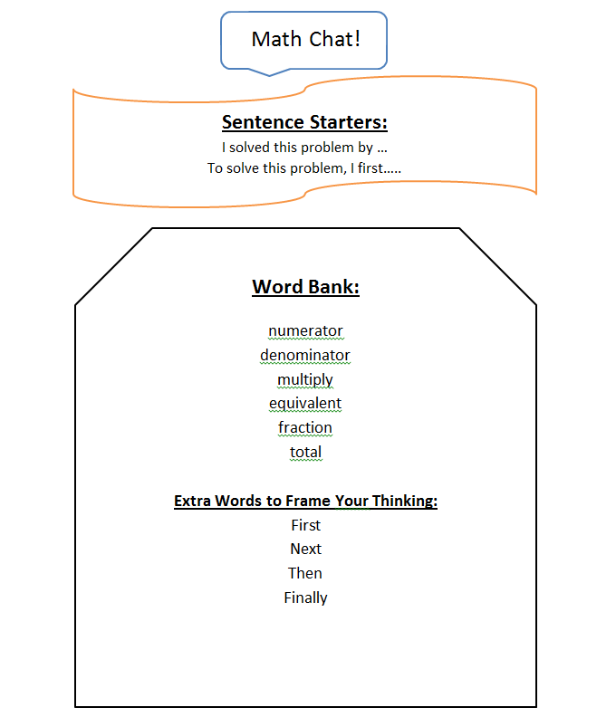
Word Banks and Checklists: Math Chat
Students describe how to solve a problem using the vocabulary in the word bank.
  Version 1: Partner listens and checks off the “points” they earn with each word correctly used.
  Version 2: Student must keep talking until they have used all of the vocabulary terms correctly.

Slide 14
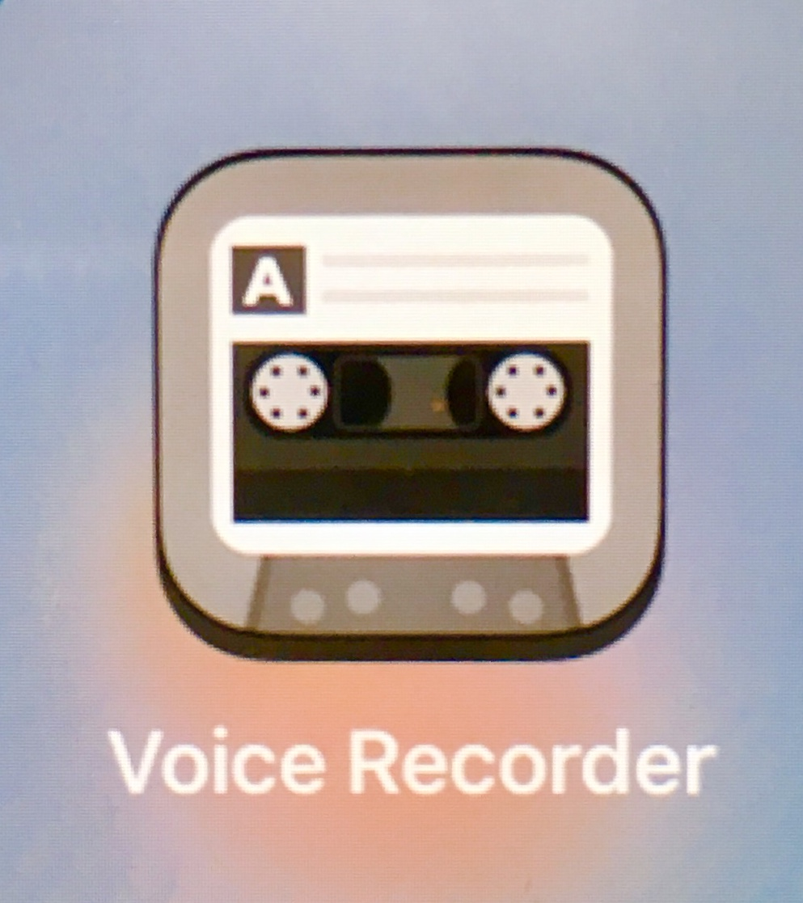
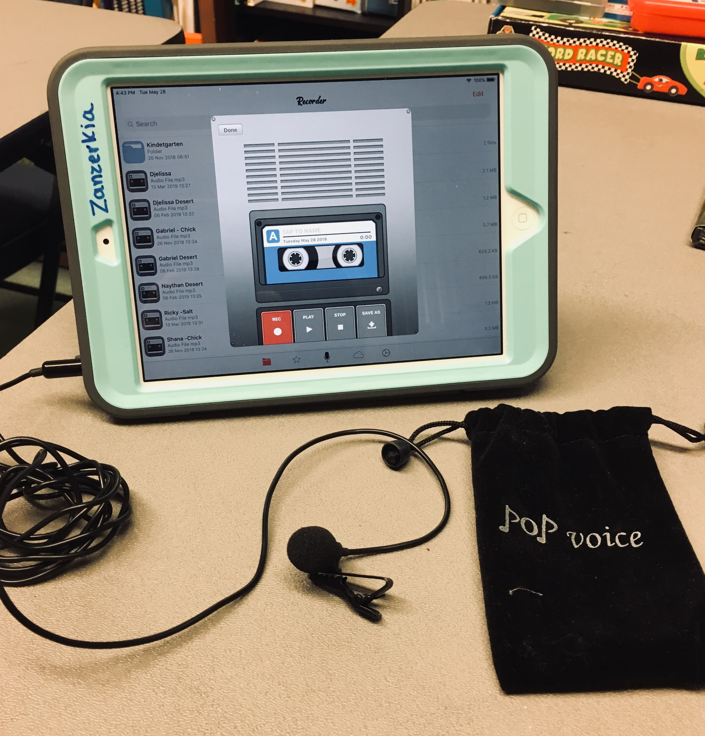
Digital Tools
What are they?
Why are they helpful?
  Helps students reflect on their own responses
  Formative Assessment
Examples of Use:
  Individual
    Student records a speaking response, listens to recording using a checklist, re-records to improve target area
  Partners
    Students take turns recording and helping partner to check work
Notes:
Focus on formative assessment
iPads with microphones (teaching in the caf!) - +ACCESS practice** (esp. First grade)
Using sentence starters and word banks - recorded for formative assessment
Retell example: Gabriel
Screencast with book talks and book reviews
FlipGrid?

Slide 15
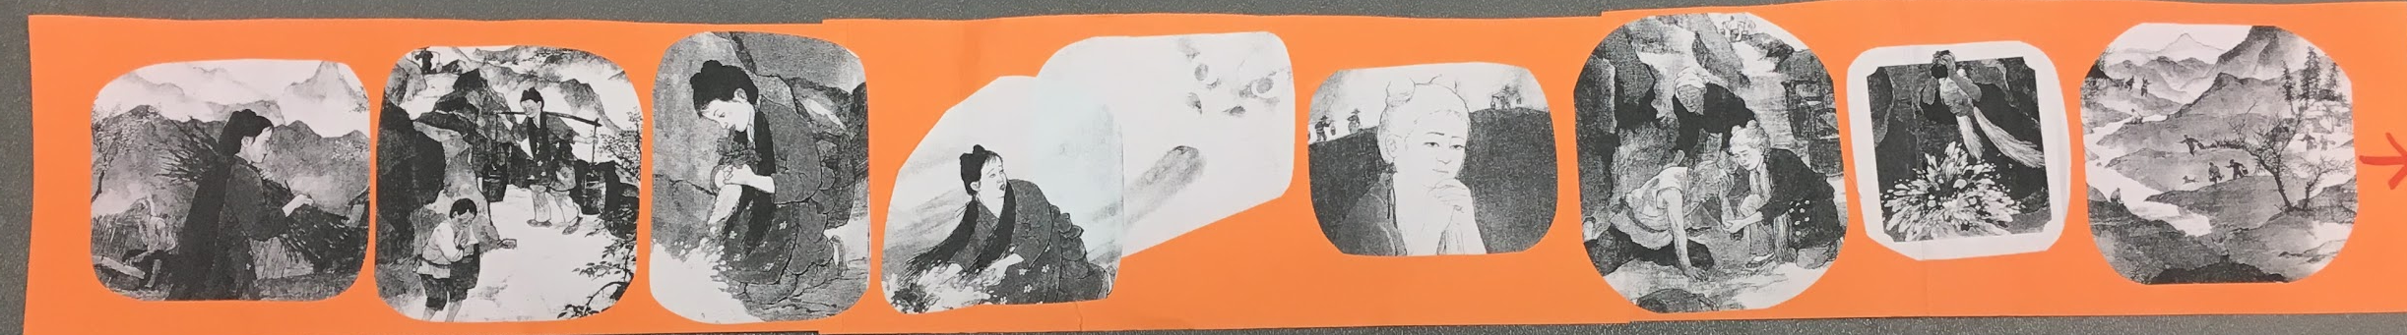
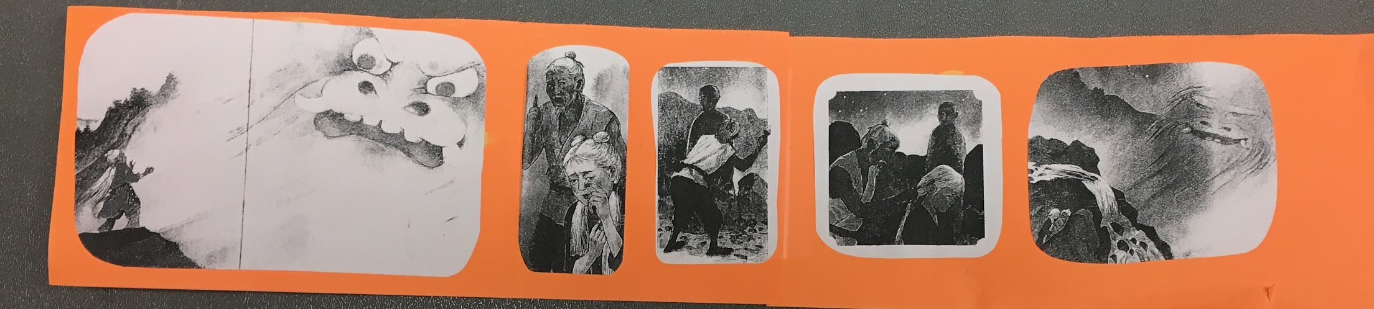
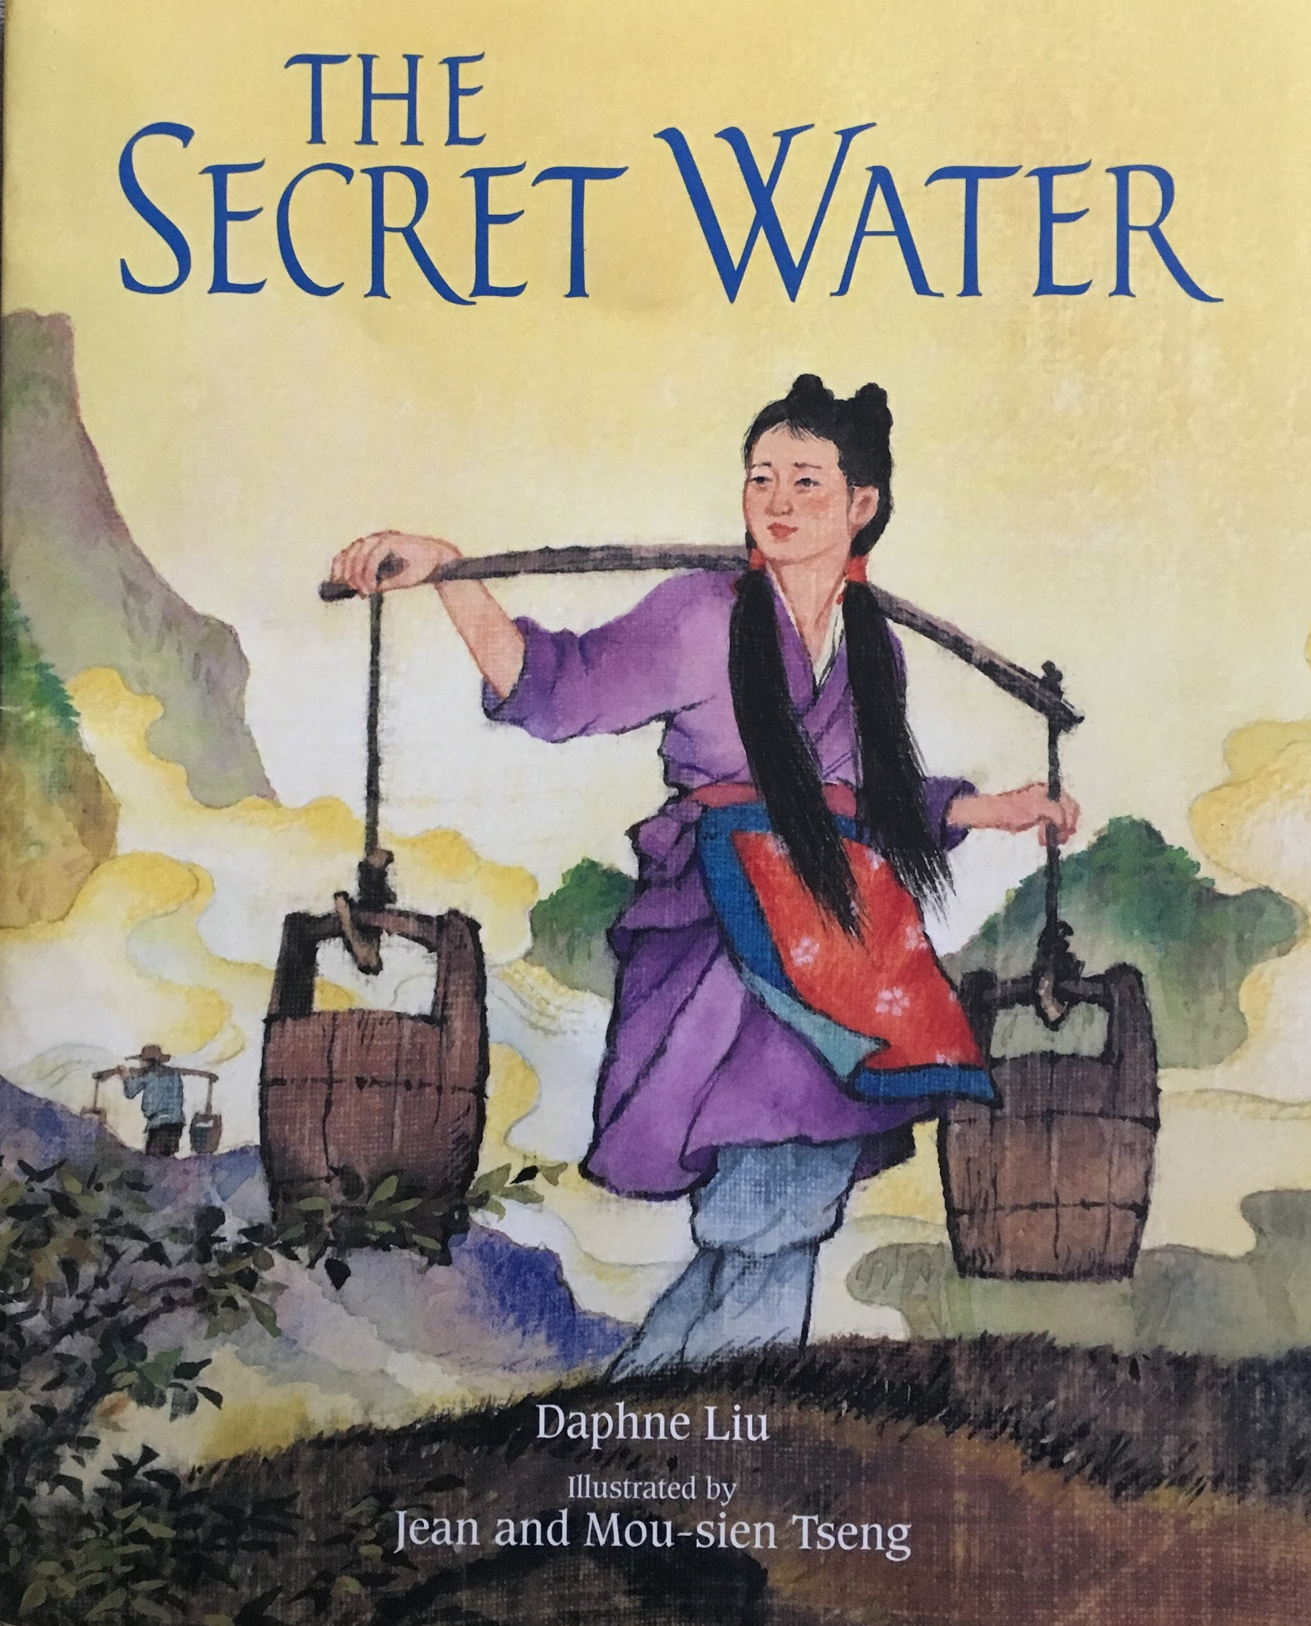
1st Grade Retell
ELP 1.3
Newcomer in Kindergarten
First Language: Brazilian Portuguese
Notes:
*Secret Water by Daphne Liu: English to a Beat - Hampton Brown
*Great thing about Word Bank is it is versatile - you could instead focus on the transition words, or using character names - whatever skill or target vocabulary you choose to focus on for that lesson.

Slide 16
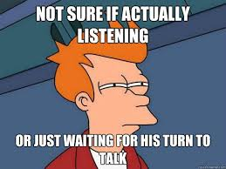
Ask, Answer, Add - Academic Conversation
What is it?
  A strategy for turn-taking during discourse
Why is it helpful?
  Helps students to practice active listening
  Helps students add details to their answers
Examples:
A: What is your favorite food?
B: My favorite food is pasta. It has meatballs.
A: What is your favorite food?
B: My favorite food is pasta.
A: Do you eat it at home or at a restaurant?
Image retrieved from http://www.quickmeme.com/p/3575s0
Notes:
Focus on accountable listening and structuring how to respond as well as how to add details
Basic sequence (original to ELL Teacher’s Toolbox):
List of questions on the board (social or academic), partners take turns asking a question while partner B has 1 minute to think about their answer - they then respond to the question (with TTQA!), and add one detail to their answer.
Example of fact/opinion conversation
Example of favorite (kindergarten lightning round) (note second part of handout has conversation options for ask/answer/add

Slide 17
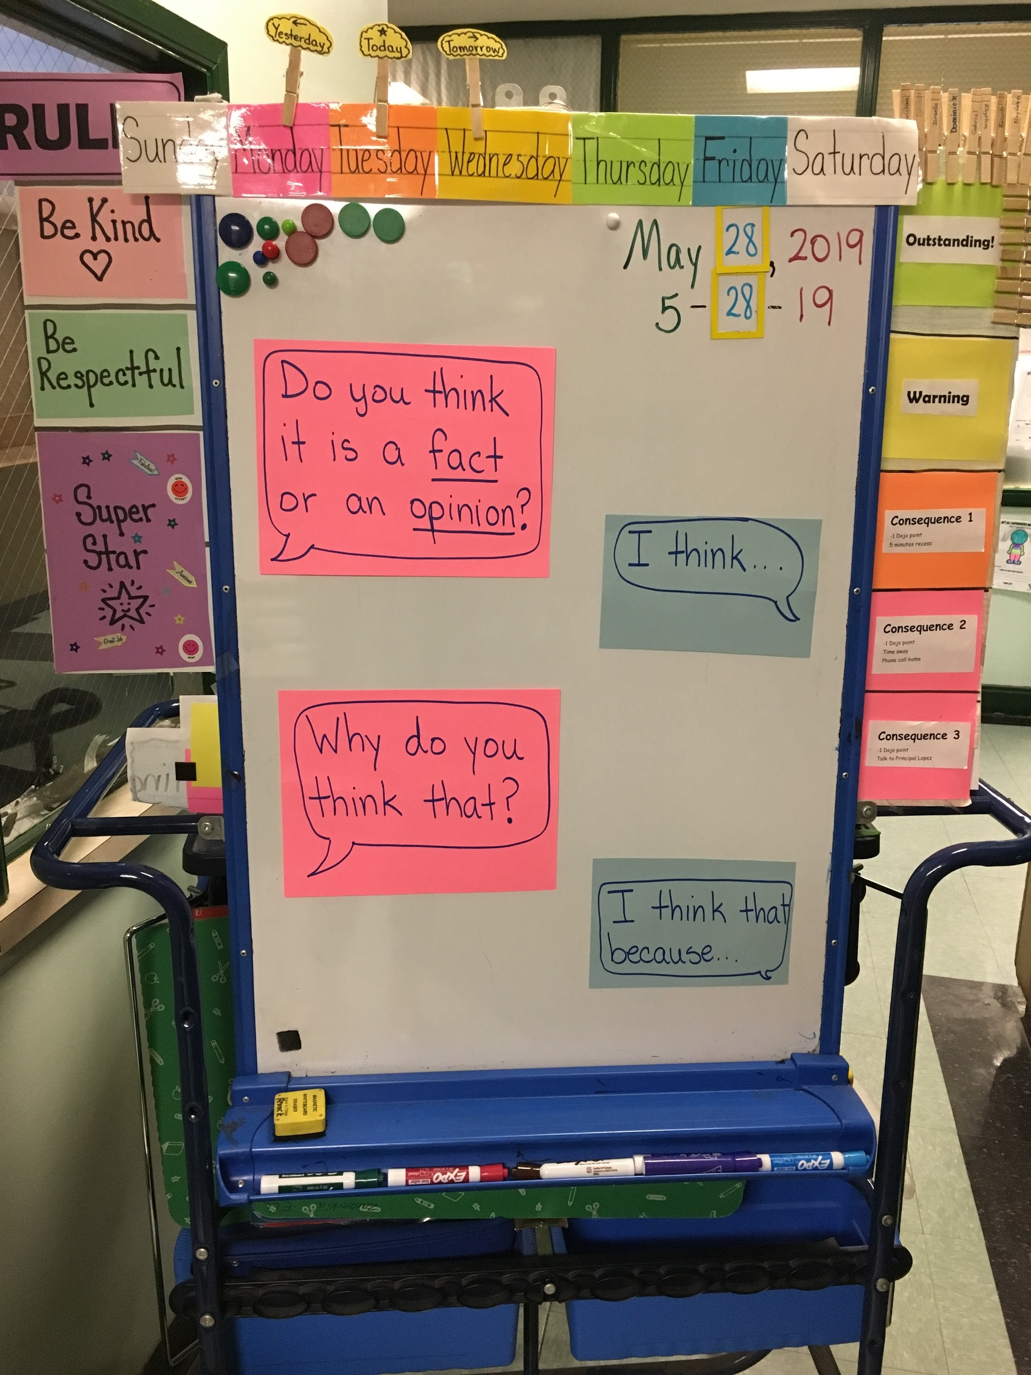
Ask, Answer, Add: Fact and Opinion
Version 1:
  Start with a list of questions on the board
  Have partners alternate who is asking and who is responding
  Lower-proficiency students can add one detail to their answer after they TTQA.
  Higher-proficiency students can ask a follow-up question based on the answer their partner gave, for their partner to answer
Version 2:
  Start with posted academic sentence starters (seen right)
  Students take turns asking and answering
  Follow-up with second-set partners
Notes:
*Have students hold cards for Partner A, Partner B (I’ve done this with just images (color-coded talking heads), or you can have color-coded cards with sentence starters on the back for older students.
More examples are in your handout - the last few pages
This lesson comes from a video on the Teaching Channel - listed in resources

Slide 18

Final Thoughts and Parting Wisdom
Narrow your focus
Use visuals as often as you can
Start small
Notes:
My own reflections - what’s worked, what hasn’t (visuals with word lists, too many target vocab words on the checklists, complicated sentence frames too early on - keep it simple)
VISUALS - either on word bank checklist or on word wall
Start small - start with one thing you want to try. One strategy, or 2 frames: start with highly versatile phrases (for example)).
As students get used to it, add more.

Slide 19
Questions?
remickk@randolph.k12.ma.us
rossm@randolph.k12.ma.us

Slide 20
Resources
Zwiers, J. (2014). Building academic language: Meeting common core standards across disciplines (2nd ed.). Jossey-Bass. San Francisco, CA.
https://www.continentalpress.com/blog/using-turn-and-talk-encourage-ells/
http://www.doe.mass.edu/ell/curriculum/collaborationtool.pdf
https://www.teachingchannel.org/video/second-set-partners-sfusd
https://www.teachingchannel.org/video/teaching-ells-to-participate-in-discussions-ousd
https://www.teachingchannel.org/video/subtraction-math-lesson-ousd
https://www.teachingchannel.org/video/fact-or-fiction-sfusd
https://www.samebutdifferentmath.com/early-numeracy
https://www.teachingenglish.org.uk/blogs/neil-t-millington/ask-answer-add-a-speaking-activity-help-learners-maintain-a-natural
https://www.stevewyborney.com/?p=893
ELL Teacher’s Toolbox: Hundreds of Practical Ideas to Support your Students by Larry Ferlazzo and Katie Hull Sypnieski (Amazon Link)
Carson-Dellosa Key Education Early Learning Language Library Learning Cards (Amazon Link)
The K-3 Guide to Academic Conversations: Practices, Scaffolds and Activities (Amazon Link)

