Slide 1
Scaling Impact: The Grantmakers’ Role
GEO National Conference, Seattle, WA
March 12, 2012

Slide 2
Agenda
Welcome/Overview
Explanation of Research & Key Early Findings
Discussion Topic Presentations
Small Group Discussion 1
Small Group Discussion 2
Closing

Slide 3
Objectives
Learn about key preliminary research findings
Engage with other attendees to assess state of the field and consider applications to your own work
Provide feedback on the research findings to date and identify areas for further exploration

Slide 4
Scaling What Works Objectives
Convene
Grow
Support
Notes:
Quick walk-through the convene, grow, and support goals

Slide 5
Session Attendee
Knowledge of the Topic
37%
33%
15%
7%
7%
1
2
3
4
5
Beginner
Expert
Notes:
Pre-Survey Results

Slide 6
What Do We Mean By Scale?

Slide 7
“What Do We Mean by Scale?”
Grantmakers of all kinds are shifting the way they think about scale… emphasizing not size or reach…. but impact
Traditional Approaches
* Growing an organization and/or program
* Replicating a program to other sites and/or populations
Emerging Approaches
* Spreading an idea or innovation
* Increasing adoption of a proven tool or practice
* Changing behavior through policy
Notes:
Ashoka’s research bears out GEO’s emphasis on scaling impact not organizations—this is what they’re seeing among fellows—use of open source, networks (Ashoka also preaches scaling ideas not organizations). Also, use of formal training programs (degrees, certificates) to create a core of practitioners who will advance the idea/innovation

Slide 8
What is scaled and scaling mechanisms
Program
Replication
Idea or Innovation
Communication
Technology or Skill
Adaptation
Marketing
Dissemination
Marketing
Distribution
Training
Granting
Policy
Implementation
Four Approaches to Scale from The Evaluation Exchange (Harvard Family Research Project), 15, no. 1 (Spring 2010).
Notes:
Taproot has found that several of these different pathways to scale are key levers for scaling impact—technology, advocacy, replication, etc.

Slide 9
Research Project Overview

Slide 10
Grantmakers’ Role in Scaling Impact Research
Research Questions:
Which grantmaker practices best support high-performing nonprofits in efforts to scale their impact?
Which grantmaker practices impede these efforts?
Outcomes:
Tips and tools for self-assessment, knowledge-building and organizational change

Slide 11
Collaborators

Slide 12

Taproot Foundation
Built upon knowledge of core practices that successful organizations have used to scale their impact
Conducted 25+ in-depth interviews with funders and high-performing nonprofits, and two focus groups

Slide 13

Ashoka
Surveyed 35 established social entrepreneurs from 20 countries on lessons learned and challenges with scaling efforts
Conducting in-depth follow-up interviews
Including questions about scaling in annual survey of 500 Ashoka Fellows

Slide 14
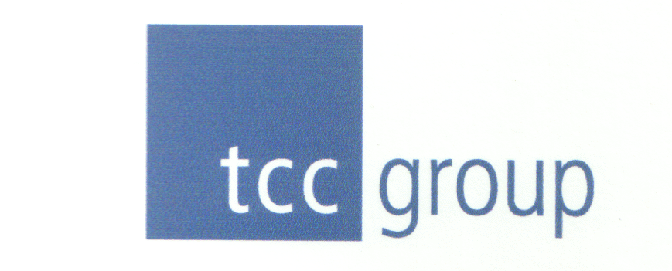
TCC Group
Analyzed Core Capacity Assessment Tool (CCAT) assessments of over 2,000 nonprofits
Identified statistically significant predicators of growth
Conducting follow up interviews with both positive and negative “deviants” with specific attention to the role of grantmakers

Slide 15

SIE
Categorizing the knowledge on scaling impact
Identifying gaps in existing literature on scale
Creating a framework to understand the stages of any type of scaling initiative
Developing an online, multimedia database of content on scaling

Slide 16
Early Research Findings
Scaling Impact:
Stages and Success Factors

Slide 17

Evolution of a Scaling Initiative
STAGE I
Assessment Financing
Assessment
Evidence of Efficacy and
Readiness to Scale
STAGE II
Business Model Financing
Business Model Development
Strategy for Scaling and
Growth Business Plan
STAGE III
Implementation Financing
Implementation & Roll-Out
STAGE IV
Growth Financing
Evaluation, Ongoing Improvements & Growth
Impact and Operations
Measurement
www.socialimpactexchange.org
Notes:
SIE is identifying what current literature covers and where there are gaps
What are the best roles for grantmakers at each stage? Pros and cons of grantmakers involvement at each stage?
What evidence of impact can grantmakers expect at each stage?

Slide 18
Scaling Impact
The Model
The Money
The People
The Pathways

Slide 19
A Sampling of Factors for Successful Nonprofit Scaling
Develop, clarify, test, codify and adapt model – fail fast
The right kind of resources for the stage of growth
The right talent for the stage of growth
Networks and collaboration
Notes:
Clarify key elements of the model: codify, then adapt (Ashoka)
Program research and design (TCC)
Test and refine before expansion: collect, use and make meaning from the right data
Ensure what needs to be reliable is codified
Get the right kind of resources (TCC, Ashoka)
No strings attached (funders/board should stay out of the “program kitchen”)
Diversified
Sustainable
Have the right staff (Ashoka top 3 factors)—look for GEO pub on talent development/scaling later this year
Build team of entrepreneurial problem-solvers—in your org AND in your network
Cultivate networks (one of Ashoka top 3 factors)—see GEO/Monitor work on networks
Open source, networked approaches
“Don’t be king of the hill: be the hill itself”—from article authored by Ashoka’s Jon McPhredran Waitzer and Roshan Paul shared with attendees online

Slide 20
Early Research Findings
Grantmaker Practices That Support Scaling Impact

Slide 21
Scaling Impact
The Model
The Money
The People
The Pathways

Slide 22
Pre-Conditions for Grantmaker Practices
Understand that most helpful practices within each category will vary at different stages of scaling impact
Recognize that individual grantmakers can focus within a stage of growth
Create mutually-beneficial grantmaker/grantee relationships
Be respectful and responsive
Don’t treat grantees as vendors or test cases for your theory of change

Slide 23
The Model
Accept that only necessary “cooks” belong in the program development “kitchen”
Build evaluation capacity to help build grantee evidence base
Assist with readiness for growth (e.g., underwrite business plans, strategy development)
Help explore if scaling is feasible

Slide 24
“Funders tend to like shiny objects. They want to fund new and innovative ideas…a few years down the road they’re eyeing the next new shiny object and haven’t spent enough time investing and helping the grantees…in the ‘old’ new area of innovation”
Nonprofit leader focus group attendee

Slide 25
The Money
Invest in the organizational engine – organizations matter
Give assistance beyond the check
Take risks and be flexible
Have a realistic timeline for scale – multi-year commitments
Don’t just move on to the next idea/issue
Growth capital is flexible capital
Distinguish buying from building – growth is not business as usual

Slide 26
“Invest in organizational capacity instead of just projects. Entrepreneurs need room to move according to the vision and strategy and should not be restricted to specific project plans when need changes.”
Ashoka Globalizer Fellow Thorkil Sonne, Specialisterne, Denmark (scaling to U.S.)

Slide 27
The People
Invest in leadership development
Help organizations identify and recruit top talent – both for board and senior leadership positions
Recognize that talent and skill needs change as the impact scales

Slide 28
“Be BOLD! Think of the multitude of ways your fiscal resources can be used beyond simply granting money. Freely share your knowledge and contacts – become strategic conspirators in the quest to scale solutions.”
Ashoka Globalizer Fellow Vickie Camck, tyze.com, Canada

Slide 29
The Pathways
Invest in and be part of coalition and community-building efforts
Think in terms of cross-sector, collective impact
Give grantees flexibility to move beyond programs/service delivery and work on system-level changes
Give grantees access to your networks
Take a more active role in raising money
Facilitate contacts with funders

Slide 30
“There are so many silos, and funders can play a larger role in breaking down those silos and building an ecosystem.”
Nonprofit leader focus group attendee

Slide 31
Research Next Steps
Collaborators complete research by mid 2012
Scaling What Works develops publications and additional content to share with funder community
Scaling What Works conducts outreach and events to help funders change practices for successful scaling

Slide 32
Agenda
Welcome/Overview
Explanation of Research & Key Early Findings
Discussion Topic Presentations
Small Group Discussion 1
Small Group Discussion 2
Closing

Slide 33
Small Group
Discussion Topics

Slide 34
Table 1: Grantmaker/Grantee Relationships
Sometimes the things that a nonprofit knows will have the greatest impact are the hardest things to get funding for – what are those things, why is this and how can the funder community respond?
Nancy Murphy, GEO
Darell Hammond, KaBOOM!

Slide 35
Table 2: Grantmaker/Grantee Relationships
How can grantmakers and grantees best partner for successful scaling?
We’ve found that successful nonprofits are able to receive funds without interference by funders in their program design.
Have you witnessed this dynamic in your own work? Is this difficult for funders to do?
Peter York, TCC Group

Slide 36
Table 3: Grantmaker/Grantee Relationships
Are the grantmaking “ingredients” to supporting a nonprofit, as compared to supporting a scaling nonprofit, really the same, as this research is suggesting?
Why or why not?
Alison Anderson, GEO

Slide 37
Table 4: Barriers
Why does it seem that the nonprofit community and the grantmaker community are still talking past each other in terms of how to best work together?
Without a closer alignment of what we are all doing together, we will not be able to scale up what works. What’s preventing us from helping each other in the ways we want to be helped?
Roshan Paul, Ashoka

Slide 38
Table 5: Barriers
What are the barriers related to funding faced by nonprofits trying to scale their impact?
Are there things funders could do to help remove these barriers?
Nadine Freeman, Ashoka

Slide 39
Table 6: Knowledge/Information
What information would help improve the grantmaker role in scaling impact, and facilitate your greater involvement?
What information do grantmakers need in helping nonprofits scale their impact?
What sources do grantmakers currently use to obtain information/knowledge about scaling what works?
Cynthia Massarsky, Social Impact Exchange

Slide 40
Table 7: Knowledge/Information
Who else needs to be a part of these conversations about scaling?
Who are all the stakeholders?
Joel Bashevkin, Taproot Foundation

Slide 41
Table 8: Pathways & Stages
The common interpretation of “scale” is program replication. However, there are multiple pathways to scale. Why are these other pathways less well-known?
How do we make these lesser known pathways to scale become part of the funder toolkit?
Aaron Hurst, Taproot Foundation

Slide 42
Table 9: Pathways & Stages
What pathways to scale are you supporting or do you want to support?
Which are less attractive? Why?
Emily Wexler, GEO

Slide 43
Table 10: Pathways & Stages
In what stages of scaling (if any) are you currently involved? Why?
Overall, why is there less information about grantmakers involved in the early stages of scaling efforts?
Should we encourage more grantmakers to become involved at earlier stages? If so, how?
Heather Peeler, GEO

Slide 44
Room Layout
Tables 1, 2, 3
(Front Row/Closest to podium) Grantmaker/Grantee Relationships
Tables 4 & 5
(Middle Row)
Barriers
Tables 6 & 7
(Middle Row) Knowledge/Information
Tables 8, 9, 10
(Back Row)
Pathways & Stages
Podium
1
2
3
4
5
6
7
8
9
10

Slide 45
Report-Out

Slide 46
Take-Aways
What is one thing you learned from this session?
What is one thing you are going to do differently as a result?

Slide 47
What’s Next?

Slide 48
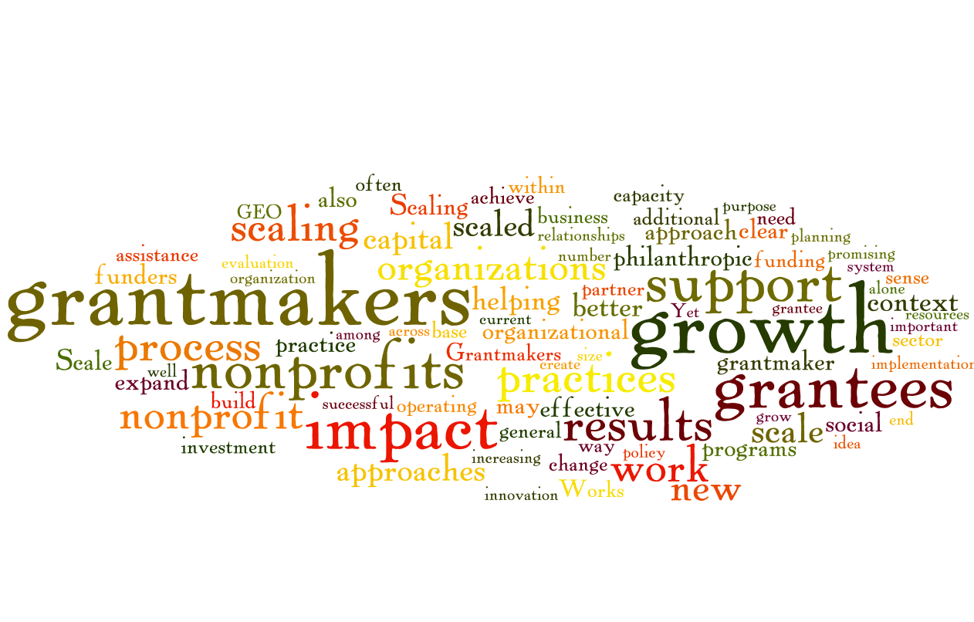
Thank you!

