Slide 1
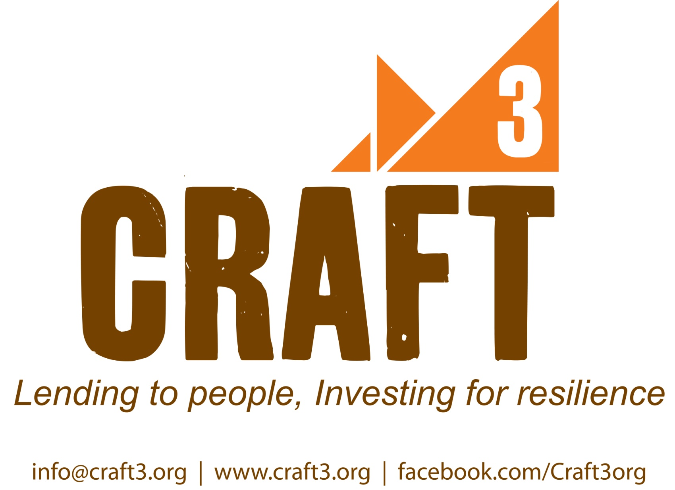

Slide 2
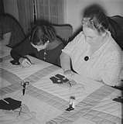
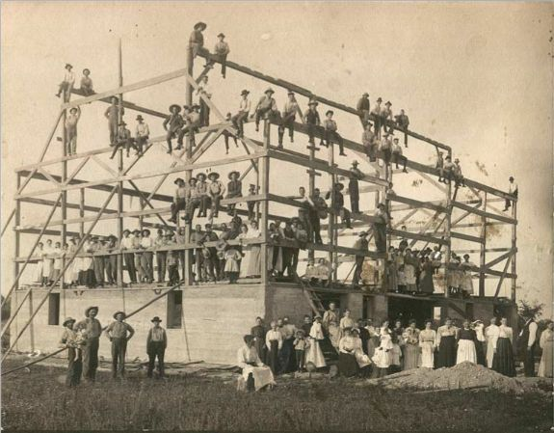
Craft3: An Unusual Name A Learned and Shared Practice
The skilled work of many hands over time triples positive impacts on local economies, the environment, and opportunity for the excluded.
Loans that improve the lives of people and the places they love require art and science to create durable progress.

Slide 3
Craft3 Is
A Community Development Financial Institution (CDFI)
Considered large CDFI in comparison to most others
Focus on many credit markets, not just one type
A non-profit and charitable corporation
Not a bank or credit union and does not take or insure deposits
17 years old (founded in 1994) with 50 employees
A regional institution serving a two-state investment area
A place challenged by rural decline and urban (metropolitan) dominance
Focused on three bottom lines instead of two…
Economy
Environment
Social
Equity

Slide 4
Craft3 Loan Products
Commercial Loans
Businesses: for real estate, start-up and expansion;
Non-Profits (NGO): for affordable housing, community development projects, health care, childcare, environmental conservation, and human services initiatives; and
Environmental Organizations: to acquire sensitive lands, restore habitat, and protect water quality.
Consumer Loans
Energy Efficiency: To property owners to reduce CO2 emissions
Septic Repair: To property owners to repair or replace failing systems to treat human waste when no sewer is available

Slide 5
Craft3 Is Multiple Business Units
But a Single Craft3 Brand
CRAFT3
Non-Profit Corporation
Total Assets: $70 Million
0.1% Owned (Managed)
Twelve Limited Liability Corporations Craft3 LLC I-XII
Total Assets: $84 Million
100% Owned Subsidiary
Craft3 Capital
For Profit Corporation
Total Assets: $80 Million

Slide 6
Craft3 Capital Under Management (000)
1995-2011

Slide 7
Craft3 New Loans By Year (Outputs)

Slide 8
Craft3 Capital Investors

Slide 9
Craft3 Loan Portfolio

Slide 10
Status: Sustainability
Aspiration: A Permanent Institution in the Region

Slide 11
Craft3 Asset Quality Scale enables prudent risk taking for mission
$350,000

Slide 12
Craft3 Measures What Matters Mission Outcomes from Loan Outputs
ECONOMY | ENVIRONMENT | EQUITY
Number of Jobs Created and/or Retained | Linear Feet of Functioning Riparian Zone | People of Color and Women Entrepreneurs Assisted
Leveraged Third Party Investment | Acres of Land in Sustainable Management | Number of Low Income Families Assisted
Added Value of Products Locally Manufactured | Gallons of Water Diverted from Waste Stream | Local Tenures Supported

Slide 13
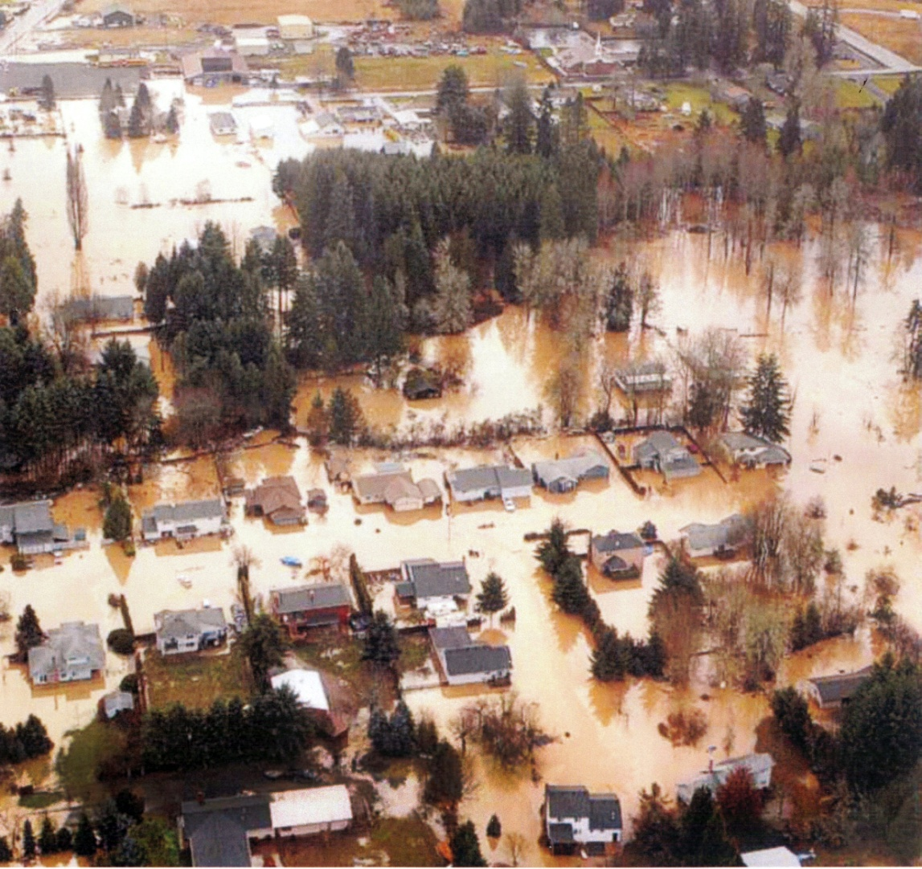
Community Action Team
Vernonia Flood Rehabilitation St. Helens, Oregon
$400,000 loan
48 low income families were assisted
7 jobs were created or retained
$6.4 million in investments were leveraged
Meyer Memorial Trust Partial Loan Guarantee

Slide 14
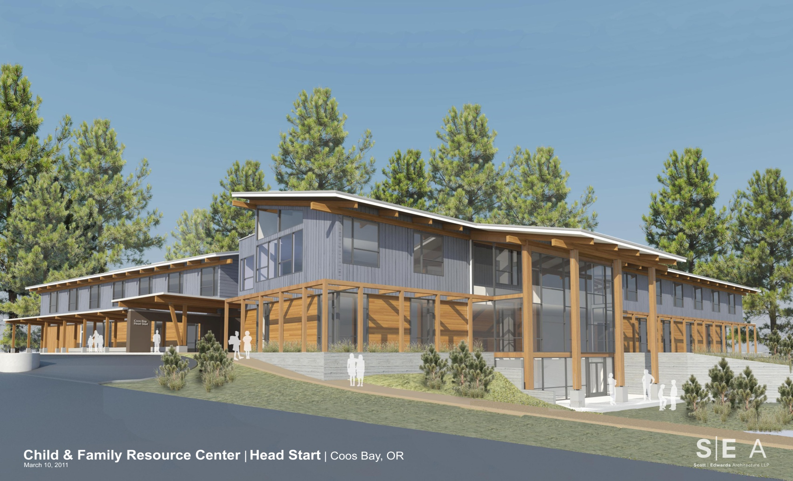
ORCCA Child & Family Resource Center Coos Bay, Oregon
$6 million investment (two loans)
4,628 low income families assisted in Coos, Curry and Western Douglas Counties
82 jobs created or retained
$7.5 million in investments were leveraged

Slide 15
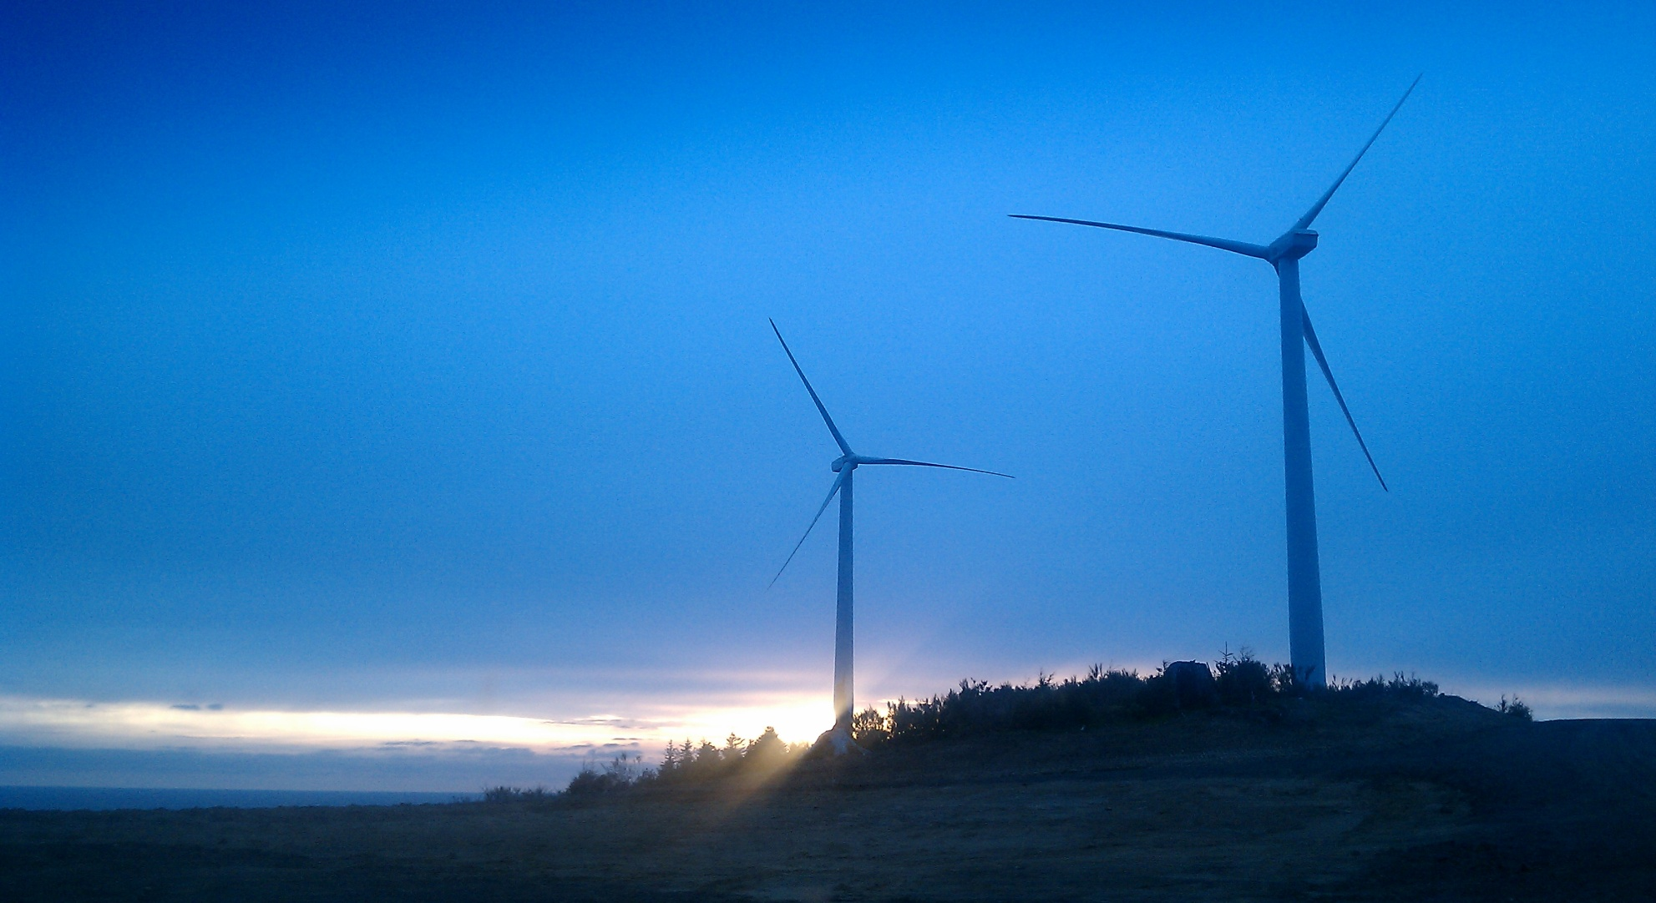
Coastal CAP Agency Wind Farm Grayland, Washington
$8 million investment, two loans
10,000 low income families assisted in Grays Harbor and Pacific Counties
30 jobs created or retained
$7 million in investments were leveraged
Secondary added value

Slide 16
Learn more about Craft3
John Berdes
jberdes@craft3.org
503-791-5197 (mobile)
Website
www.craft3.org
Social Media
Facebook.com/craft3org | Twitter.com/craft3org
Telephone
General Assistance: 011-360-642-4265 Extension 152 (office)

