Slide 1
Building An ESL Team
Resiliency, Intentionality, and Change
Collins Middle School - ESL Team
Salem, MA
Salem Public Schools
May 31, 2019

Slide 2

Welcome!
Do Now
Turn and Talk:
What is one thing that your team is doing well?
What is one thing that your team could improve?
We’ll come back to this later!

Slide 3

Objectives
Participants will:
Reflect on the current status of your ELL Team
Be provided with framework for robust structures that lead to strong student outcomes
-
Be provided with concrete examples of effective
collaboration between teammates
Enhance Teamwork practices of ELL Teams for SY 20-21

Slide 4
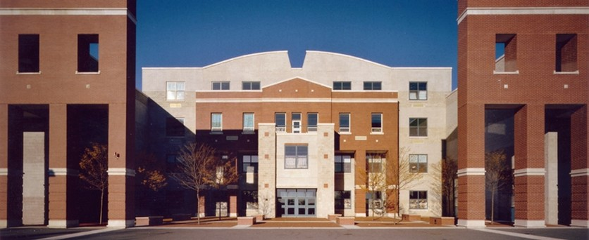
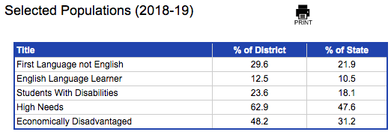
Salem Public School Background Information

Slide 5
Rationale: What Has Changed?
District - Salem Public Schools | School (Collins Middle School)
Closed K-8 school New ESL Coach the high school and Collins | Absorbed 200 new students 2 New ESL Teachers 1 ESL Bilingual Math Tutor - from out of district 2 AmeriCorps Members
Superintendent Left in May | New Principal and AP in August ESL teacher (from closed school) left in January Math tutor left and came back Long-term sub hired in March for ESL position
 | For next year: 1 New Coach hired for just Collins 1 New ESL Teacher will be hired
Notes:
grew from 500 to 700 -more than anticipated -created problems with one-to-one Chromebook rollout and scheduling
one new ESL teacher from closed school, one from out of district - that’s me! moving back from NY - new laws, procedures
both coaches promotion from within district

Slide 6
Resiliency and Intentionality in the face of Change
Resiliency in the face of changing...
caseloads
curriculum
coaches
colleagues
taking on other classes midyear
Being intentional about...
making CPTs student-focused
teambuilding
Notes:
veteran teachers new cohorts - 3 teachers, each had a grade
build out curriculum for newcomers - some had never taught them before
one to one Chromebooks, can’t plan w/or replan without technology

Slide 7
Approach
Team Assessment
Reflect and Adjust Plan
Plan
Execute Plan

Slide 8
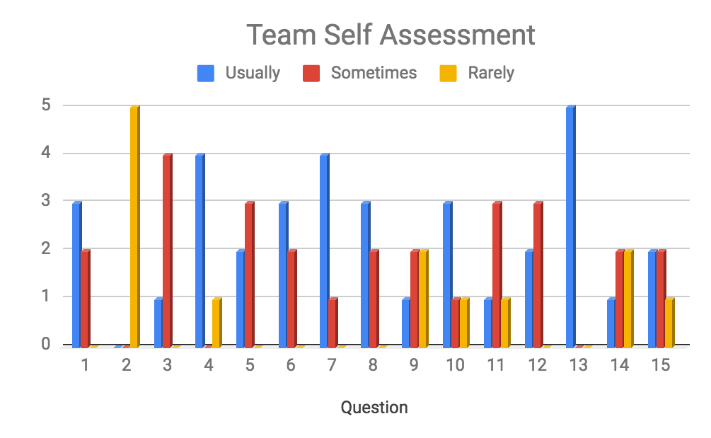
Pre Assessment
Strengths
Meetings are compelling (not boring) (Q7)
Meetings are results-oriented (Q13)
Areas of Development
Teammates do not challenge others’ approaches (Q14)
Everyone should feel like they are in a safe space and respected (Q15)
What team needs: Trust between teammates and learning about others’ classroom work, practices, classroom environment etc.
(Lencioni, p. 116)
Refer to Team Assessment Handout

Slide 9

Tools for Building A Team
Activities
Trust Building
Planning Tool
Sharing & Analyzing
Student Work

Slide 10
Structures
CPT Agenda
  Norms
  Mission
  Rolling Agenda
https://docs.google.com/document/d/1-NgK3FihR8K4y0u7fLpudT0-4JHiYKAFjUhDYMPD0Dk/edit
  LASW protocol https://docs.google.com/document/d/1opz8eVH8dszqL3JSKM-3HuwlPhYTEDWJ/edit#heading=h.gjdgxs
ELL Facilitator
Monthly District PD

Slide 11
Personal Histories
How it works
Ask three questions:
Where did you grow up?
2) How many kids were in your family?
3) What was the most important challenge of
your childhood?
Key Takeaway: Building trust through shared experiences
(Lencioni, p.19)

Slide 12
Trust Building
Personal Histories Cont...
“get comfortable with moderate vulnerability.”
* Empathy and Understanding
* Judgement and Accusation
Fundamental Attribution Error:
  Negative behavior of others is due to character
  Own negative behavior is due to environment
(Lencioni, p. 19)

Slide 13

Your Turn!
Personal Histories
Turn and Talk with a neighbor.
Ask and Answer the three questions.
Remember to have a moderate level of vulnerability.

Slide 14
Planning Tool: Building Trust Through Communication
 | Clear Topic | Language Domain (Speaking and Writing) | Language Function | Assessments (formative and summative)
Guiding Questions/Tools/ Resources | Is there a plan that includes some version of:a unit plan, trajectory and lessons? Tools and Resources: Unit Plan, trajectory, lessons, Language Function Tool, etc. | Is there a focus on a Language Domain? Tools and Resources: Lingt.com, WIDA model, writing tasks, Language Function Tool | Is there a focus on Language Function(s) for the ELD Unit? Tools and Resources: Language Functions Tool (Confianza), INSIDE Resources | Is there a joyful assessment with an exemplar and rubric? Tools and Resources: PD resources, INSIDE Resources, Language Function Tool
Language and Curriculum Tracker | Where your Food Comes From | Speaking, Listening, Reading, Writing | Compare and contrast, language words Multi-paragraph report on two different crops | Comparative essays on schoology
Student Centered Feedback (Pluses and Deltas) | +: | +: | +: | +:
 | ∆: | ∆: | ∆: | ∆:
Notes:
NB: How much do we want to tie in this tool with trust? Another potential point of emphasis could be communication as a component of team resiliency. If we are going to address the obstacles we’ve faced in the presentation, it may be helpful to shift the focus more towards team resilience rather than team building
Mention…

Slide 15
Planning Tool Applications
Depending on the needs on your team, the tool can be used
At the beginning of a unit for clearly communicated and student centered planning (with less emphasis on pluses and deltas)
Mid unit to make student centered adjustments
At the end of a unit to assess what positives can be carried into the next unit and what should be changed to improve student engagement and achievement
Potential Application
Allow each team member 1 minute to fill in their language and curriculum section (1 row per member)
Engage in a 5 minute critical discussion on which aspects of the unit reflected positively on the students. Fill in pluses section accordingly
Engage in a 5 minute critical discussion on which aspects of the unit were difficult for the student to understand/relate to. From there, gather information from teammates on how these obstacles can be overcome. Fill in the deltas section accordingly
Complete tool once every unit during common planning time/team meetings. After 2 weeks, look back at the tool and have a 5 minute discussion on what feedback/information/resources were most helpful and what could have been helpful in hindsight
Key Takeaway: This tool provides a means of clear and intentional communication that can help build a sense of trust and transparency within your team while also making unit planning more student centered.

Slide 16
Trust Building
“The key ingredient to building trust is not time. It is courage.” (Lencioni pg18)
Vulnerability is not about being “touchy-feely”
  being brave
  being honest
  admitting when you are wrong
  knowing your strengths and weaknesses along with those of your teammates
Important not to ask for too much too soon
  Why personal history is first step
Personality profiles
  next step in getting to know each other after personal histories
  expensive tests available but try this free one: http://www.viacharacter.org/www/ or www.16personalities.com

Slide 17
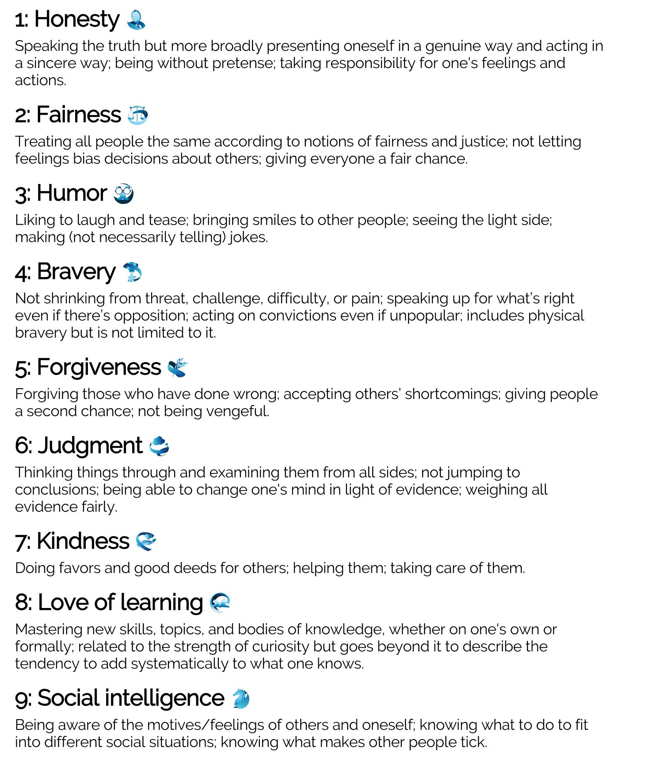
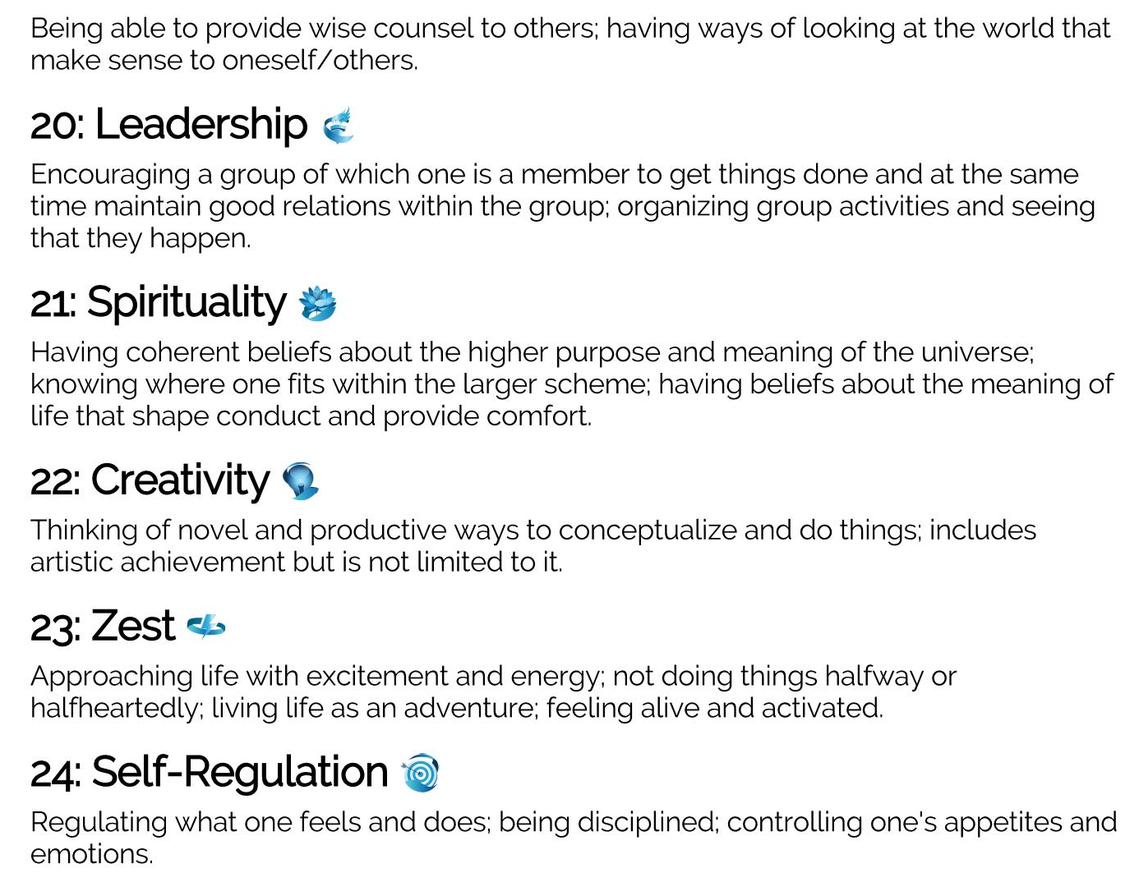
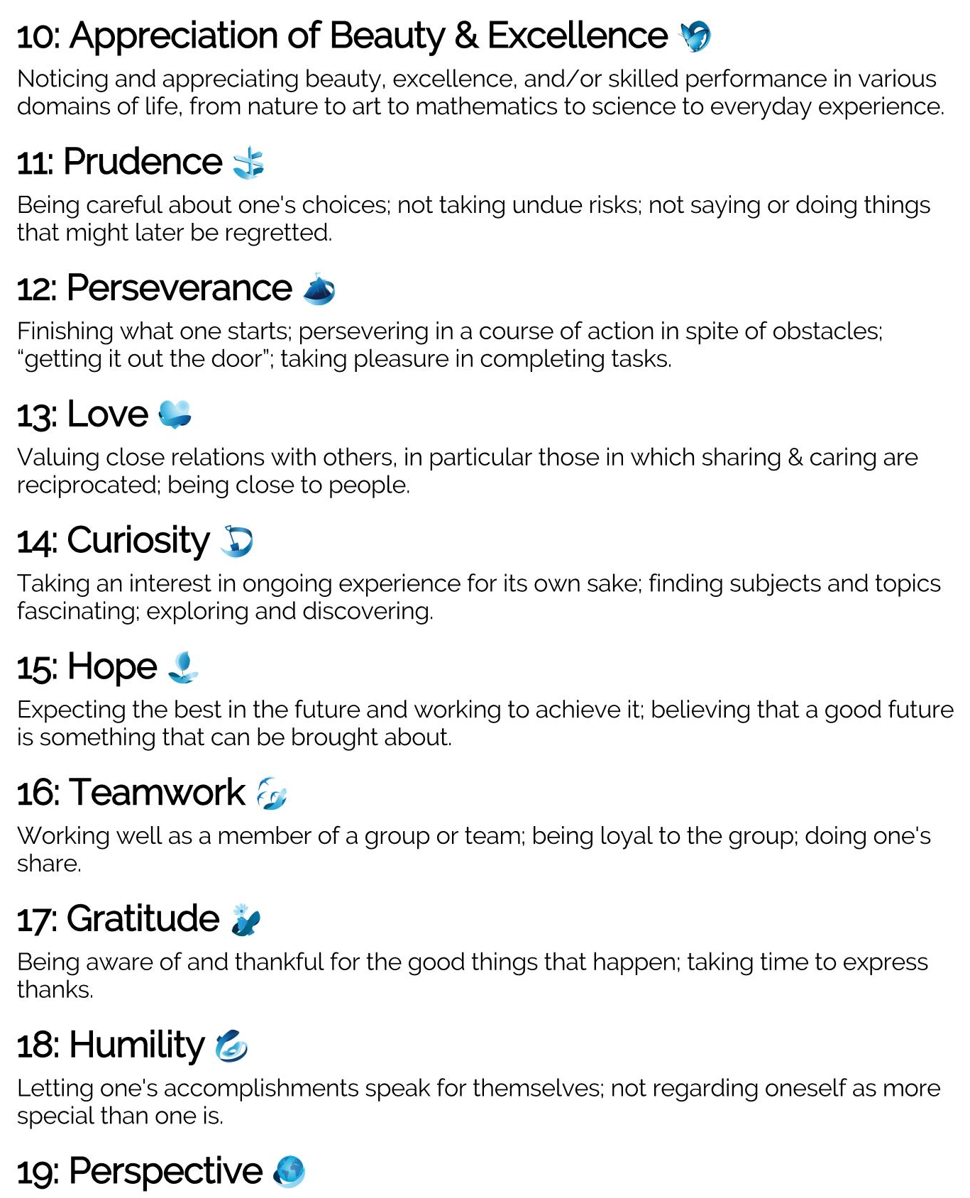

Slide 18
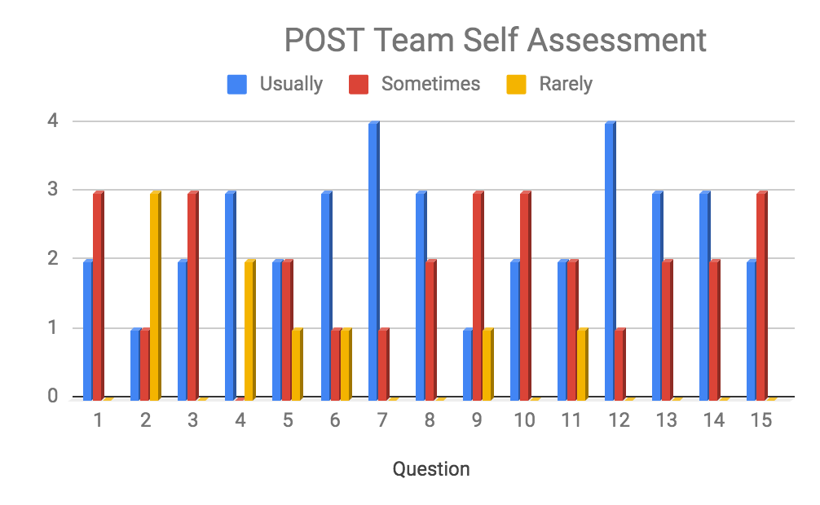
Post Assessment
Key Takeaways
Deeper knowledge of teammates’ personal lives (Q12)
Give and take between team building and obtaining results (Q13)
More constructive feedback taking place in CPTs
Next Steps
Continue to grow as team and build trust
Balanced Approach to Team Building vs. Results Orientation
(Lencioni, p. 116)
Refer to Team Assessment Handout

Slide 19
Successes
Type of Success | Rationale
Teacher Schedule | Had one weekly CPT Divided all ELL students for services Managed FEL monitoring
Integration of ESL teammates | Two Americorps Members New teammates
Time Management | Rolling agenda for meetings CPT Meetings should be student-focused

Slide 20
Challenges/Next Steps
Type of Success | Example
Scheduling | Avoid Wednesdays and Friday afternoons
Staff Turnover | Many staffing changes throughout the year
Coaching | Not on-site full time WILL be more accessible next year Coaching of content level teachers next year
MCAS/ACCESS | Have “living documents” updated as students arrive

Slide 21

What Else Did We Learn?
If one teammate:
  Disagrees
  Does not feel welcome/invested…
IT IS A BIG DEAL!
Change is happening all the time
Take advantage of spontaneous connections by being vulnerable
Utilize resources effectively

Slide 22

Recap/Resources
Recap
Structured/Student-Focused Team Meetings
Team Building is a journey
Resources for you:
Rolling Agenda
LASW Protocol
Team Assessment Questionnaire
Notes:
Another big shift expected this year is the practice of explicitly assessing student work against standards-based rubrics or proficiency scales.
What is a proficiency scale? (see bullets in slide)

Slide 23

Questions + Reflections
One commitment I will make is…

