Slide 1
Speaking in the secondary science classroom
Miguel Hernando
Chelsea High School
hernandom@chelseaschools.com

Slide 2
Agenda
Some key ideas.
A routine for backwards planning.
Student work examples.

Slide 3
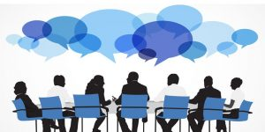
Key idea 1: Interaction is an important part of science
I want my students to discuss science with one another.
Interactions between scientists (peer review, lab meetings, conferences) are an important part of the scientific process.
To recreate that in my classroom, I need my students to speak about science.

Slide 4
Key idea 2: The importance of pronunciation
How important is it that students pronounce scientific words correctly?
Carbon Dioxide
Notes:
Speaking a second language is difficult for many reasons --- but one reason students mention frequently is that they are stressed about pronouncing so many difficult and unfamiliar words.
But in my experience, supporting students to learn the correct pronunciation builds up students’ confidence.
Since I started supporting students with pronunciation, I have seen an sharp increase in confidence and engagement during speaking activities at all proficiency levels.

Slide 5
Key idea 2: The importance of pronunciation.
Create a classroom culture where:
correct pronunciation is valued and
students are supported to achieve it
→
Less stress, more confidence
→
More speaking and more talk about science

Slide 6
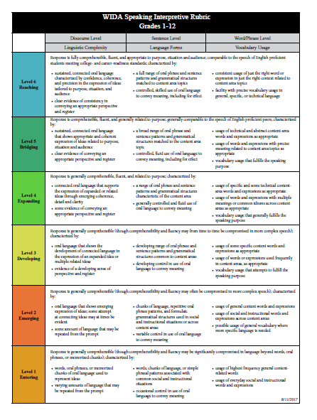
Key idea 3: The WIDA speaking rubric

Slide 7
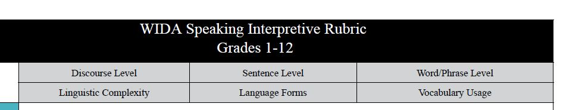
Dimensions of academic language development
A good quality speaking assignment needs to allow students to practice at the word, sentence and discourse levels.
This means that speaking activities need to be reasonably complex.

Slide 8
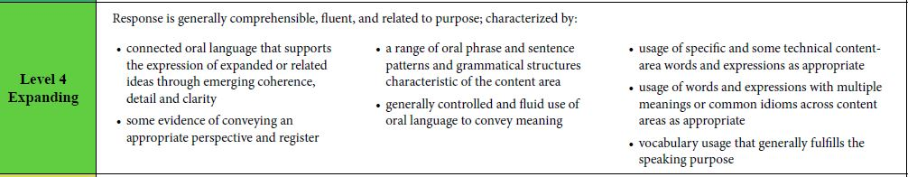
Some keywords for me
Technical vocabulary.
Range of sentence patterns.
Grammatical structures characteristic of the content area.
Expression of related ideas.

Slide 9
Key idea 4: Recording capability.
To assess speech properly, recording students is essential.
Recording equipment is needed.
Currently I use a website, lingt.com.
Pros: It works. It allows all students to record their speech simultaneously, so it saves time. Students can preview their work before submitting it. Students can submit multiple recordings.
Cons: It is browser-based, so there are more steps involved in accessing it. I cannot listen to it in my car. Students cannot access their recording after submission. It is not free.
Materials required: Subscription, laptop with internet access. Headphones and microphone are very important as well.
Thanks to my colleague Evelyn Manning for sharing this website with me!

Slide 10
Key ideas summary
Science has an interactive component and speaking is a large part of that.
Create a culture where the correct pronunciation is valued and students are supported to achieve it.
Draw on the WIDA rubric for speaking: 3 dimensions and some key elements.
Obtain recording equipment.

Slide 11
A routine for planning and implementing
Part 1 - Planning
Select open-ended problem. Supporting visuals or data are very very good.
Craft an exemplary answer.
Identify key vocabulary.
Part 2 – Implementing
Vocabulary pronunciation.
Speaking in sentences.
Answer the problem.
→Thanks to my colleague Sarah Harrington for helping me get started in the topic of discussions and the importance of discussion vocabulary.

Slide 12
Examples

Slide 13
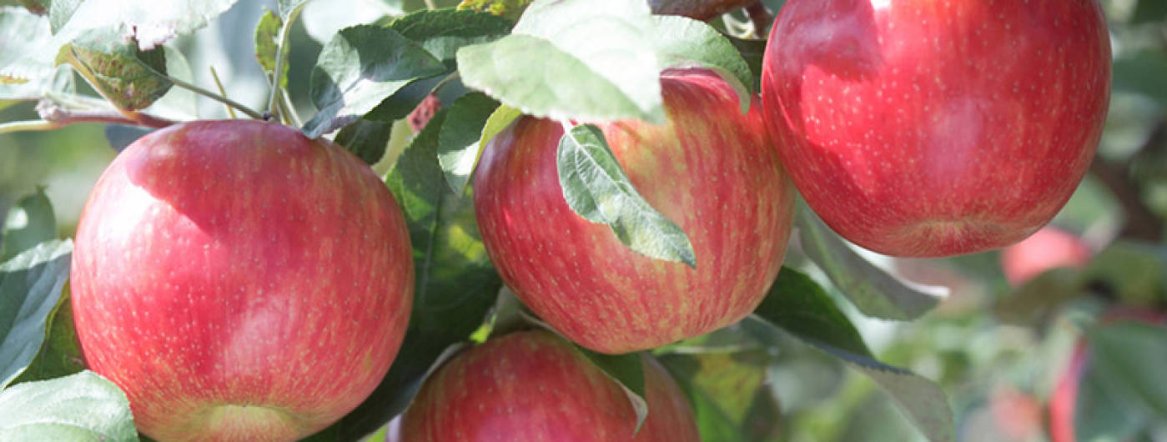
Example 1: How do apples get sugar?
This is a Biology example.
Students in the class are WIDA level 1-3.
My objective is that students will display their knowledge of photosynthesis by answering this question.
This assignment will allow students to learn and practice at the word, sentence, and discourse levels.

Slide 14
Planning 2: My exemplary answer
The apple gets sugar from the leaves. The tree carries out photosynthesis to make sugar in the leaves. In photosynthesis, the tree uses sunlight, water and carbon dioxide to make glucose and oxygen. At the end, the fruit gets the sugar from the leaves.

Slide 15
Prepare a vocabulary list. Focus on content vocabulary…
The apple gets sugar from the leaves. The tree carries out photosynthesis to make sugar in the leaves. In photosynthesis, the tree uses sunlight, water and carbon dioxide to make glucose and oxygen. At the end, the fruit gets the sugar from the leaves.

Slide 16
…but do not forget verbs…
The apple gets sugar from the tree. The tree carries out photosynthesis to make sugar in the leaves. In photosynthesis, the tree uses sunlight, water and carbon dioxide to make glucose and oxygen. At the end, the fruit gets the sugar from the leaves.

Slide 17
…and do not forget prepositions and adverbs.
The apple gets sugar from the tree. The tree carries out photosynthesis to make sugar in the leaves. In photosynthesis, the tree uses sunlight, water and carbon dioxide to make glucose and oxygen. At the end, the fruit gets the sugar from the leaves.

Slide 18
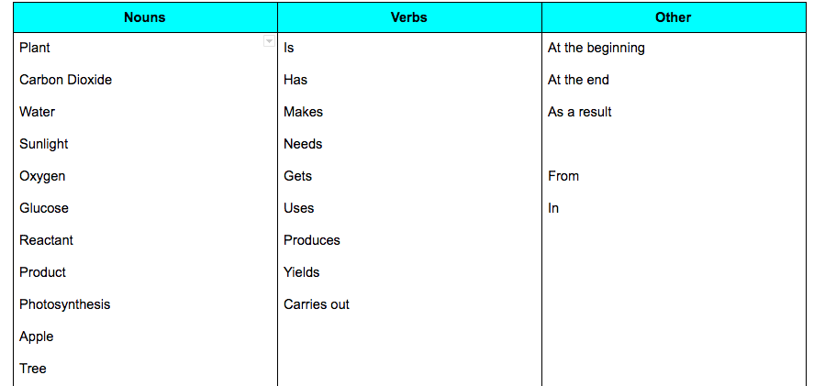
Prepare a vocabulary list

Slide 19
Implementation 1: Vocabulary pronunciation
Print and give the vocabulary list to students.
Choral practice.
Sometimes, phonics explanation.
Phonetic spelling: “Makes” → Meiks.
Pair practice
Individual practice
Record yourself speaking the words.

Slide 20
Implementation 1: Vocabulary pronunciation assessment.
Offline, I listen to all recordings.
I note trends to address in the next class.
I give students a numerical grade (0/100) for their recording.
Scoring: I take a few points for each word not correctly pronounced.
→ Let’s take a listen.

Slide 21
Implementation 2: Sentences
Record yourself describing the photosynthesis equation, by speaking.
Students have a printout of the photosynthesis equation.
Carbon Dioxide + Water + Sunlight → Oxygen + Glucose
Students first have time to practice, individually, in partners, and as a whole class.
Then they record themselves.

Slide 22
Implementation 2: Sentences assessment
Offline, I listen to all recordings.
I assign a score to students (0/100).
Correct pronunciation: 25 points.
Correct identification of reactants: 25 points.
Correct identification of products: 25 points.
Correct use of verbs to present reactants and products: 25 points.
→ Let’s take a listen.

Slide 23
Implementation 3: Explain how the apple gets sweet.
Explain how the apple gets sugar.
Some students did it as an straight presentation.
Other students did it as an interview.

Slide 24
Sweet apple rubric
 | Emerging | Needs Improvement | Proficient
Pronounce words correctly | Many words are pronounced incorrectly. | A few words are pronounced incorrectly. | All words are pronounced correctly
Vocabulary used | No scientific words are present. | Some scientific words for the topic are missing. | Uses all the scientific words for the topic.
Correct sentences | Some sentences are not grammatically correct | Almost all sentences are grammatically correct simple sentences. | All grammatically correct simple sentences, and some compound or complex sentences.
Speech organization | Ideas are disorganized and in the wrong order. | Ideas are in the correct order, but there is little or no transition language to connect them. | Uses transition vocabulary to connect sentences.
Photosynthesis knowledge | Explanation of photosynthesis is confusing. | One or two small mistakes when explaining photosynthesis. | Photosynthesis is correctly explained.
Connecting photosynthesis to the tree and the apple | There is no mention of the tree or the apple. | The tree or the apple are mentioned, but it is not clear how they are connected. | There is a clear explanation of how the tree and the apple are connected.

Slide 25
Sweet apple rubric categories
Pronounce words correctly.
Use scientific vocabulary.
Correct sentence structure.
Speech organization.
Photosynthesis knowledge.
Connecting photosynthesis, the apple and the tree.
→ Let’s take a listen.

Slide 26
Example 2: Explain the structure of DNA by speaking.
Previously, students have been studying the composition of DNA.
They have also assembled a DNA molecule using paper cutouts.
They have not seen a complete text describing the structure of the DNA molecule. Their task is to produce such a description by speaking.

Slide 27
Vocabulary to describe DNA
Useful names:
DNA.
Nucleotides.
Deoxyribose, a sugar.
Phosphate.
Nitrogenous base.
Adenine.
Cytosine.
Guanine.
Thymine.
Chain.
Double helix.
Chargaff’s rules.
Useful verbs and expressions:
Has
Is made of
Join / joined
There is / There are
Parts
Components
Twist / twisted

Slide 28
Students describe DNA by speaking.

Slide 29
Example 3: Describe the path of the nervous impulse
Situation 1. A person is walking in the street and steps on a nail. The nail punctures his shoe, and he feels pain.

Slide 30
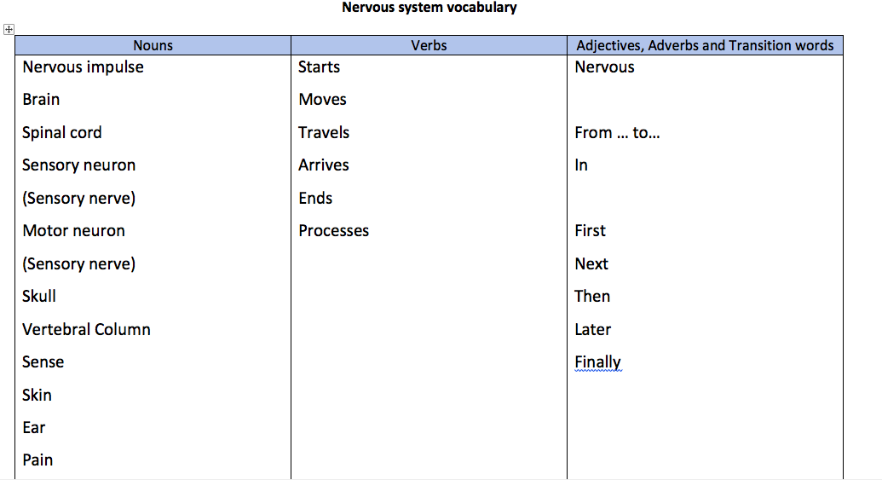
Path of the nervous impulse vocabulary

Slide 31
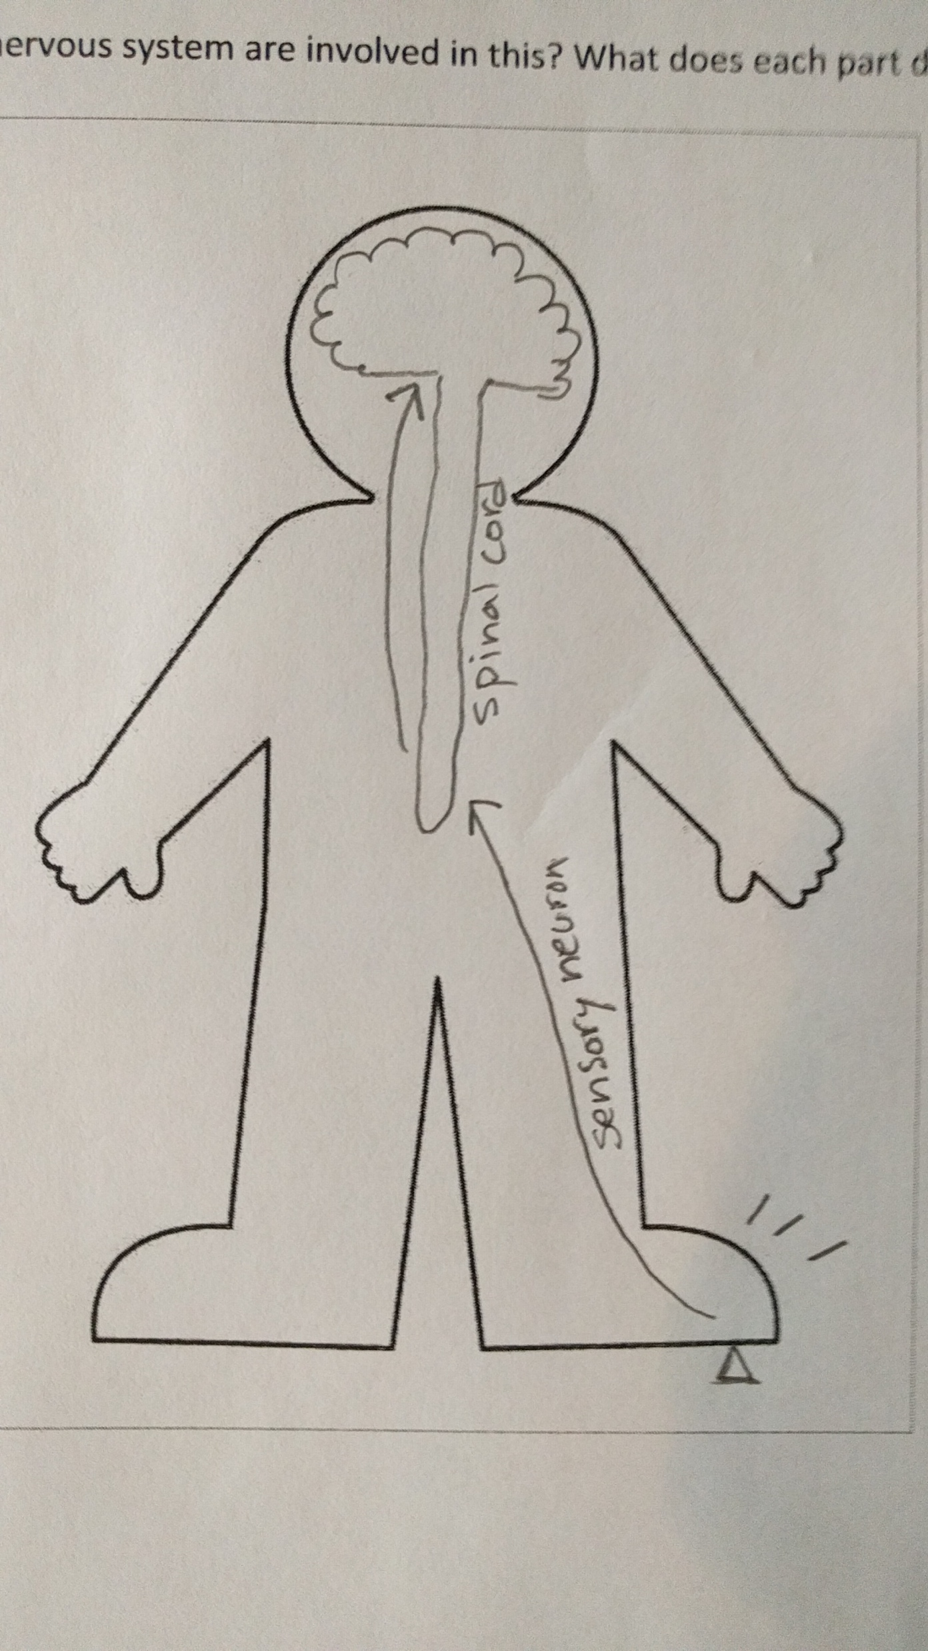
Path of the nervous impulse
Situation 1. A person is walking in the street and steps on a nail. The nail punctures his shoe, and he feels pain.

Slide 32
Positive takeaways
Multiple chances to practice pronunciation of words builds students’ confidence and reduces stress.
Breaking up the work into stages gives me a change to identify areas of difficulty and address them. Students have meaningful opportunities to improve.
Recording answers gives me multiple chances to listen to them. I can also use the recordings when I debrief with individual students.
The question is sufficiently complex that I can use students’ product as a content assessment. I do not need to do a separate test to see if students understand photosynthesis.

