Slide 1



Learning Language and Reasoning in Mathematics with English Learners
Presenters: Keila Colon & Dana Thorsen

Slide 2
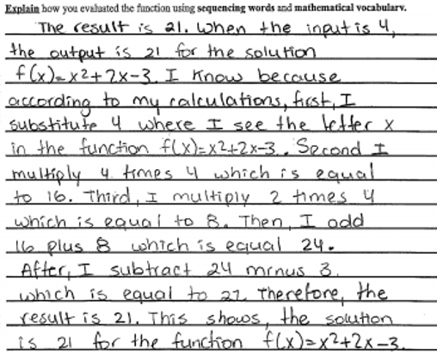
How long do you think this student has lived in the U.S.?
6 months

Slide 3

How do we do it?

Slide 4

How can we as educators assess students’ mathematical understandings beyond calculations?

Slide 5

Problem
Students become overwhelmed with the process of problem solving.

Slide 6

Solution
We create a way to break down problems and form solutions before putting pencil to paper using explanatory essays.

Slide 7
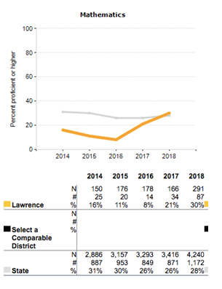
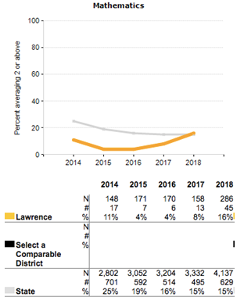
MCAS Open Response ELs
Percentage of ELLs scoring proficient or higher.
Percentage of ELLs scoring 2 or higher.

Slide 8


What does this do for ourselves?
What does this do for our students?
Allows us to identify point of error
Builds common language
Connects mathematical operations to English language
Increases EL opportunities to practice English language
Gives students language to ask specific questions
Builds confidence

Slide 9

Percent of ELs in Massachusetts:
19%
Percent of ELs in Lawrence:
34%
Percent of ELs in Enlace:
100%

Slide 10


ENLACE (Engaging Newcomers in Language & Content Education) is an academy at Lawrence High School serving recent immigrant English learners ages 14-16.

Slide 11





School Demographics
Dominican, Puerto Rican, Vietnamese, Haitian
Average WIDA Level upon entry:
Average Common Core Math Grade Level upon entry:
1
3

Slide 12





Benefits of Explanatory Essays
“..students need to explain not only the “What” of a process/concept but also the “Whys”
This will help formulate students thinking and understanding of mathematical concepts and terms.
Thinking and communicating with clarity and precision.

Slide 13
How do we do it?

Slide 14



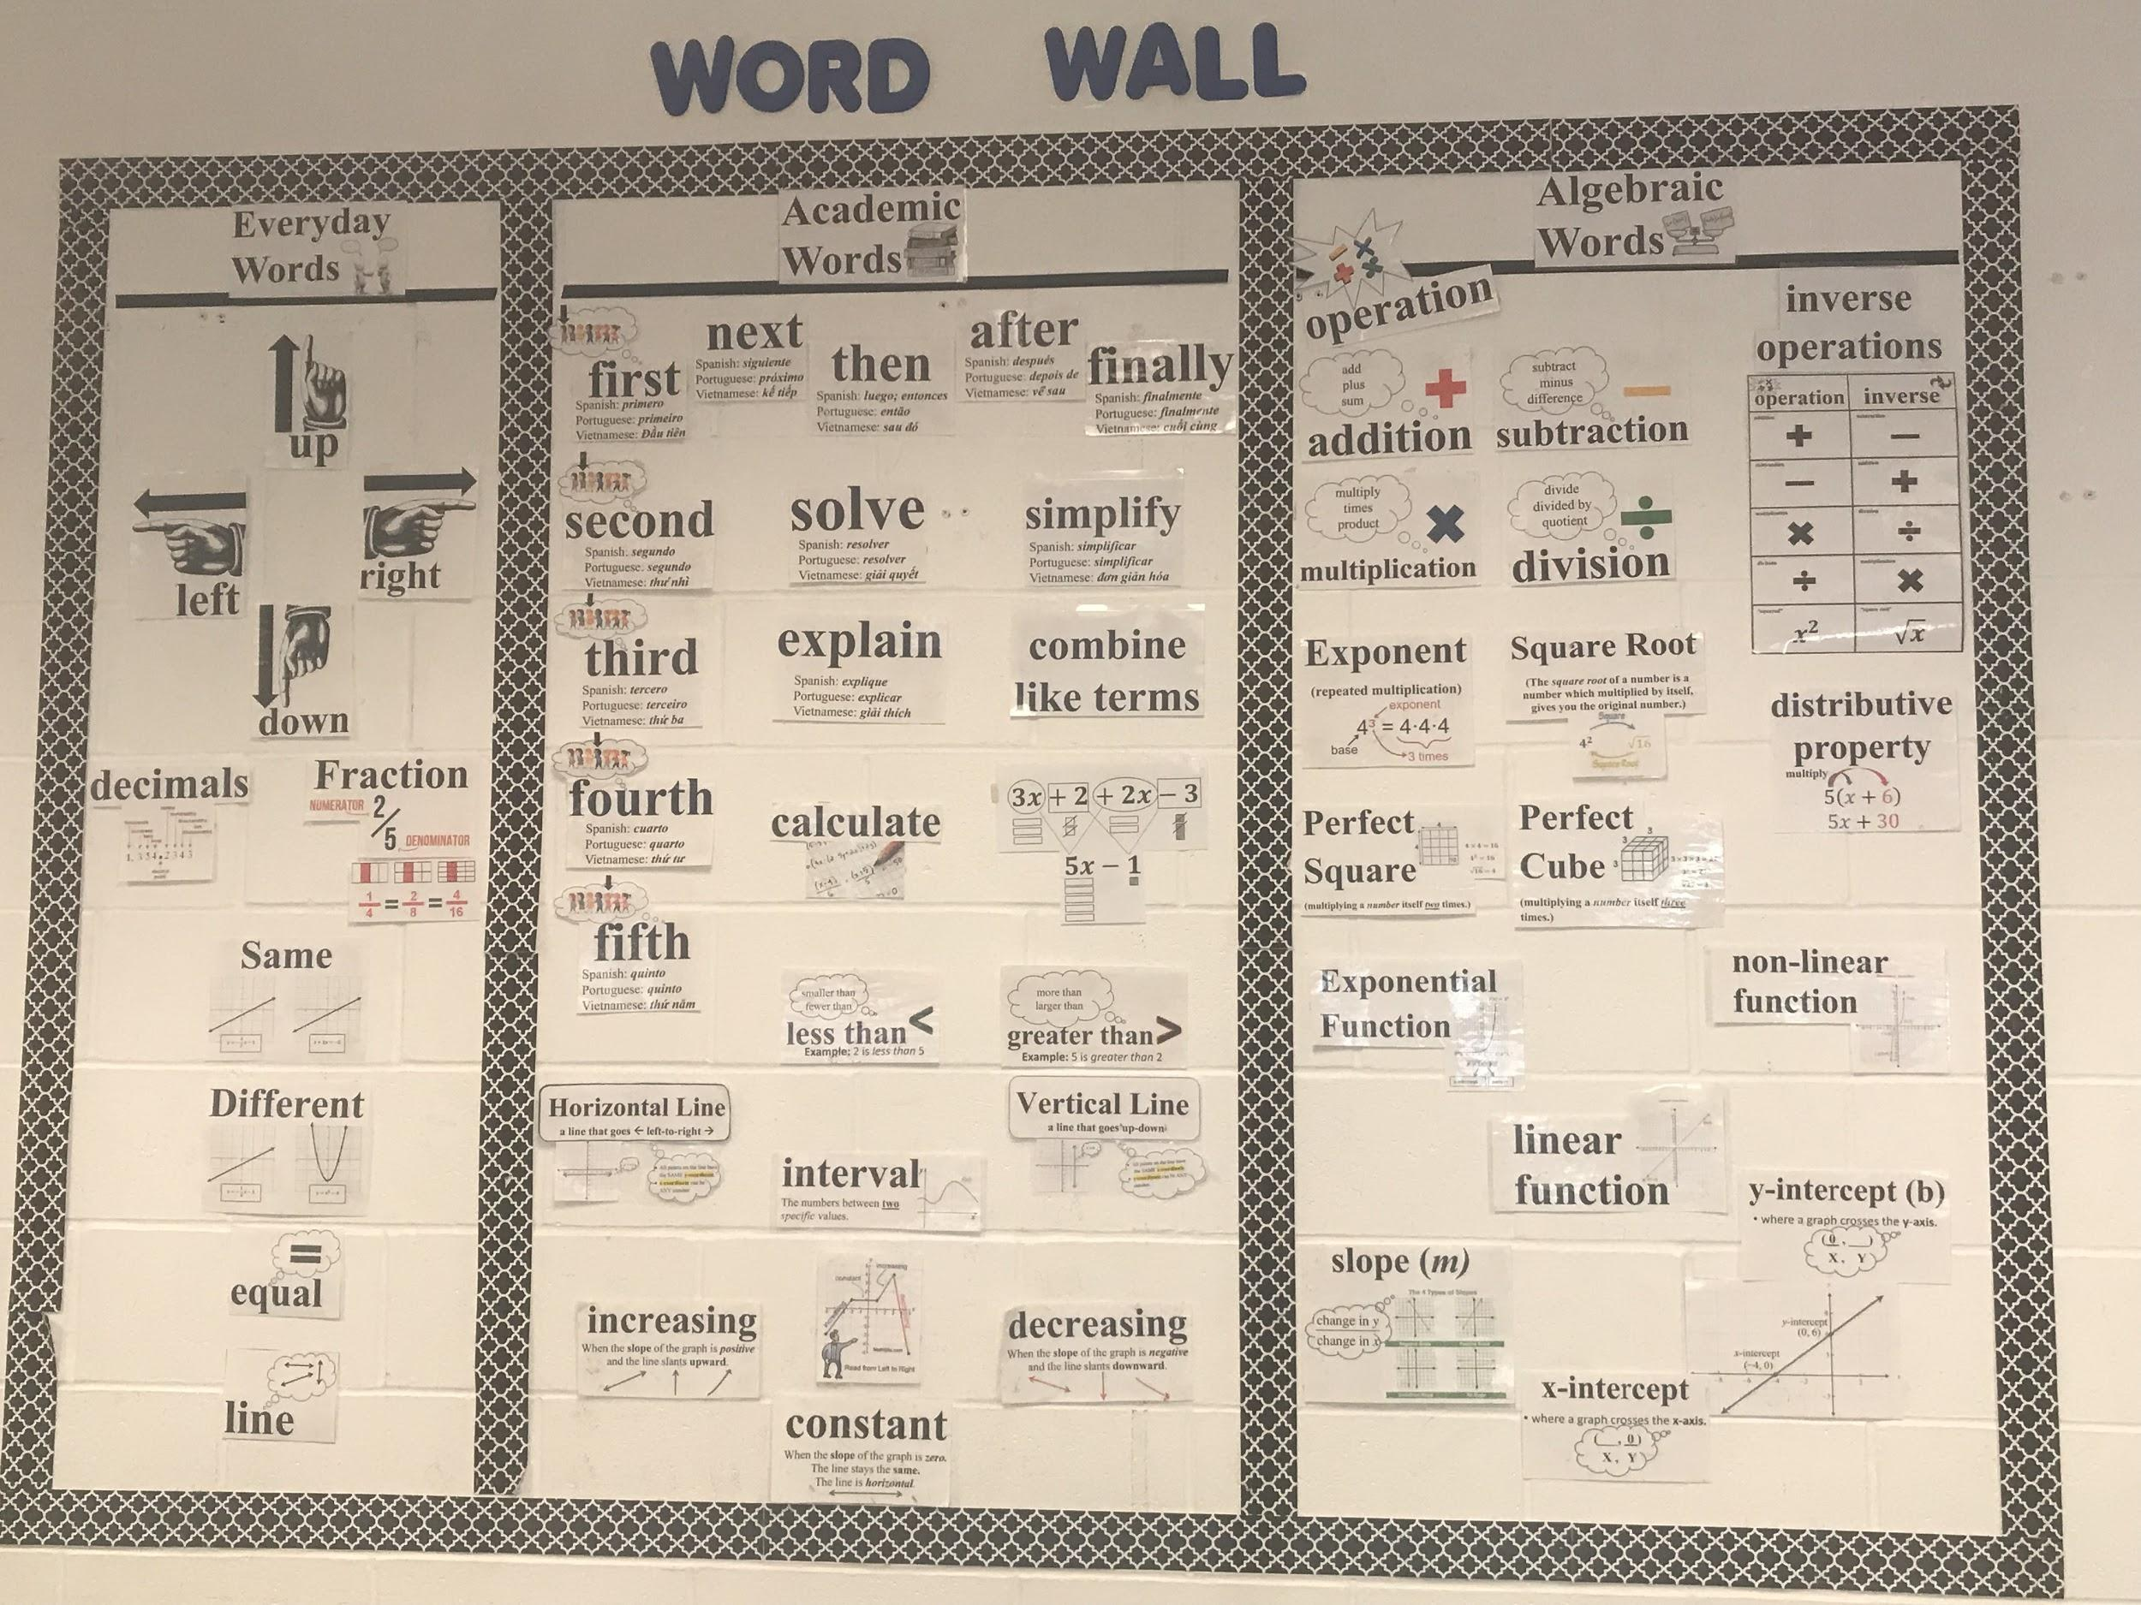
Word Wall
Keeping an updated word wall allows students to work independently.
We target word choice towards cognates in order to increase early literacy accessibility and confidence.

Slide 15
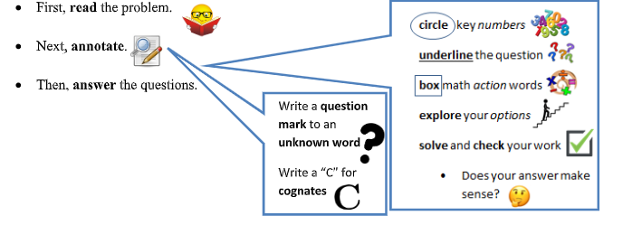
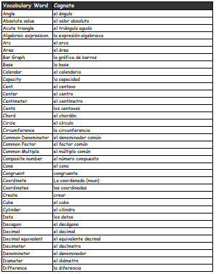
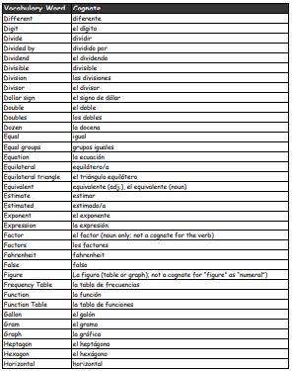
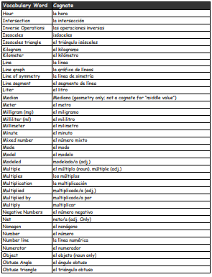
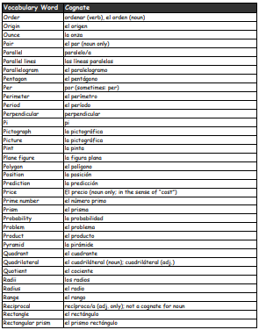
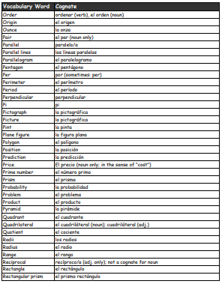
Cognates

Slide 16
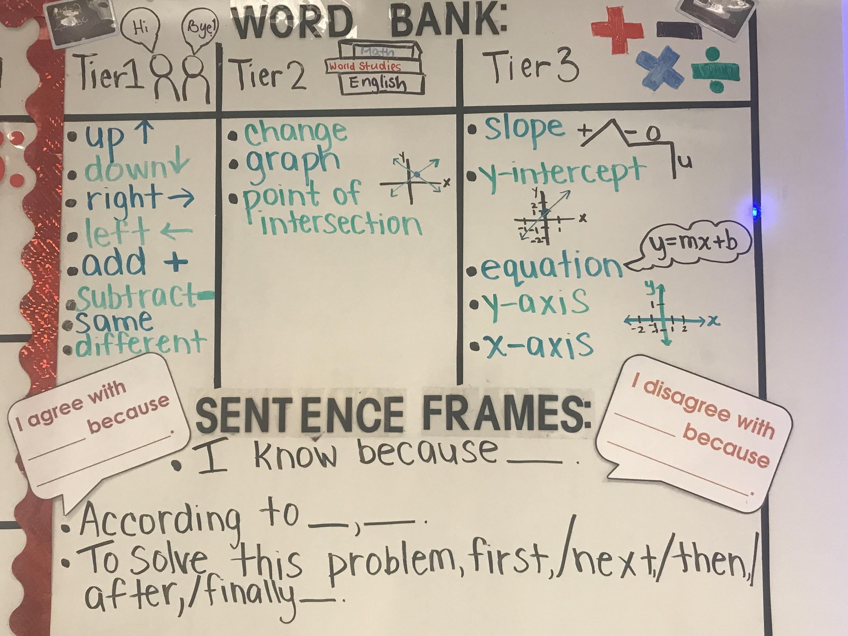
Word Bank & Sentence Frames on the Whiteboard
Keeping an updated word bank and sentence stems allows students to work independently.
We change these on a weekly/biweekly basis to ensure students are actively referring to these words. Students WILL and DO use these often.

Slide 17
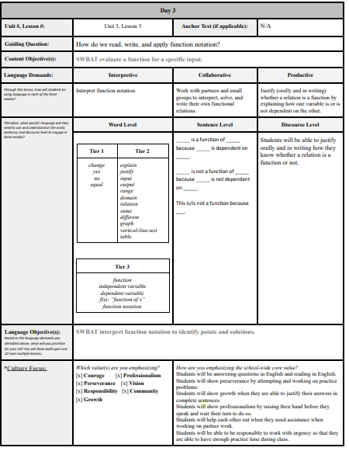
Weekly Lesson Plans!
We create lesson plans that allow us to support our students through an entire week that allows them to become successful mathematicians at the end of the week. These lesson plans allow us to have consistent structures on our handouts that that include sentence frames, word banks, visual supports, and graphic organizers.

Slide 18
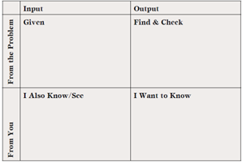
Lesson Plan Overview:
First View of the Problem
Day 1: Students learn to evaluate function for a specified input. Students learn to use thinking grid with the support of teacher.

Slide 19
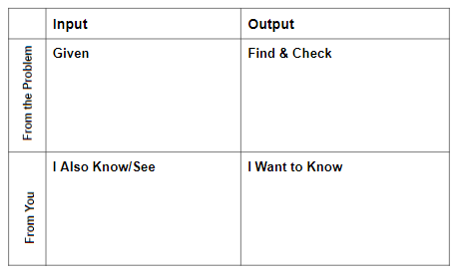
Thinking Grid
I do. We do. You do.
The Thinking Grid helps to take students through the problem solving process so they do not become overwhelmed.
Activates problem solving skills.
Students are able to annotate and take information directly from the problem.
*Gillette 2018

Slide 20
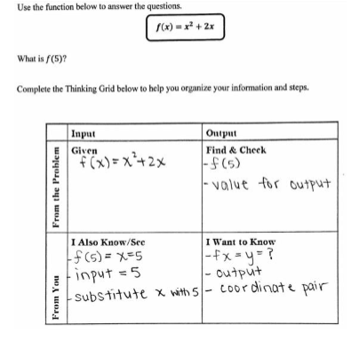
Student Sample

Slide 21
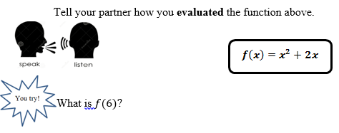
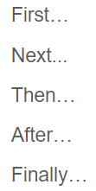

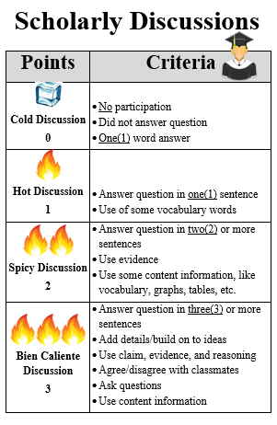
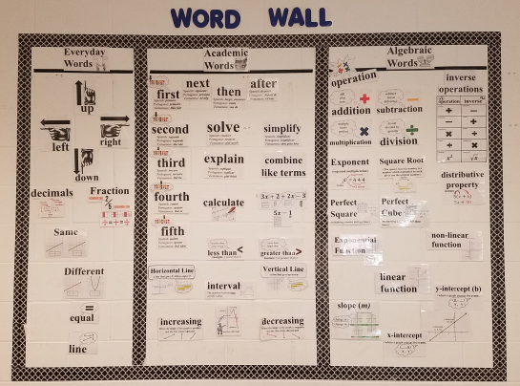
Day 2: Students continue to evaluate functions for a specified input and engage in whole-class discussion using thinking grid and sequencing language through peer collaboration.
Lesson Plan Overview:

Slide 22

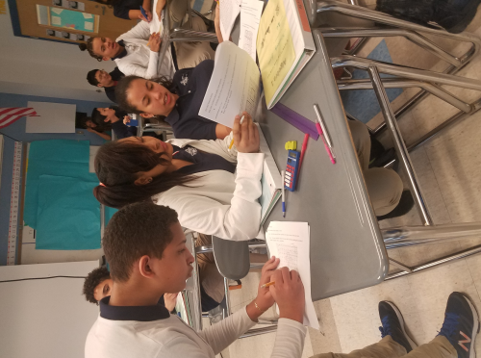
Turn & Talk
When we do Turn & Talks, students use sentence frames that may be projected on the board and/or handout materials.Turn & Talks are crucial for their learning and for this reason students can be intentionally arranged in homogenous or heterogenous groupings.

Slide 23
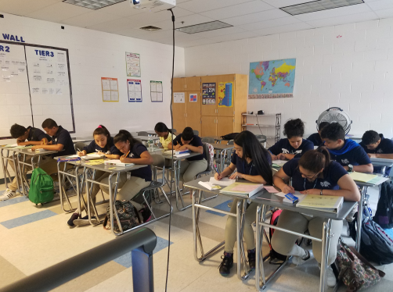
Consistent Sequencing Language
First…
Next...
Then…
After…
Finally…

Slide 24
Whole-Class Discussion
In addition, students participate in whole-class discussions and then reflect on how their discussions went in accordance to a student-friendly rubric with criteria that depicts Can Do items from WIDA Levels 1-3, since the goal is for our Newcomers to reach a Level 3 English at the end of their journey at ENLACE.

Slide 25
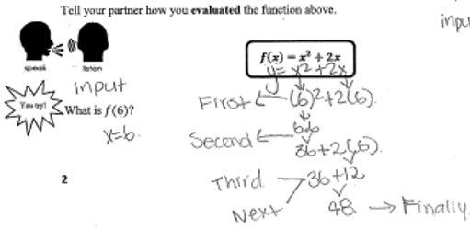
Student Sample
Students were not required to label their steps, but some students do so in order to help them when sharing with their partner how they solved the problem.

Slide 26
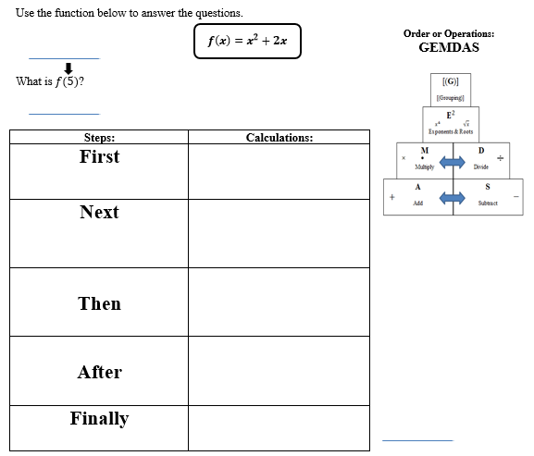
Lesson Plan Overview:
Day 3: Students evaluate functions for a specified input and explain the process on how it was solved using sequencing words; teacher uses sequencing words when modeling.

Slide 27
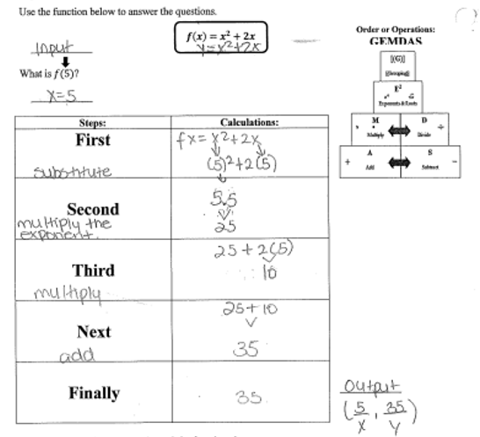
Student Sample

Slide 28
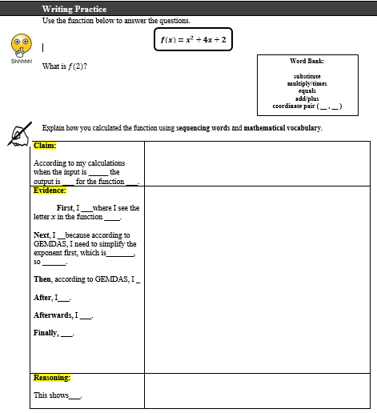
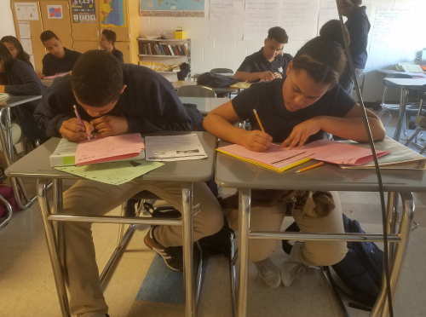
Lesson Plan Overview:
Day 4: Students practice writing an explanatory essay with the support of sentence frames and word bank.

Slide 29
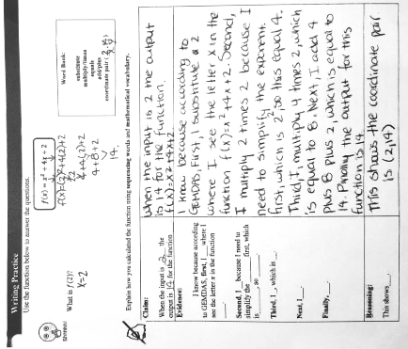
Student Sample

Slide 30
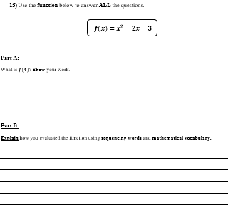
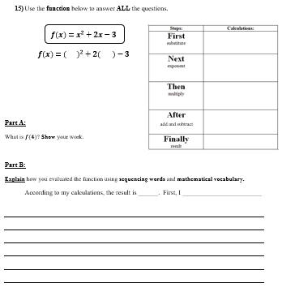
Day 5: Post instruction-Students evaluate a function for a specified input independently with limited to no scaffolds.
Accommodated Version

Slide 31
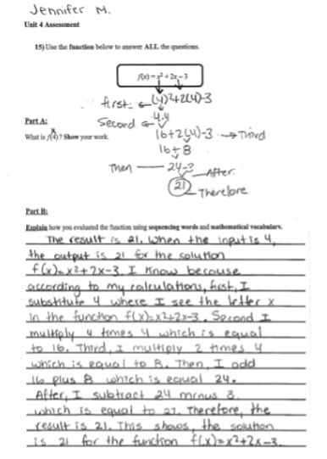
Student Sample 1
About the student: Jennifer M.-This is the work of an English Learner who at the time, was a WIDA level 2.5. She had been at the country for about 6 months. In her work, I was able to observe her annotating skills for her steps; she was able to use sequencing words through her step-by-step solutions to evaluating the function. In her explanatory essay, I was able to see how the use of annotation facilitated her skills for her written product. This shows that she was able to use what she had learned during instructional time to producing the written product.

Slide 32
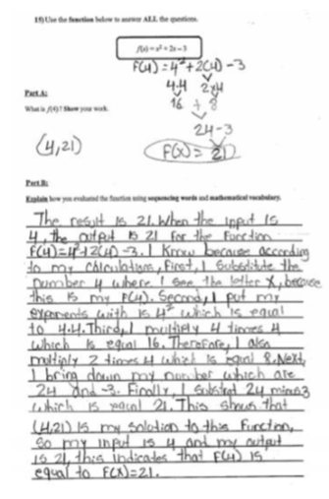
Student Sample 2
About the student: Miguel A. - This is the work of an English Learner who was a WIDA level 2.5. At the time, he had been at the country for about 5 months. In his work, I am able to see that he remembers that the input represents the x-coordinate, and the output, is the y-coordinate. He was able to explain his step-by-step process to solving this answer and go beyond the right answer and stating that the result is 21.

Slide 33
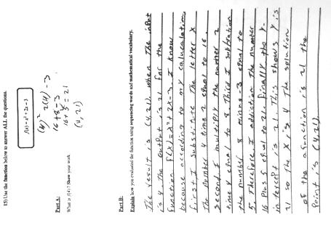
Student Sample 3
About the student: Pedro R. - This is the work of an English Learner who was a WIDA level 1.9. Pedro had been at the country for about 6 months. He had a good understanding on how to use sequencing words, such as first, second, third, finally and even found a place to include the word therefore, which pushed him to think of other words to use when explaining how he derived to his answer. While there was some misuse of vocabulary words, such as y-intercept rather than saying y-coordinate, I was still able to understand that a student like Pedro was thinking beyond the correct answer, and considering that the number 21 for this problem, is the y-coordinate or output.

Slide 34
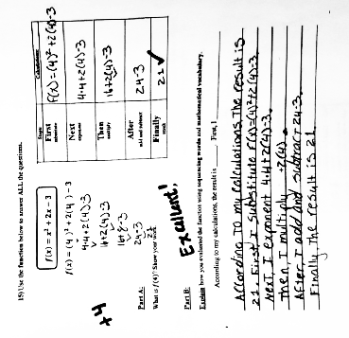
Student Sample 4
About the student: Wilmy D. - This is the work of an English Learner who was a WIDA level 1.3. Wilmy had been at the country for about 3 months at the time. Unlike his peers, Wilmy had scaffolds provided on his problem in order to help him derive an answer. This scaffold was one he was familiar with because it was one similar to the one used in class during instructional time. He was given a graphic organizer that included sequencing words and a math term, as well as, two sentence starters that would help him to begin his explanatory essay. As noted, Wilmy disregarded his sentence starters, and went on his was to write his paragraph independently. His explanatory essay was shorter than his peers, but nonetheless carried the same idea as others. He used sequencing words, and even provided a claim, “According to my calculations…”

Slide 35
How can you incorporate these skills as a push in?
Cognates
Sentence frames
Sequencing
Accomodations
Mirrored problem solving and writing
Practice labeling work

Slide 36


Slide 37

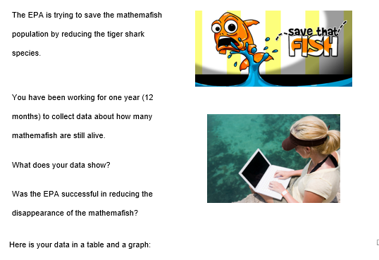
How to expand into real world problems…

Slide 38
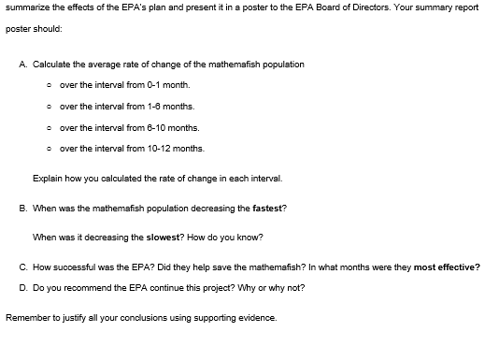
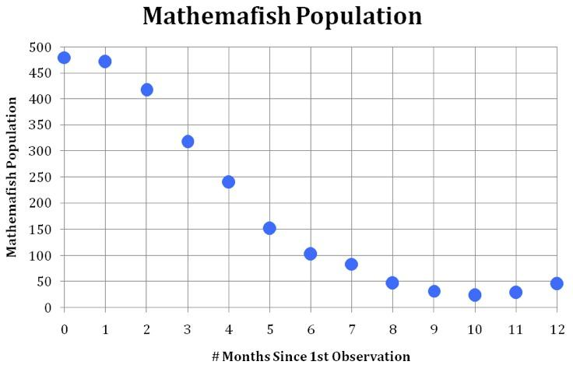
How to expand into real world problems…

Slide 39
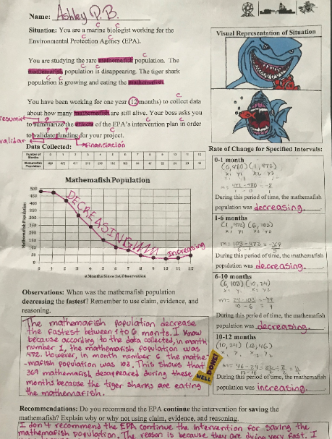
Student Sample

Slide 40
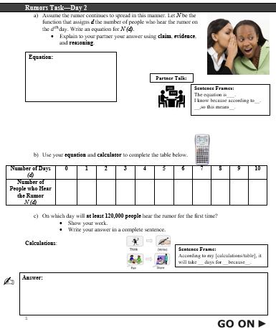
How to expand into real world problems…

Slide 41

Other Resources
https://www.teachingchannel.org/video/writing-in-math-ells

Slide 42
Contact Information
Keila Colon
E-Mail: keila.colon@lawrence.k12.ma.us
Dana Thorsen
E-Mail: dana.thorsen@lawrence.k12.ma.us

Slide 43

Think about your students. Which one of your students would benefit from having the first handout, accommodated handout?
What will they write? What supports will they need?
Cognates
Sentence frames
Word bank

