Slide 1
The Ultimate Discovery Catalog
ER&L - March 2013
Jose Luis Andrade
President of the Americas

Slide 2

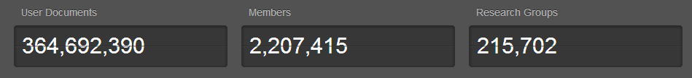
Papers
Notes:
Brief Introduction to Mendeley.
Mendeley Unique: 80+ million unique documents
Web of Knowledge / Scopus: 49 million
Made possible by the collective libraries of 2.2 million researchers.

Slide 3
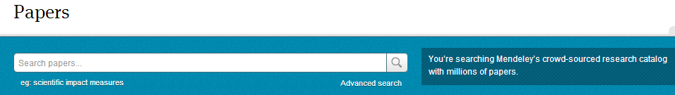
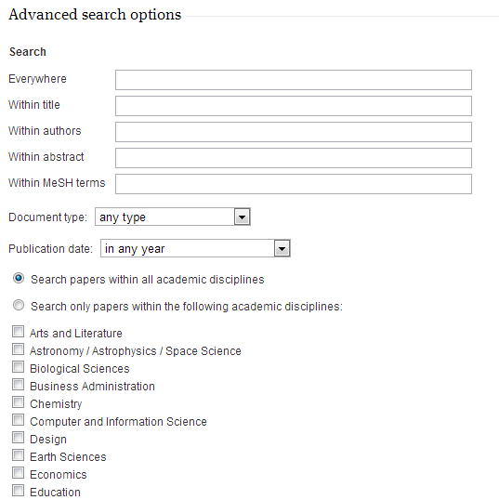
Search
Notes:
Ability to Search for papers.

Slide 4
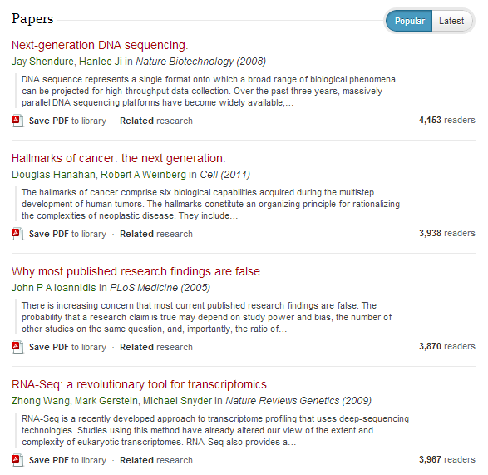
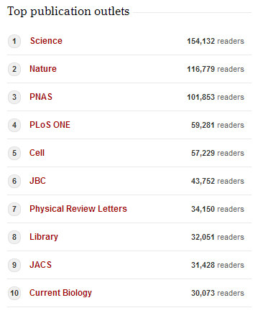
Browse

Slide 5
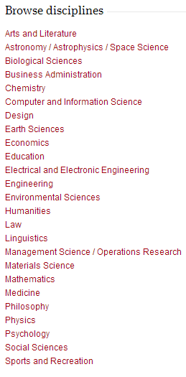
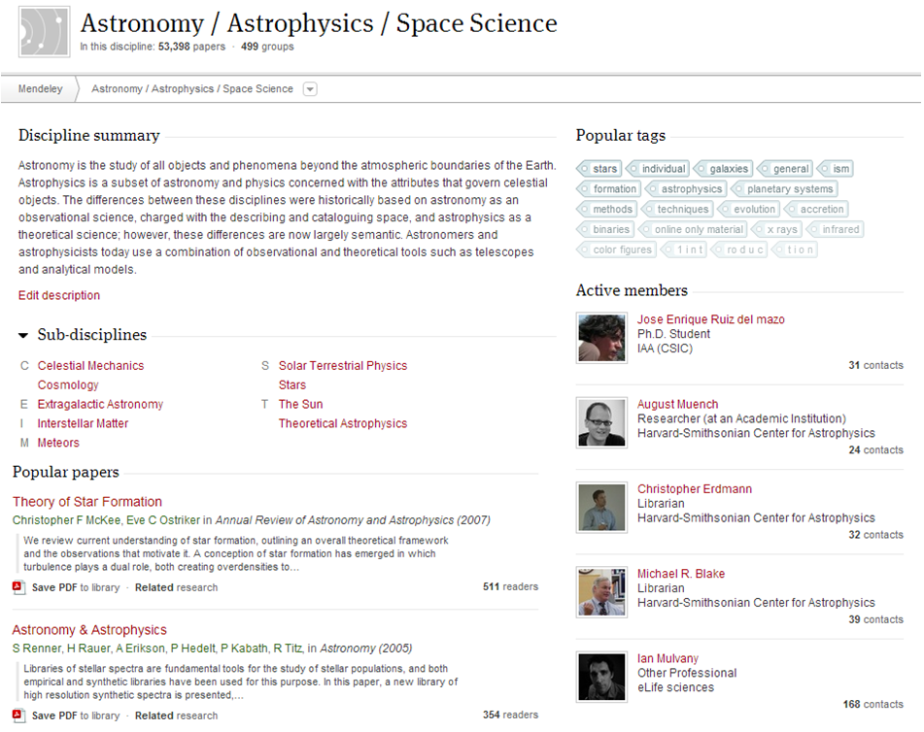
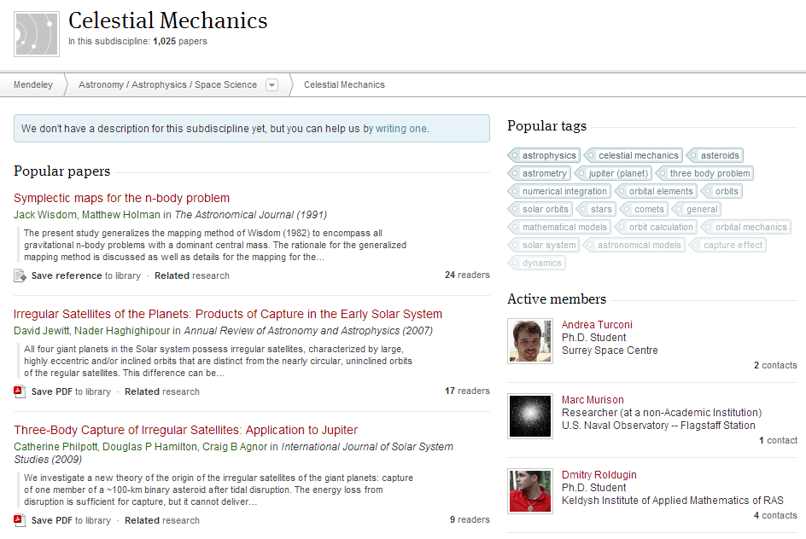
Discipline

Slide 6
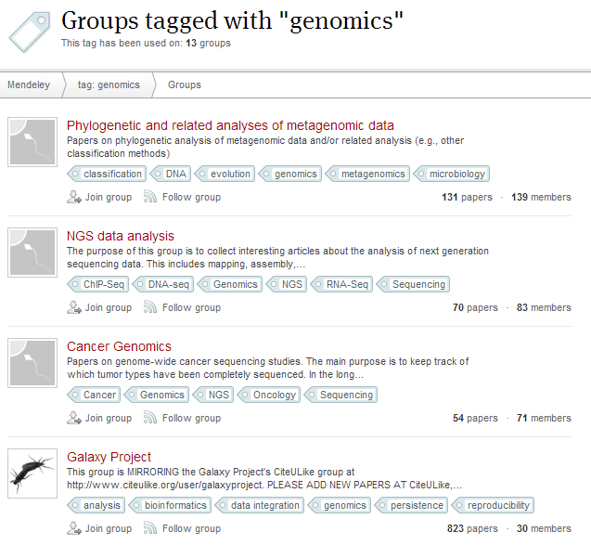
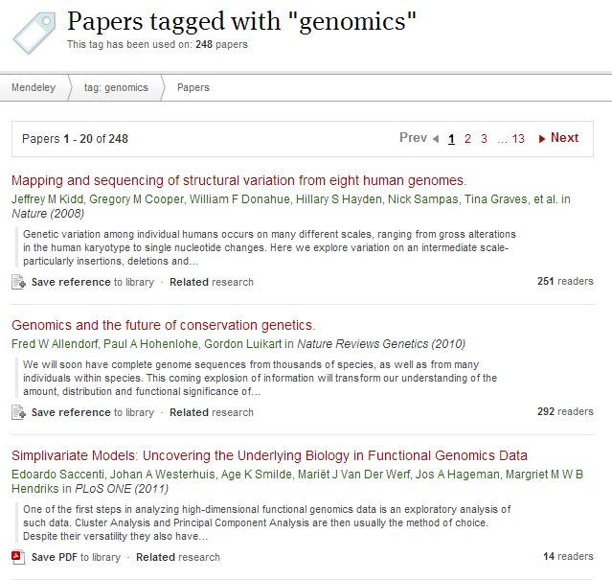
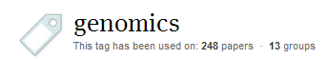
Tags

Slide 7
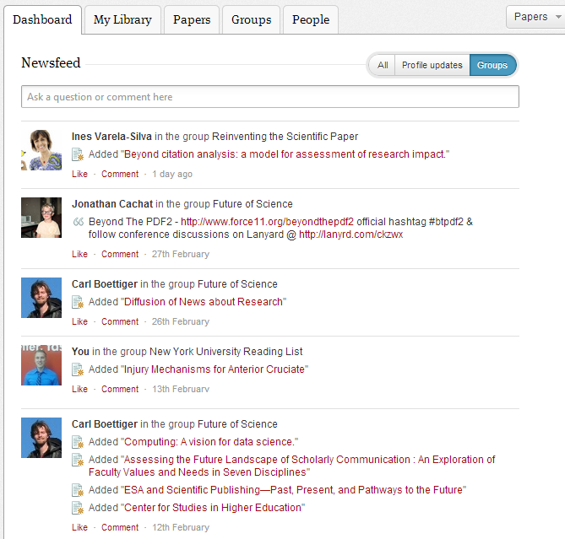
Peers

Slide 8
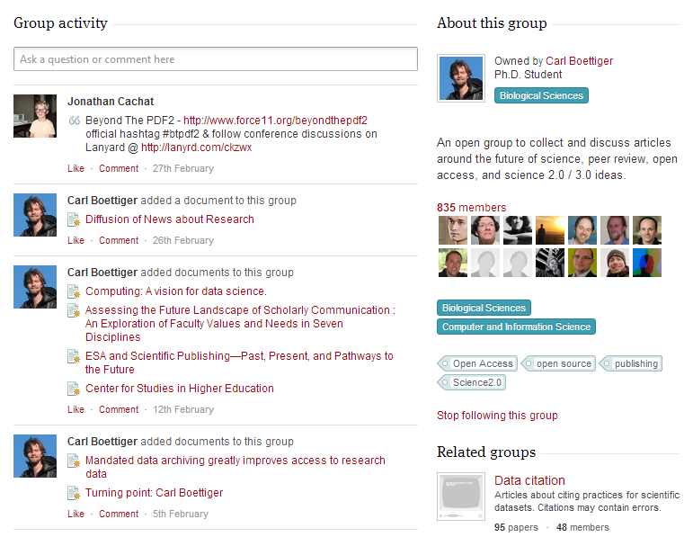
Groups

Slide 9
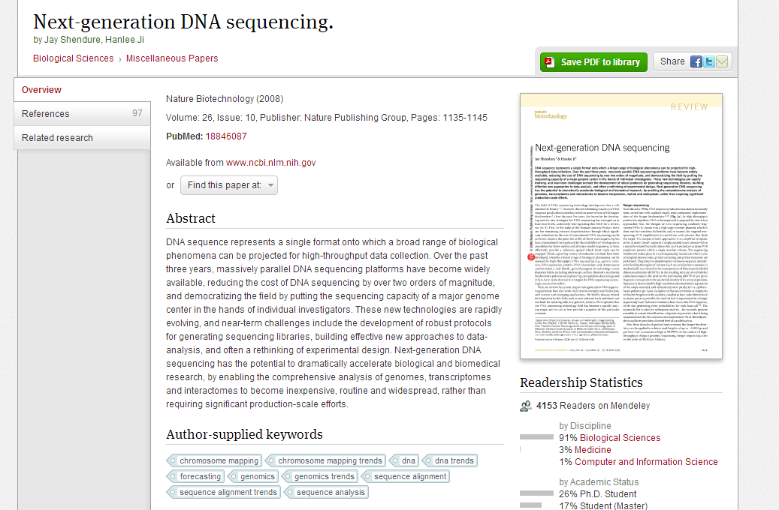
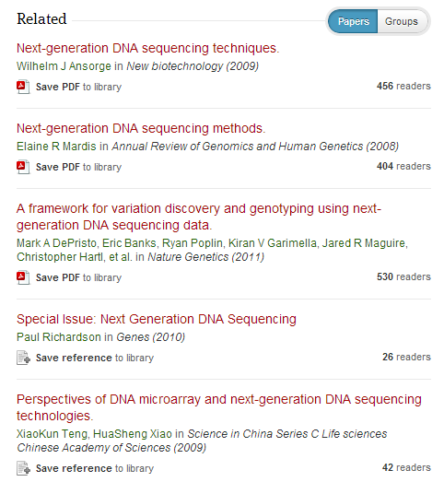
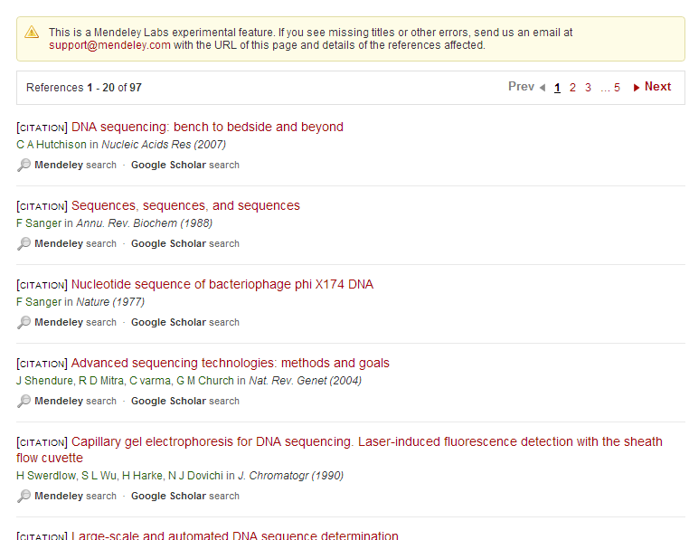
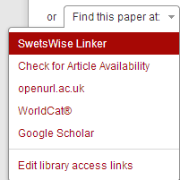
Access / References / Related Papers

Slide 10
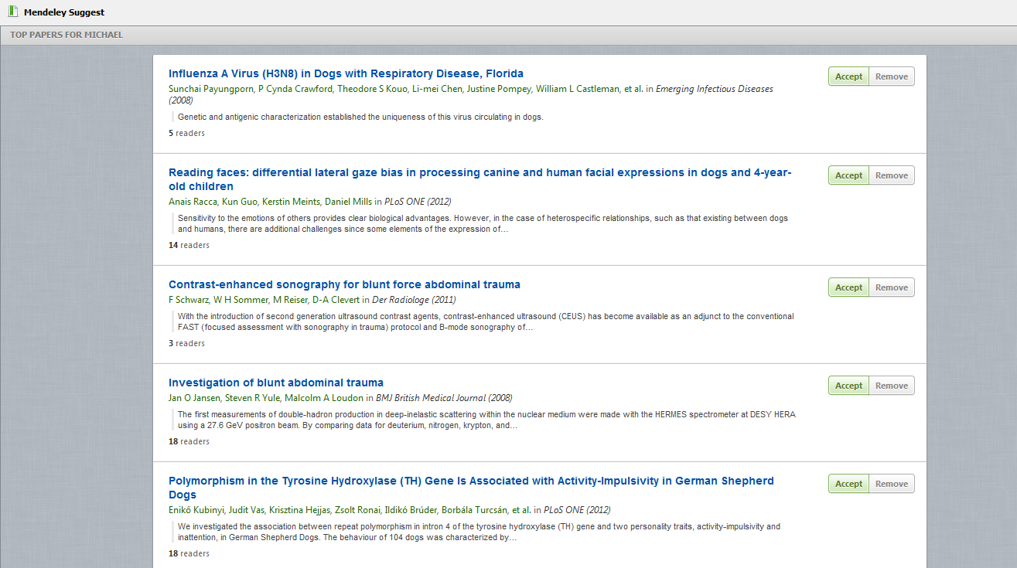

Suggest
Notes:
Mendeley Suggest uses collaborative filtering: http://en.wikipedia.org/wiki/Collaborative_filtering.

Slide 11
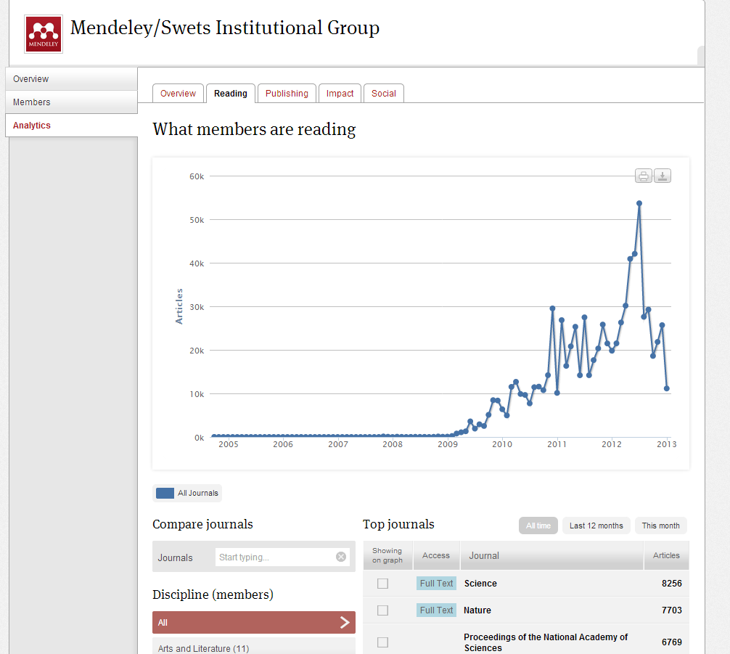
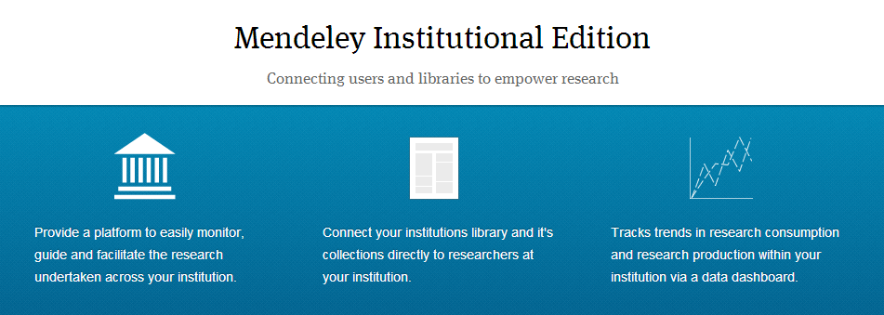
MIE

Slide 12

Thank you!

