Slide 1

The Problem in Our Textbooks
Encouraging Simplified Grammar
Mandie Bauer | ASC English | Boston, MA
Notes:
Welcome! - Mandie Bauer - English Instructor at ASC English in Boston - TOEFL, Academic Writing, Grammar

Slide 2

Oh, Grammar.
Notes:
Who enjoys teaching grammar? Who absolutely hates it? Why? What are some problems we encounter?
High-level students know too much - so many books to choose from - puzzle - exceptions - different knowledges between students - things taught a long time ago. HISTORY example
How can we bring these people together, different knowledges and all, and successfully teach them all equally?

Slide 3

Group Work:
Using the grammar point given to your group, decide how to begin teaching it to your class.
Required Pre-Knowledge: What do your students need to know before they can successfully understand this point?
Potential Issues: What are some potential issues with your grammar point?
Damage Control: How will you attempt to fix these issues?
Class Info:
→ Each grammar point comes from an integrated skills book, level 4
→ Your students tested into this level, but they vary in strengths, as any class does.

Slide 4
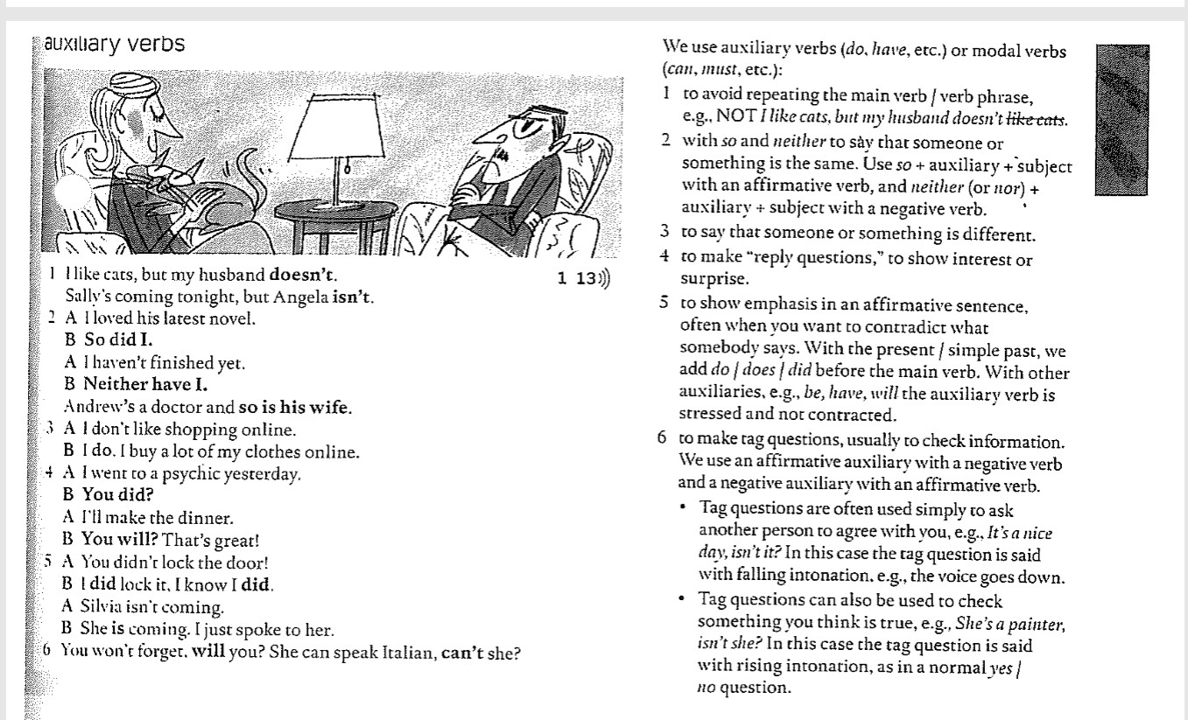
Feedback
Notes:
Is this the most general use of auxiliary verbs? What are they primarily used for?

Slide 5
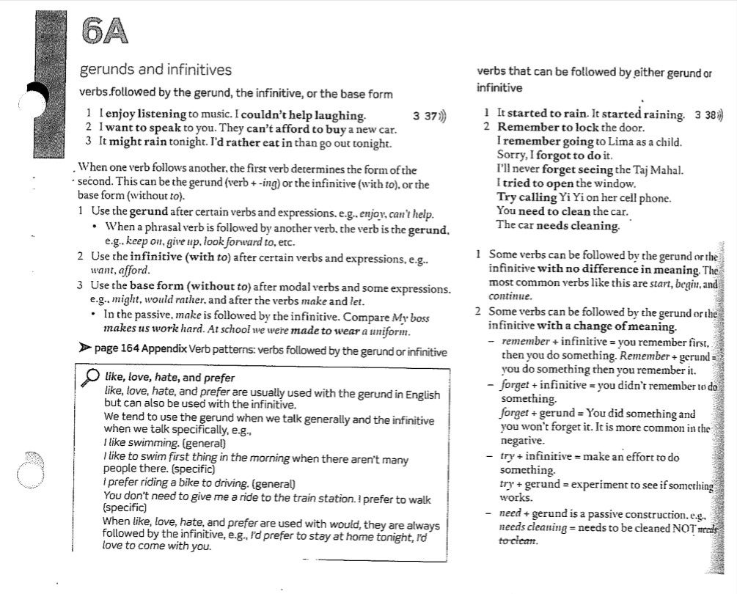
Feedback

Slide 6
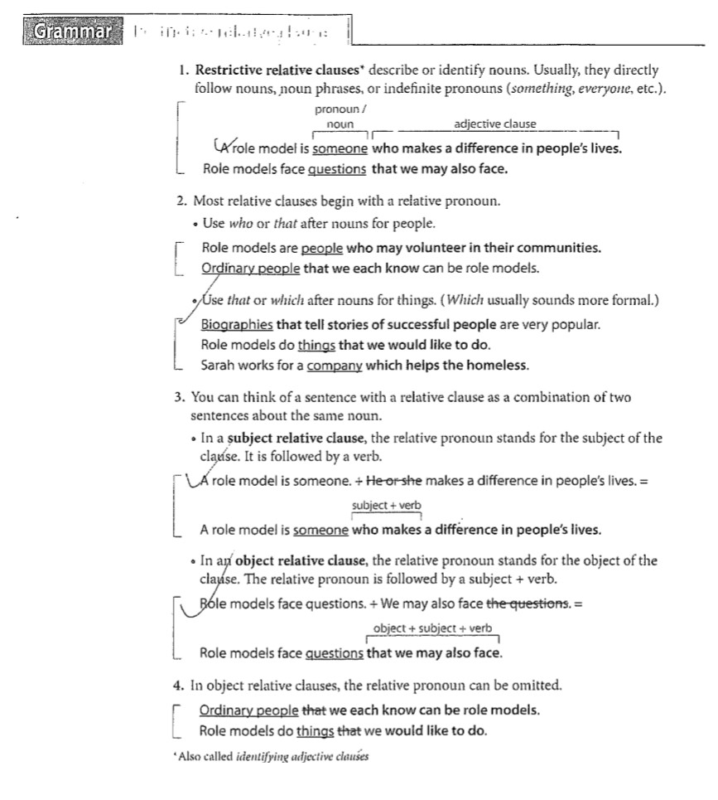
Feedback

Slide 7
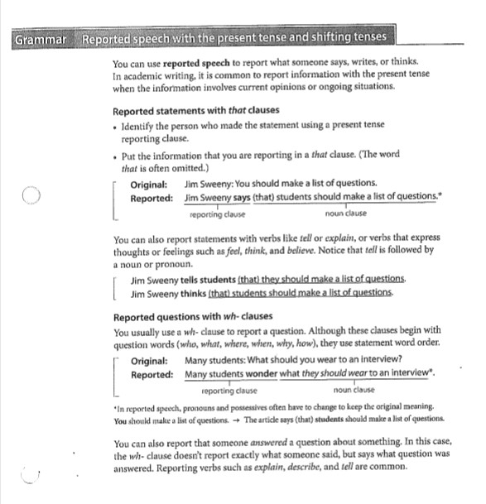
Feedback

Slide 8
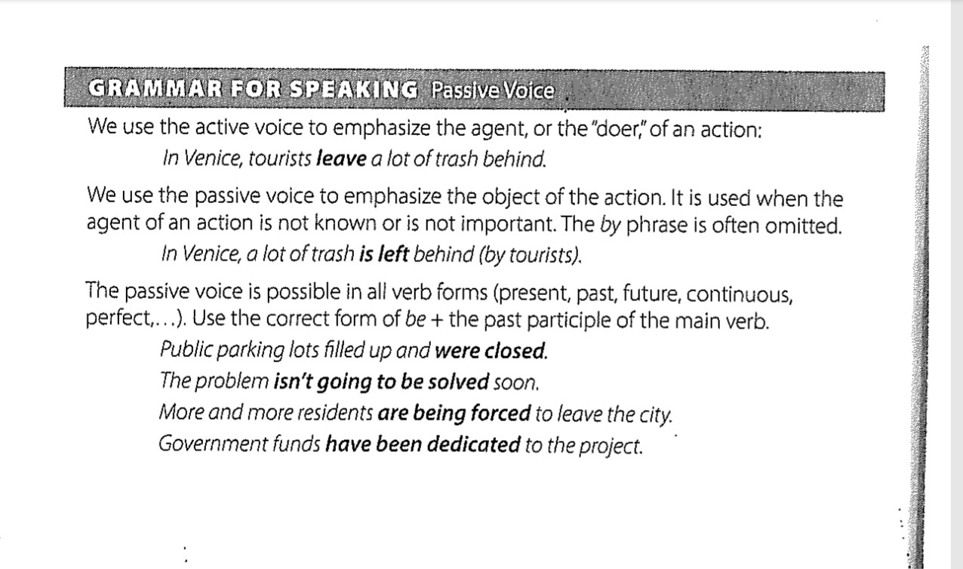
Feedback

Slide 9
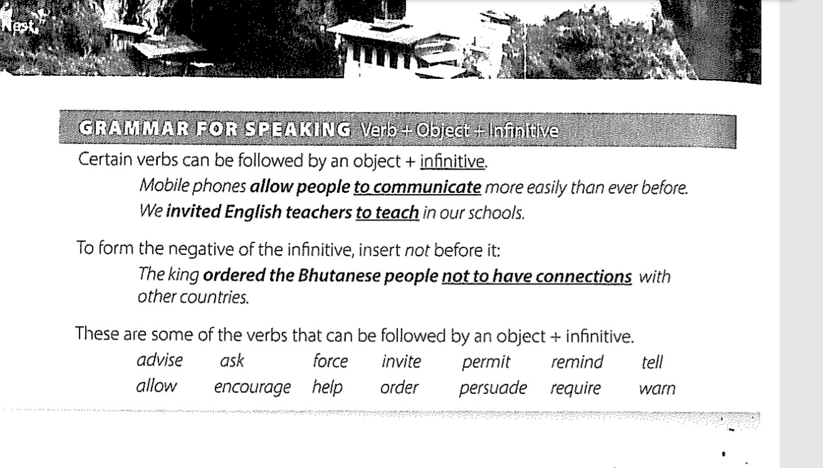
Feedback
Notes:
Help can also be followed by a bfv

Slide 10

adjective
adverb
agent
auxiliary verb
base form
clause
defining
doer
gerund
identifying
indefinite
infinitive
main verb
modal
noun
object
passive
past participle
phrase
possessive
present participle
pronoun
restrictive
sentence
subject
tag question
tense
verb
verb + ing
wh - clause
Notes:
When I was a new teacher, one of my biggest challenges as I read through all the grammar explanations was quite simple: what do all of these stupid words mean?!

Slide 11

Step 0:
Required Pre-Knowledge
What do your students need to know before they can successfully understand this point?
Notes:
Prepwork. Really look at the grammar point you’re given. Sometimes we don’t get to choose! Can you complete the activities without looking at the answer key?

Slide 12
Required
Pre-Knowledge
Passive Voice
Gerunds and Infinitives
Reported Speech
tenses, active voice, parts of speech, transitive and intransitive verbs
parts of speech, parts of a sentence, verb forms, continuous tense
tenses, shifting tenses, direct and indirect speech
What do your students need to know before they begin studying these grammar points?

Slide 13

Step 1: Vocabulary
If your students don’t understand the vocabulary you use, they will not understand the lesson.
Notes:
If your students do not understand the vocab you and the book use, they will not understand the lesson.
Simple? Learned a long time ago in their native language? Assume they will figure it out?

Slide 14
Simple definitions... Or maybe not?
Noun | Sentence
Subject | Clause
Object | Phrase
Notes:
Let’s see if you can define these. They should be “simple,” but are they really?

Slide 15
Simple definitions... Or maybe not?
Noun: person, place, or thing | Sentence: must include at least one independent clause
Subject: noun doing the action | Clause: must contain a subject and a verb. An independent clause is a complete thought. Dependent, relative, and noun clauses are incomplete thoughts.
Object: noun receiving the action | Phrase: expression; a group of words without a subject and/or a verb. Ex: gerund phrase, prepositional phrase, idiom

Slide 16
After I finish my lesson planning for the week, I’ll go to the store to buy groceries because I'm trying to save money by cooking at home and not eating at restaurants so often so I can travel to Europe next year for a 2-week vacation with Jenn, who has been my roommate for 3 years, before I teach English abroad in Japan for a year and she moves to London for work.
Notes:
What is wrong with this paragraph?

Slide 17

After I finish my lesson planning for the week, I’ll go to the store to buy groceries because I'm trying to save money by cooking at home and not eating at restaurants so often so I can travel to Europe next year for a 2-week vacation with Jenn, who has been my roommate for 3 years, before I teach English abroad in Japan for a year and she moves to London for work.
Notes:
Let’s look at the different clauses in this single sentence.

Slide 18

Problematic Vocabulary
Notes:
Sometimes, defining vocabulary is not enough.

Slide 19

Present Continuous or Present Progressive?
Conjunctions or Transitions or Subordinators or Adverb Clause Words?
Relative Clause or Adjective Clause?
→ Identifying, Restrictive, Defining, or
Essential?
Notes:
These all mean essentially the same thing, and yet every book calls them something different.
Explain the vocab you use, and possible synonyms

Slide 20
What’s the Difference?
Swimming with sharks is dangerous.
I’m running errands after work.
The new book I’m reading is very entertaining!
I enjoy drinking coffee in the morning.
What is he looking at?

Slide 21
Mandie’s #1 Grammar Rule:
verb + ing

Slide 22

Step 2:
Form and Function
Notes:
In your opinion, what is the most difficult part of learning a new grammar point?
Advanced students know too much.
Fix the foundation.

Slide 23
The Problem with “verb + ing”
 | Form: How do we make it? | Function: How and when do we use it?
Present Participle | verb + ing | forms continuous tenses and adjectives
Gerund | verb + ing | noun
Notes:
Form they can do. They often struggle with Function.

Slide 24
What’s the Difference?
Swimming with sharks is dangerous.
I’m running errands after work.
The new book I’m reading is very entertaining!
I enjoy drinking coffee in the morning.
What is he looking at?

Slide 25
Sample: Form & Function
 | Example | Form How do we make it? | Function How and when do we use it?
Present Continuous | I am talking about grammar. | present “be” + present participle | Used for actions that are occurring right now
Present Perfect | I have been to Spain. | present “have” + past participle | Used for actions that occurred at an unknown time in the past *the focus is the action, not the time
Notes:
Is there are anything else we use Present Continuous for?

Slide 26

Dealing with Exceptions

Slide 27
Different Uses of Present Continuous
 | Example | Form How do we make it? | Function How and when do we use it?
Present Continuous | I am talking about grammar (at the moment). | present “be” + present participle (+ time stamp showing now) | Used for actions that are occurring right now, often with words such as “now” and “currently”
Present Continuous in Future | I am talking about grammar next month. | present “be” + present participle + future time stamp | Used for actions that will occur in the future, specifically for plans, and always includes a future time stamp
Notes:
Eliminate exceptions. Acknowledge the questions but show them why it matters to build the foundation first before talking about the exceptions.

Slide 28

Step 3: Exposure
Notes:
Where are your students likely to see, hear, or read these grammar points?
How and when will they use these grammar points?

Slide 29
Which skill(s) uses these grammar points the most?
Auxiliary Verbs
Reported Speech
Passive Voice
Conditionals
Past Tenses
Present Perfect
Notes:
Grammar books often force the point by giving examples that are not something a native speaker would normally say.
Too easy - ridiculous - unnatural - exceptions

Slide 30

Auxiliary Verbs - Grammar, Writing
Reported Speech - Reading/Listening, News
Passive Voice - Reading, Biographies
Conditionals - Speaking, Small Talk
Past Tenses - Reading/Speaking, Storytelling
Present Perfect - Speaking, Small Talk

Slide 31

Sample Grammar Lesson:
Conditionals
Notes:
Let’s practice! What’s the first thing we do?

Slide 32
Step 0:
Prep Work
Notes:
Your turn!

Slide 33
Prep Work
Before you teach your class Conditionals, which skills do they need to possess?
tenses
clauses
hypothetical situations
“if” clauses
modal verbs
especially “will” and “would”

Slide 34
Step 1: Vocabulary
Notes:
If your students do not understand the vocab you and the book use, they will not understand the lesson.

Slide 35
Vocabulary
What are some possible vocabulary words in conditionals?
if / when
will / would
conditional
conditional clause
result / consequence
result / consequence clause
certainty
unreal
hypothetical
fantasy
imaginary
modal verb
Watch out! Some books call them “real” and “unreal” conditionals!

Slide 36
Step 2:
Form and Function
Notes:
What is the most important part of forming conditionals? TENSES. Change the tense, change the conditional.

Slide 37
Zero Conditional
If you heat ice, it melts.
If you don’t eat, you get hungry.
If you look directly at the sun, it hurts your eyes.
Form: If + simple present, simple present
Function: 100% certainty, used for facts, general knowledge, and things that are always true.

Slide 38
First Conditional
If it rains, we will go see a movie.
If it is sunny, we will have a picnic in the park.
If she studies, she will pass her final exam.
Form: If + simple present,
will + bfv (simple future)
Function: ~75% certainty, used for actions and situations that are likely, possible, or generally true.

Slide 39
Second Conditional
If she studied, she would pass her final exam.
If I won the lottery, I would immediately pay off my student loans.
If I were you, I wouldn’t go outside without a jacket.
Form: If + simple past,
would + bfv
Function: 0-20% certainty, used for actions and situations that are very unlikely, fantasy, hypothetical, or unreal

Slide 40
Third Conditional
If I had known you were in the hospital, I would have visited you.
If he had called sooner, we would have been home.
If Steve had not eaten so much candy, he would not have gotten sick.
Form: If + past perfect,
would have + past participle (past modal)
Function: 0% certainty, used for hypothetical situations in the past and their consequences

Slide 41
Other Kinds of Conditionals
mixed conditionals
  If I had gone to bed earlier, I would not be so tired today!
  If I knew the answer, I would not have asked you!
modals other than “will” and “would”
  If I were an owl, I could see at night.
  If you want a better job, you should update your resume first.
continuous tenses
  If I weren’t teaching English, I would be working on my Ph.D. in Europe.
  If Sam weren’t talking so much, he could hear the movie better!
What are some other kinds of conditionals not included in the previous slides?

Slide 42

 | Form: How do we make it? | Function: How and when do we use it?
Zero Conditional | Example: If you touch a hot stove, it burns. If + simple present, simple present | Certainty: 100% Present/Future Used to talk about things that are general knowledge, facts, or always true
First Conditional | Example: If Bobby studies, he will pass the test. If + simple present, will + bfv (simple future) | Certainty: ~ 75% Present/Future | Common in conversation Used to talk about things that are likely or generally true
Second Conditional | Example: If Sam practiced, she would be the best player. If + simple past, would + bfv (present/future modal) | Certainty: less than 20% Present/Future | Common in conversation Used to talk about things that are very unlikely, unreal, fantasy, hypothetical, or imaginary
Third Conditional | Example: If I had known you were visiting, I would have called you. If + past perfect, would have + past participle (past modal) | Certainty: 0% Past Used to talk about hypothetical past situations and their consequences

Slide 43
Step 3: Exposure
Notes:
Where are your students likely to see, hear, or read these grammar points?
How and when will they use these grammar points?

Slide 44

If you could go anywhere right now, where would you go?
Notes:
Small talk! Essay questions. Very common on applications.

Slide 45

If you had a fairy godmother, what would you wish for?
Notes:
Small talk! Essay questions. Very common on applications.

Slide 46

Practical Application
Notes:
This sounds all fine and good, but we don’t have weeks to cover all potential vocab, etc. So how is this method practical?
Build that foundation! You cannot cover everything in one class period.

Slide 47
Grammar Vocab Terms
subject |  | adverb
noun |  | auxiliary verb
verb |  | modal verb
object |  | main verb
adjective |  | base form verb (bfv)

Slide 48
 | Example | Form | Function
Simple
Continuous
Perfect
Perfect Continuous

Slide 49
Gerunds and Infinitives - Common Verbs List
Gerund consider dislike enjoy finish go keep | Infinitive agree choose hope promise want would like | Both, Same Meaning love hate continue start begin Both, Different Meaning forget, regret, remember, stop, try Base Form have, help*, let, make

Slide 50

Conclusions:
Keep it simple. At least at first.
Building that foundation will increase their understanding as exceptions and specific uses are introduced.
Grammar is a puzzle.
Find the common rules and eliminate unnecessary
terms.
We all use language differently.
Give your students the tools to use and understand
language the way they are exposed to it.
Notes:
History class: don’t assume students connect their knowledge NOW to their knowledge in the PAST.

Slide 51

Follow me!
ESL Instagram & Kahoot:
nerdyteachings

